Slide 1
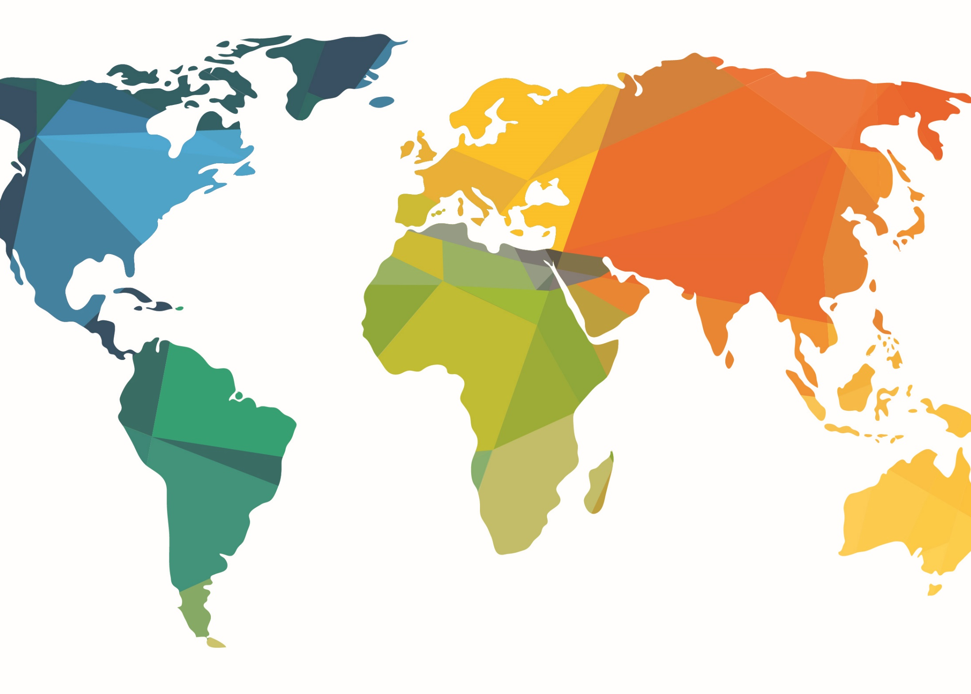
The Global Free Methodist Church

Slide 2
CONNECT WITH GOD’S HEART FOR THE WORLD
Free Methodist World Missions
makes disciples
by mobilizing the global church
and empowering international leaders
to establish transformational churches.

Slide 3
CONNECT WITH GOD’S HEART FOR THE WORLD
The Free Methodist Church has ministry in more than 100 countries in six world areas:
Africa, Asia, Europe, Latin America, Middle East and North America.

Slide 4
Total worldwide Free Methodist membership is just over 1.5 million.

Slide 5
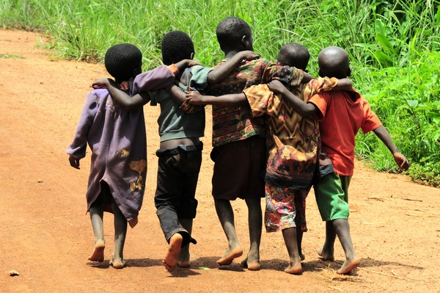
Africa
Membership: 979,980
Countries: 28
2018 membership statistics

Slide 6
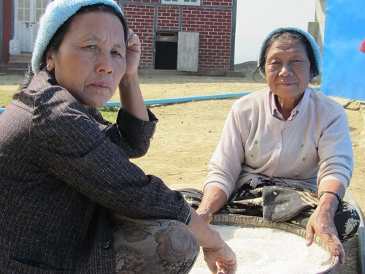
Asia
Membership: 365,623 Countries: 22
2018 membership statistics

Slide 7
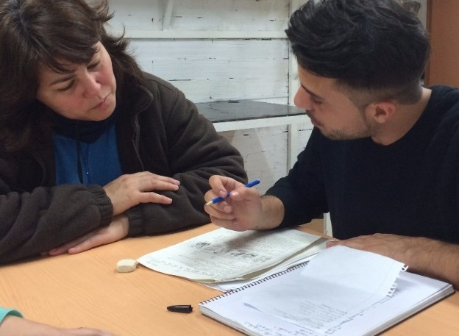
Europe
Membership: 5,023
Countries: 16
2018 membership statistics

Slide 8
Latin America
Membership: 89,475 Countries: 23
2018 membership statistics

Slide 9
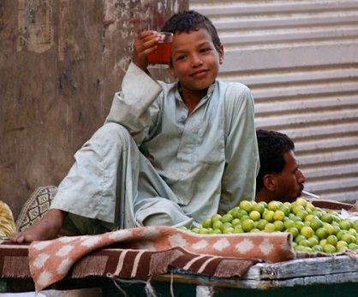
Middle East Membership: 30,000 + more than 8,000 house churches
Countries: 9
2018 membership statistics

Slide 10
Canada & U.S.A.
Membership: 77,819
Countries: 2
4.2% of worldwide total
2018 membership statistics

Slide 11
Worldwide Free Methodist Church Membership

Slide 12
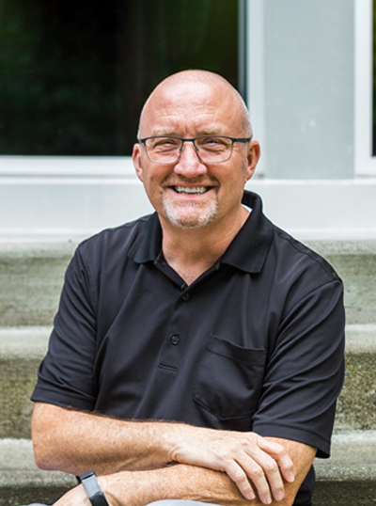
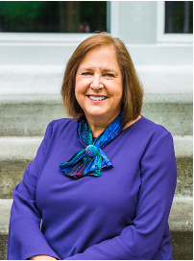
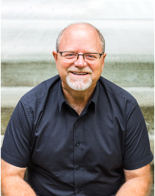
Free Methodist World Missions Leadership Team - Bishops
Matthew
Whitehead
Africa
Asia
Linda
Adams
Latin America
Keith
Cowart
Europe
Middle East

Slide 13
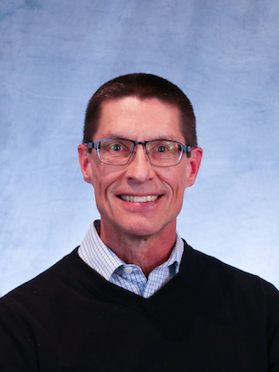
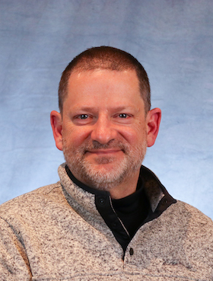
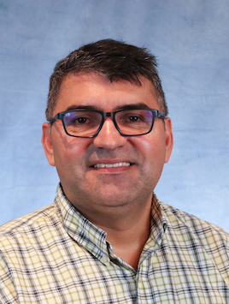
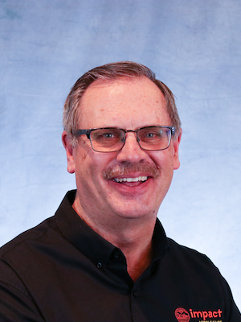
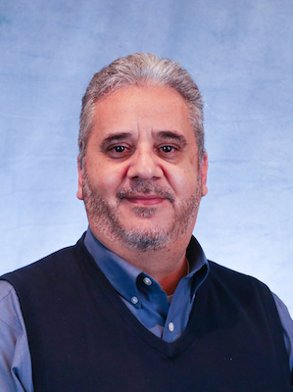
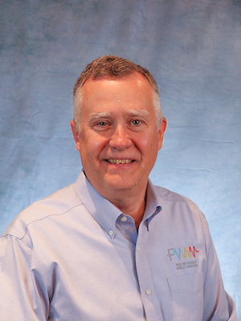
Free Methodist World Missions Leadership Team - Area Directors
Mike Reynen
Africa
Pastor Eric
Asia
Ricardo Gomez
Latin America
Pastor Dale
Middle East
Josh Fajardo
Southern Europe
Gerald Coates
Global Engagement

Slide 14
Three Pillars of FMWM
MAKE DISCIPLES
Empower
International
Leaders
Mobilize
the Global
Church
Establish
Transformational
Churches

Slide 15
Approximately 100 missionaries
(including extended-term, associate, affiliate and global missionaries)
currently serve with Free Methodist World Missions

Slide 16
VISA Ministries offers training and short-term missions service, connecting Free Methodists with a wide variety of global opportunities.

Slide 17
Free Methodist World Missions Funding Priorities:
Missionary Support Accounts (MSAs)
Church Planting & Development (CPDs)

Slide 18
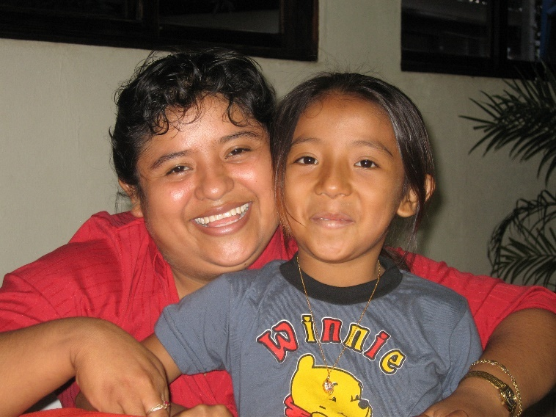
Missionary Support Accounts (MSAs) include:
fixed amount (salary, insurance, basic benefits)
variable amount specific to field (children’s education, rent, utilities, travel, etc.)

Slide 19
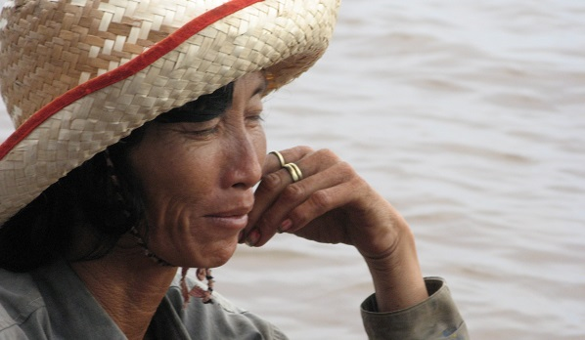
Church Planting & Development (CPDs) help resource leaders and strategic initiatives:
FM national leaders who minister with cultural effectiveness
FM ministries:
church planting & evangelism
leadership development
compassion & community transformation

Slide 20
Funding the Three Pillars of FMWM
Mobilize
the Global
Church
Empower
International
Leaders
Establish
Transformational
Churches
Missionary Support
Church Planting & Development Funds

Slide 21
www.fmcusa.org/fmmissions

