Slide 1
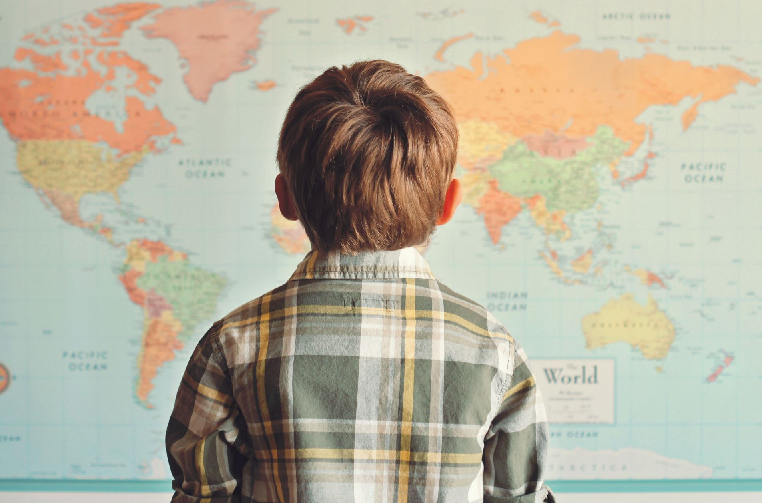
Global Adventures
Problems Faced by Children Around the World

Slide 2
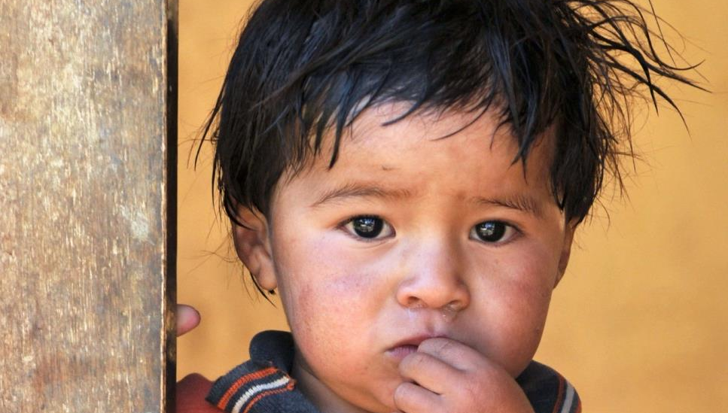
Poverty

Slide 3
Poverty
Worldwide 333 million children live in extreme poverty.
Almost half the world – over 719 million people – live on less than $2.50 a day.
The COVID-19 pandemic drove an additional 97 million people into extreme poverty.

Slide 4
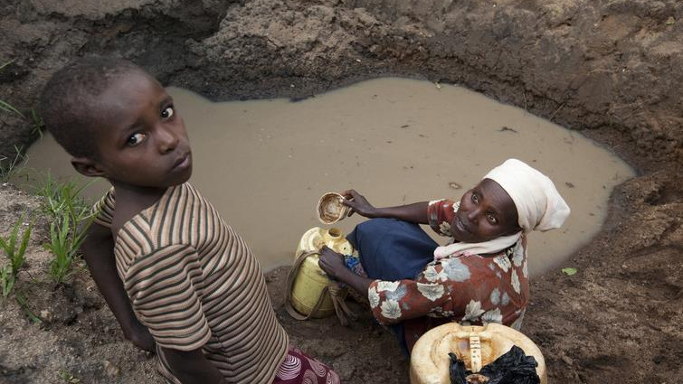
Unsafe Water

Slide 5
Unsafe Water
About one out of three people in the world do not have clean, safe drinking water.
Each day more than 1,000 children under age 5 die from diseases spread by unsafe water or lack of sanitation.
Millions of women spend several hours a day collecting water.

Slide 6
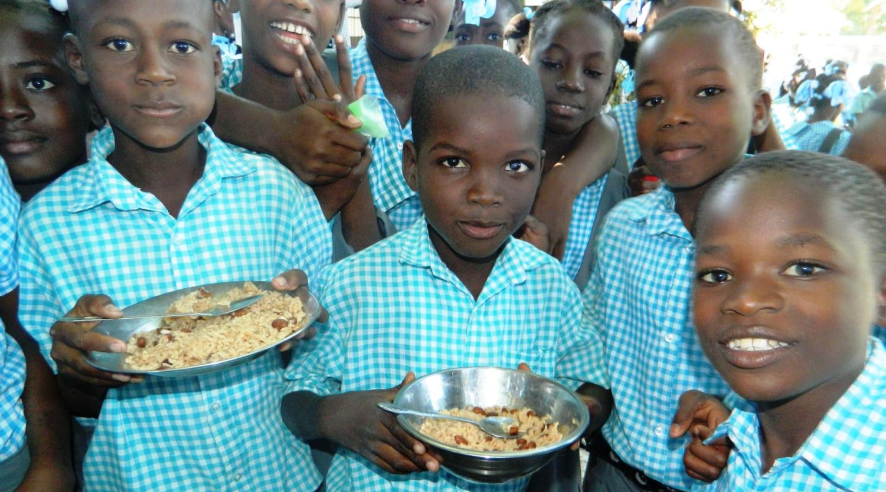
Hunger

Slide 7
Hunger
Malnutrition (not enough to eat or eating the wrong foods) is one of the world’s most serious health problems.
Malnutrition is the single biggest contributor to child deaths – more than 1 millions children per year.
The war in Ukraine has increased global hunger by about 1.7 billion people.

Slide 8
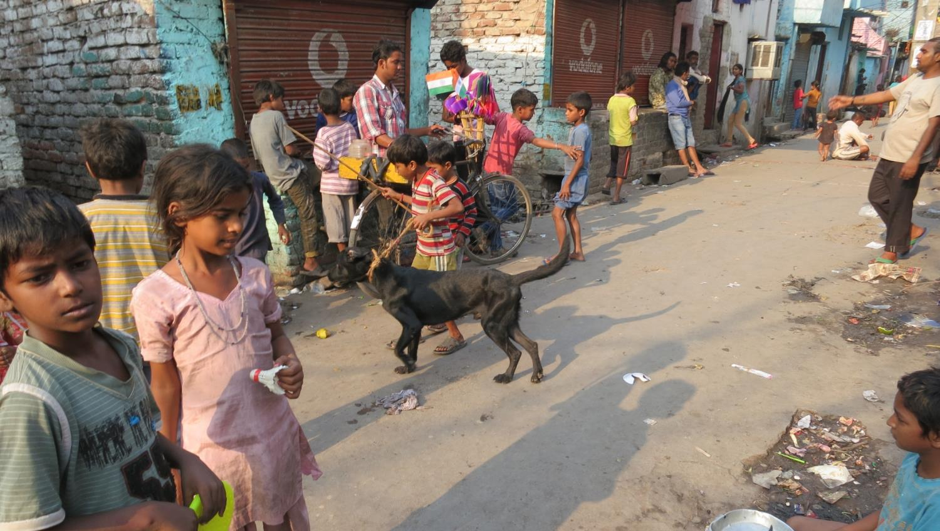
Inadequate Shelter

Slide 9
Inadequate Shelter
Up to 150 million children live on the streets in the world today.
Street children are not necessarily orphans but may have left home because of violence, drug and alcohol abuse, family problems or economic need.
At least 600 million people – most of them women and children – live in housing that is not safe.

Slide 10
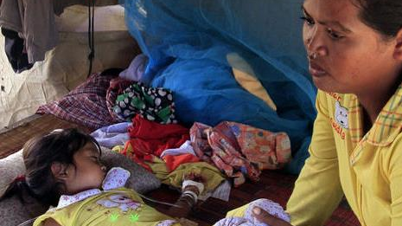
Sickness

Slide 11
Sickness
Every year, over 2 million children under the age of 5 years die from illnesses which could have been avoided or treated.
Around 500,00 children die of malaria every year.
Around 3.5 billion people lack access to basic sanitation – toilets and latrines.

Slide 12
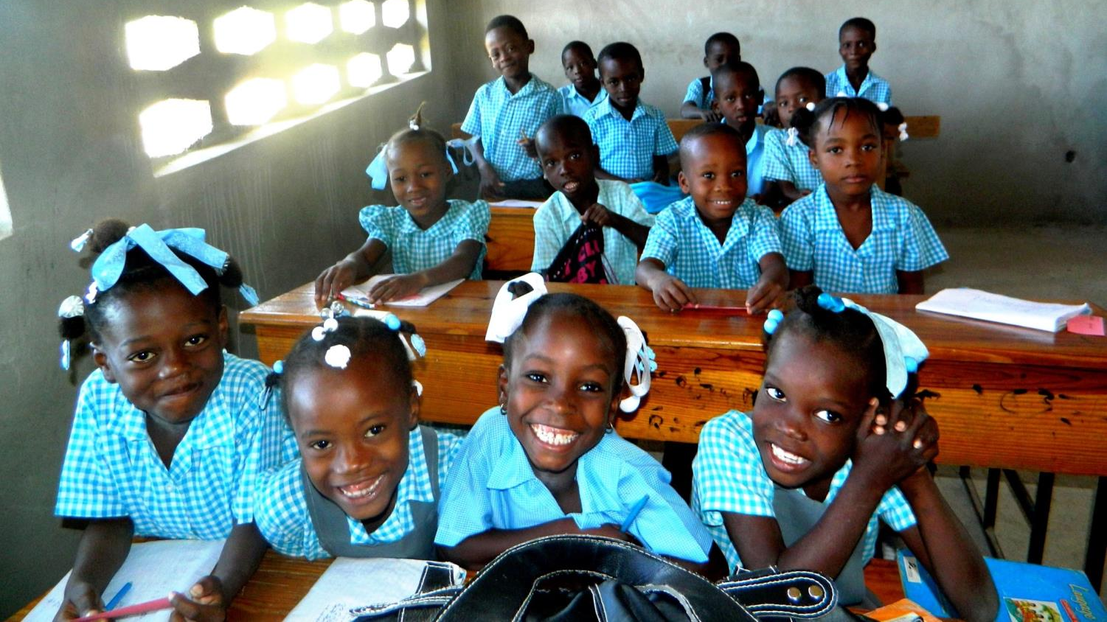
Lack of Education

Slide 13
Lack of Education
Around the world 75 million children – more than half of them girls – have no opportunity to attend primary school.
In many countries families cannot afford to pay school fees or buy uniforms and books.
Nearly 250 million children must work to help their families and cannot go to school.

Slide 14
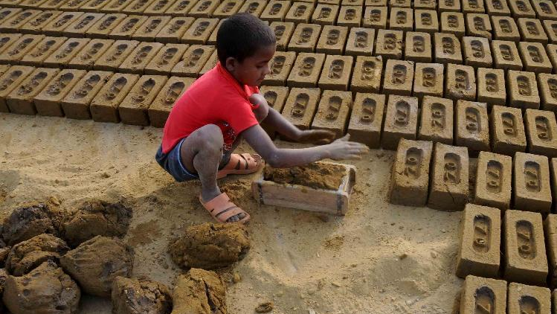
Child Labor

Slide 15
Child Labor
Child labor is work that harms children or keeps them from attending school.
Underage children work at all sorts of jobs around the world usually because they are extremely poor.
There are 218 million child laborers around the world.

Slide 16
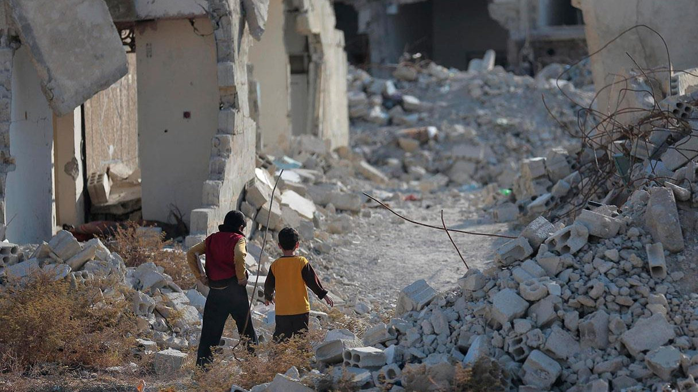
War

Slide 17
War
Millions of children have been killed or injured in wars over the last ten years.
400 million children are living in areas of violent conflict.
250,000 children have been forced to participate in fighting in the last 10 years.
More than 1 million children have been orphaned or separated from their parents.

