Slide 1
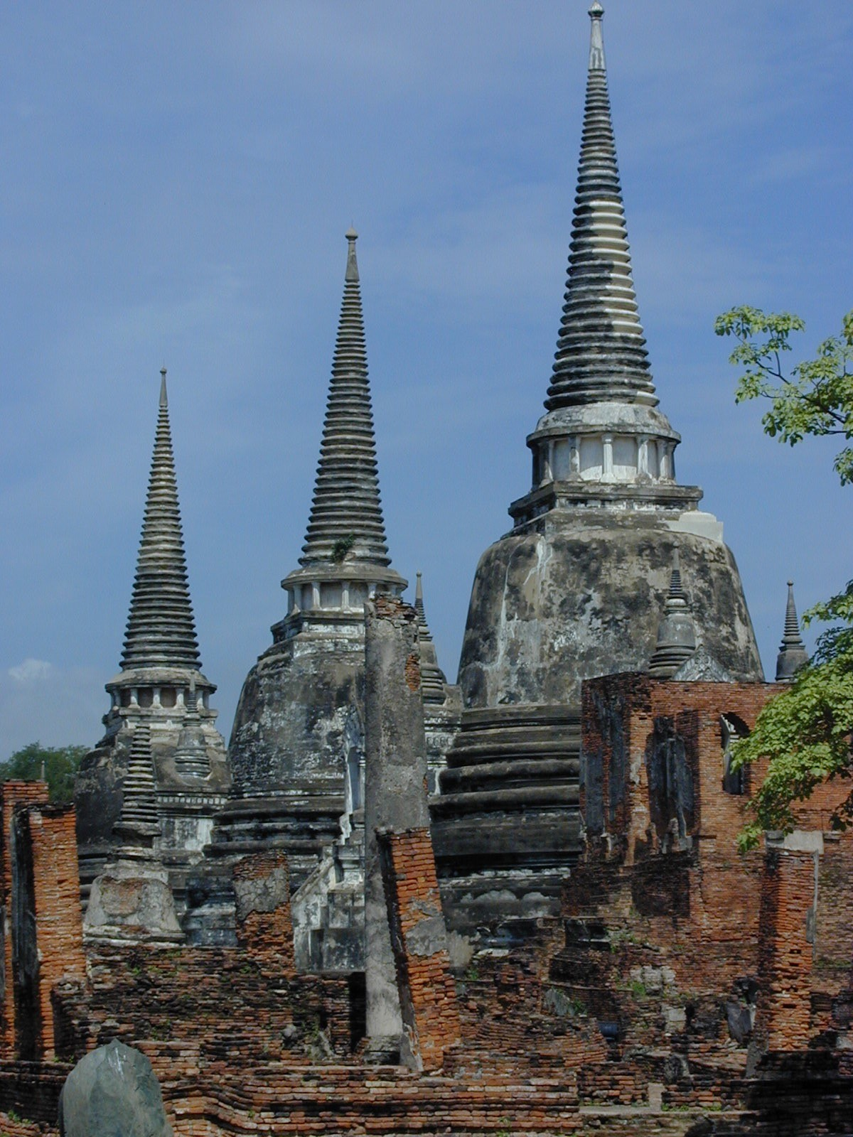
Global Adventures
World Religions

Slide 2
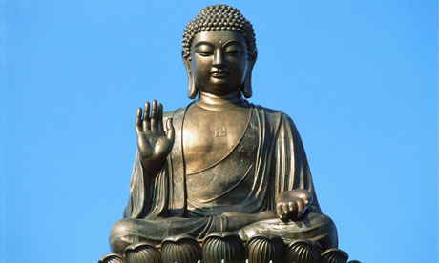
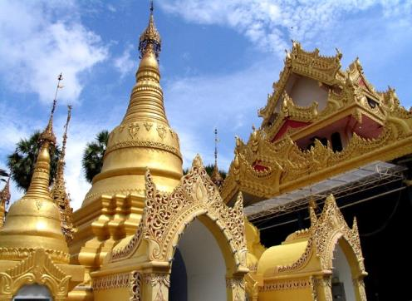
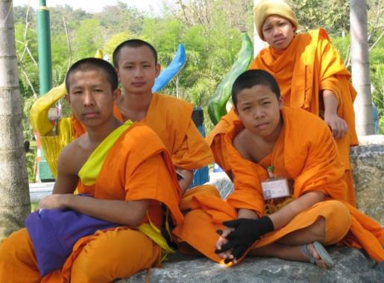
Buddhism

Slide 3
Buddhism is the fourth largest religion in the world.
Buddhists follow the teachings of “the Buddha,” a man who lived 2,500 years ago.
Buddhists believe:
they can learn to be good by following the Eightfold Path, a set of rules for acting, thinking and feeling.
when a person dies, they are reborn again, living many lives, until they perfect themselves.
They do not believe in a God who is separate and different from mankind, but that every person contains a part of God within himself.

Slide 4
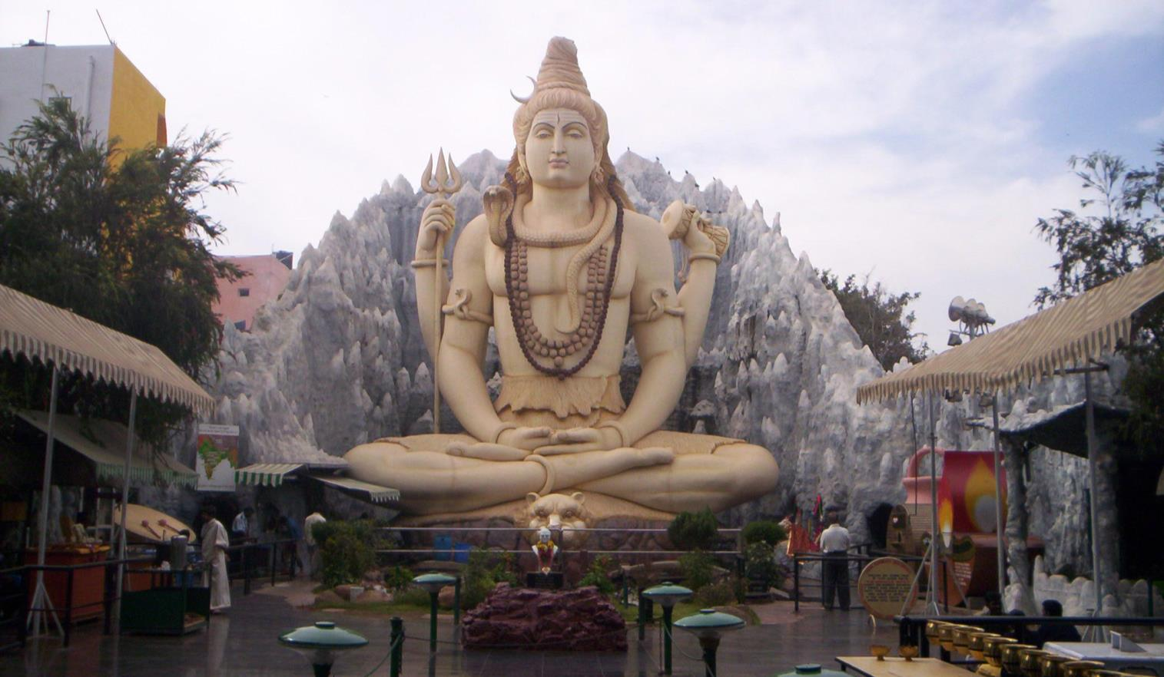
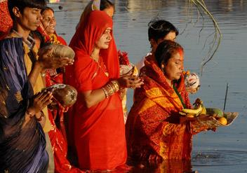
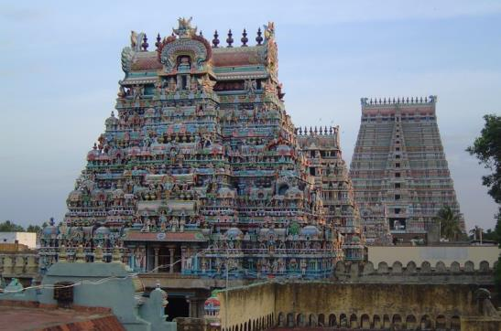
Hinduism

Slide 5
Hinduism is the third largest religion in the world.
Hindus believe in millions of gods, both good and evil.
Hindus worship idols at the temple or at a special shrine set up in their house.
Through praying, visiting temples and offering gifts to the “gods,” Hindus believe they can make their hearts clean.
Hindus believe in reincarnation, a continuous cycle of birth, death and rebirth. A person may come back in the next life as another person, an animal or a bug.

Slide 6
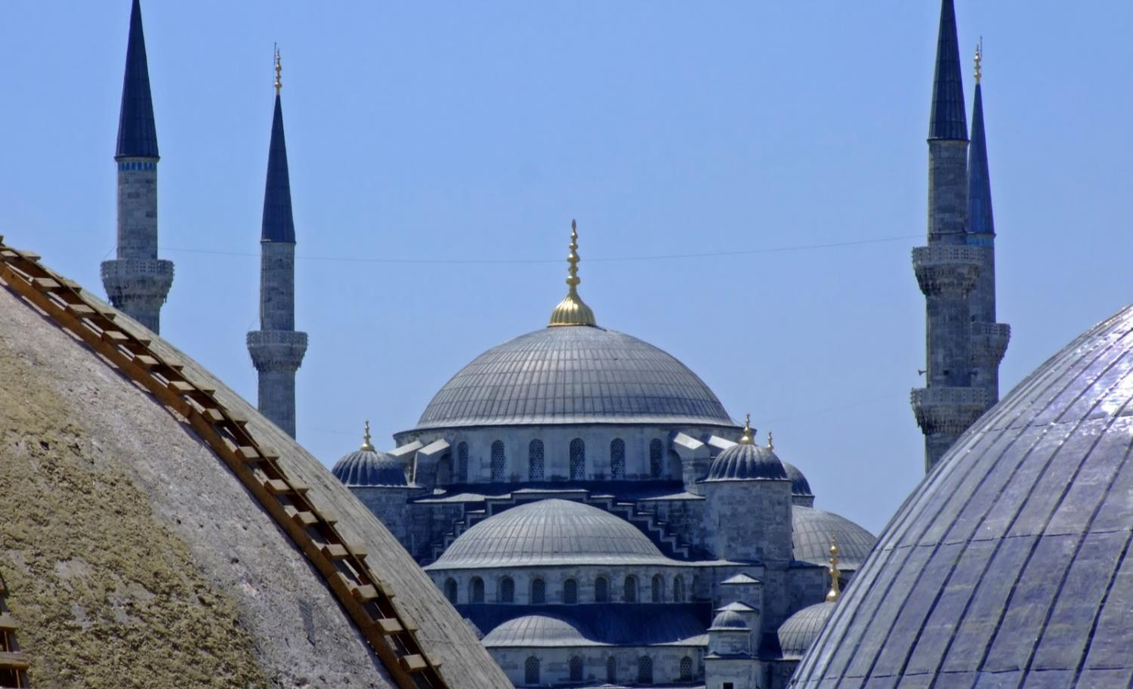
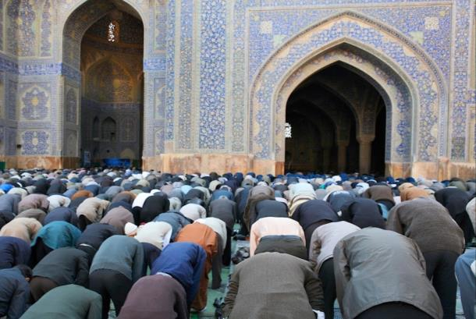
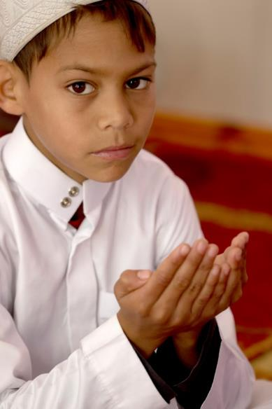
Islam

Slide 7
Islam is the second largest religion in the world.
People who follow Islam are called “Muslims.”
Muslims must follow the “Five Pillars of Faith” which include:
Reciting the mantra, “There is no God but Allah, and Mohammed is his prophet.”
Praying five times a day facing in the direction of Mecca, Saudi Arabia.
Giving alms to the poor.
Keeping the 28-day fast of Ramadan.
Making the trip to Mecca once in their lifetime.

Slide 8
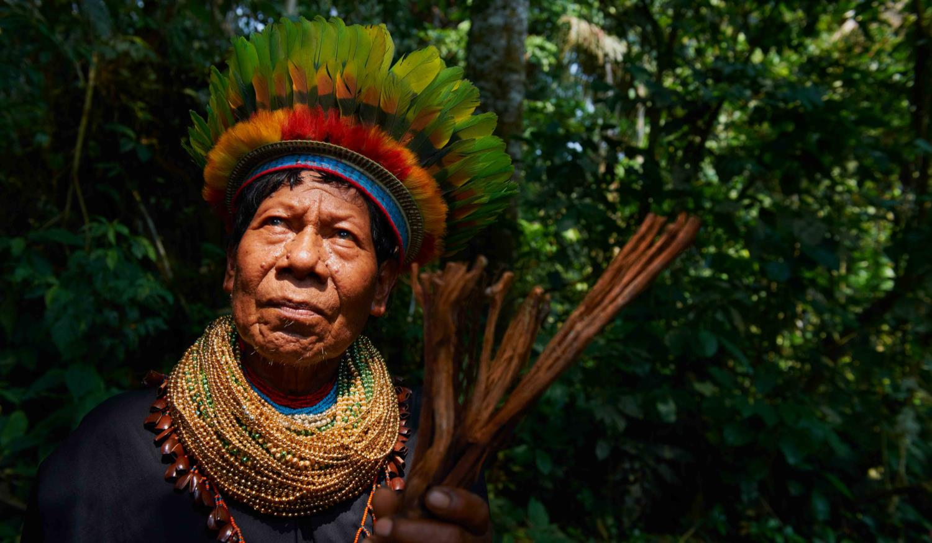
Animism
Tribal Religions

Slide 9
Animism is often practiced by tribal groups.
Animists believe that powerful spirits, capable of helping or harming people, live in everything in nature, such as animals, rocks, trees, the wind or the sun.
They live in fear of displeasing one of these spirits.
Animists believe disasters such as drought, famine, sickness, earthquakes and floods are the work of evil spirits.
They have faith in witch doctors or a medicine man, sometimes called a shaman, for healing.

