Slide 1
Global Adventures
People on
the Adventure

Slide 2
AFRICA
Edinger Family
Scott, Natasha, Sam, Allie and Brady Edinger
Lorenz Family
Glenn, Wendy, Libby, Isaac, Jakin and Ellie

Slide 3
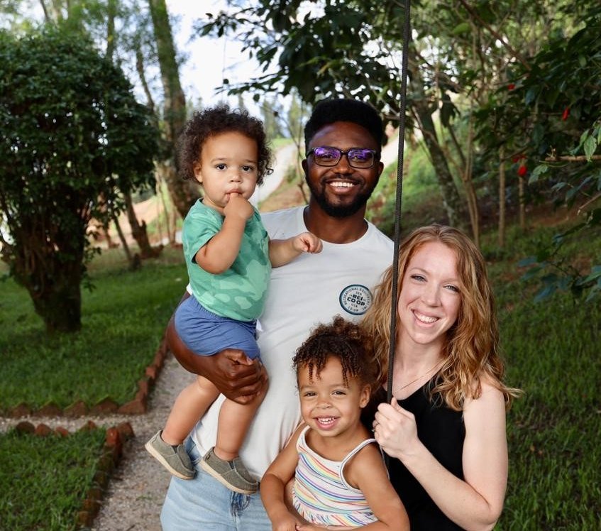
Kaufmann Family Jordan, Audrey, Jack and Piper
Nzungize Family
Emmanuel, Rachel, Noella and Matayo

Slide 4
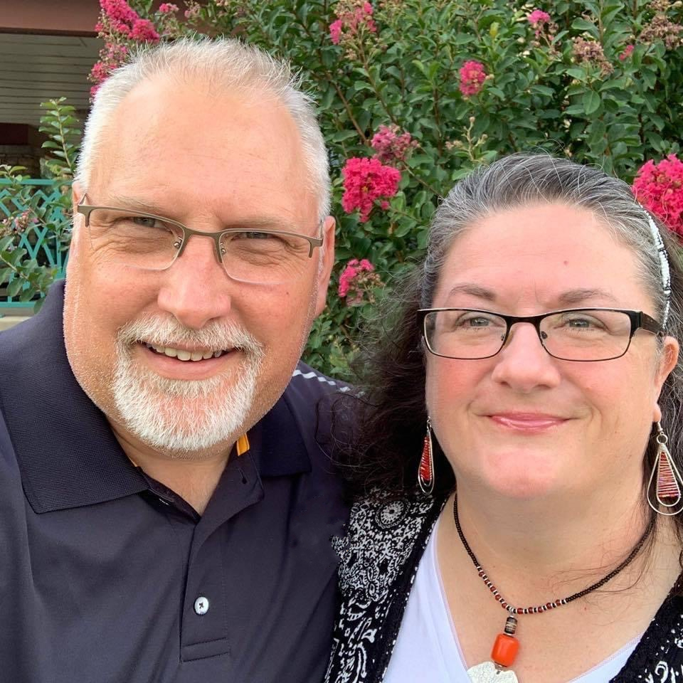
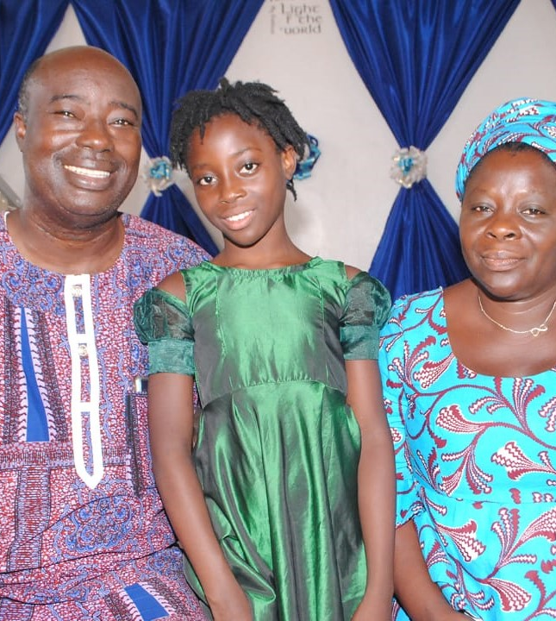
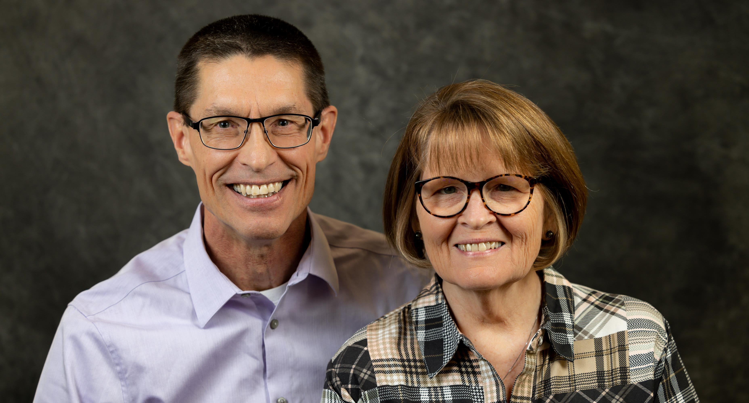
Hendrik & Kaylene Smidderks
Dosseh Takpale
International Missionary
Flora and Elvira
Mike & Vickie Reynen
Africa Area Director

Slide 5
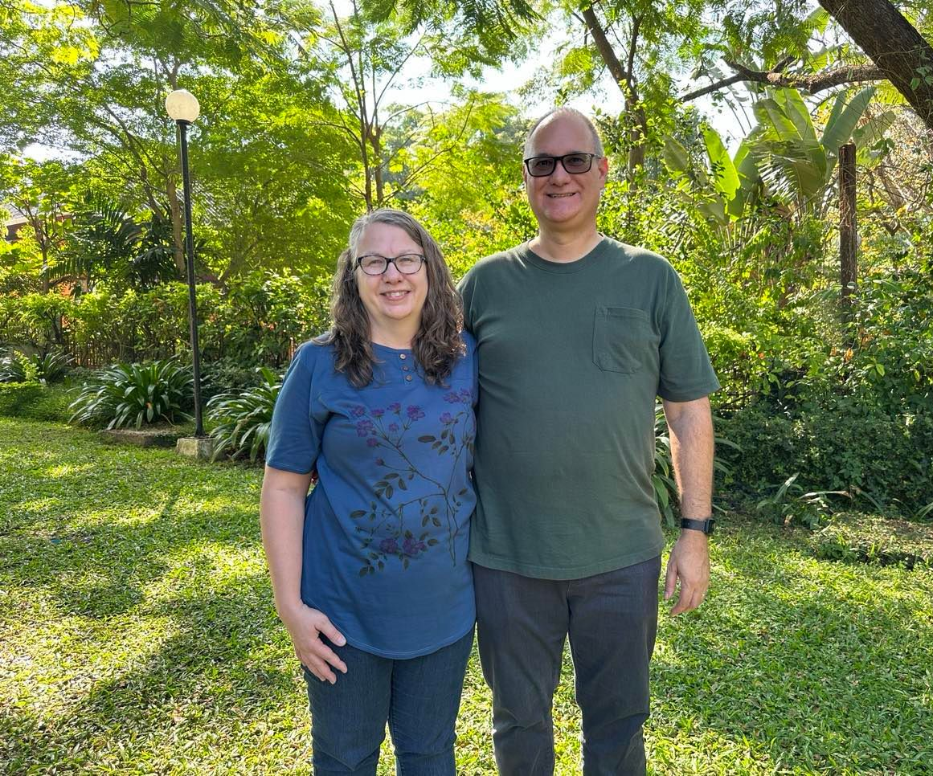
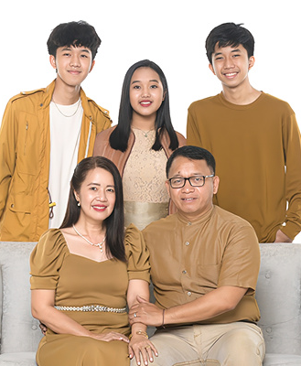
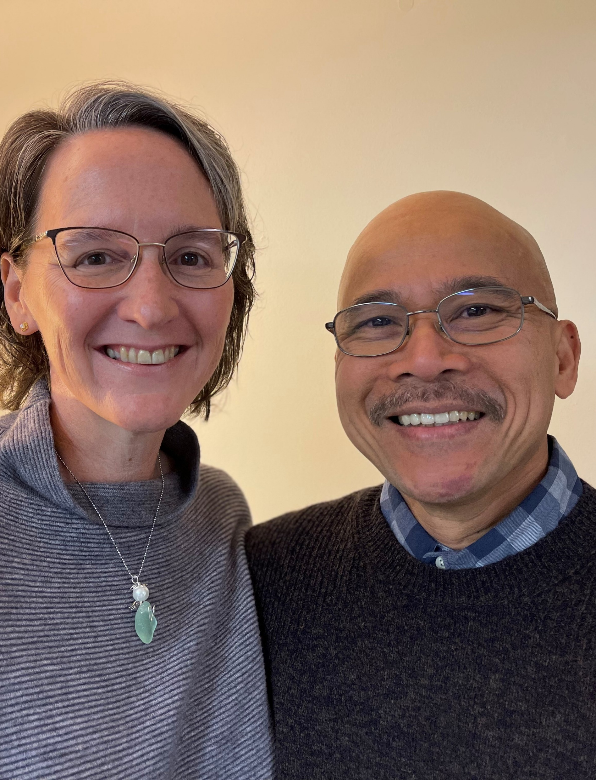
Thom & Sherri Cahill
ASIA
The Bacus Family
Alan, Ammabellee, Alan Josiah, Azaneah Jannah and Asher Jedd
International Missionaries
David & Sarah Clemente

Slide 6
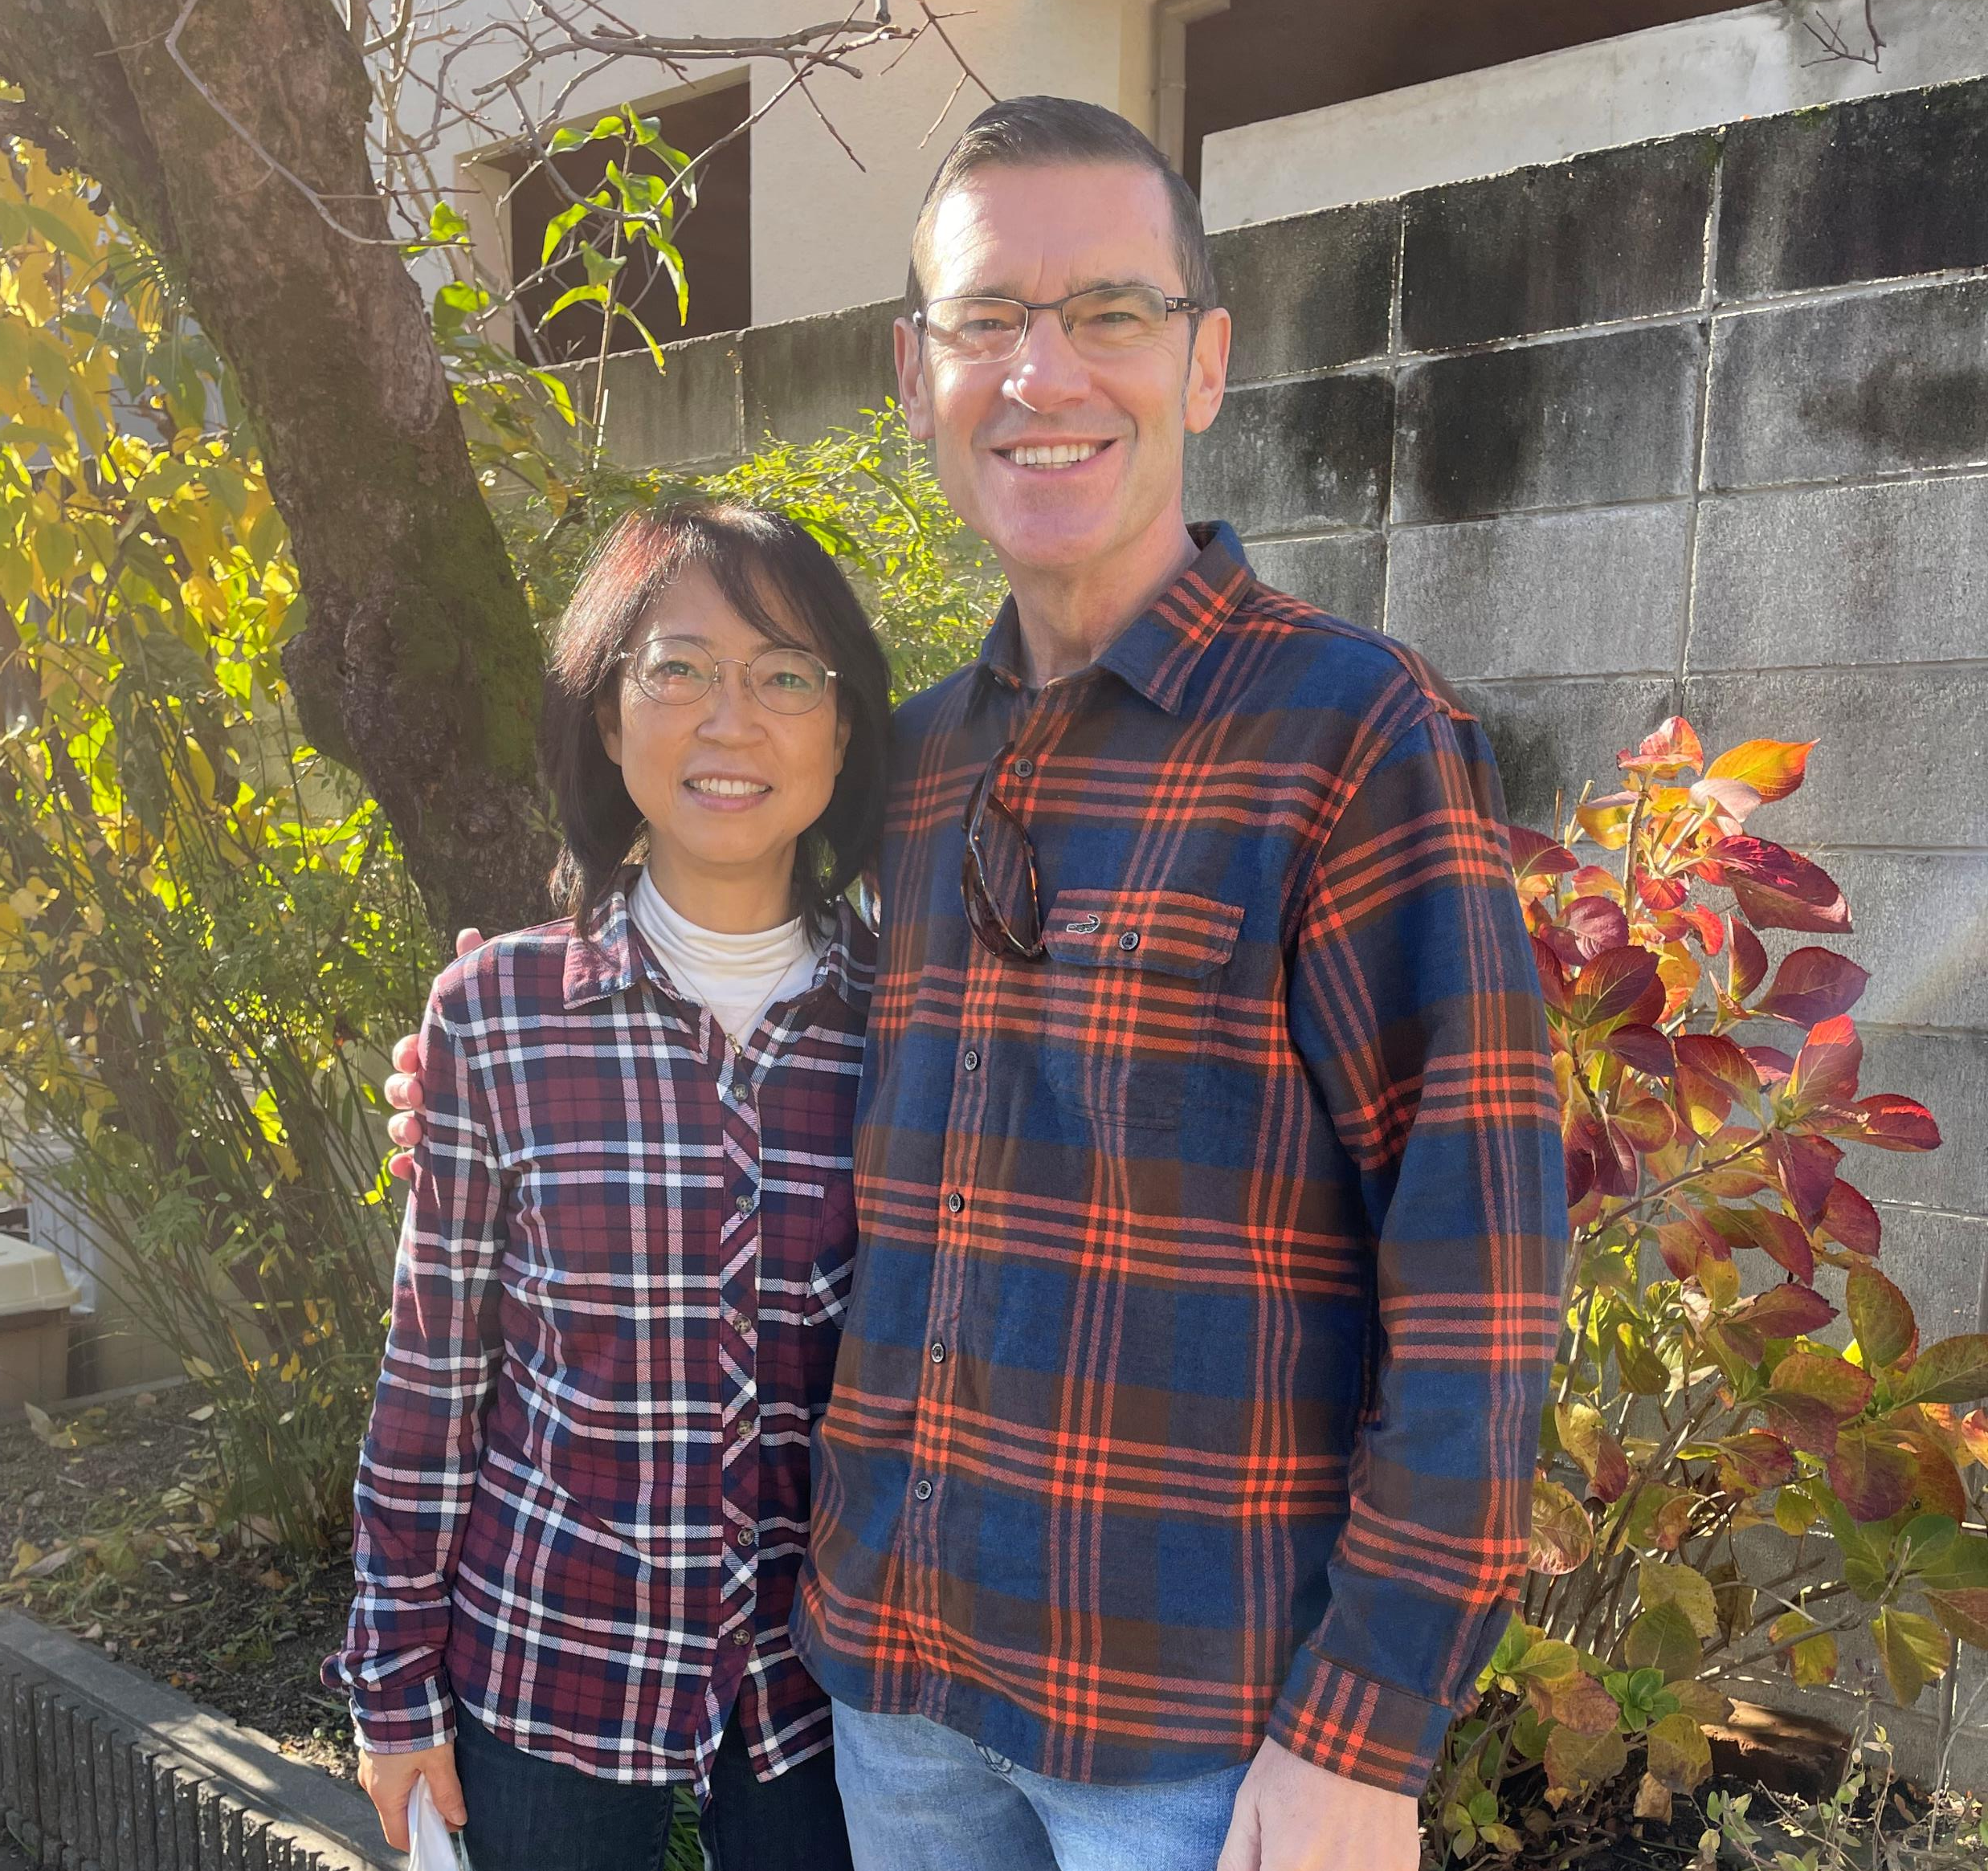
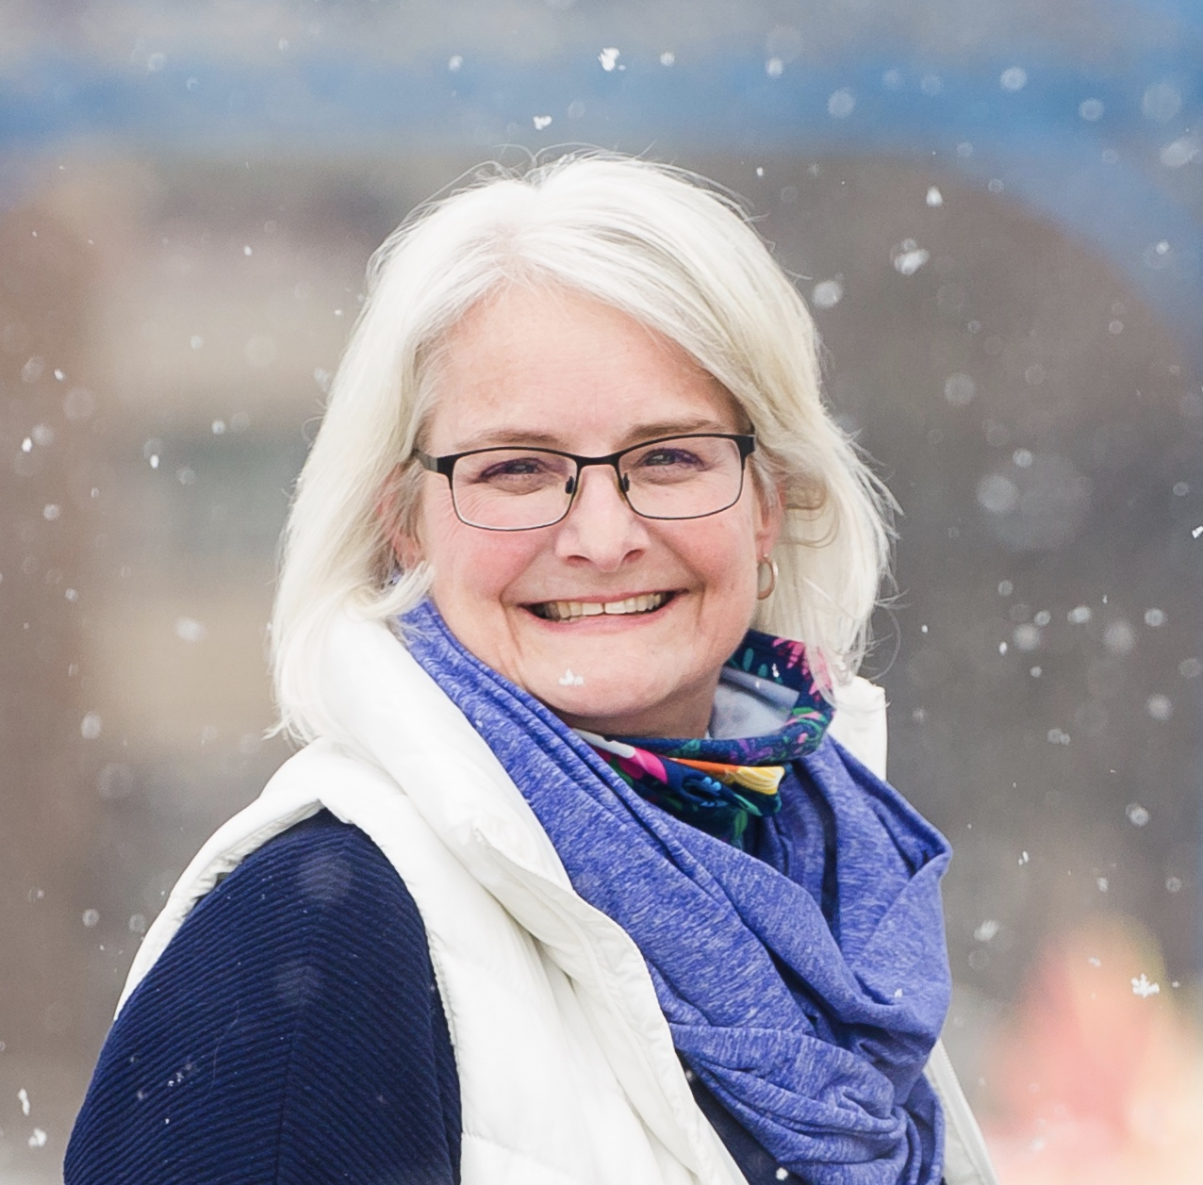
Trevor Foley
Affiliate Missionary
Gene & Minori Hall
Laurie

Slide 7
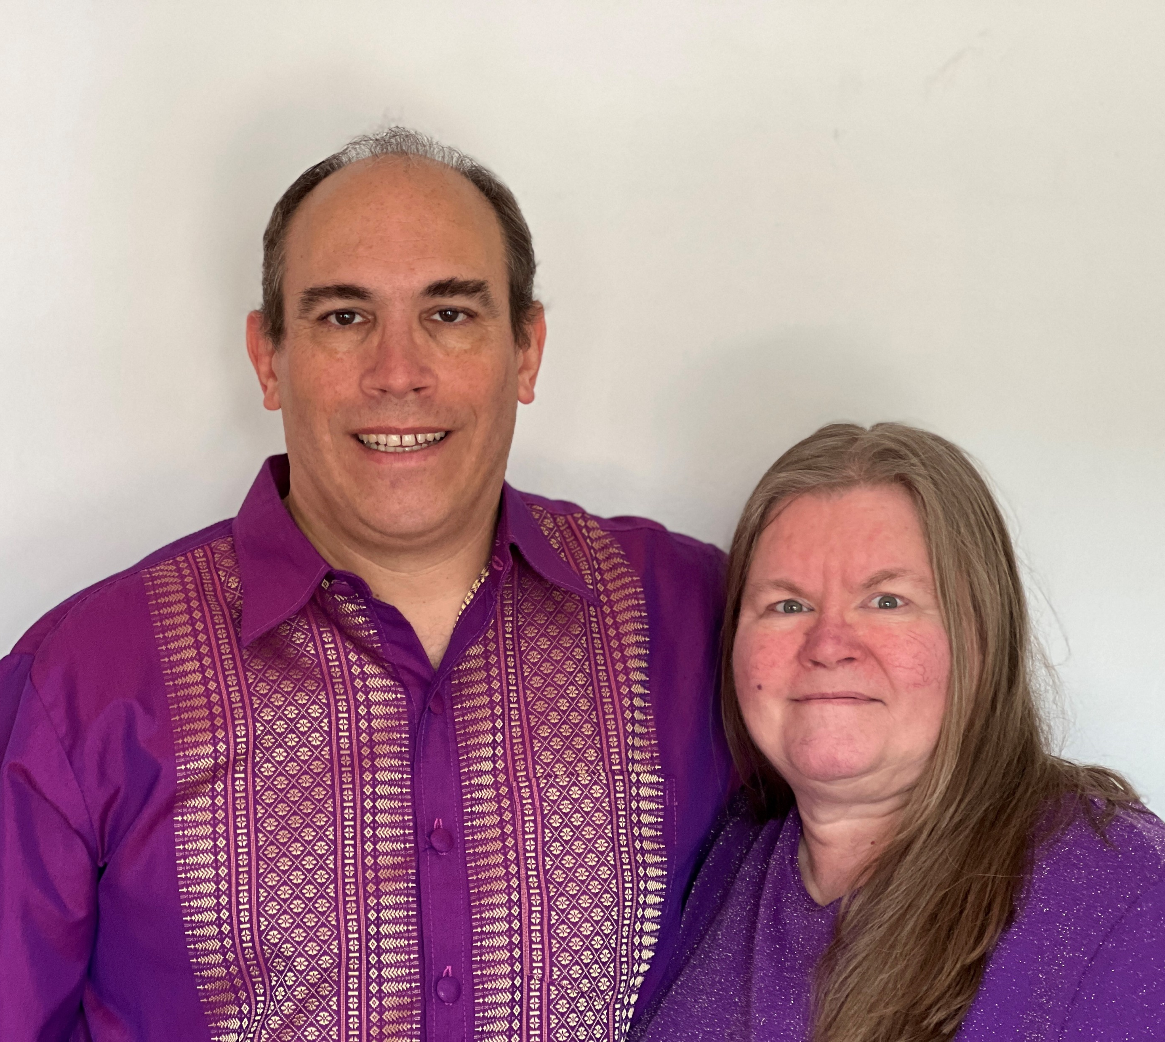
Mark & Judi Morrison
Corey & Connie Persing

Slide 8
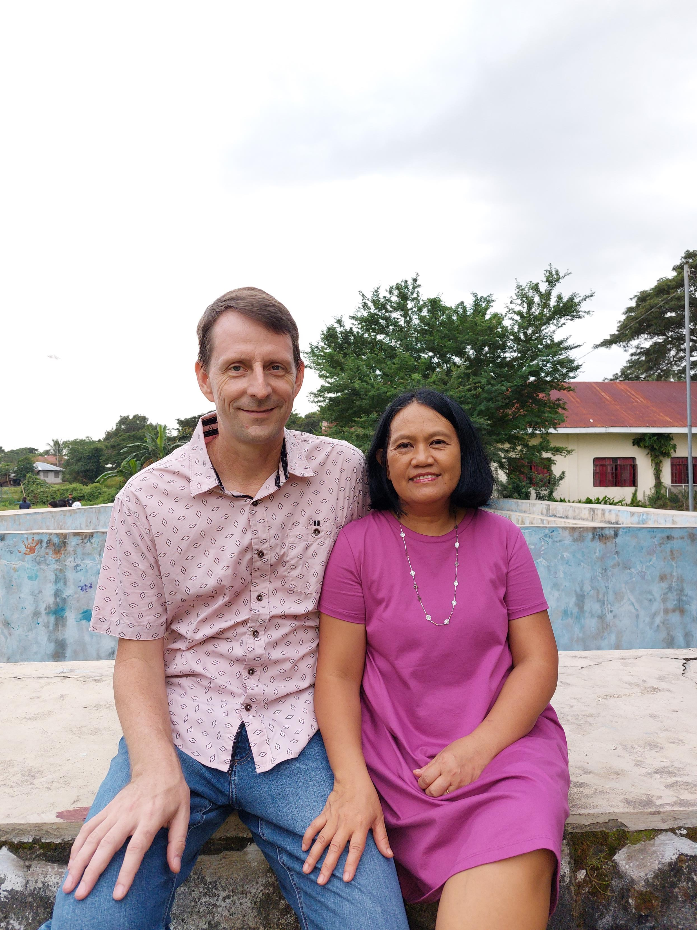
Roger & Vangie Stone Affiliate Missionaries
Helri & Phuong
International Missionaries

Slide 9
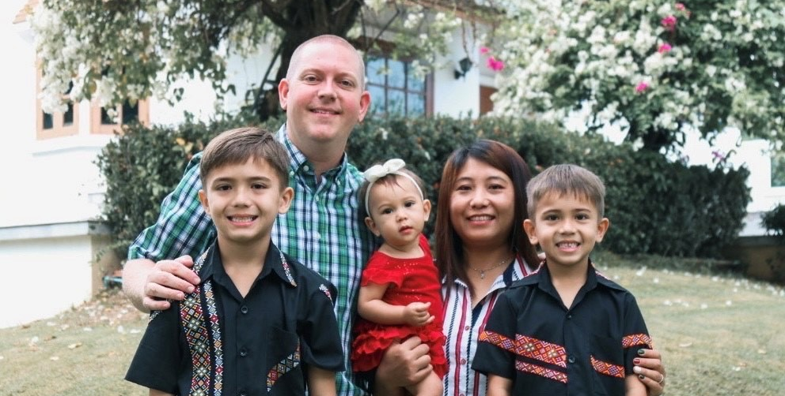
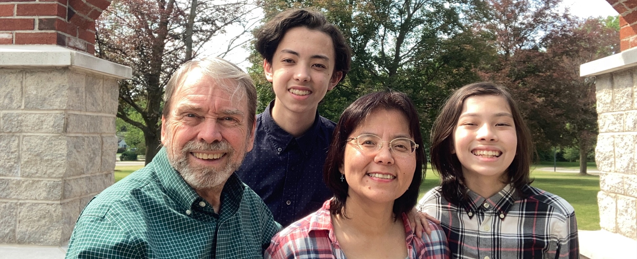
The Van Tifflin Family Seth Hlawn Hlawn, Jason, Noah and Abigail
The Wilkins Family
Chris, Yuko, Caleb and Corey

Slide 10
Asia Creative Access
Adam & Rebecca
Becca
Bryan & Tammy
Darin & Jill
Eric & Virginia (Asia Area Director)
Jason & Wendi
Keith & Julie
Mark & Lena
Scott
Susan

Slide 11
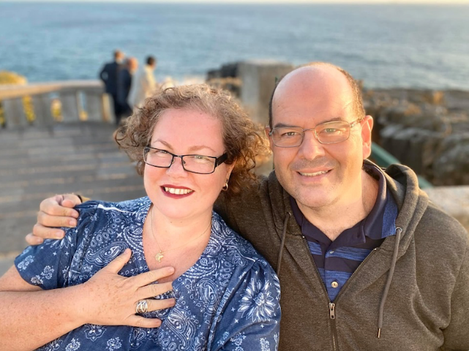
EUROPE
Cathy Alford
Eduardo & Cindi Angelo
International Missionaries

Slide 12
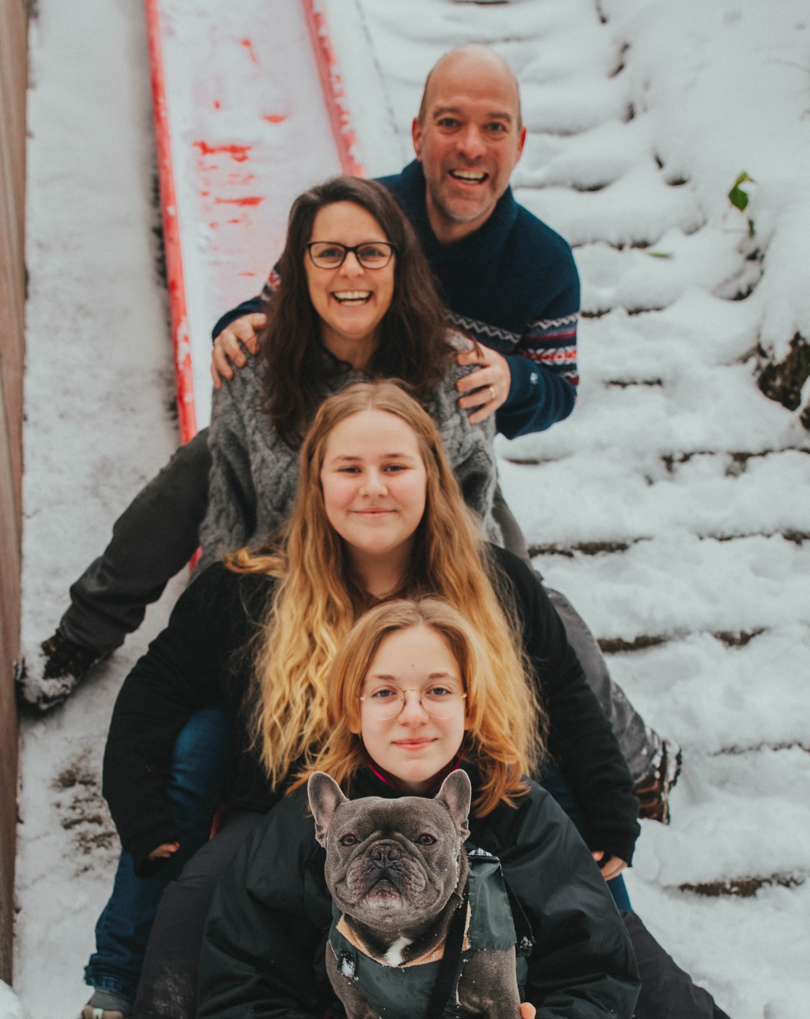
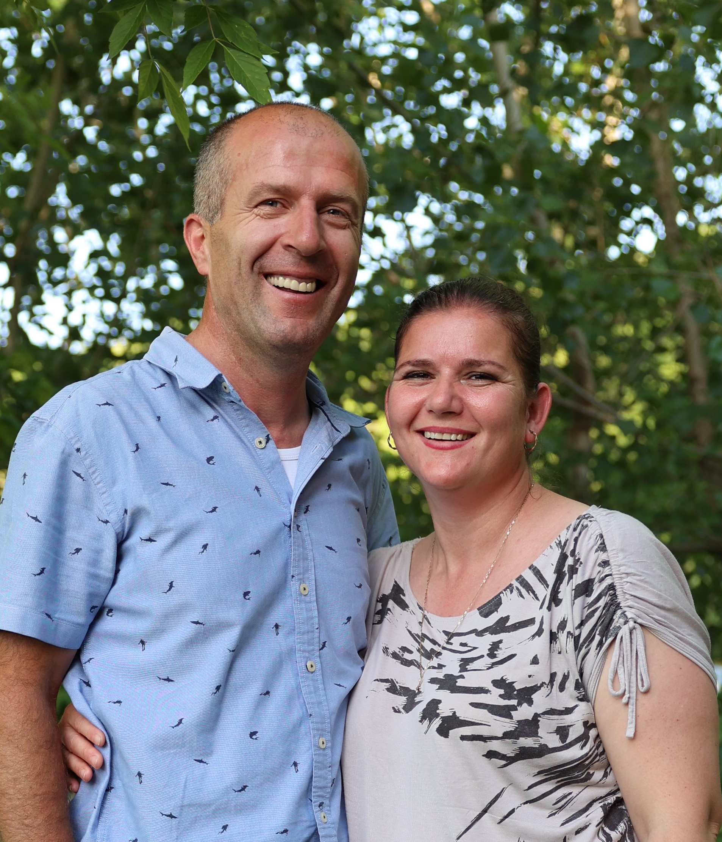
The Arana Family Raul, Abi and Alex National Missionaries
FamilyID=Office_ArchiveTorn
Eric Casteel
Affiliate Missionary
Amy, Kathryn and Allyson
Algent & Erjona Bregu
Affiliate Missionaries

Slide 13
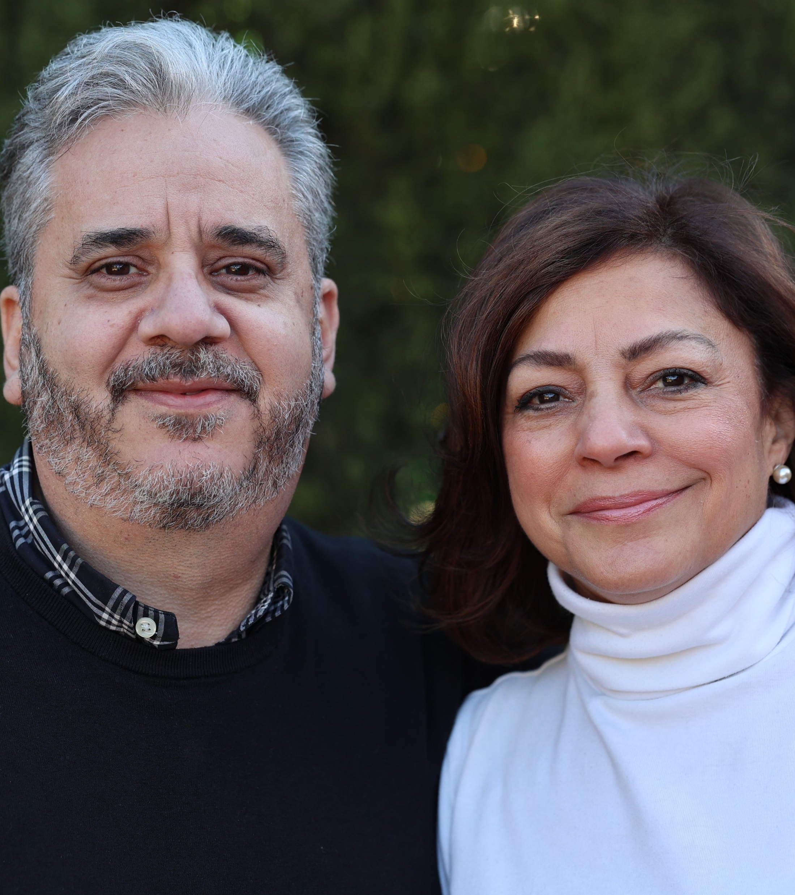
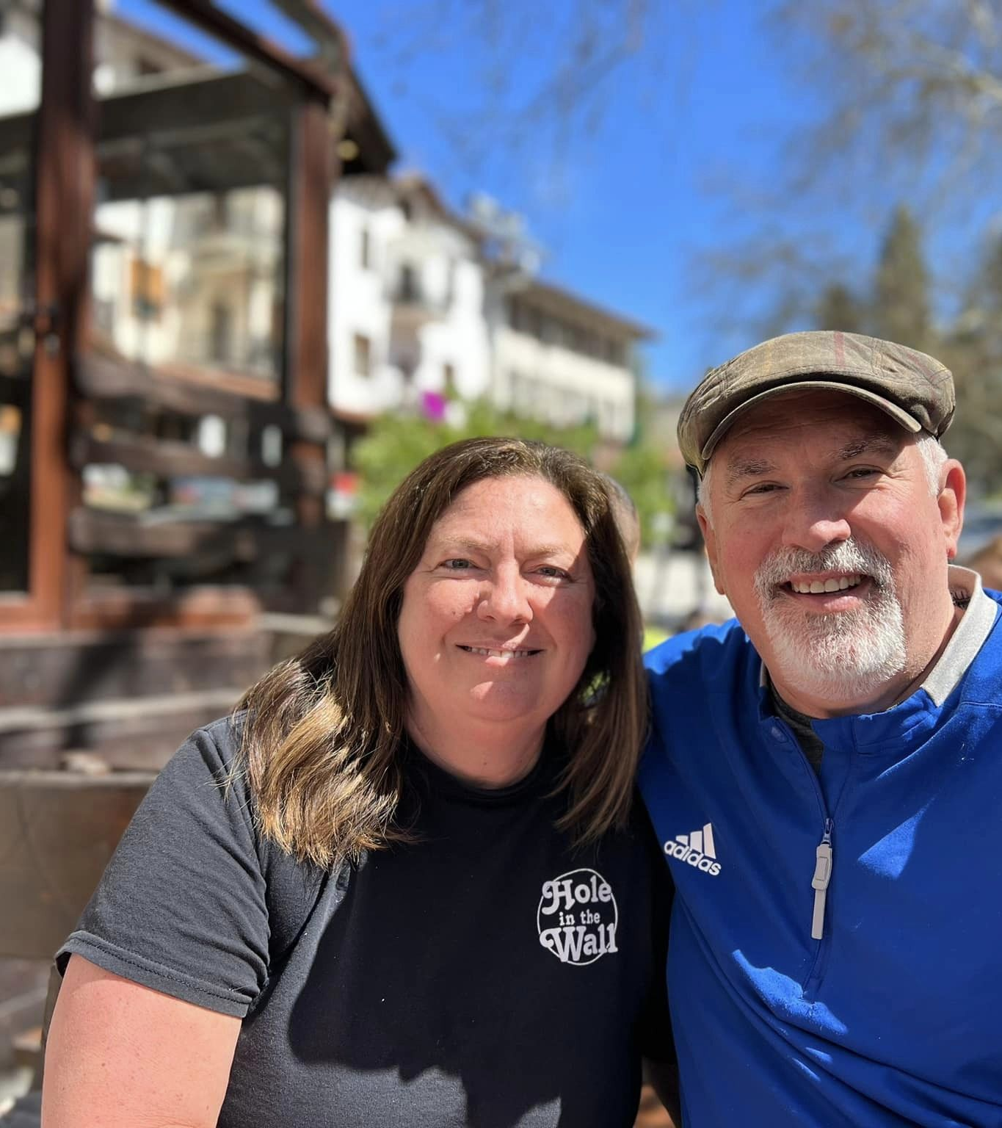
Josh & Susy Fajardo
Europe Area Director
Chance & Dee Dee Galloway

Slide 14
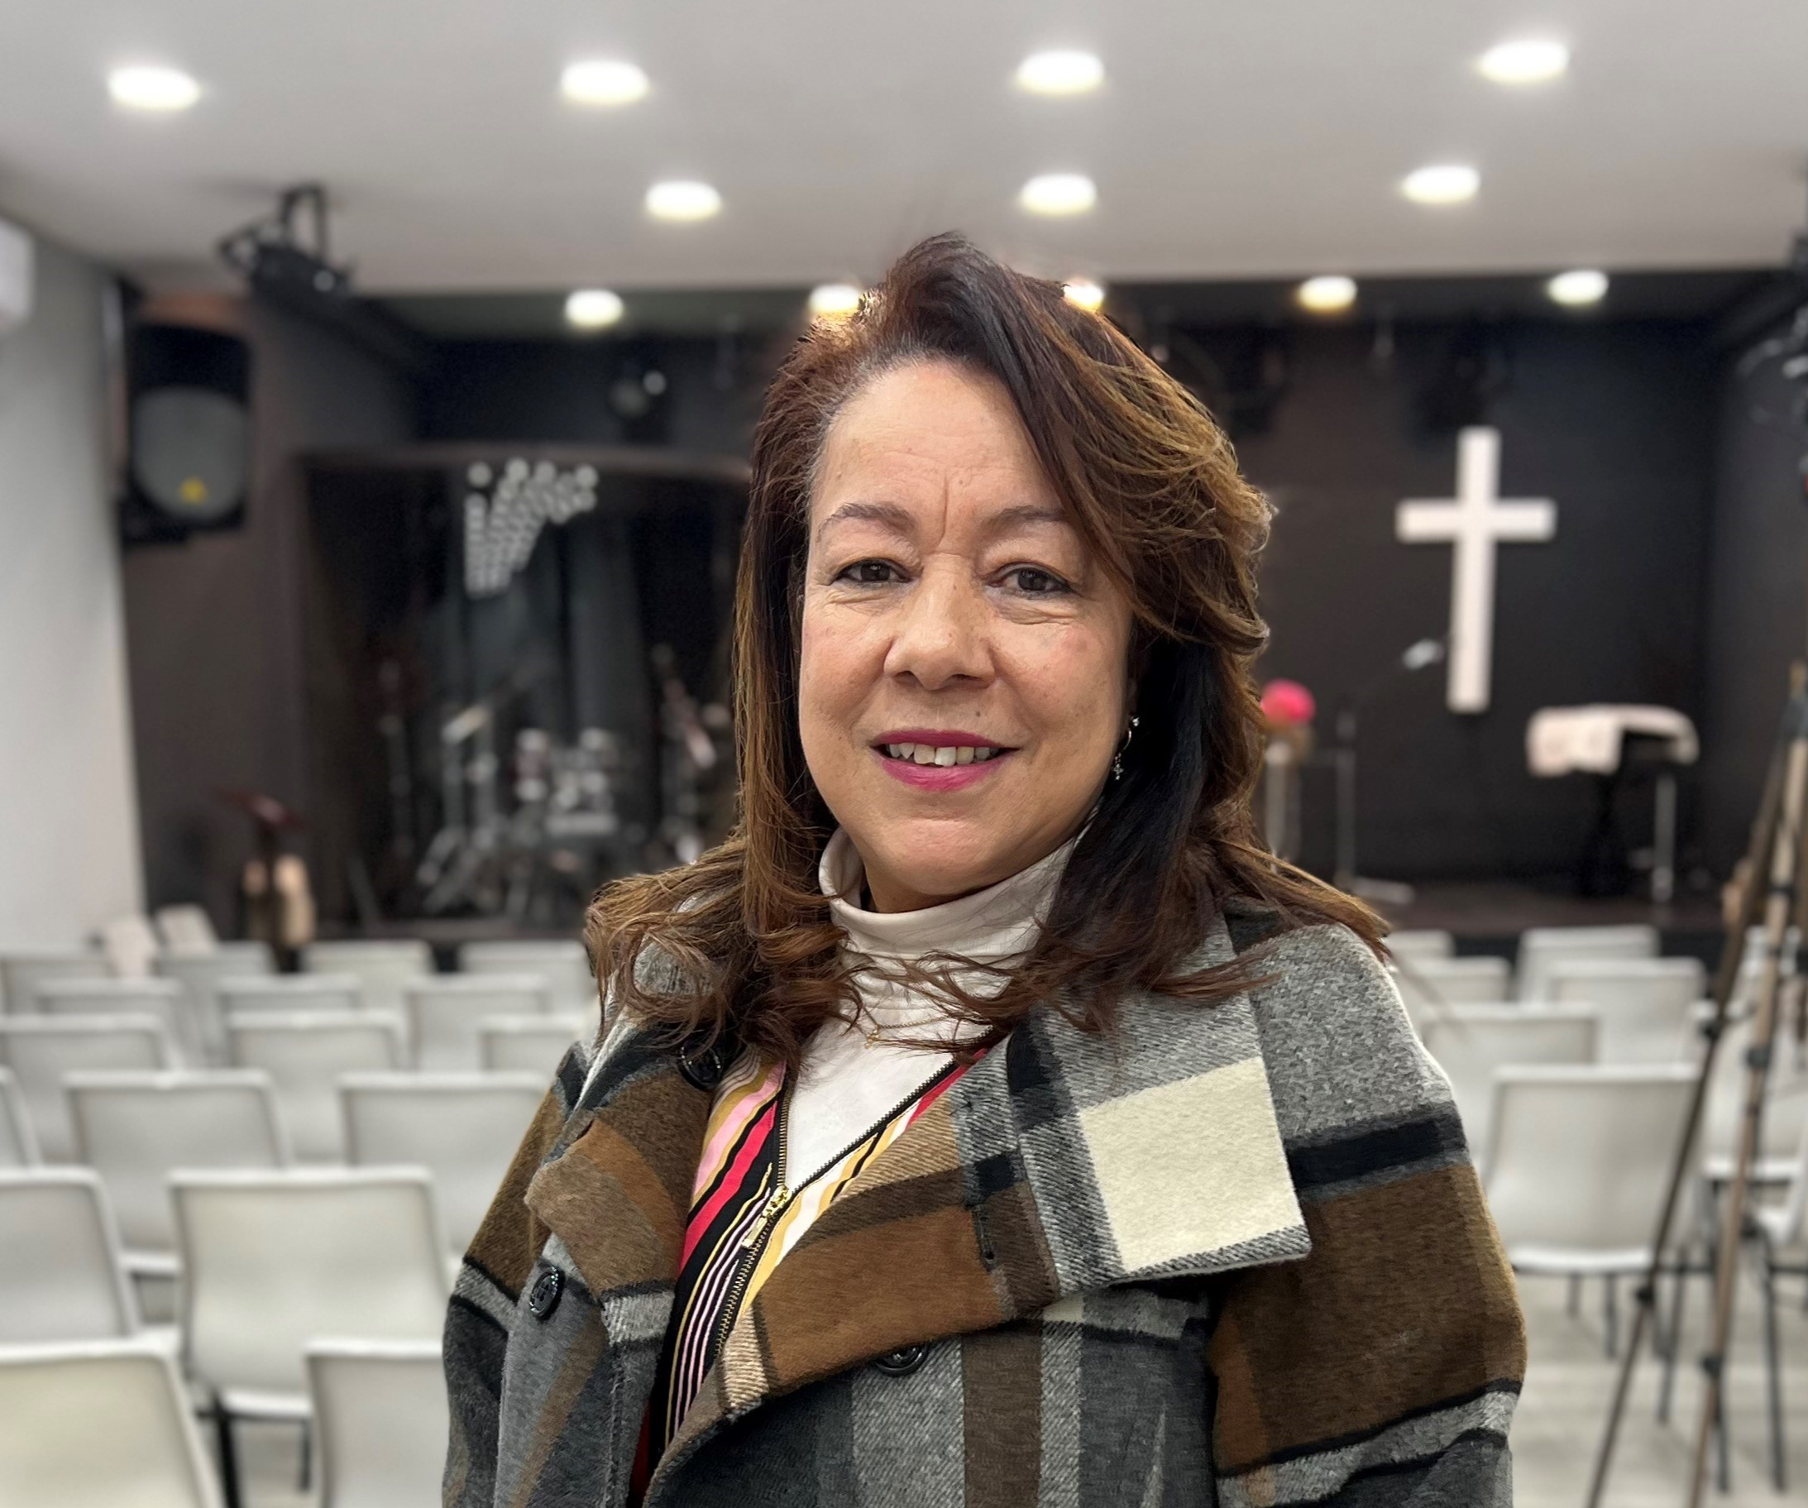
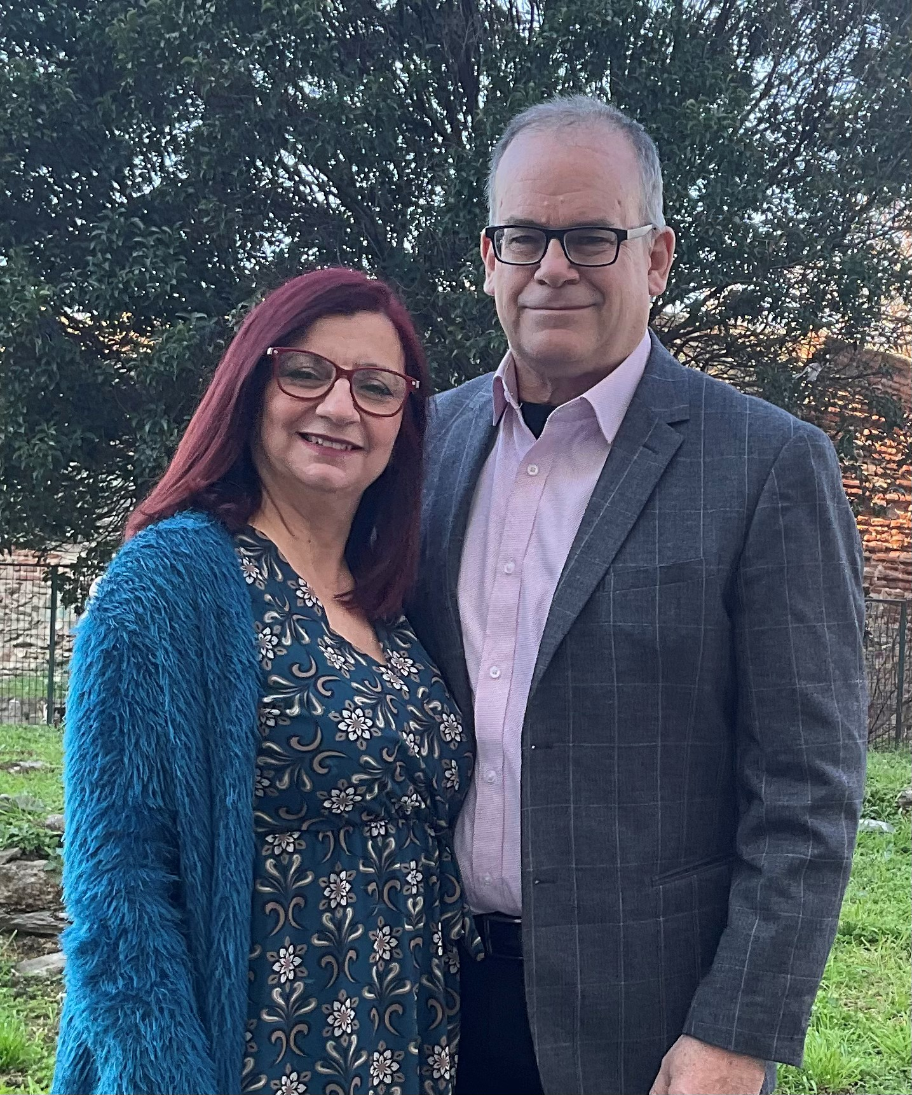
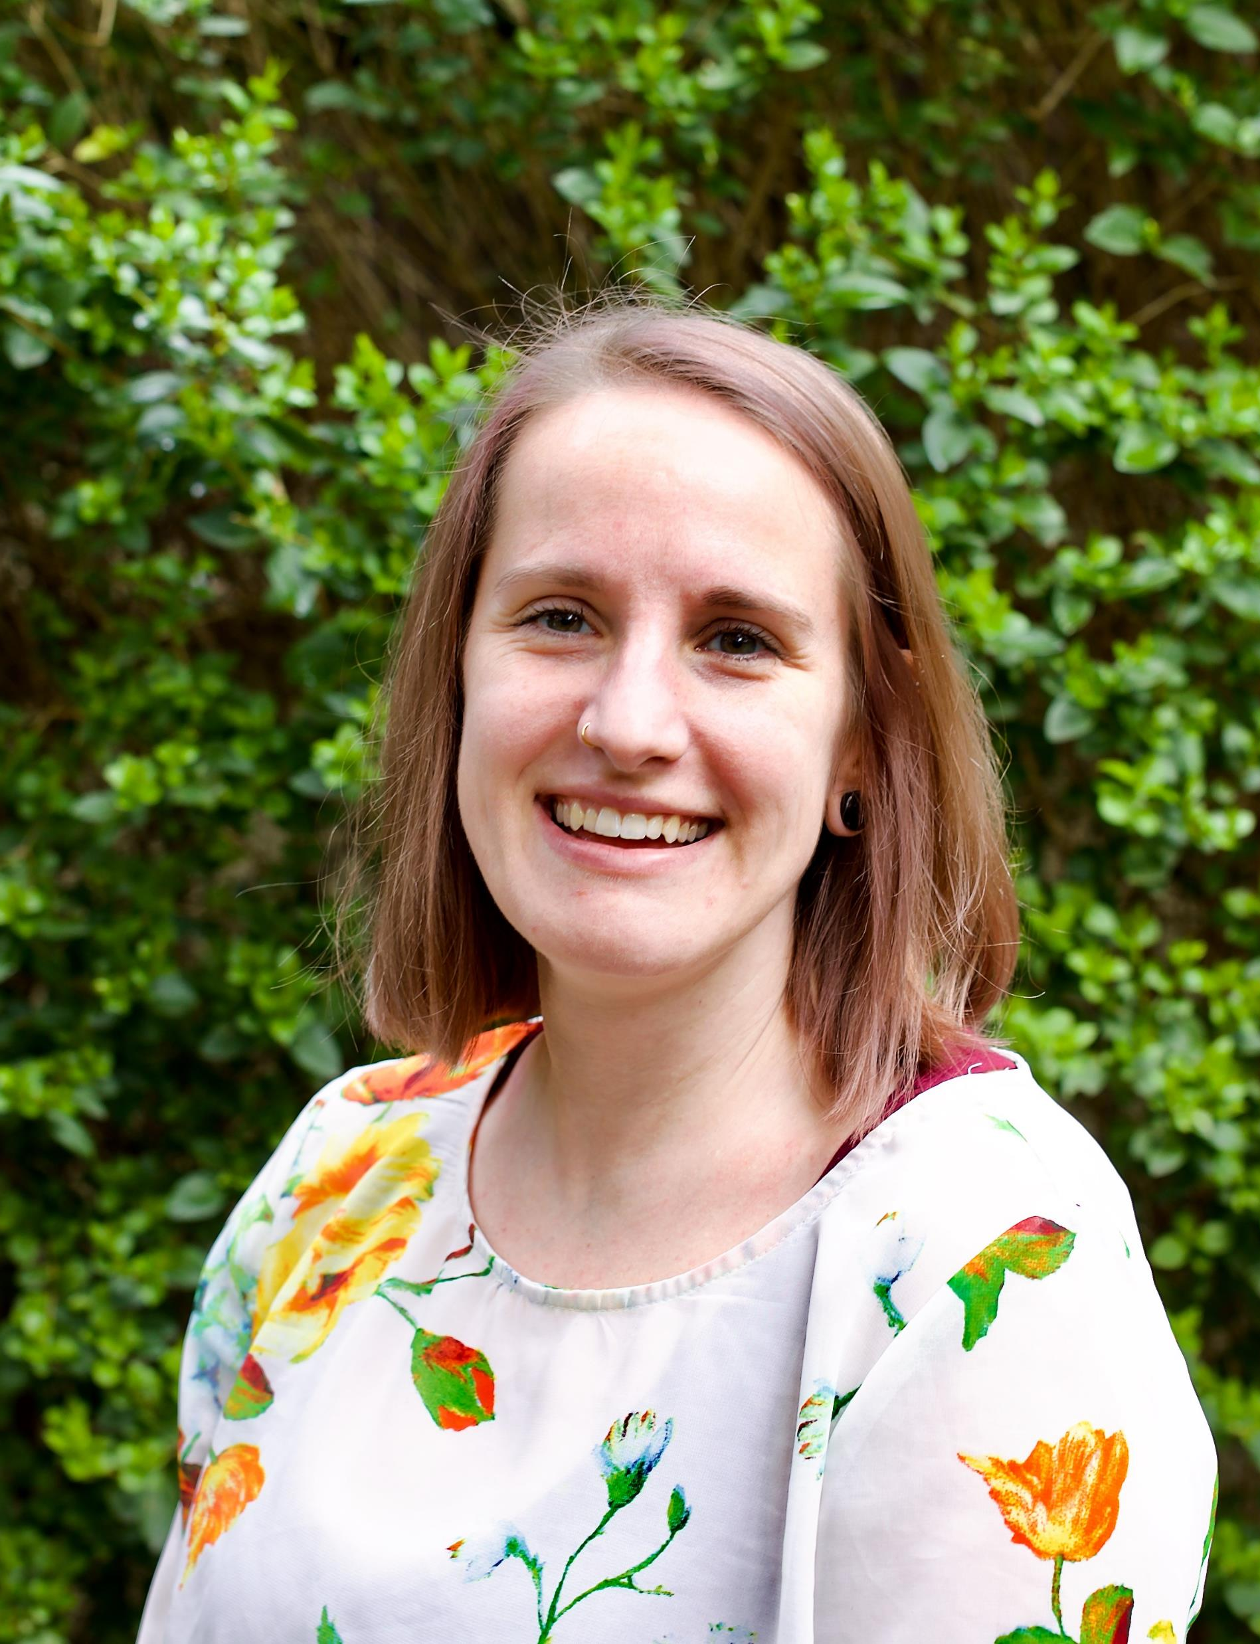
Cida Matos International Missionary
Michael & Maria Long
Erin Kingsley

Slide 15
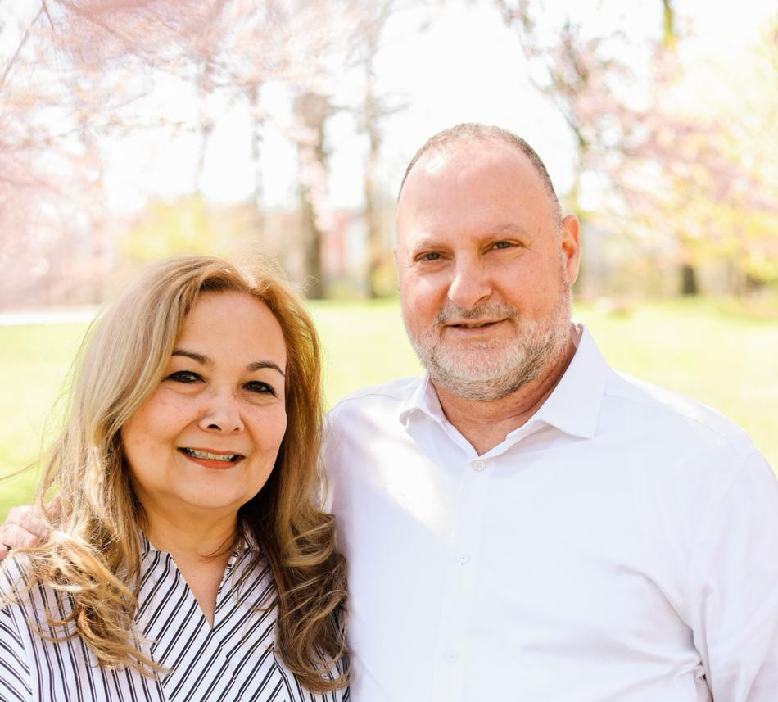
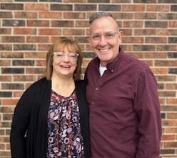
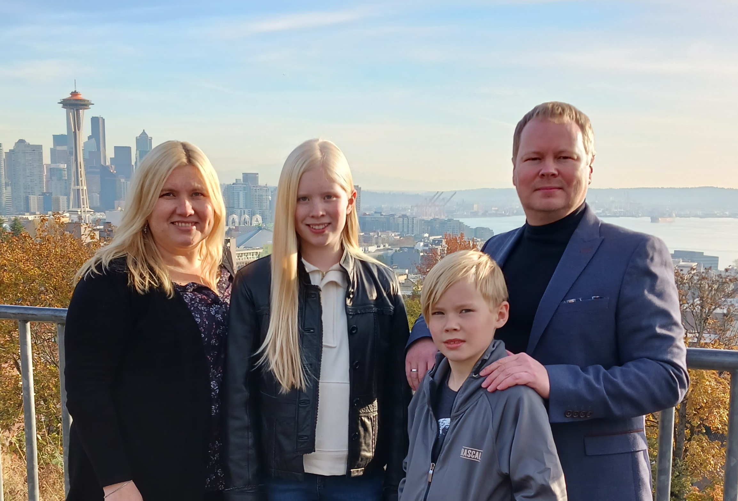
Camilo & Magaly Mora
(left)
Todd & Deann Miller
(right)
Michael, Tanya, Liana and Erik
Affiliate Missionaries

Slide 16
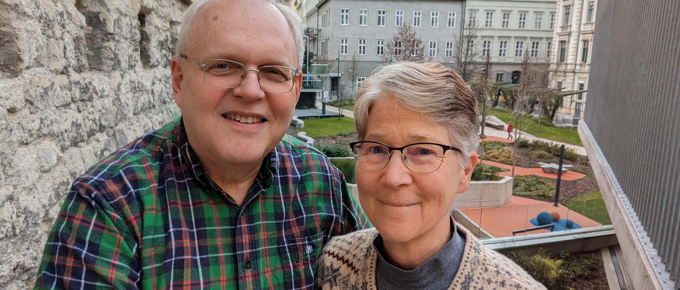
Larry & Katie Winckles
The Souza Family
Moises, Jacione, Filipa and Giovanna
International Missionaries

Slide 17
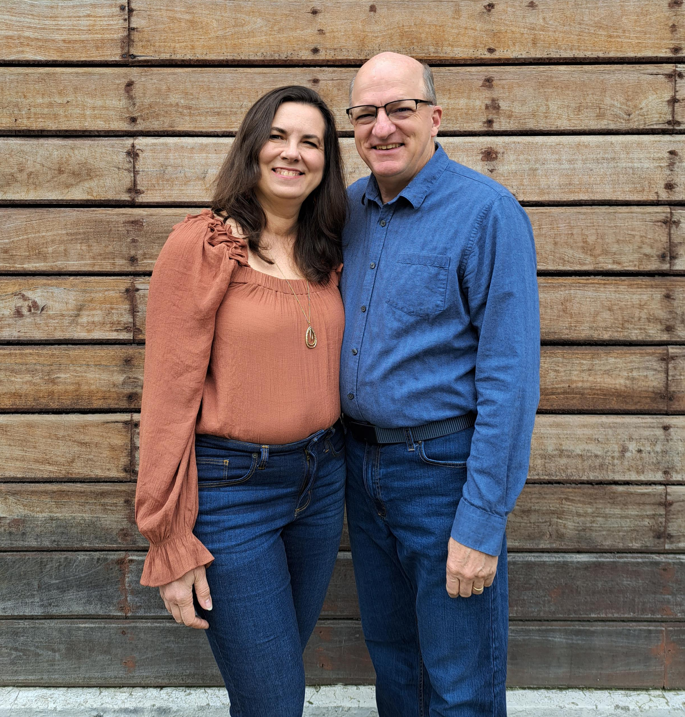
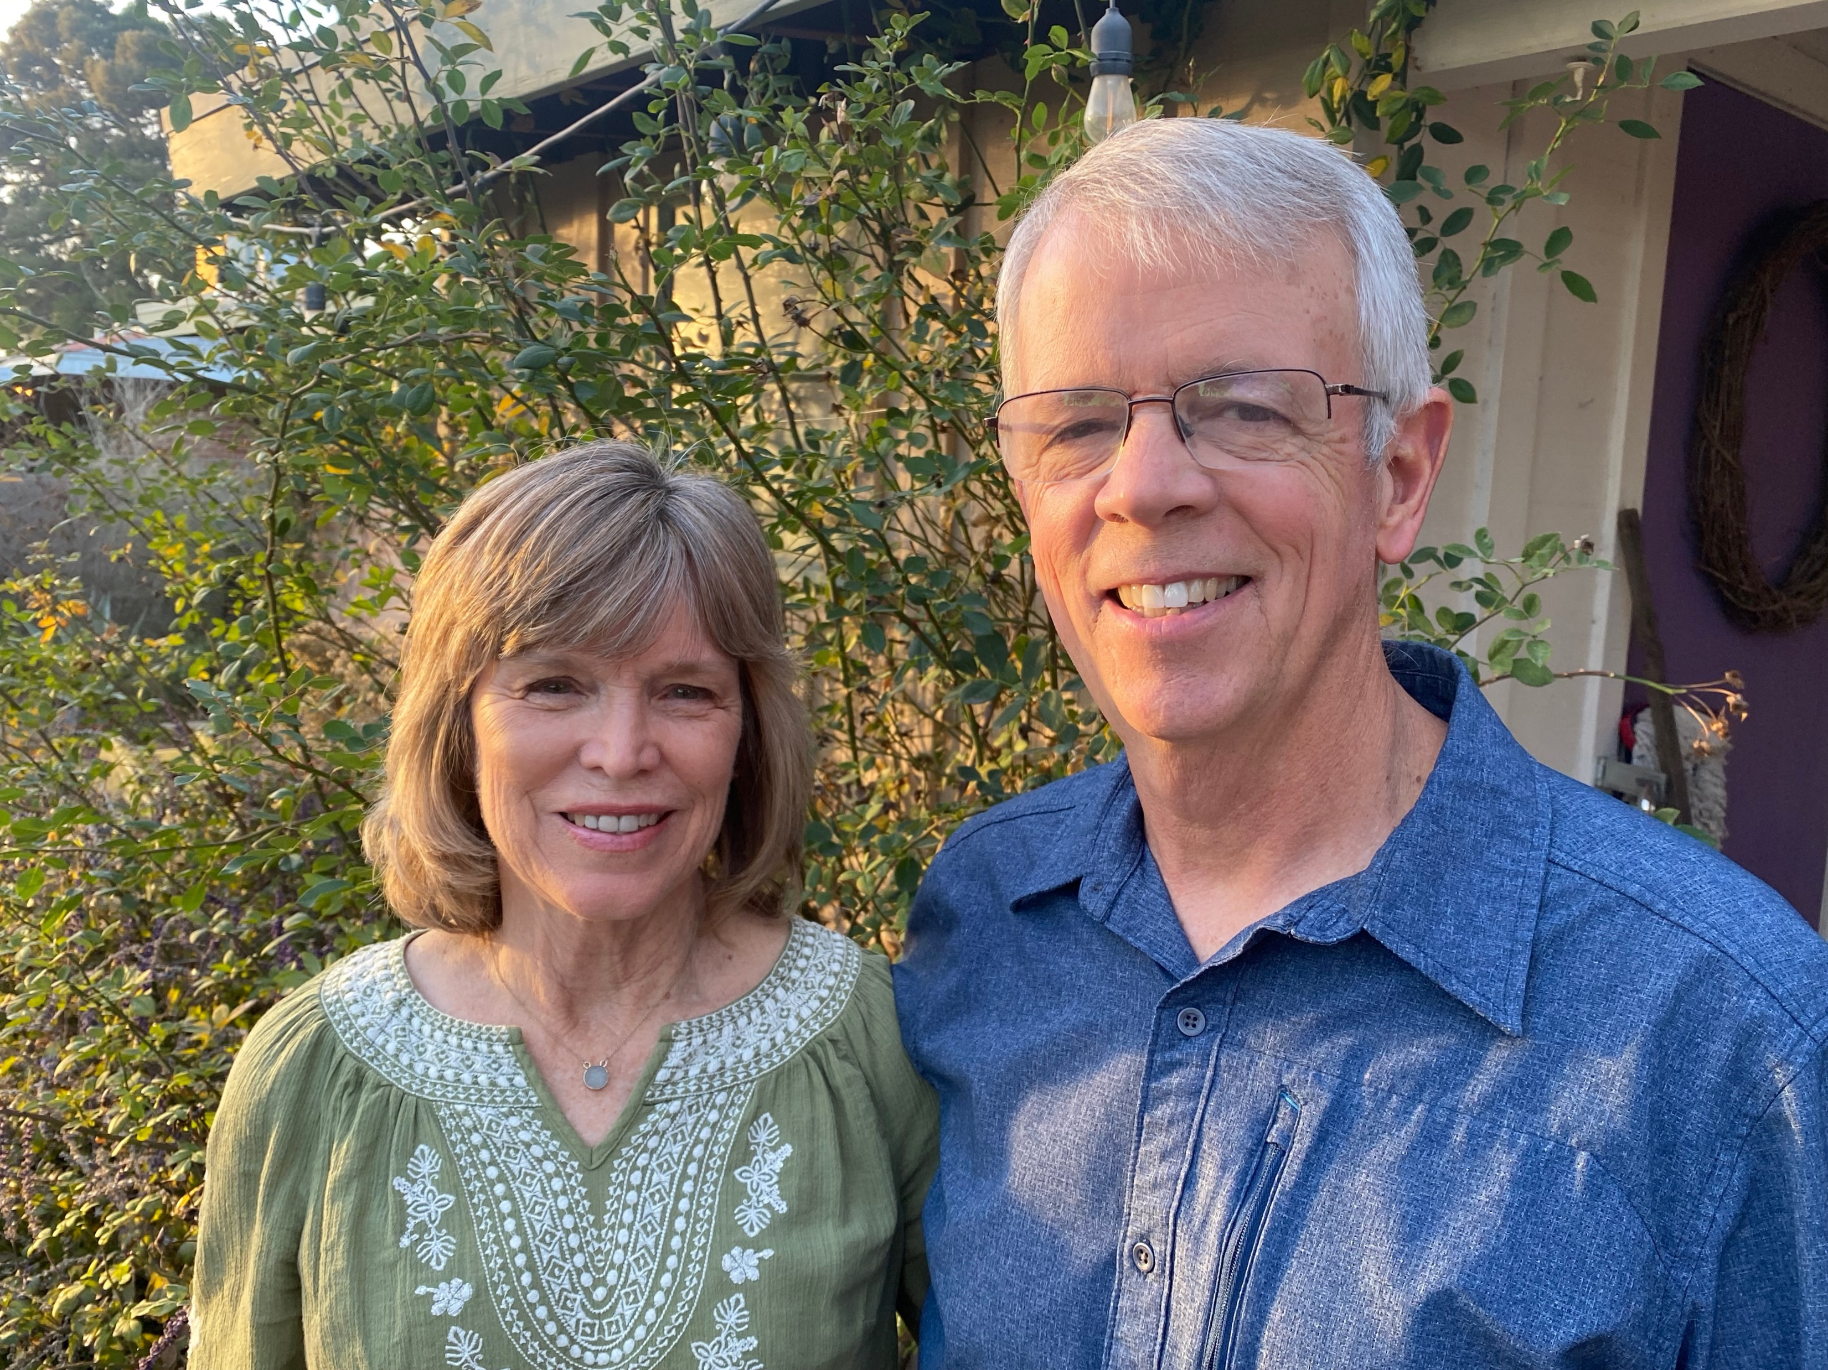
LATIN AMERICA
J.R. & Becky Crouse
Guy & Betsy Crawford

Slide 18
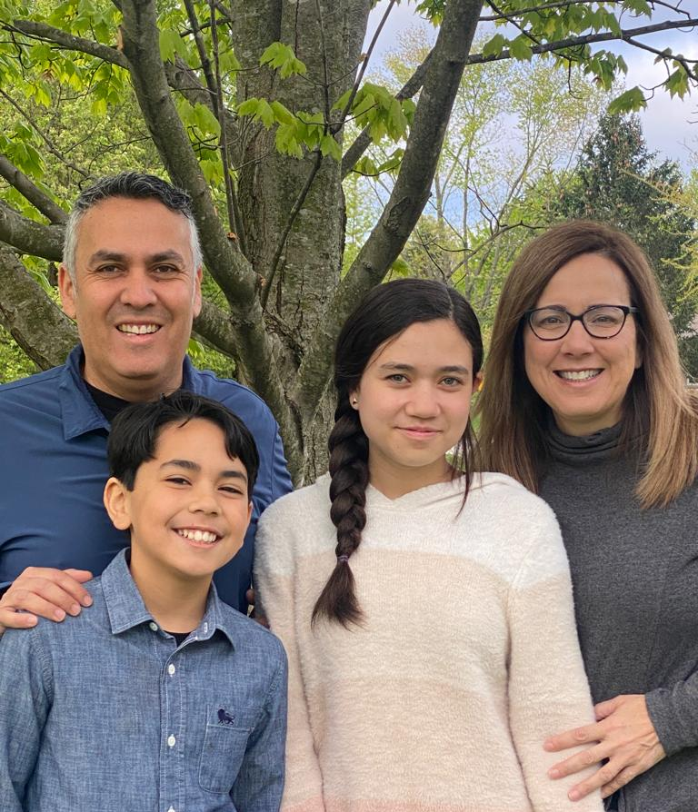
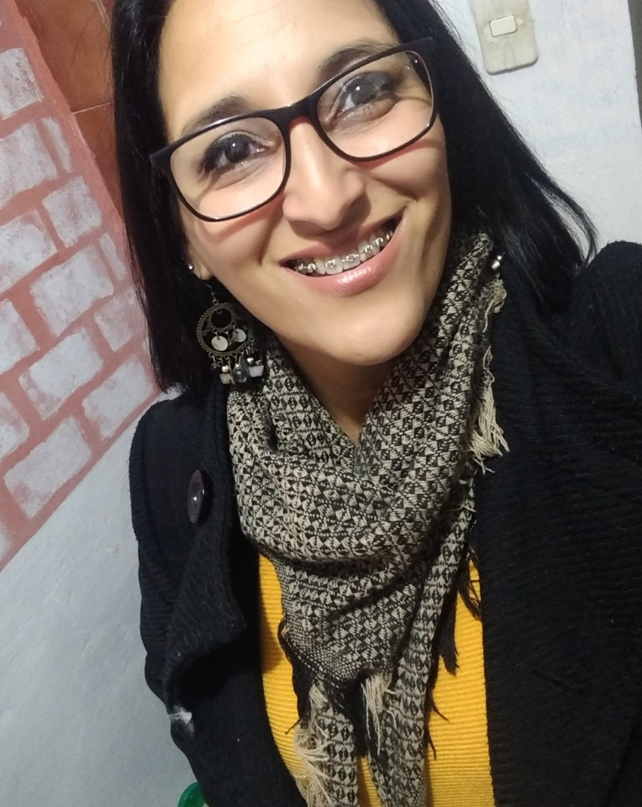
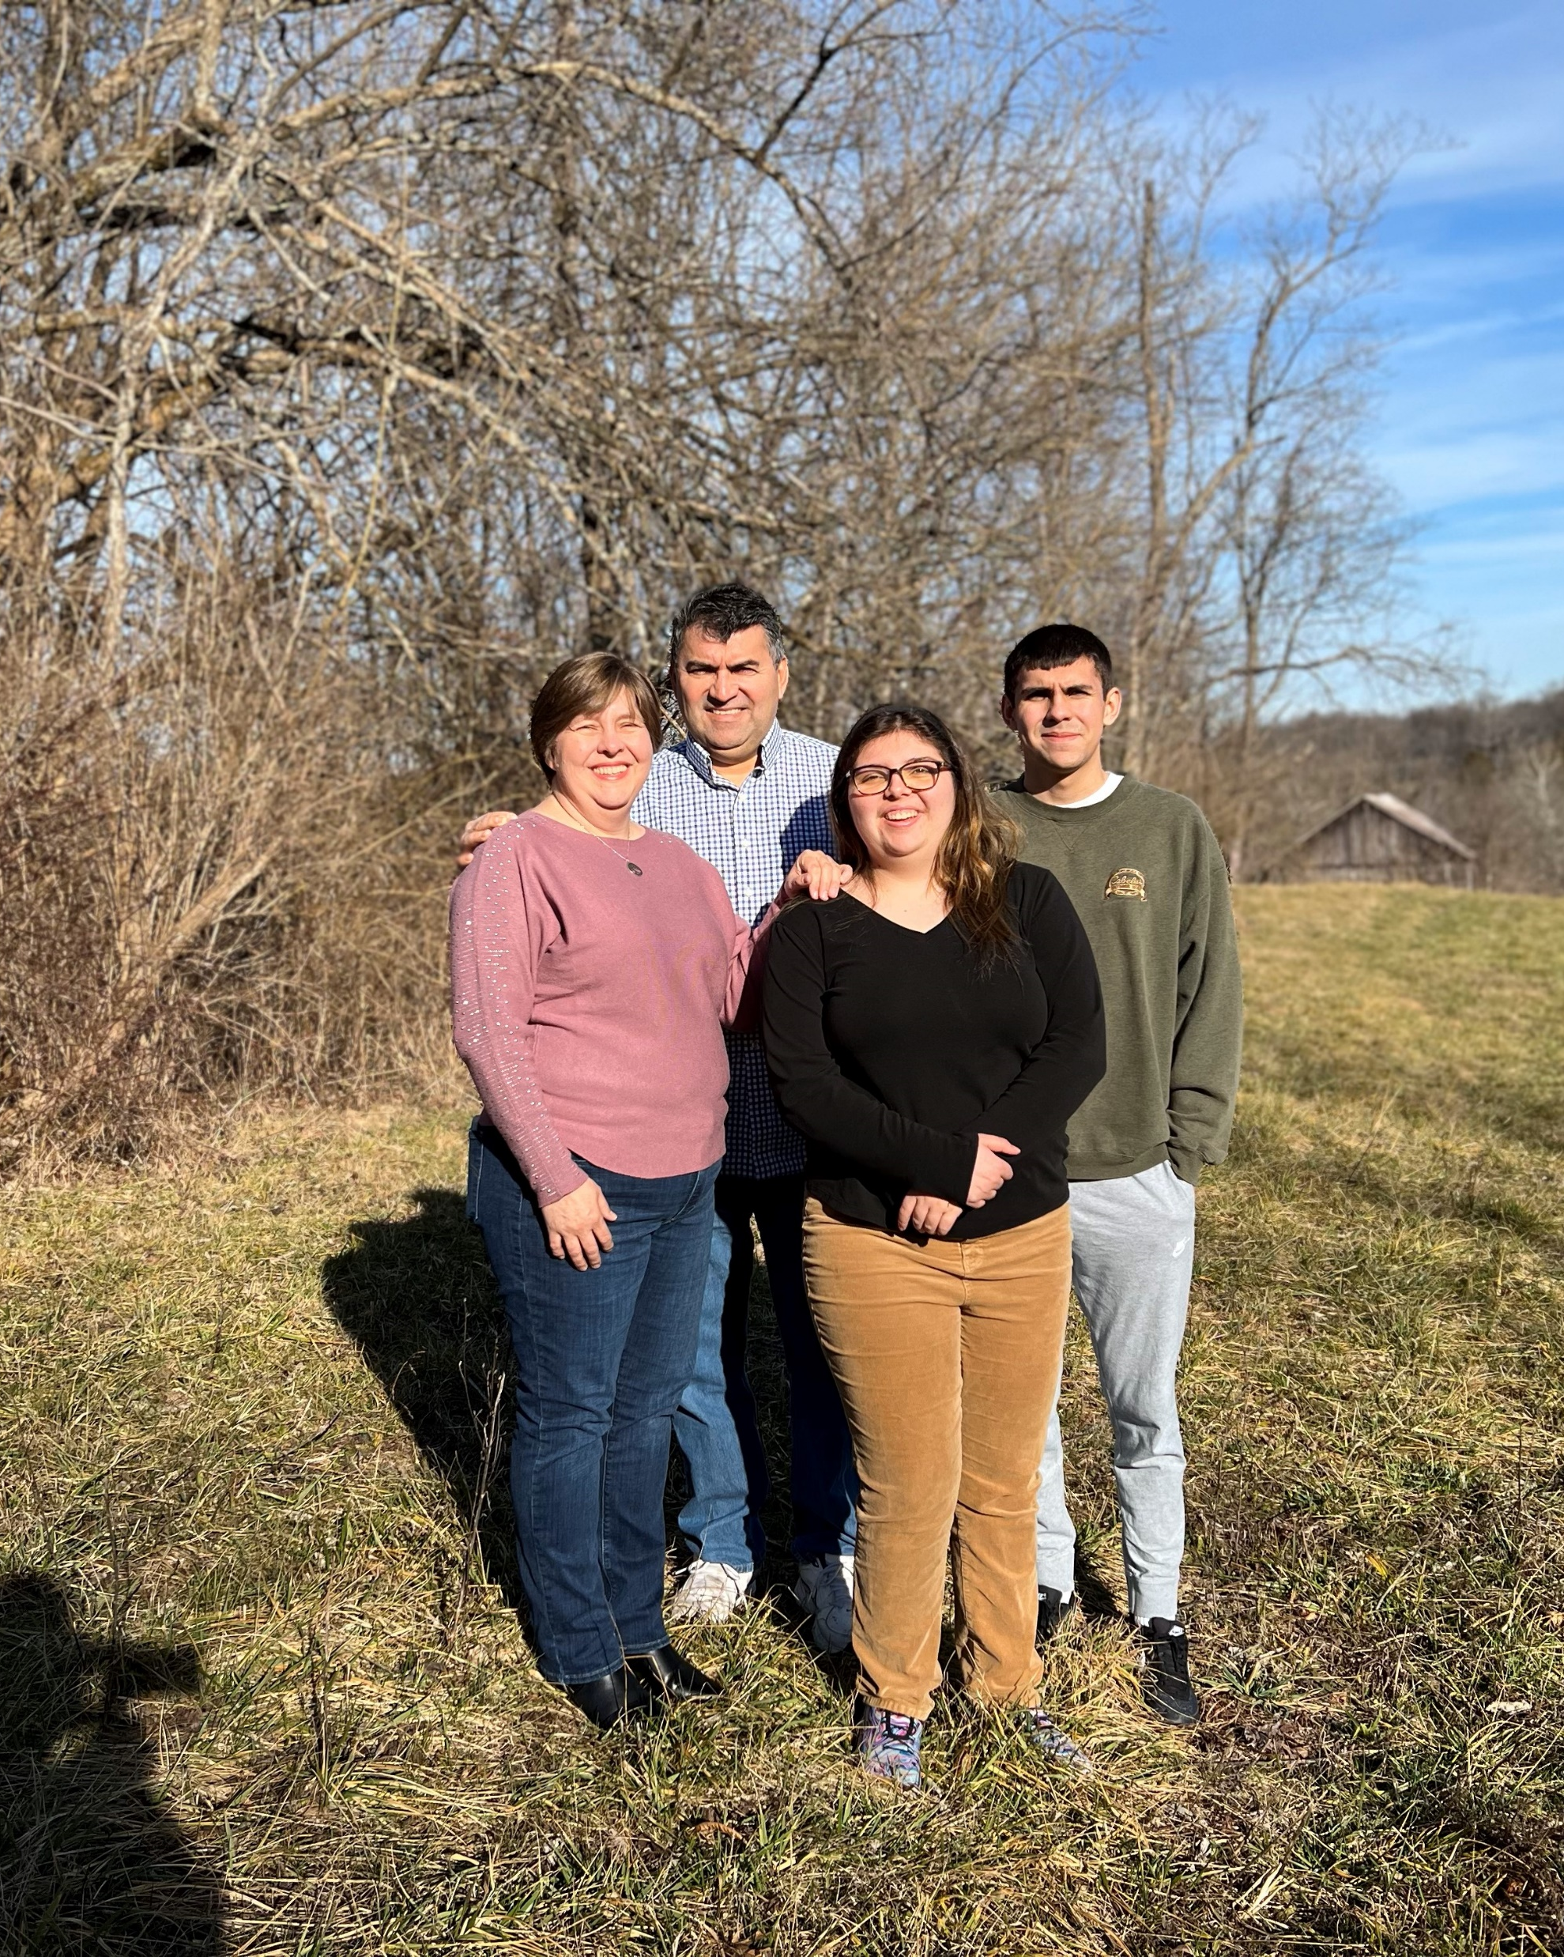
The Godoy Family Leo, Kay, Sofia and Ben
FamilyID=Office_ArchiveTorn
Daniela DaCunha
International Missionary
The Gomez Family
Ricardo, Beth, Juliana and Jonathan
Latin America Area Director

Slide 19
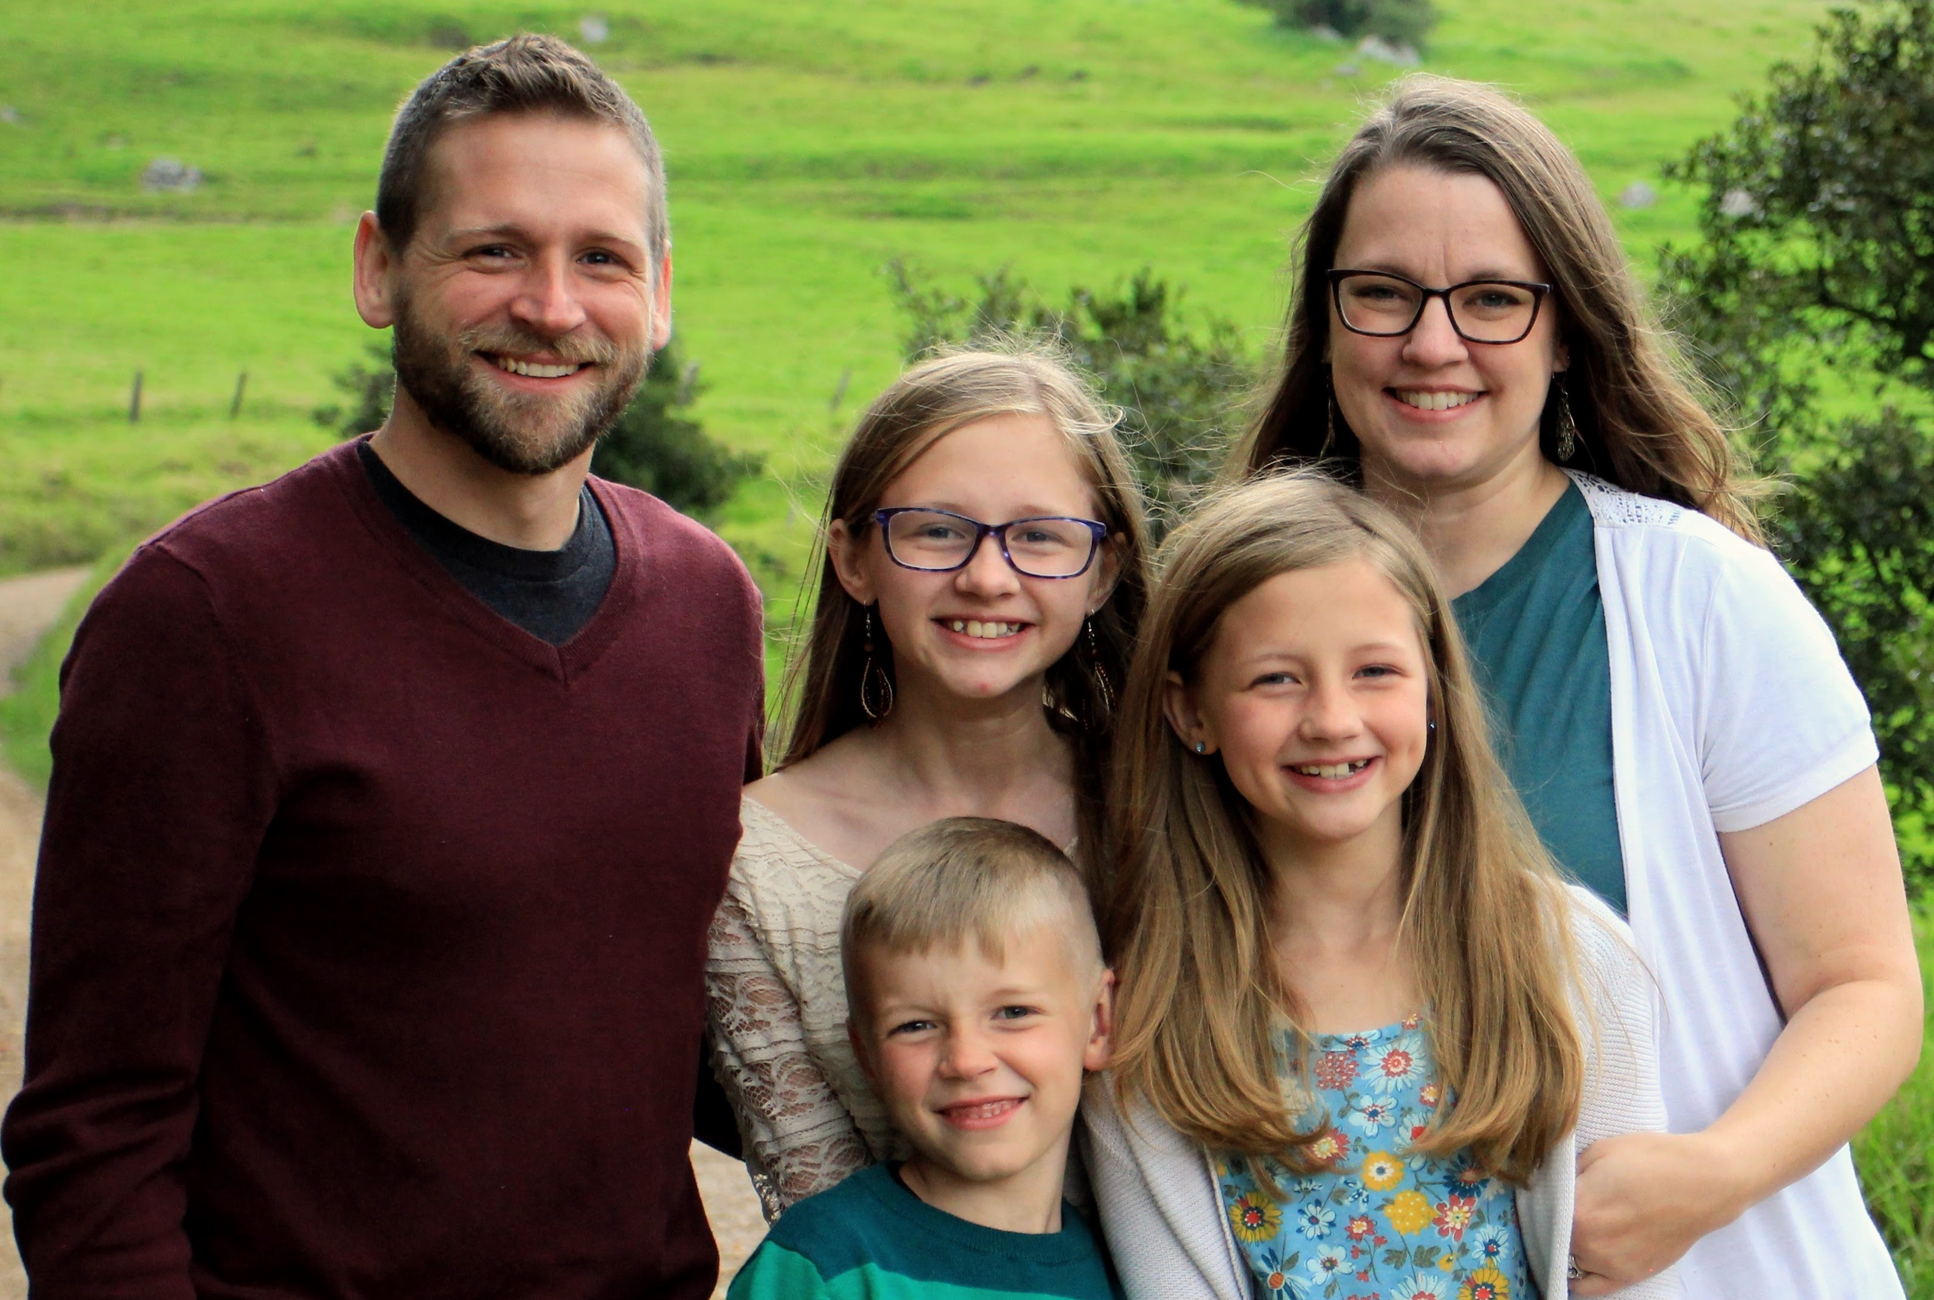
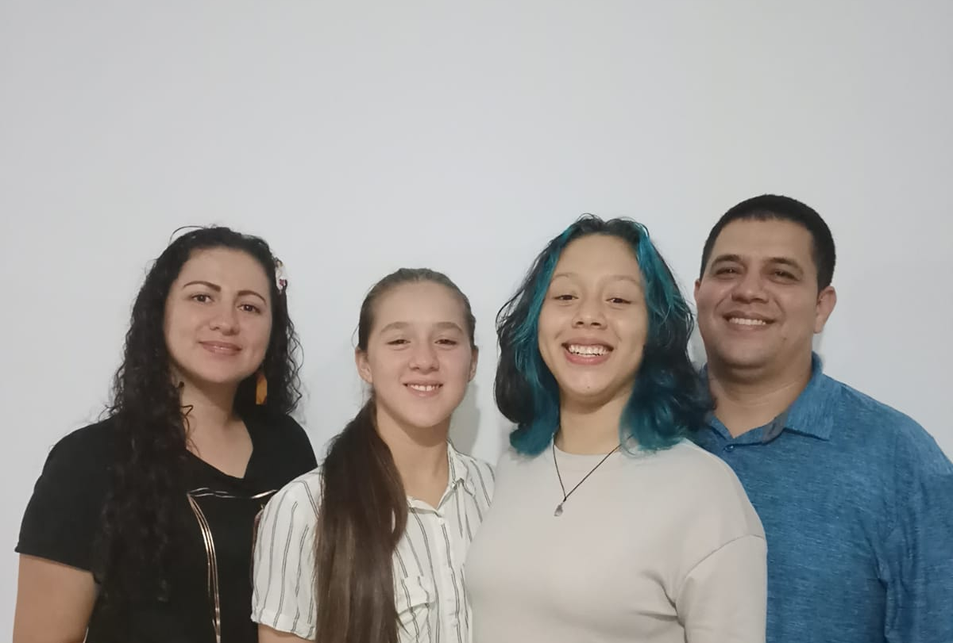
The Jewel Family
Shane, Katie, Josie, Norah and Asher
John Jairo Leal & Susana Castro
International Missionaries
Isabella and Valentina

Slide 20
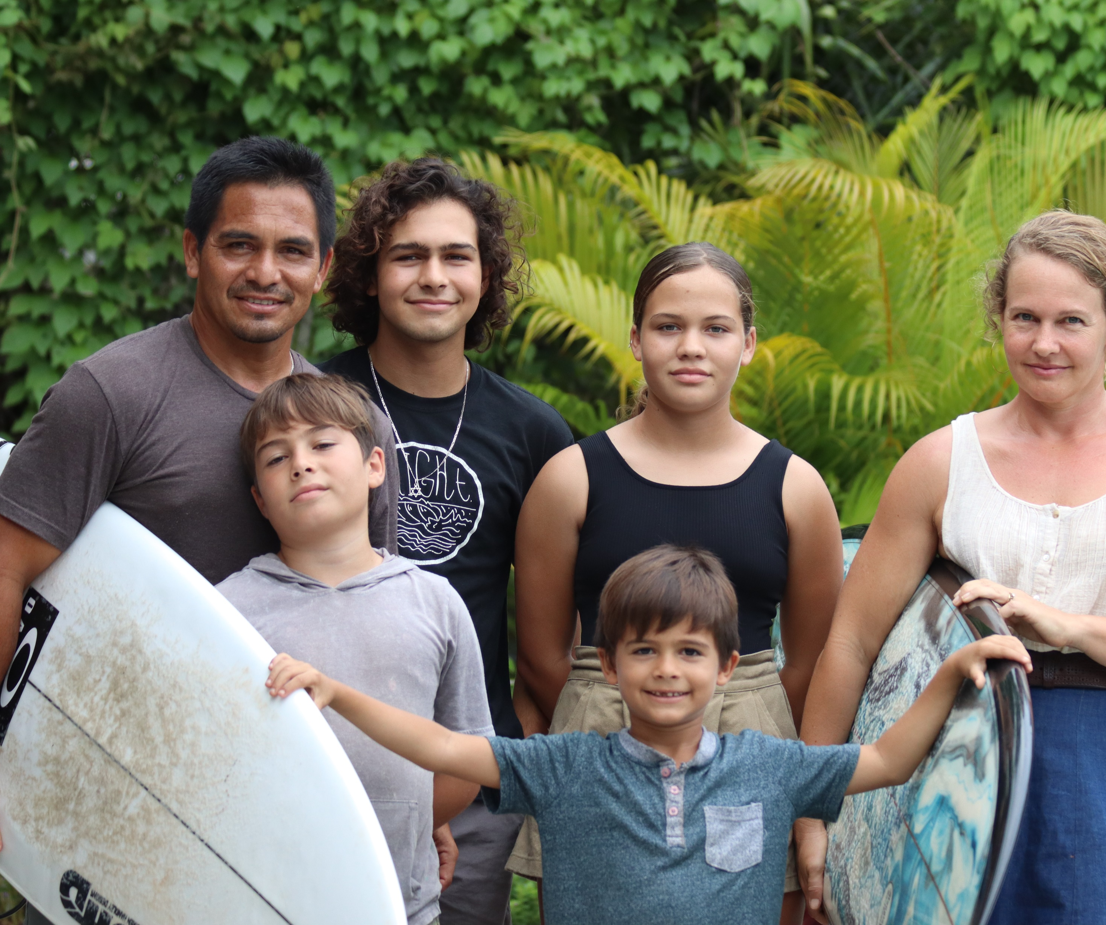
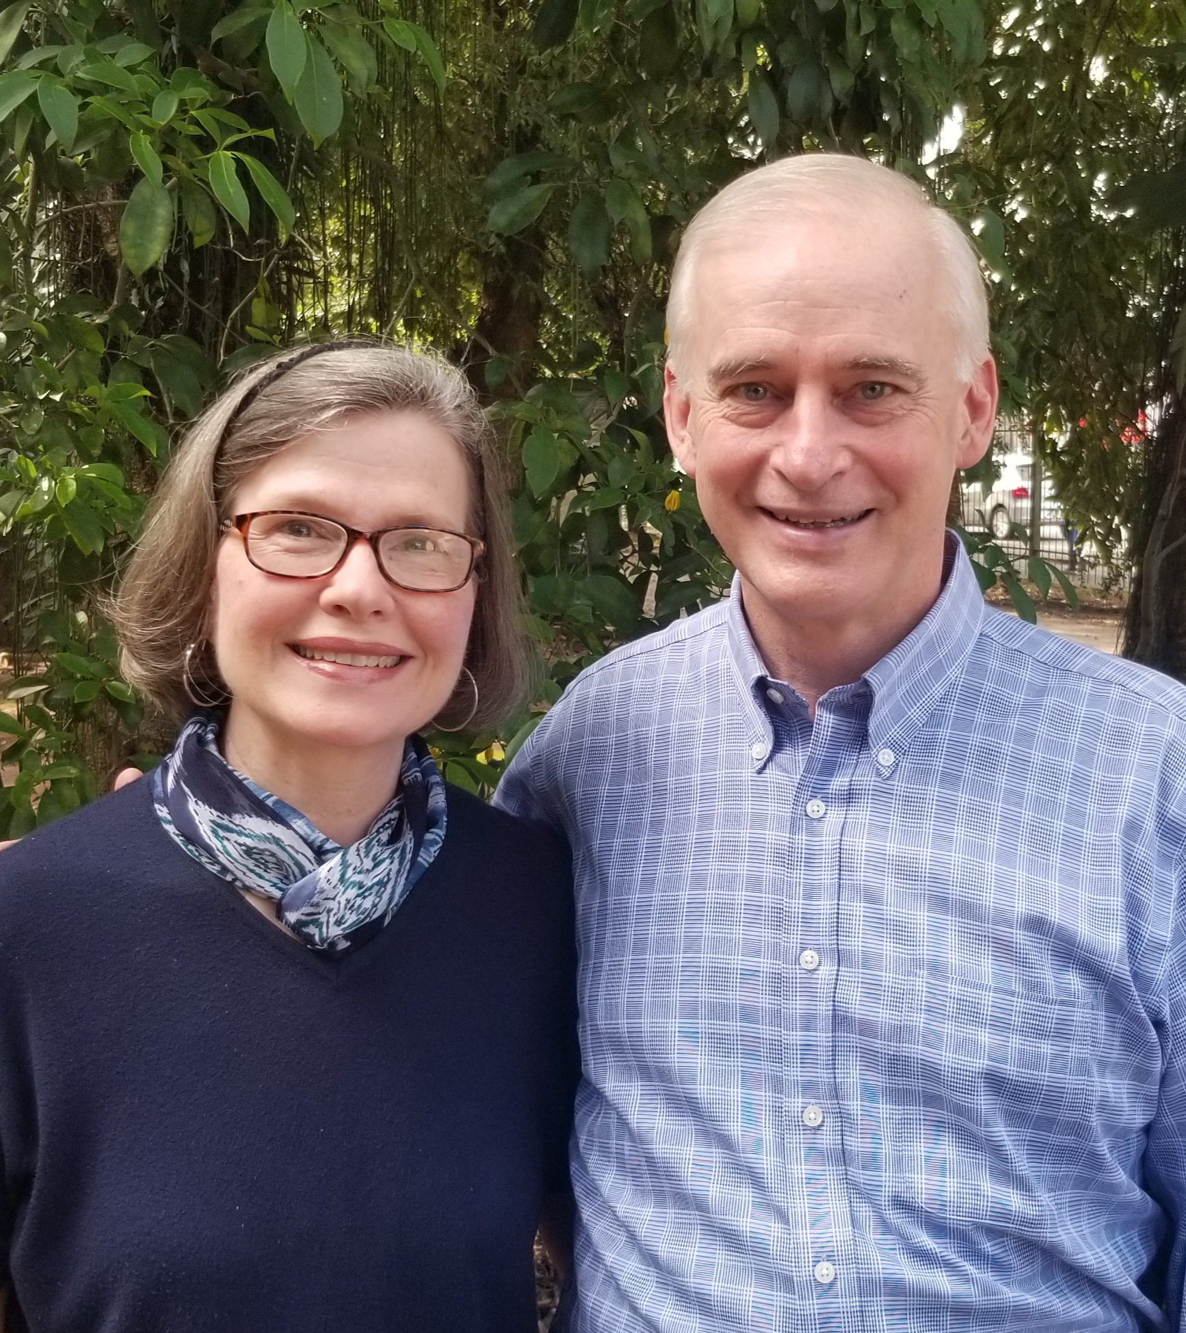
The Leon Family Dennis, Kyle, Elias, Selah, Cyrus and Lucas
Dan & Hope Owsley

Slide 21
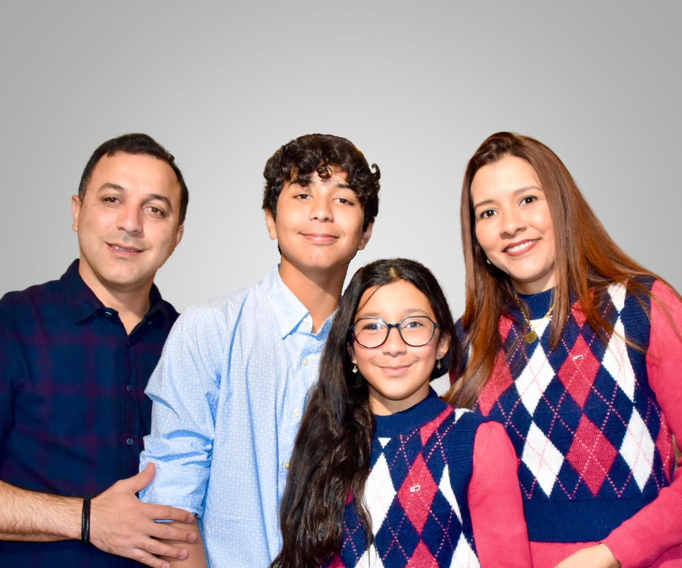
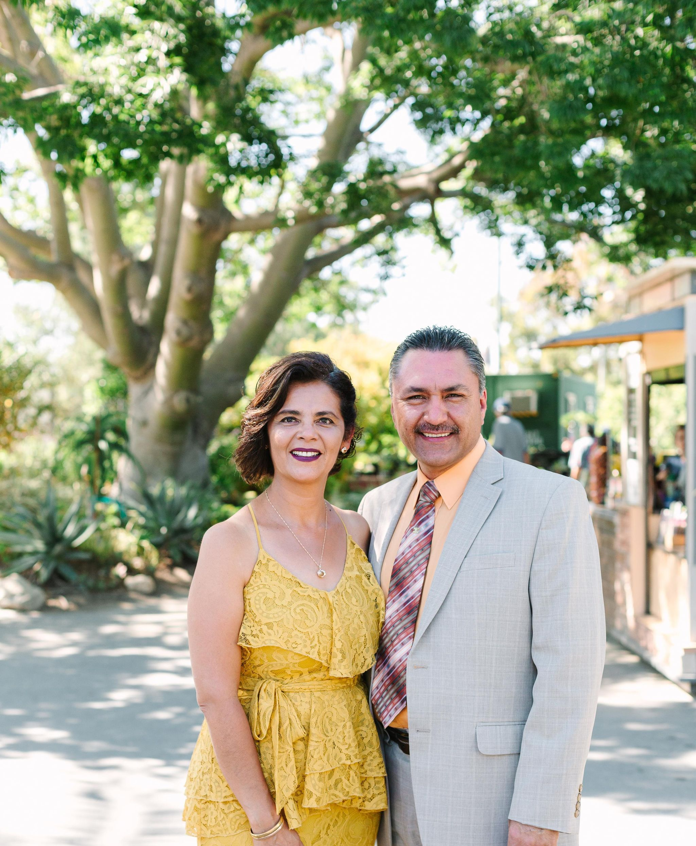
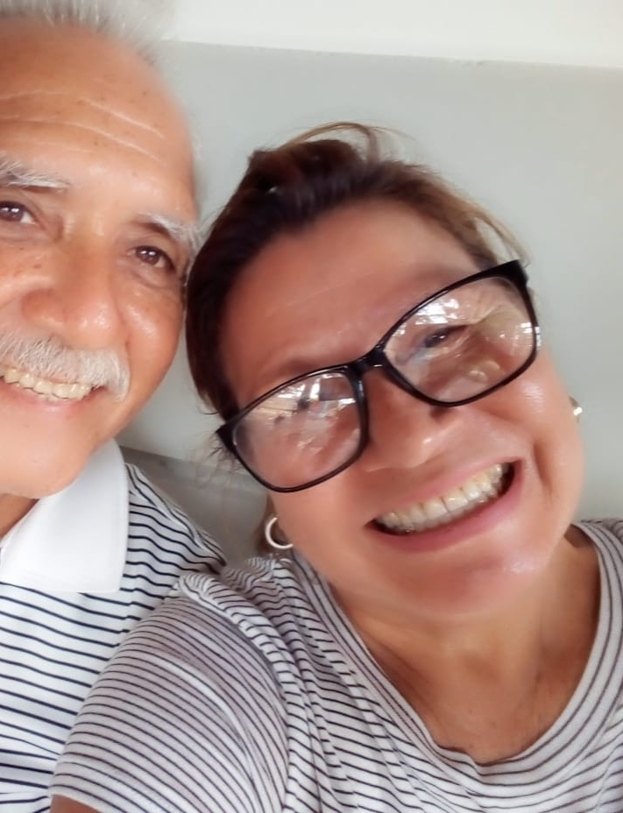
International Missionaries
The Lopez Family
David Ginegda, David Alejandro and Valery
Juan Carolos Rodriguez
& Yaneth Aguirre
Casto & Flor Marlene

Slide 22
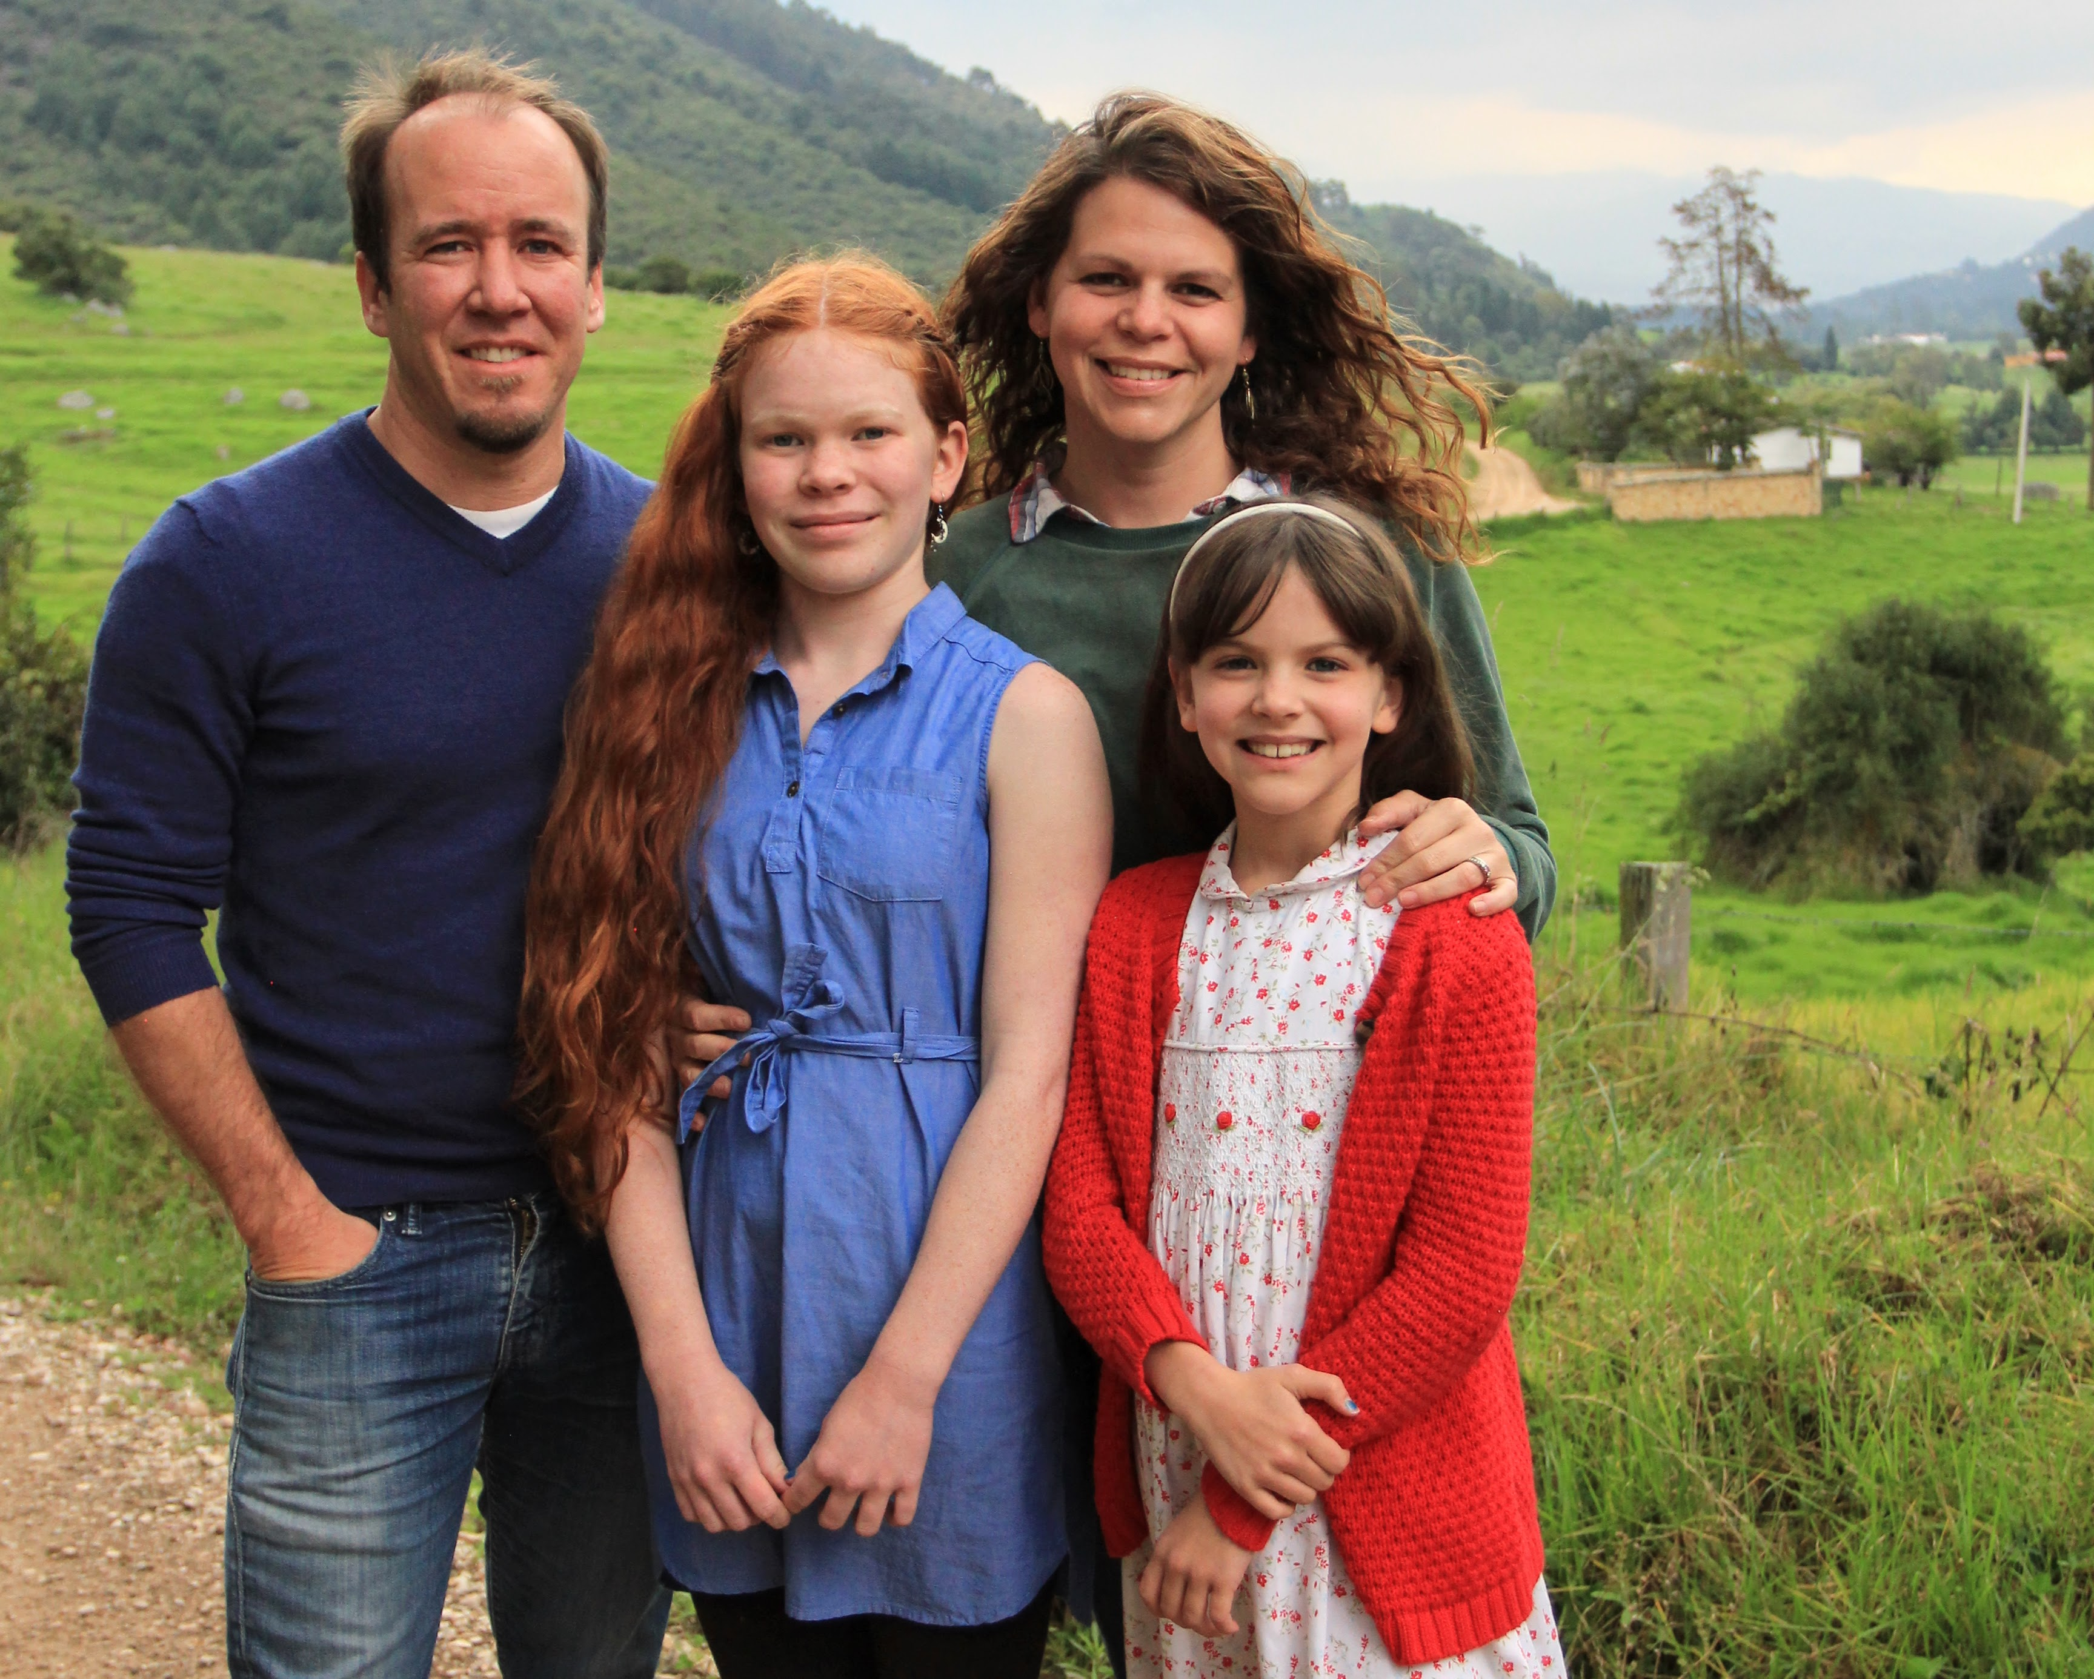
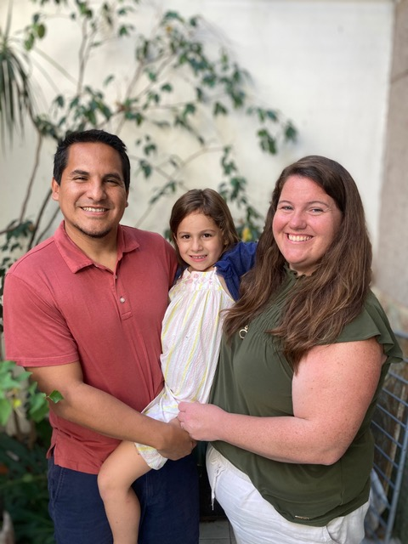
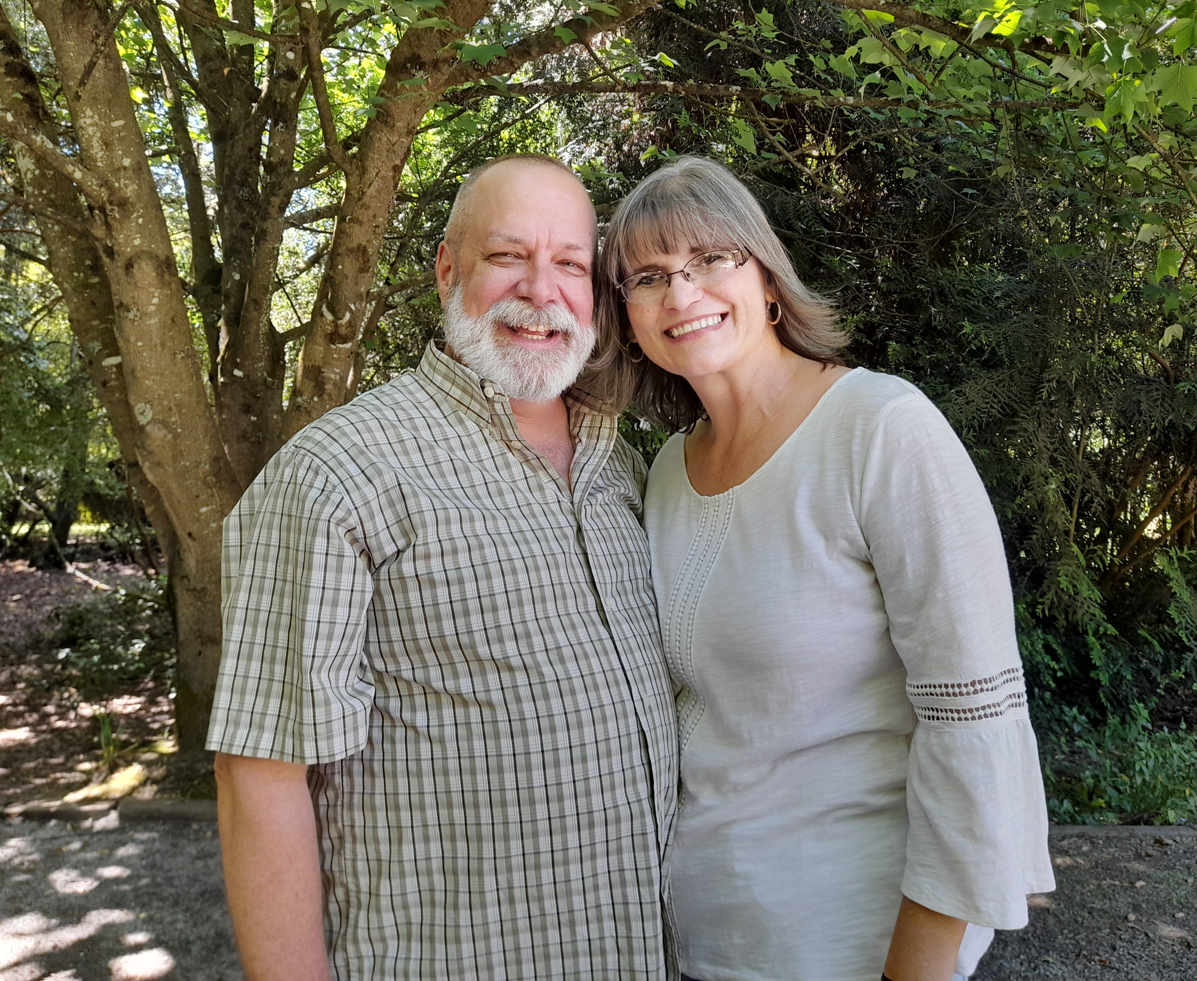
The Rosado Family
Rodrigo, Tanya and Ellia
Rich & Laurie Sheriff
The Roller Family
Thad, Nikki, Liliana and Evelyn

Slide 23
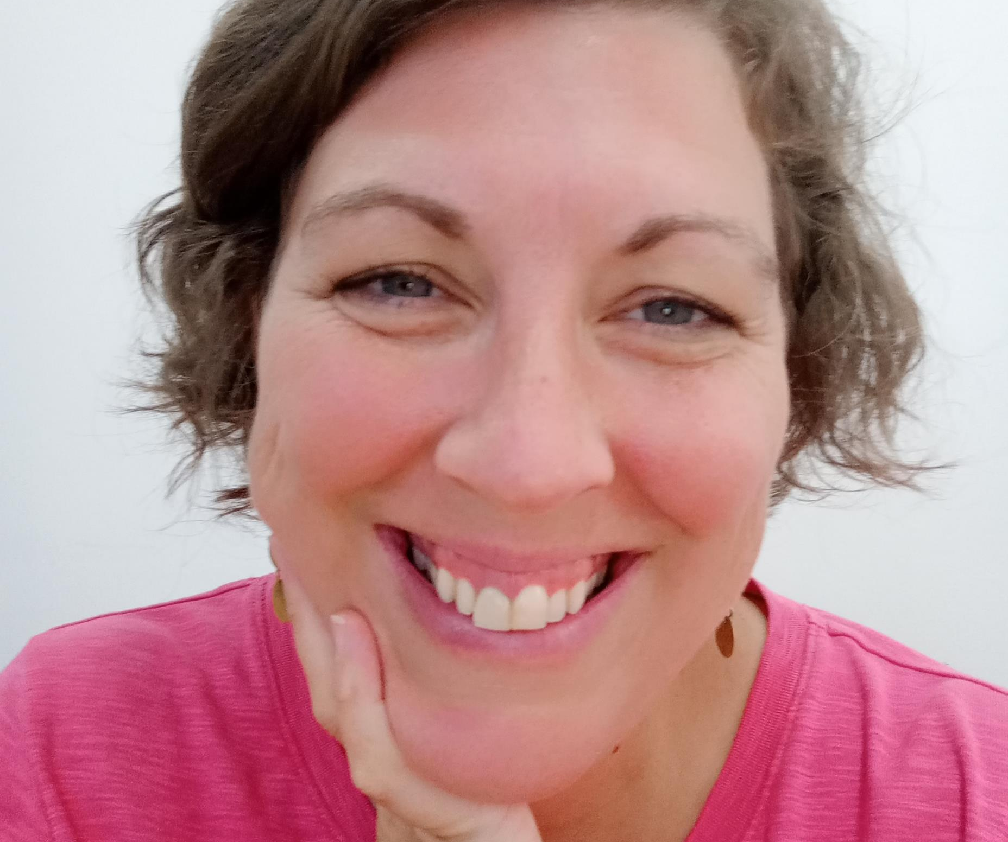
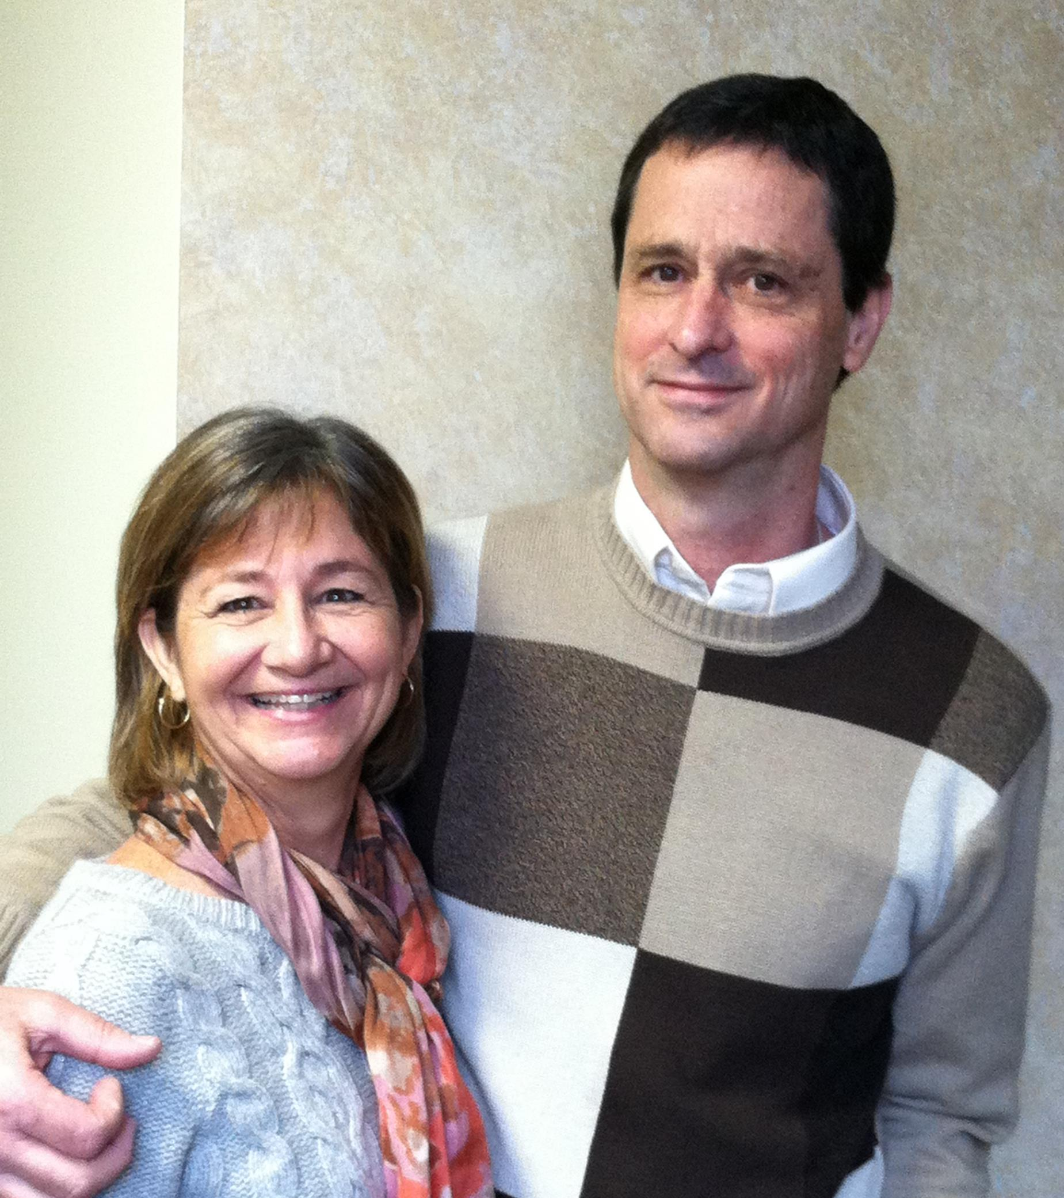
Andrea Tinsley
Dan & Dee Ann Snyder
U.S. Based Partners

Slide 24
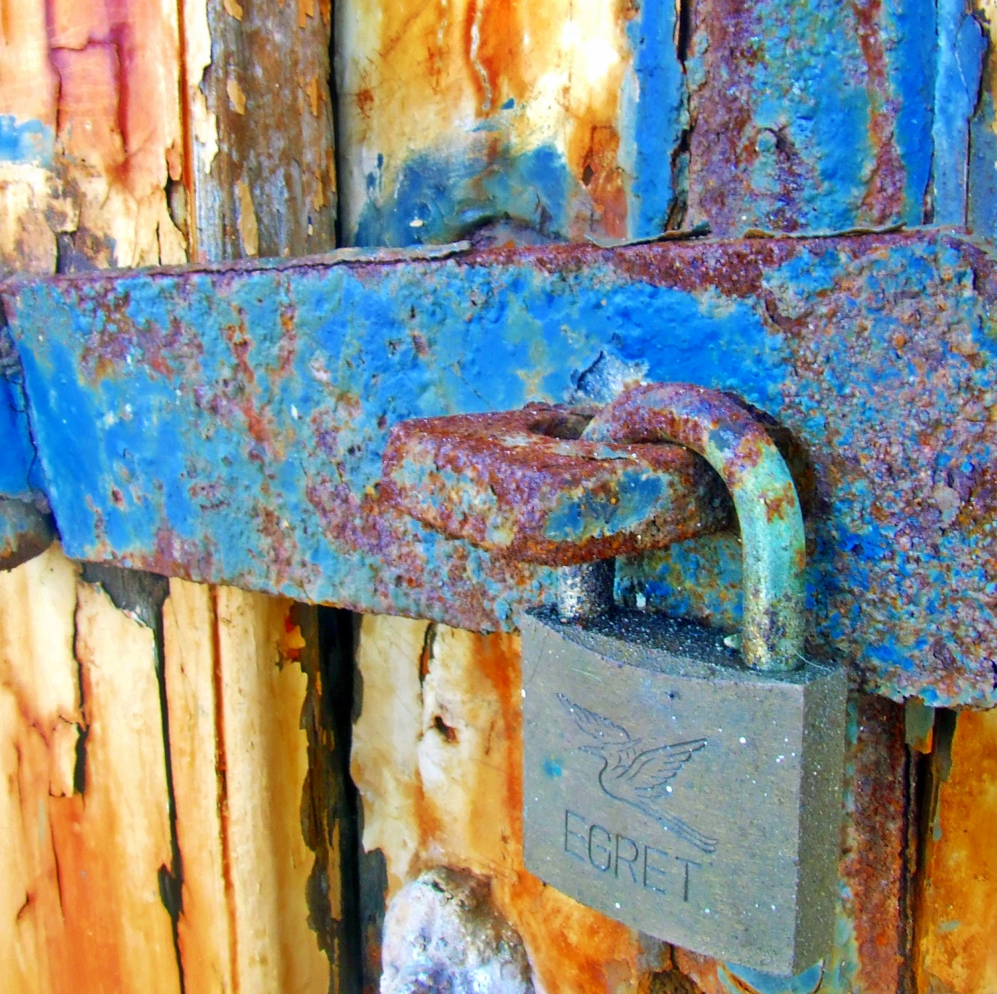
MIDDLE EAST
Dale & Dawn
Hany & Joanne

Slide 25
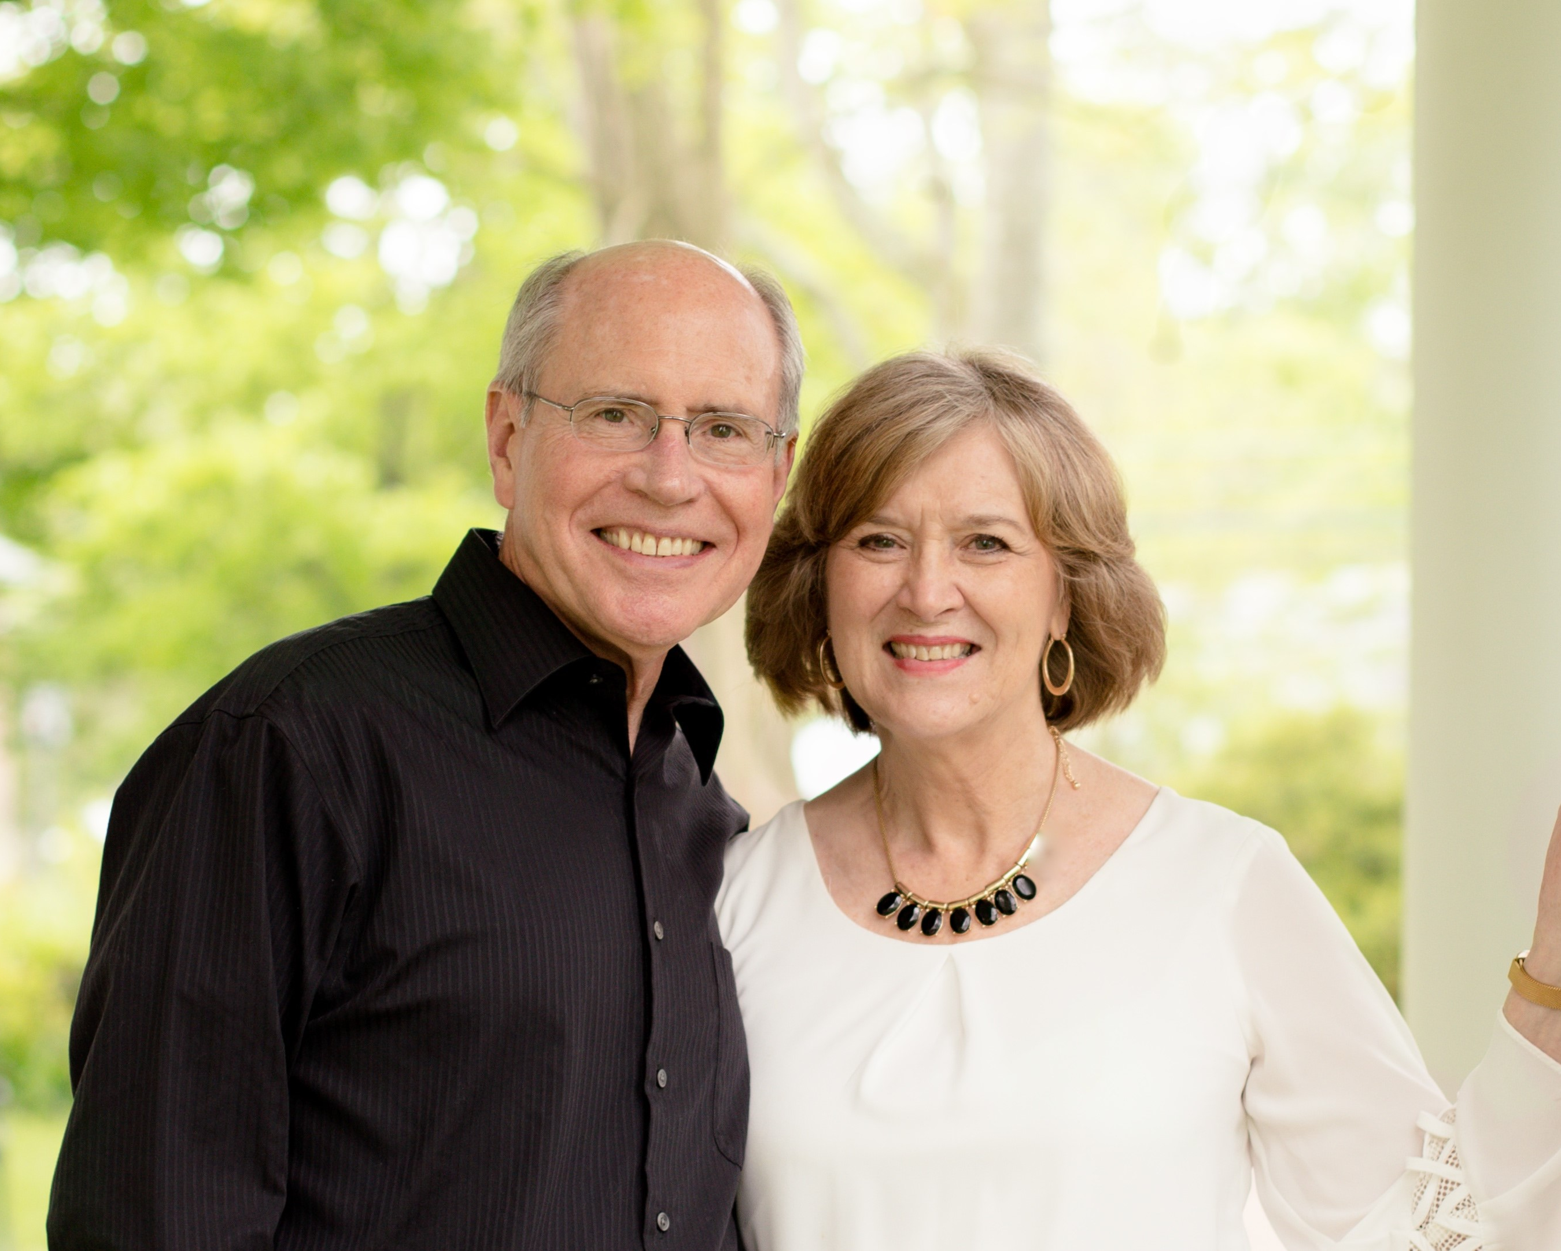
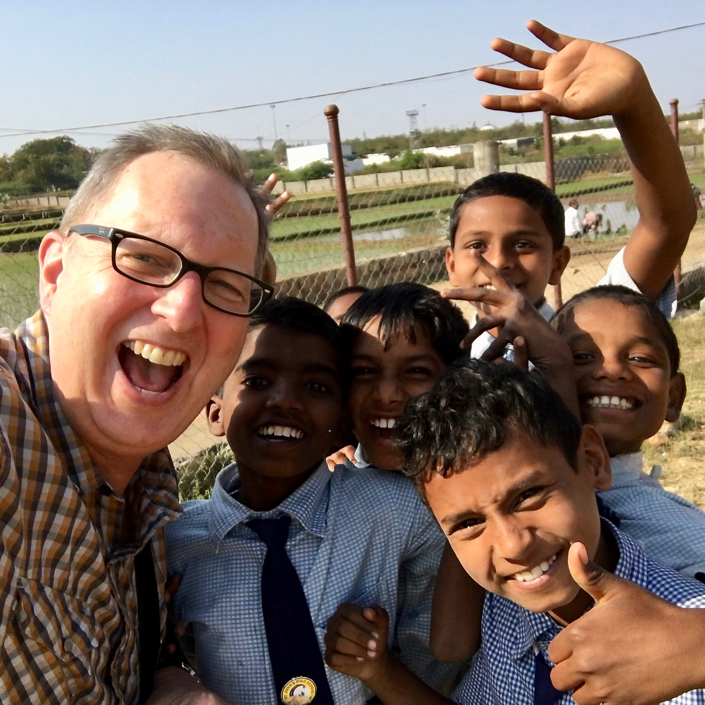
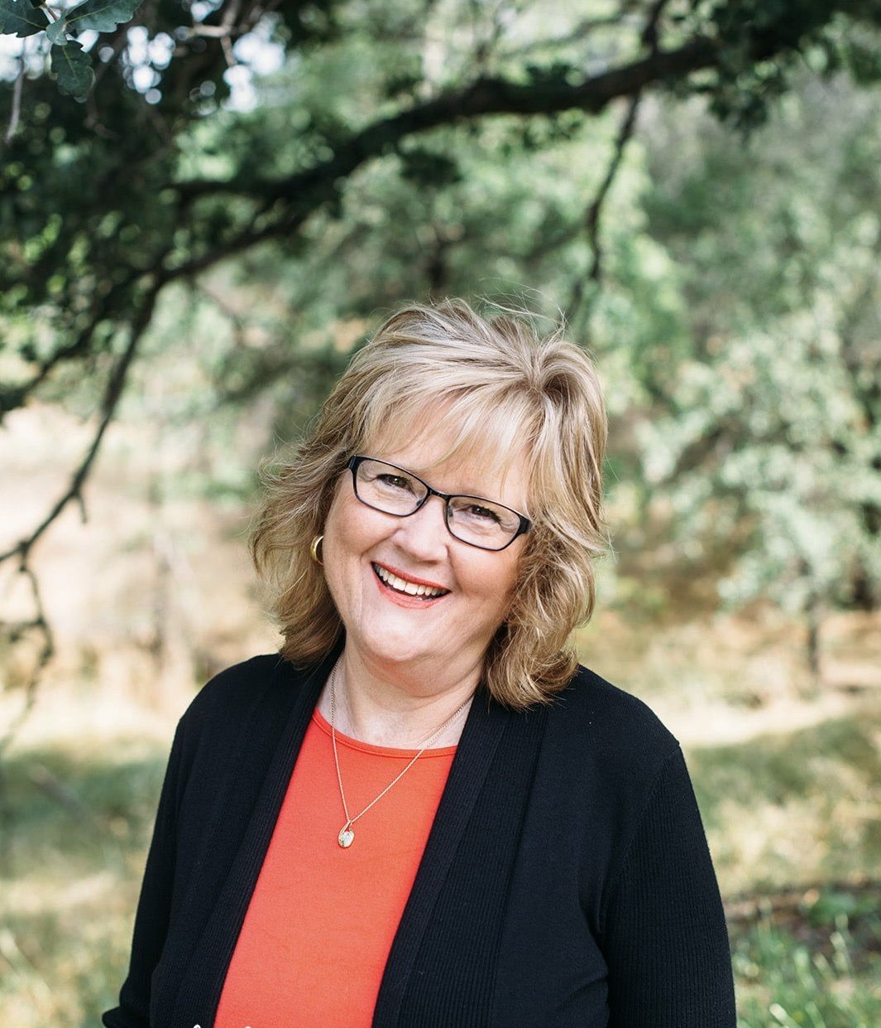
Debra Gilmore
GLOBAL
Art & Sylvia Brown
Kevin Austin

