Slide 1

Global Adventures
CAMBODIA

Slide 2
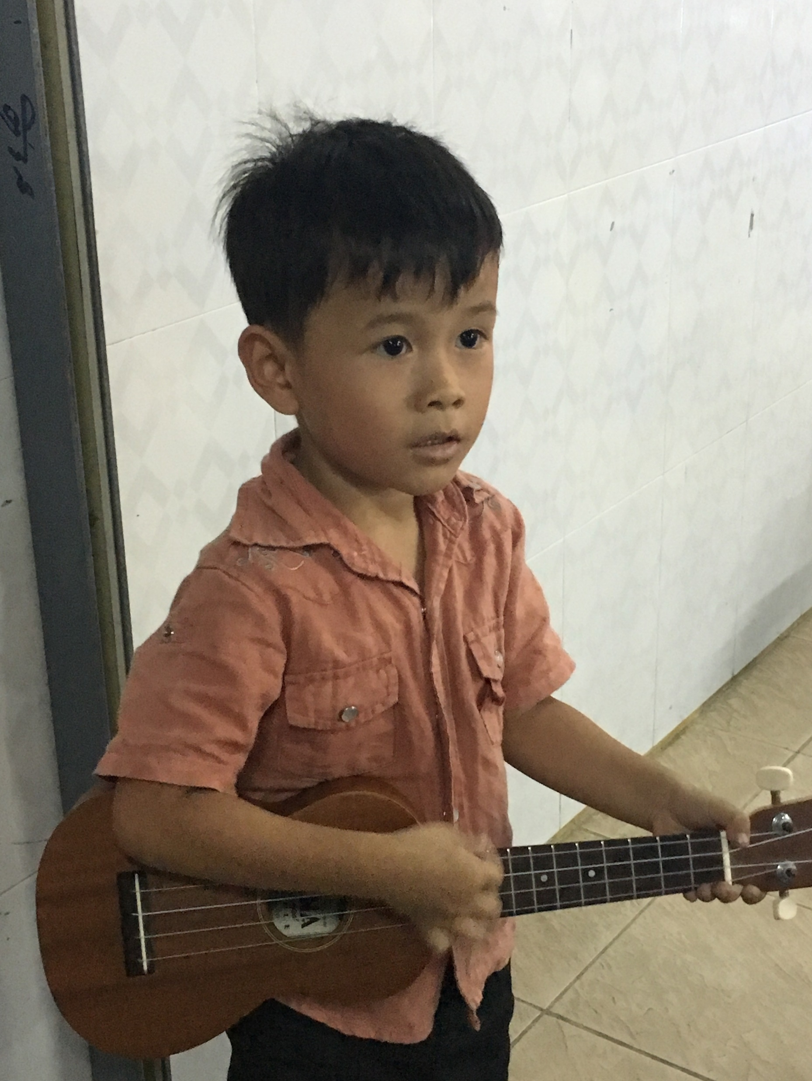
Theme Verse
Sing to the Lord a new song; sing to the Lord,
all the earth.
Sing to the Lord, praise his name; proclaim his salvation day after day.
Declare his glory among the nations, his marvelous deeds among all peoples.
- Psalms 96:1-3
Unsplash: Ben White

Slide 3

Explore the Country

Slide 4
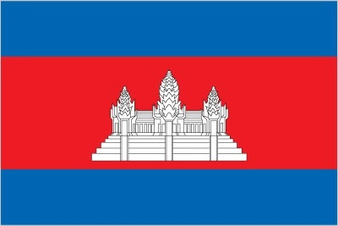
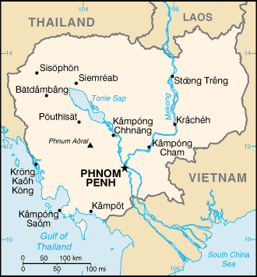
CIA World Fact Book
Cambodia
Wikimedia Commons: US CIA Public Domain

Slide 5
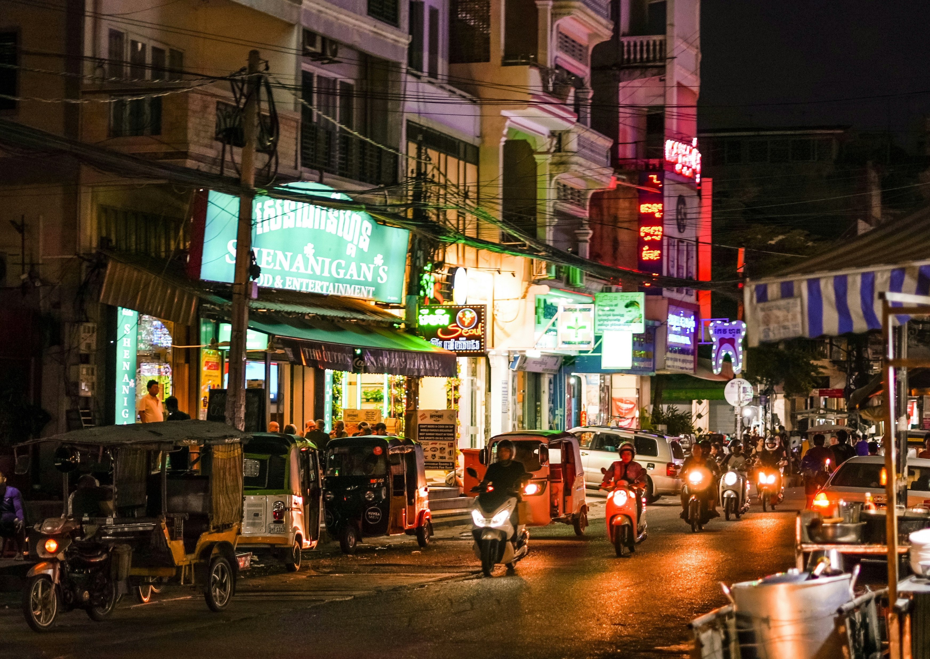
Phnom Penh
(the capital city)
c
The Streets At Night
Photo: Unsplash/Vanna Phon

Slide 6
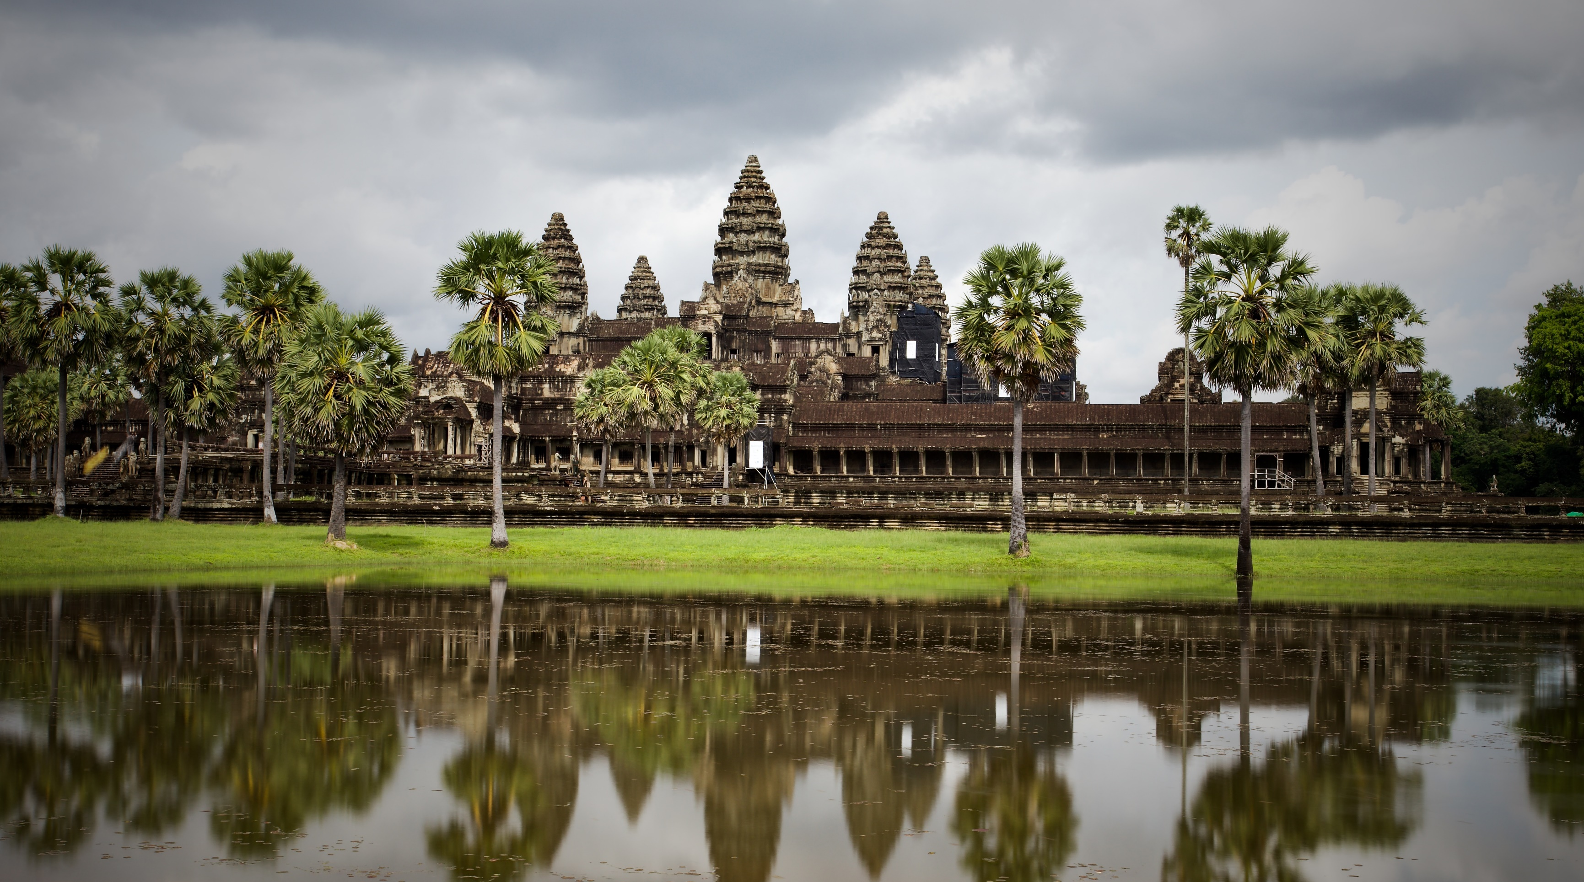
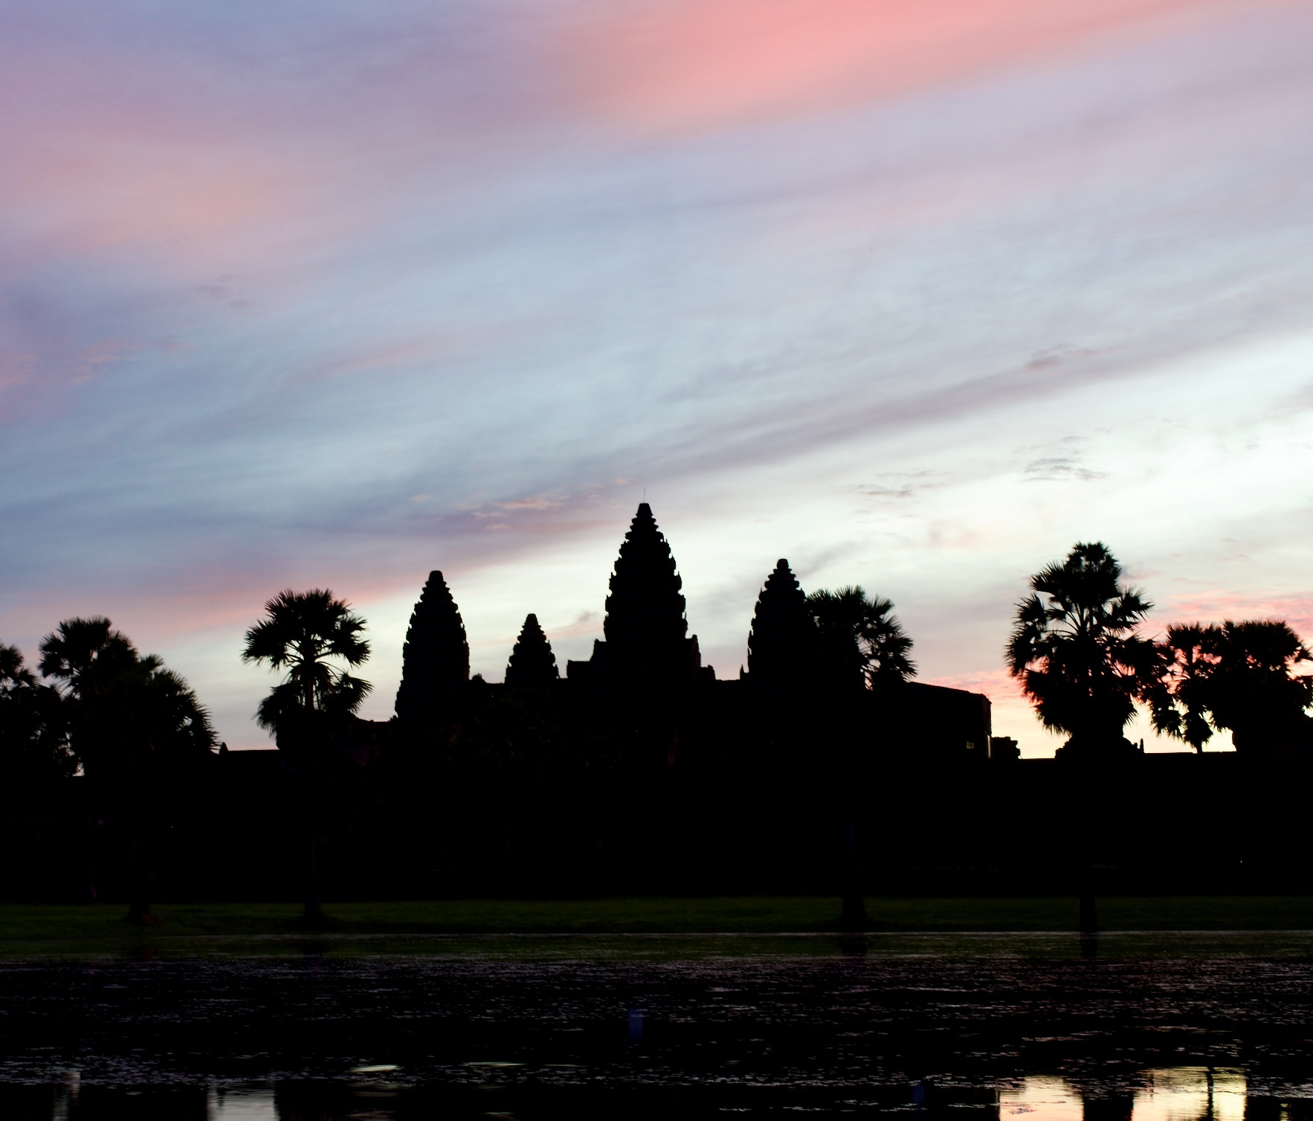
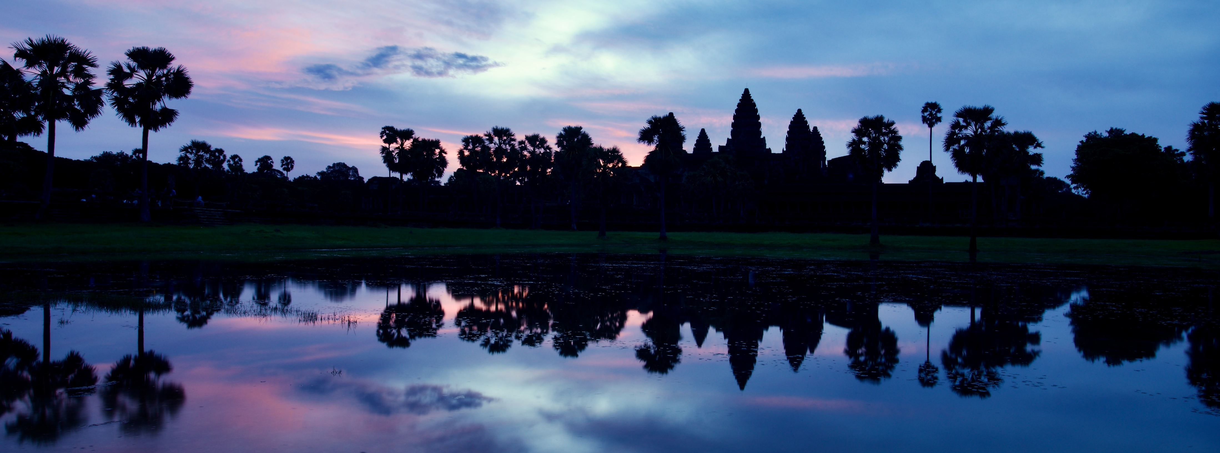
Beautiful & Historic
Angkor Wat
Photo: Kevin Austin
Photo: Kevin Austin
Photo: Kevin Austin

Slide 7
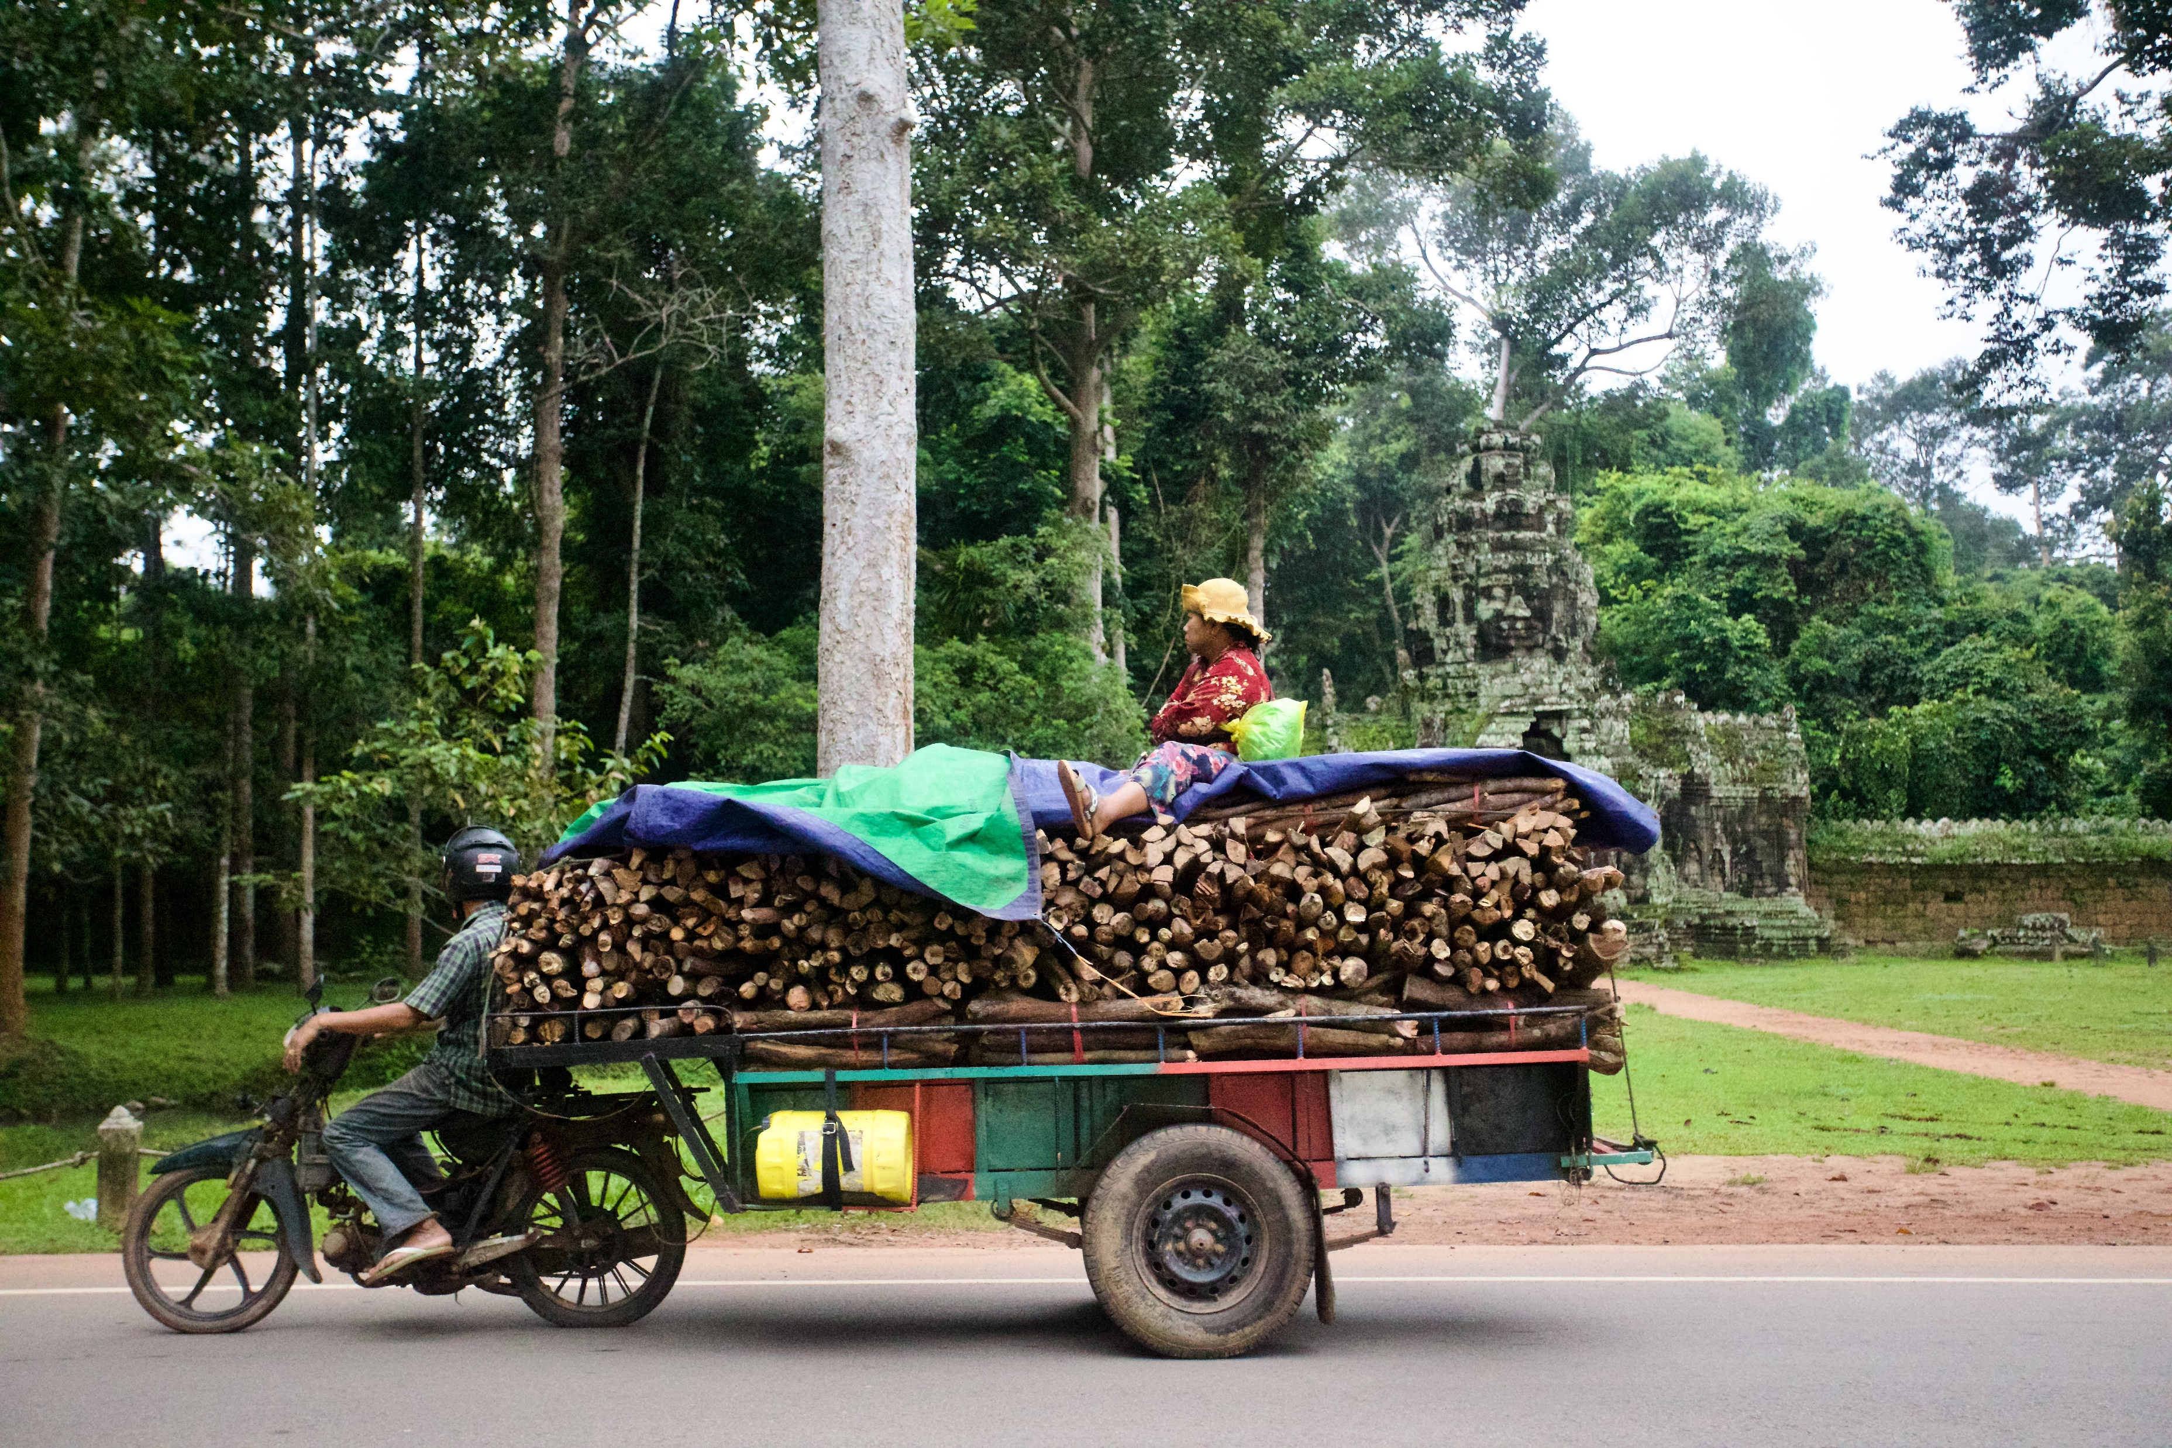
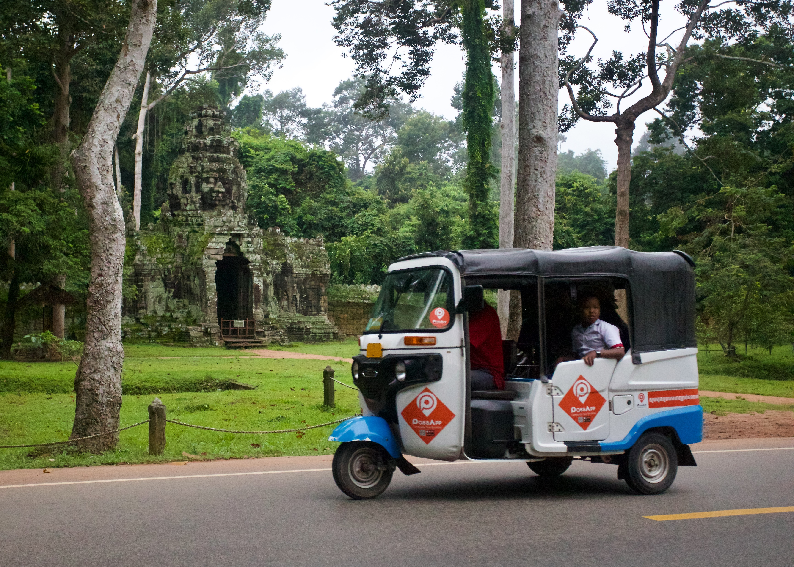
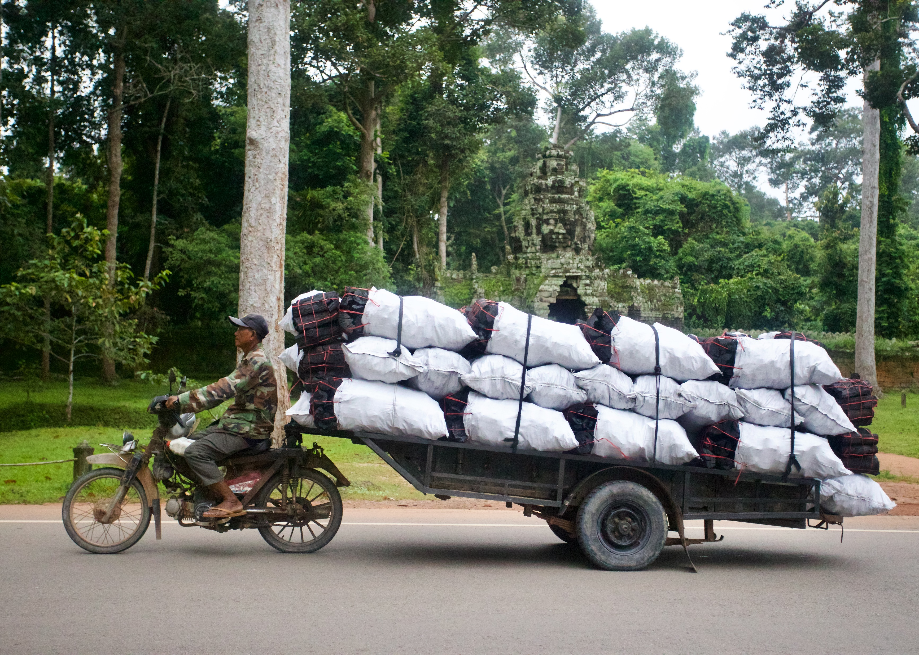
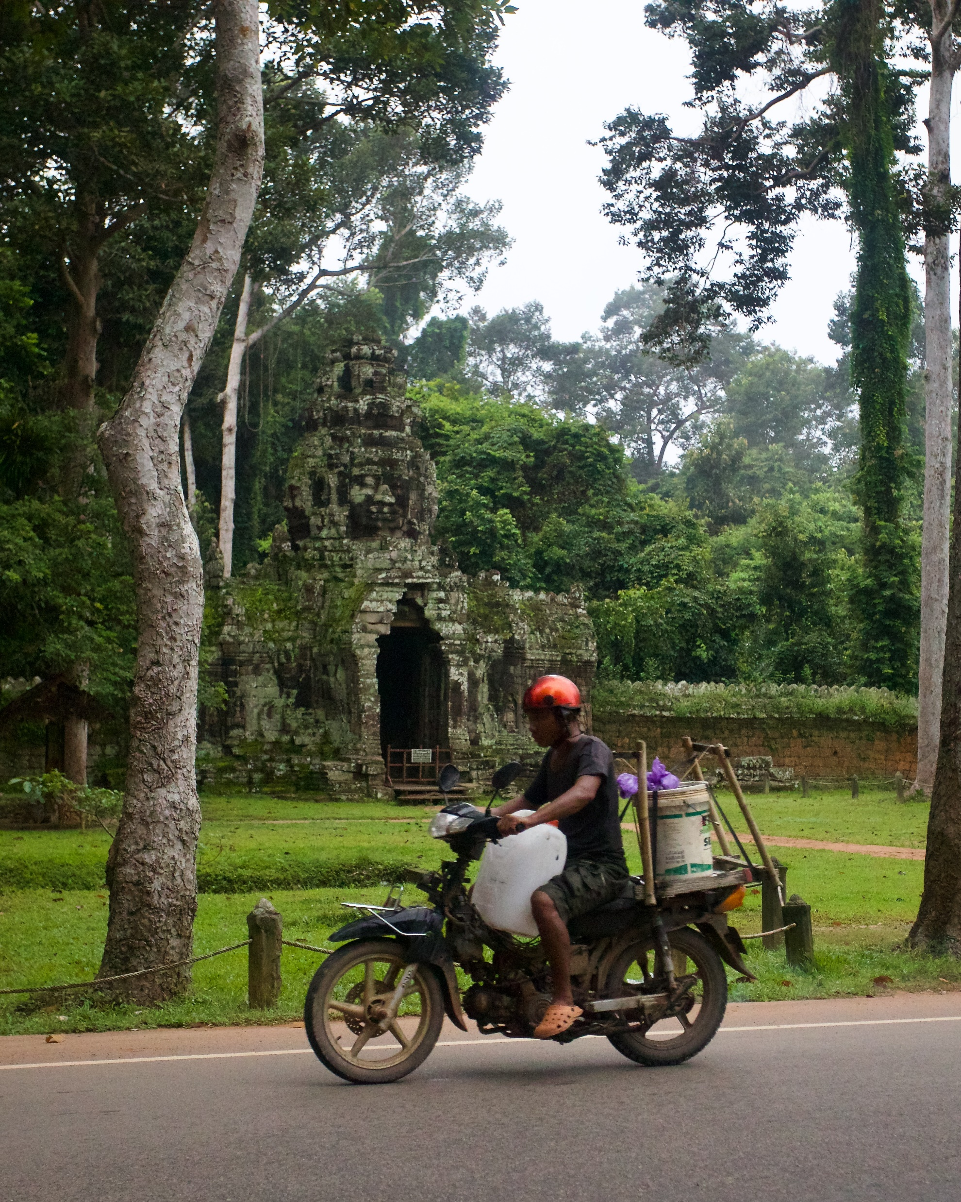
Interesting Ways to Transport People and Supplies
Photos: Kevin Austin

Slide 8
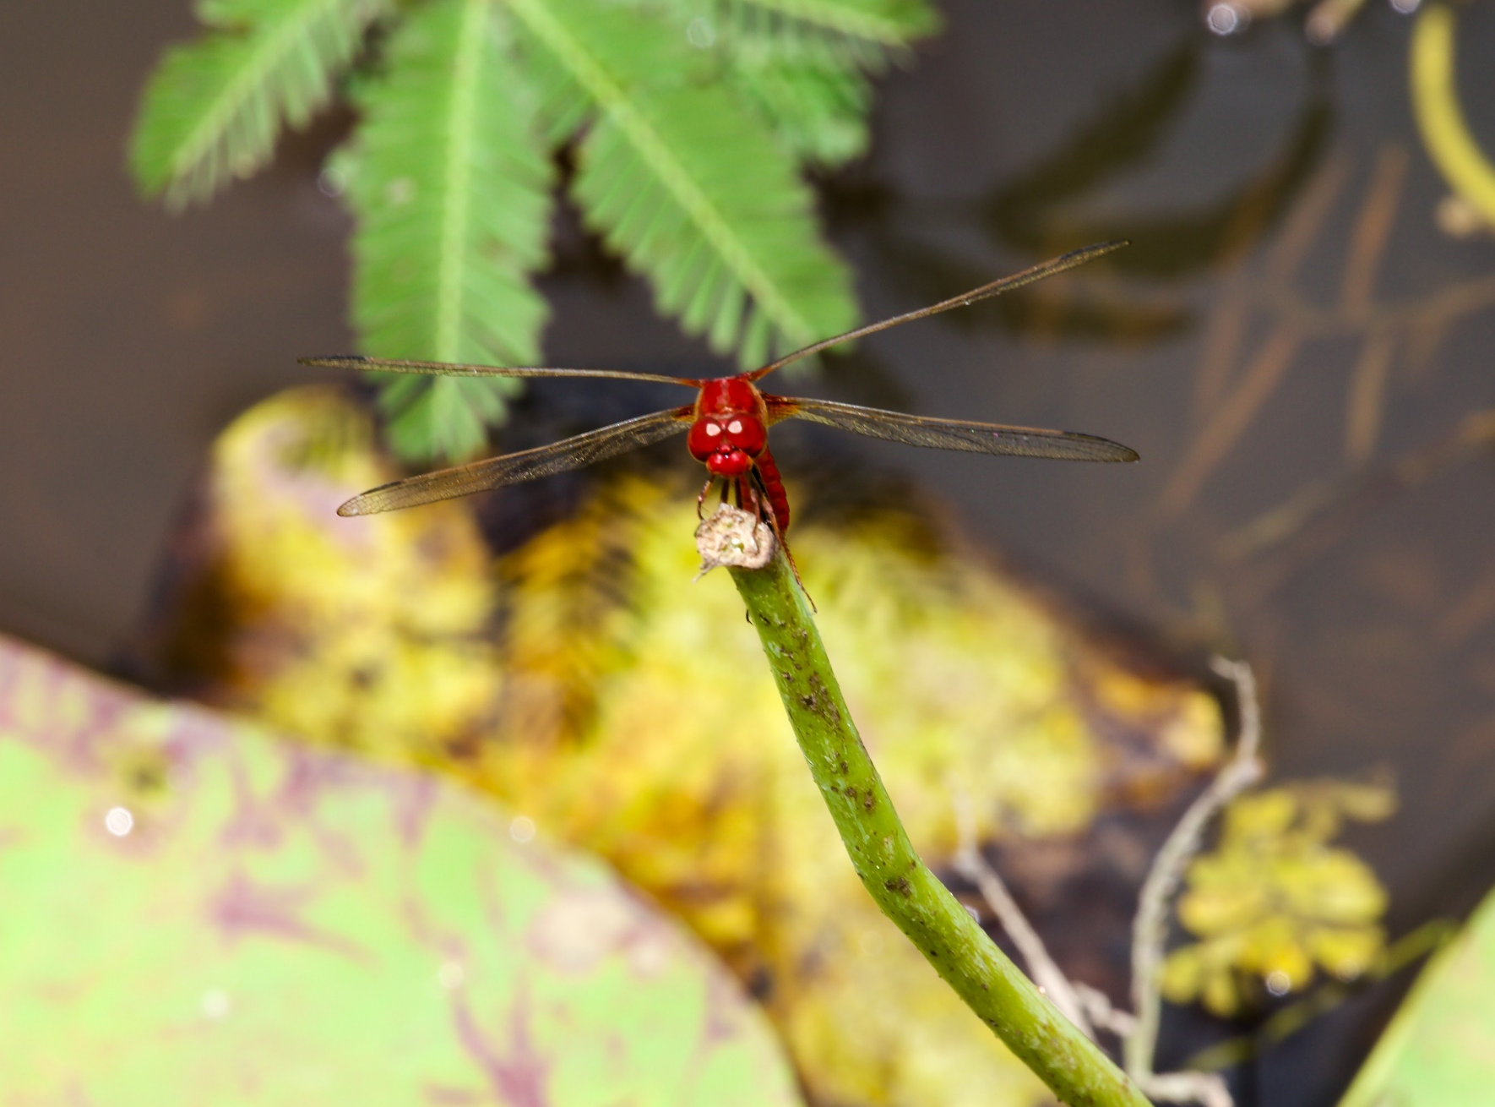
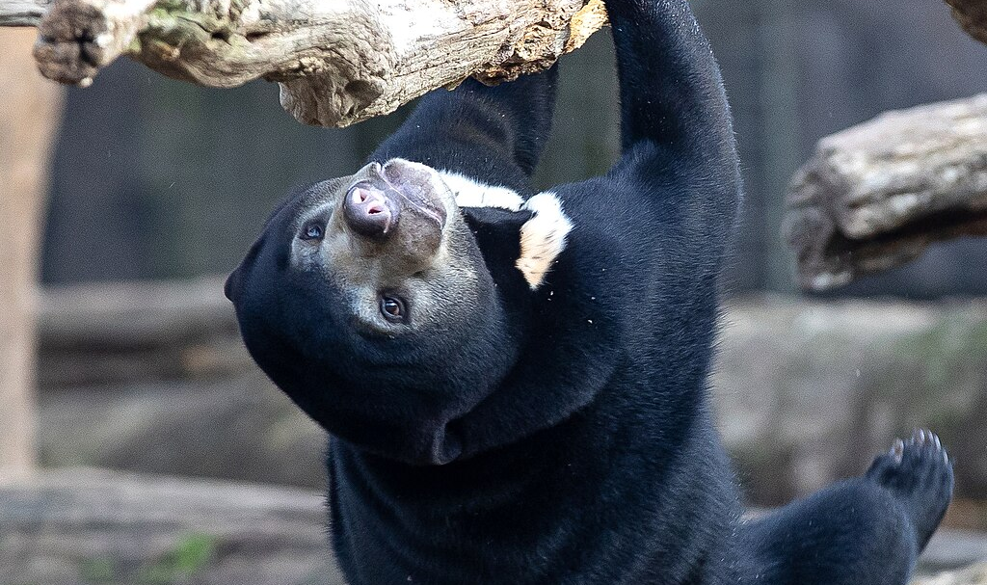
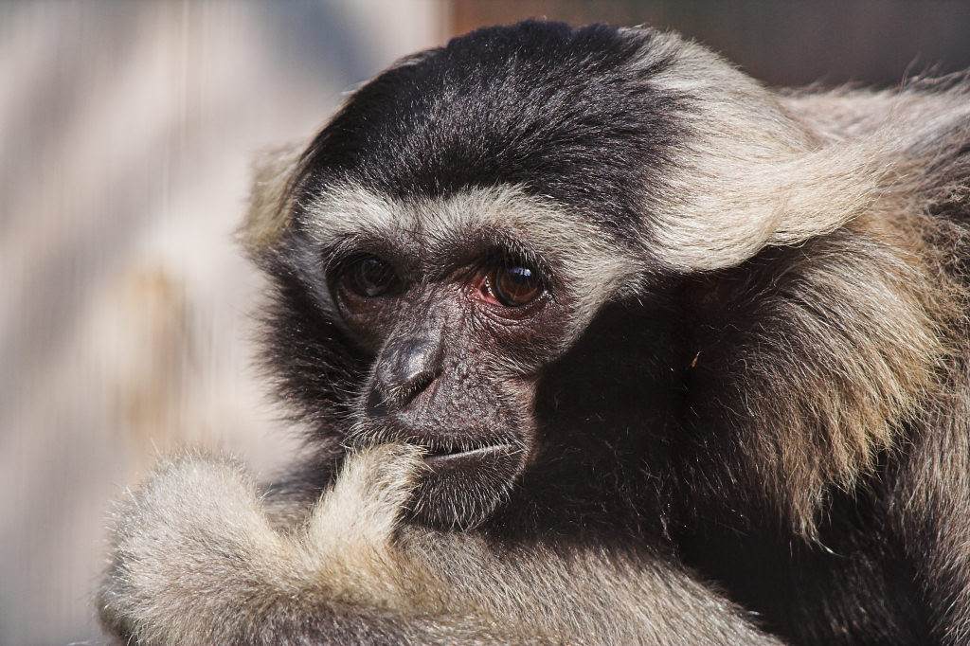
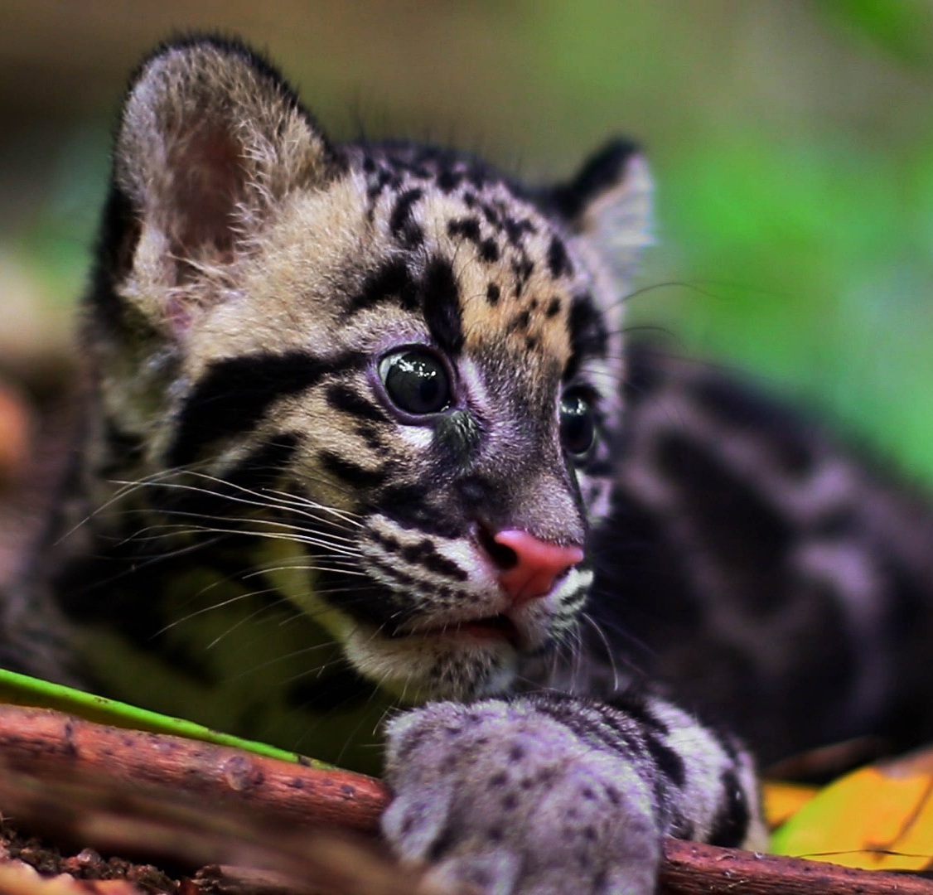
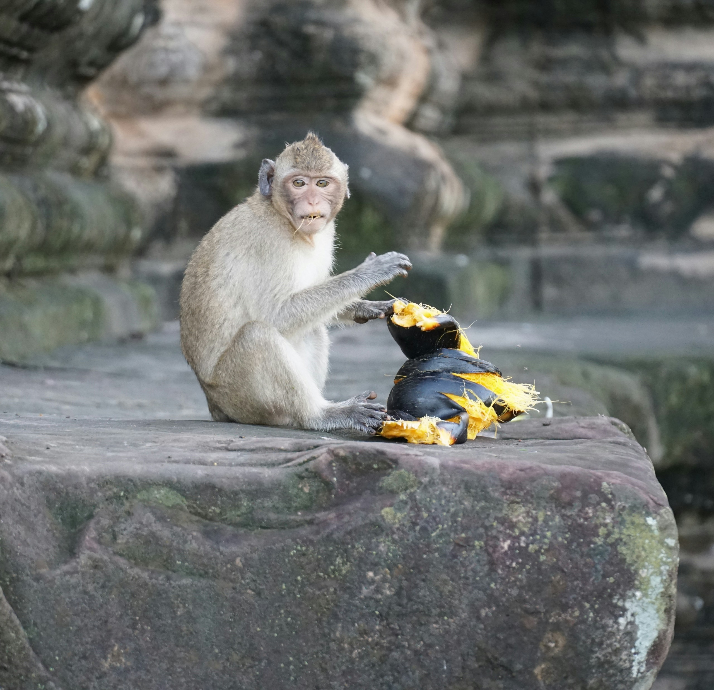
Photo: Kevin Austin
Sun Bear
Pileated Gibbon
Photo:Theo Kruse via Wikimedia Commons
Clouded Leopard
Amazing
Wildlife
Photo: Christo Ras/Pixaby
Unsplash: Sheila C
Photo: Su Neko via Wikimedia Commons

Slide 9
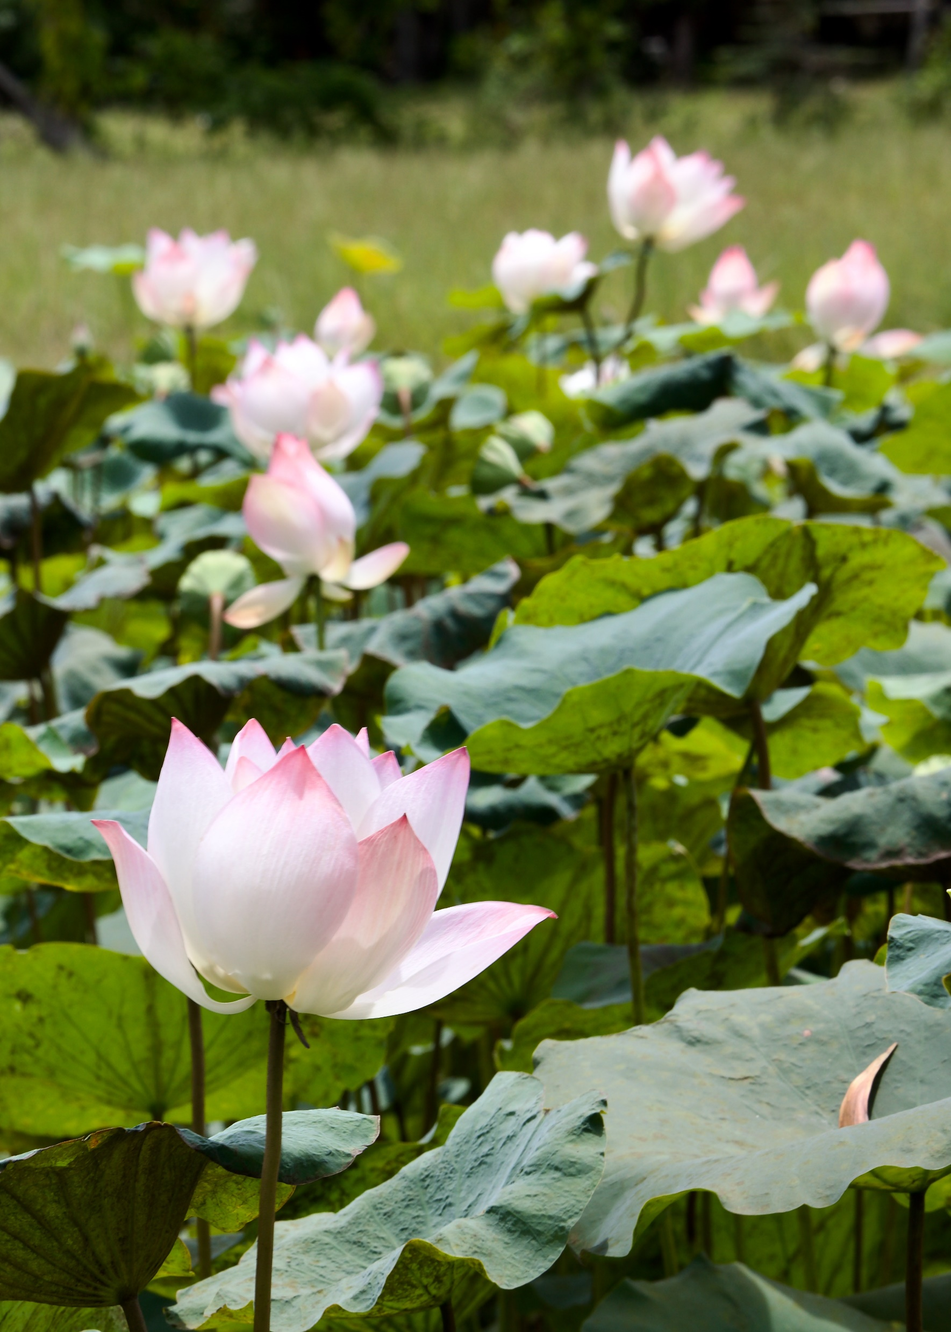
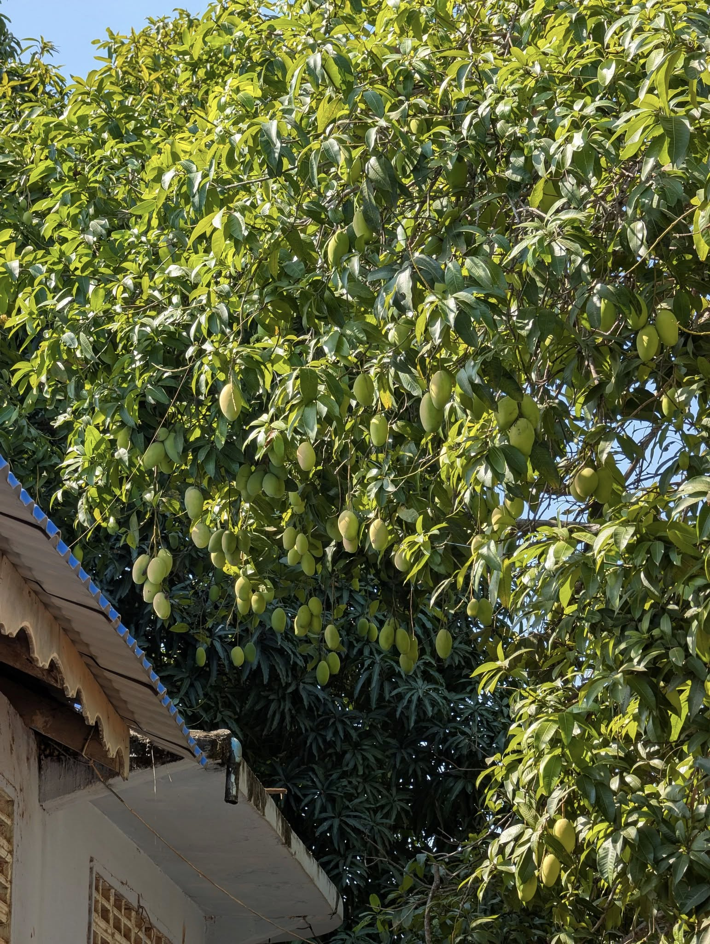
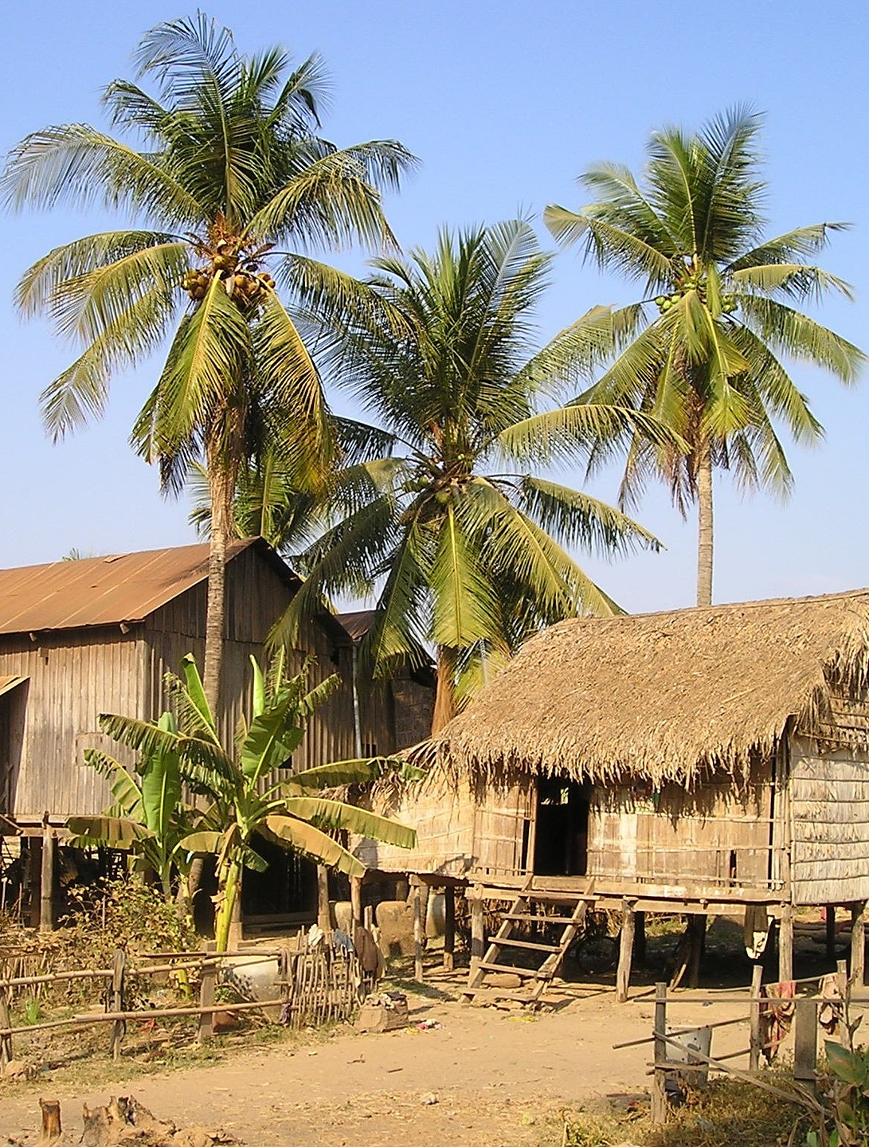
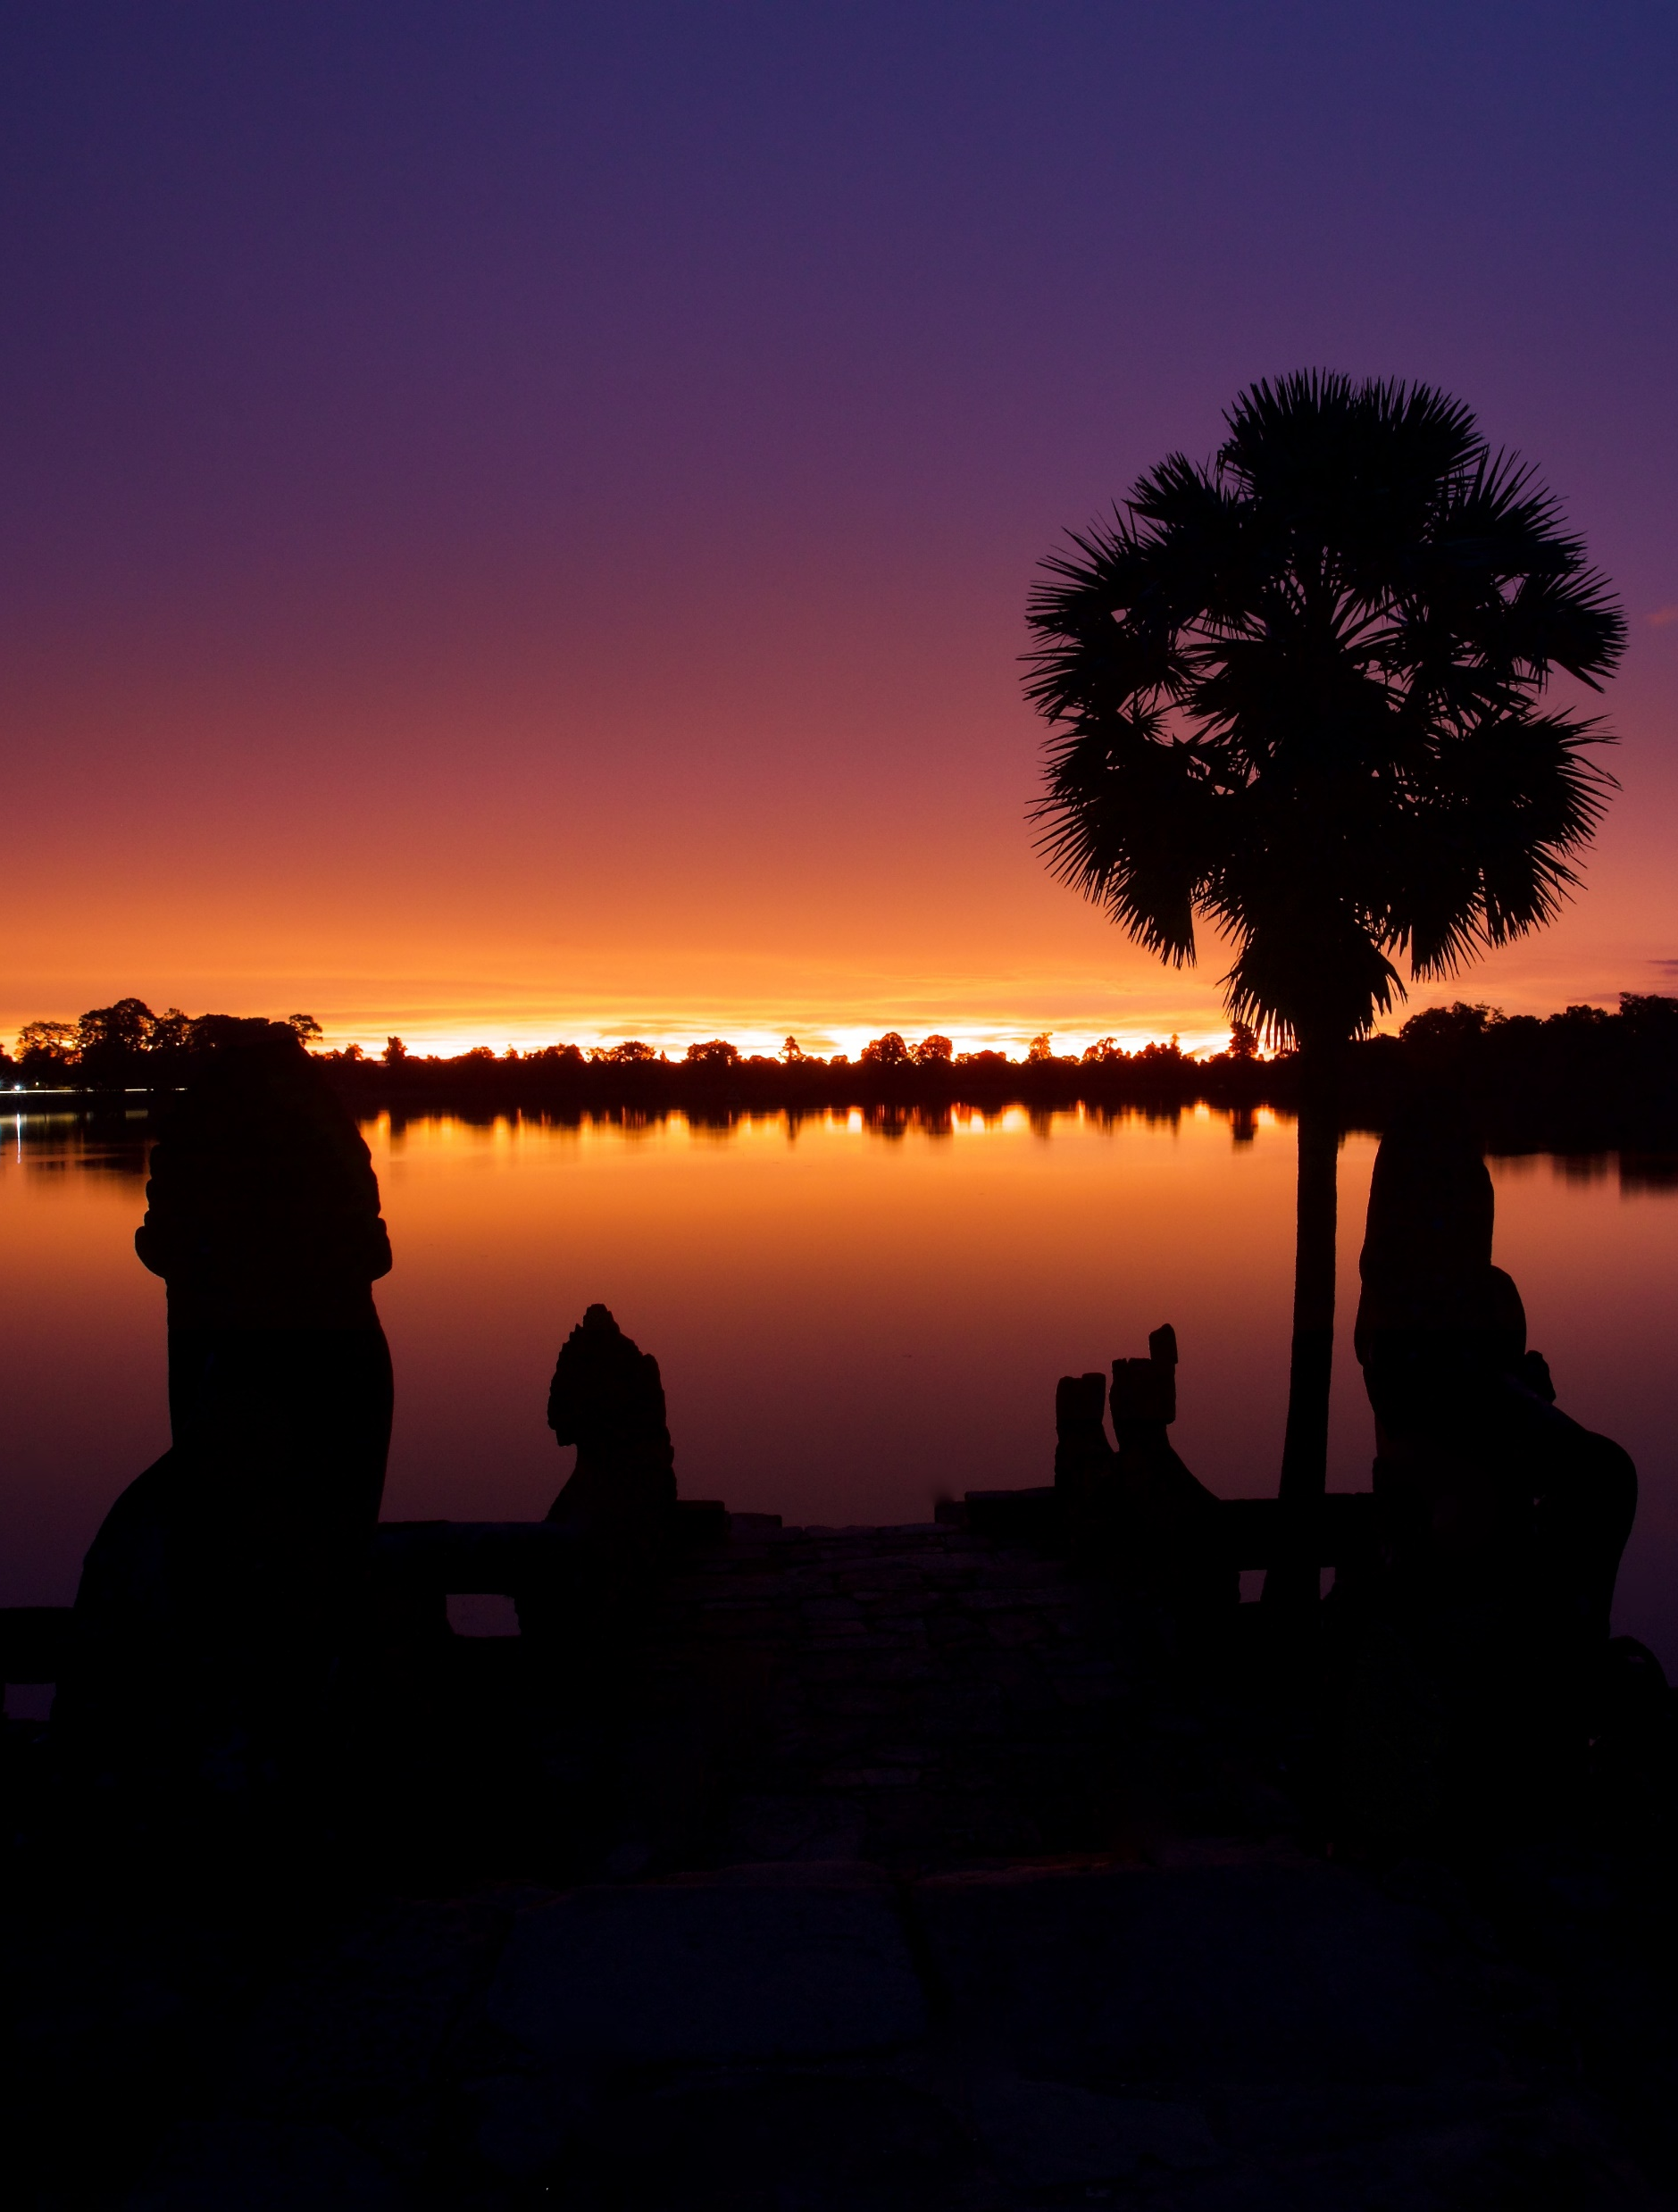
Beautiful Country

Slide 10
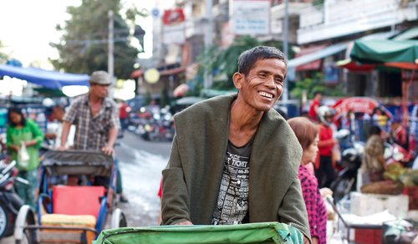
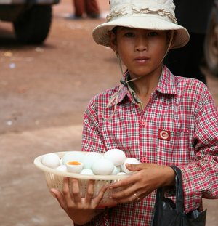
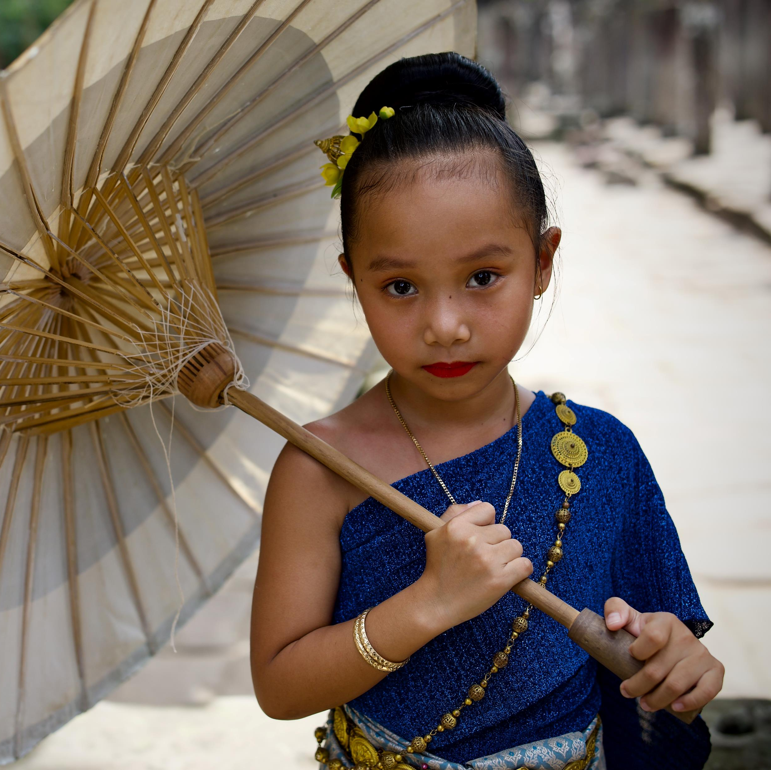
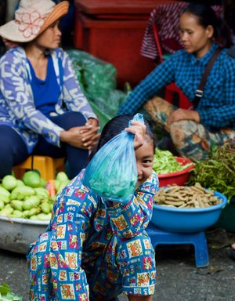
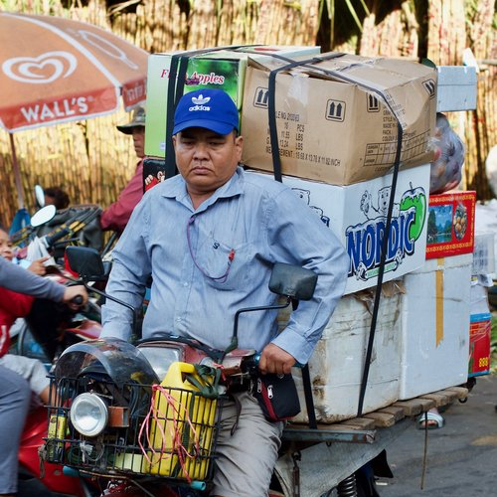
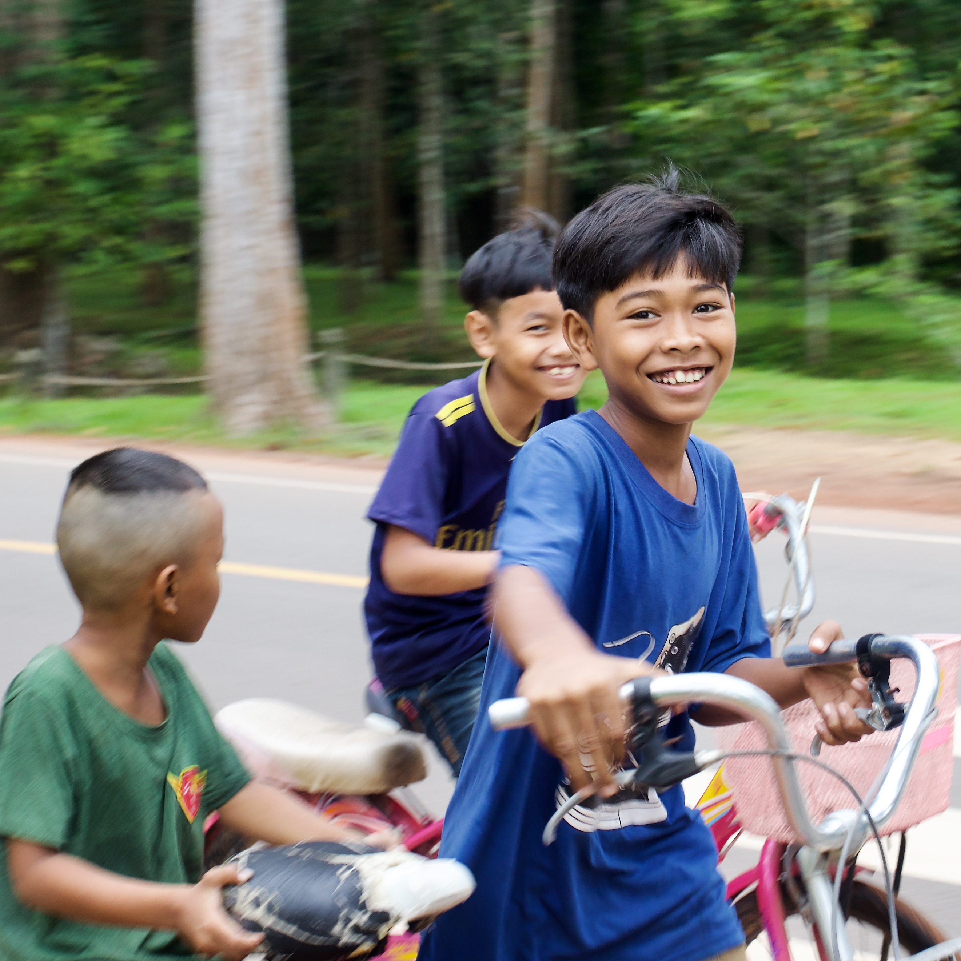
Beautiful People
Photos: Kevin Austin

Slide 11

Explore God’s Work

Slide 12
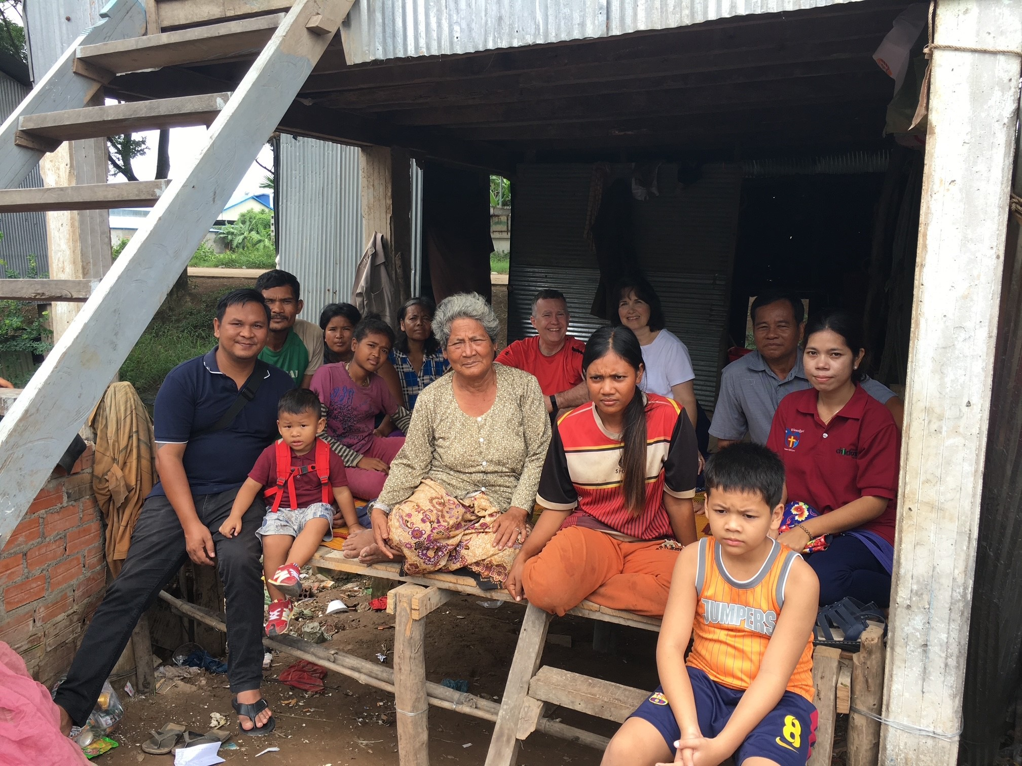
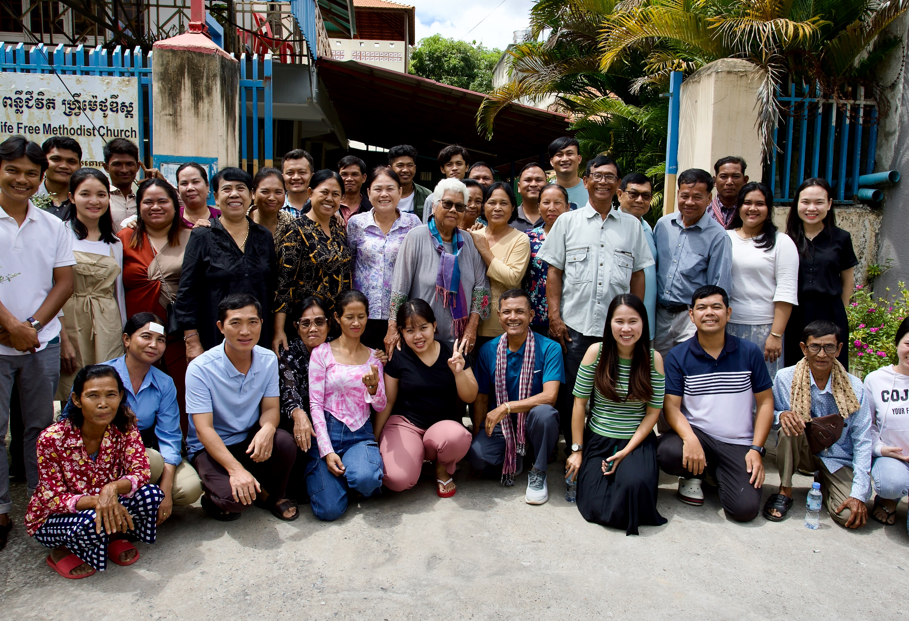
The Free Methodist Church in Cambodia
Photo: Daniel Sar
Photo: Kevin Austin

Slide 13
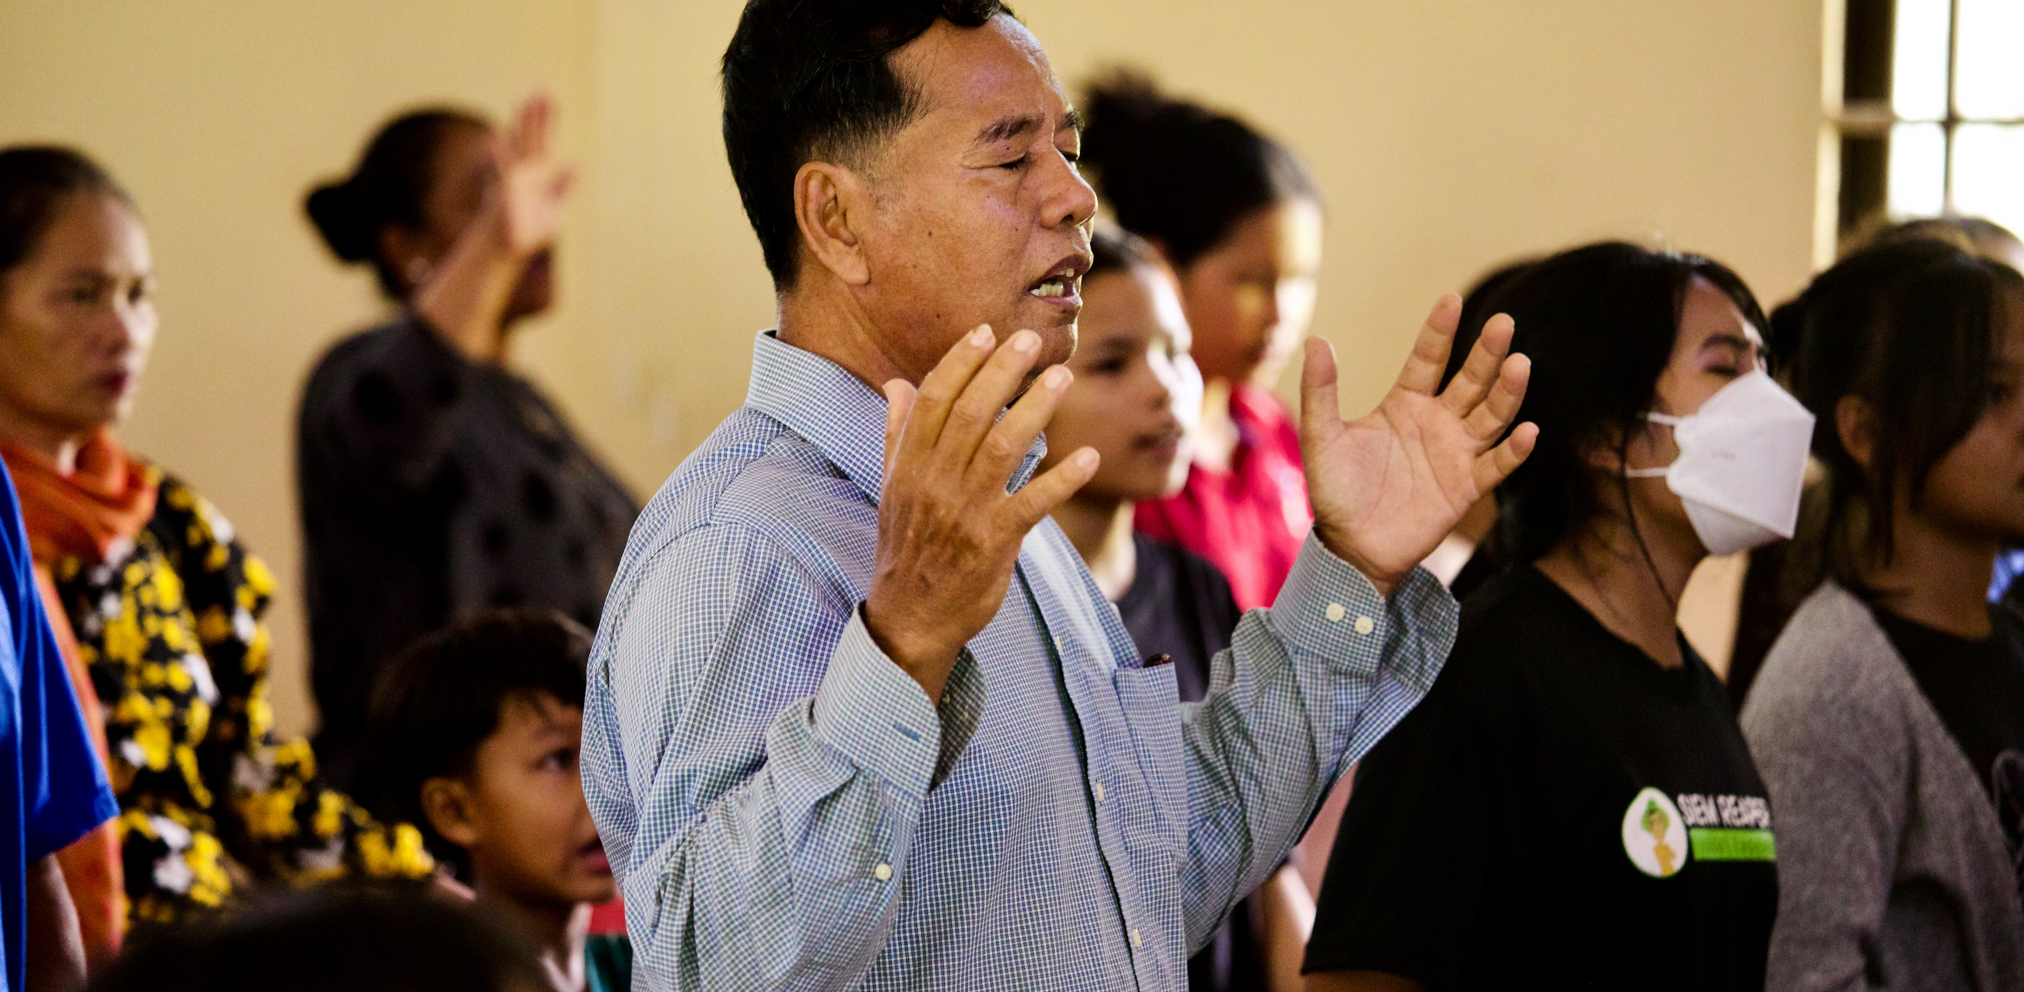
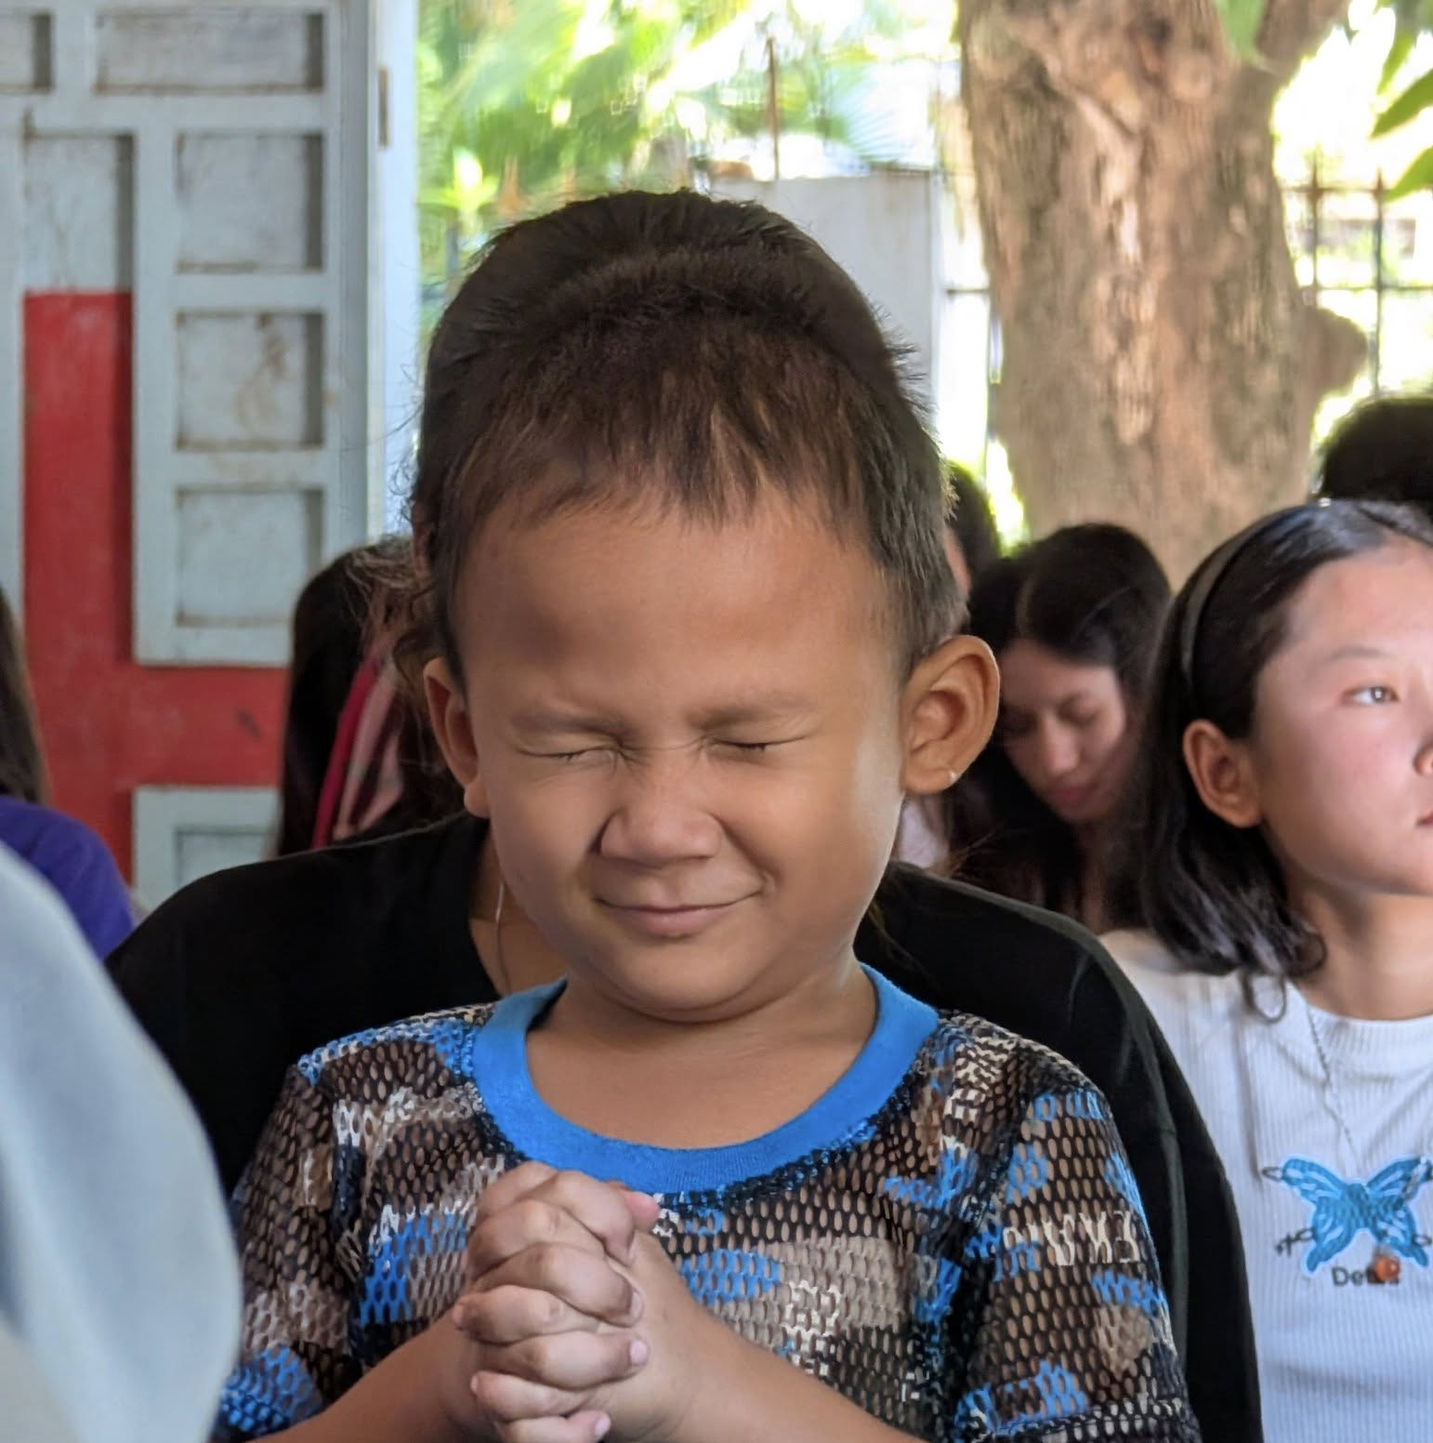
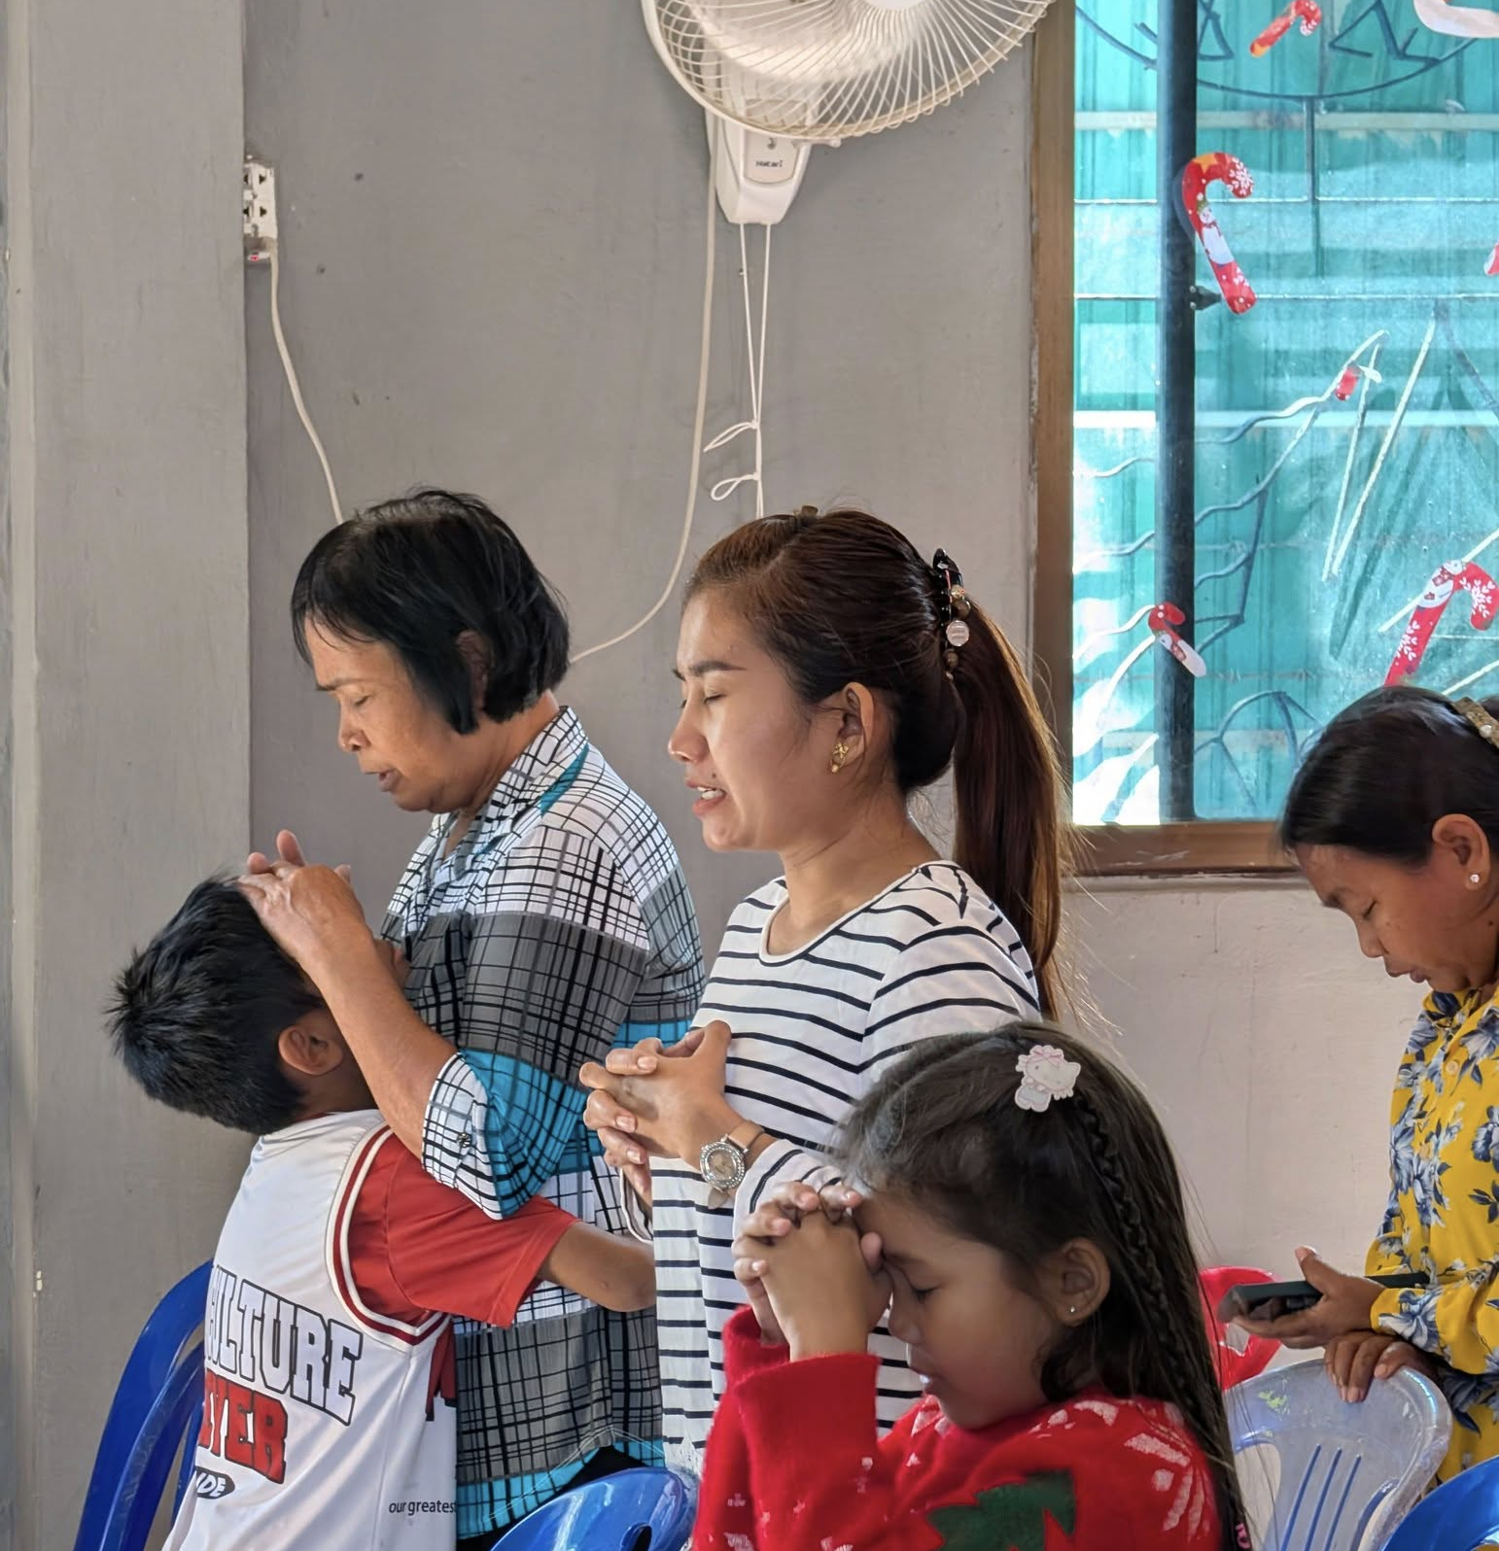
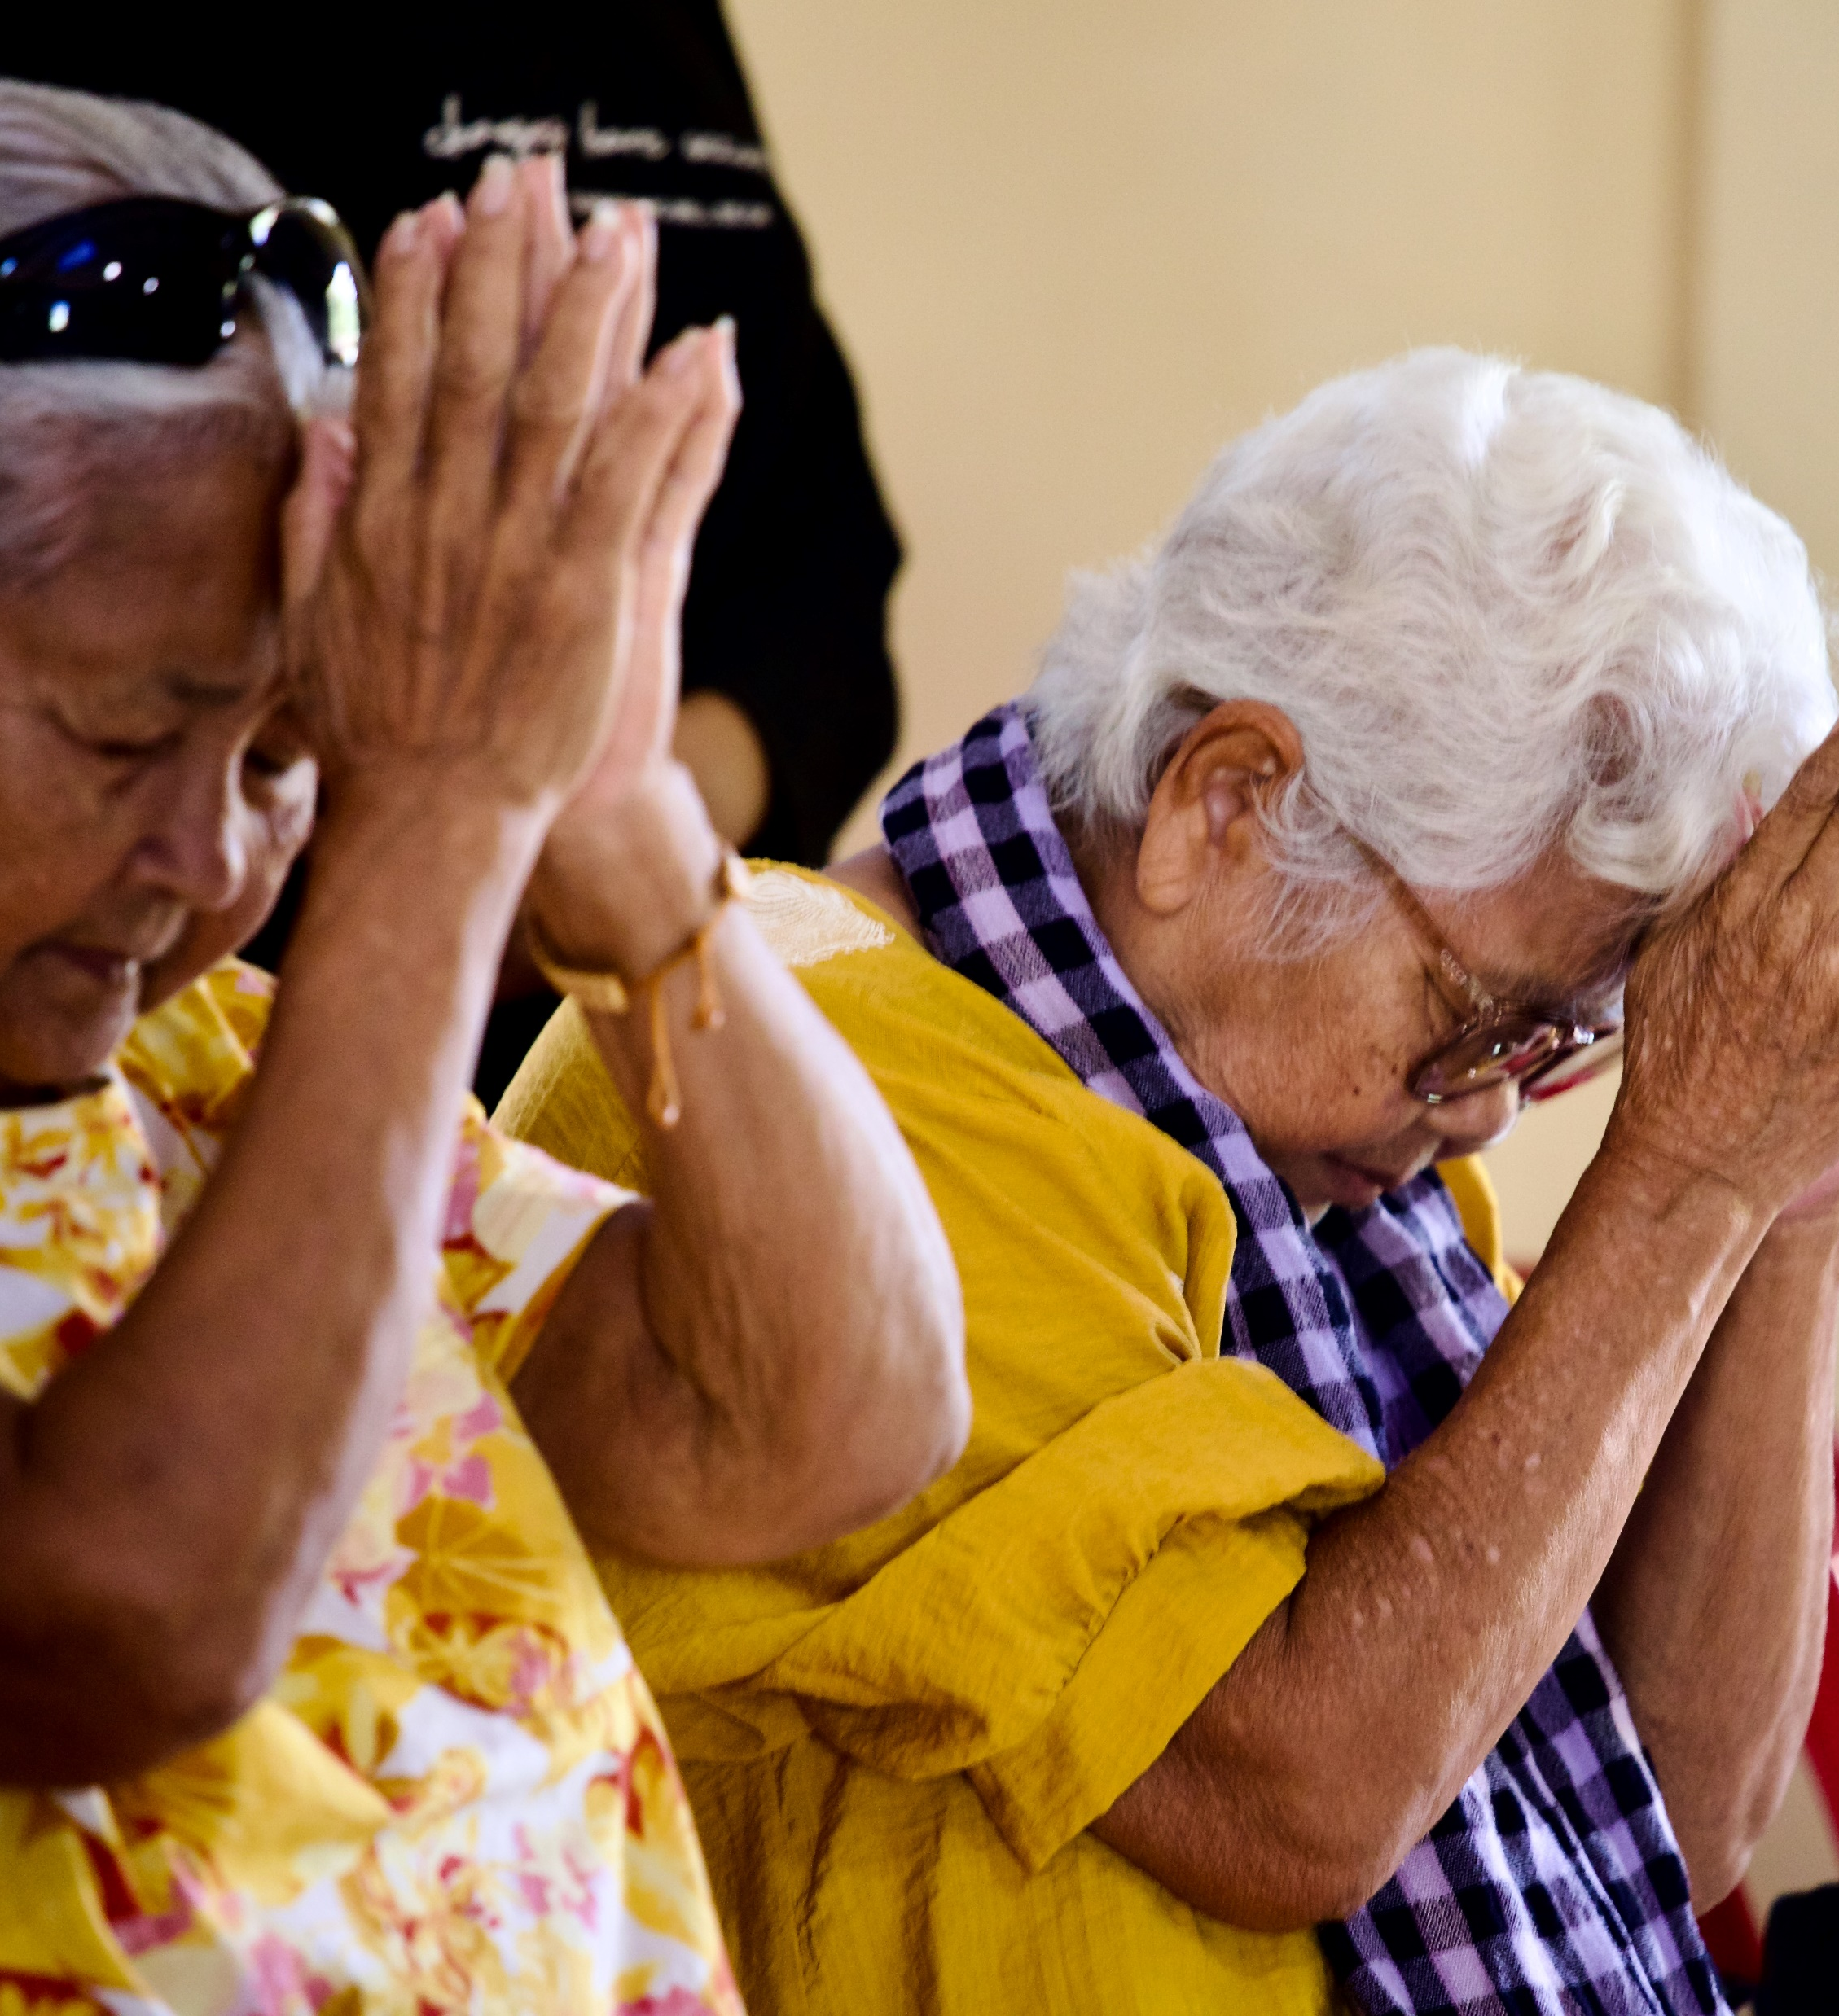
A Praying Church
Photos: Pastor Philip
Photos: Kevin Austin

Slide 14
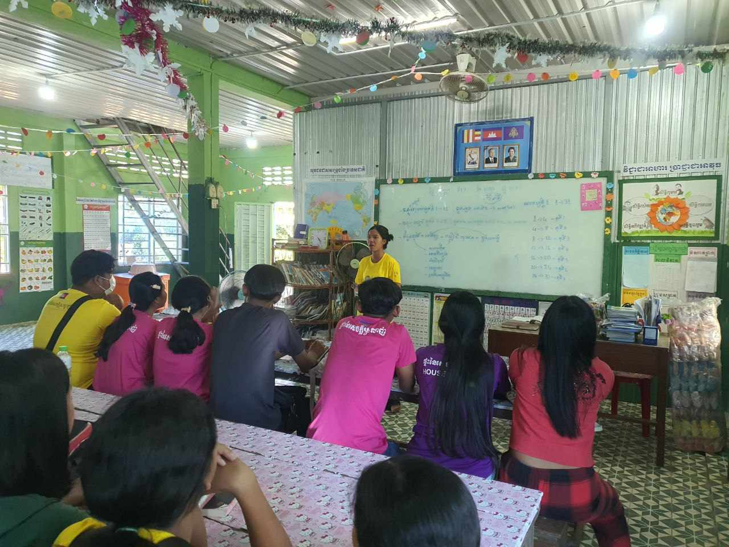
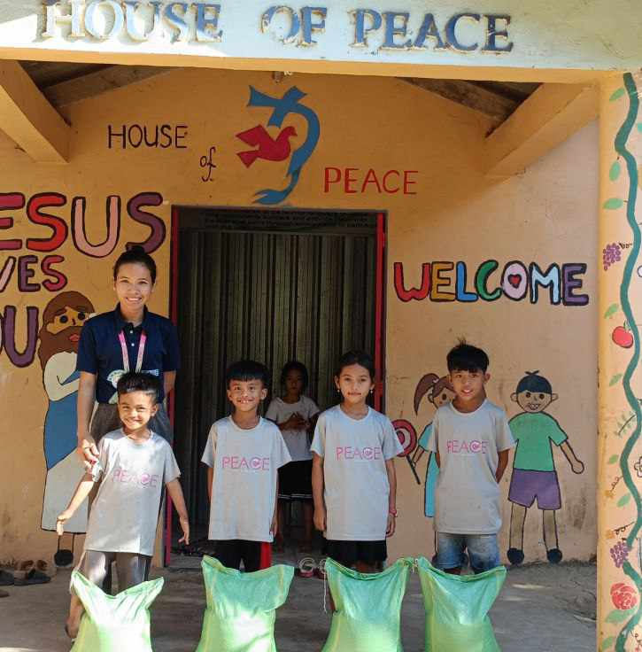
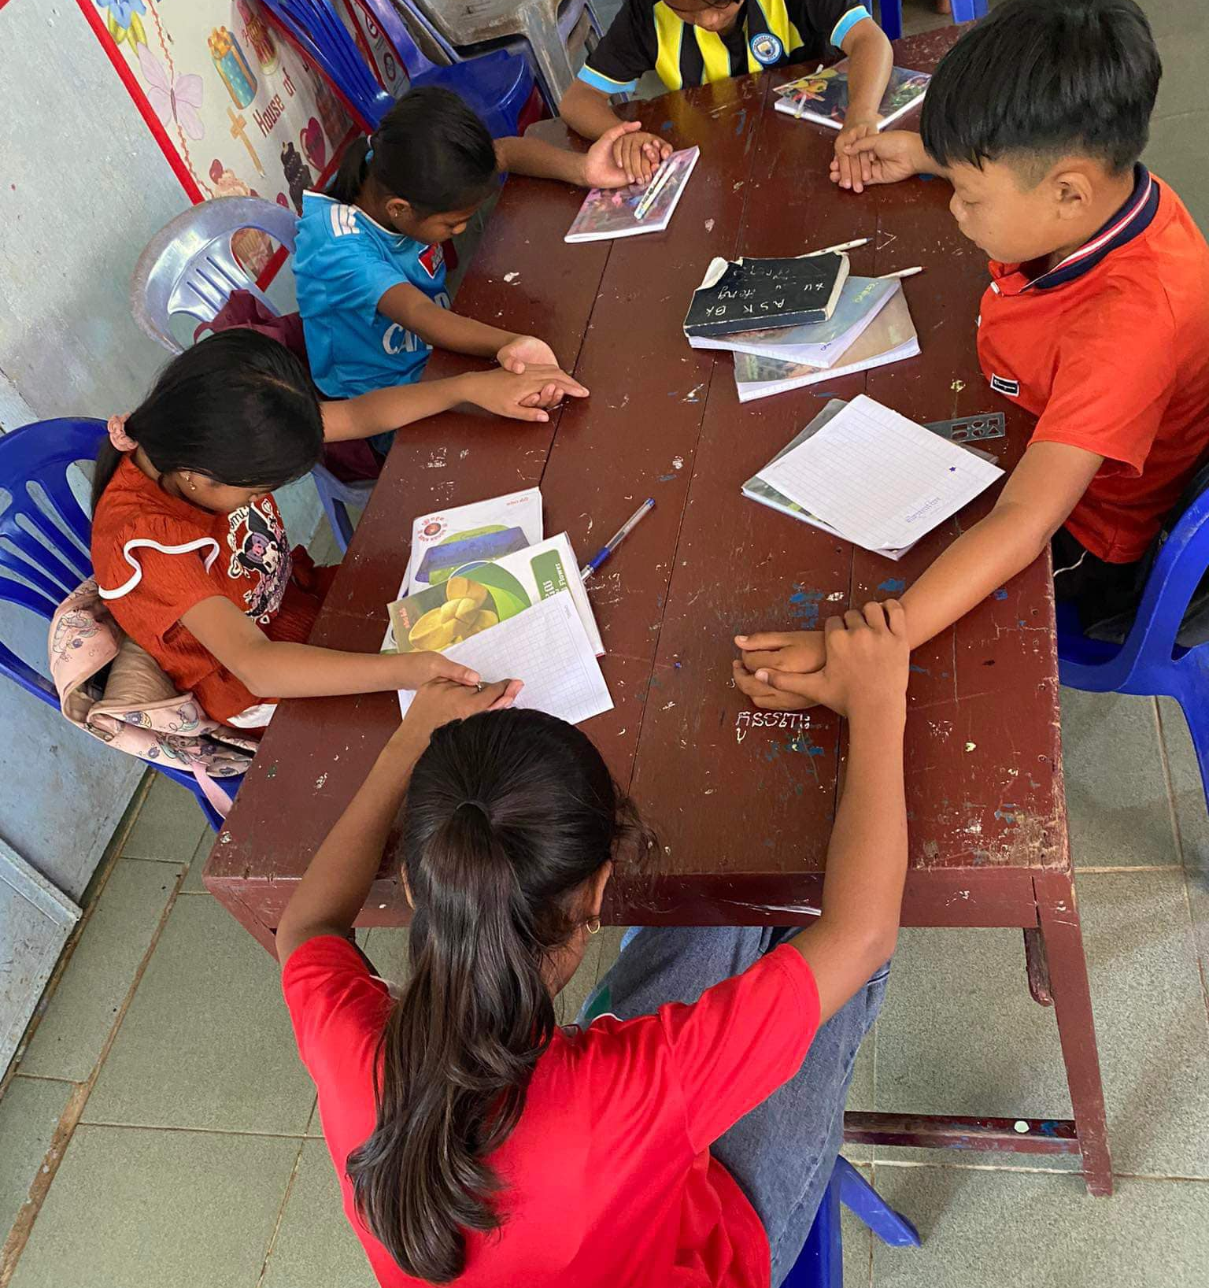
International Child Care Ministries
Photos: Pastor Philip

Slide 15
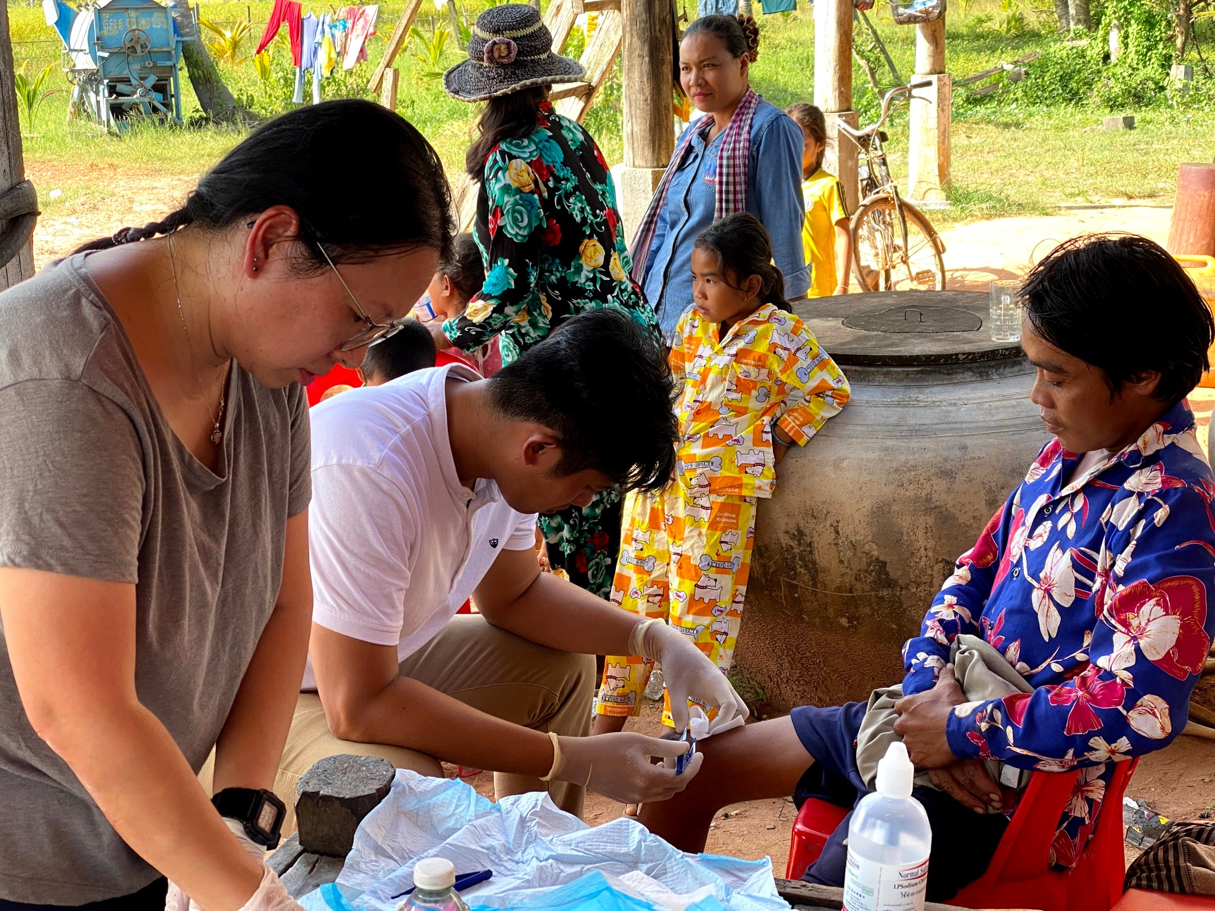
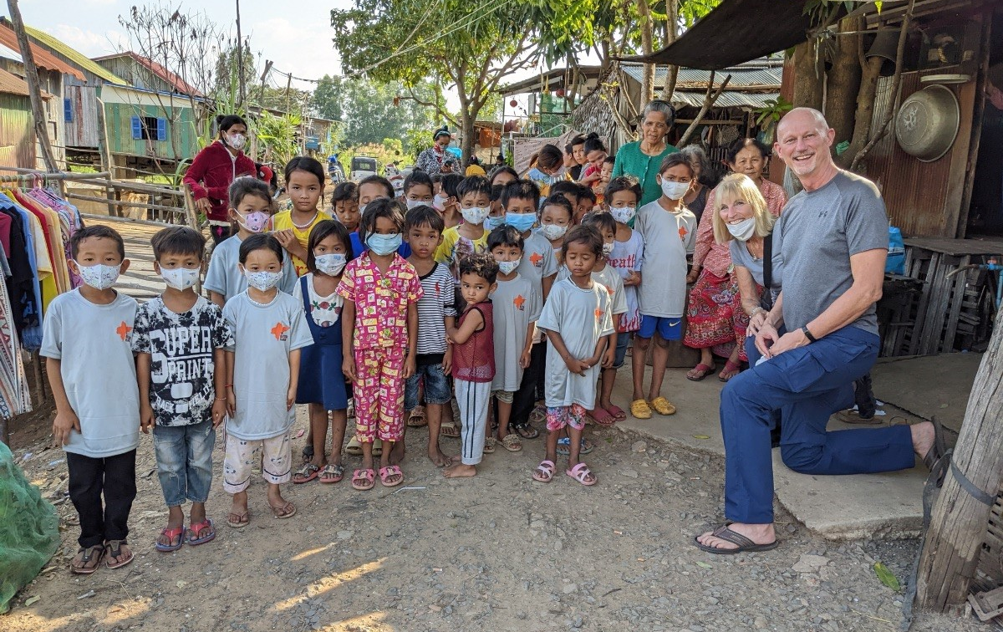
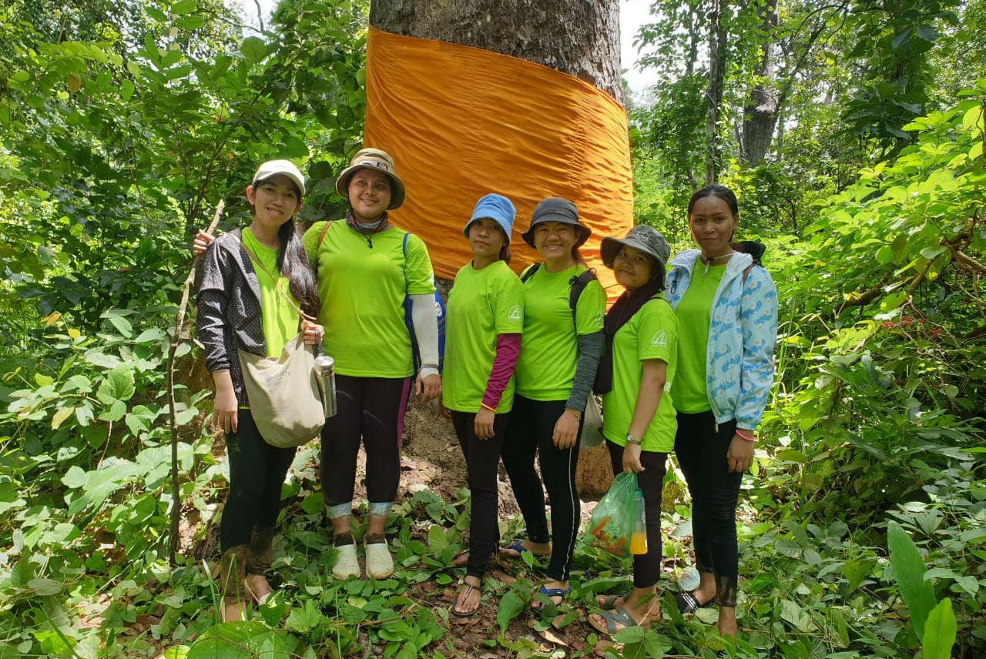
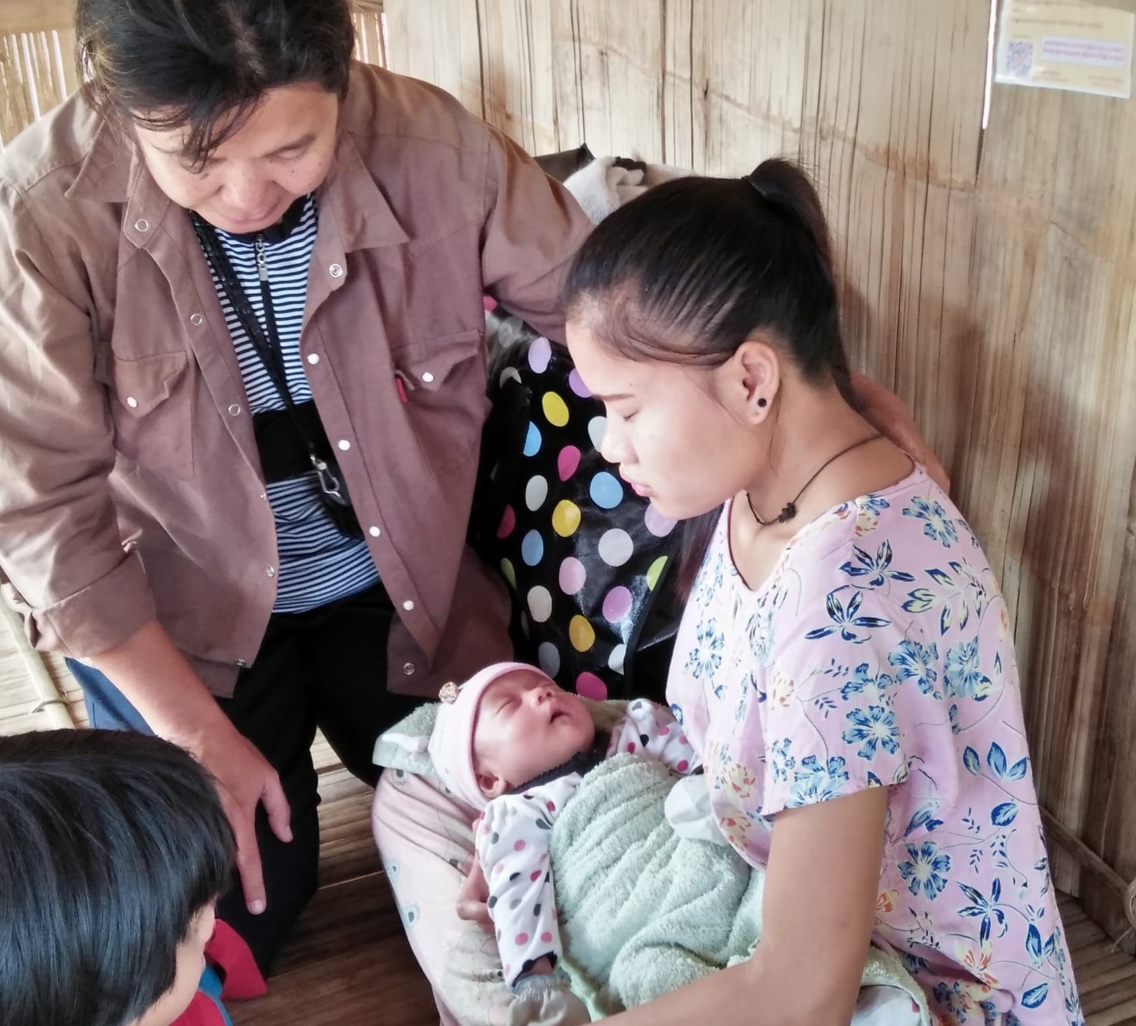
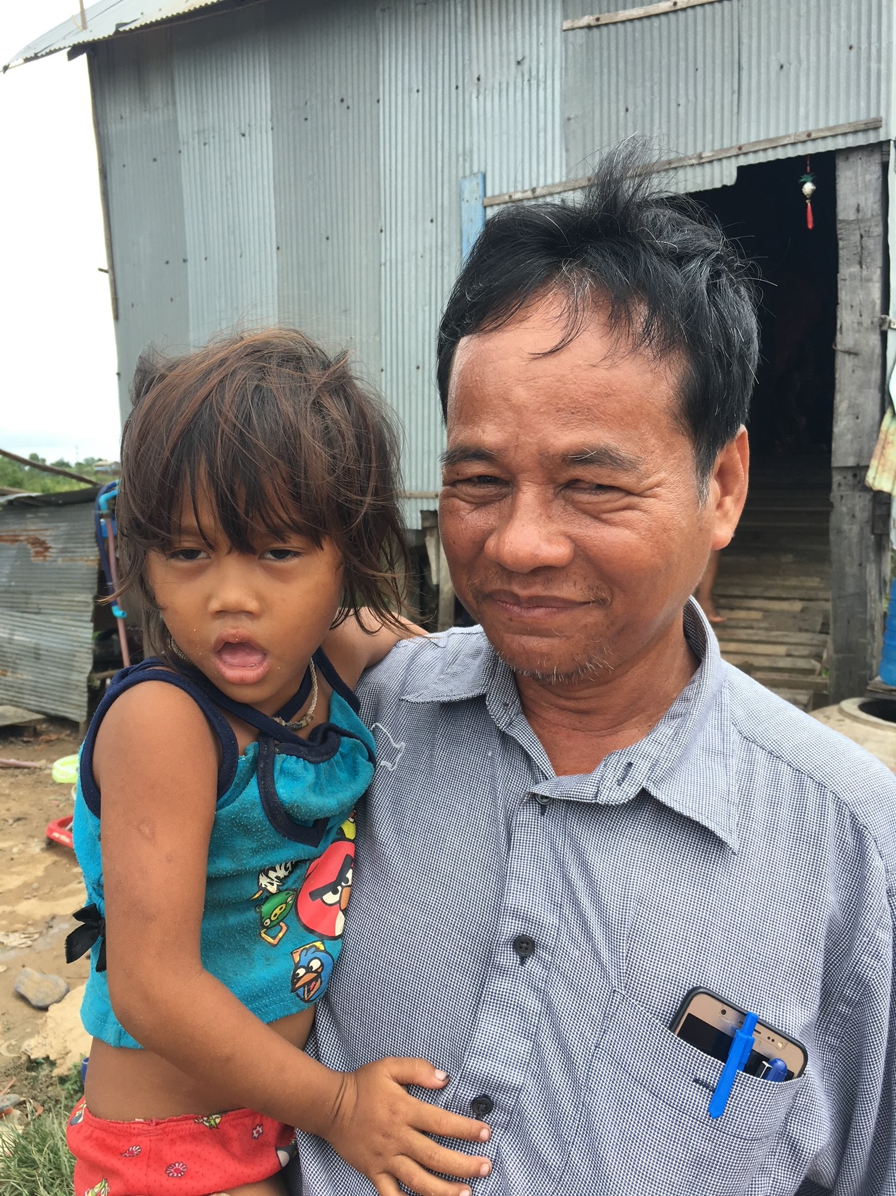
The Church on Mission to Serve
Photos: FMWM Asia Leaders

Slide 16

Adventure Story

Slide 17
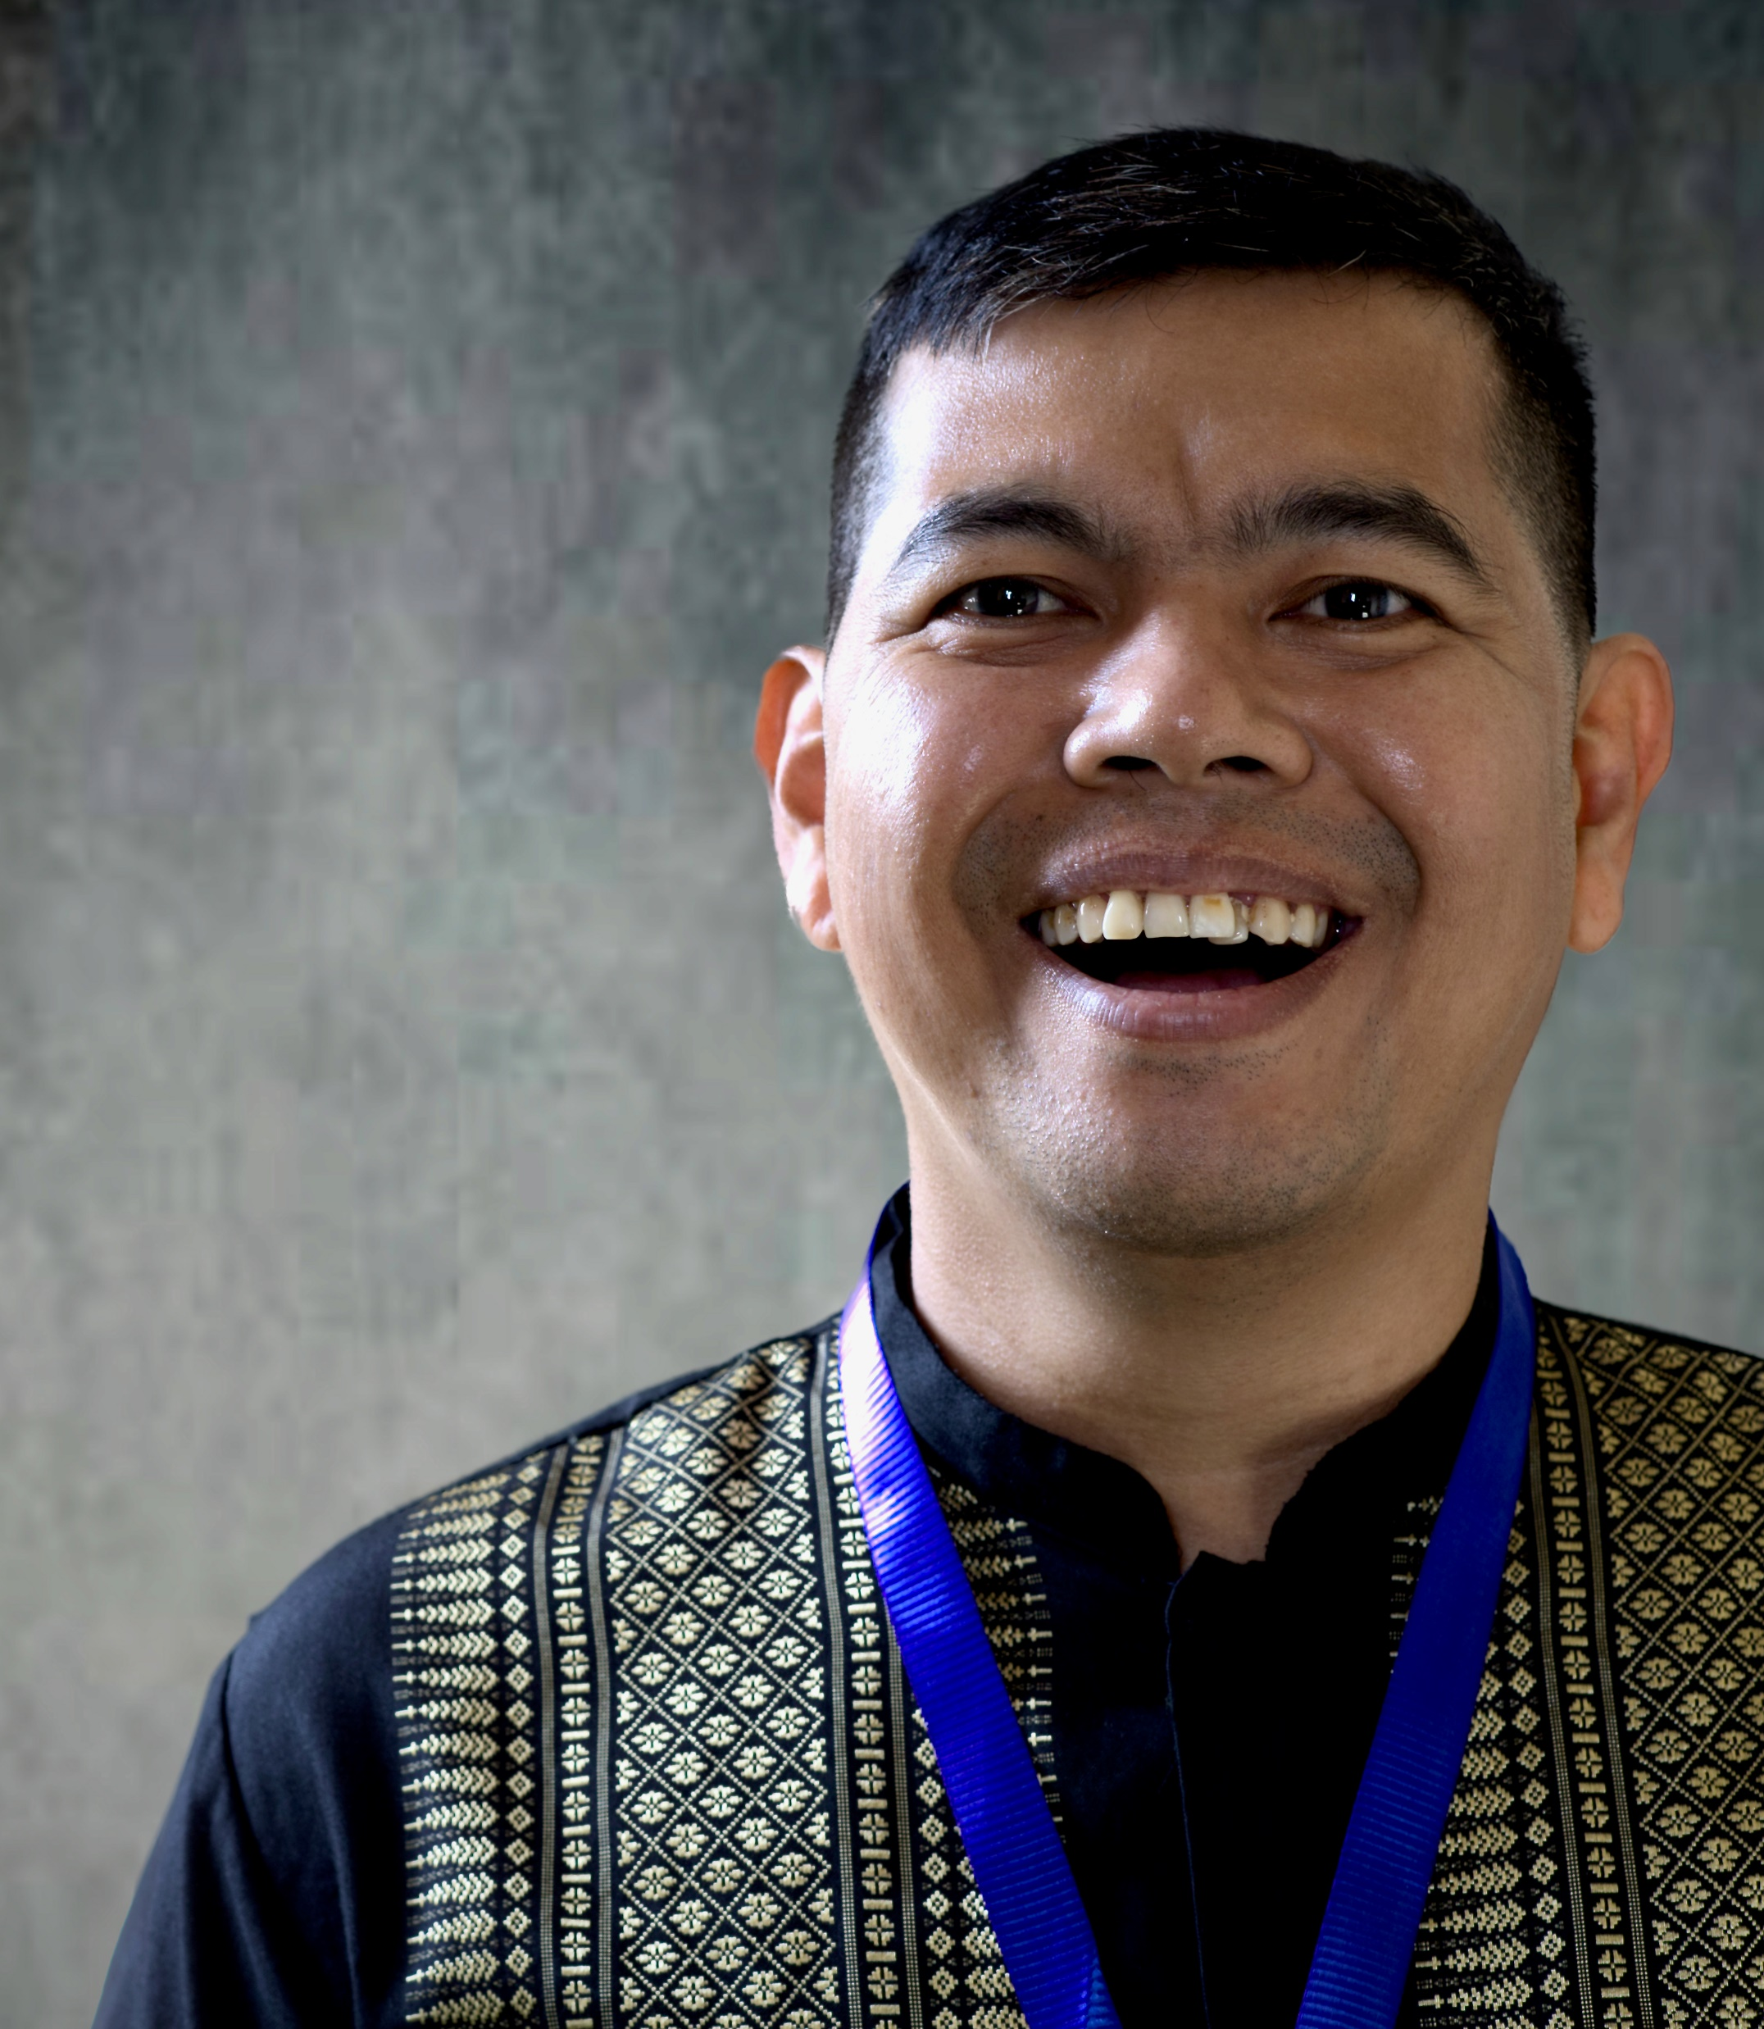
Daniel
Has a New Song of Joy
Photo: Kevin Austin
Photo:Kevin Austin

Slide 18

People on Adventure

Slide 19
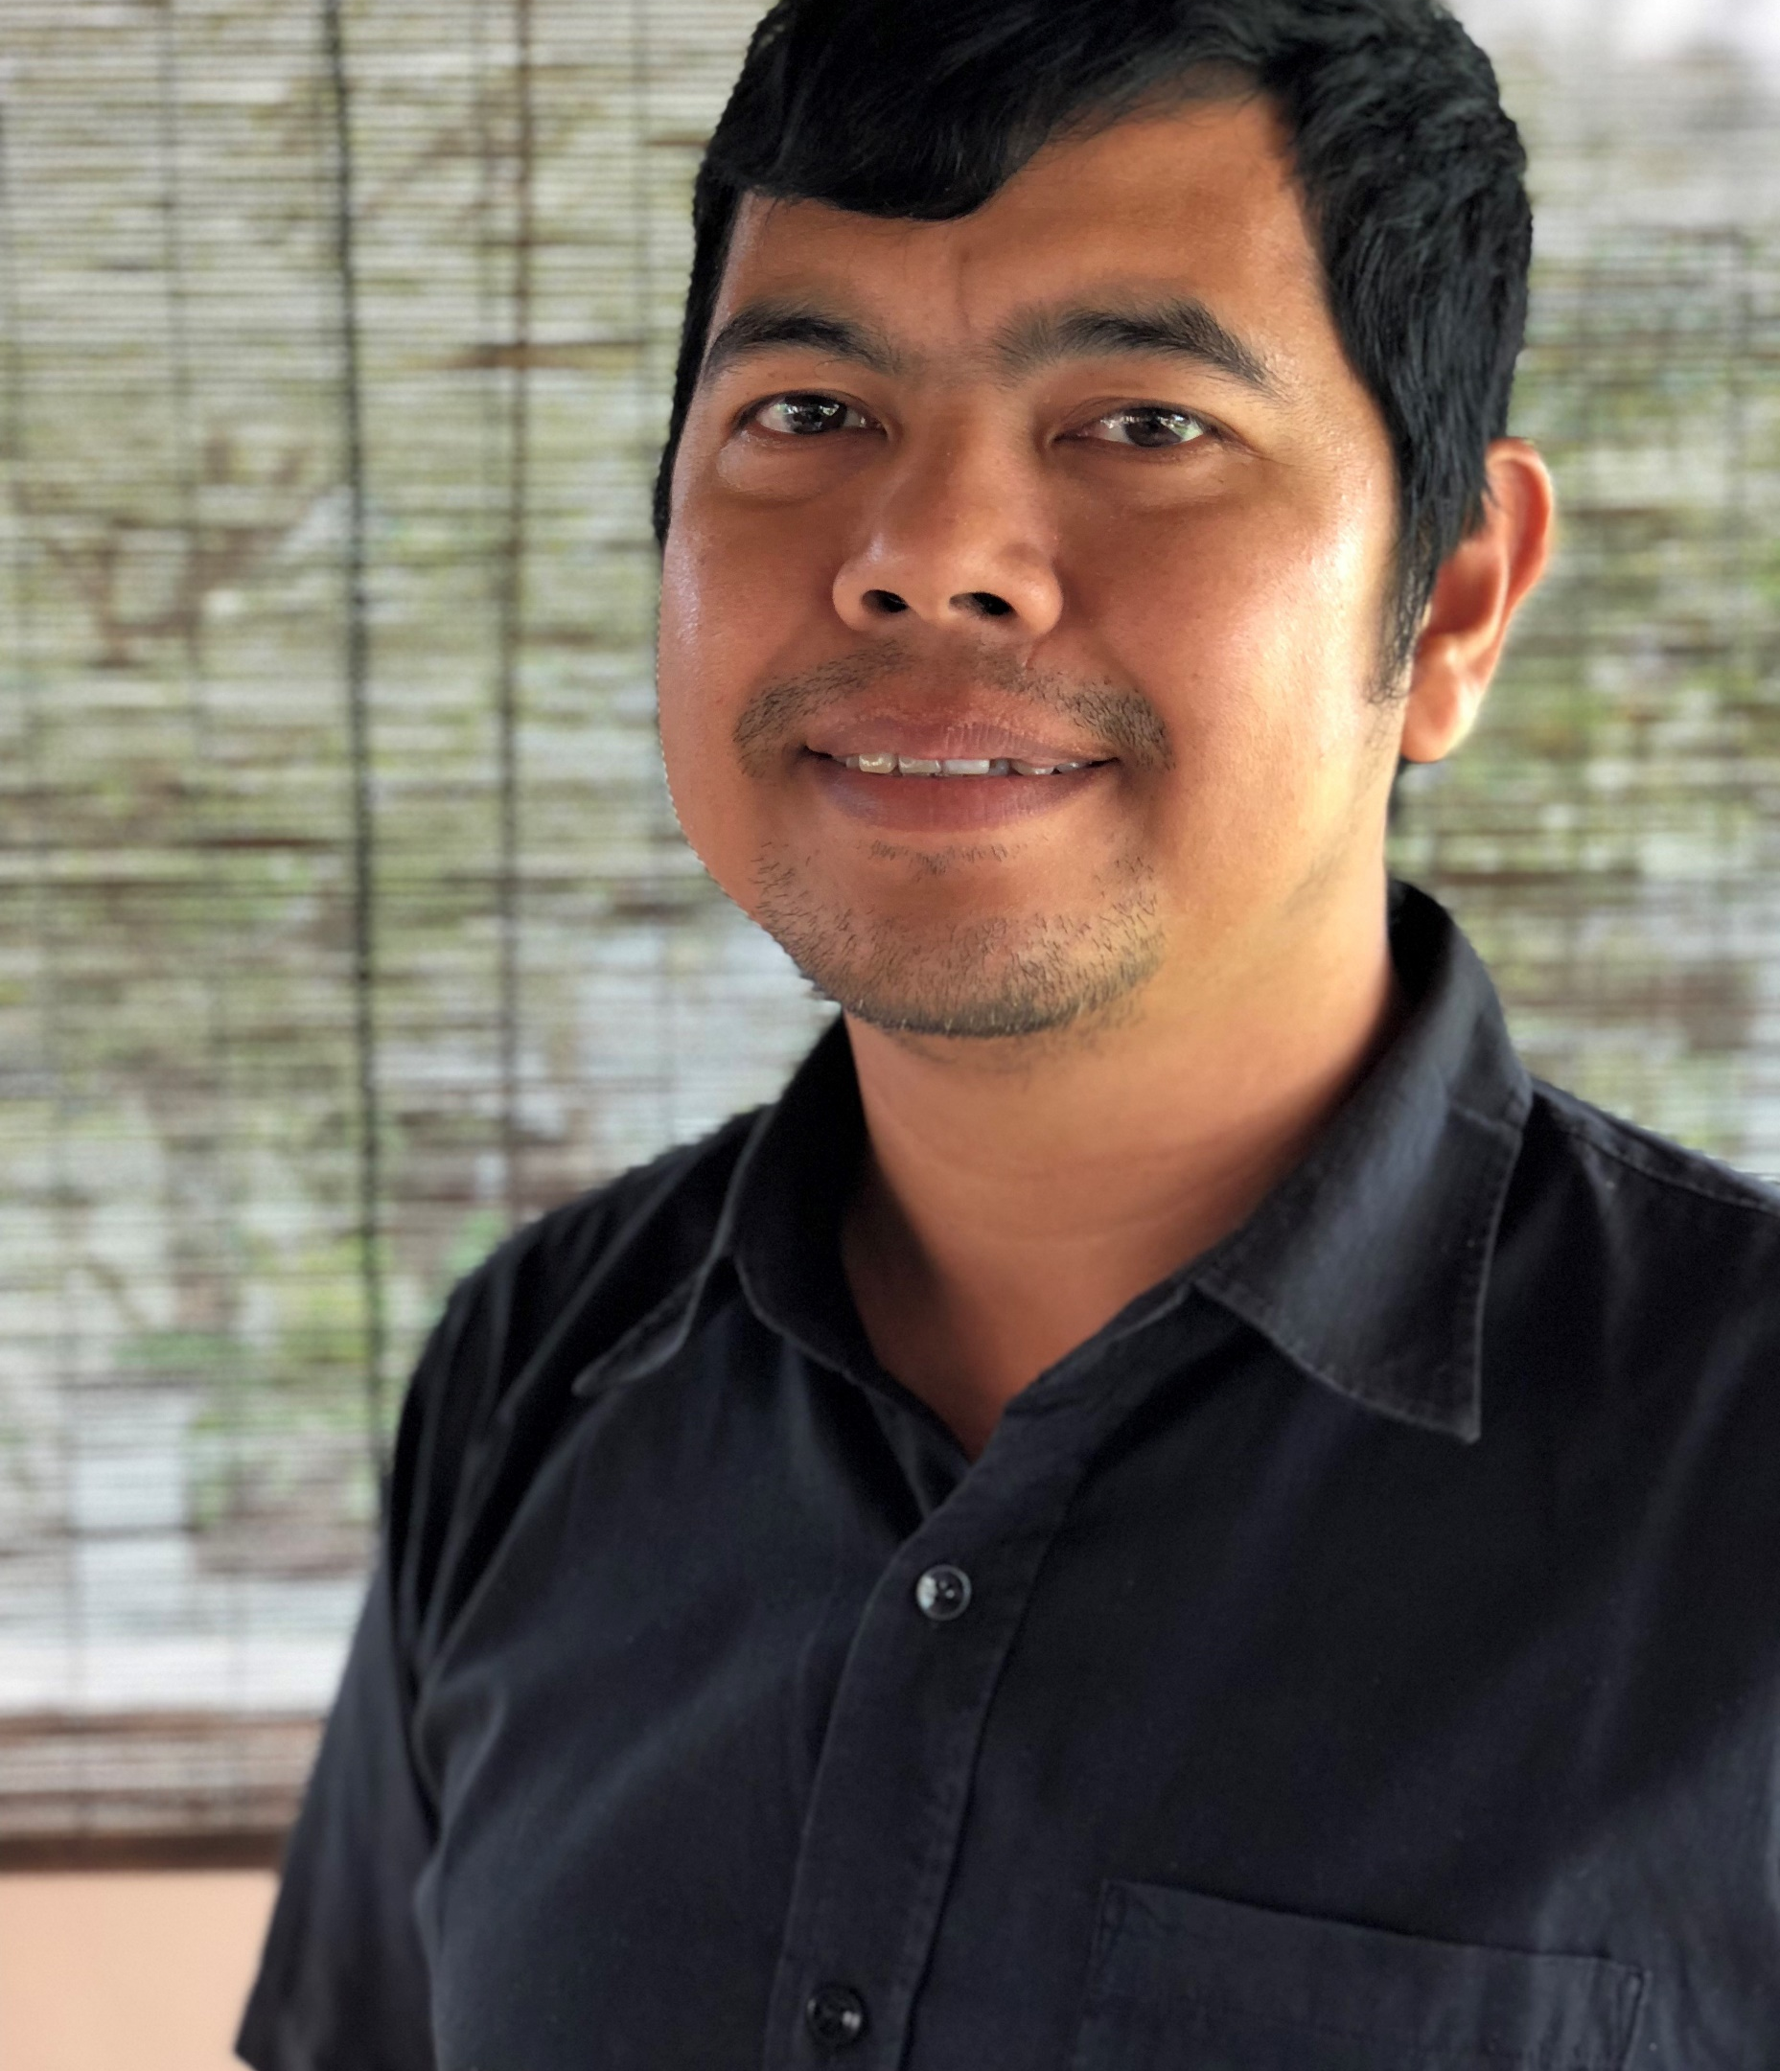
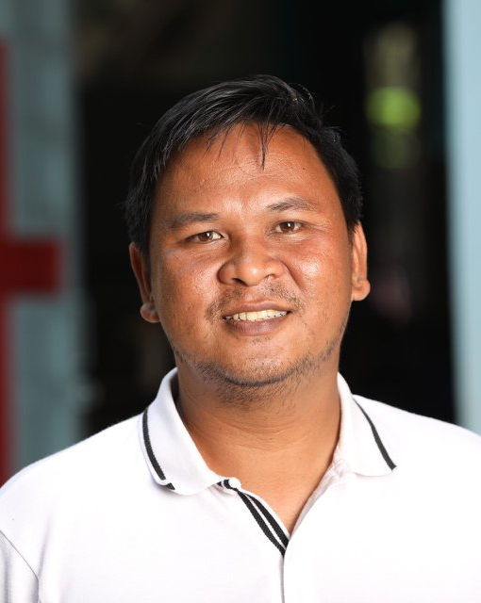
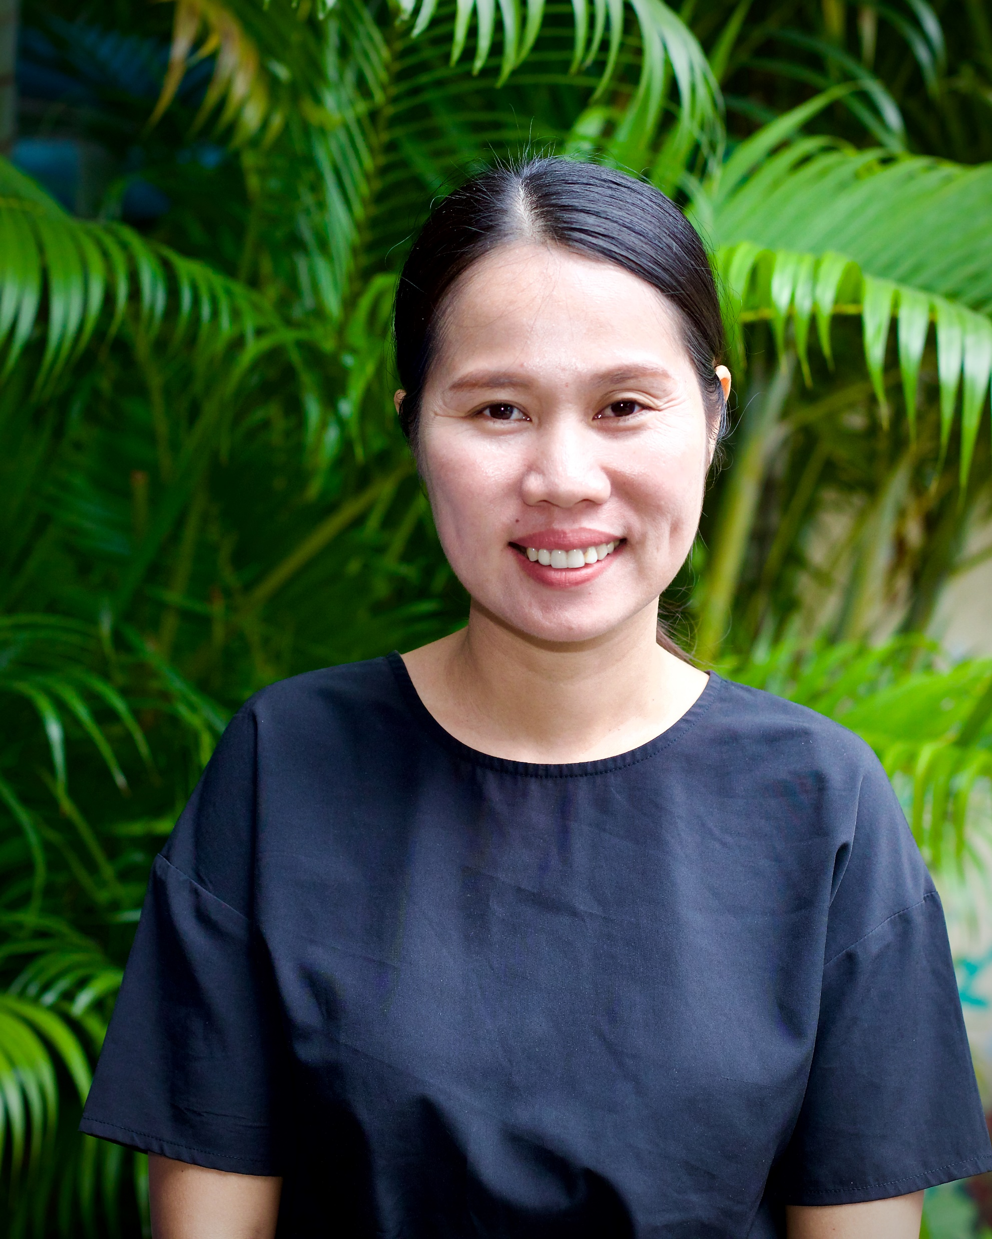
Meet Daniel, Philip & Sokleap
FamilyID=Office_ArchiveTorn
Photo: Area Director Eric
Photos: Kevin Austin

Slide 20

Adventures in Culture

Slide 21
Language
Hello (informal)
Suasdey
SOO-wer sa DUH-ee
Goodbye (informal)
Lia Haeuy
LEE-er High
Thank you
or kun chraeun
Or KUN CHRA-ern
Good Morning
arun suasdey
Arun
SOO-wer sa DUH-ee

Slide 22



This Is the Day
Author – Les Garret
MUSIC
This is the day (echo)
that the Lord has made. (echo)
I will rejoice, (echo)
and be glad in it. (echo)
This is the day that the Lord has made.
I will rejoice and be glad in it.
This is the day, this is the day that the Lord has made.

Slide 23


Khmer
(Pronunciation)
Nee guh-jee-a tngai.(echo)
Daahl Preah baan bongkaat.(echo)
Yerng mee-un omnor (echo)
Howie yerng aw sup-baai.(echo)
Nee guh-jee-a tngai Daahl Preah baan bongkaat.
Yerng mee-un omnor Howie yerng aw sup-baai.
Nee guh-jee-a tngai (echo)
Daahl Preah baan bongkaat.

Slide 24
Hallelu, Hallelu
Author Anonymous
Hallelu, Hallelu, Hallelu, Hallelujah!
Praise ye the Lord! (repeat)
Praise ye the Lord, Hallelujah!
Praise ye the Lord, Hallelujah!
Praise ye the Lord, Hallelujah!
Praise, ye the Lord!

Slide 25
Khmer
(Pronunciation)
Ha-le-lu, (3x)
Ha-le-lu-jah!
Sor-sah preah ong!
Sor-sah preah ong! Ha-le-lu-jah! (3x)
Sor-sah preah ong!

