Slide 1

Global Adventures
RWANDA

Slide 2

Theme Verse
Sing to the Lord a new song; sing to the Lord,
all the earth.
Sing to the Lord, praise his name; proclaim his salvation day after day.
Declare his glory among the nations, his marvelous deeds among all peoples.
- Psalms 96:1-3
Unsplash: Ben White

Slide 3

Explore the Country

Slide 4

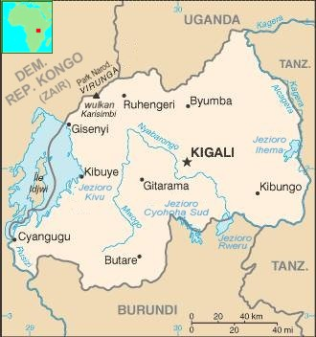
RWANDA
Wikimedia Commons: Public Domain

Slide 5
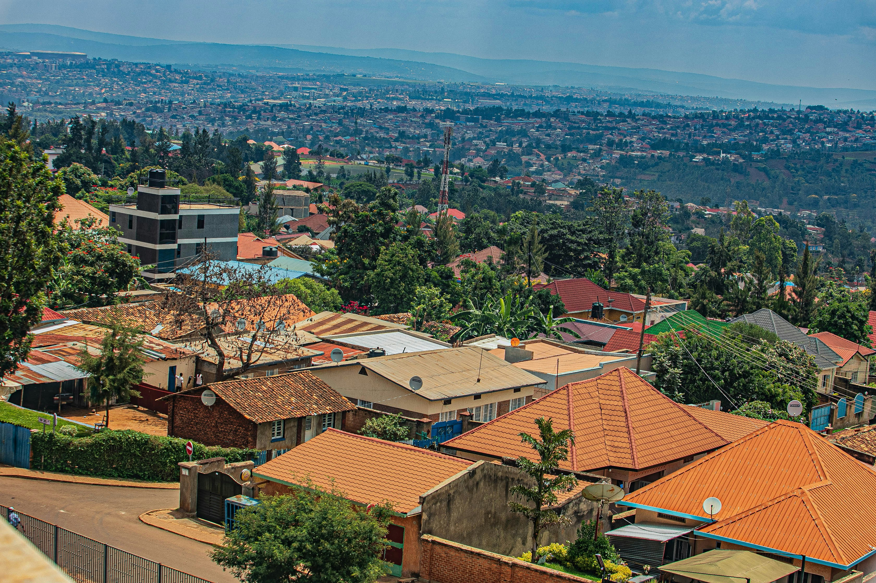
Kigali
(the capital city)
c
Unsplash: Protais Benjamin Mugenzi

Slide 6
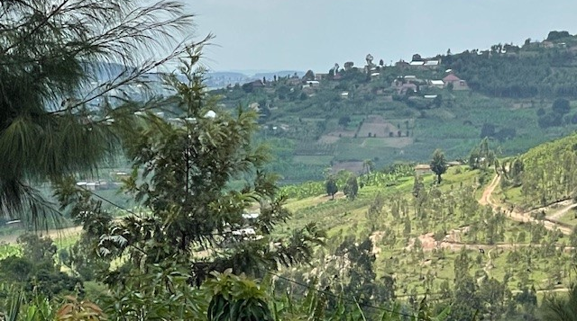
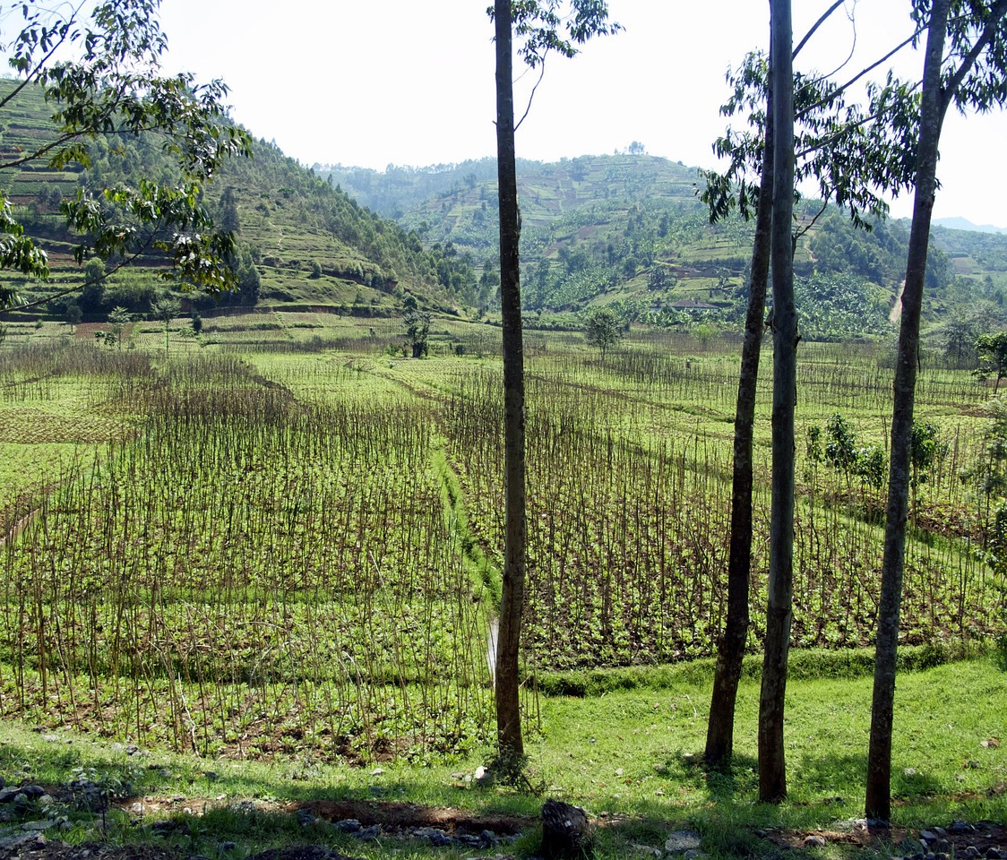
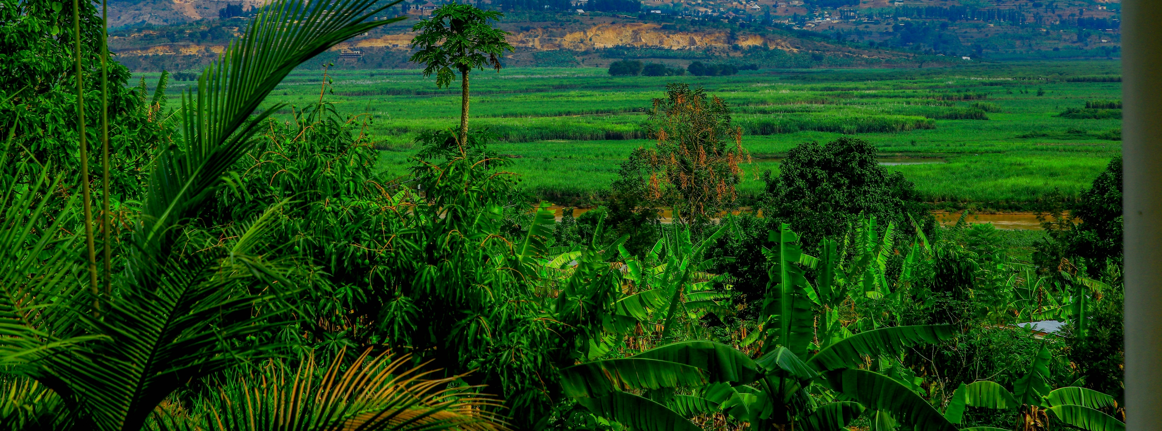
Rwanda’s nickname is -
“The Land of a Thousand Hills”
Photo: Pixaby
Photo: Jan Coates
Unsplash: Protais Benjamin Mugenzi

Slide 7
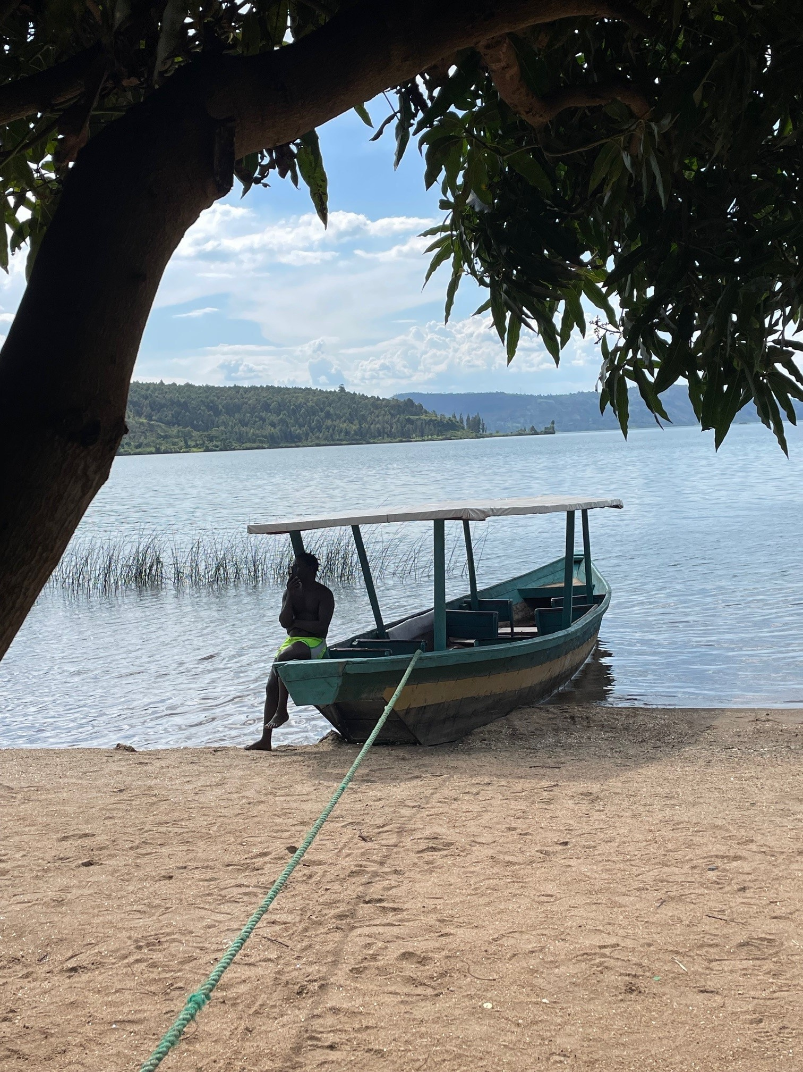
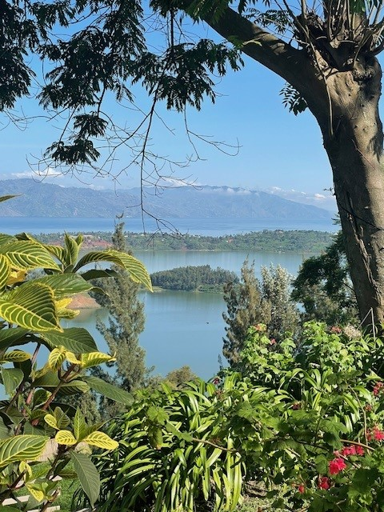
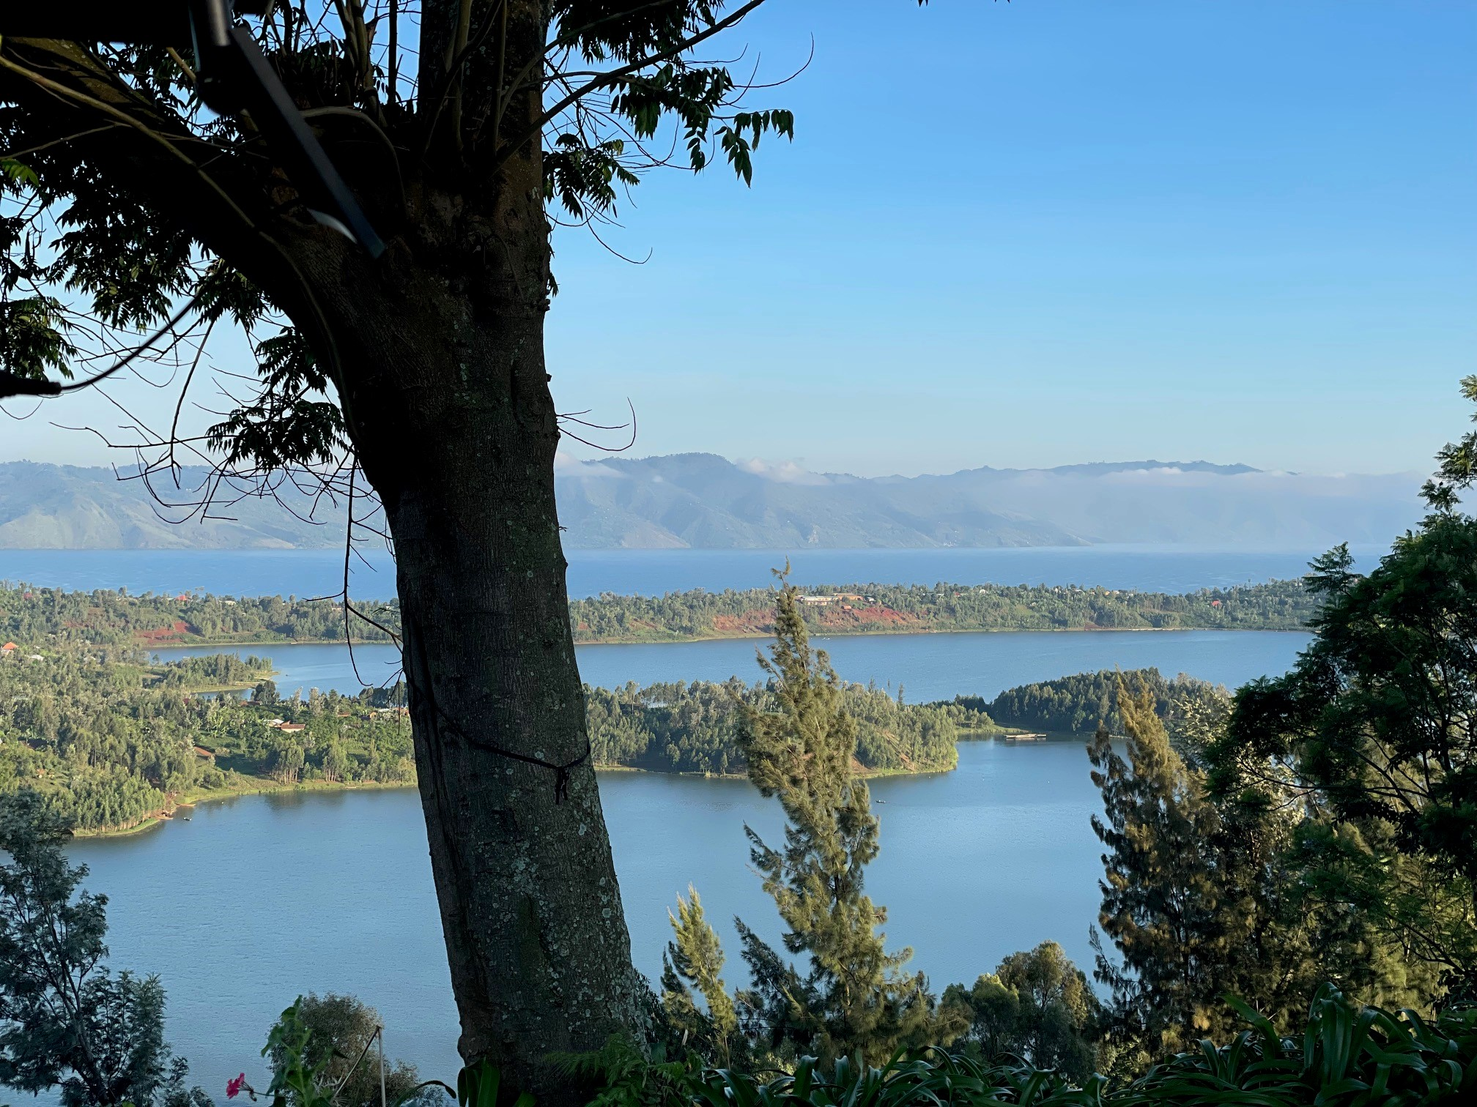
Beautiful Lake Kivu
Photos: Jan Coates

Slide 8
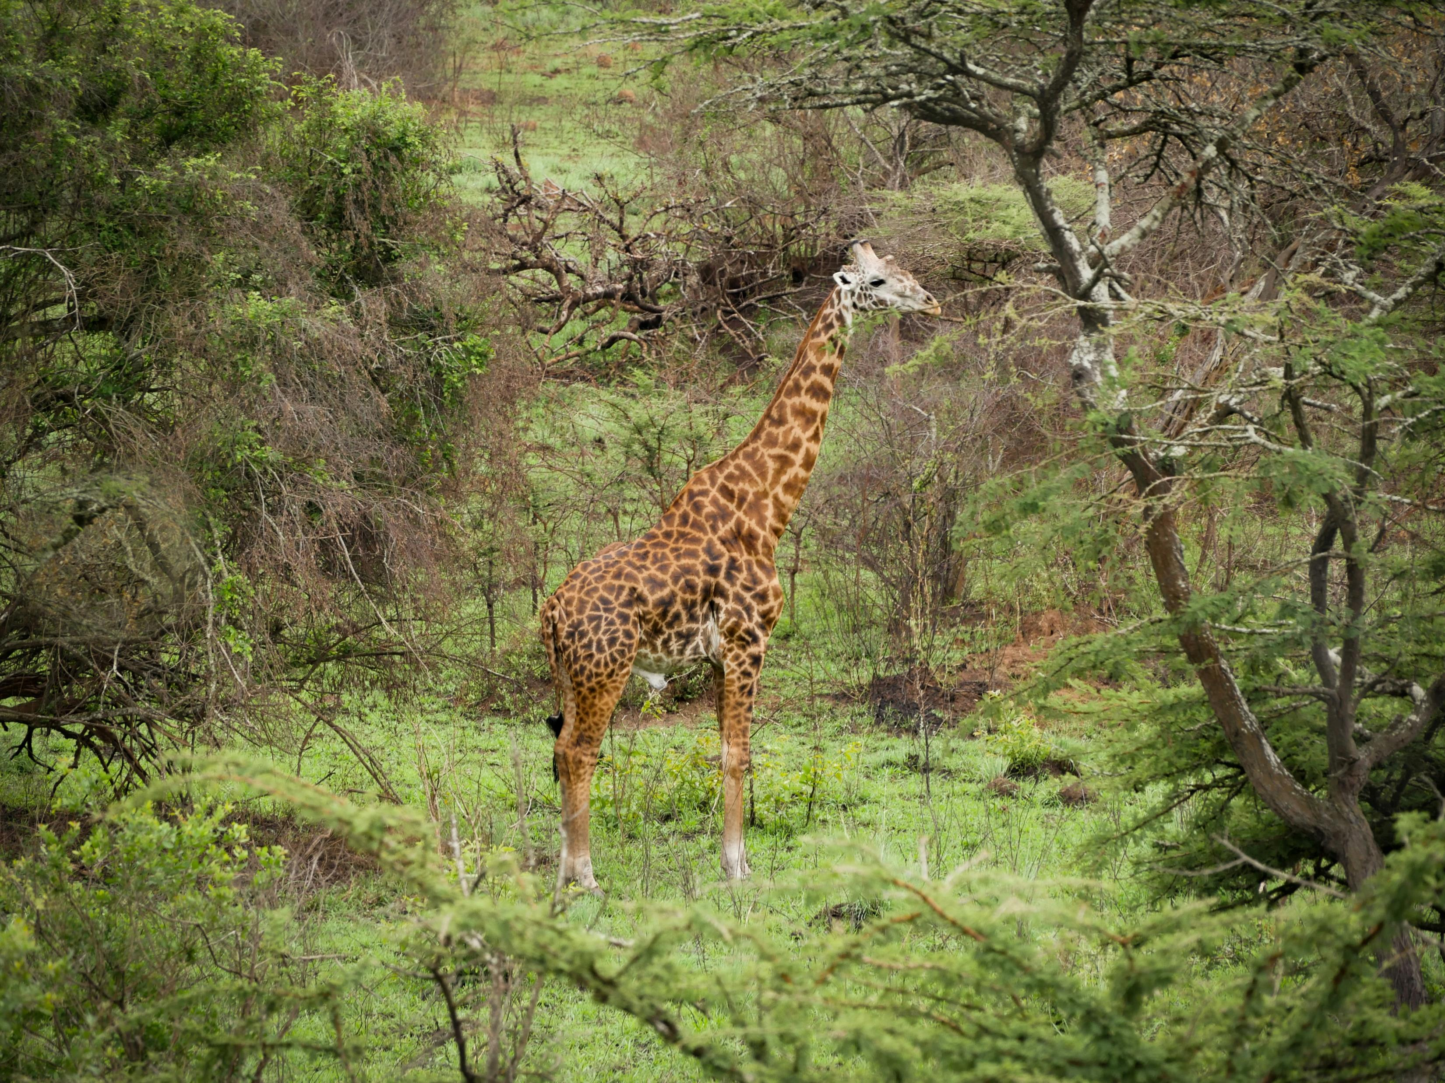
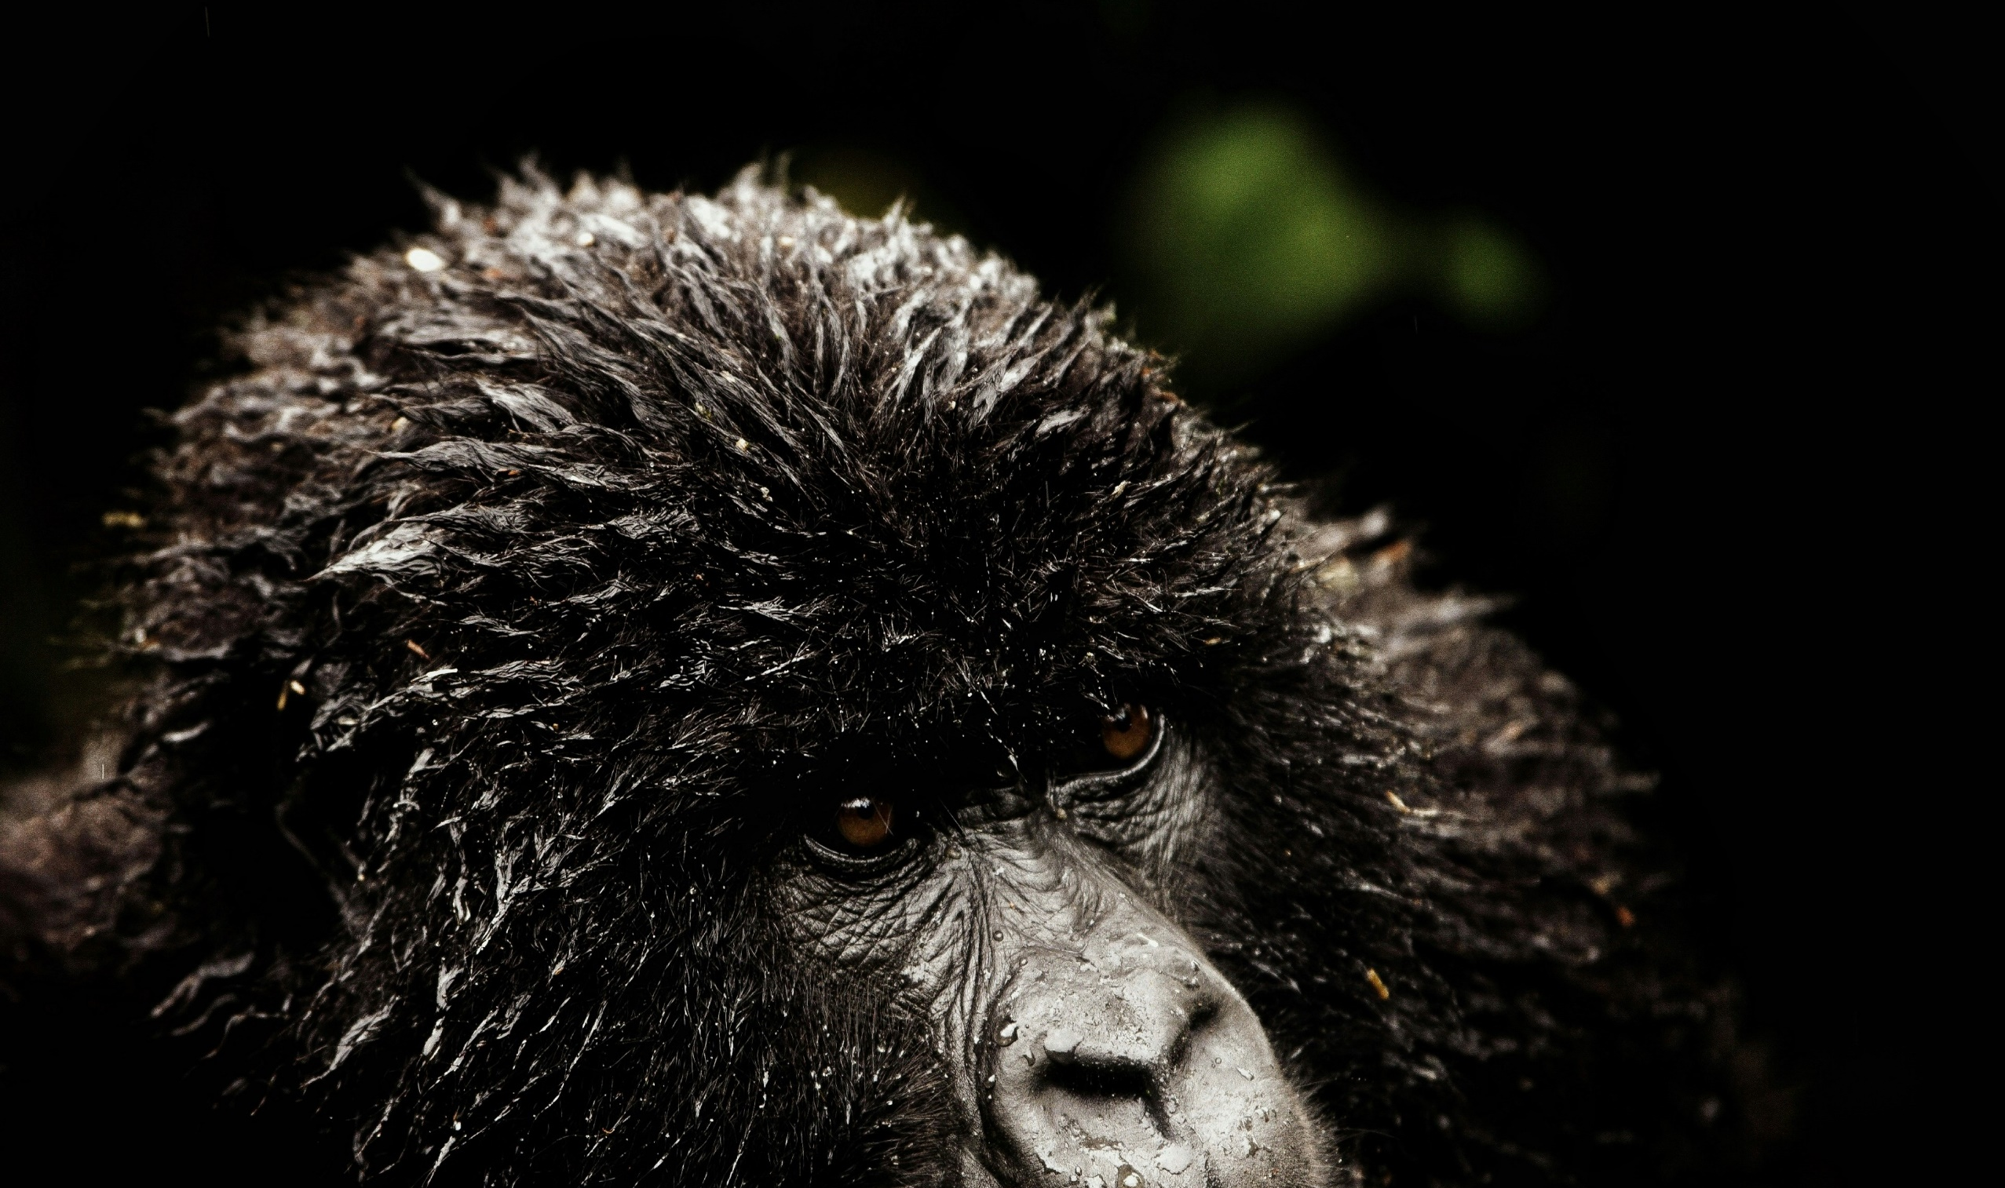
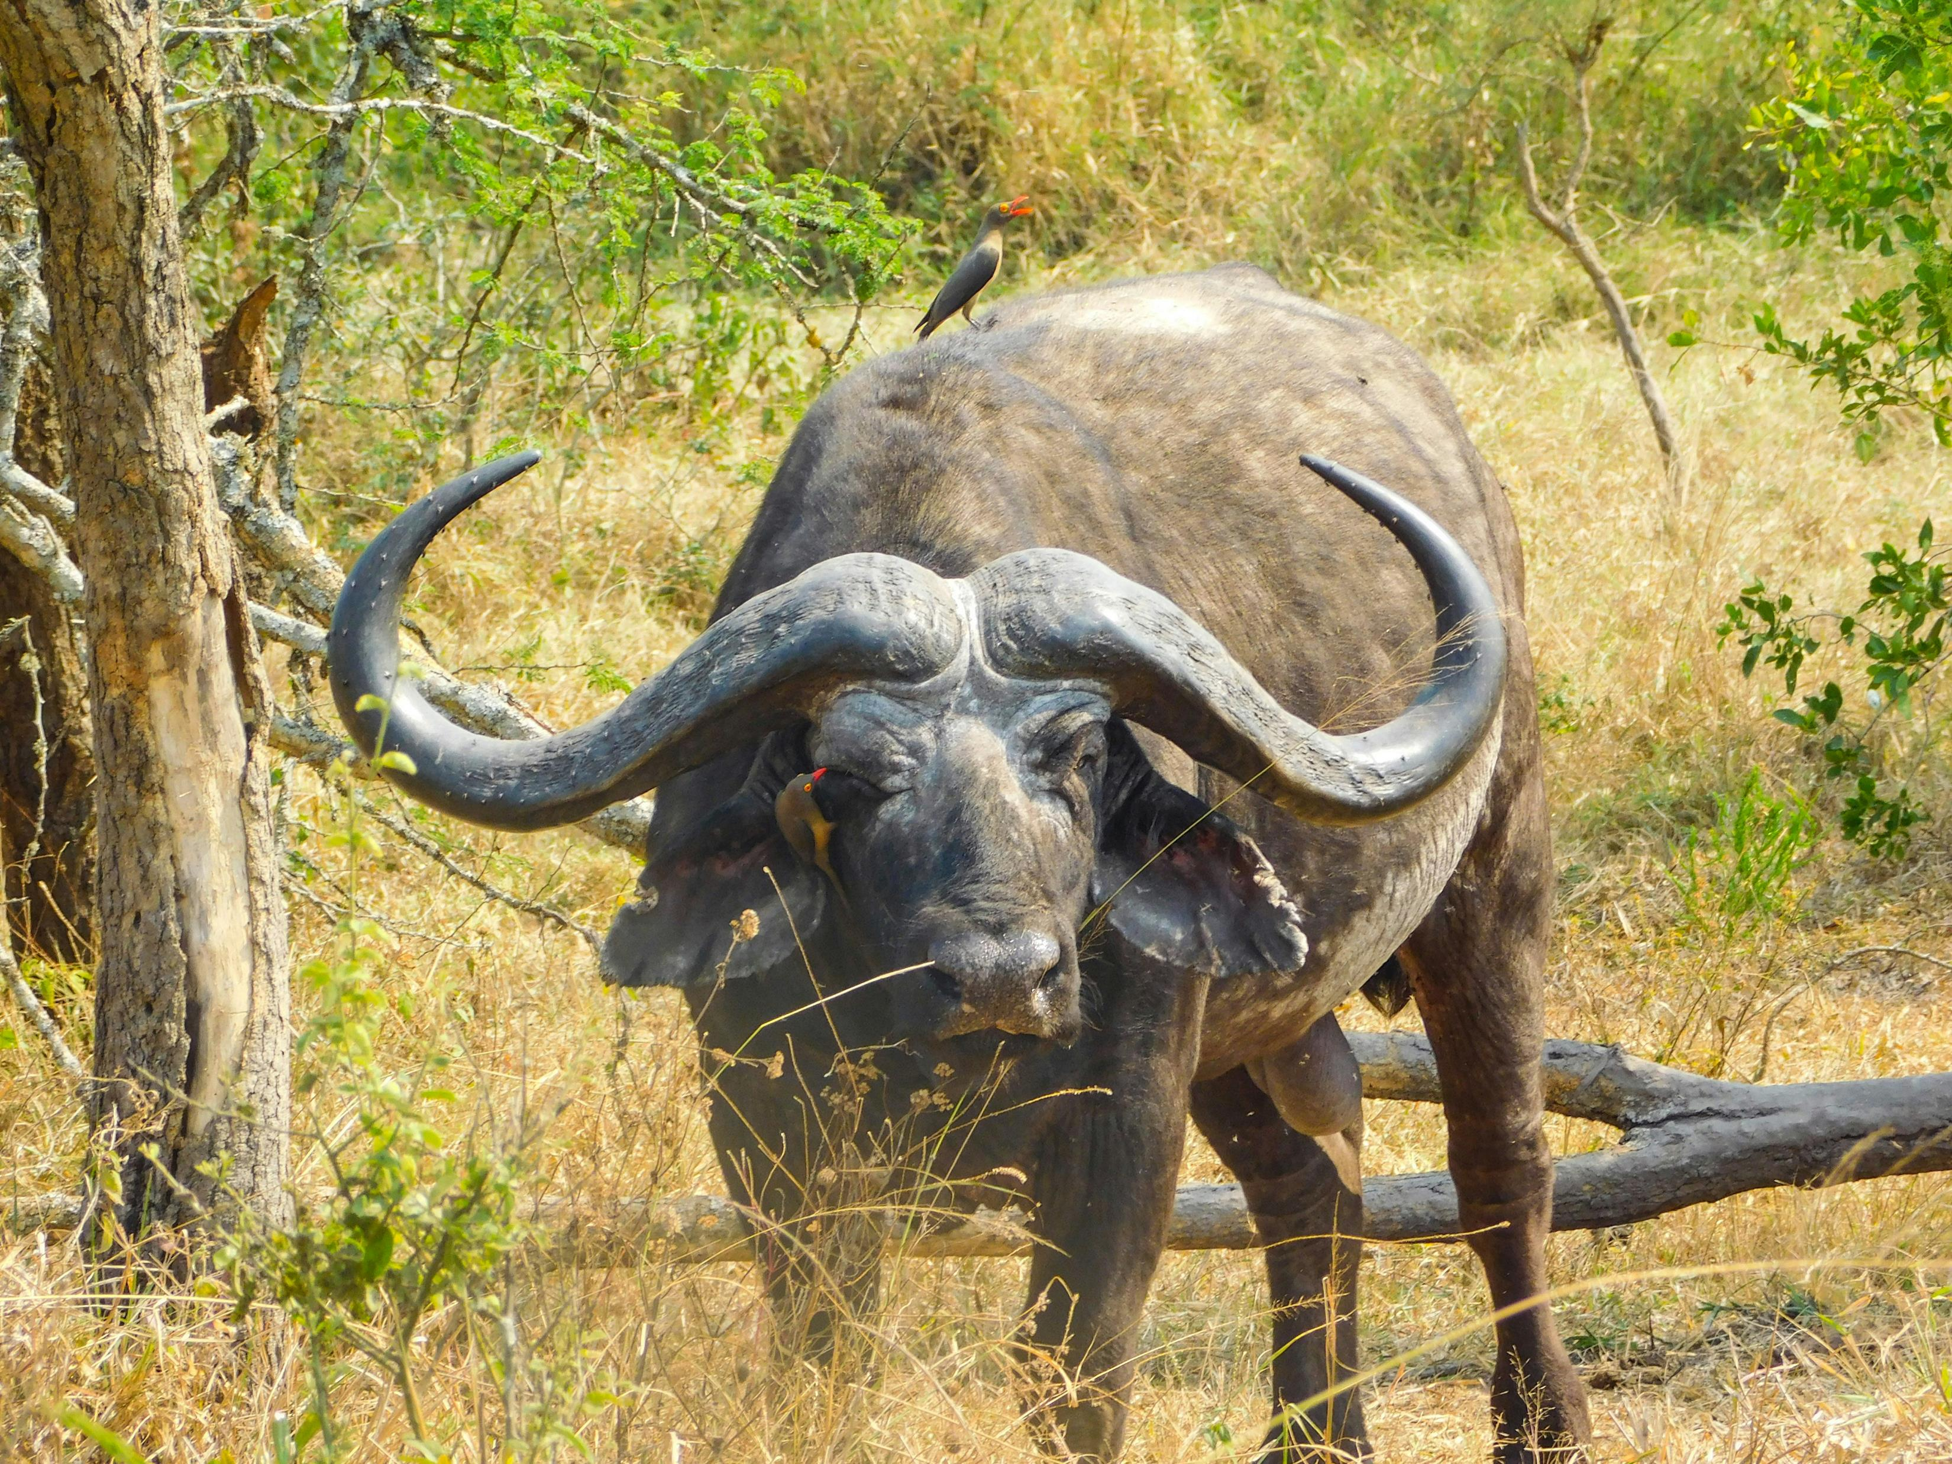
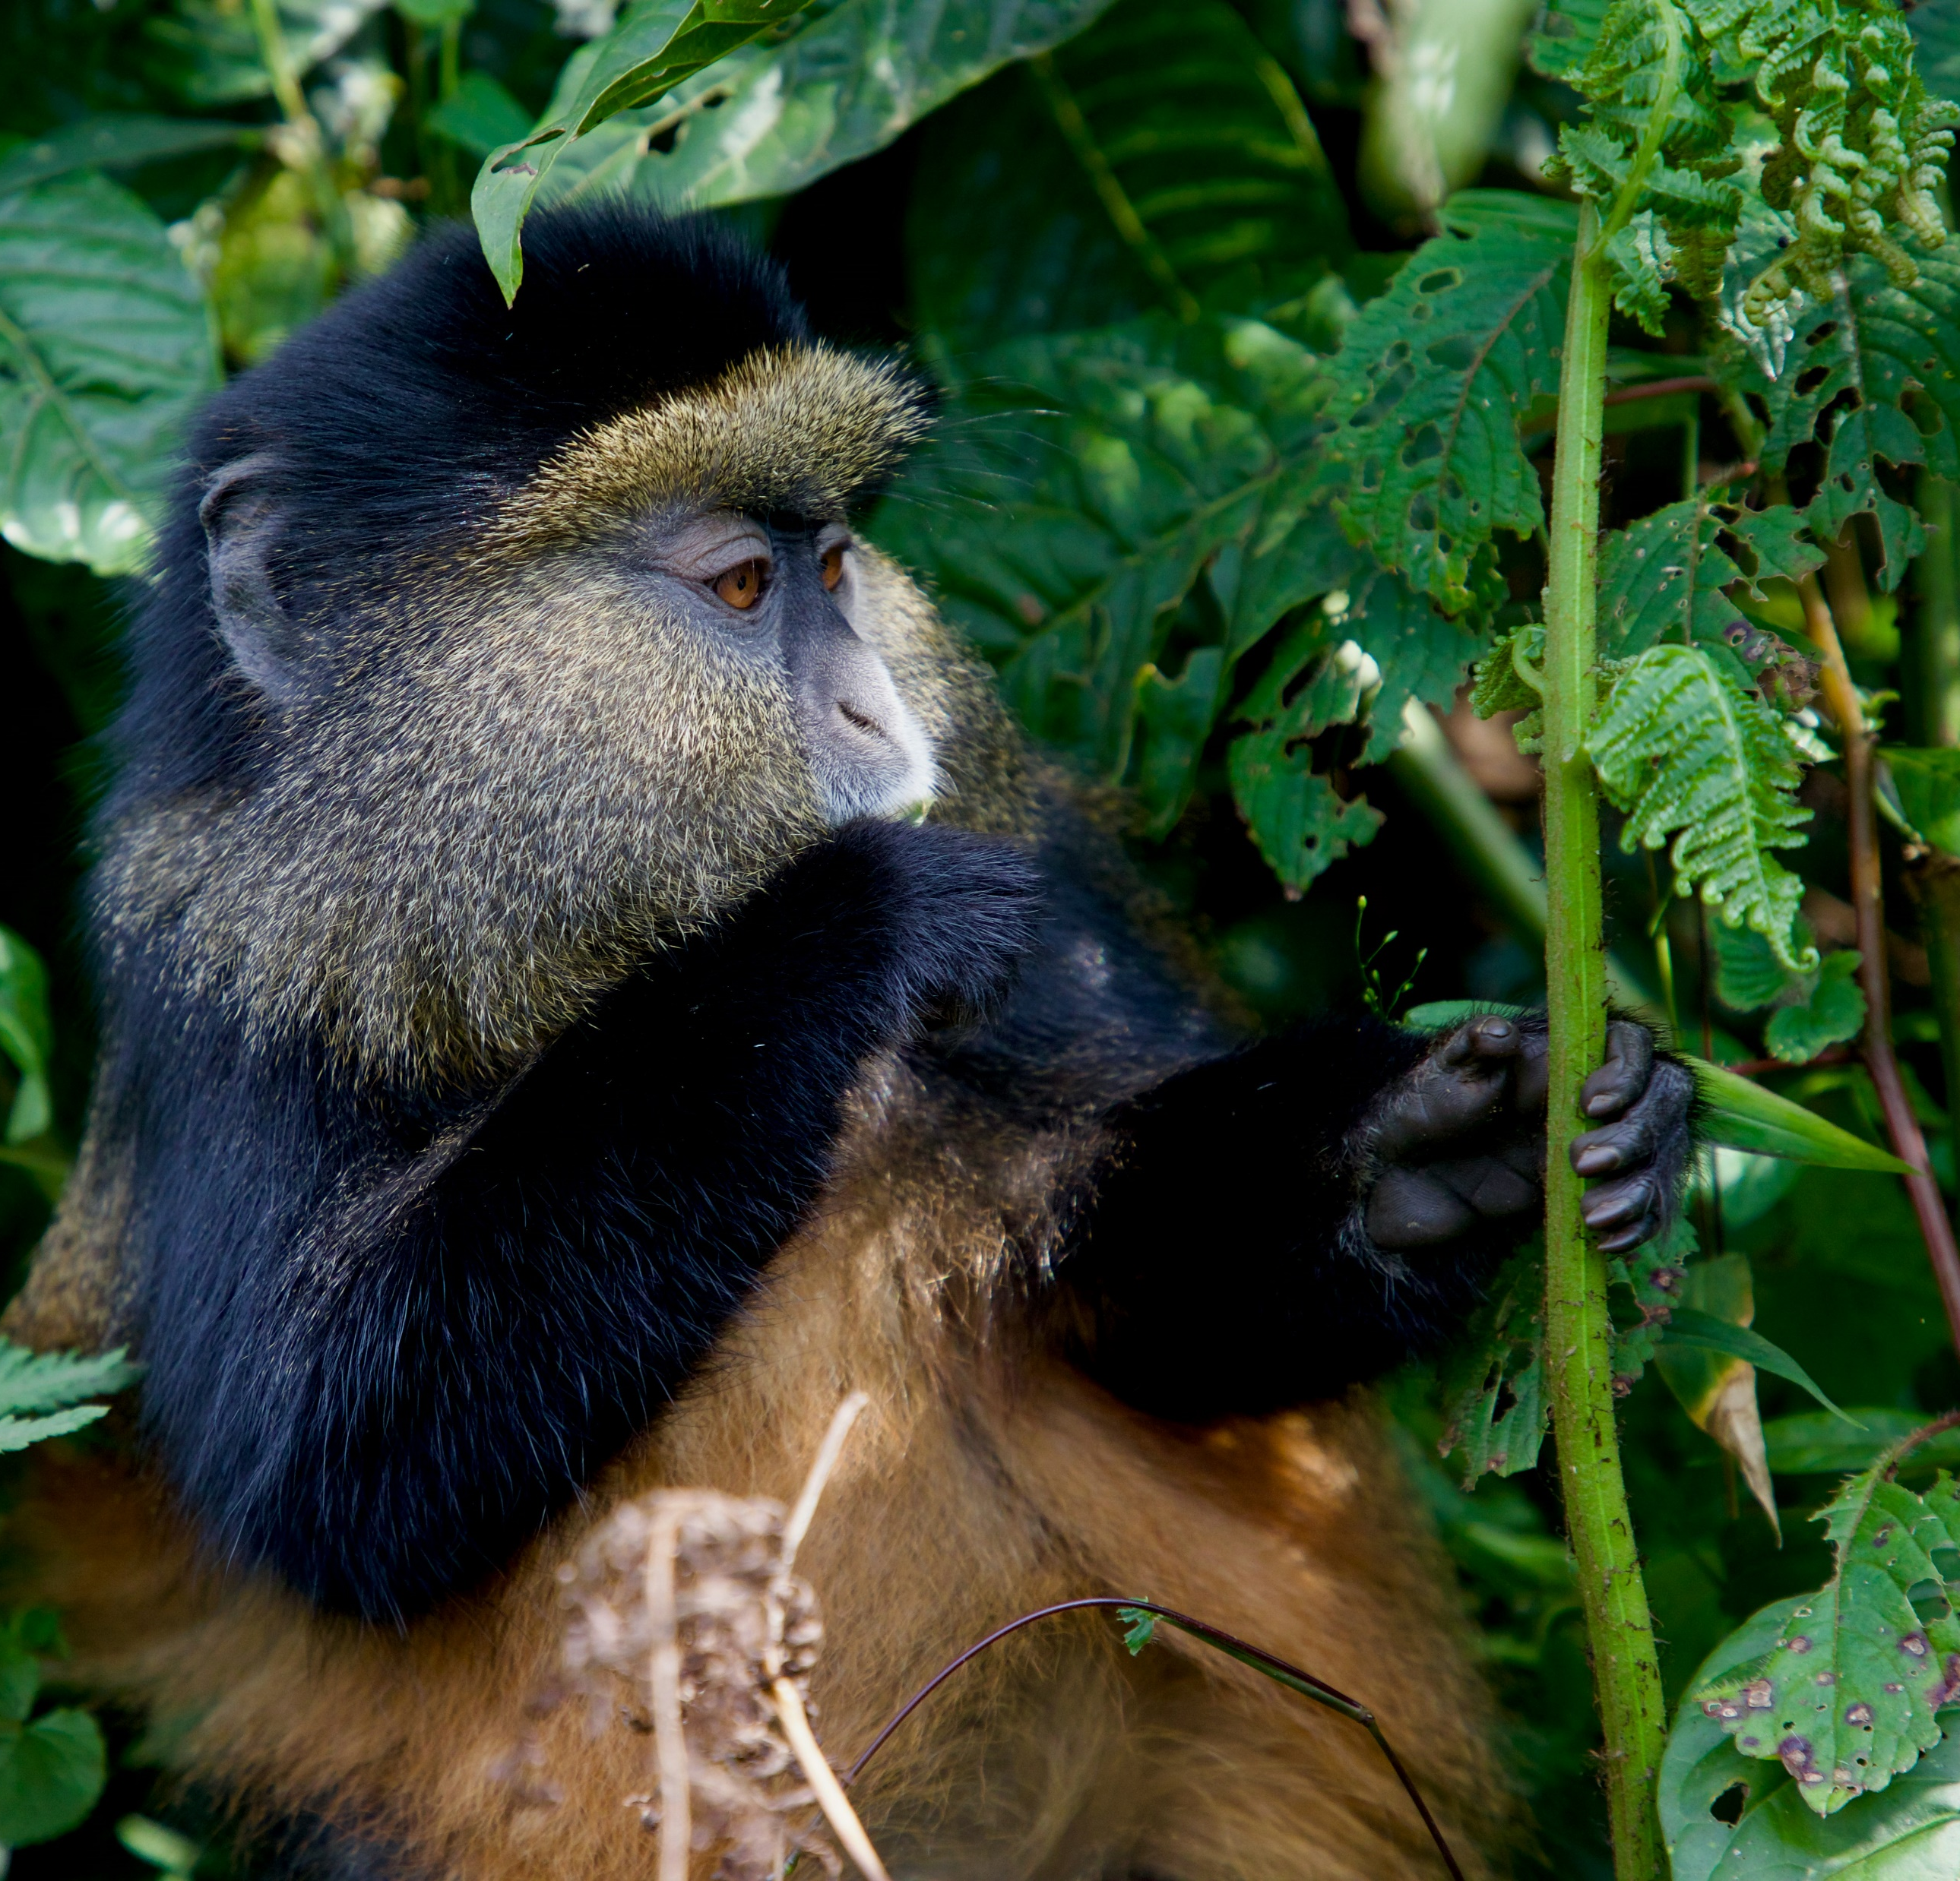
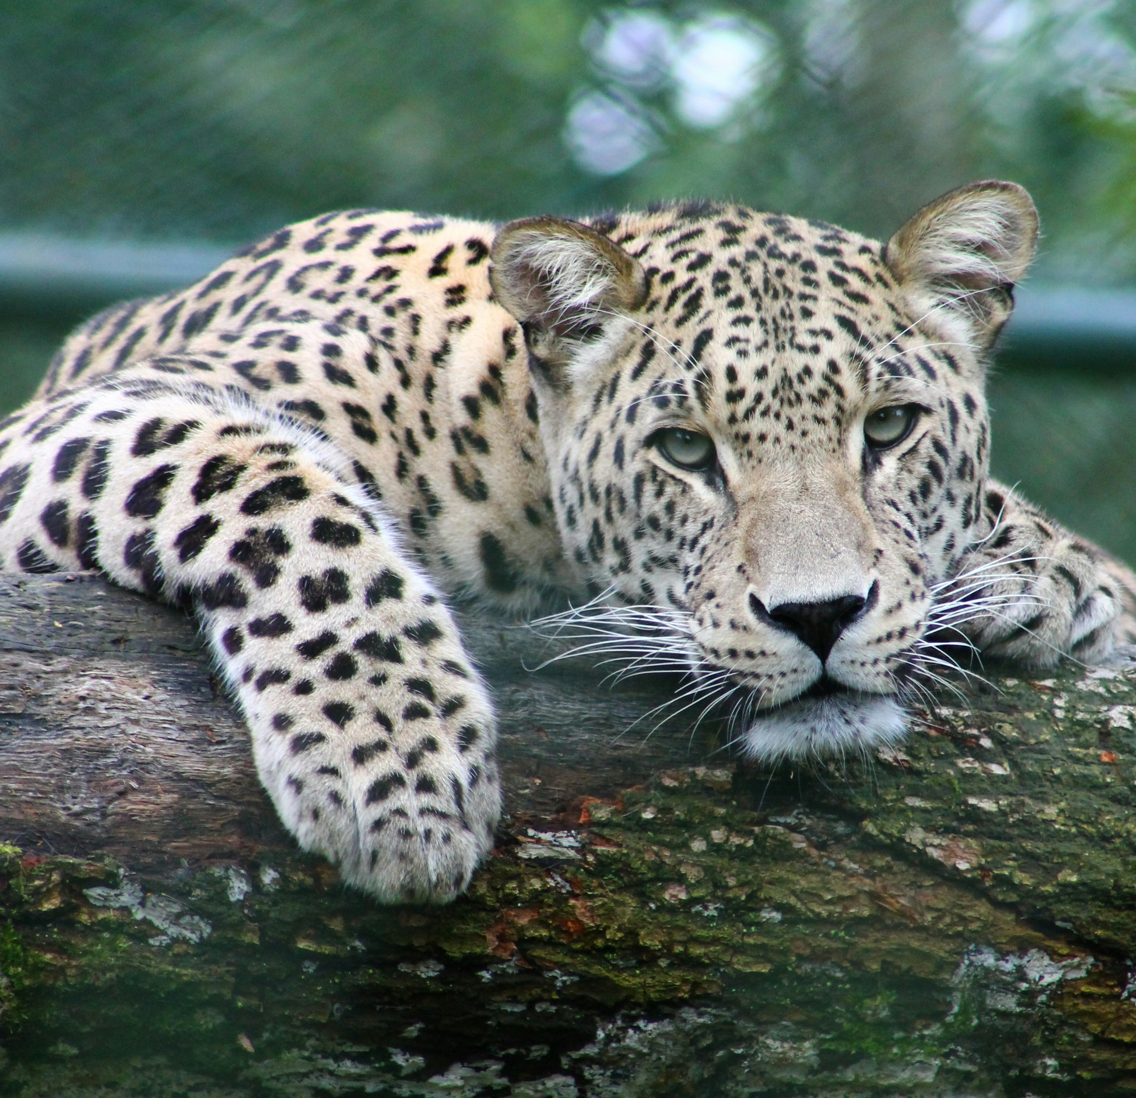
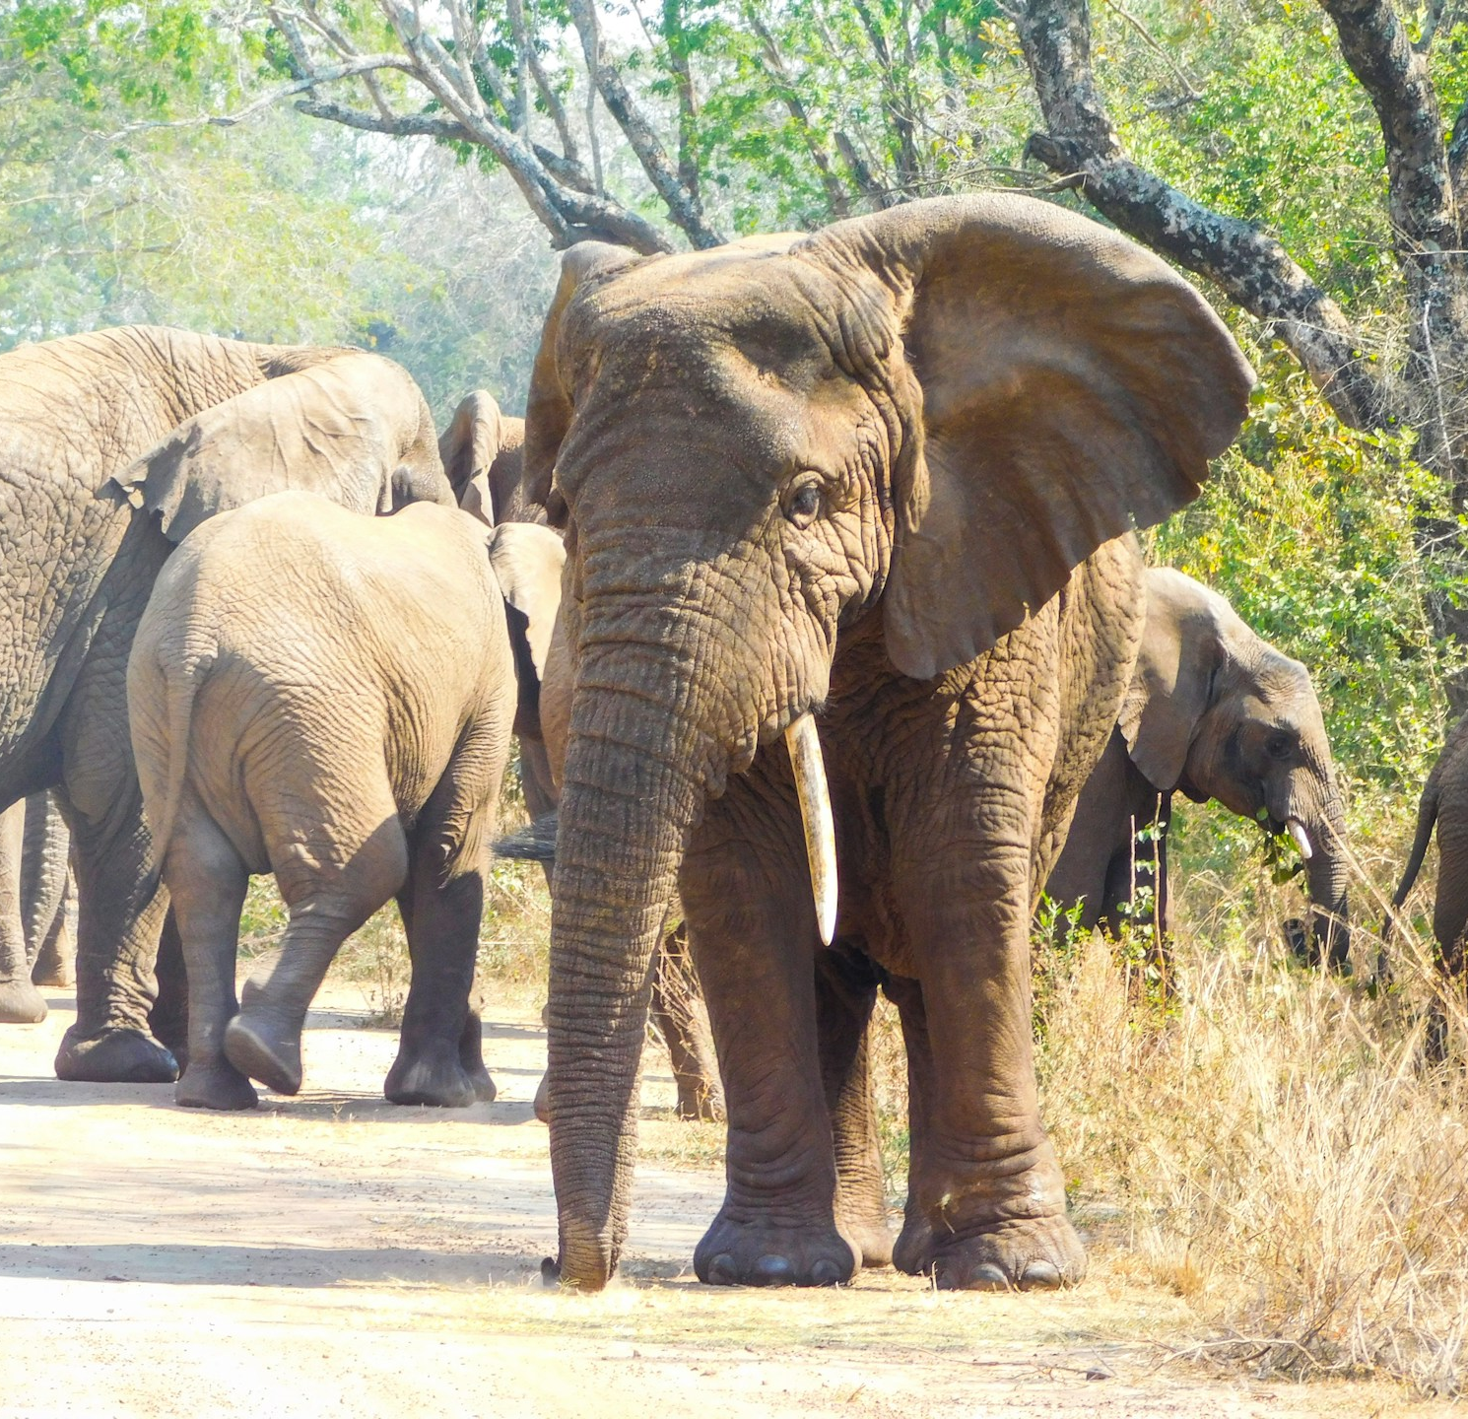
Amazing Wildlife
Unsplash: Max Christian
Mountain Gorilla
Unsplash: Jeremy Stewardson
Colobus Monkey
Unsplash: Emmy Shingir
Unsplash: Gwen Weustink
Unsplash: Emmy Shingir

Slide 9

Explore God’s Work

Slide 10
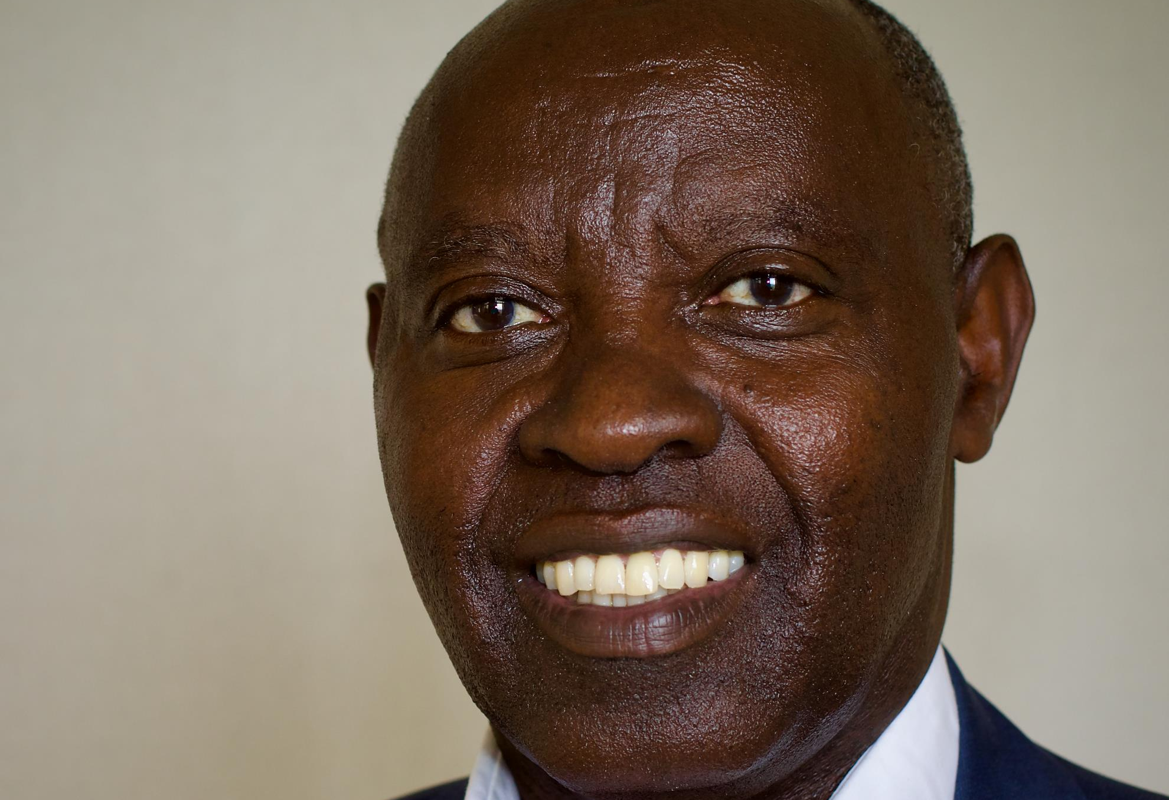
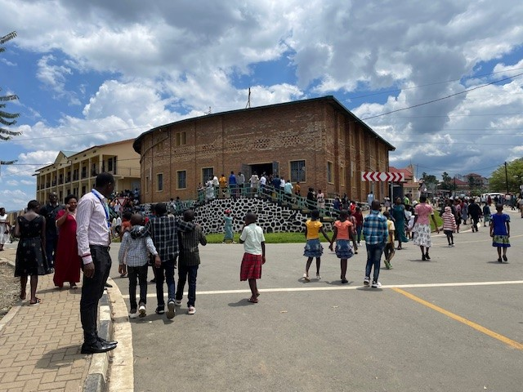
The Free Methodist Church in Rwanda
Bishop Samuel
Photo: Kevin Austin
Photo: Jan Coates

Slide 11
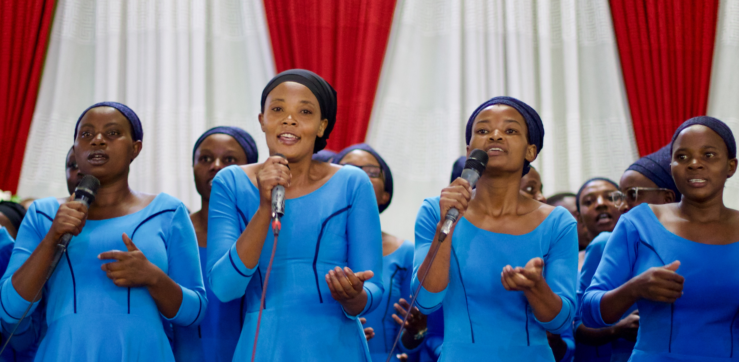
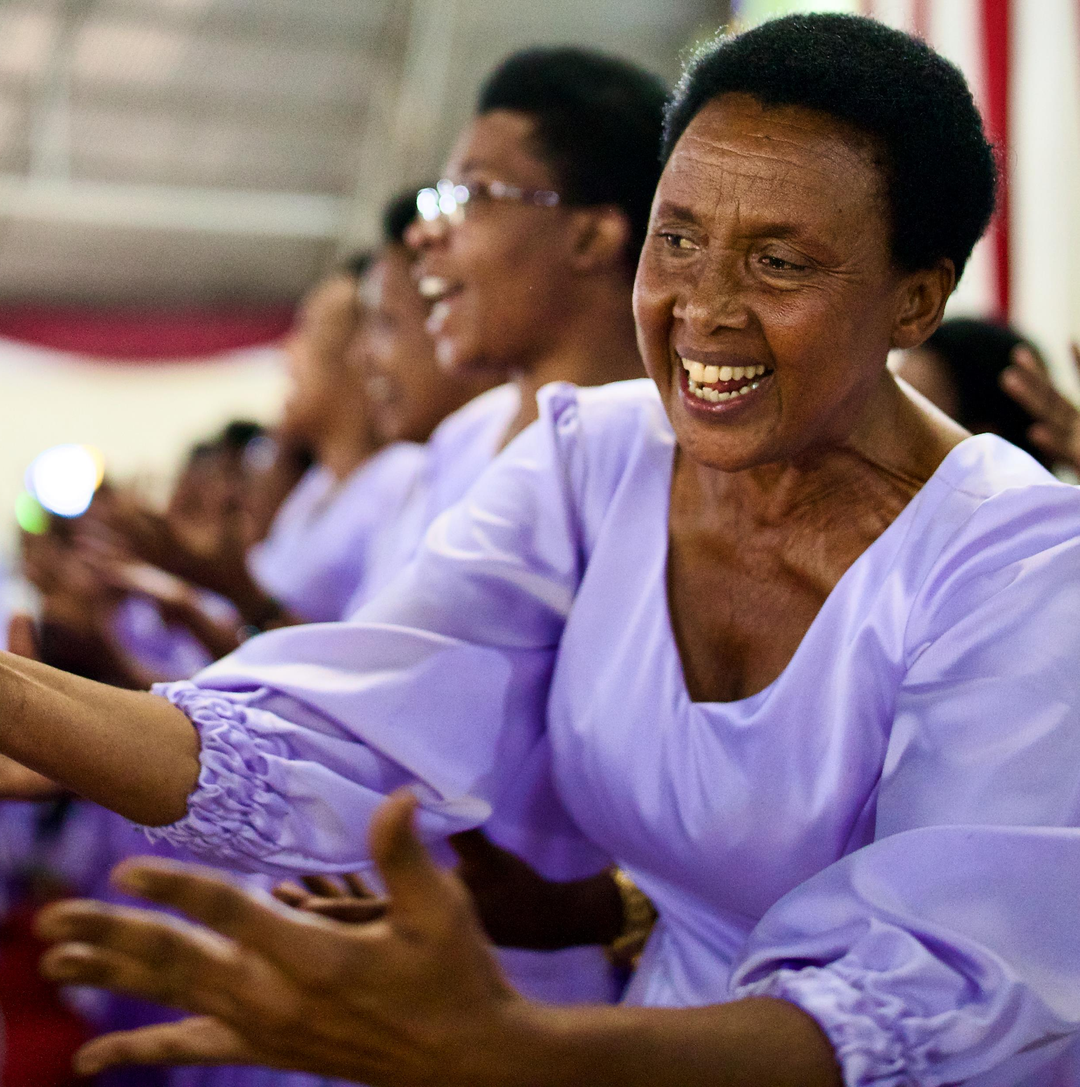
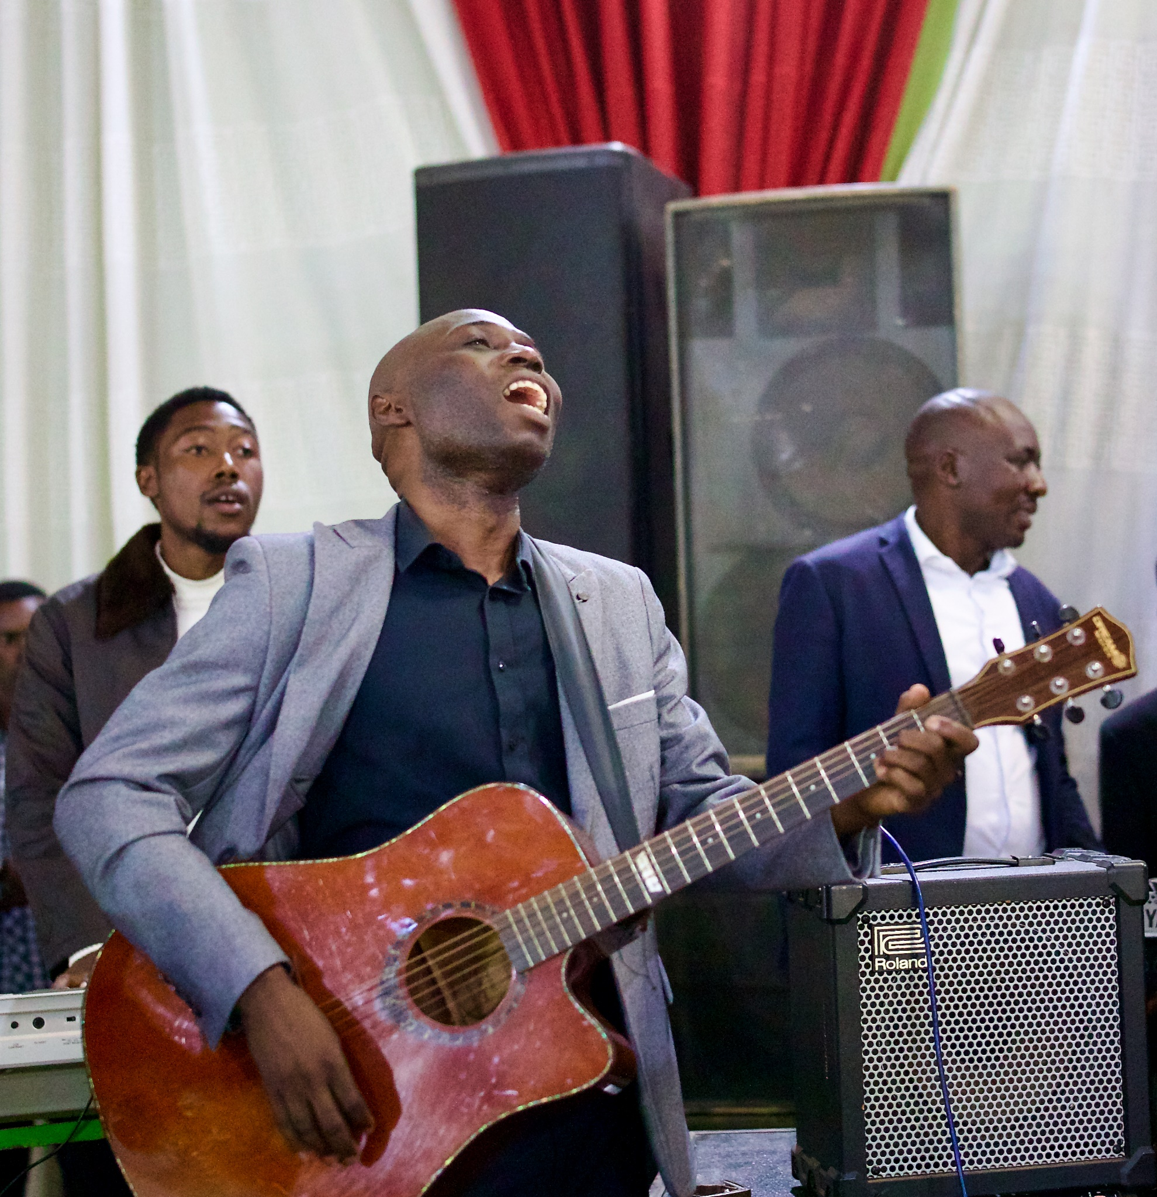
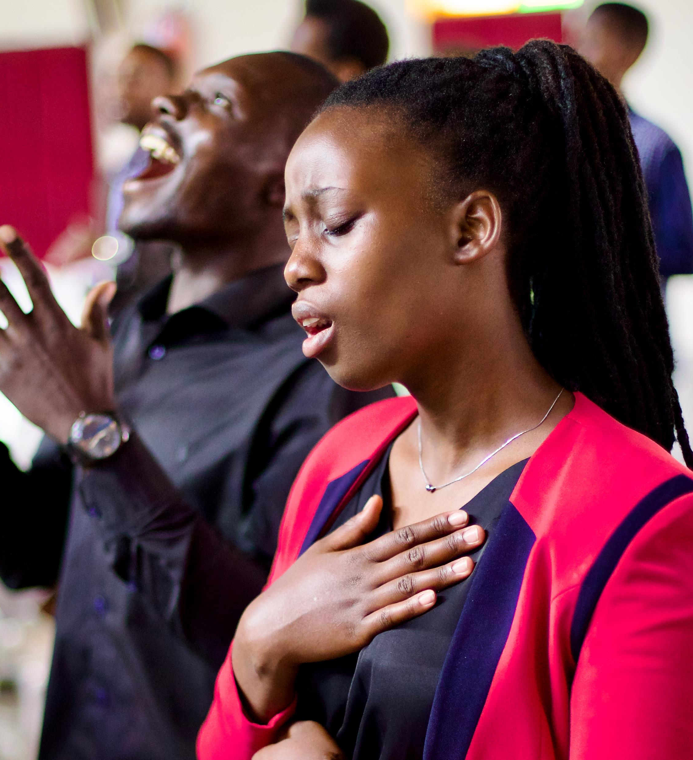
A Worshiping Church
Photos: Kevin Austin

Slide 12
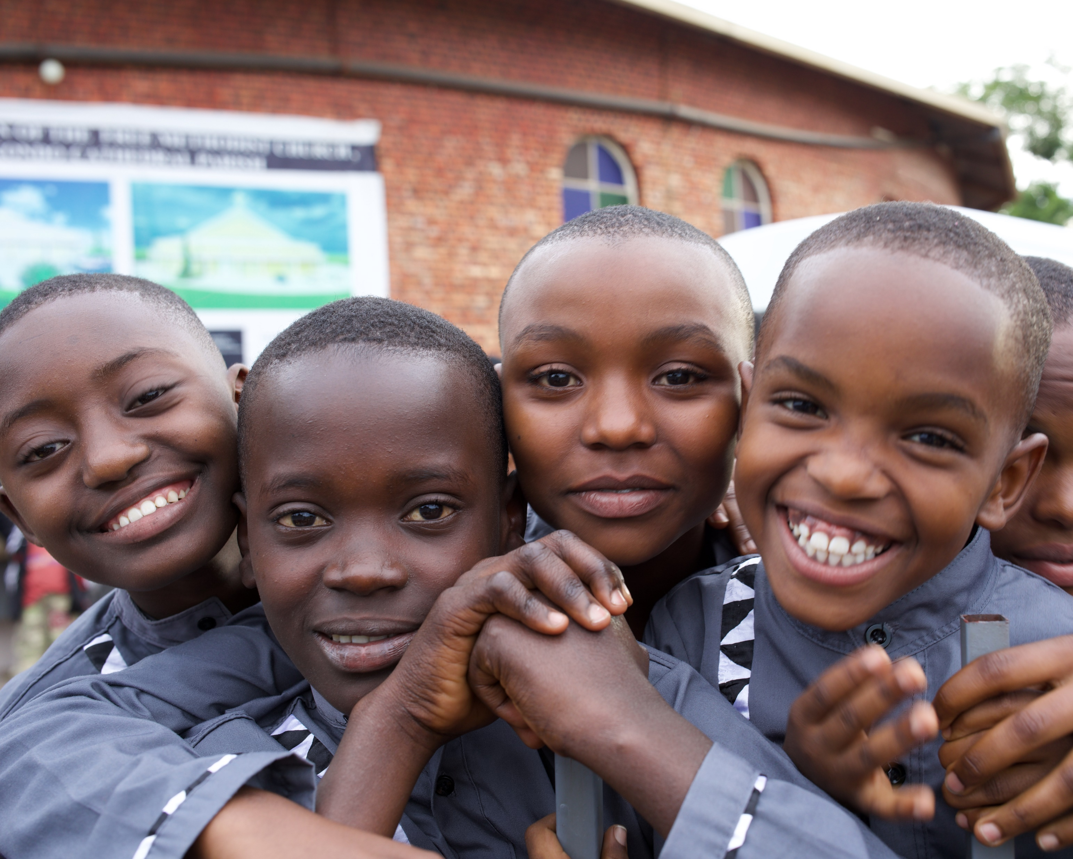
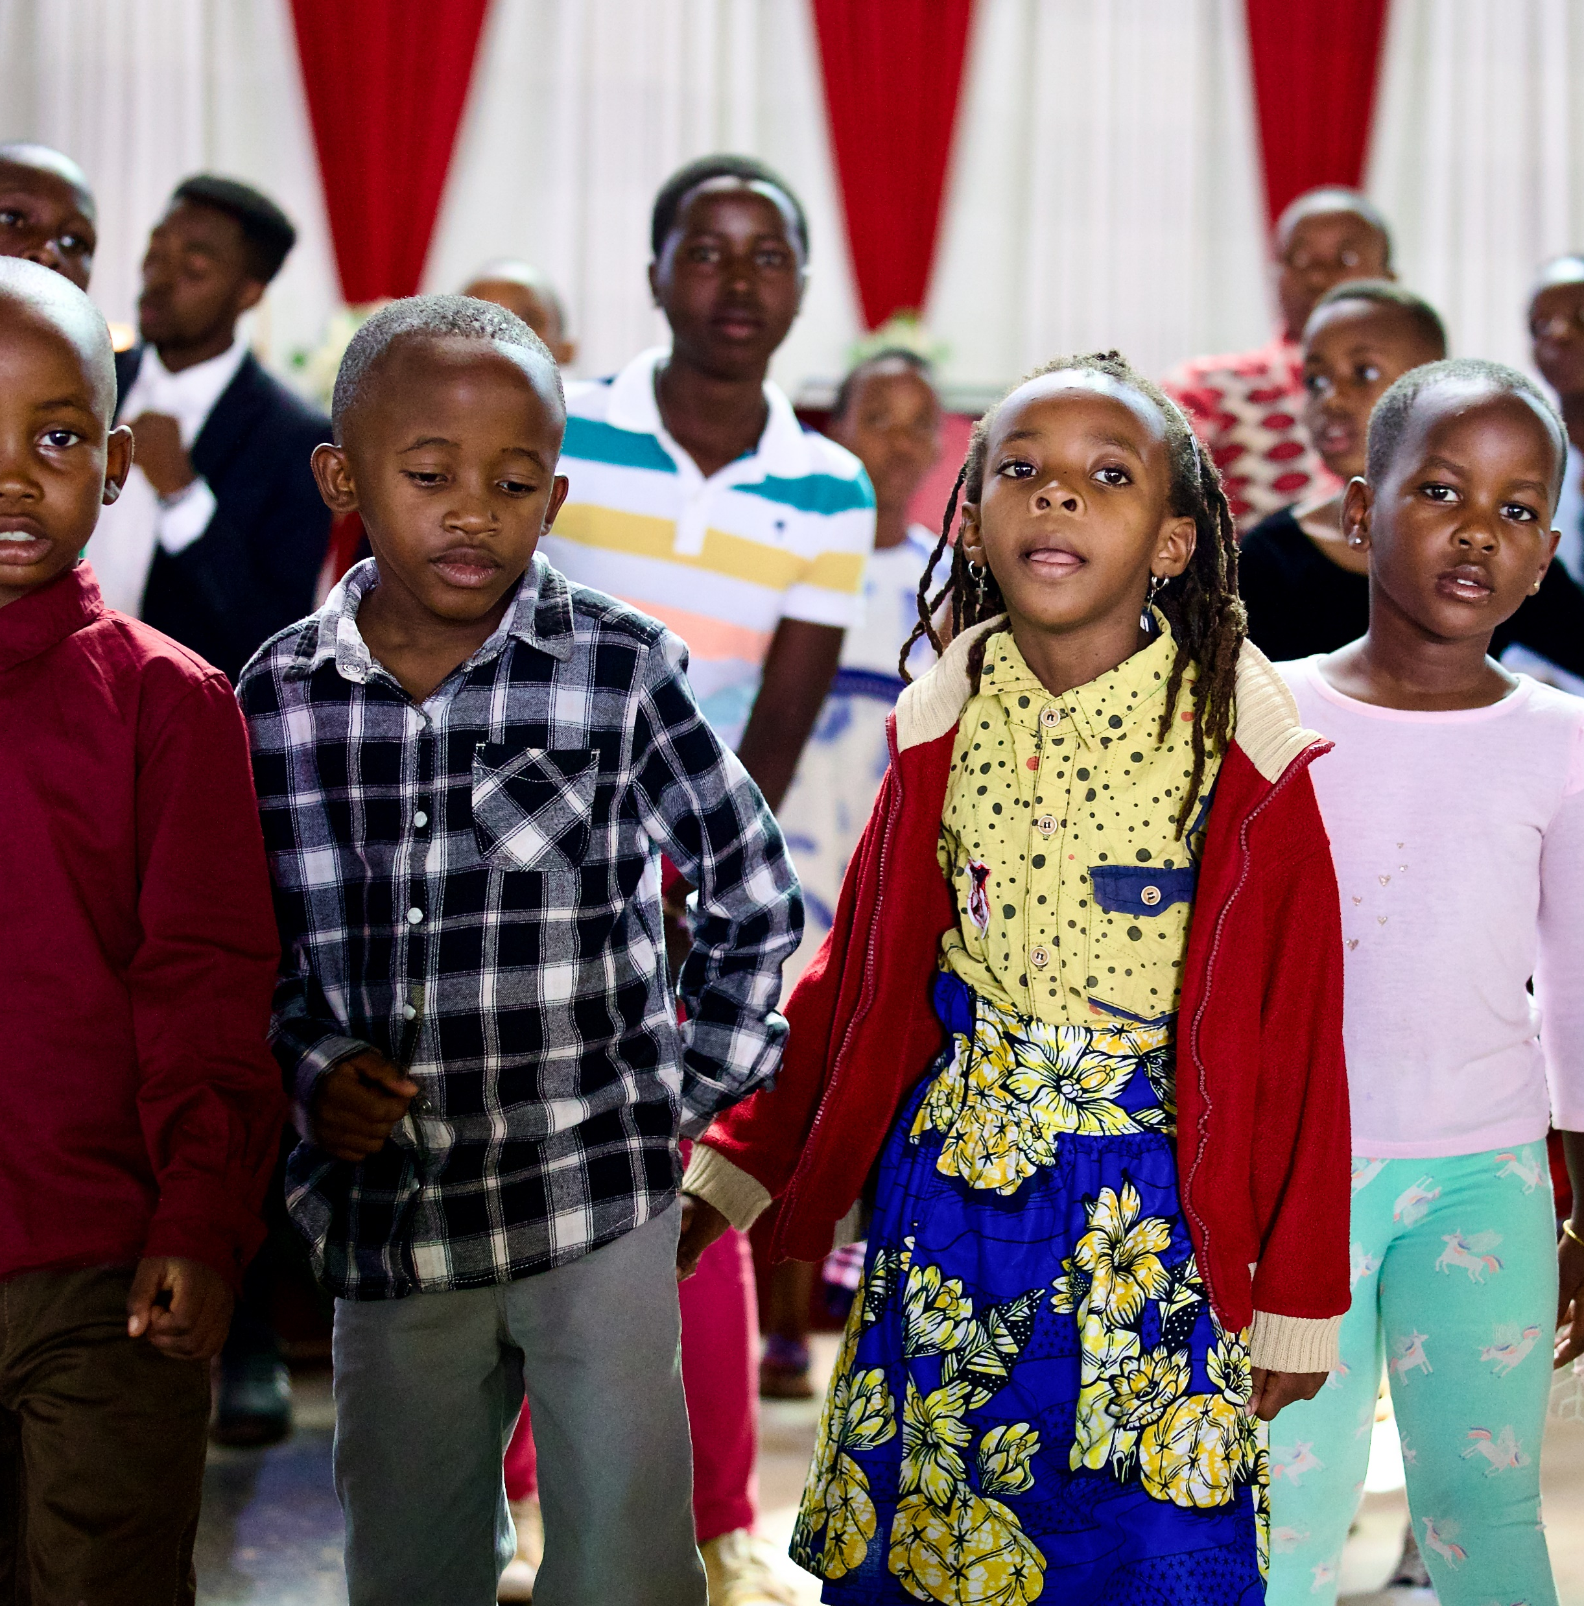
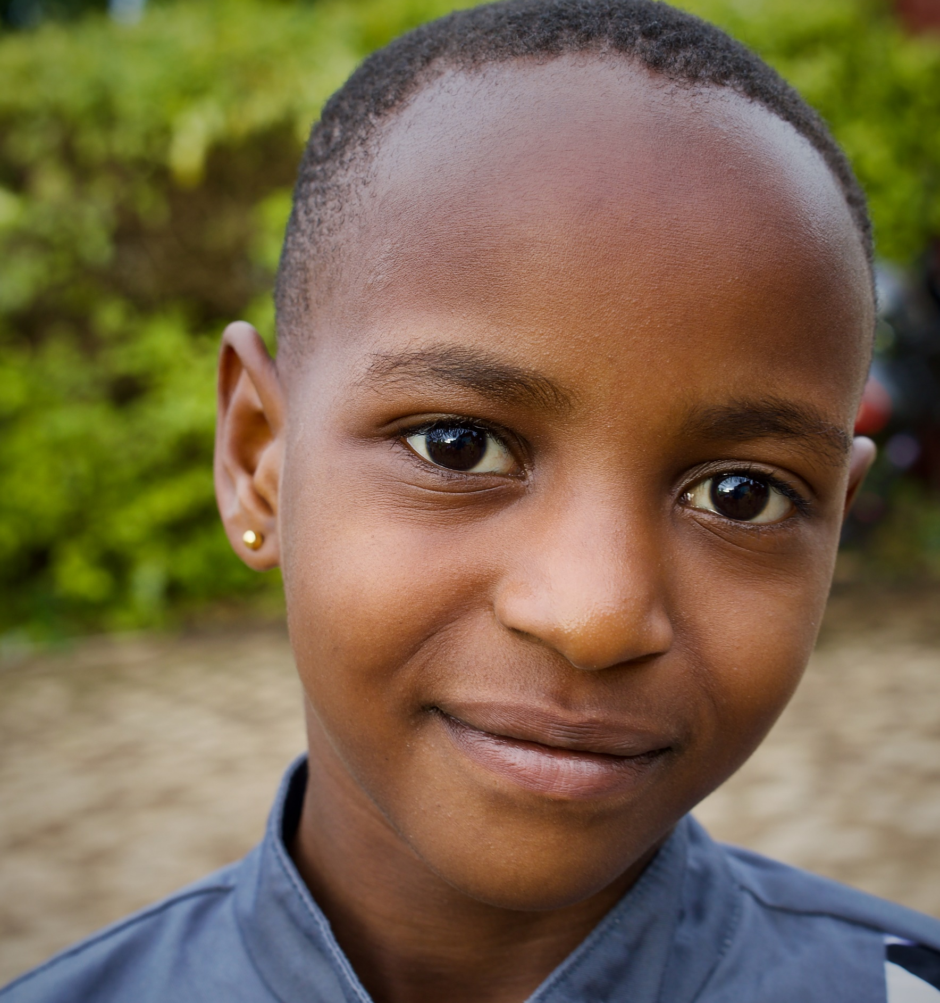
International Child Care Ministries
Photos: Kevin Austin

Slide 13
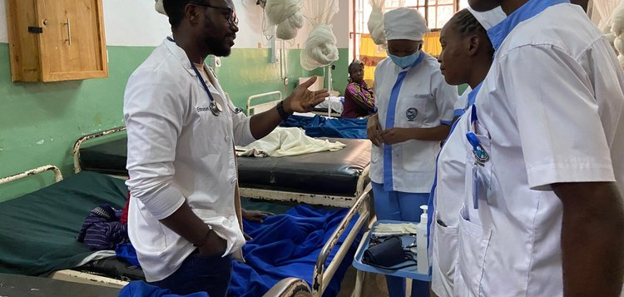
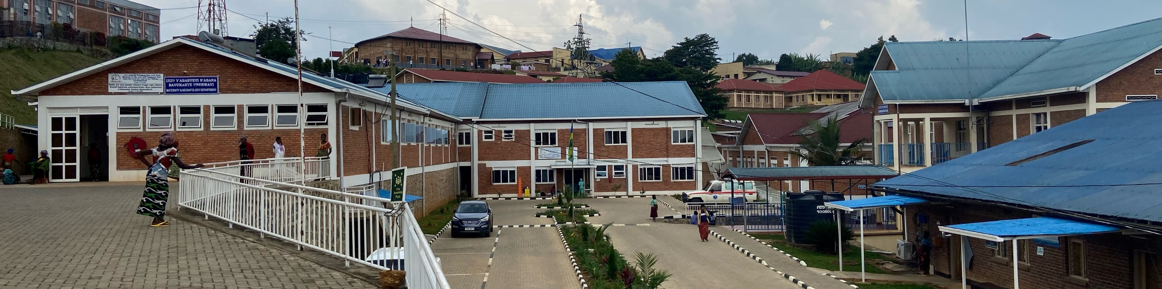
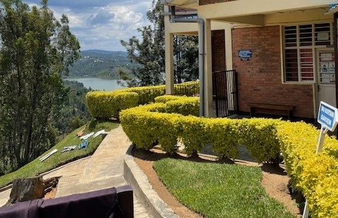
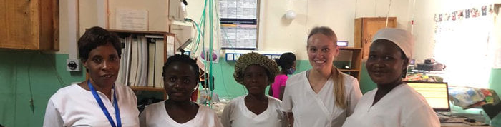
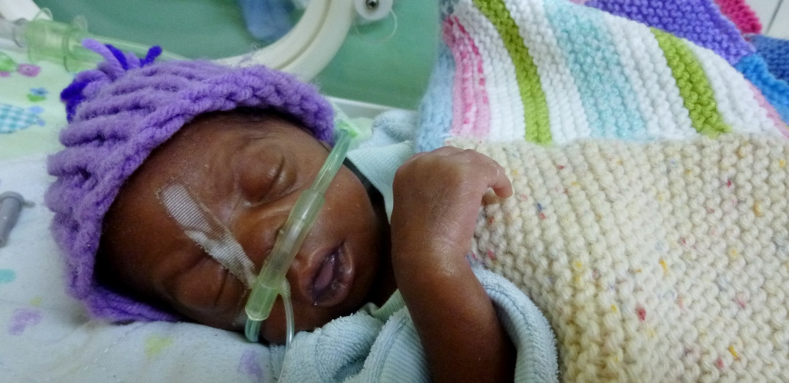
Kibogora Hospital
Photos: FMWM Missionaries

Slide 14

Adventure Story

Slide 15
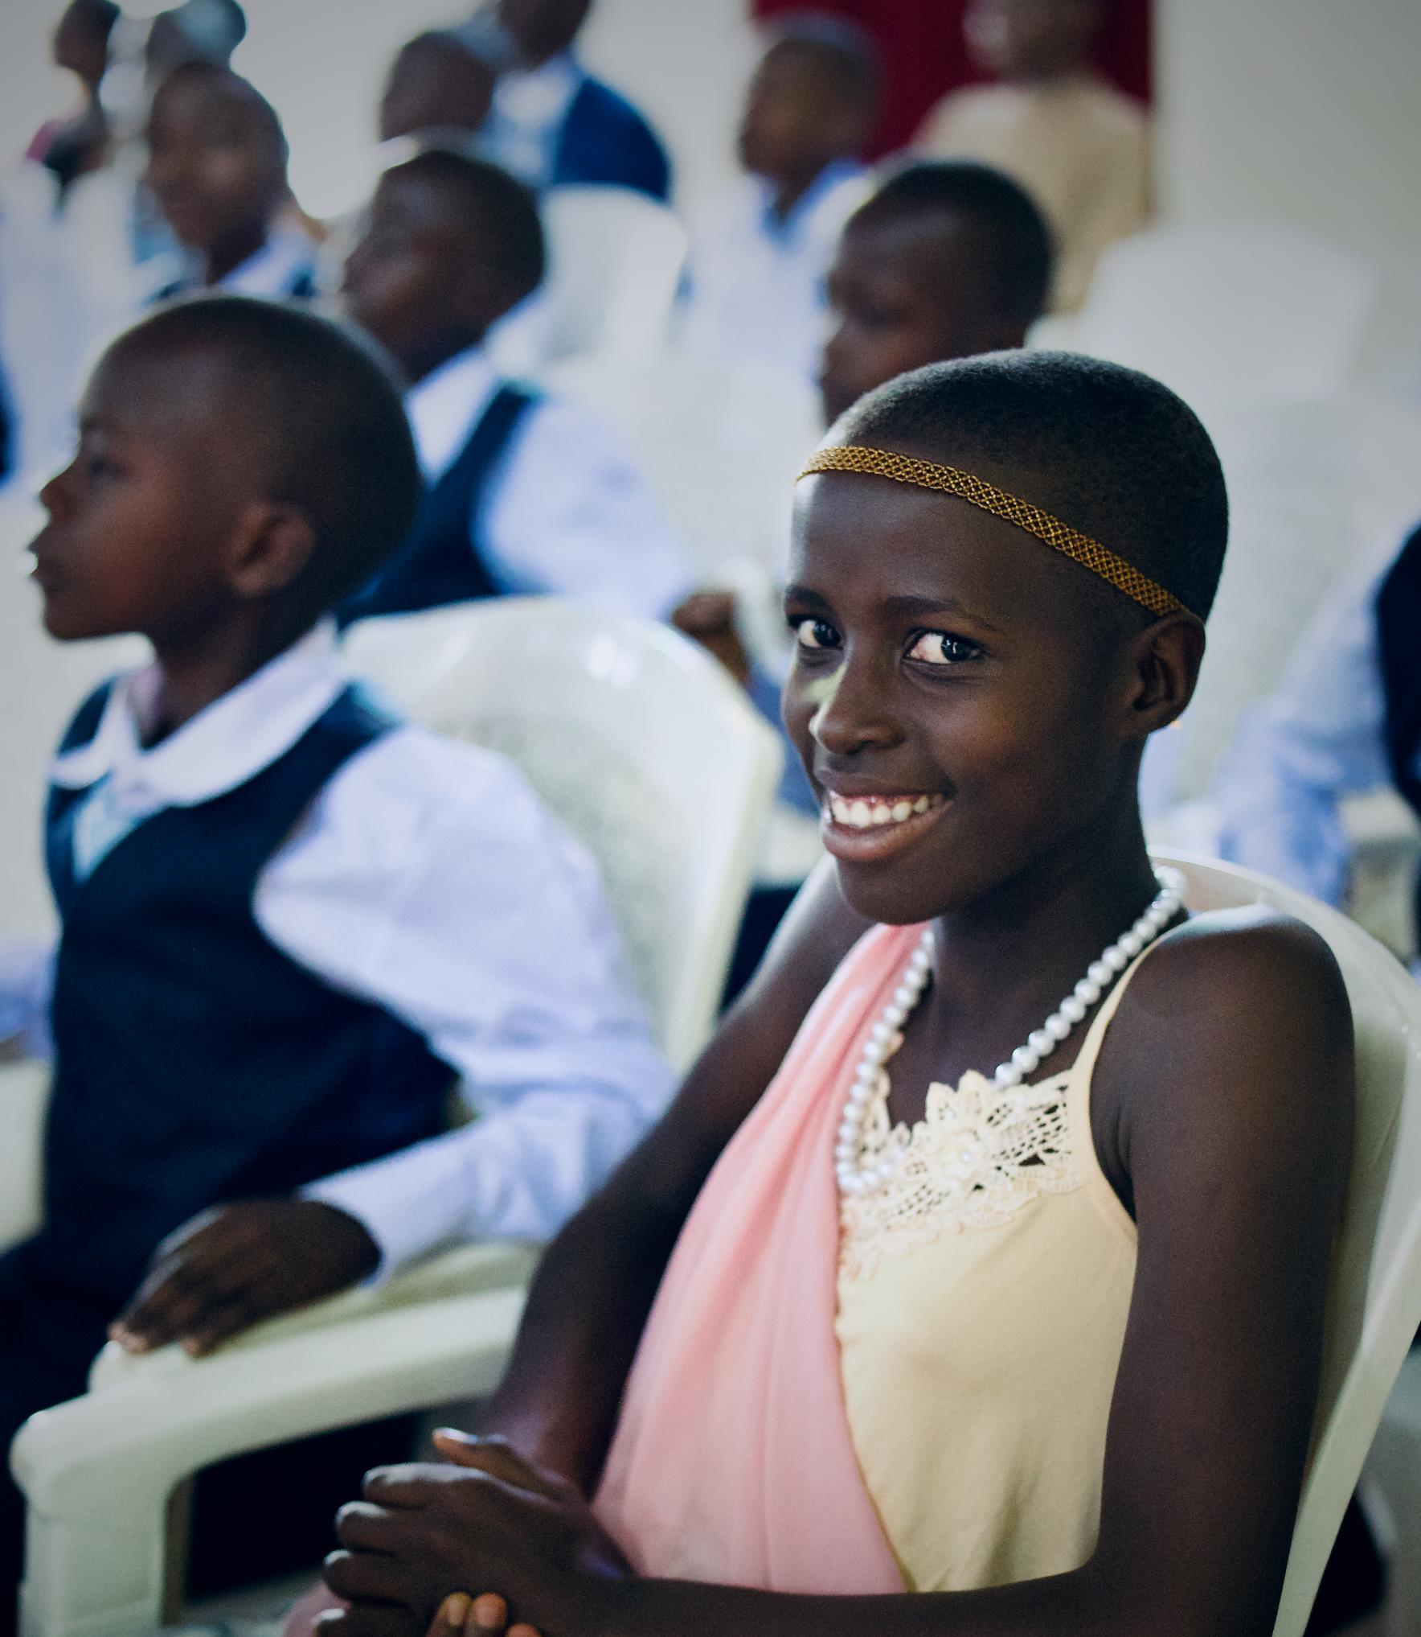
Donocian
Has a New Song of Joy
* Photo is not the actual person.
Photo:Kevin Austin

Slide 16

People on Adventure

Slide 17
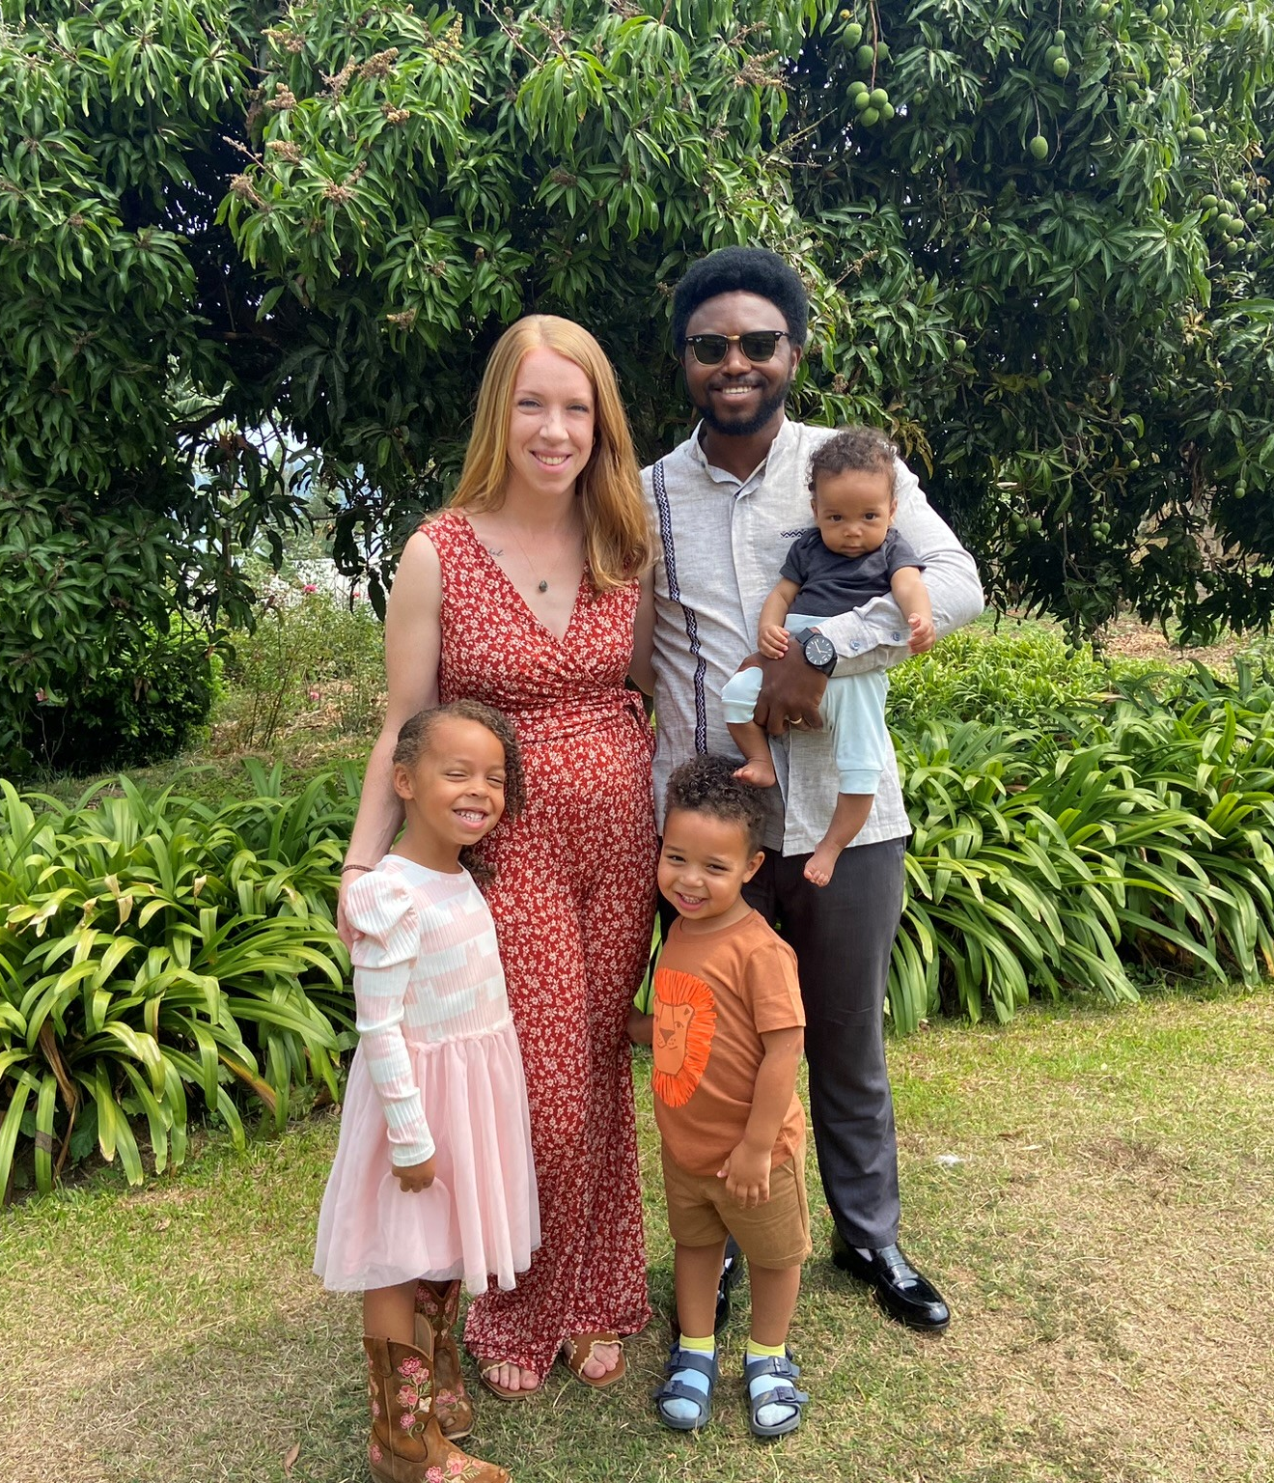
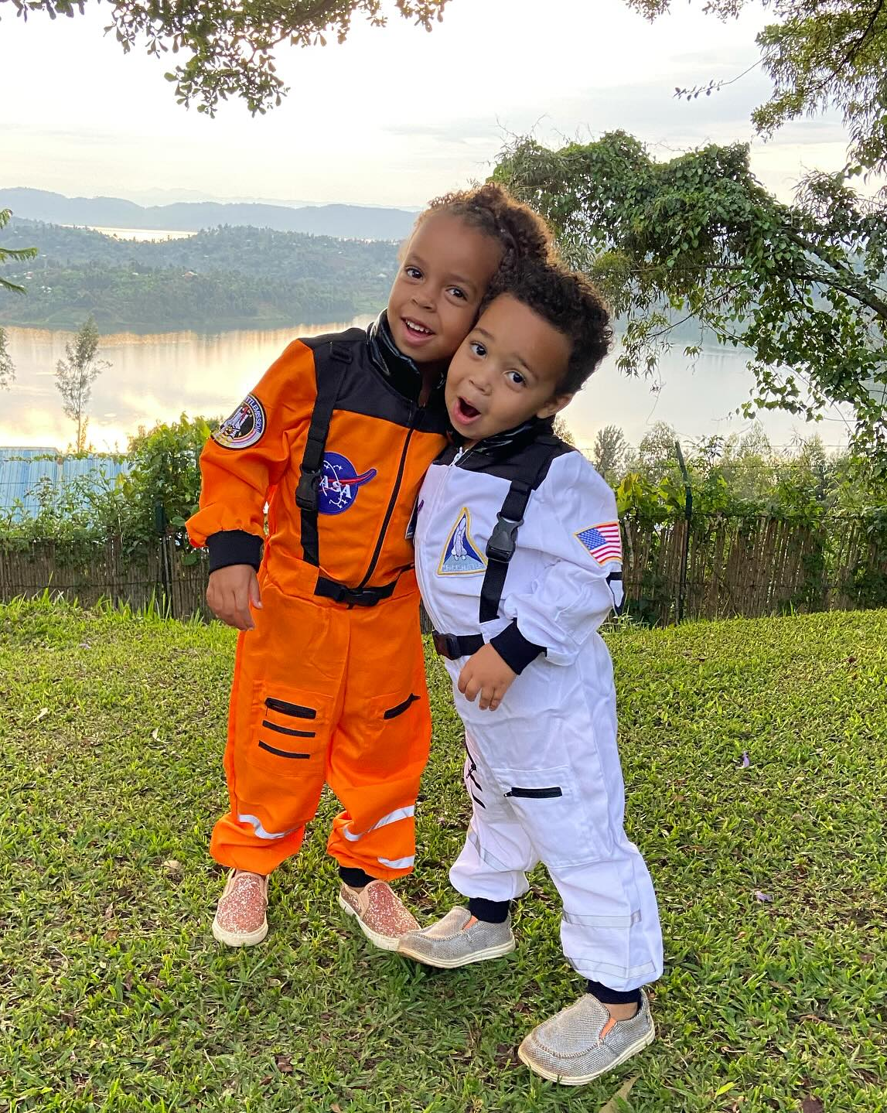
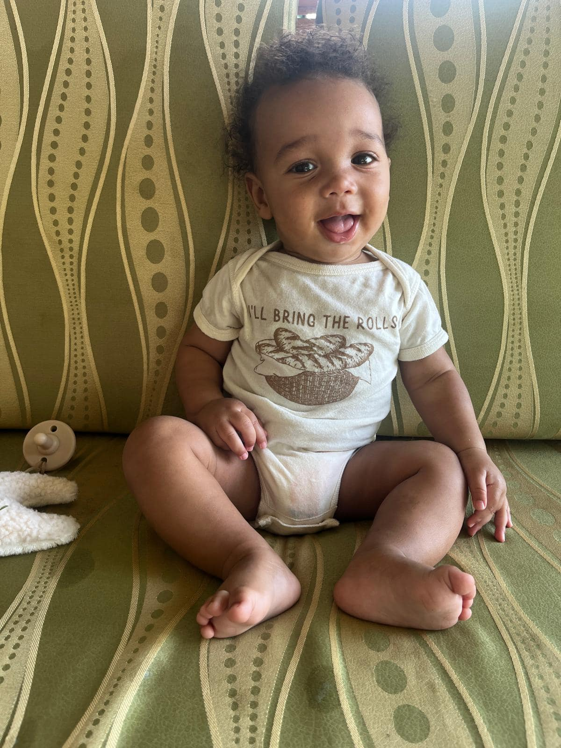
Meet the Nzungizes
Emmanuel, Rachel, Noella, Matayo, & Luka
FamilyID=Office_ArchiveTorn

Slide 18

Adventures in Culture

Slide 19
Language
Good morning
Mwaramutse
mwa-ra-mut-se
Good afternoon
Mwiriwe
mwi-re-we
Good evening
Mwanbere
mwa-mbr-re
Goodnight
Mwirirwe
mwe-ri-rwe
Hello
Muraho
Moo-RAH -Hoh
How are you?
Amakuru?
ah-mah-koo-roo
I’m good
Ni Meza
Nee-MAYza
Thank you
Murakoze
Moo-Rah-Koh-Zay
Goodbye
Murabeho
mer-a-bay-ho

Slide 20
Music
Hallelu, Hallelu, Hallelu, Hallelujah
Percy B. Crawford
Hallelu, Hallelu, Hallelu, Hallelujah
Praise ye the Lord.
(repeat first two lines)
Praise ye the Lord, Hallelujah
Praise ye the Lord, Hallelujah
Praise ye the Lord, Hallelujah
Praise ye the Lord

Slide 21


Kinyarwanda
(Pronunciation)
Ha-lay-LU, Ha-lay-LU, Ha-lay-LU
Ha-lay-LU-YA.
SHEE-mee-muh-nah.
(repeat first three lines)
SHEE-mee-muh-nah,
Ha-lay-LU-YA
SHEE-mee-muh-nah,
Ha-lay-LU-YA
SHEE-mee-muh-nah,
Ha-lay-LU-YA
SHEE-mee-muh-nah.

