Slide 1

Global Adventures
International Child Care Ministries

Slide 2
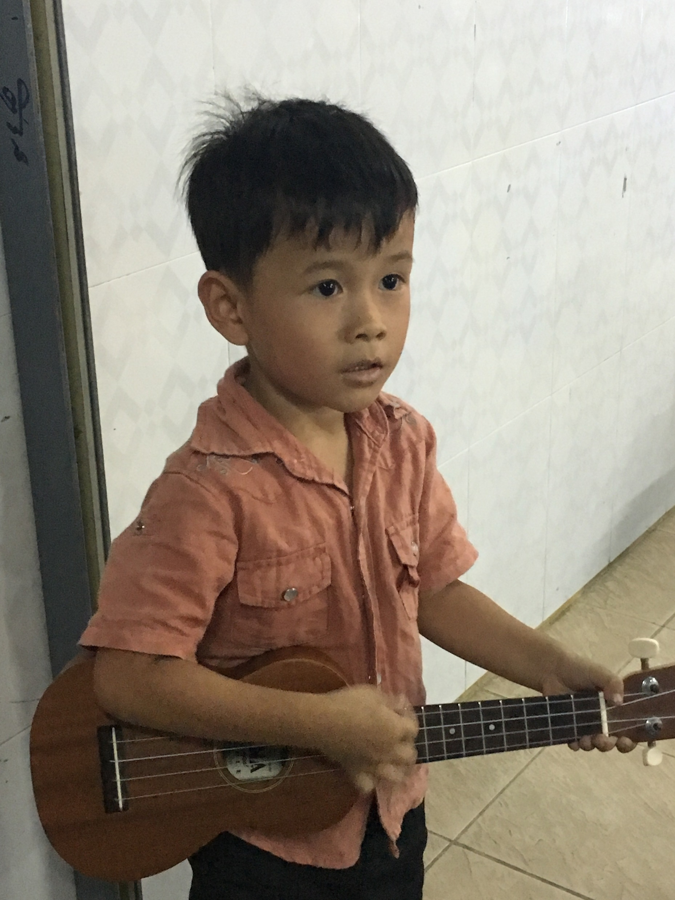
Theme Verse
Sing to the Lord a new song; sing to the Lord,
all the earth. Sing to the Lord, praise his name; proclaim his salvation day after day. Declare his glory among the nations, his marvelous deeds among all peoples.
- Psalms 96:1-3
Unsplash: Ben White

Slide 3

Explore the Problems Faced by Children Around the World

Slide 4
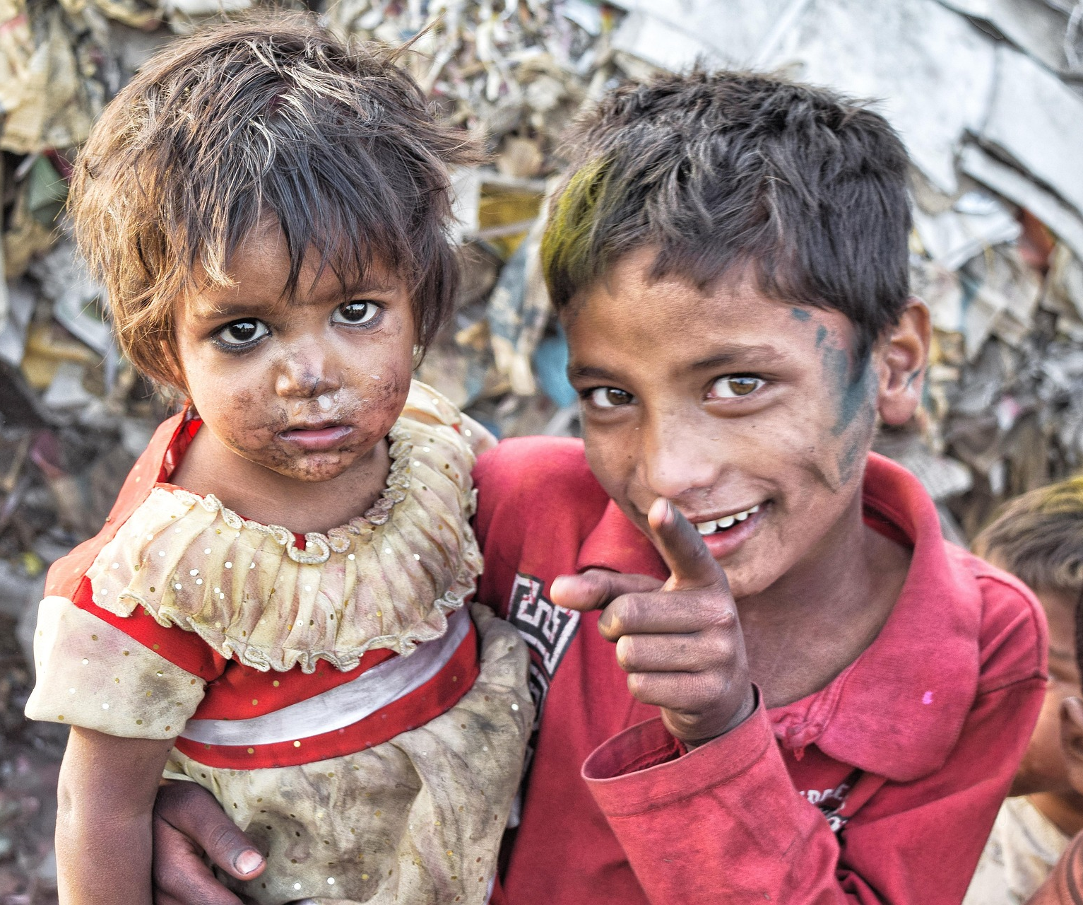
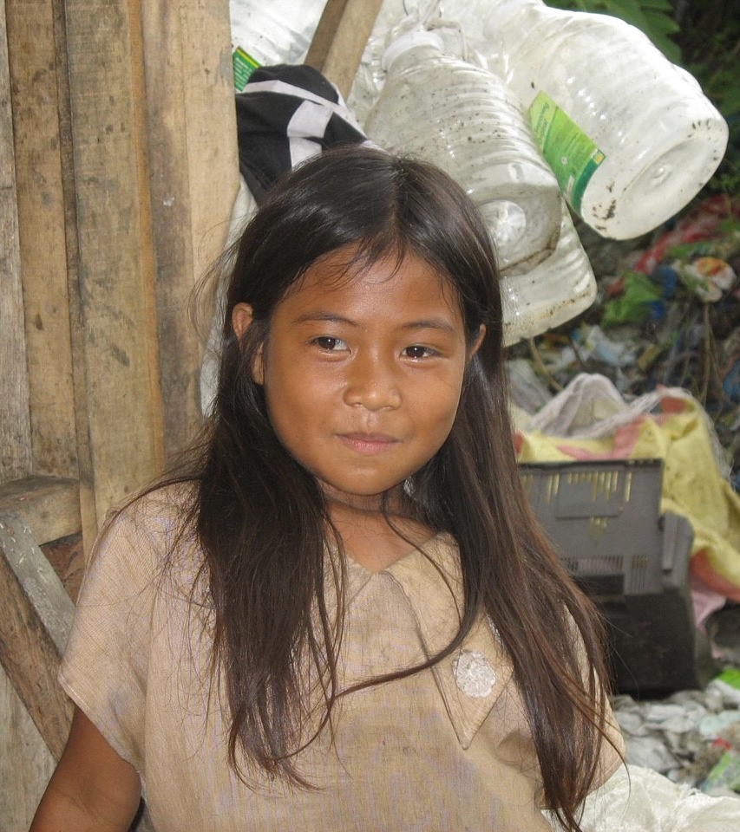
Poverty
Photo Billy Cedeno/Pixabay
Photo: Jan Coates

Slide 5

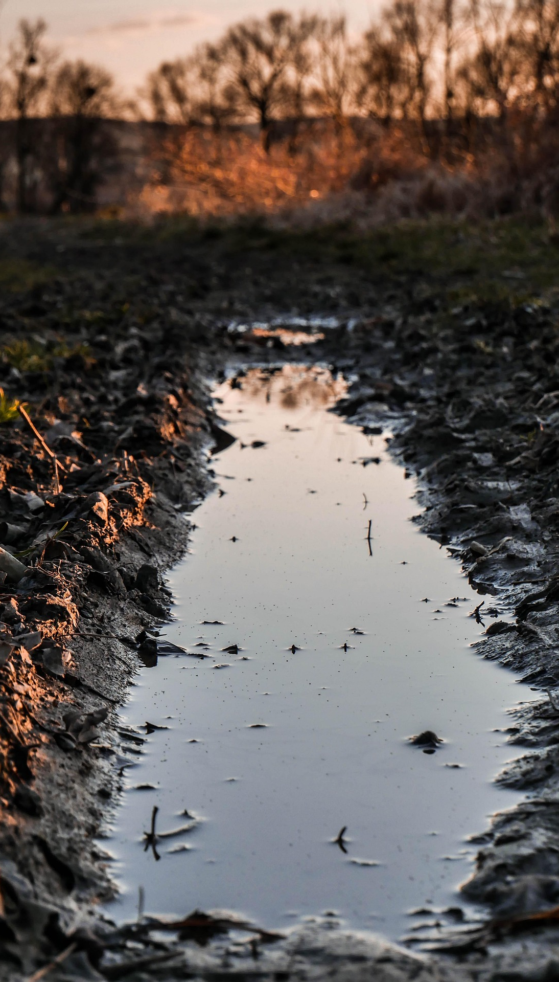
Unsafe Water
Photo: Trevor Gerzan Unsplash
Photo: u_yirilulxqp/Pixabay

Slide 6
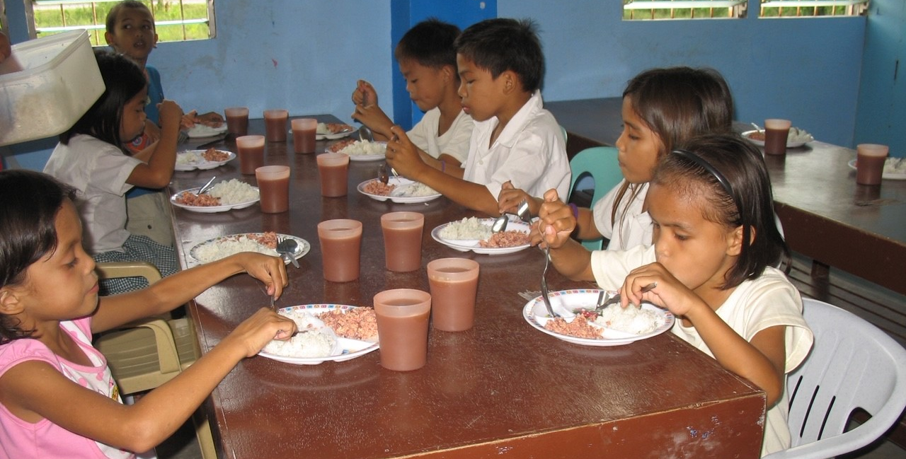
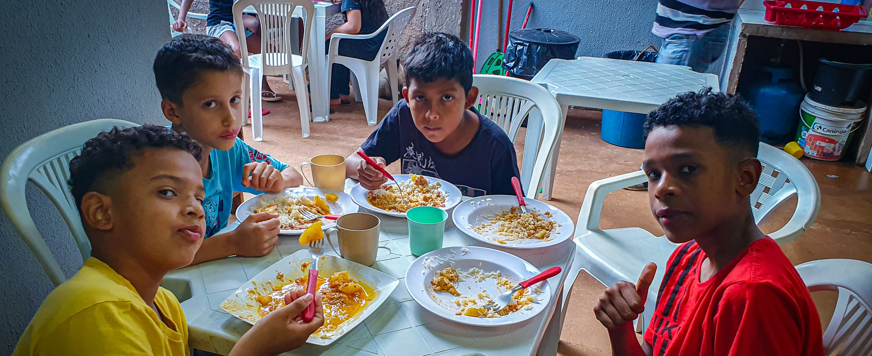
Hunger
Photo: Jan Coates
Photo: Calo Britto

Slide 7
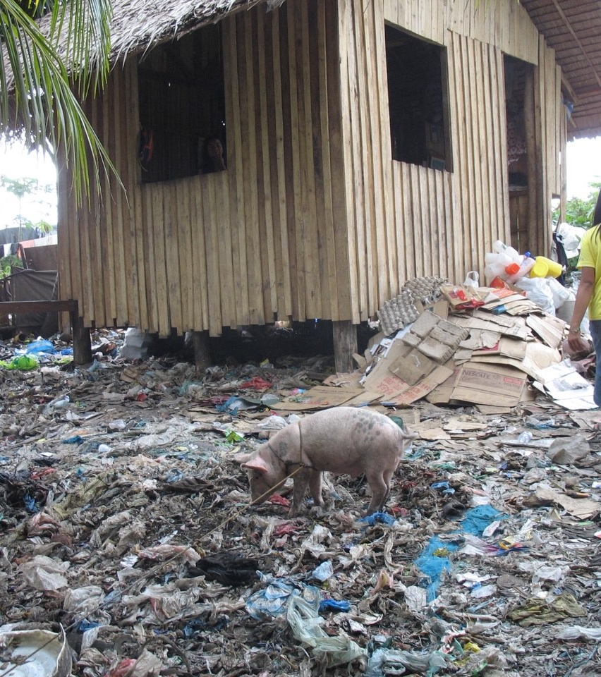
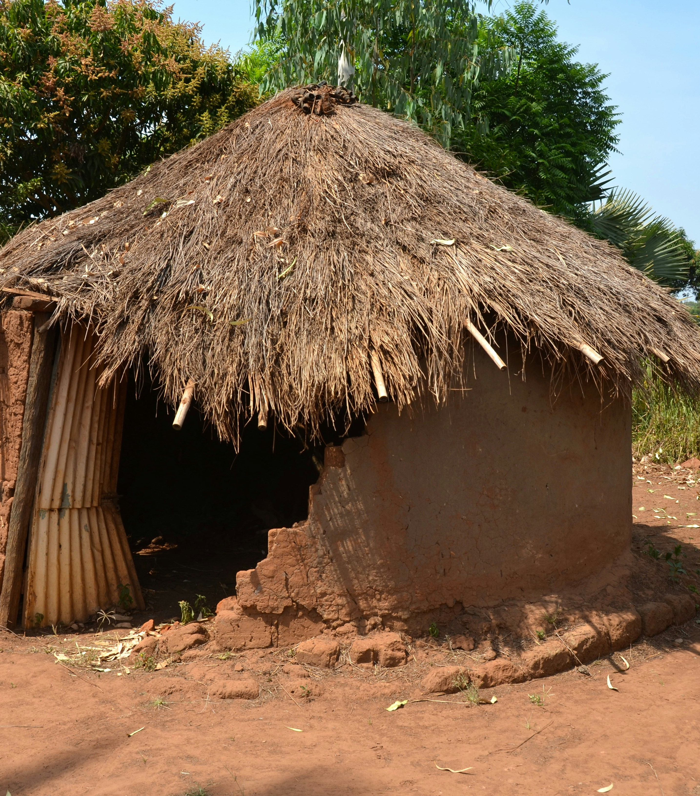
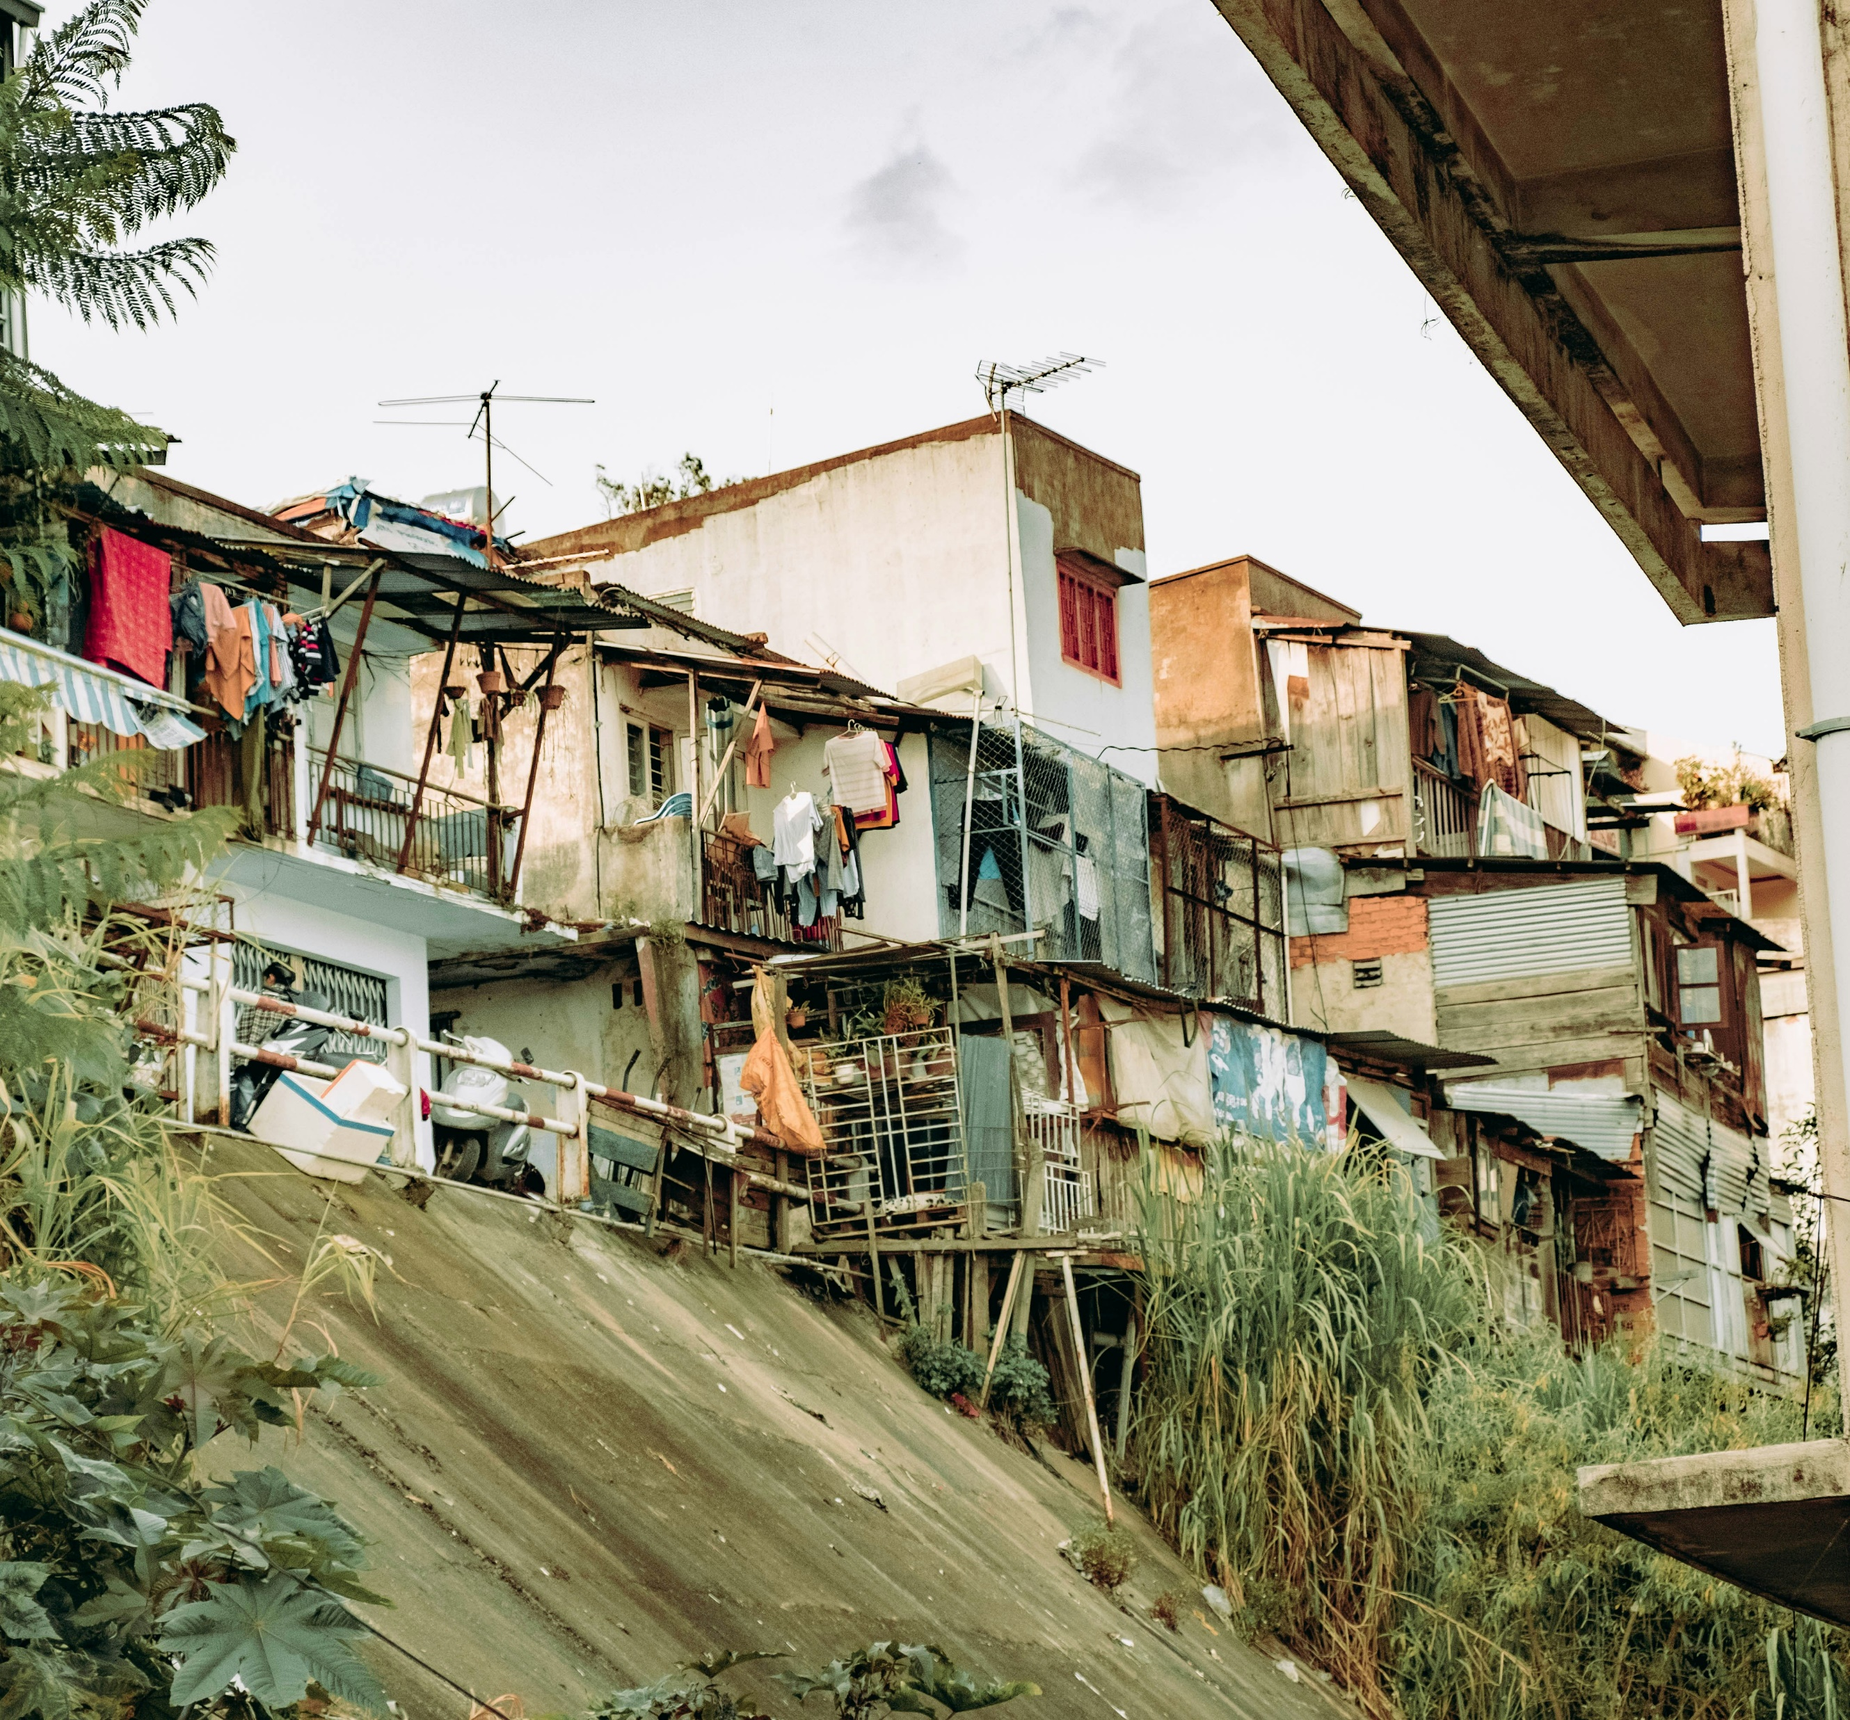
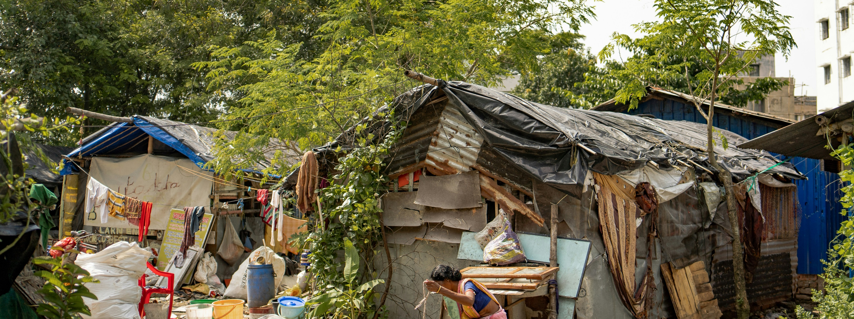
Inadequate Shelter
Photo: Laron Taylor/Unsplash
Photo: Nguyen Kiet/Unsplash
Photo: Ján Coates
Photo: Shelby Murphy/Unsplash

Slide 8
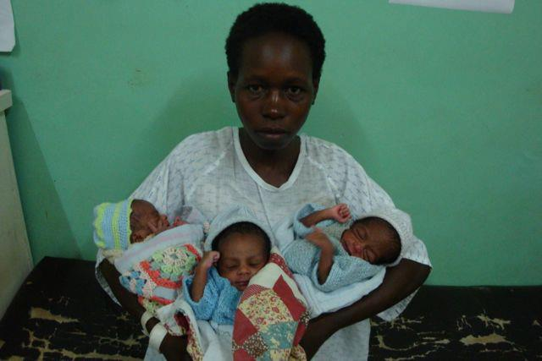
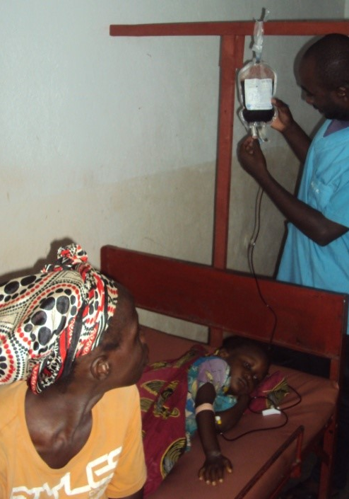
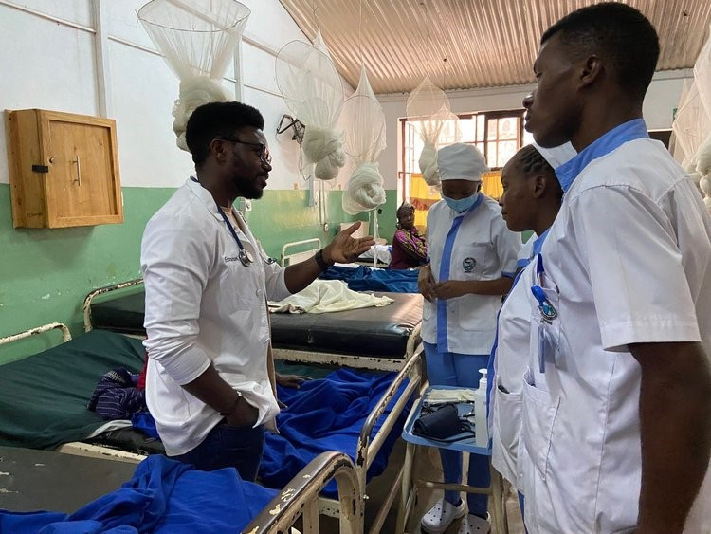
Sickness & Disease

Slide 9
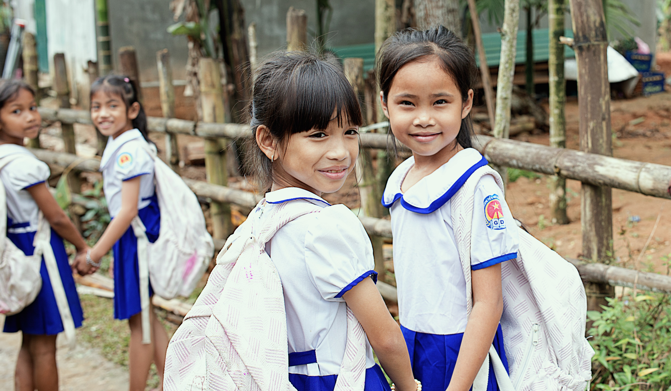
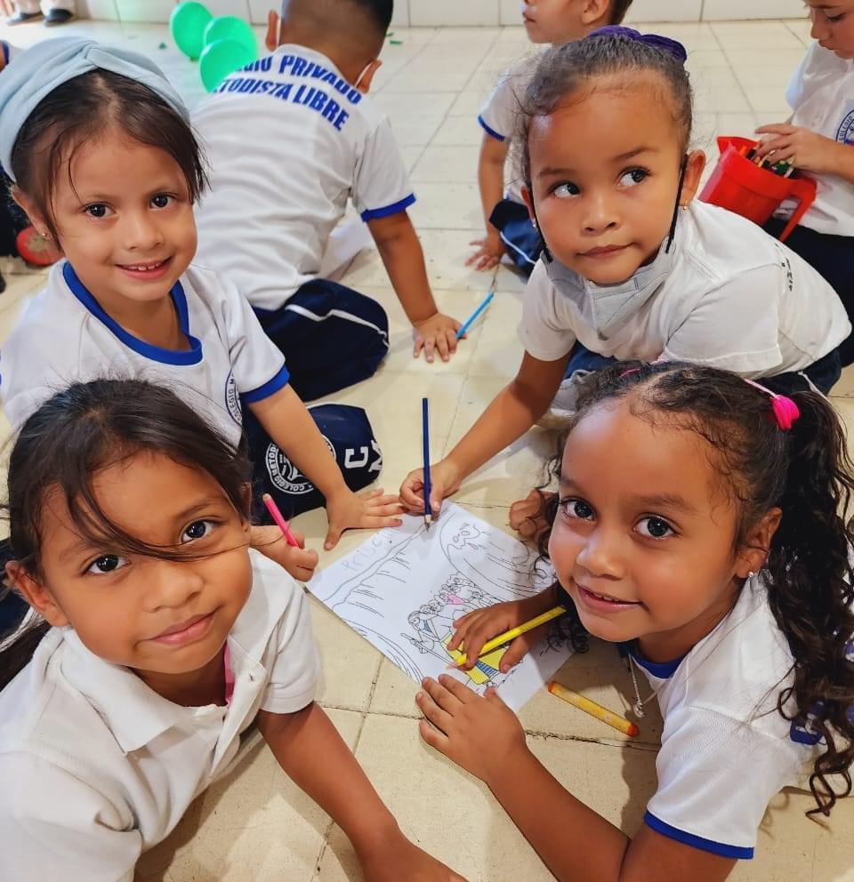
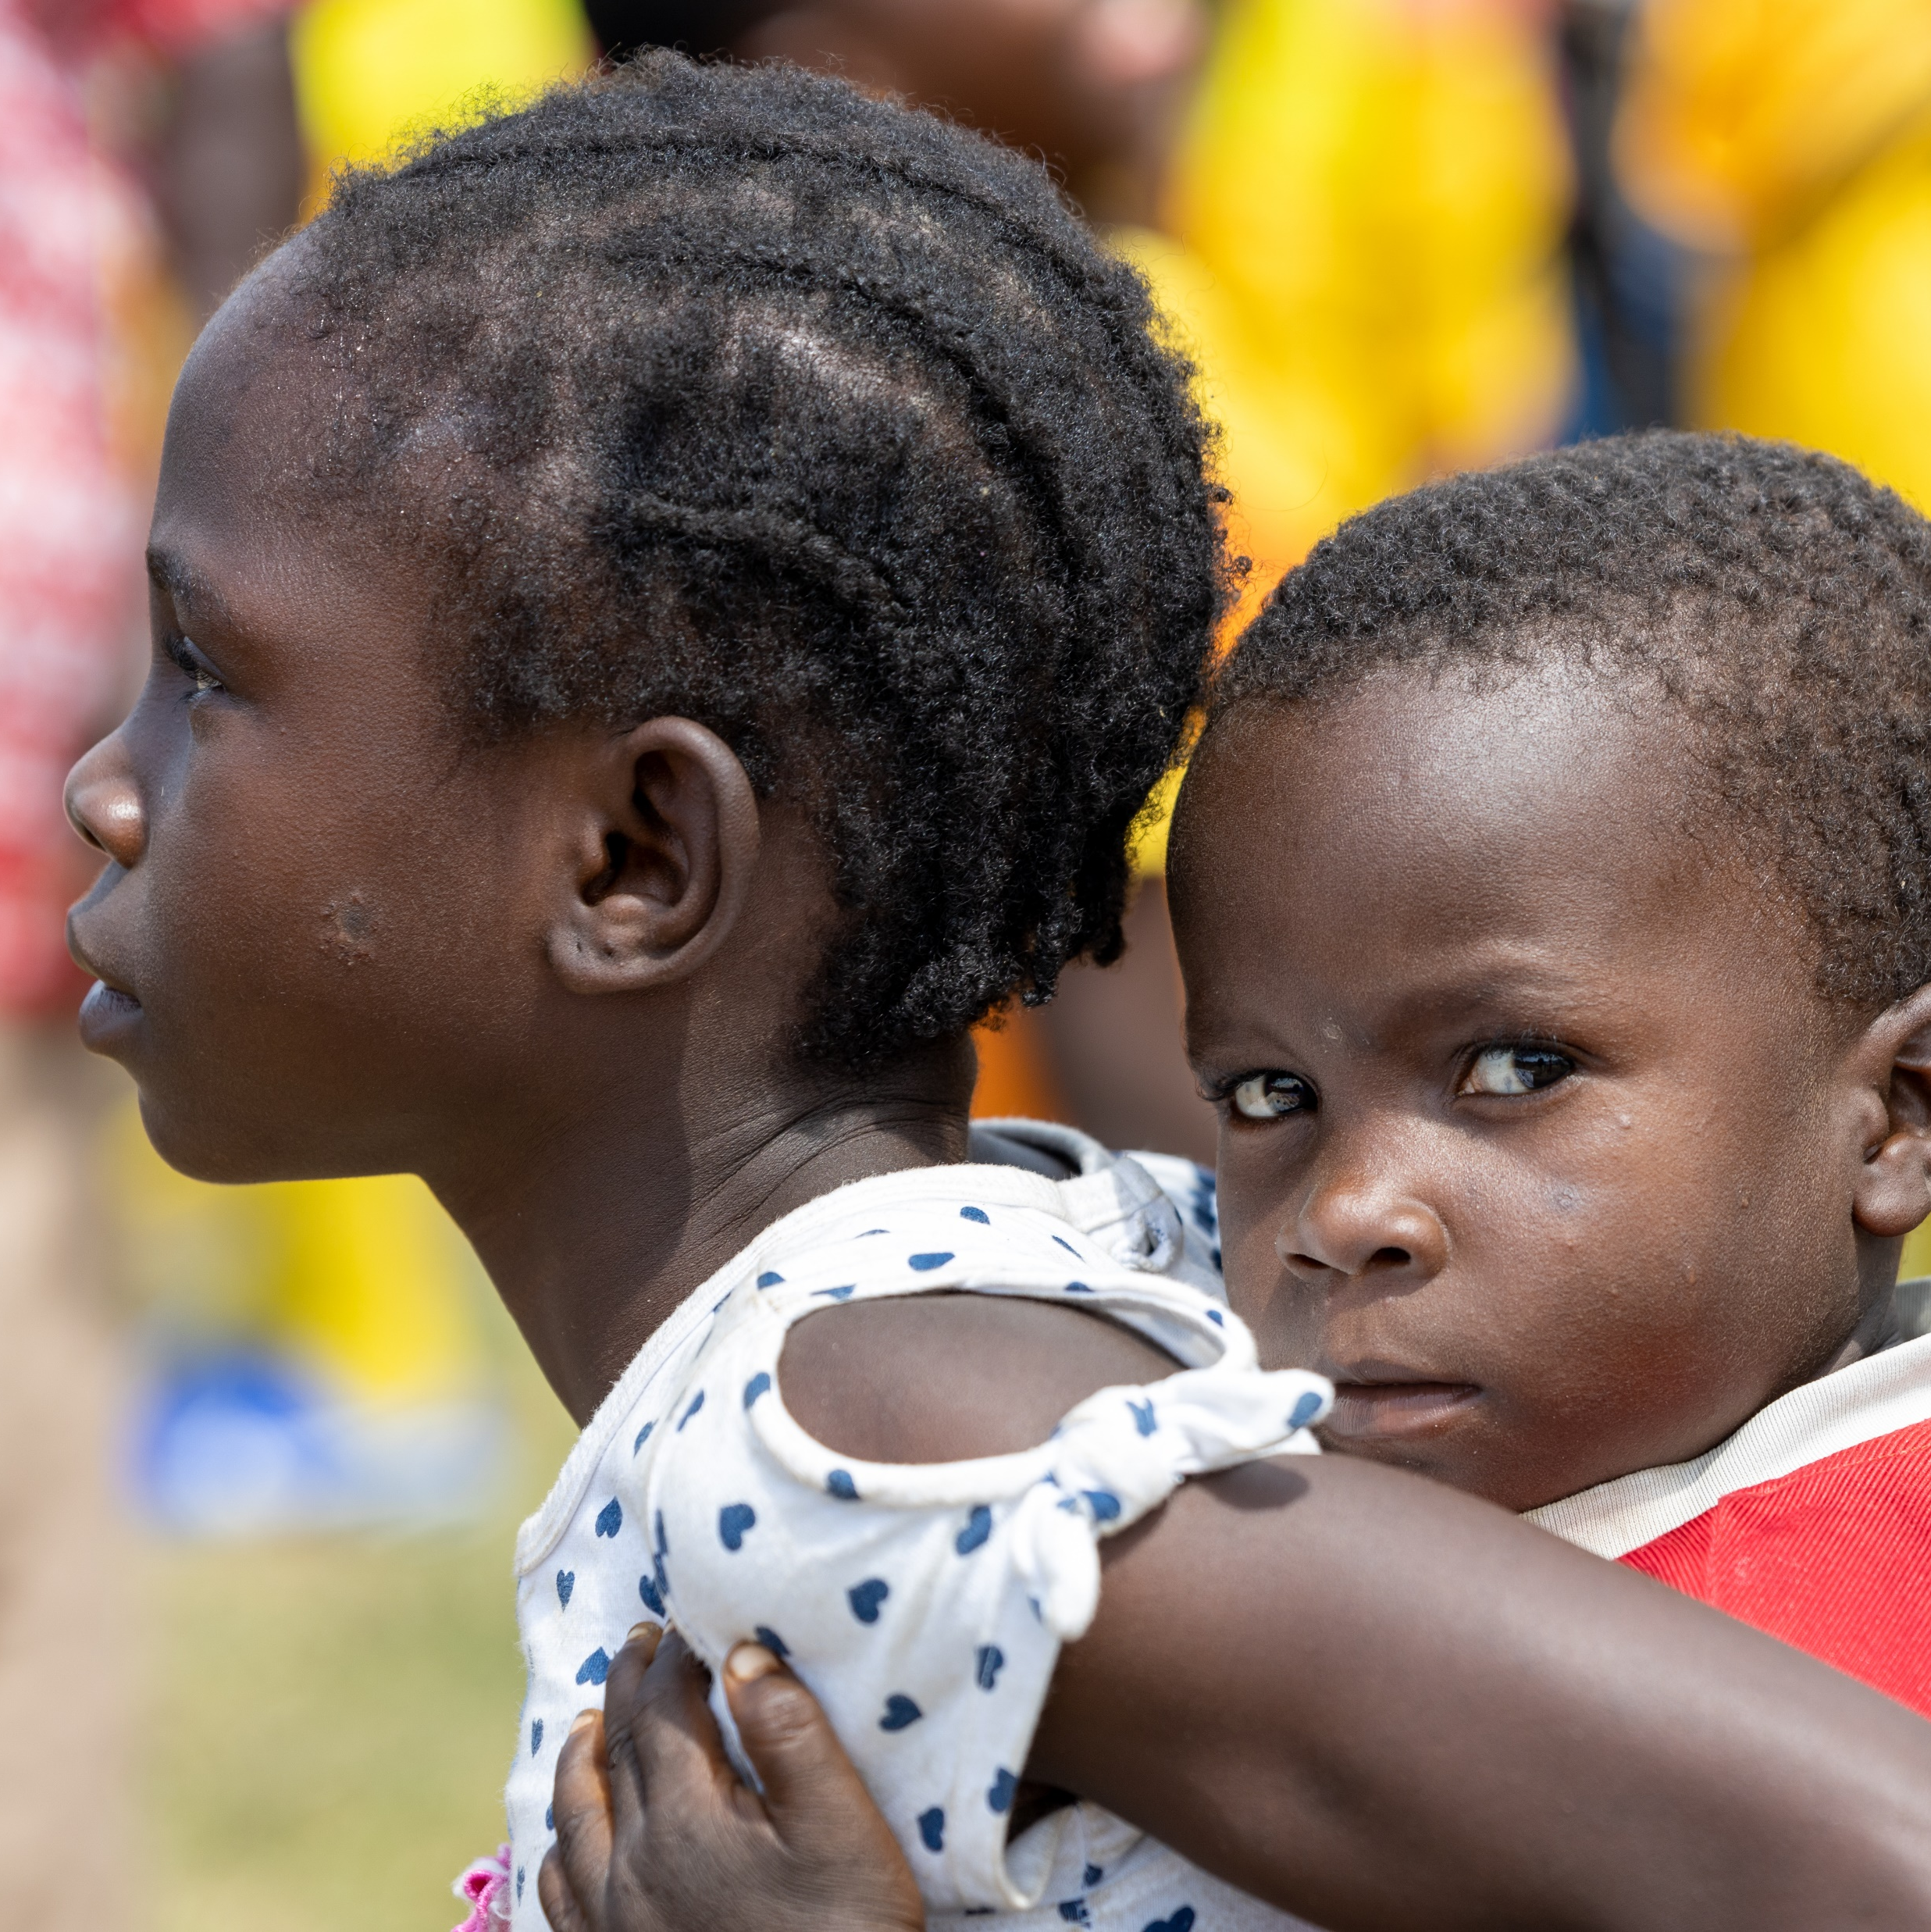

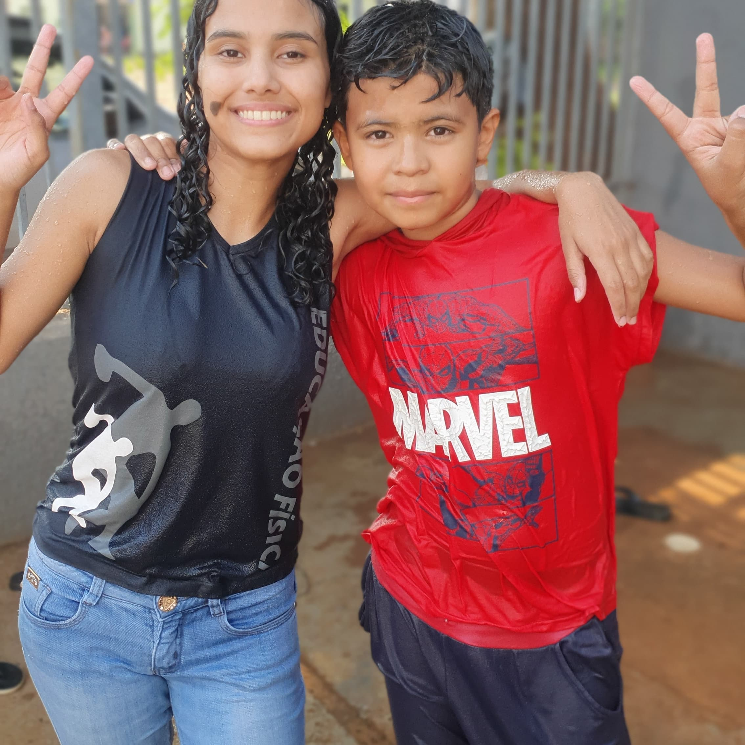
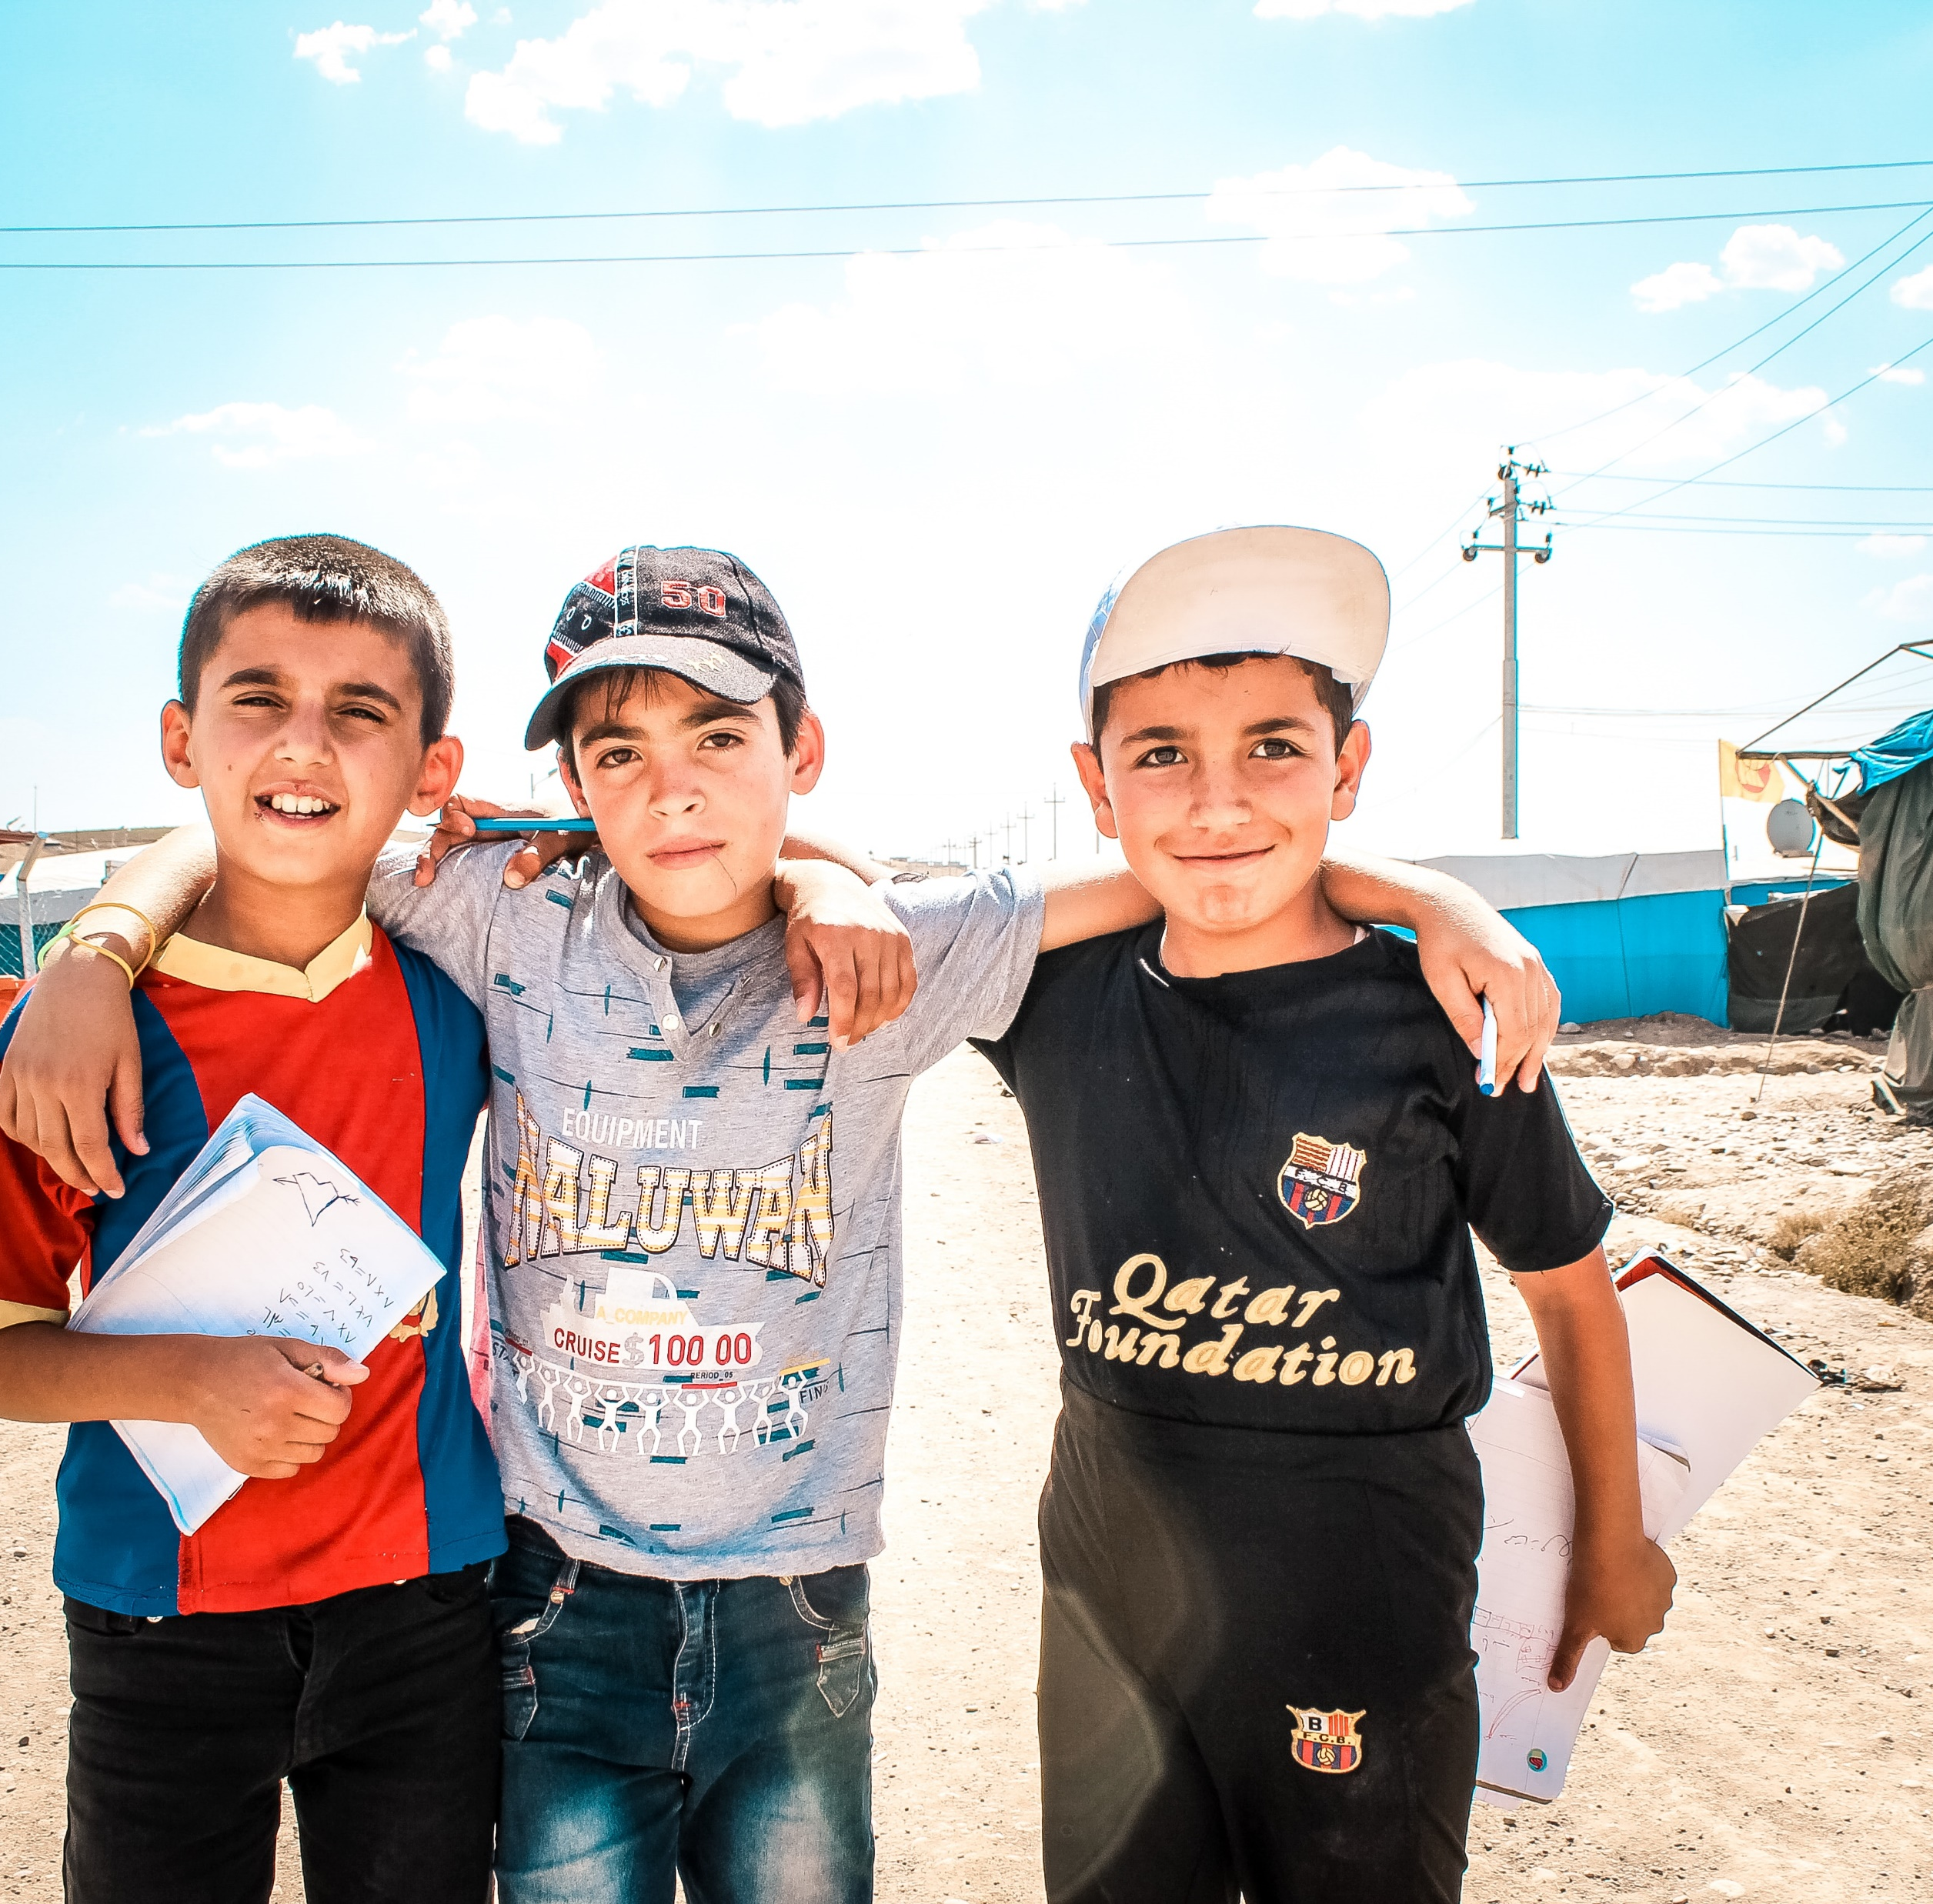
Lack of Education
Photo: Kevin Austin
Photo: Trevor Owen
Photos: Latin America Area
Photo: Calo Britto
Photo: Kevin Austin
Photo: Jonathan Ramalho/Unsplash

Slide 10
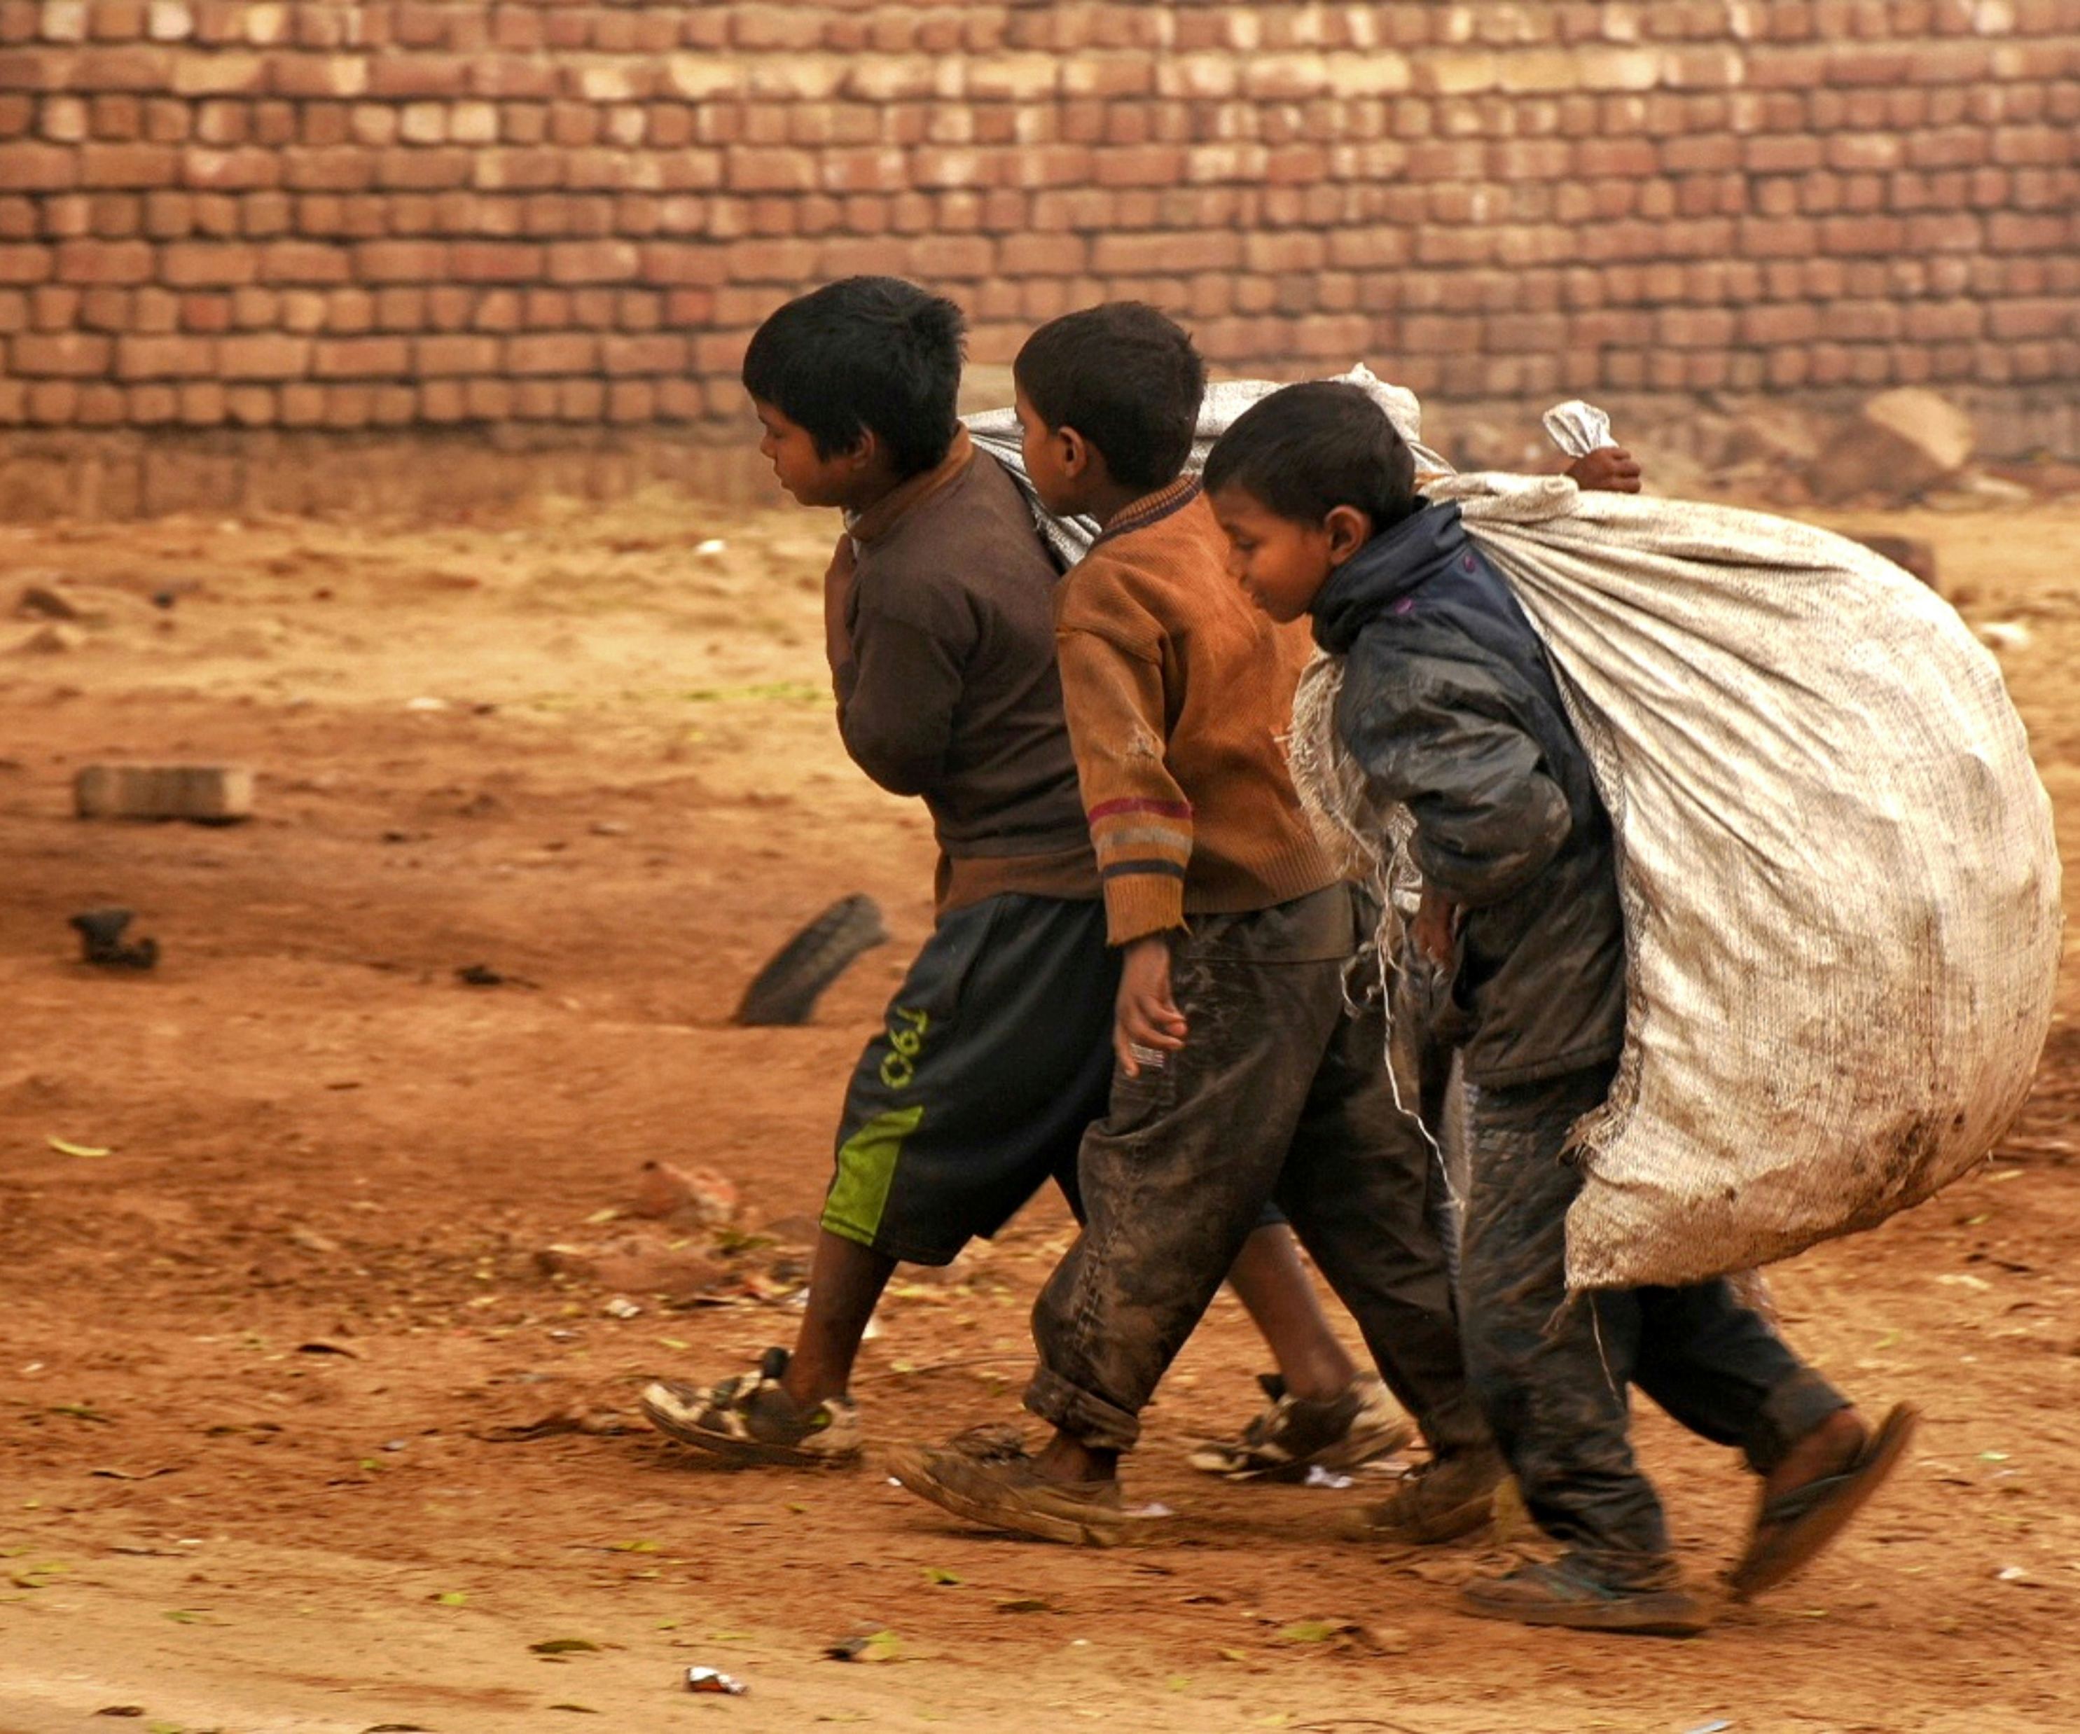
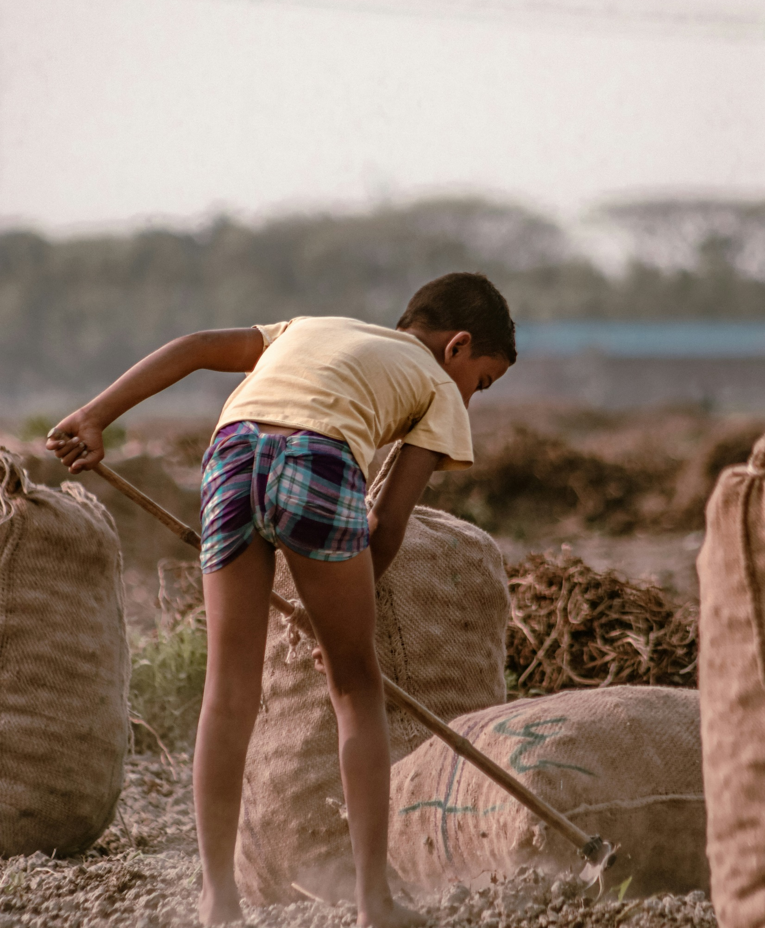
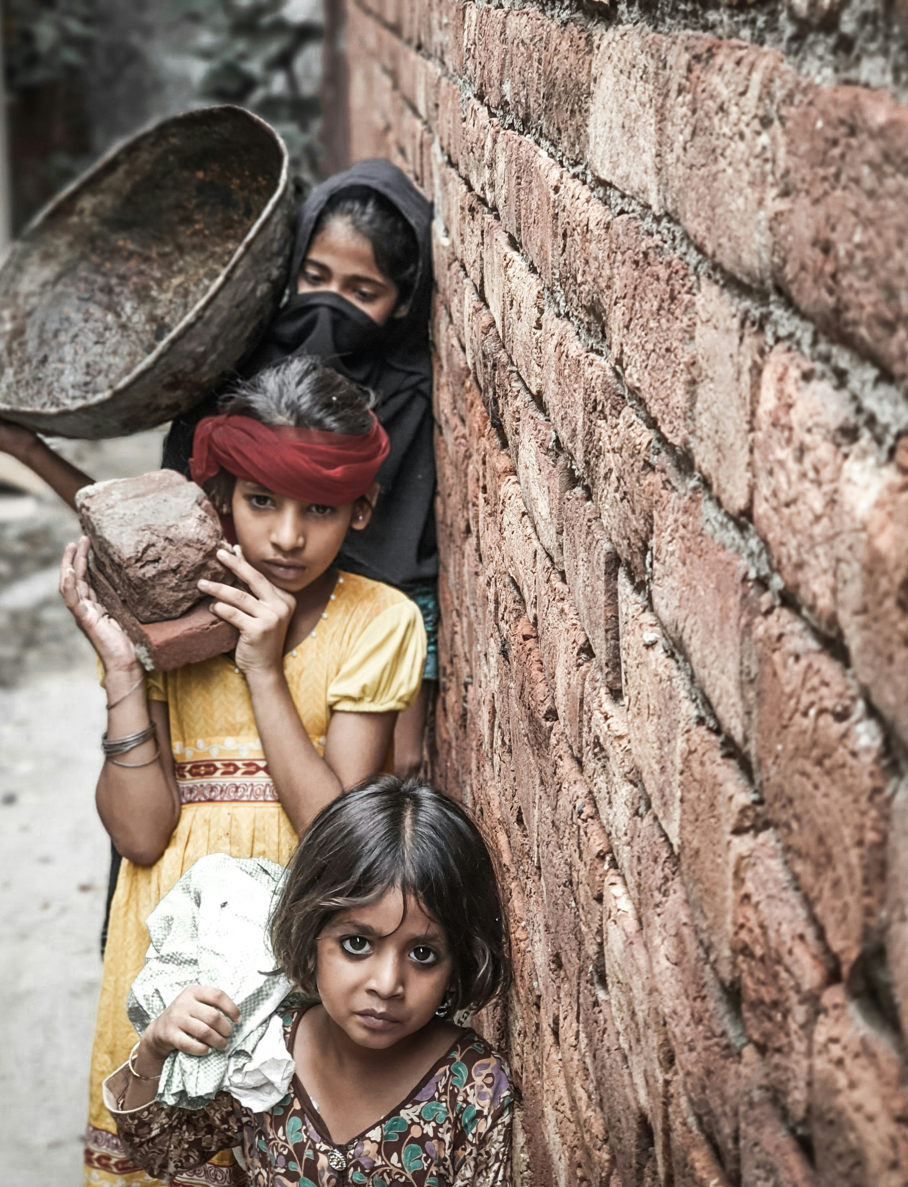
Photo: Simon Reza/ Unsplash
Photo: Dulana Kodithuw/ Unsplash
Child Labor
Photo: Aima Yasir/ Unsplash

Slide 11
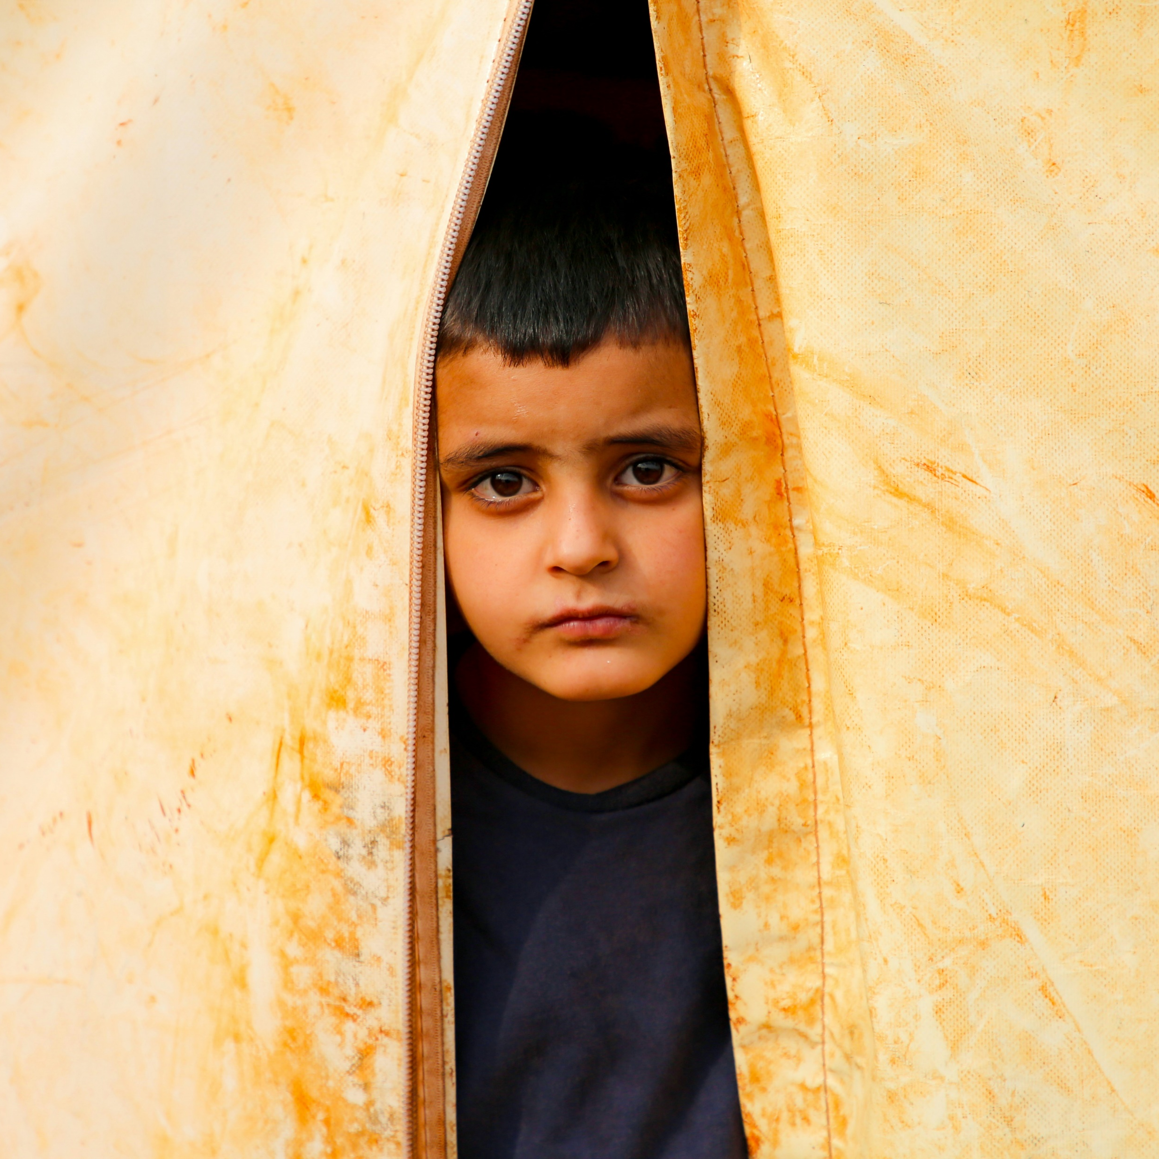
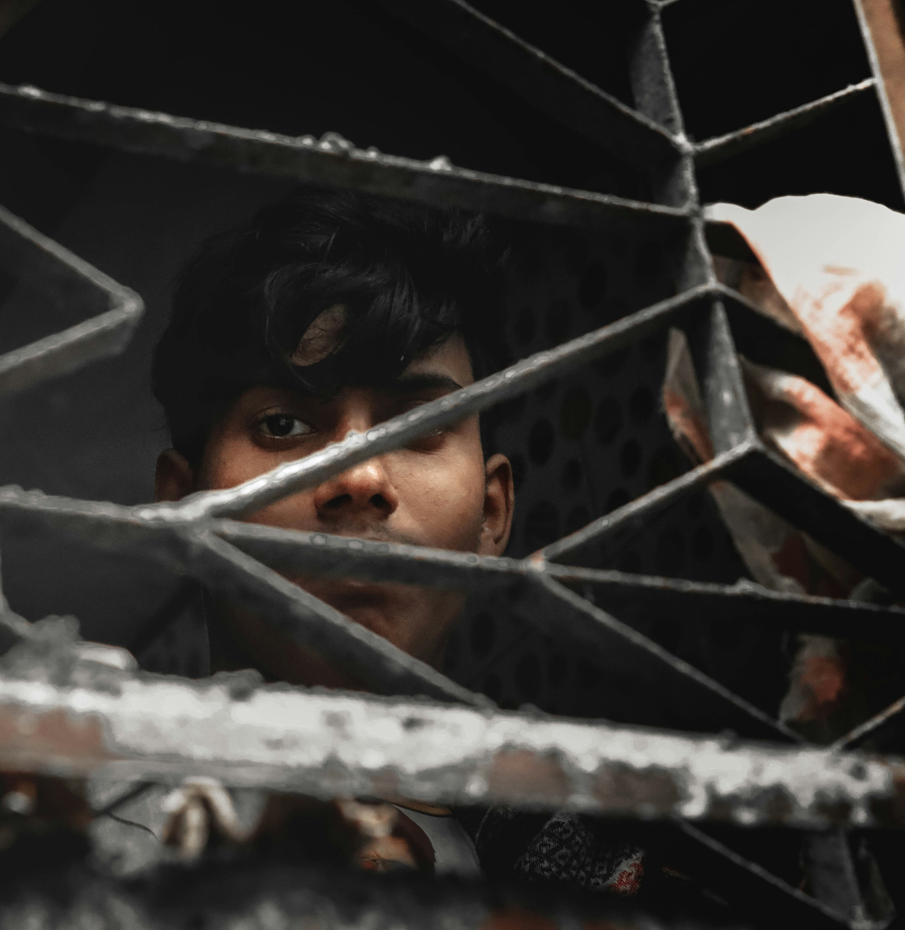
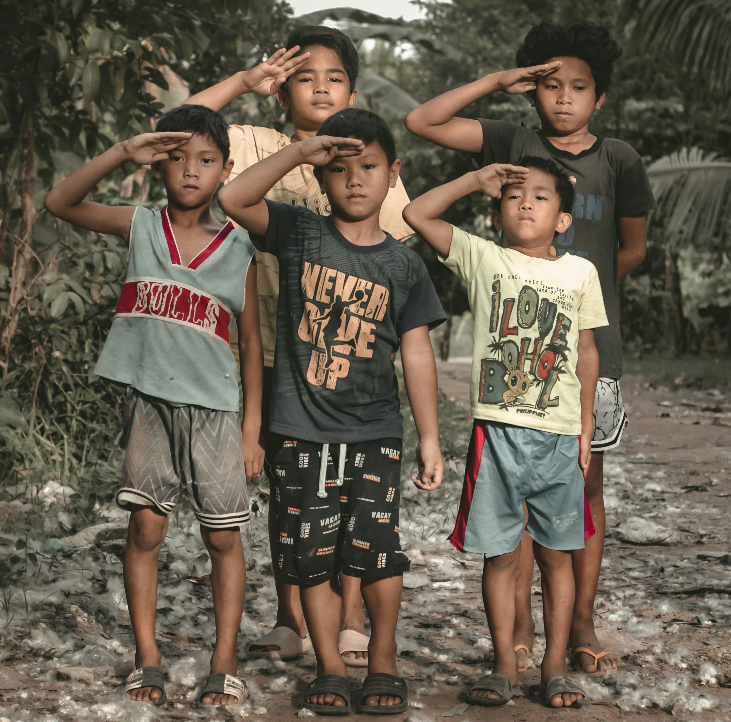
War & Displacement
Photo: Ehteshamul Haque
Photo: Colorblind Photo/Unsplash
Photo: Salah Darwish/Unsplash

Slide 12

Explore God’s Work

Slide 13
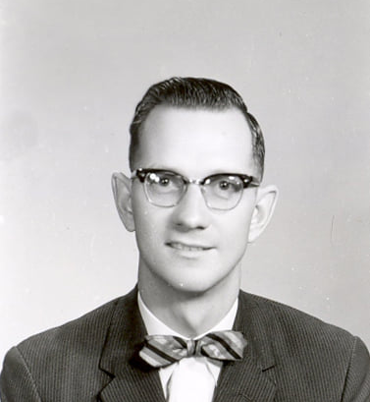
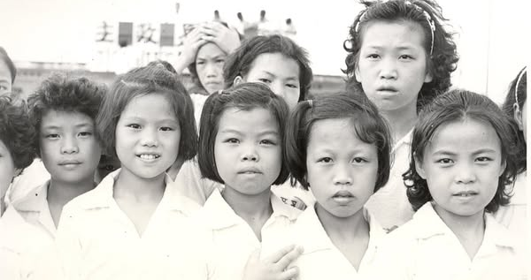
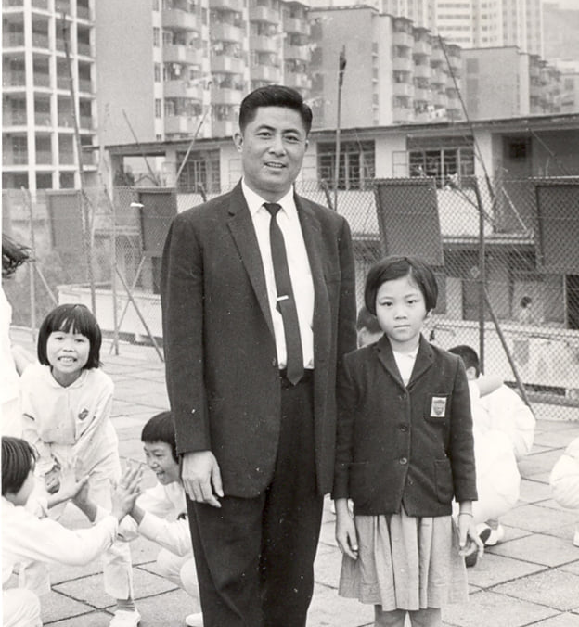
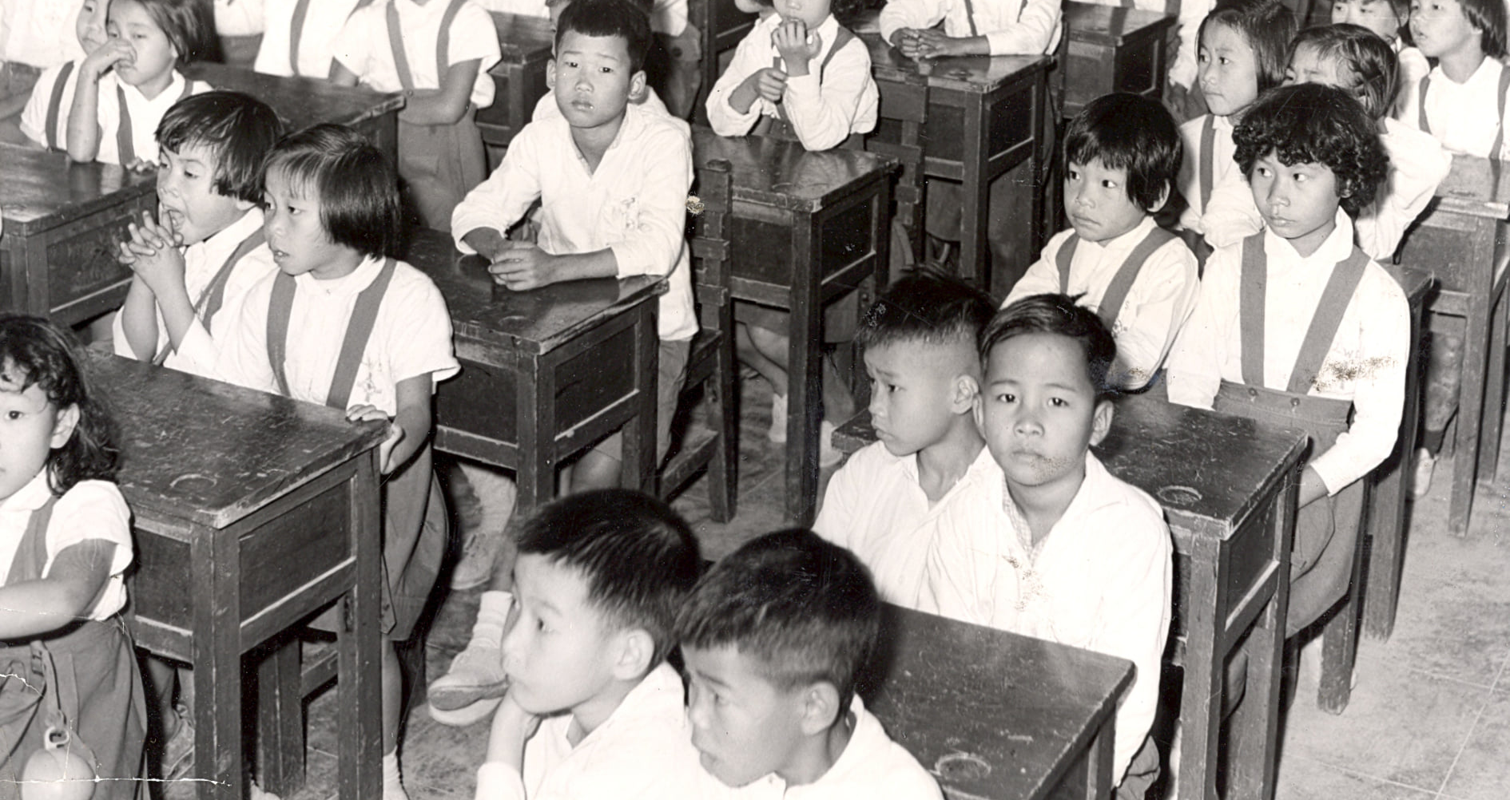
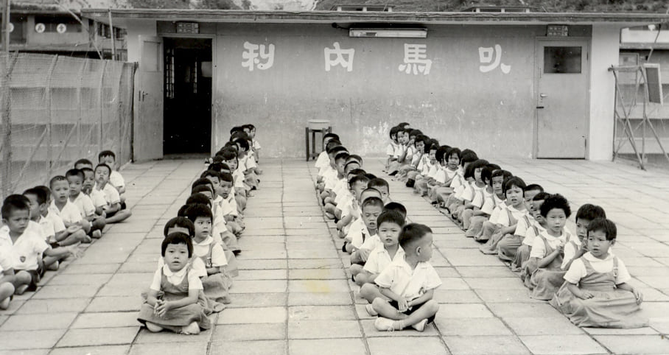
ICCM Began in Hong Kong in 1966
Photos: ICCM Historical Files

Slide 14
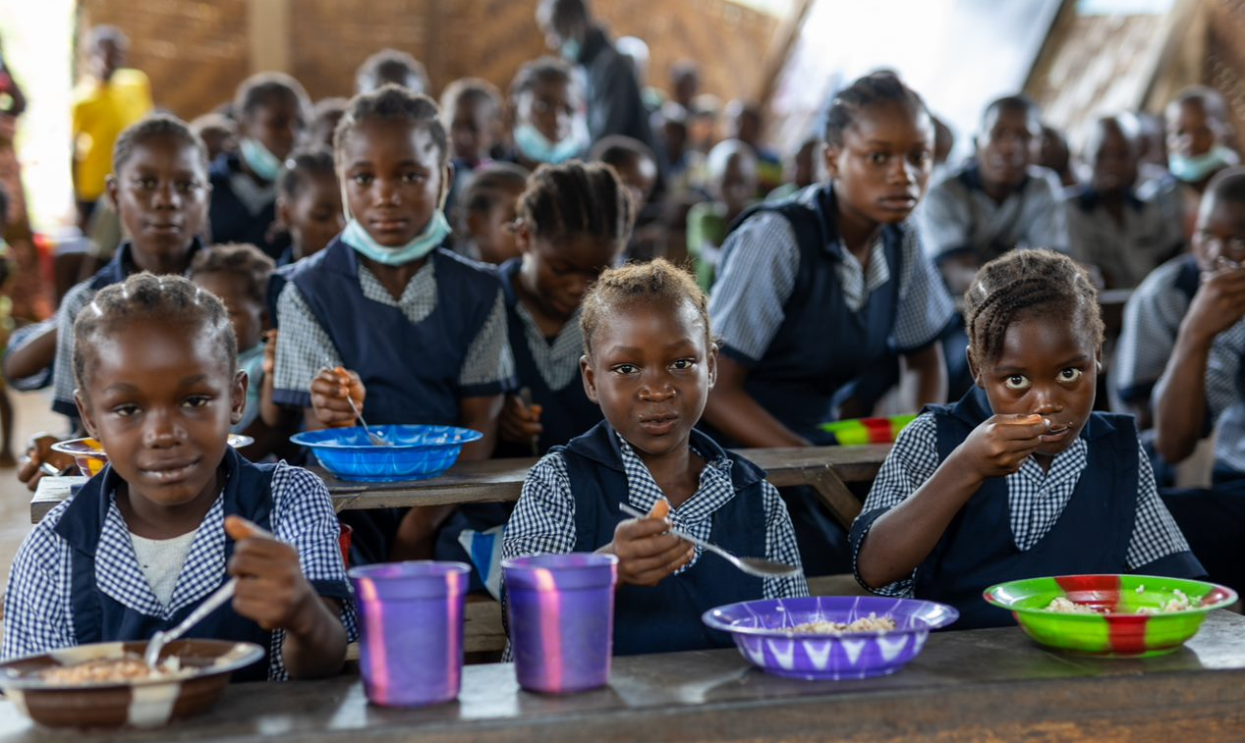
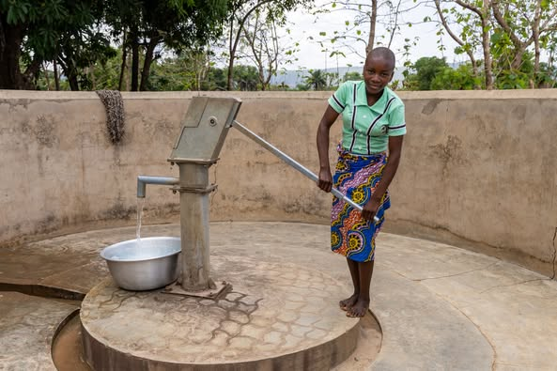
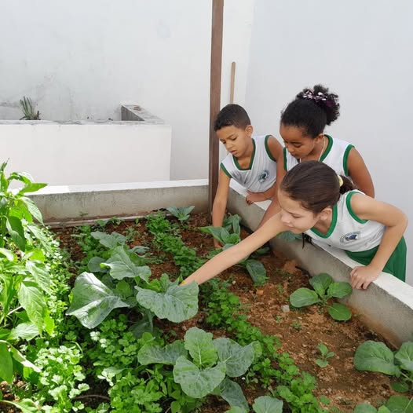
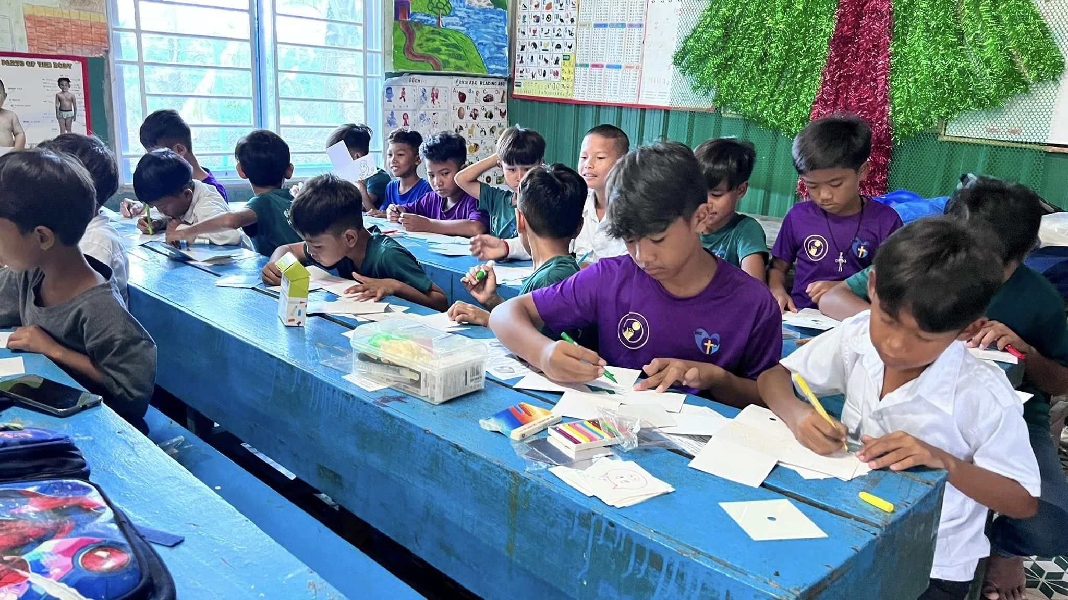
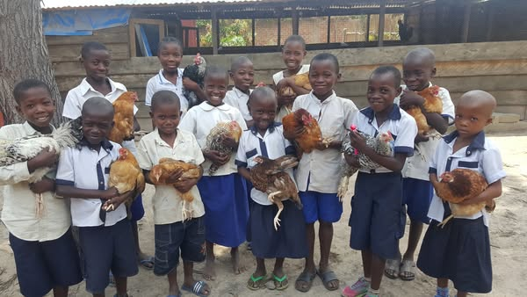
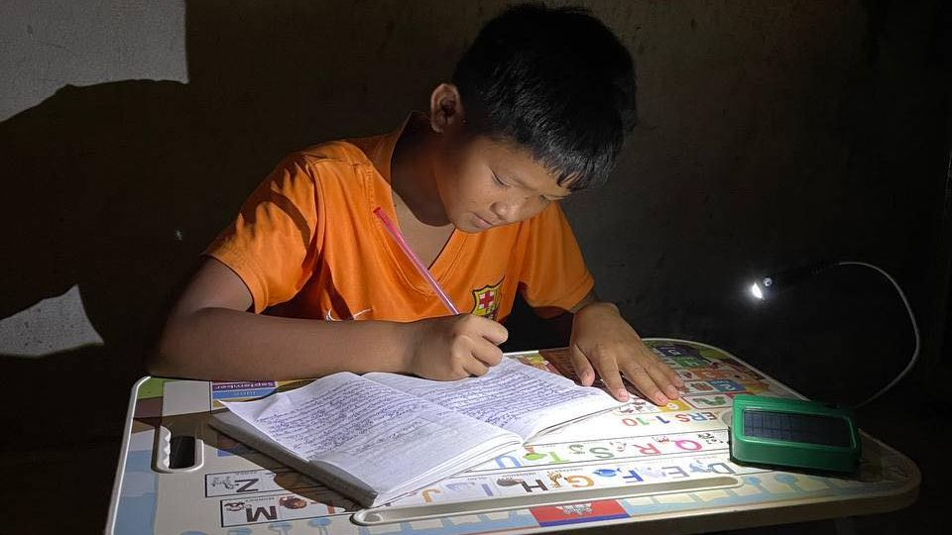
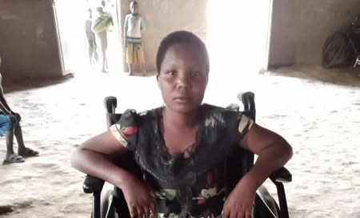
ICCM Provides Child Sponsorship and Many Special Projects

Slide 15

Adventure Story

Slide 16
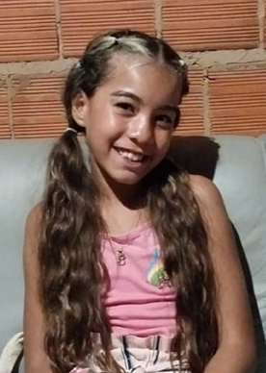

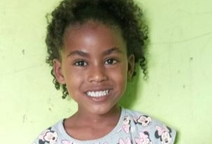
These Children Can Sing a New Song of Joy Because of Ann’s Angel Fund
Nicolly
Gilmara
Rute

Slide 17
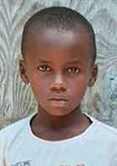
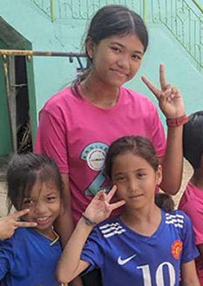
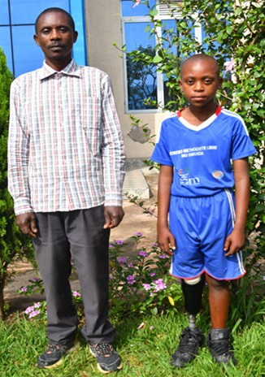
Allyza
Jerome
Fradson

Slide 18

People on Adventure

Slide 19
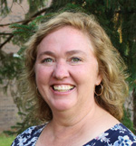
Meet ICCM Director Alma Thompson

Slide 20
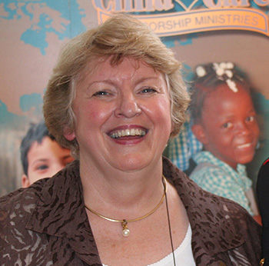
Meet Ann Van Valin
(Ann’s Angel Fund was named in her honor)

Slide 21

Adventures in Culture

Slide 22
L
A
N
G
U
A
G
E
English He heals the brokenhearted and binds up their wounds. Psalm 147: 3
Spanish El sana a los que brantados de corozón, Y venda sus heridas.
Swahili Anawaponya waliovunjika moyo na kuwafunga majeraha yao.
Tagalog Pinagagaling niya ang mga may sugat sa puso at tinitilian ang kanilang mga sugat.

