Slide 1

Global Adventures
Portugal

Slide 2
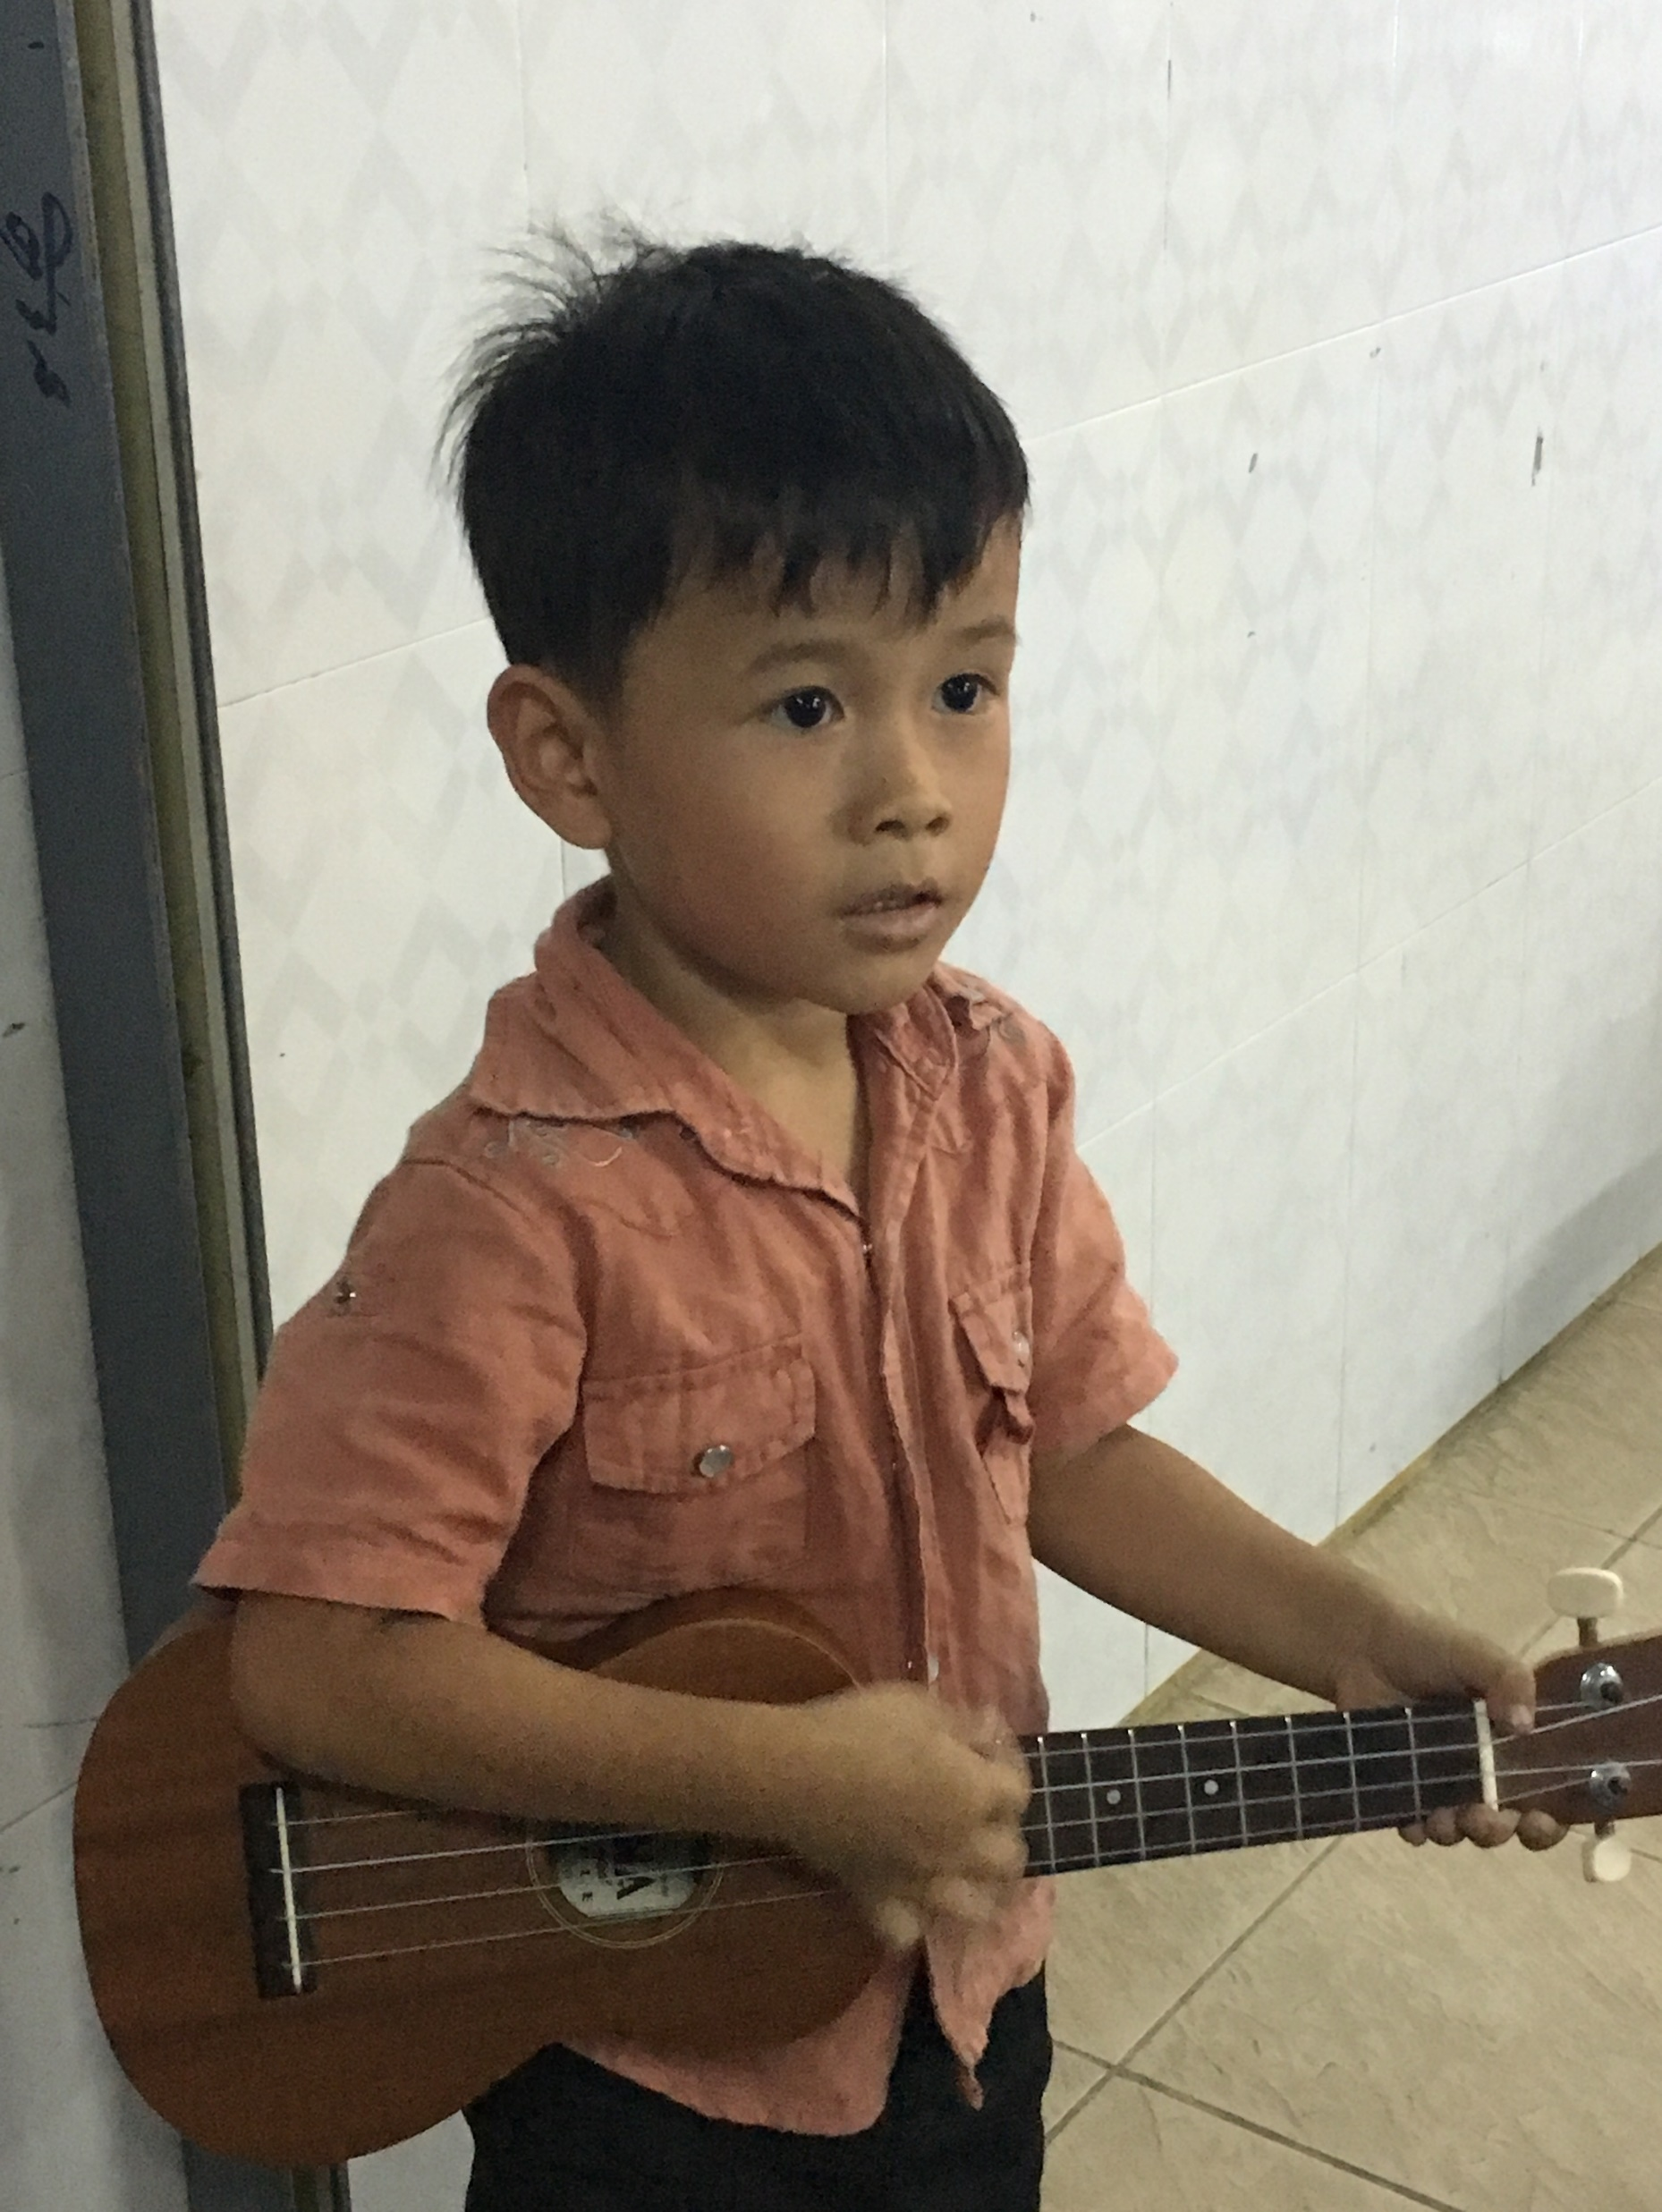
Theme Verse
Sing to the Lord a new song; sing to the Lord,
all the earth. Sing to the Lord, praise his name; proclaim his salvation day after day. Declare his glory among the nations, his marvelous deeds among all peoples.
- Psalms 96:1-3
Unsplash: Ben White

Slide 3

Explore the Country

Slide 4
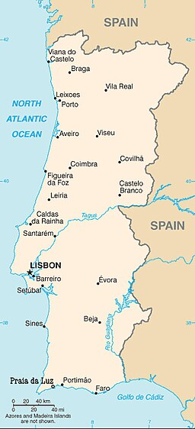
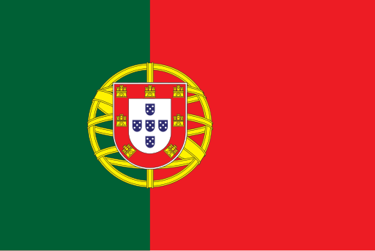
Columbano Bordalo Pinheiro, Public domain, via Wikimedia Commons
Portugal
Public domain, via Wikimedia Commons

Slide 5
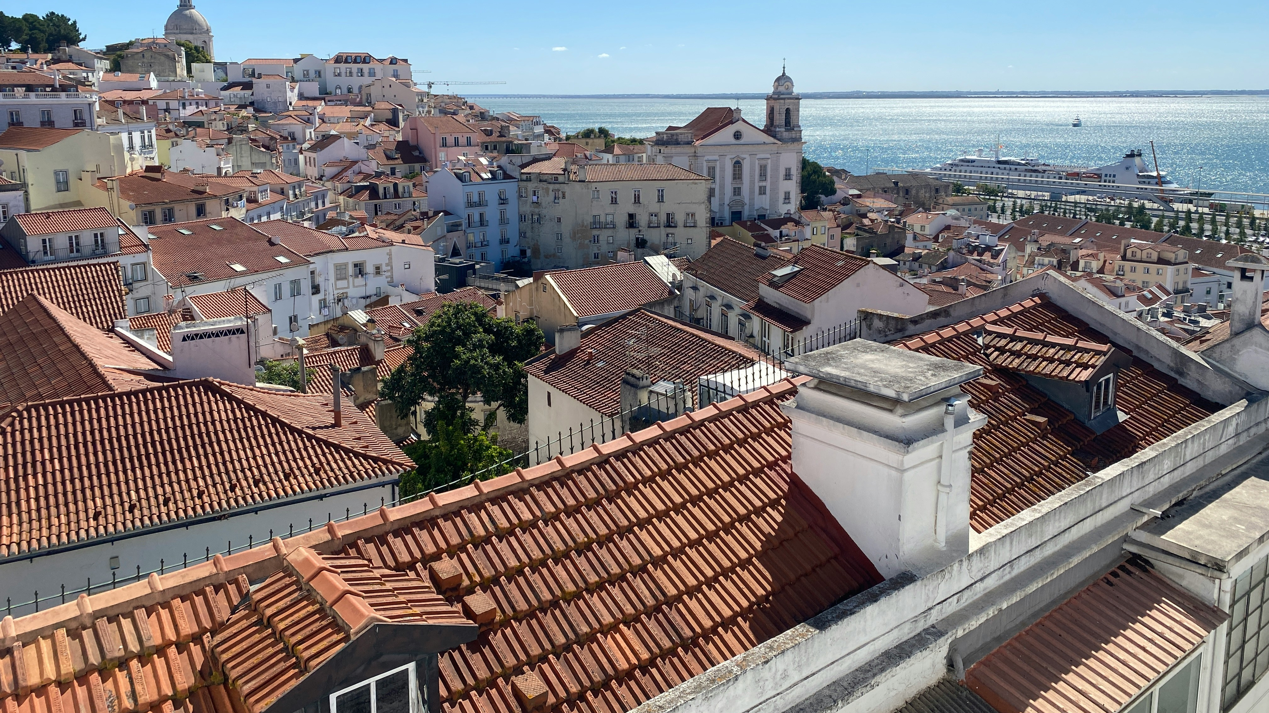
Lisbon (the capital city)
Photo: Jude Wilson/Unsplash

Slide 6
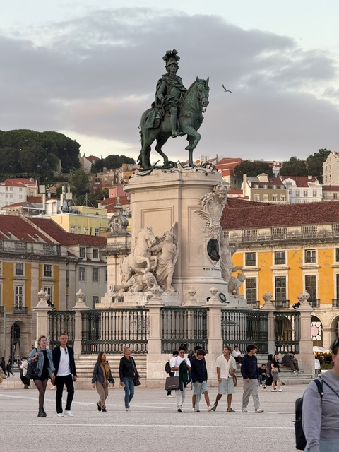
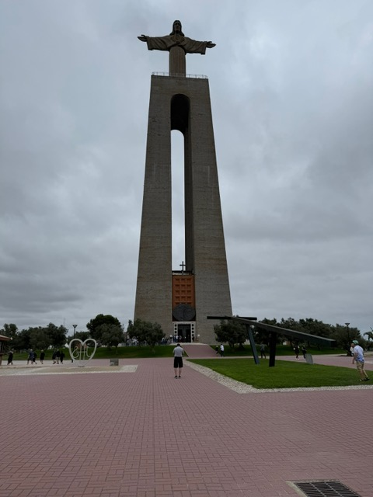
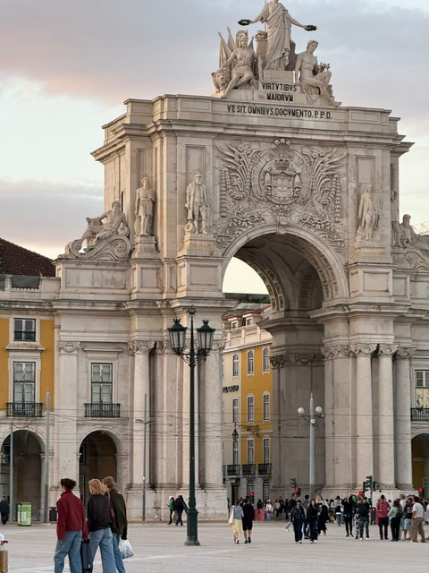
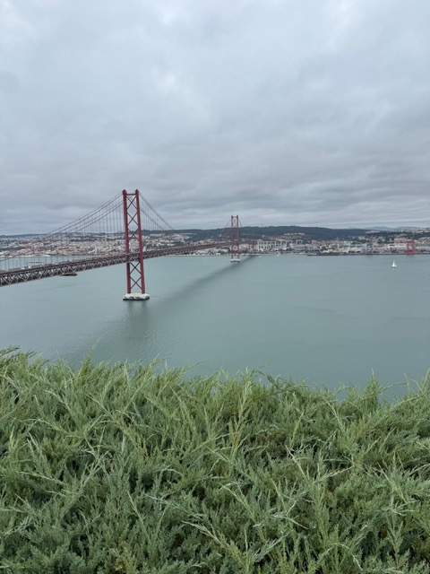
Historical and Architectural Beauty
Photos: Jan Coates

Slide 7
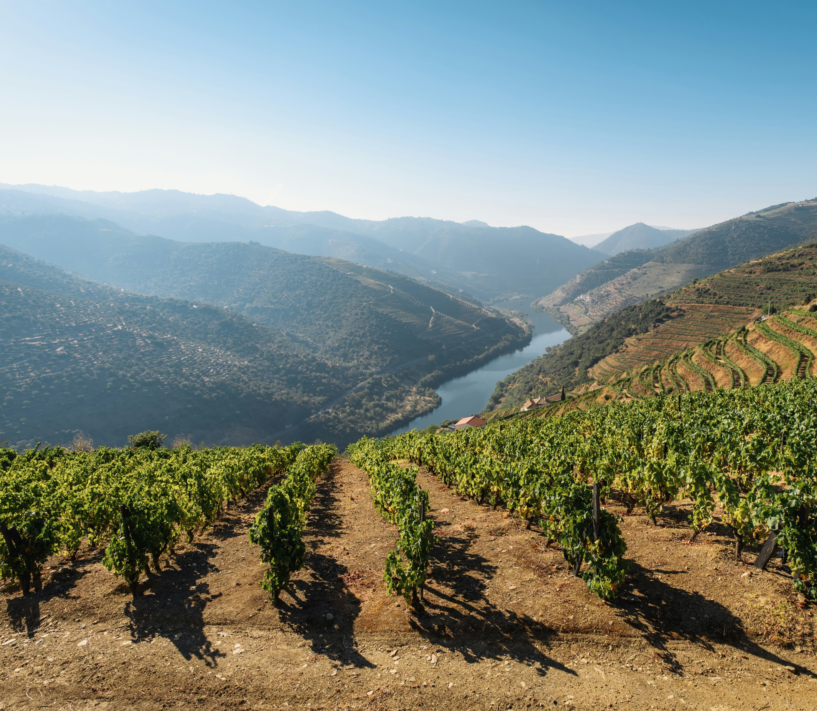
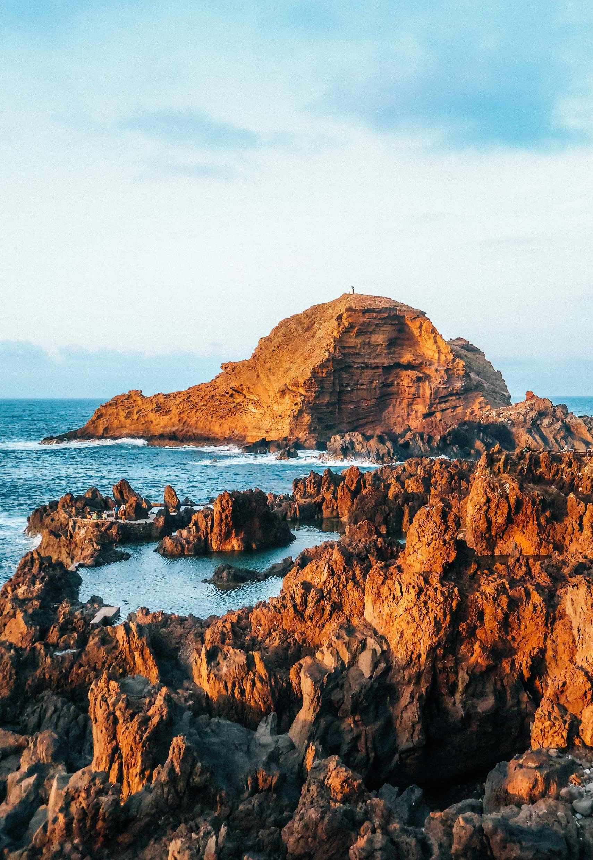
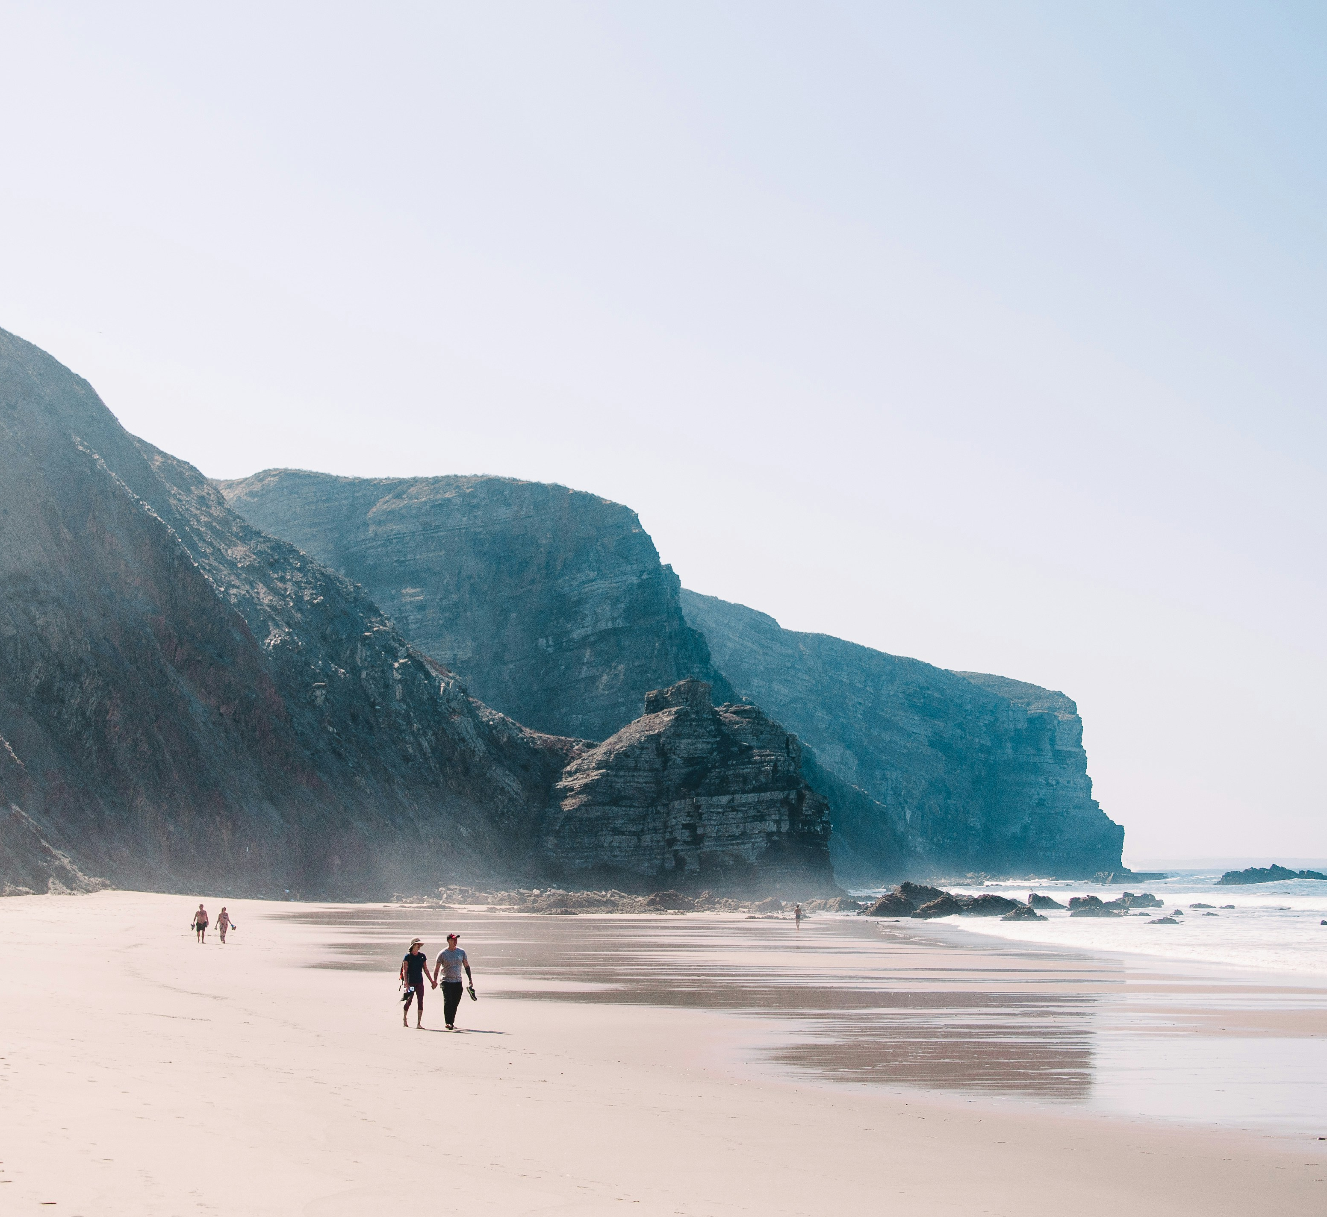
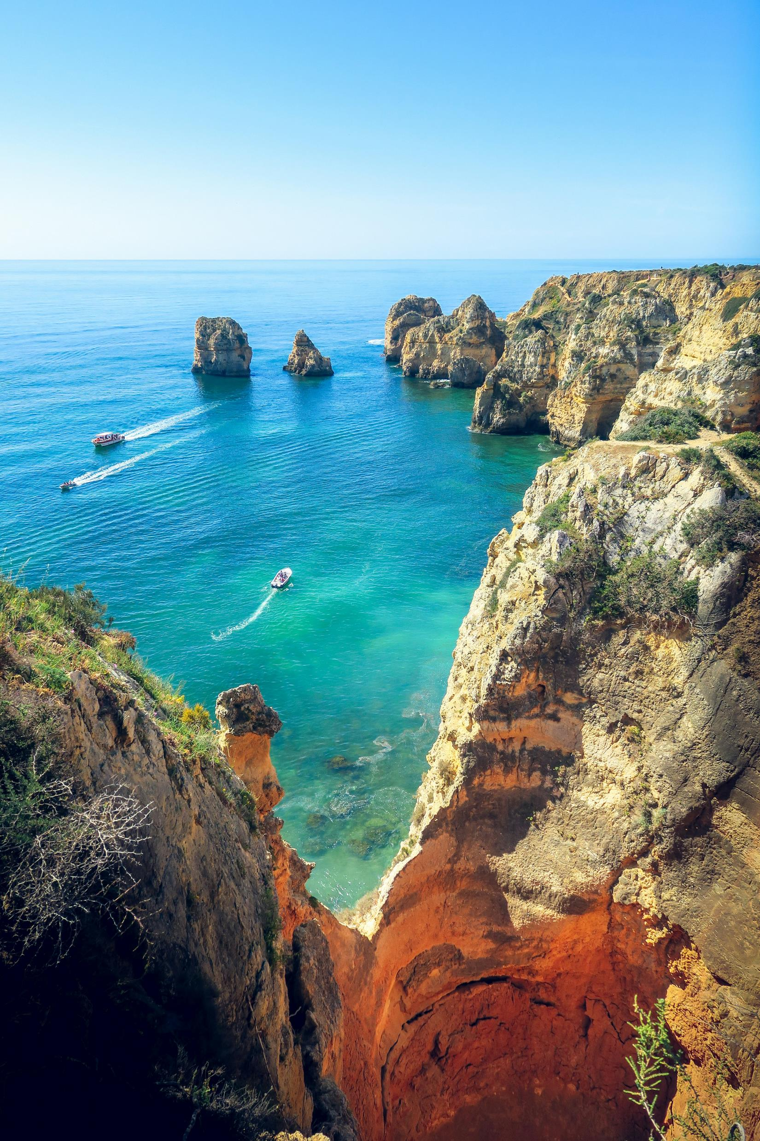
Natural Beauty
Photo: Maksym Koshulynskyi/Unsplash
Photo: Grillot Edouard/Unsplash
Photo: Leon Bublitz/Unsplash
Photo: Max Zed/Unsplash

Slide 8
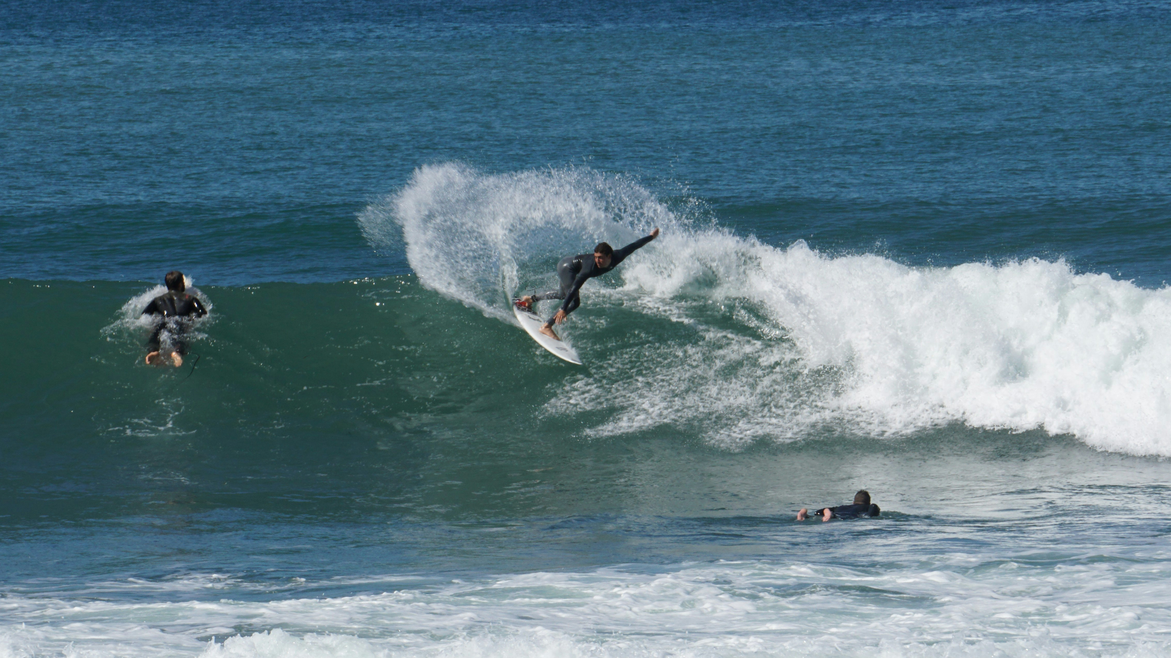
Surfers Paradise
Photo: Borasurfer/Unsplash

Slide 9
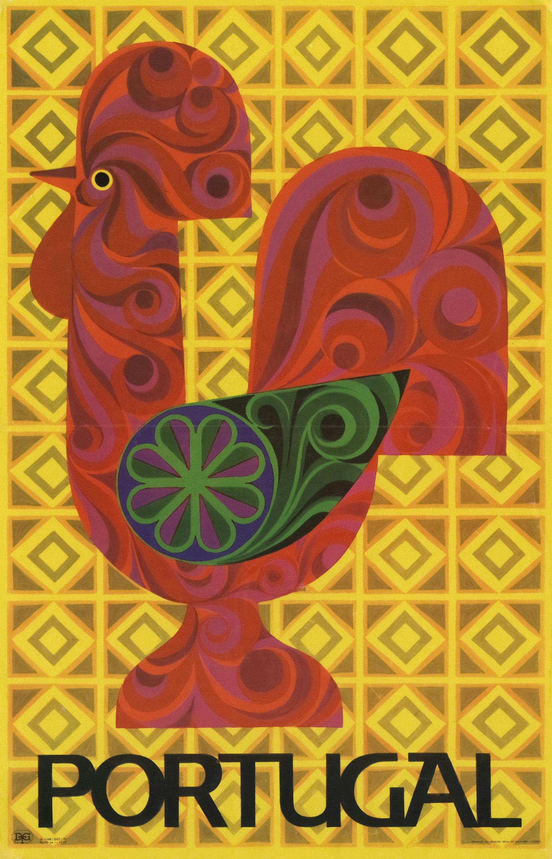
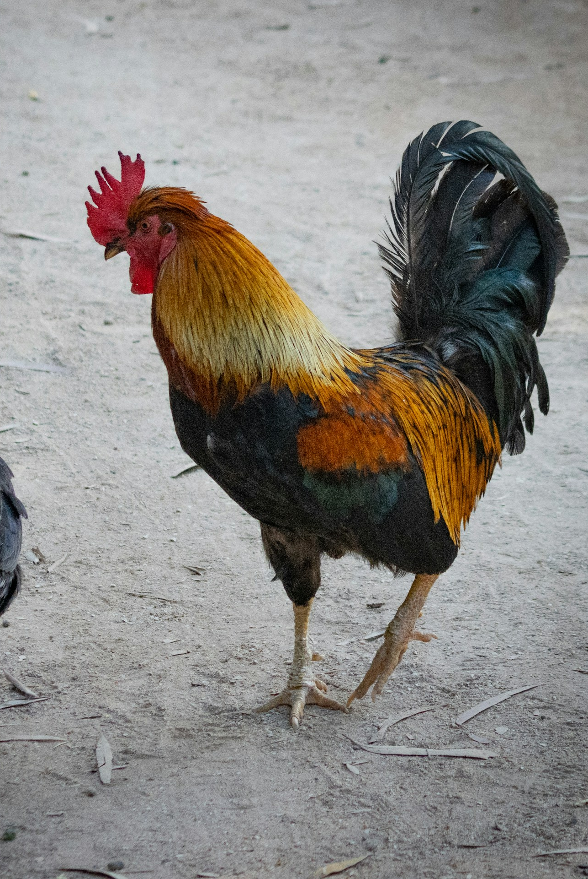
The Barcelos Rooster (the national symbol)
Photo: Europeana/Unsplash
Photo: Fabian Joy/Unsplash

Slide 10
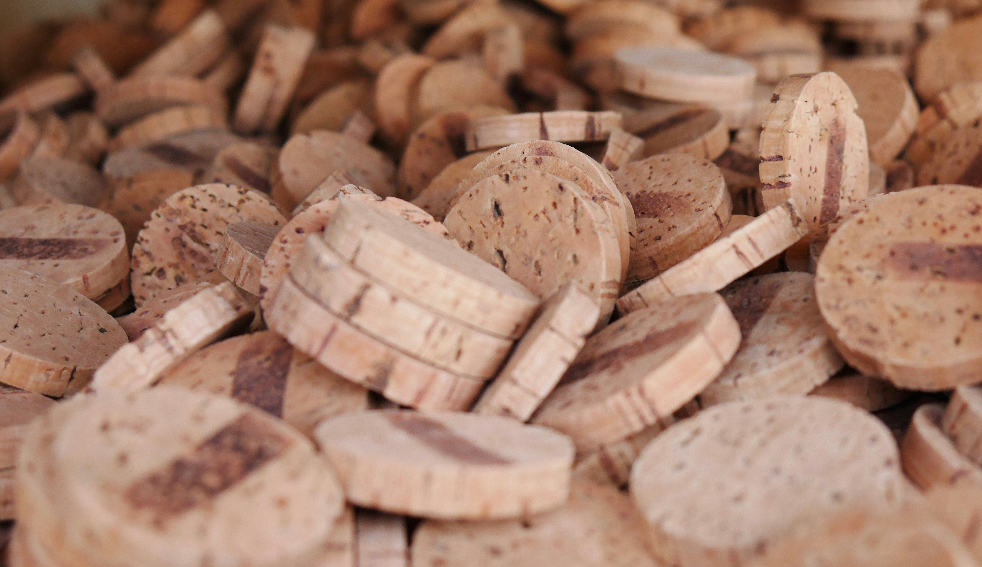
More than half of the world’s
cork comes from Portugal.
Photo: Clem Around the Corner/Unsplash

Slide 11
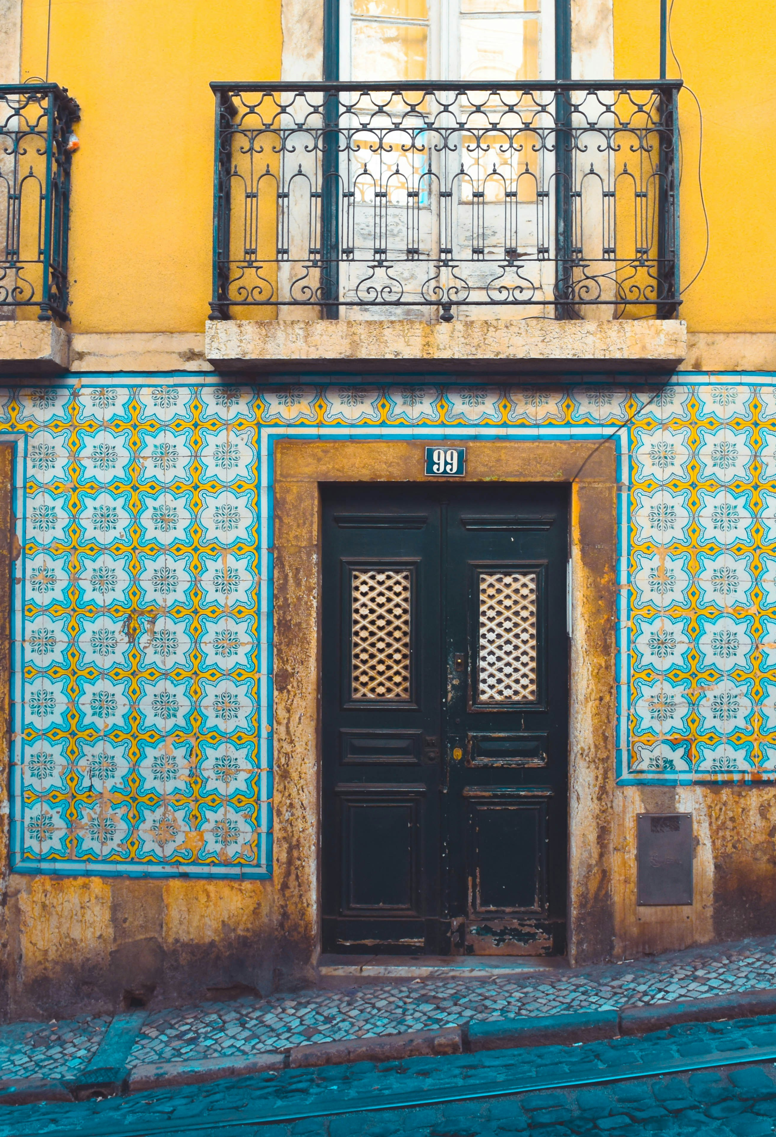
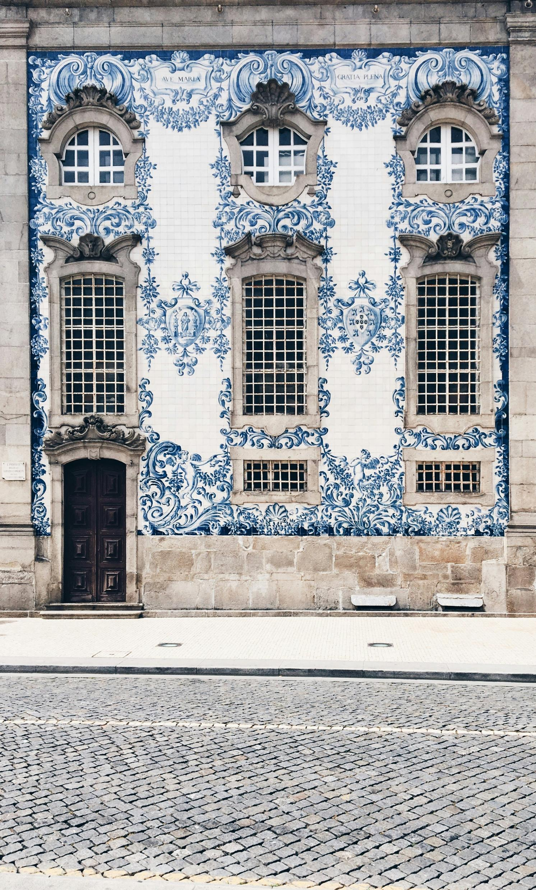
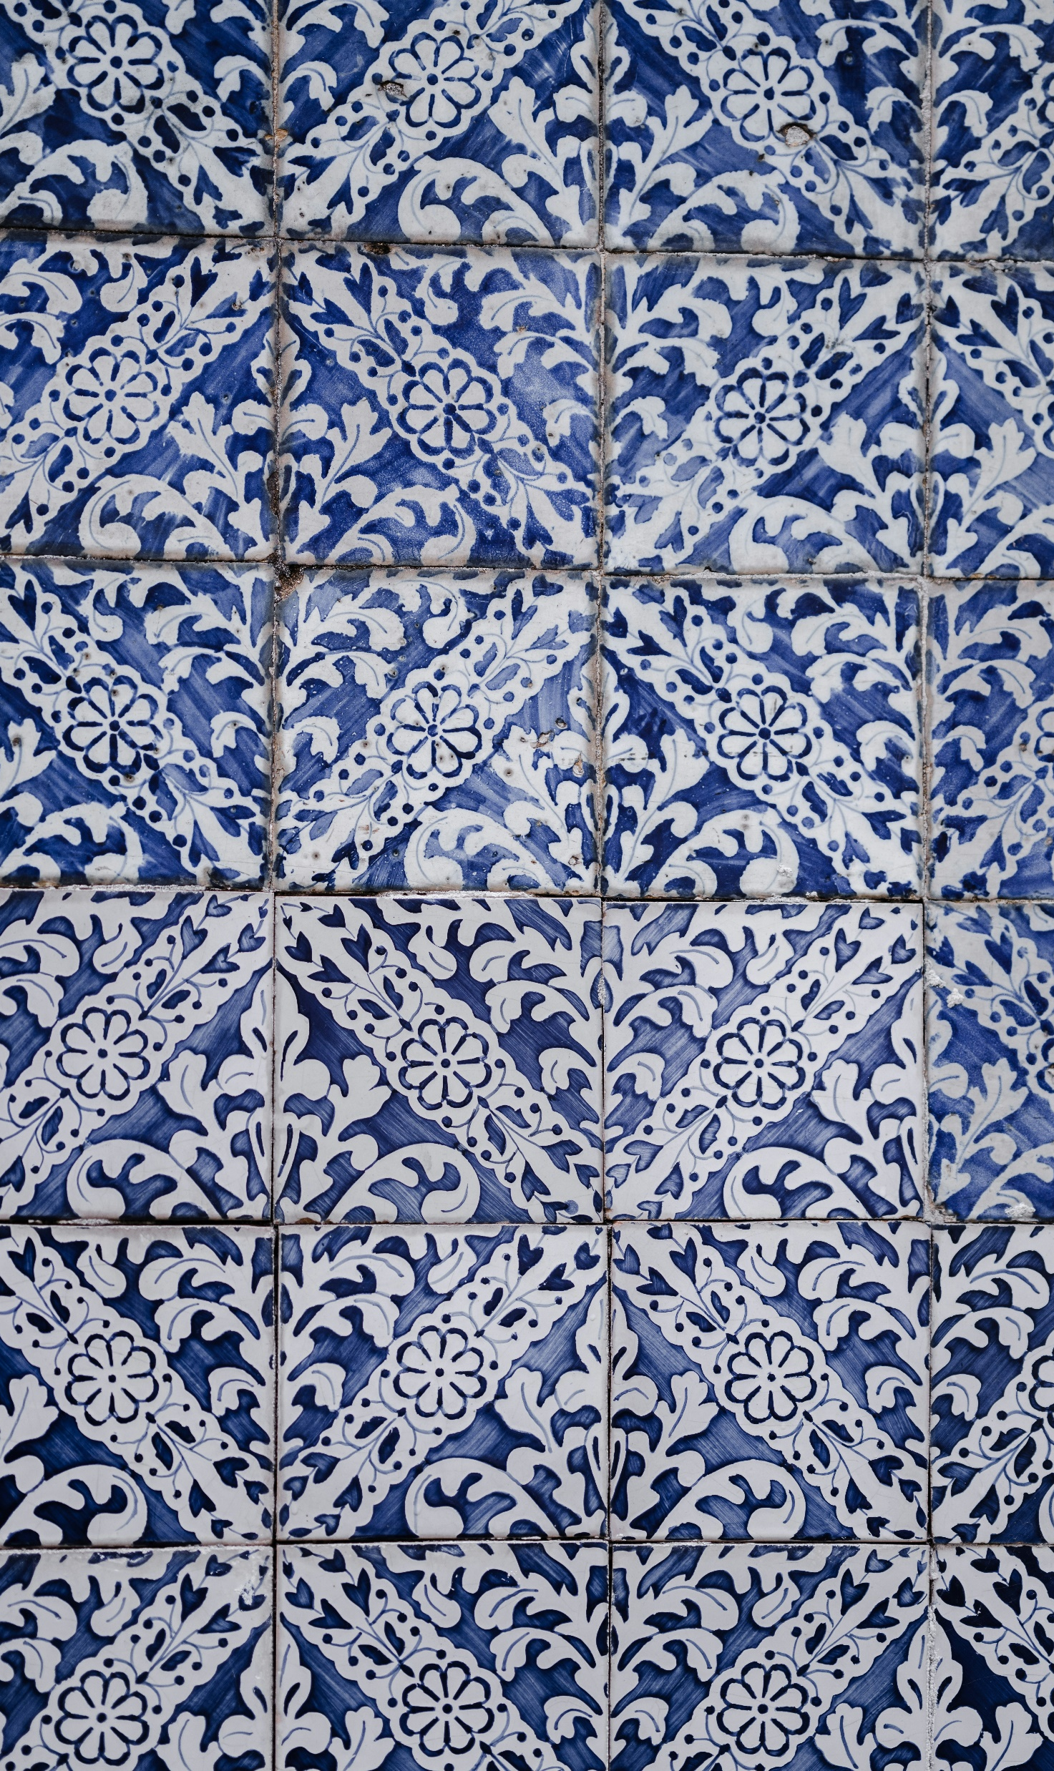
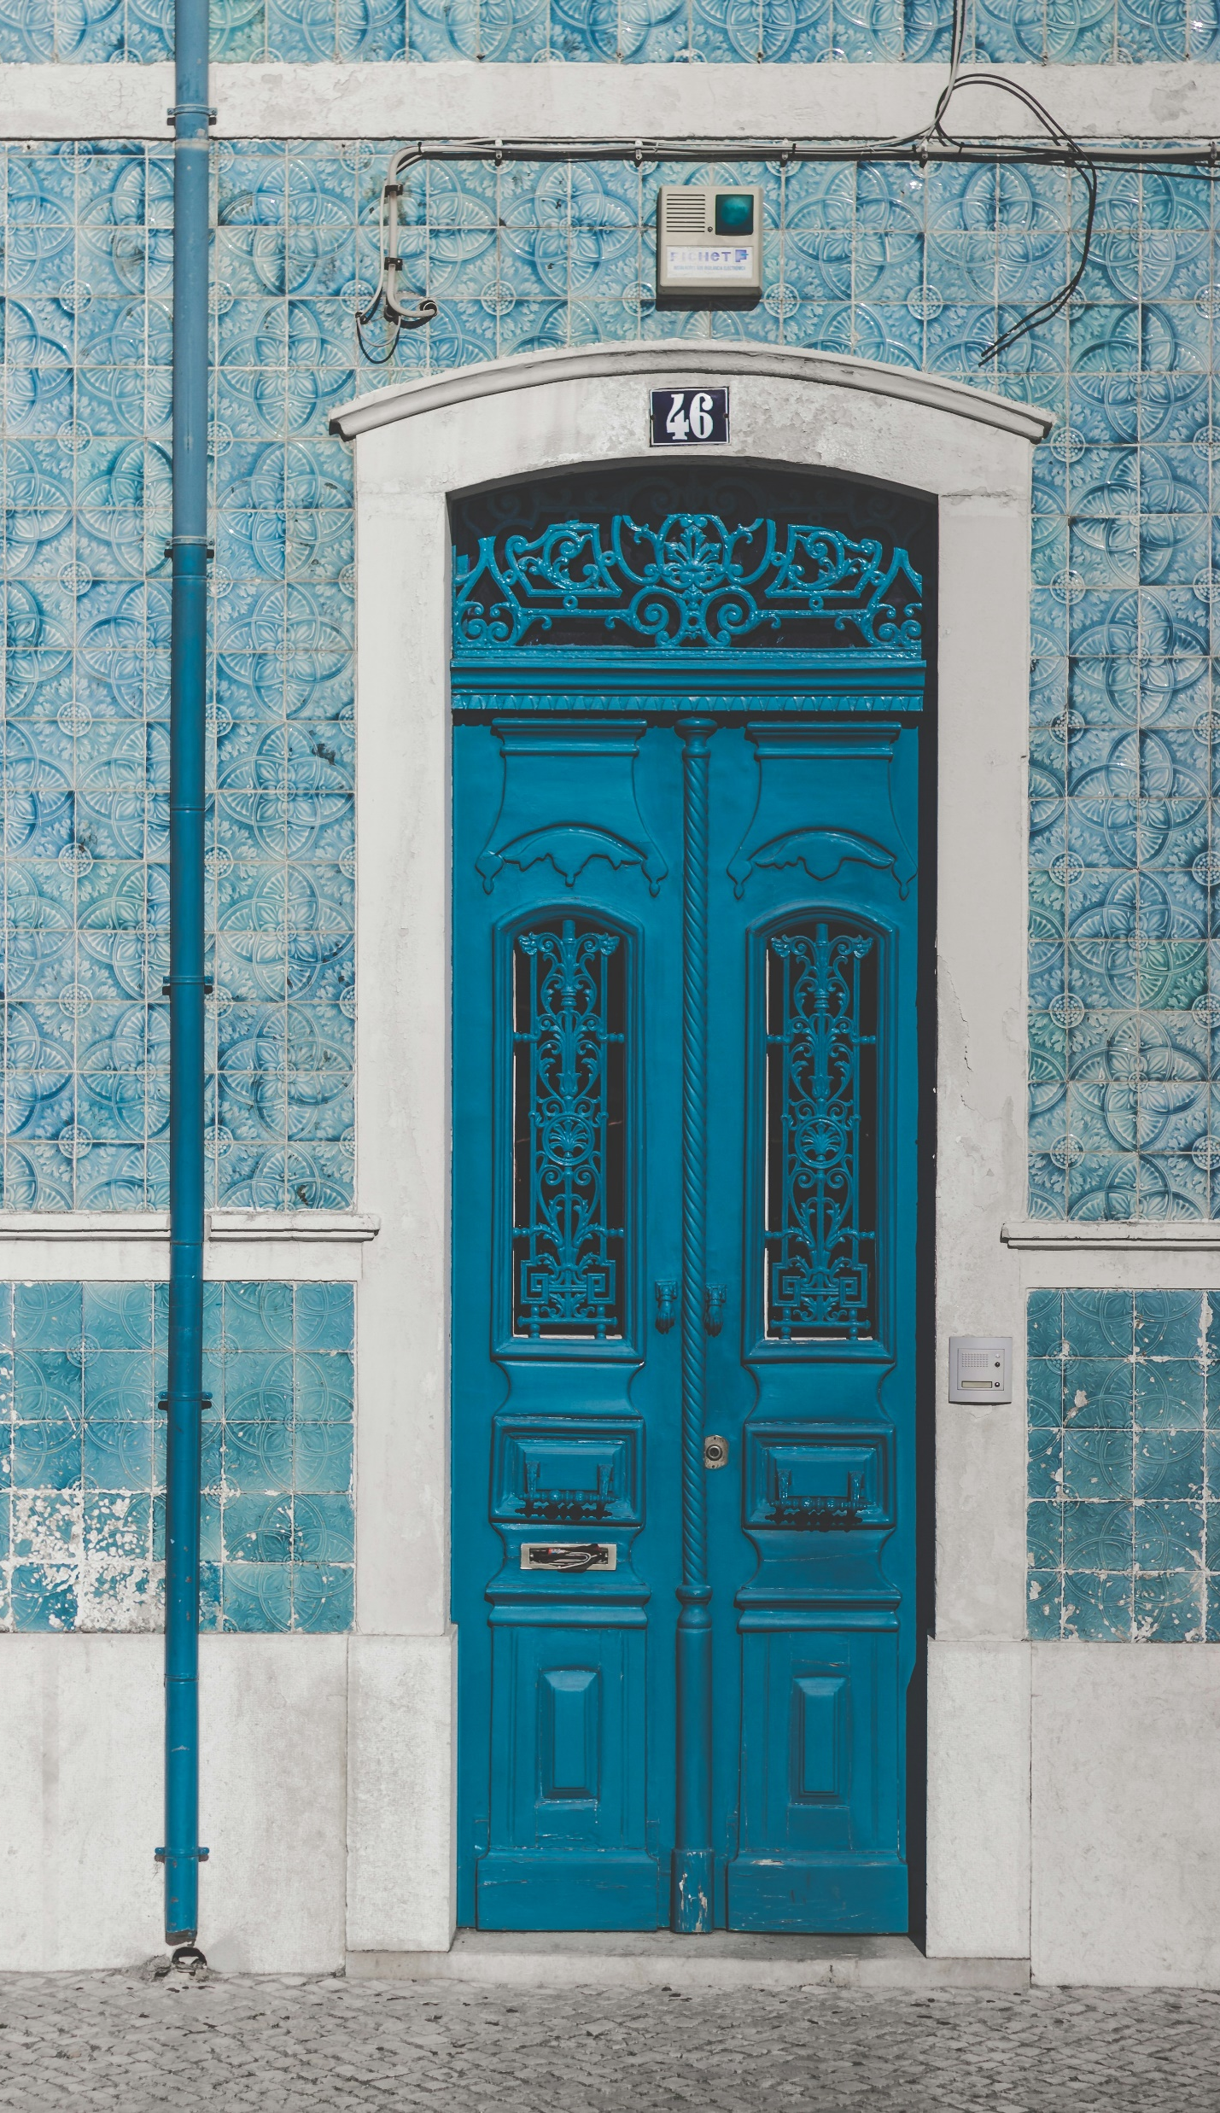
Azulejos (Portuguese tiles)
Photo: Diego Garcia/Unsplash
Photo: Yana Marudova/Unsplash
Photo: Annie Spratt/Unsplash
Photo: Catarina Caravalho/Unsplash

Slide 12
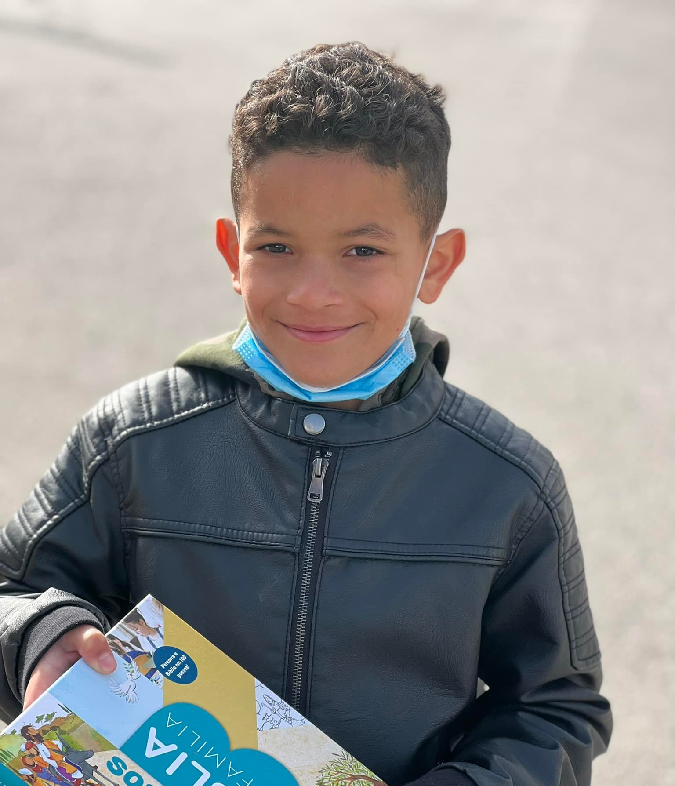
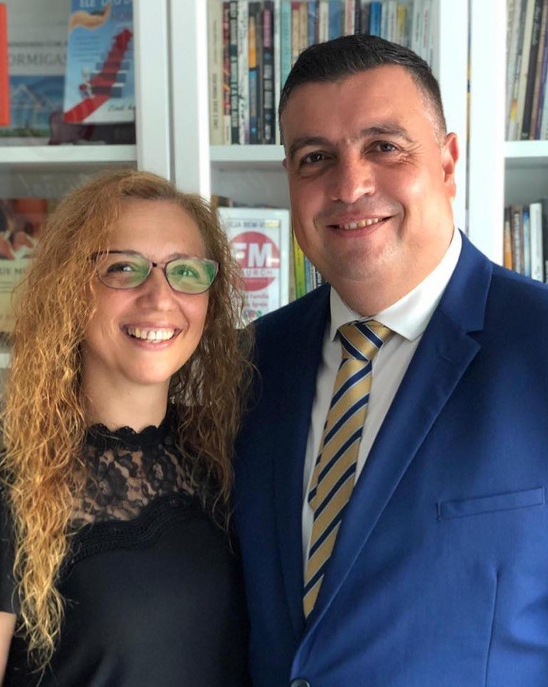
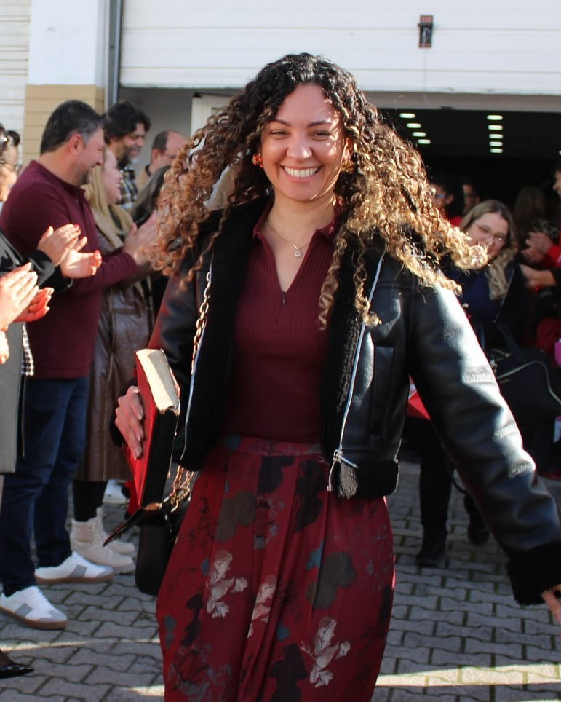
Beautiful People
FamilyID=Office_ArchiveTorn
Photos: Eduardo & Cindi Angelo

Slide 13
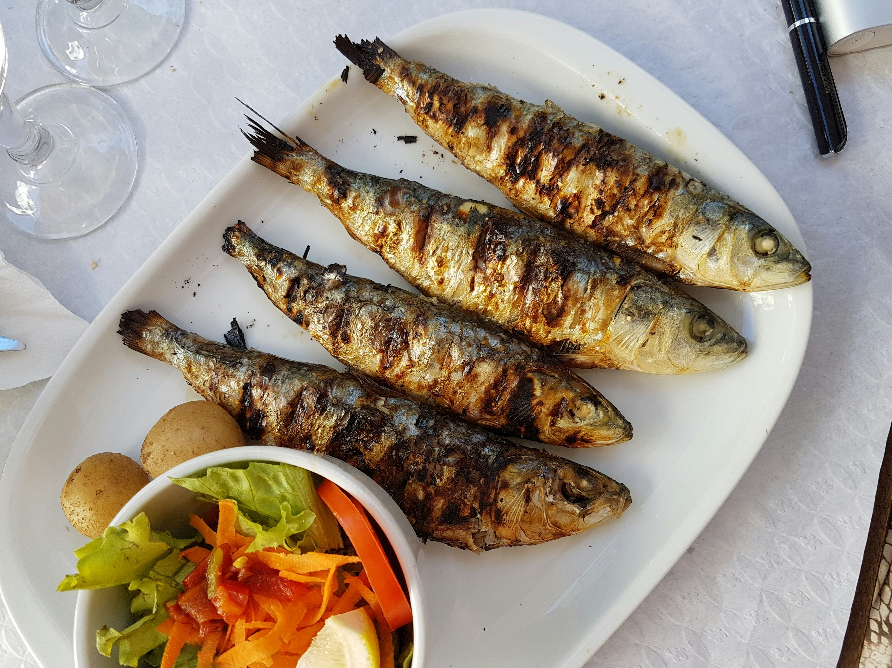
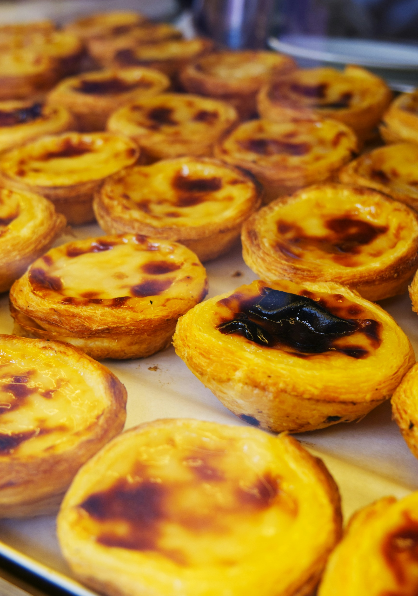
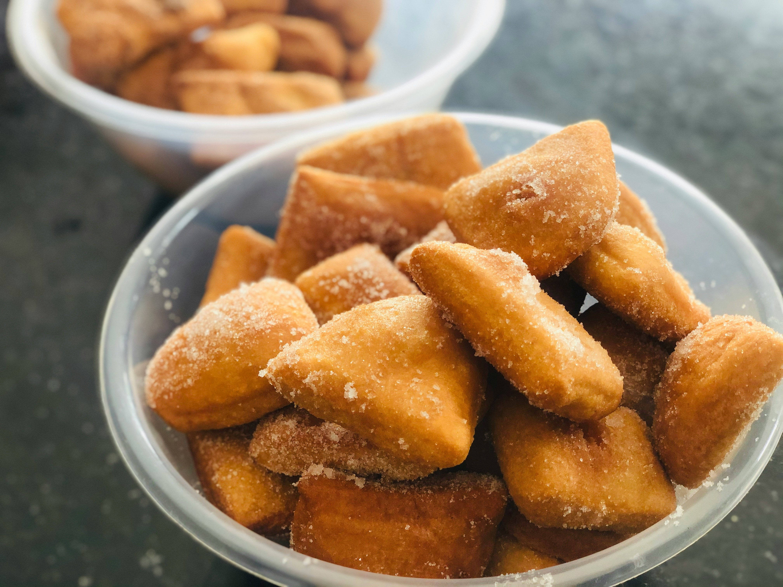
Delicious Food
Cod Fish
Photo: Alex Teixeria/Unsplash
Portuguese Donuts
Custard Tarts
Photo: Cristiano Pinto/Unsplash
Photo: Andy Kennedy/Unsplash

Slide 14

Explore God’s Work

Slide 15
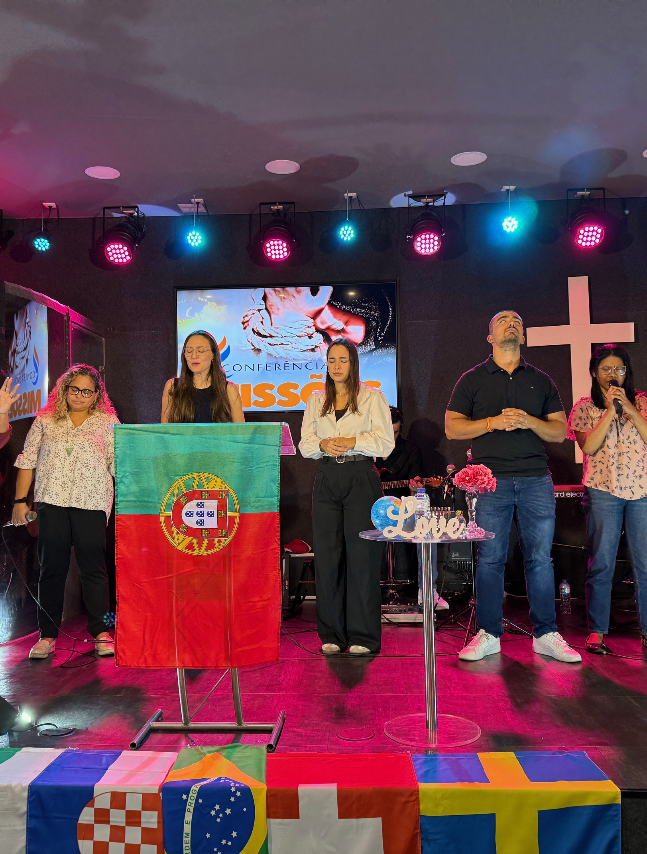
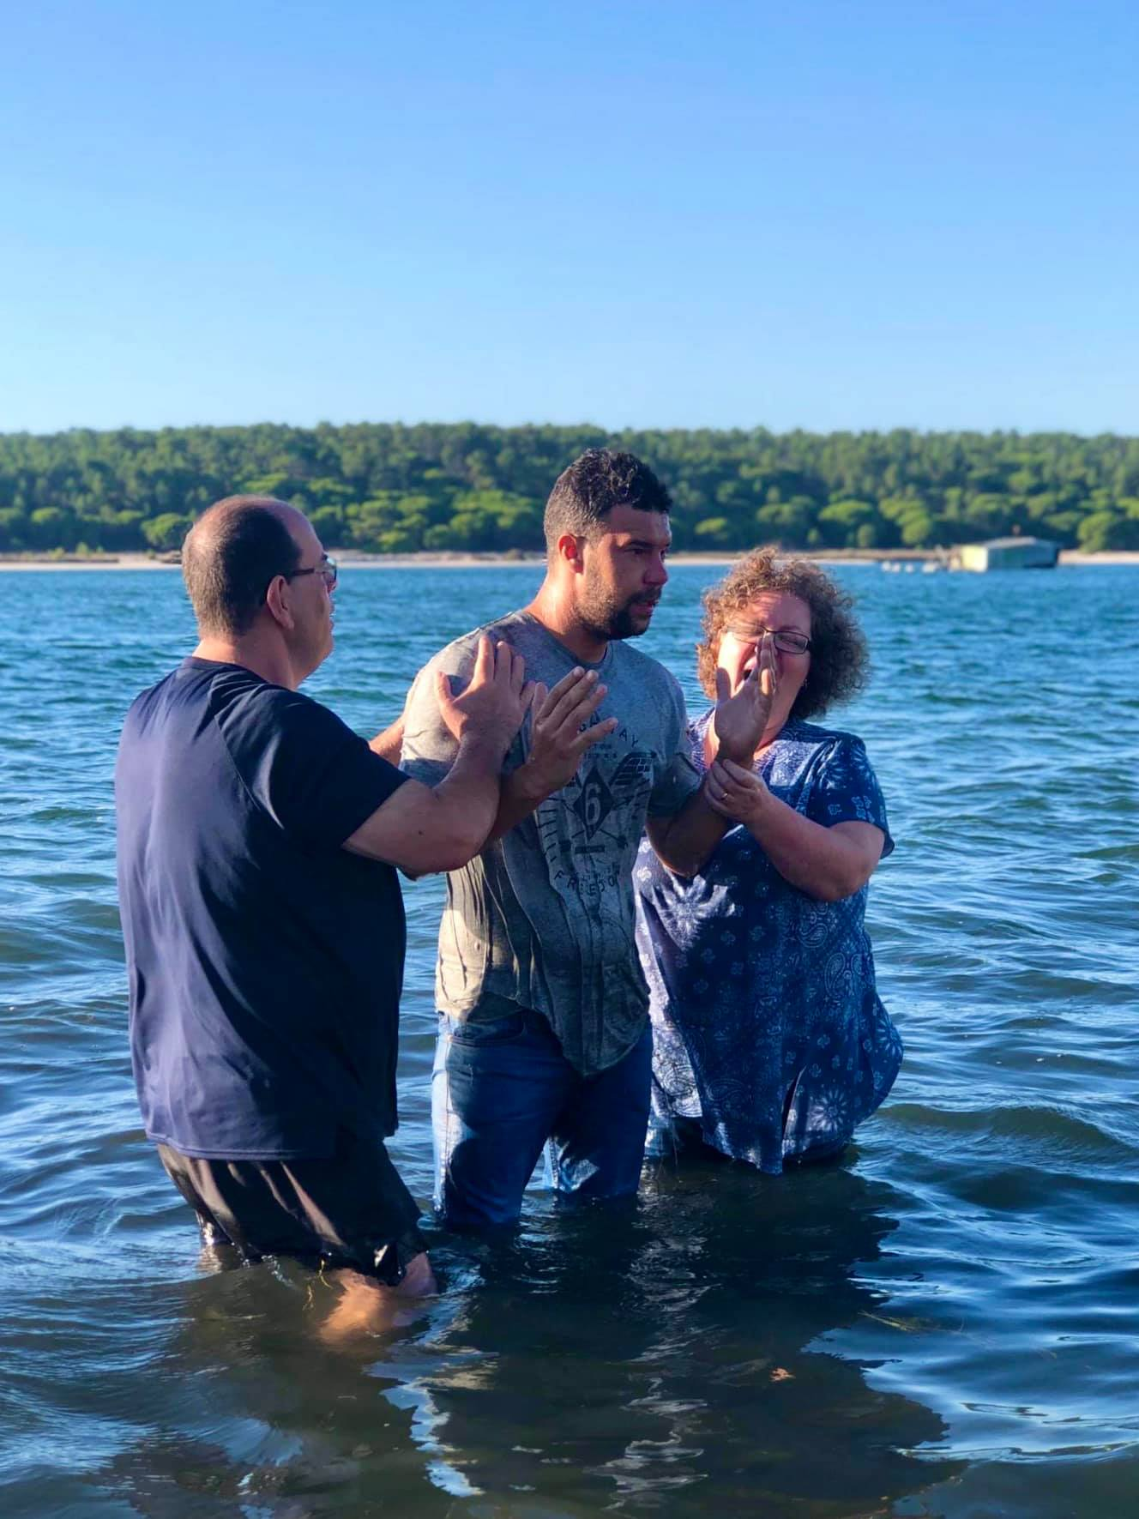
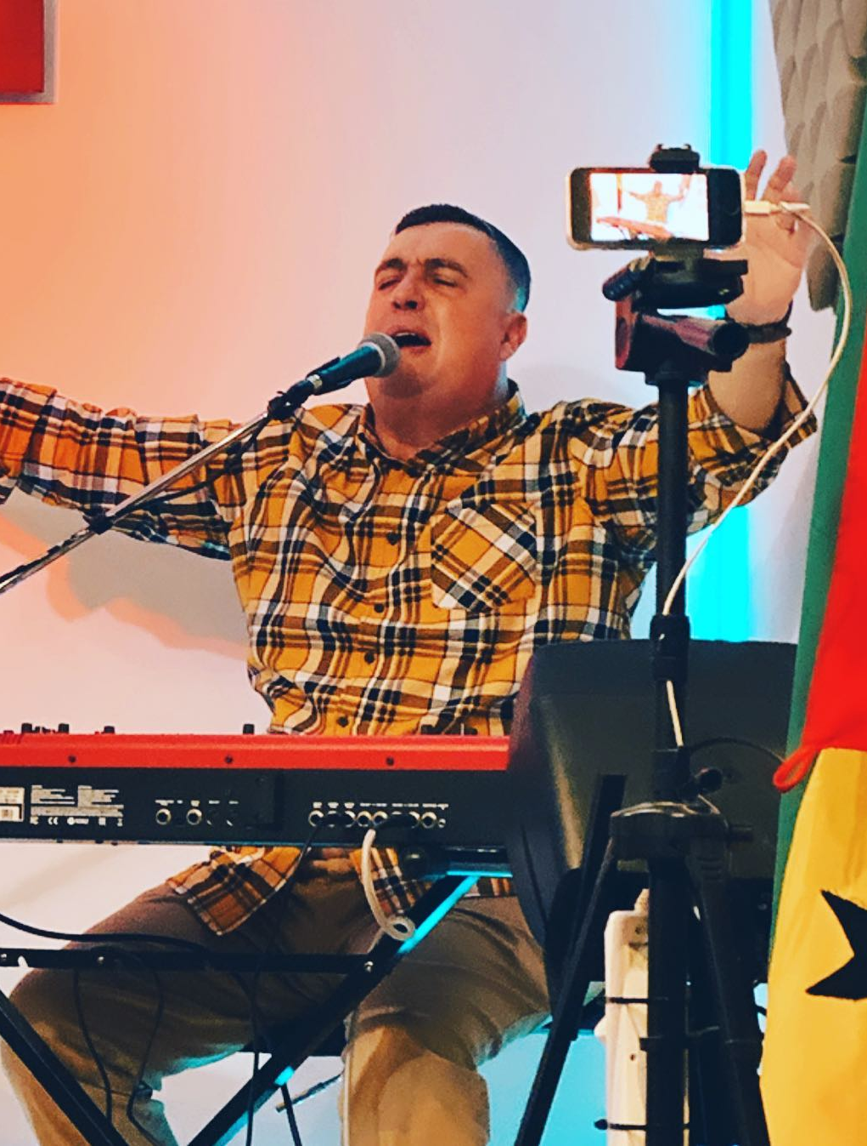
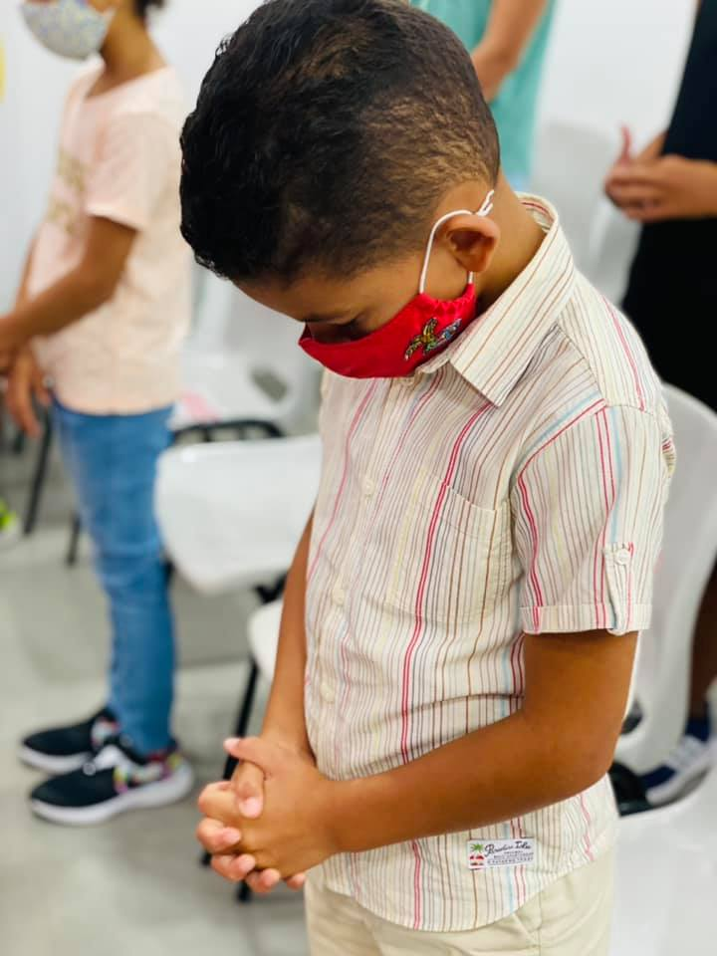
Photos: Eduardo & Cindi Angelo
The Free Methodist Church
Portugal

Slide 16
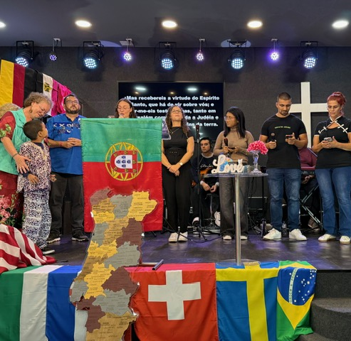
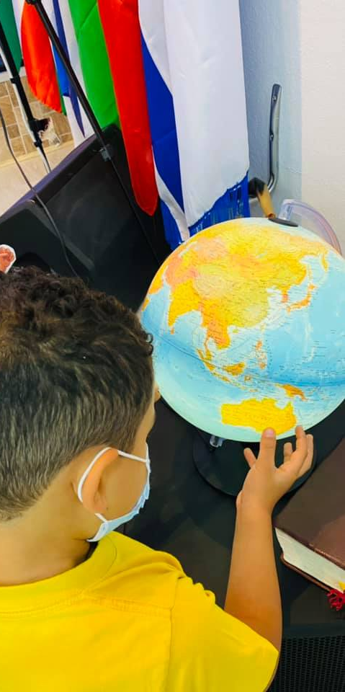
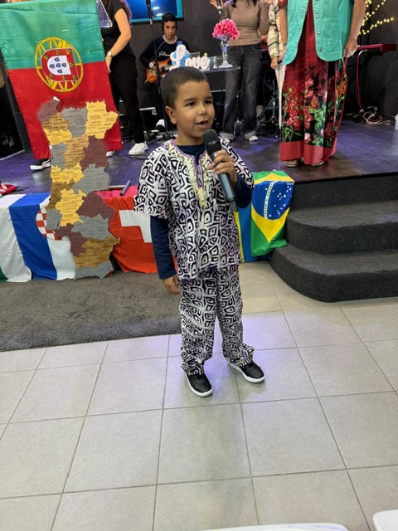
A Church with a Global Heart

Slide 17

Adventure Story

Slide 18
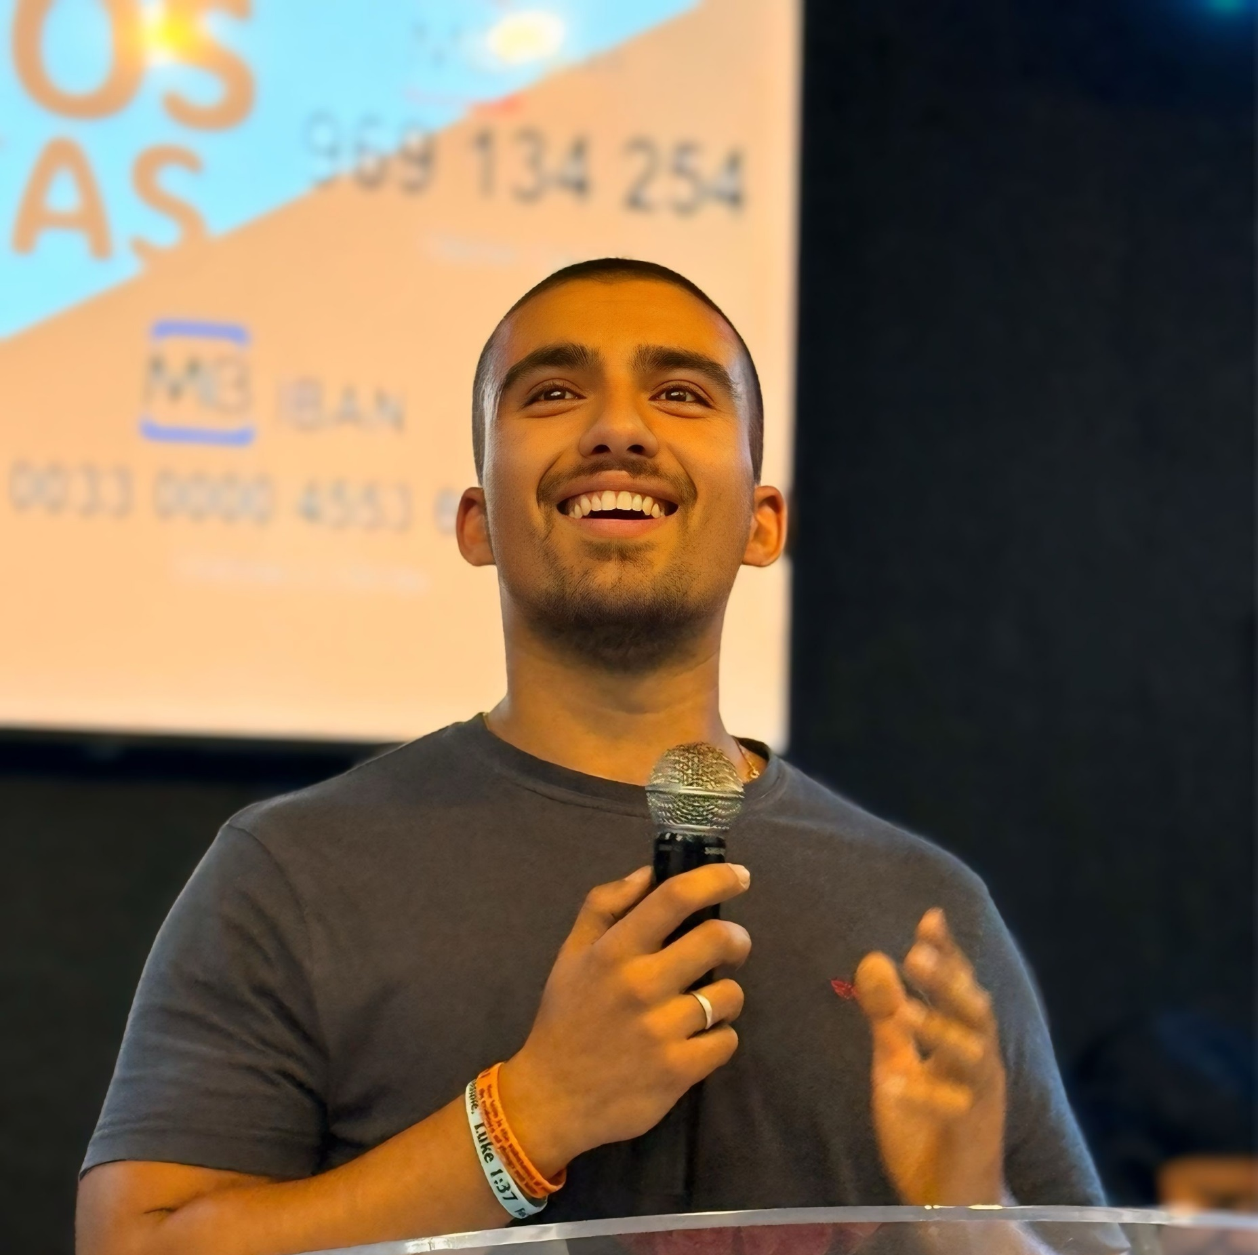
I Want to Grow in God and Learn More!
Tiago
Photo: Cindi Angelo

Slide 19

People on Adventure

Slide 20
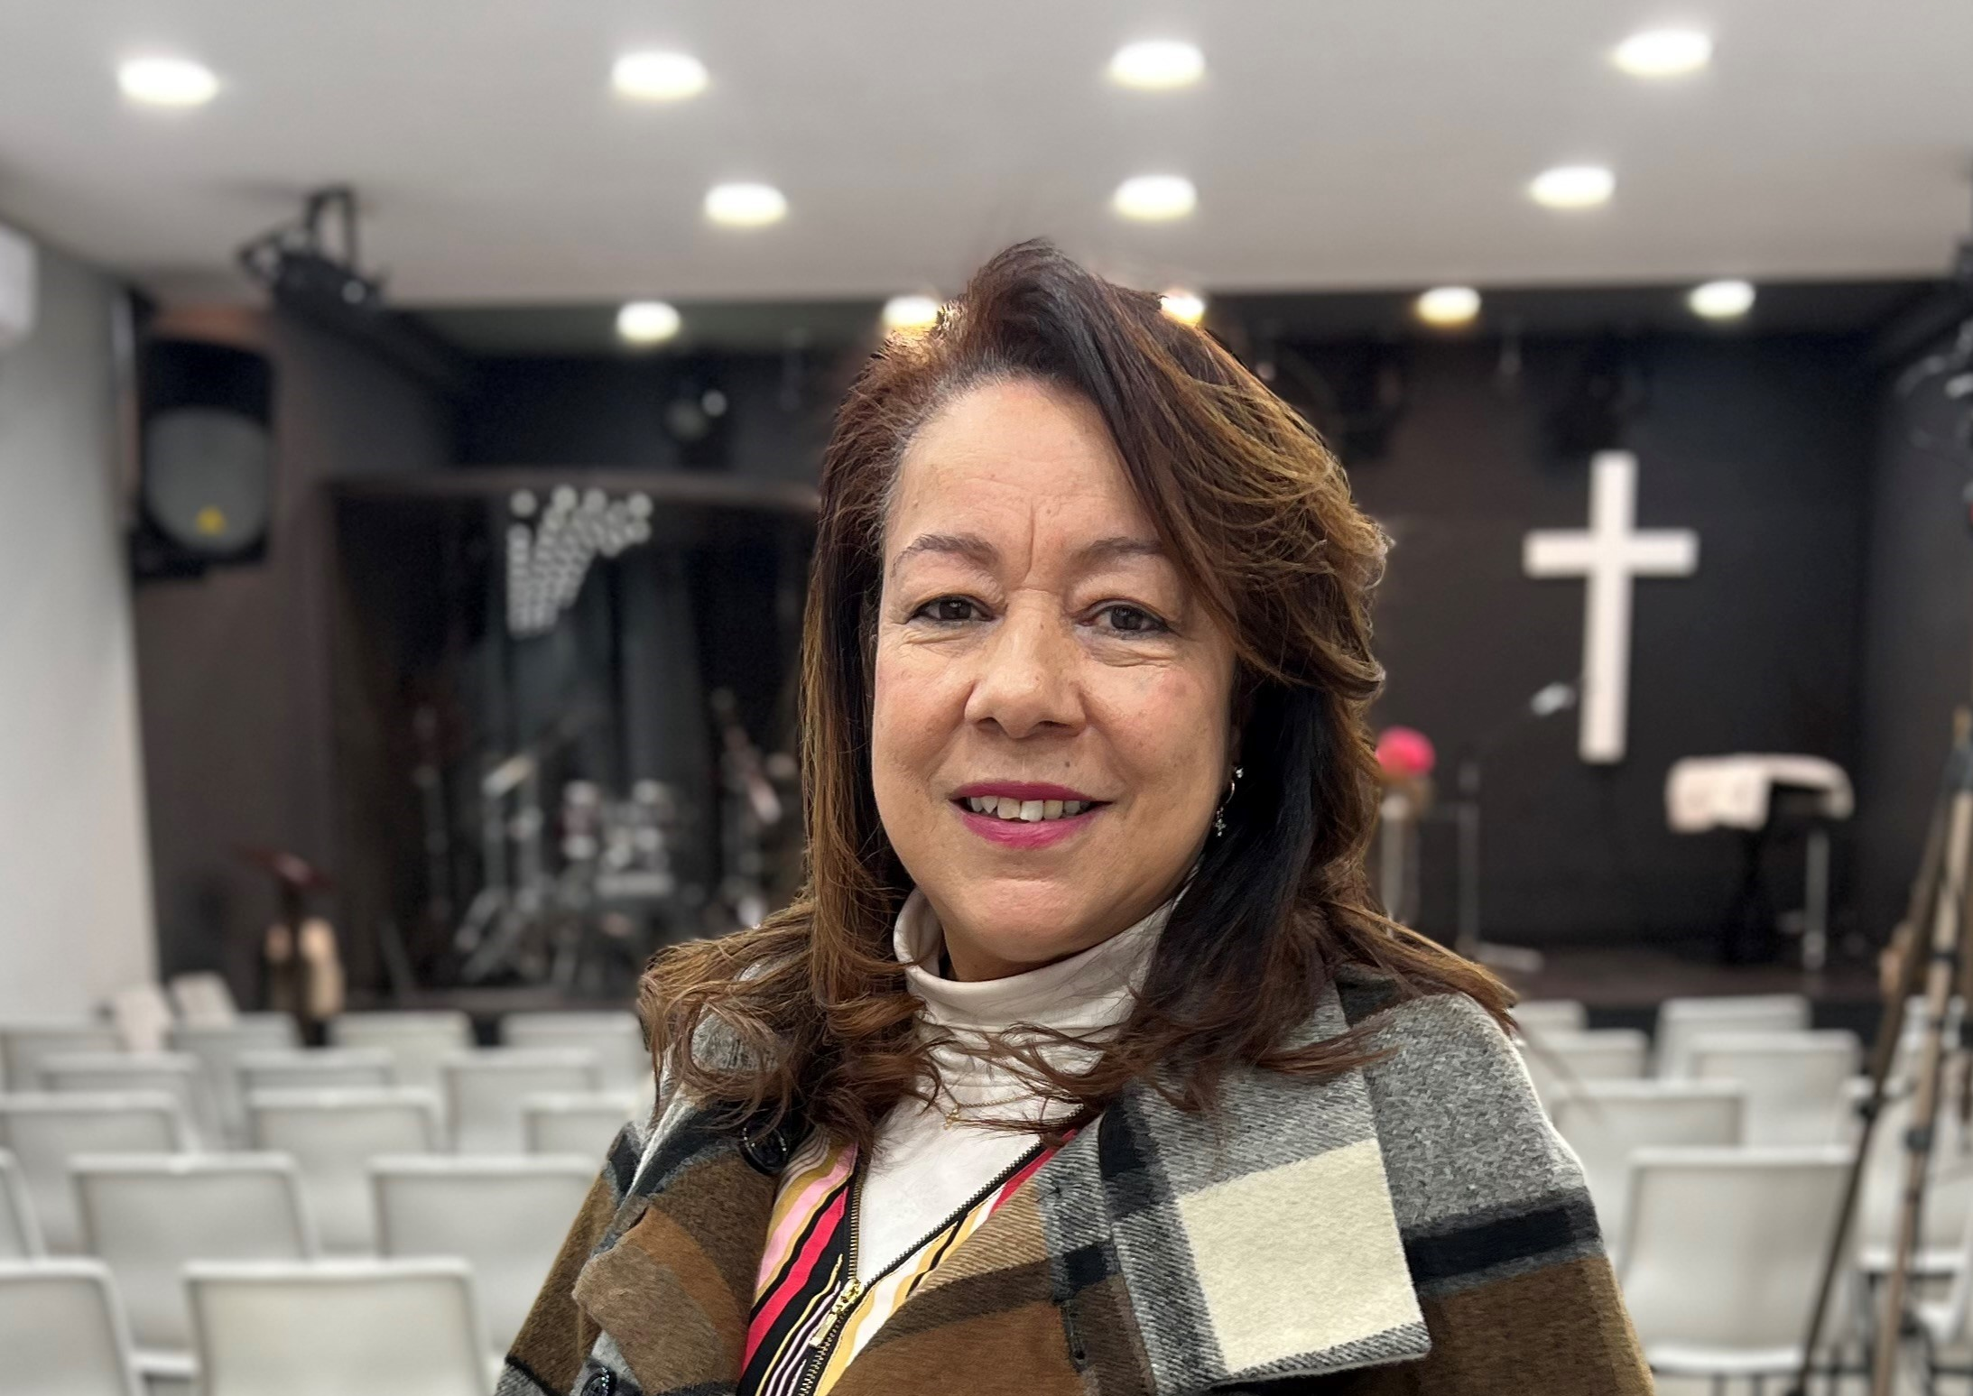
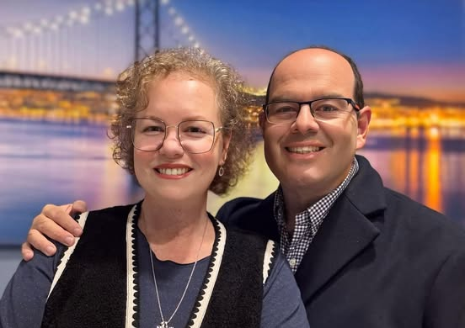
Cida Matos
Eduardo & Cindi Angelo
Eduardo, Cindi and Cida are
international missionaries from Brazil.

Slide 21

Adventures in Culture

Slide 22
Language
Portuguese | English
Bom Dia | Good Morning
Boa noite | Good Night
Por Favor | Please
Obrigada (female) Obrigado (male) | Thank you
Como está? | How are you?

Slide 23

God Is So Good
God is so good,
God is so good,
God is so good,
He’s so good to me.

Slide 24

Portuguese
Deus é tão bom (DAY-oos eh ton bom)
Deus é tão bom (DAY-oos eh ton bom)
Deus é tão bom (DAY-oos eh ton bom)
É tão bom p’ra mim. (Eh ton bom prah me)

