Slide 1

Global Adventures
Middle East

Slide 2
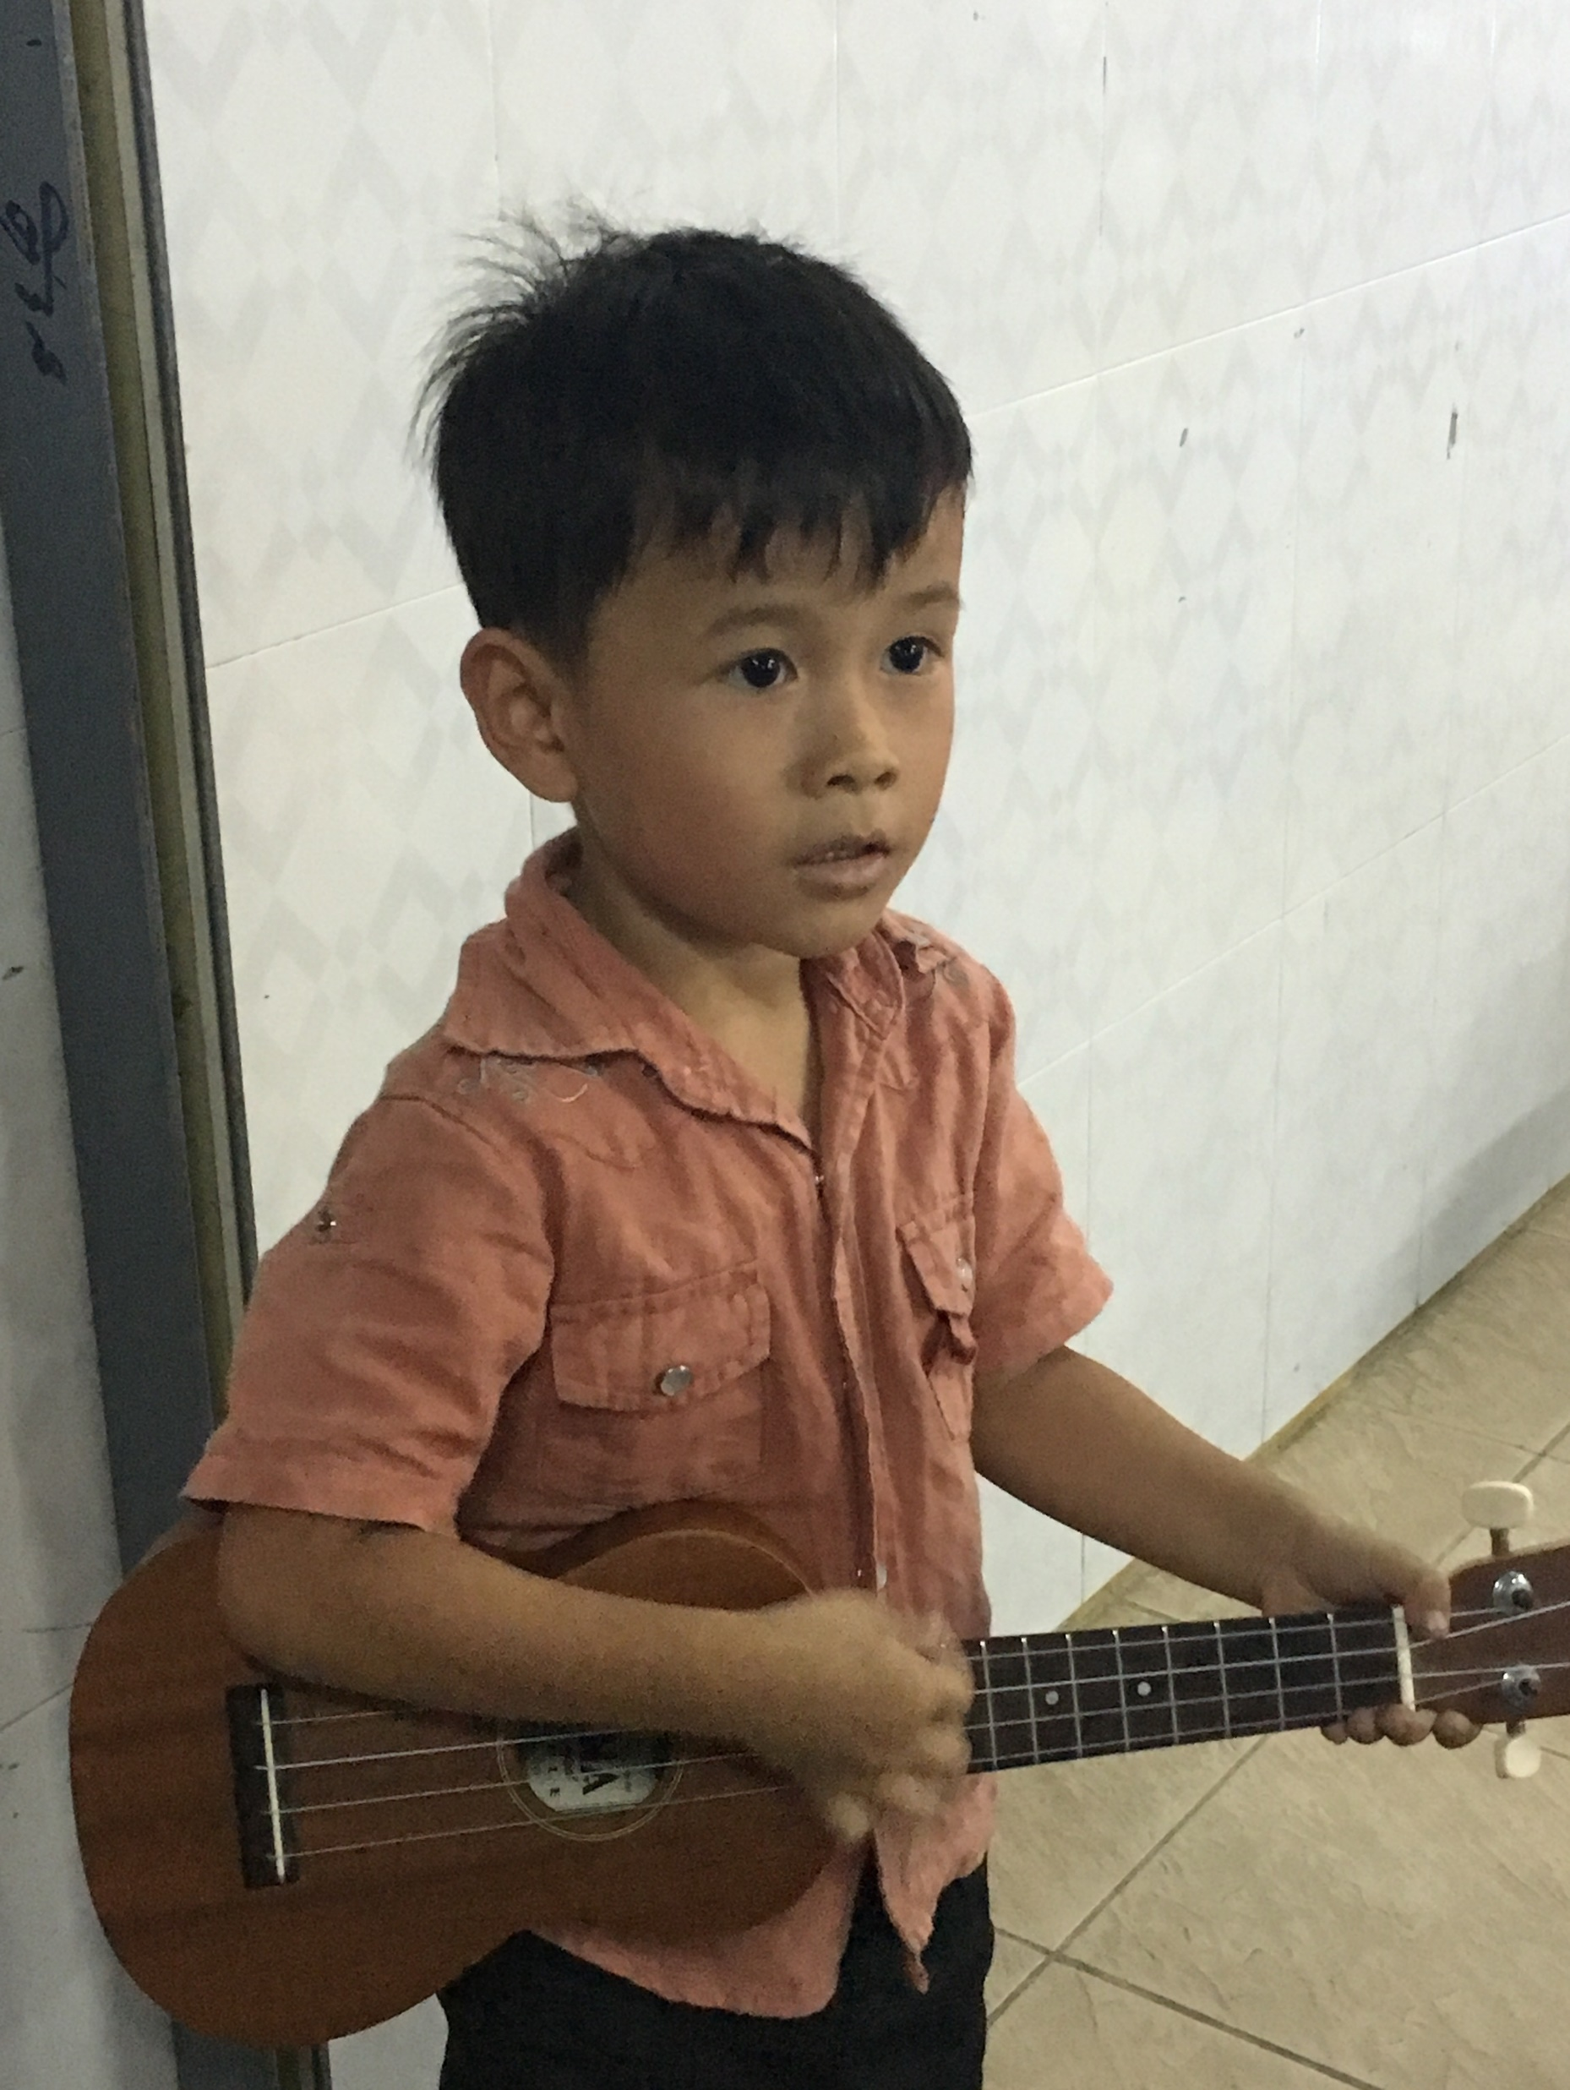
Theme Verse
Sing to the Lord a new song; sing to the Lord,
all the earth.
Sing to the Lord, praise his name; proclaim his salvation day after day.
Declare his glory among the nations, his marvelous deeds among all peoples.
- Psalms 96:1-3
Unsplash: Ben White

Slide 3

Explore the Country

Slide 4

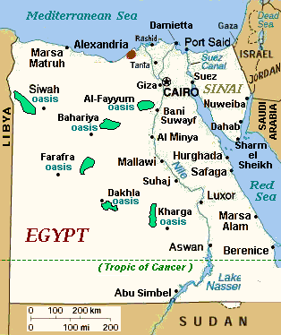
CIA World Fact Book
Egypt
Wikimedia Commons: US CIA Public Domain

Slide 5
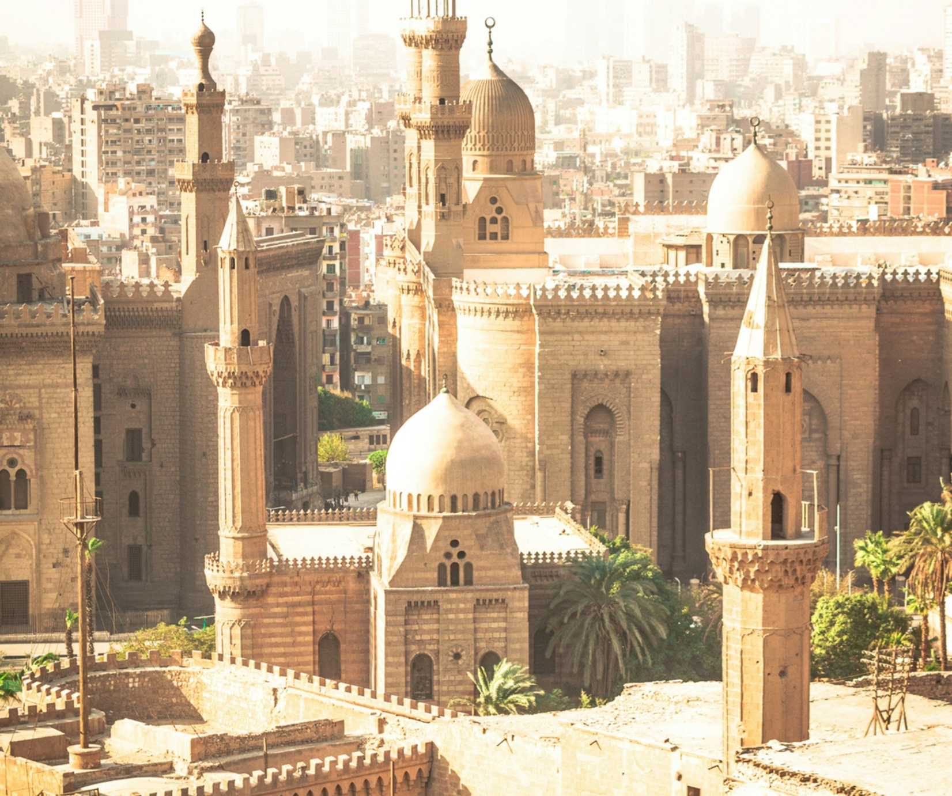
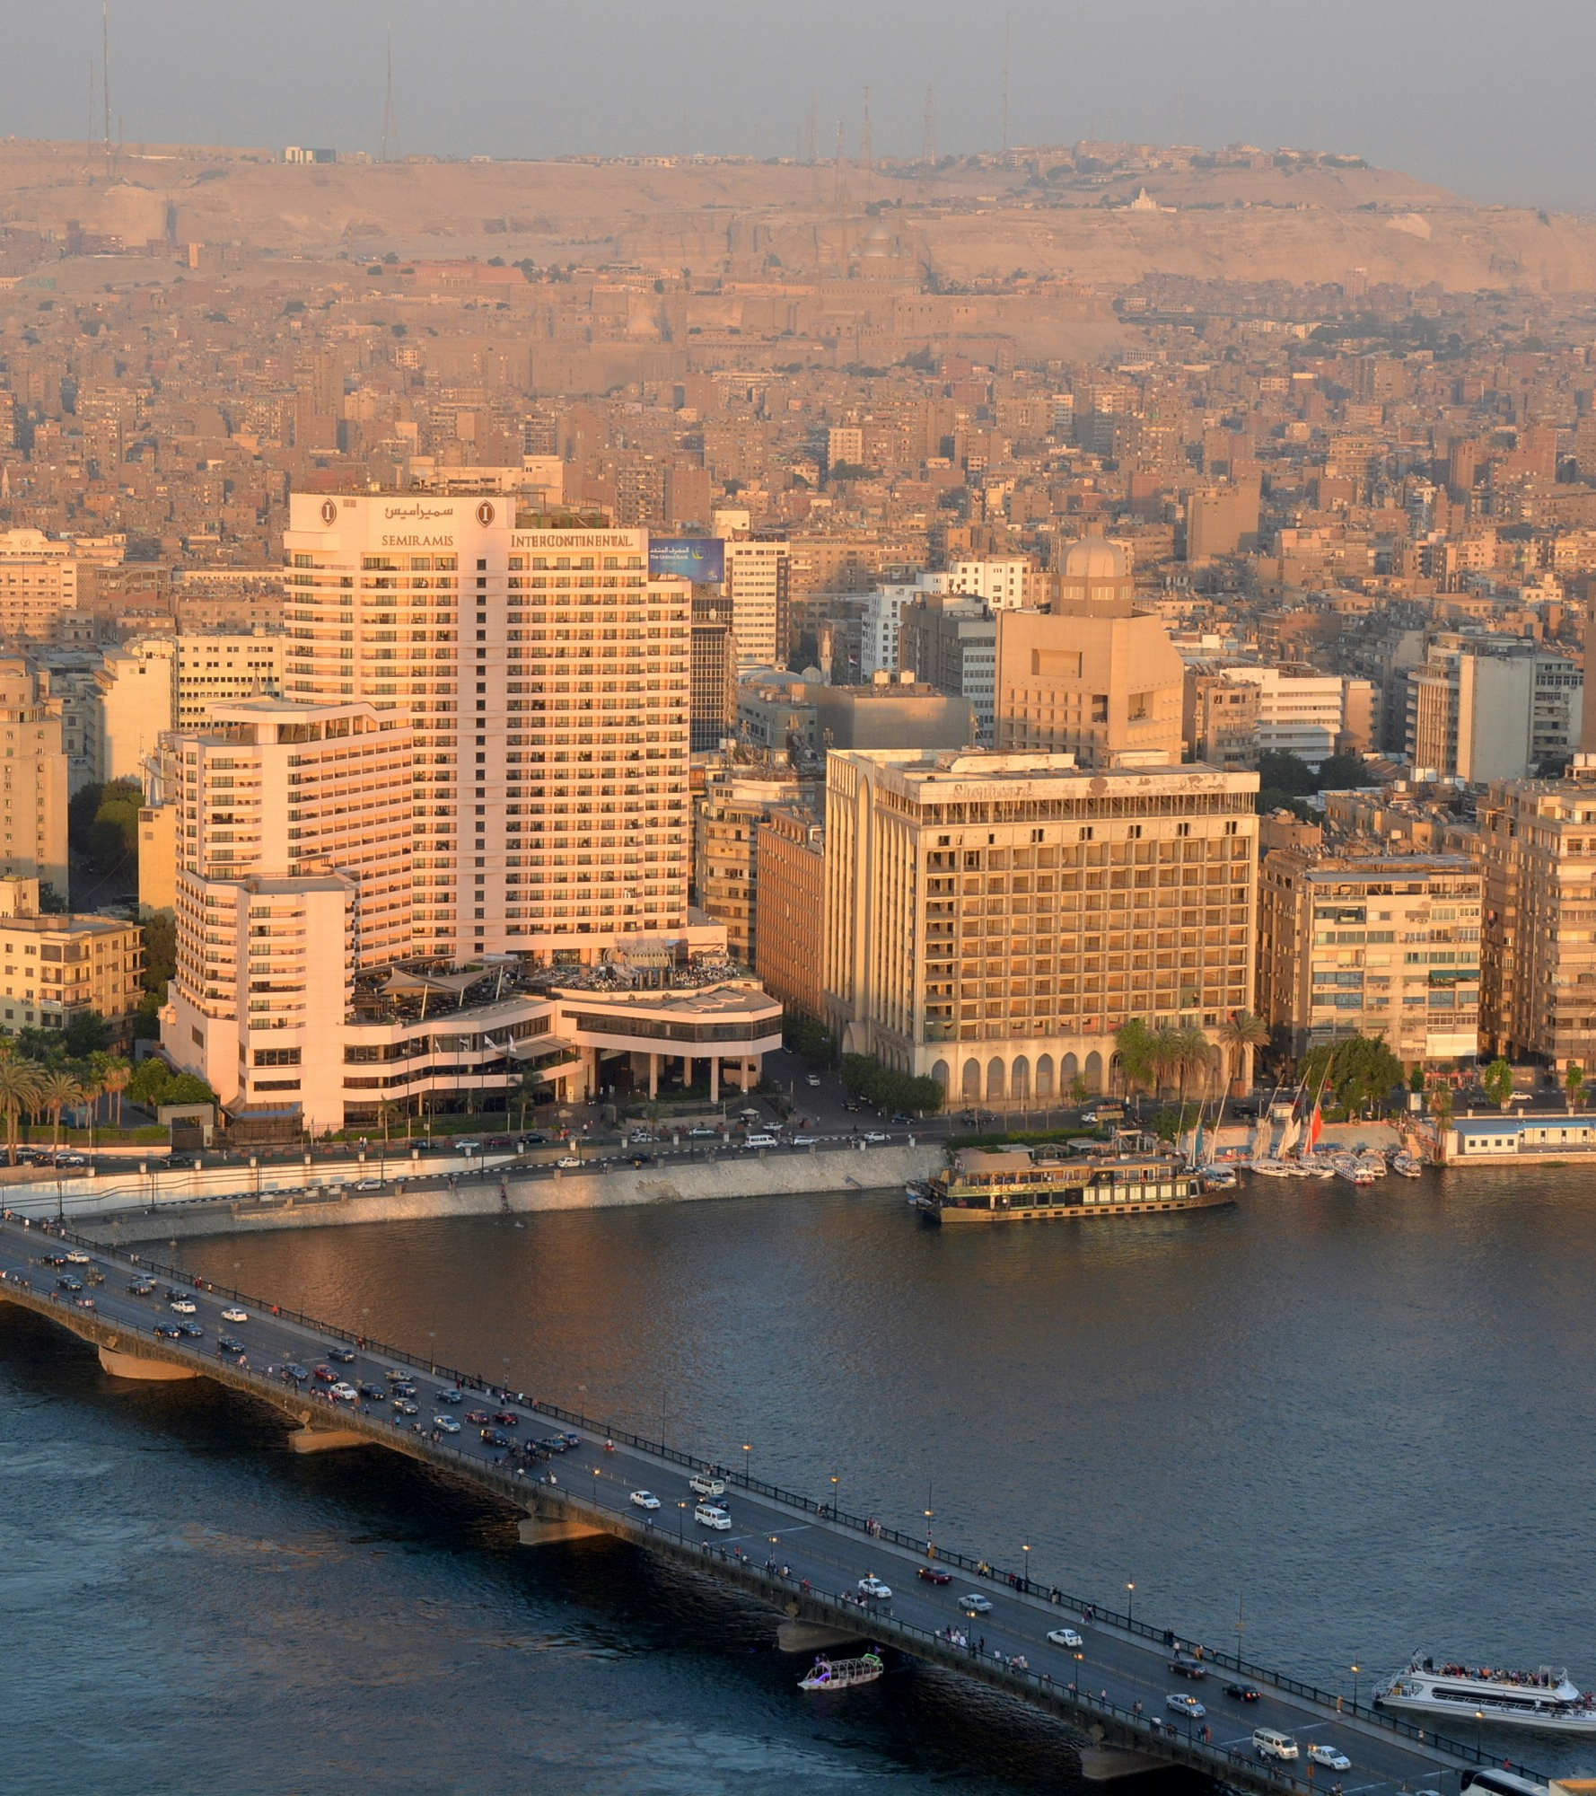
Cairo
(the capital city)
Photo: Omar Adel/Unsplash
Photo: Manuel Jimenez/Unsplash

Slide 6
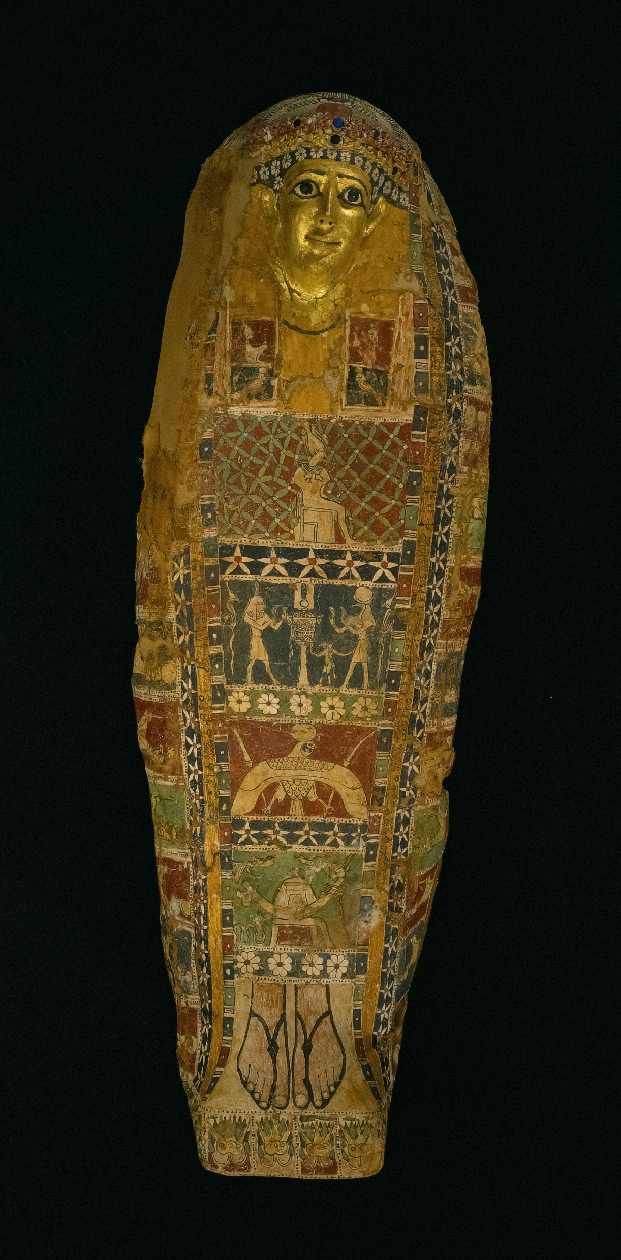
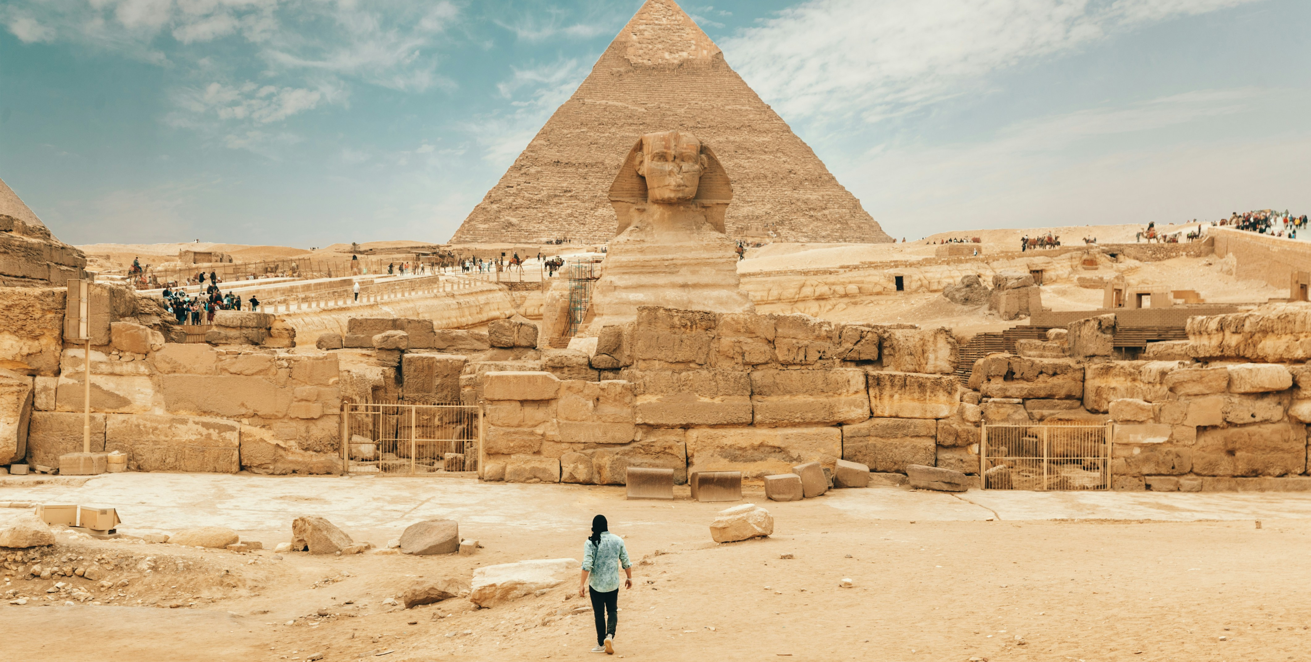
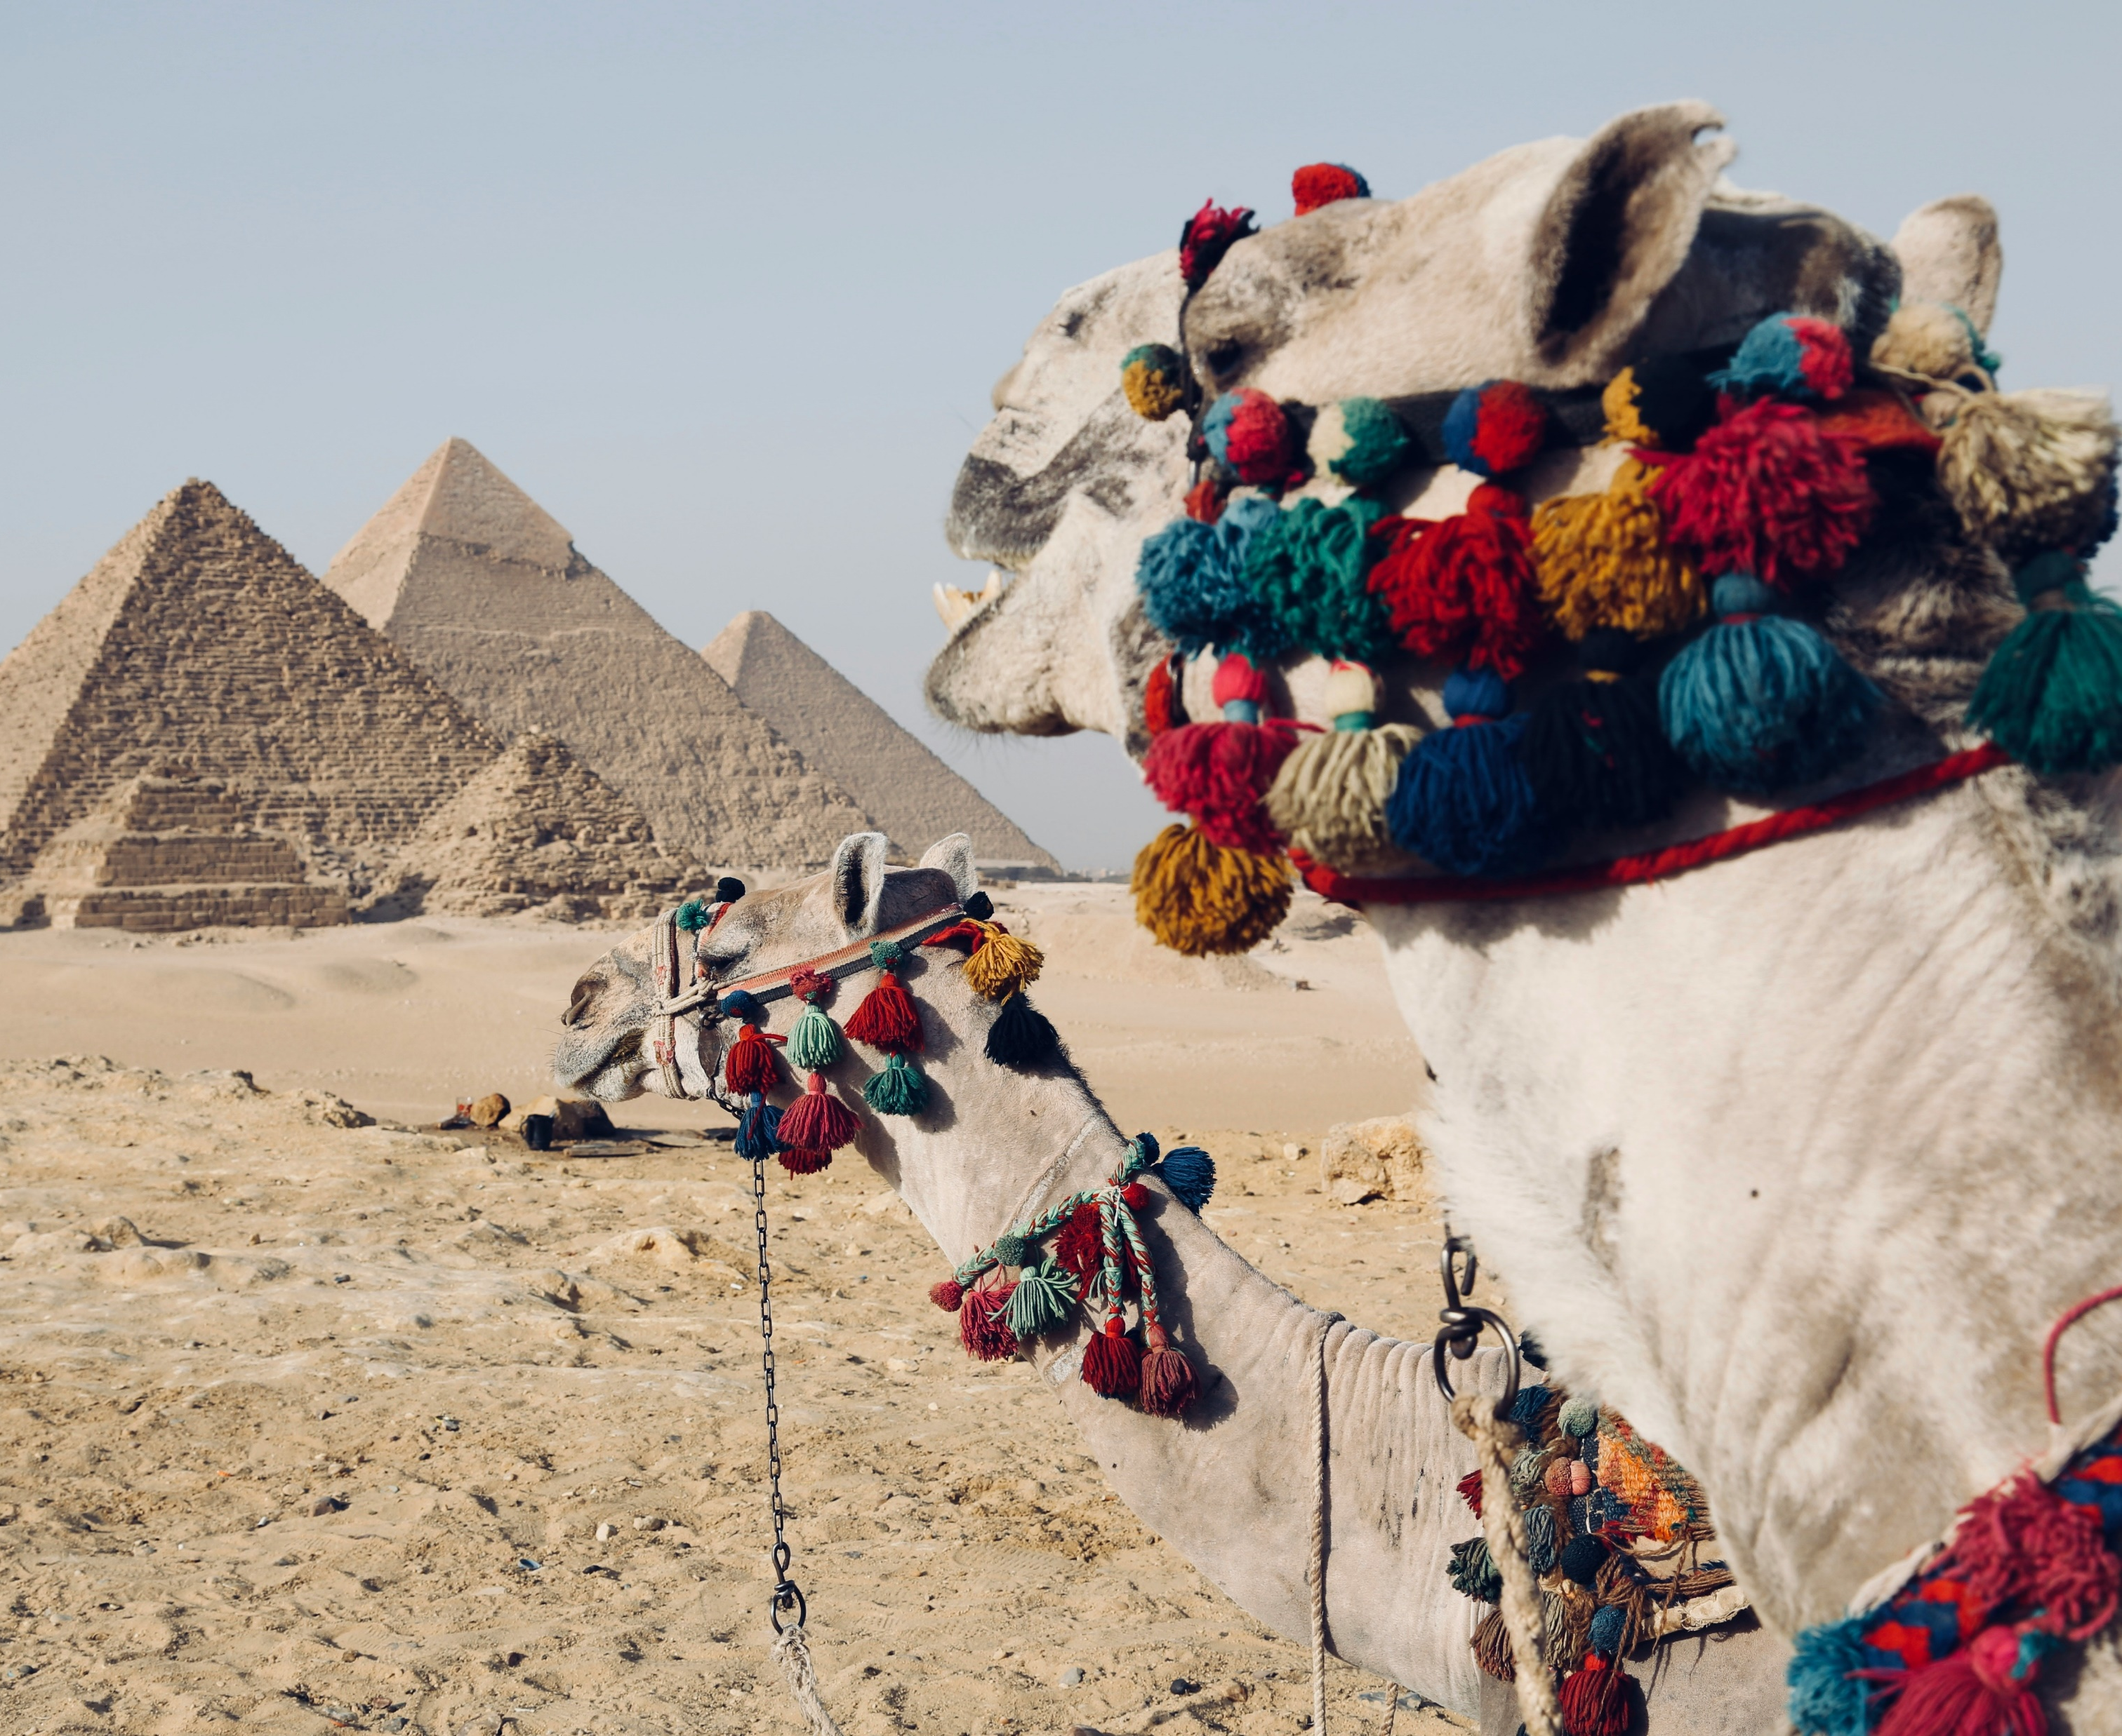
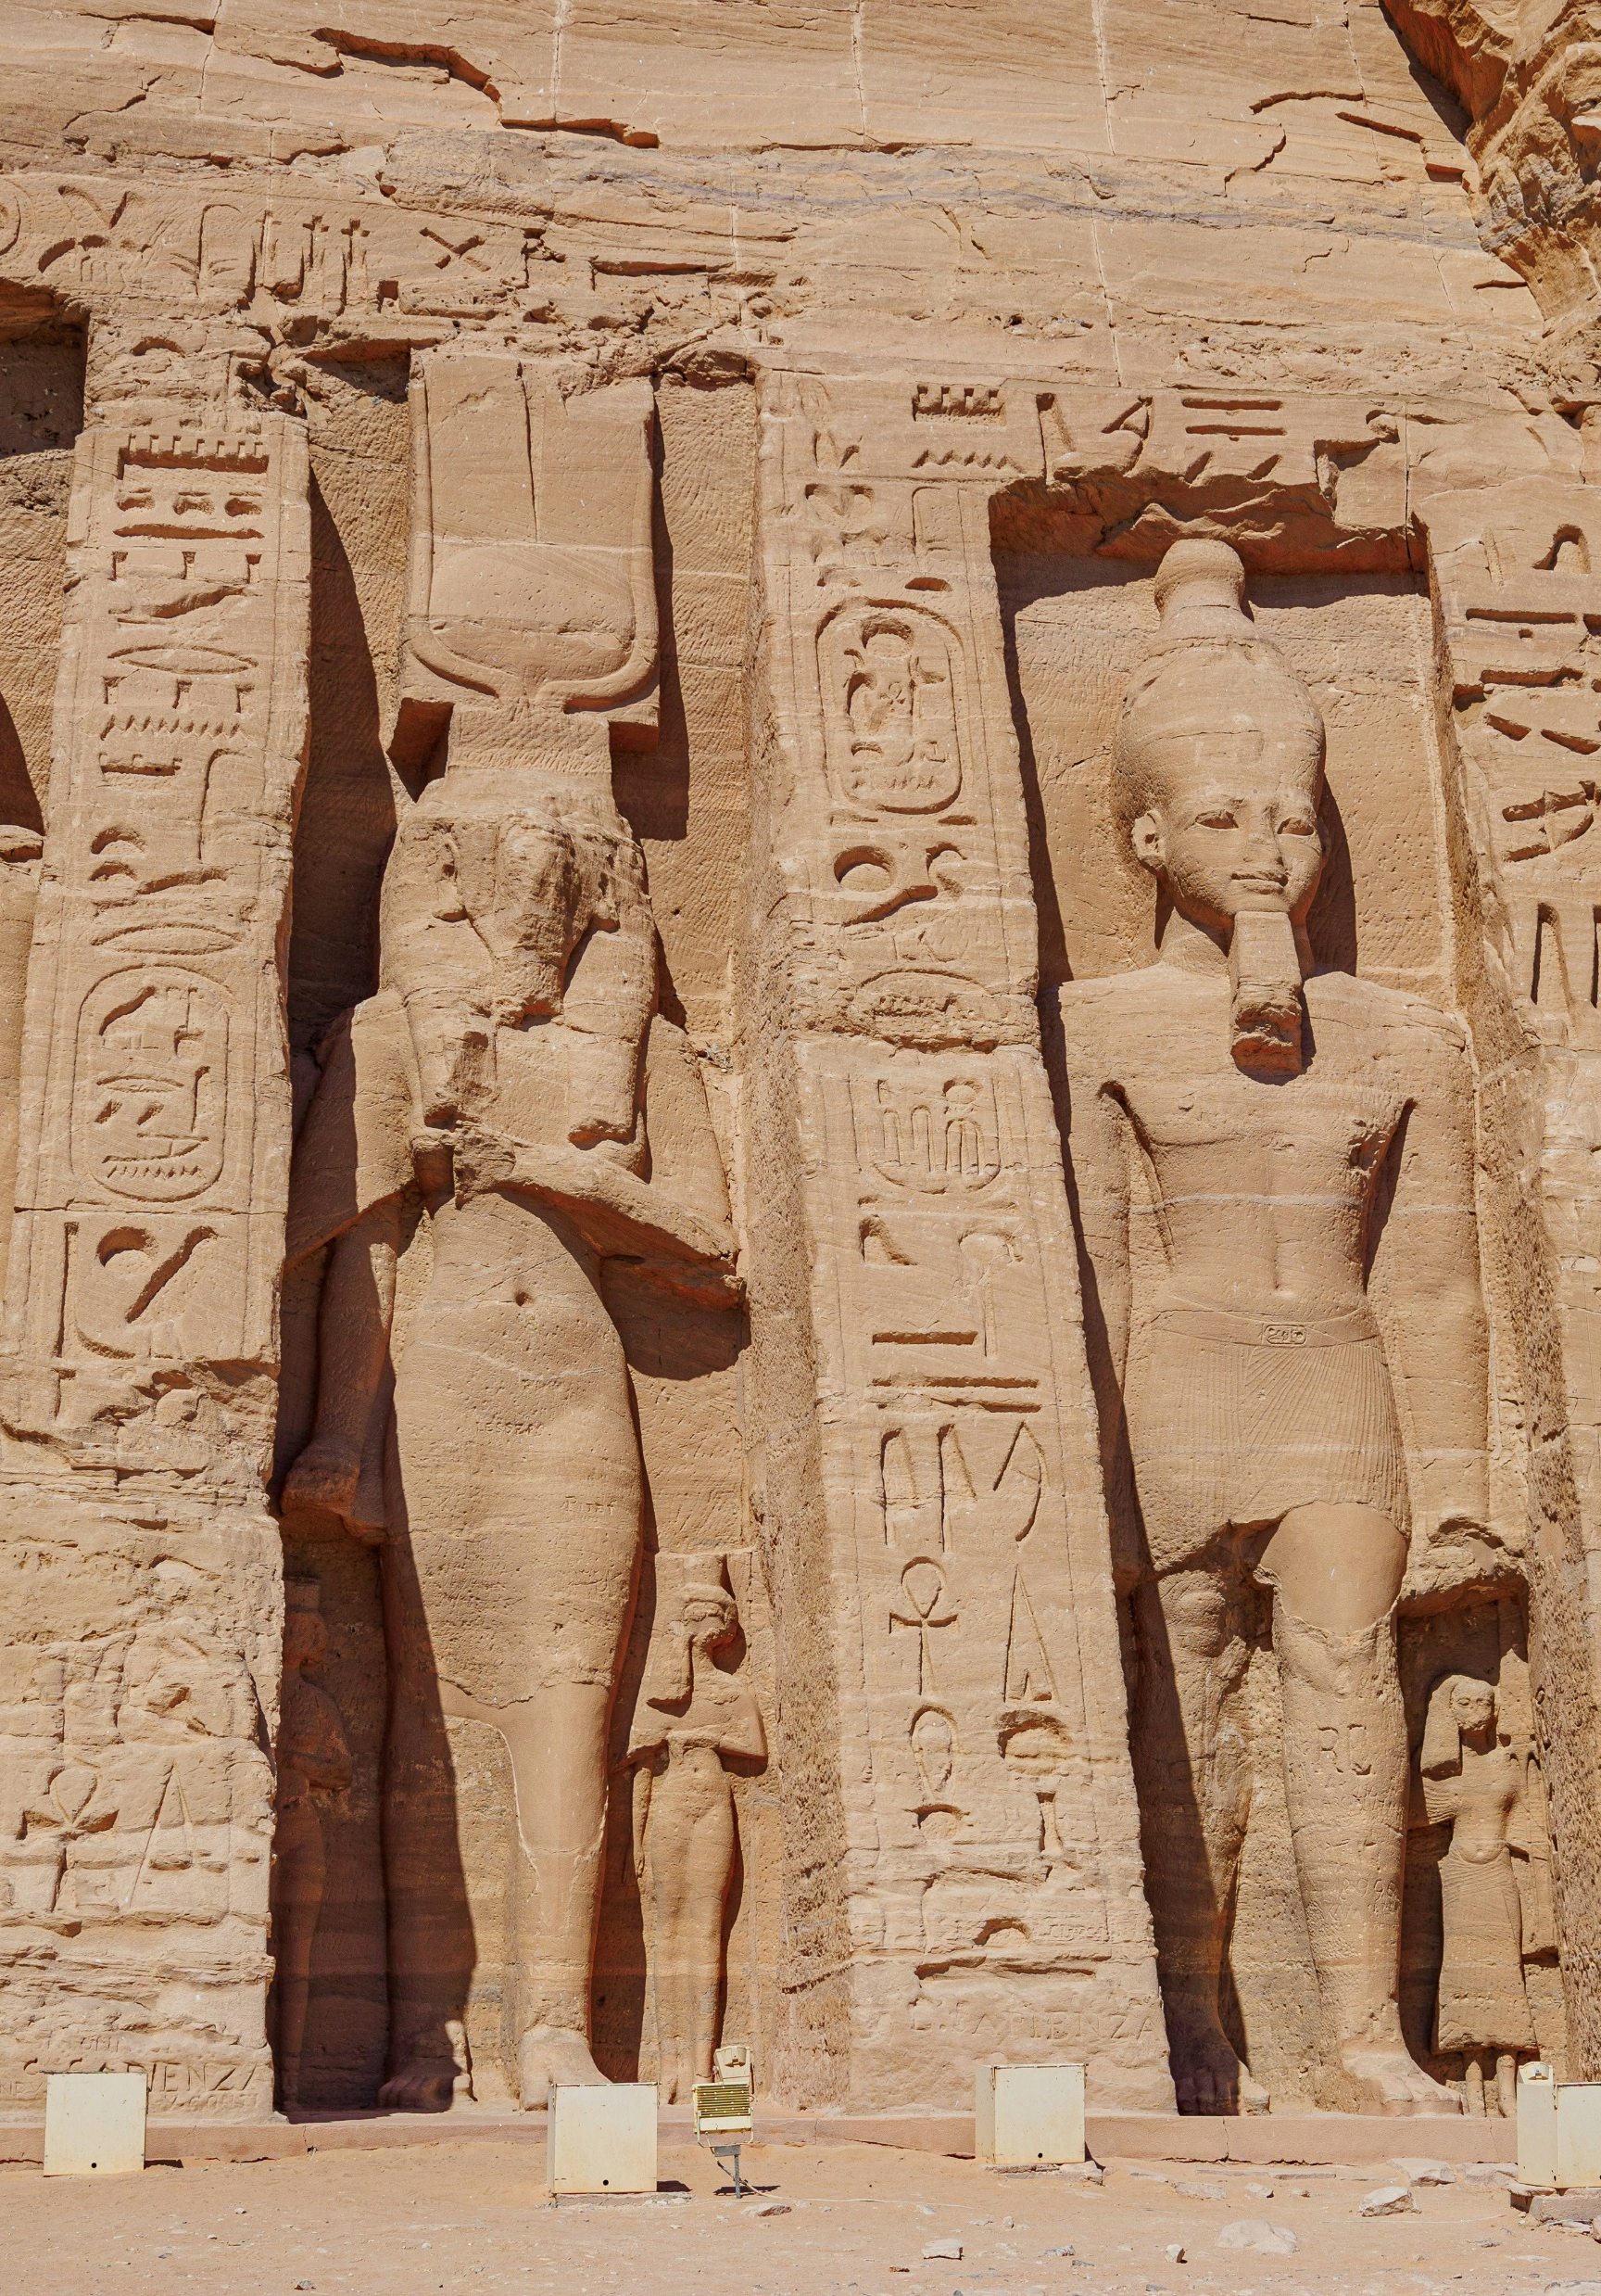
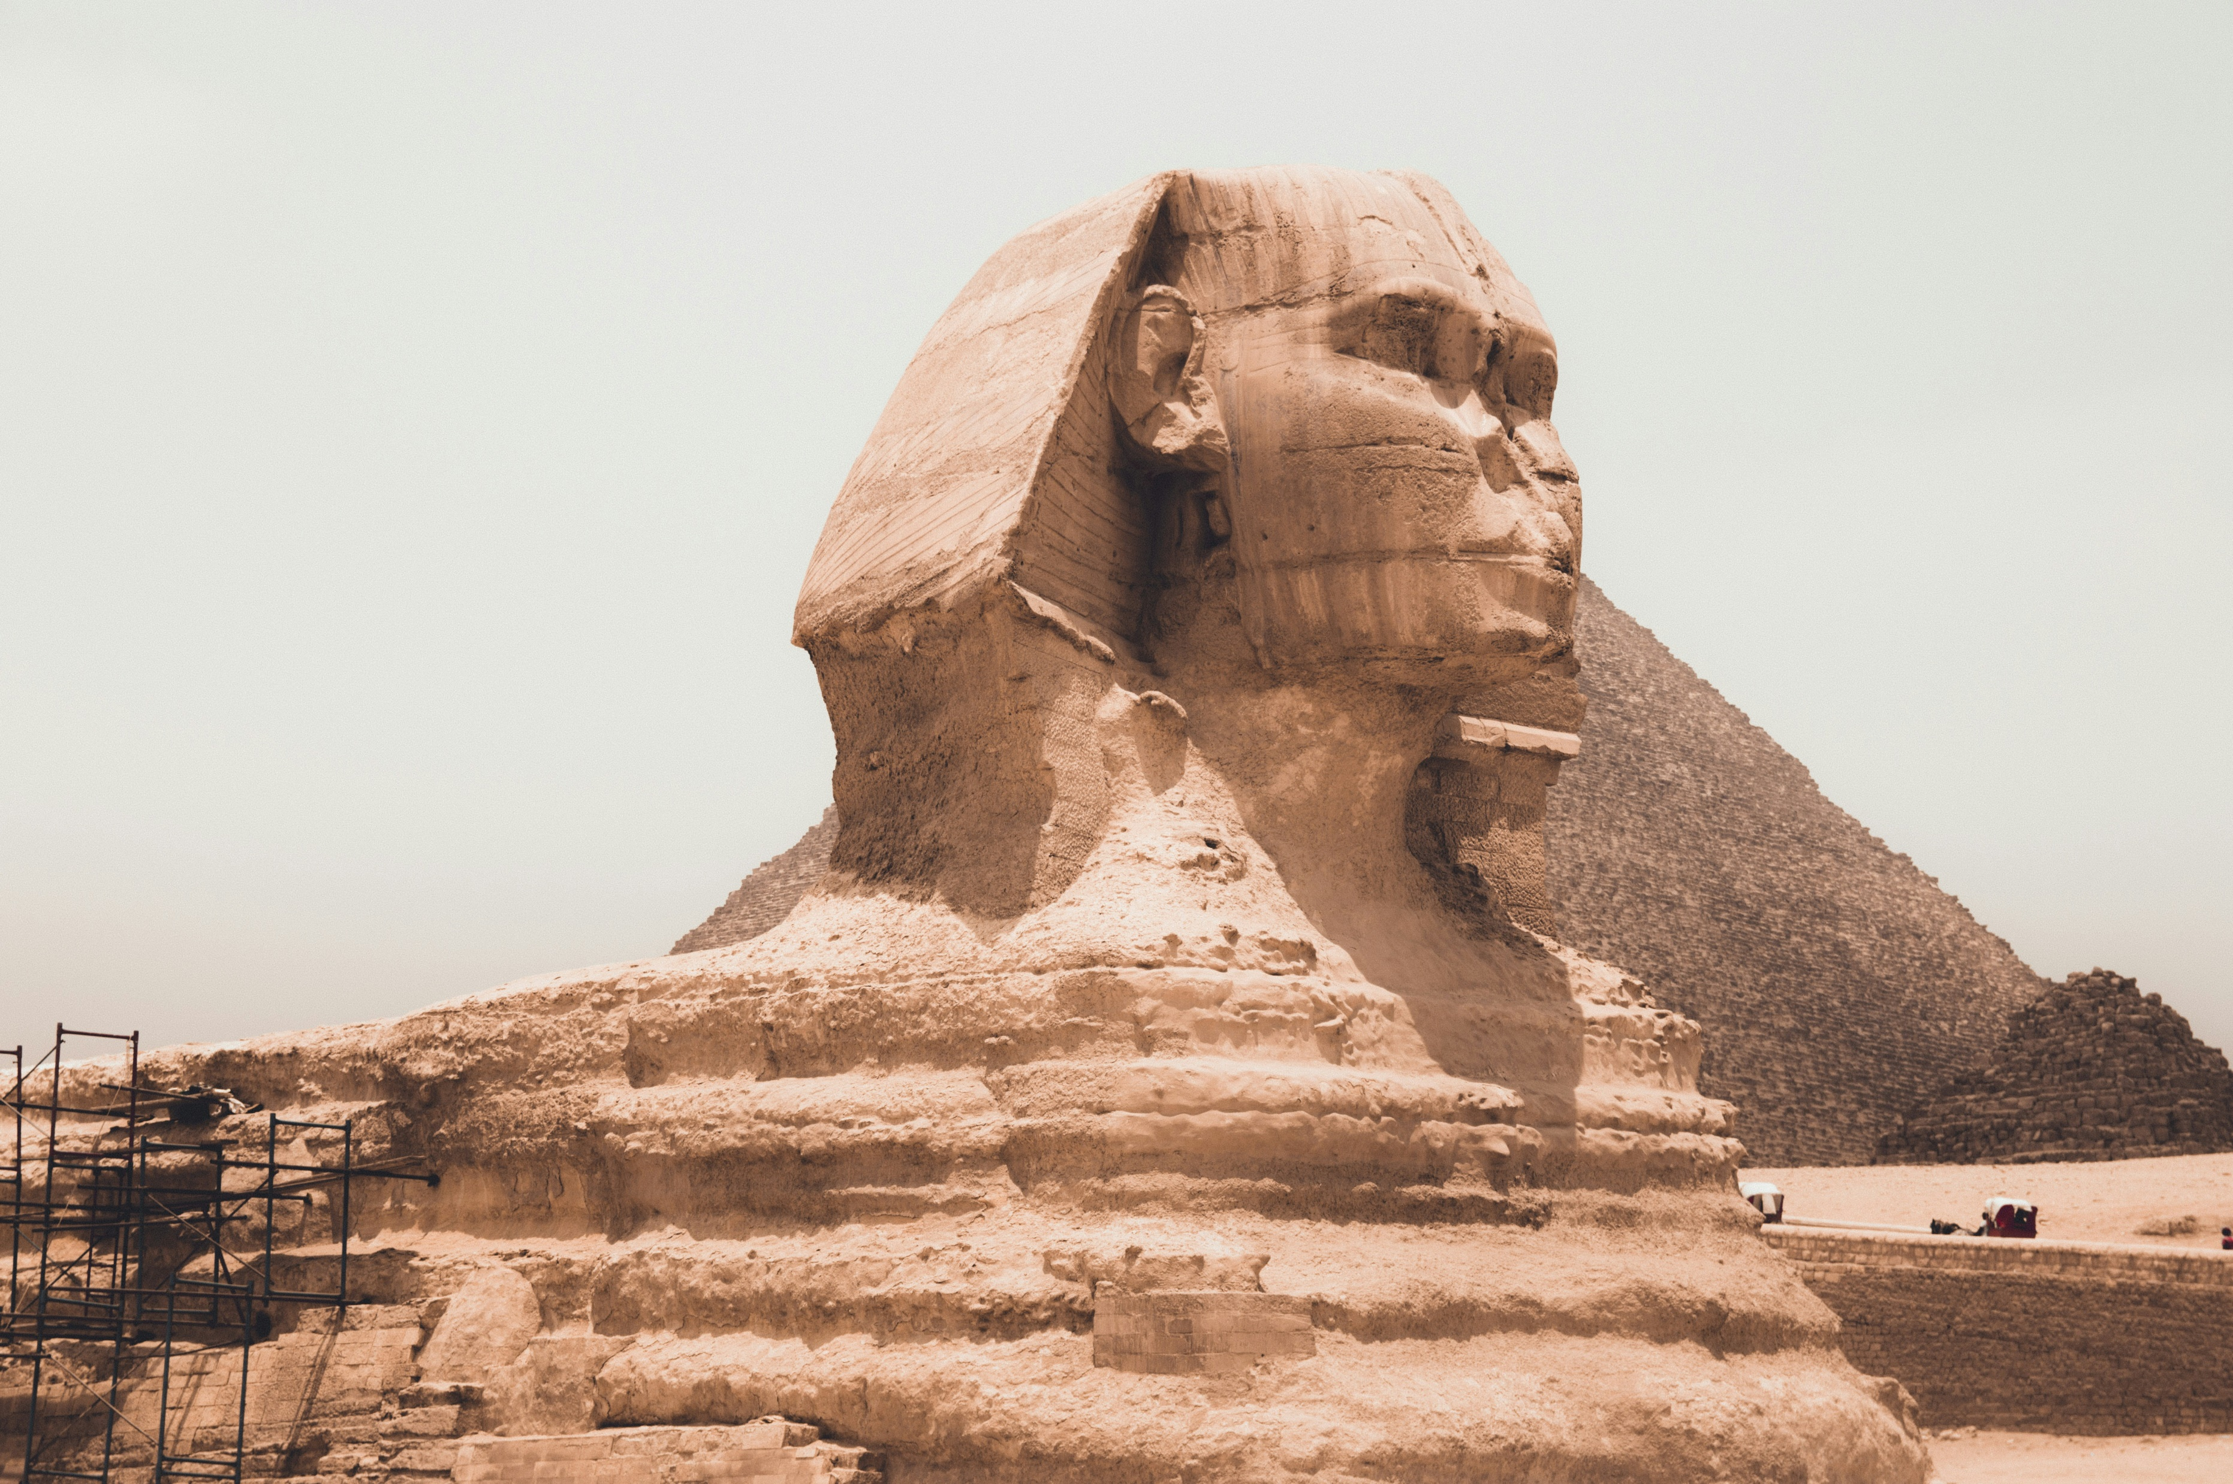
Sites of Ancient Egypt
Photo: Spencer Davis/ Unsplash
Photo: The Cleveland Museum/Unsplash
Photo: Fynn Schmidt/Unsplash
Photo: Adrian Dascal/Unsplash
Photo: Martijin Vonk/Unsplash

Slide 7
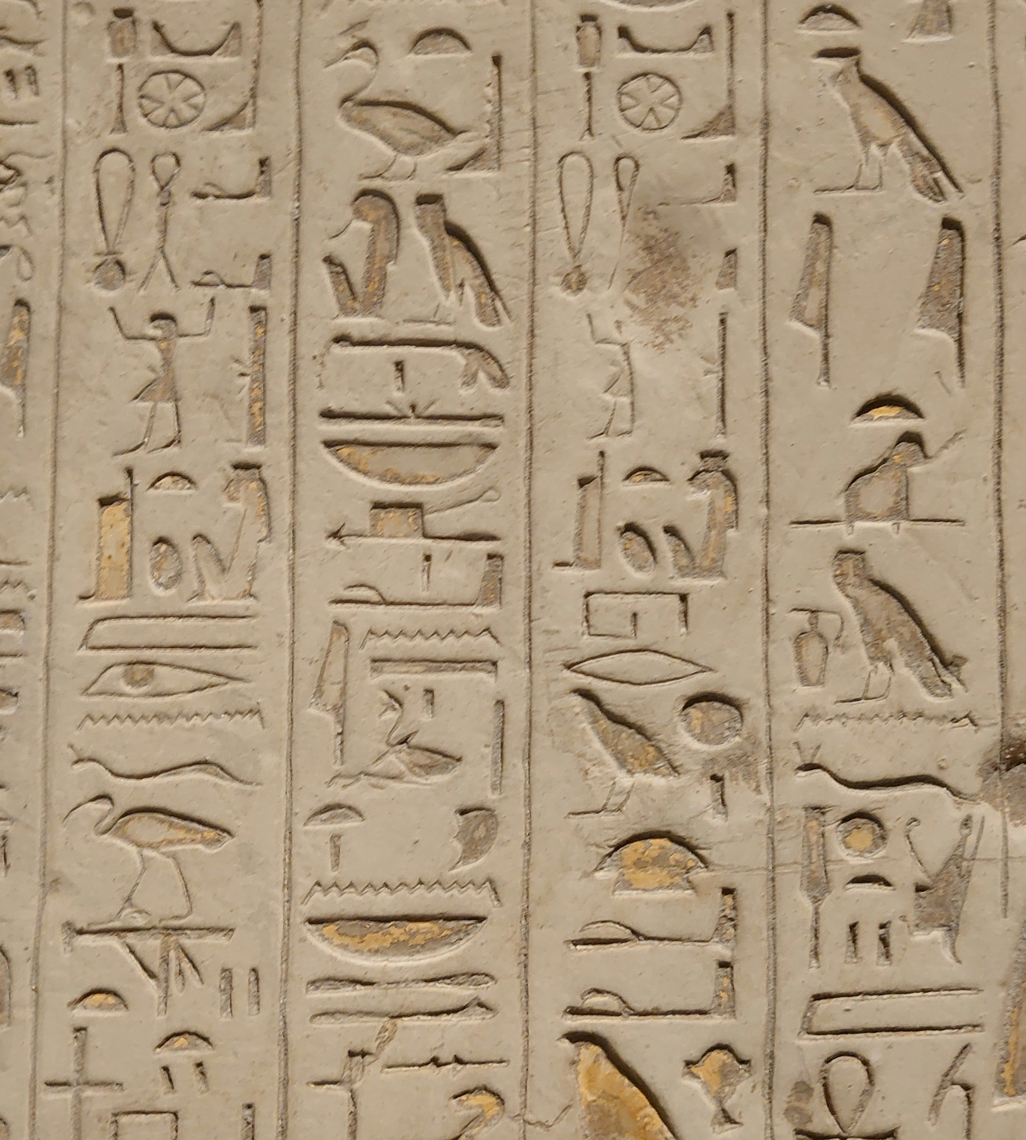
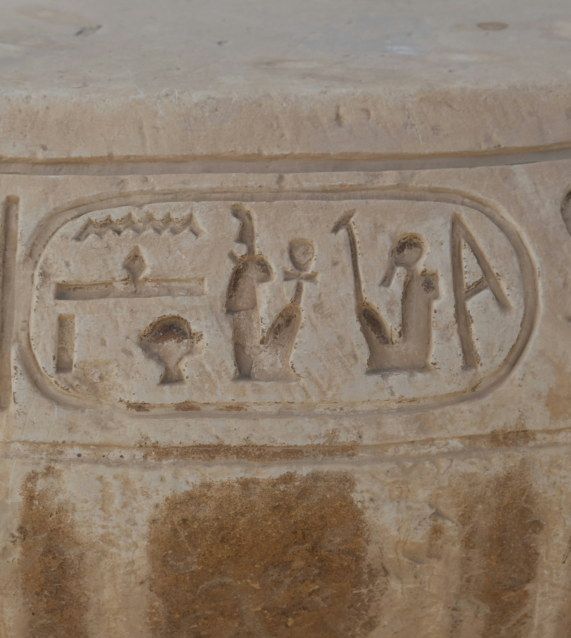
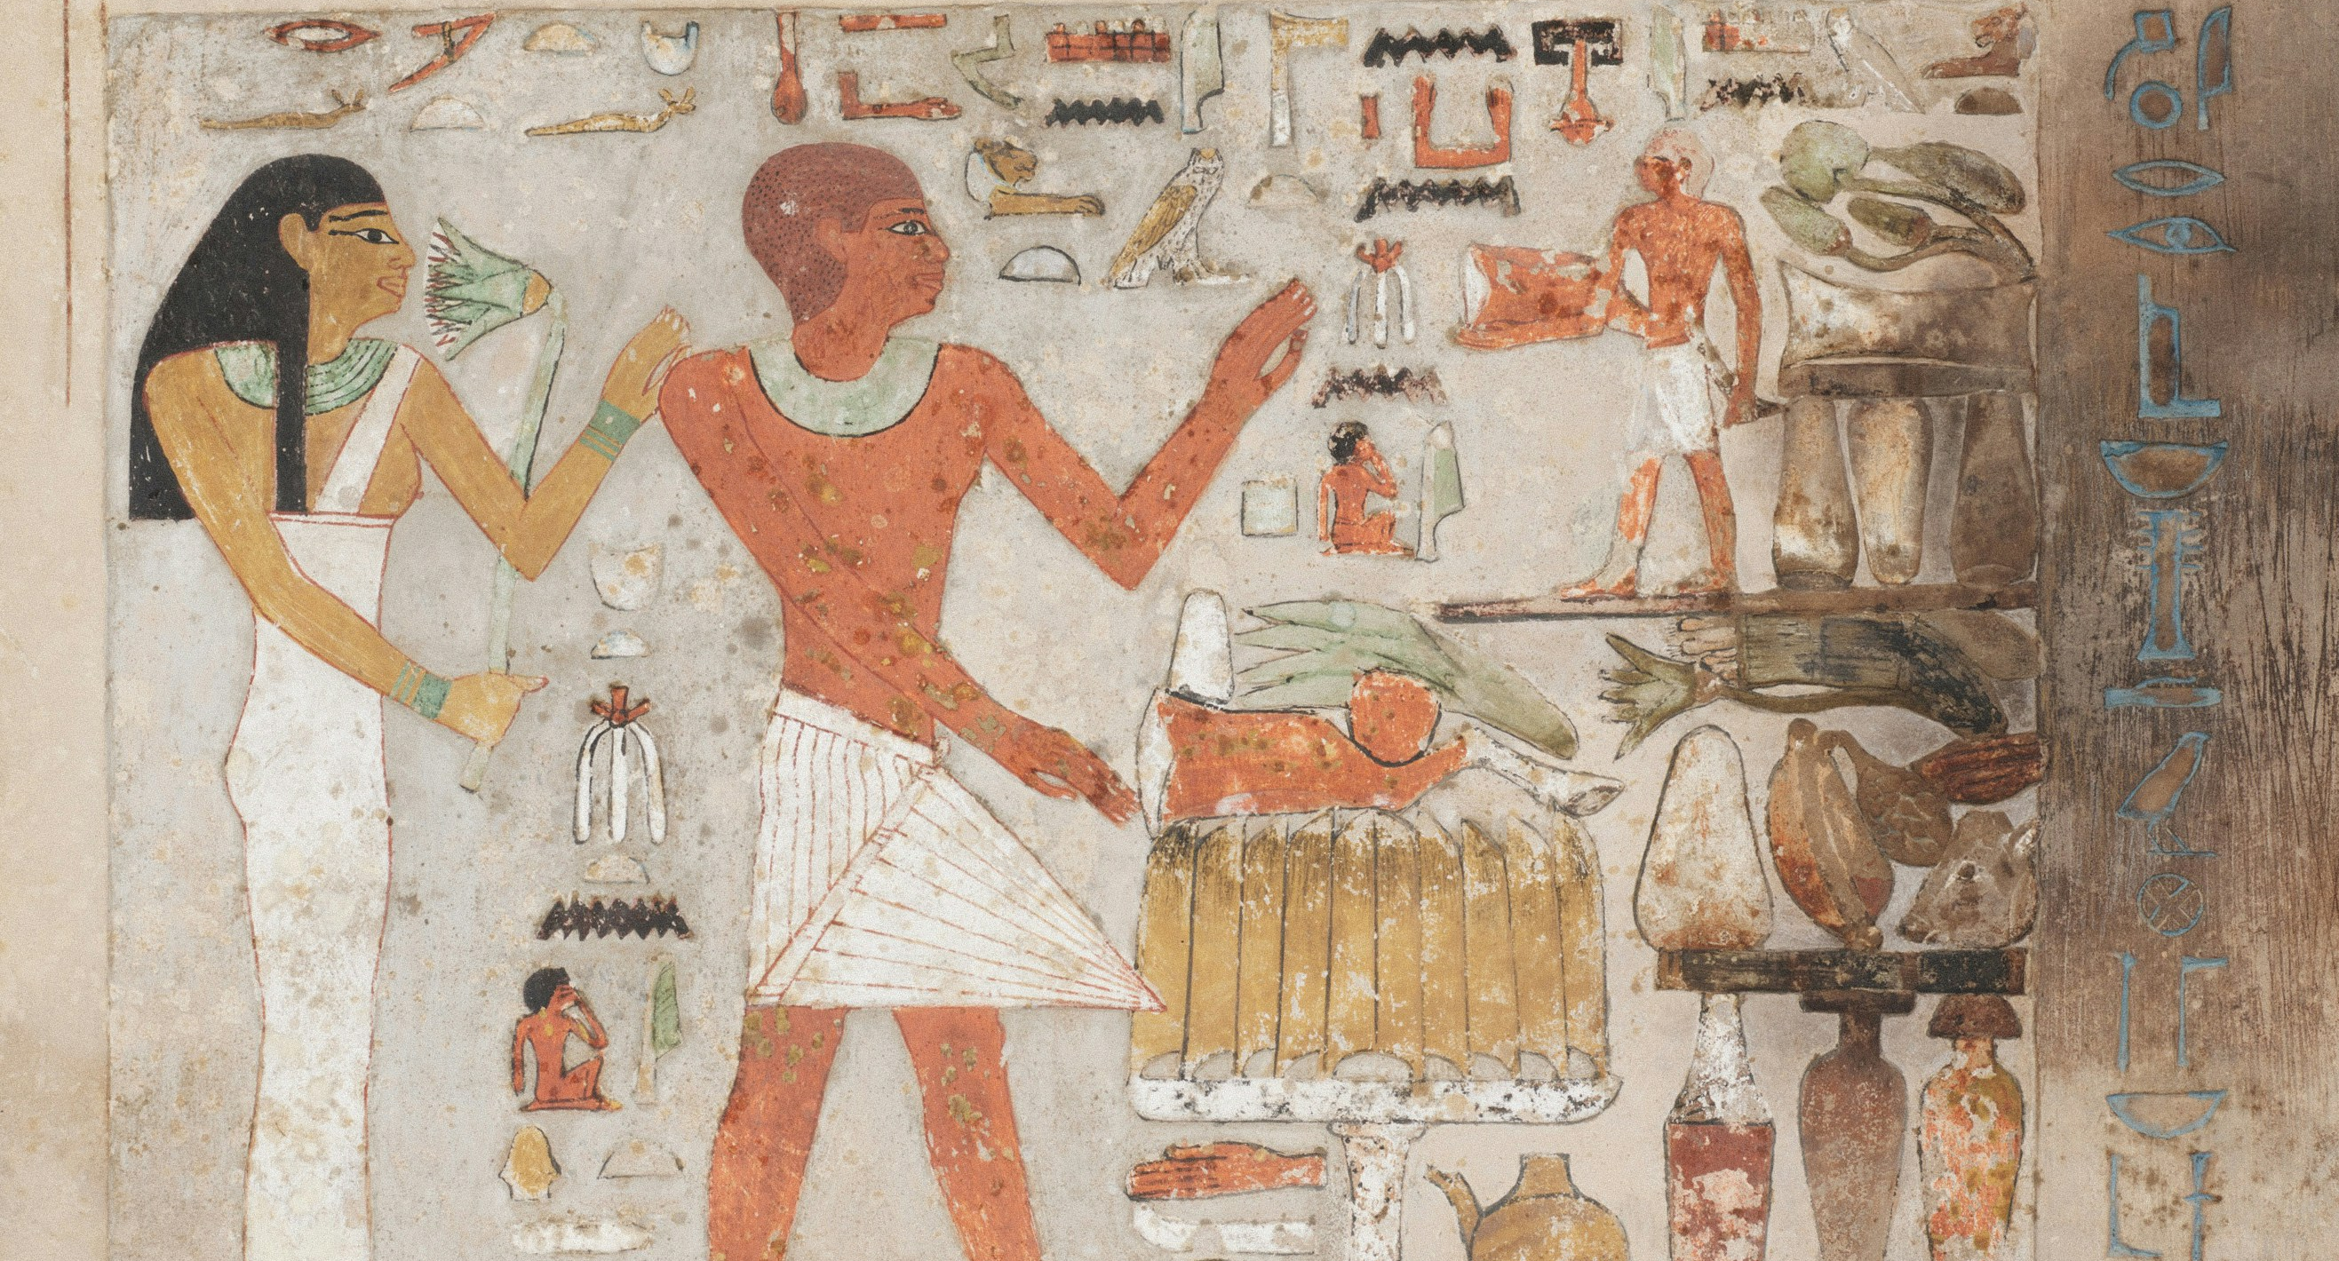
Egyptian Hieroglyphics
Photo: Amador Loureiro/Unsplash
Photo: Lisette Harzing/Unsplash
Photo: Art Institute of Chicago/ Unsplash

Slide 8
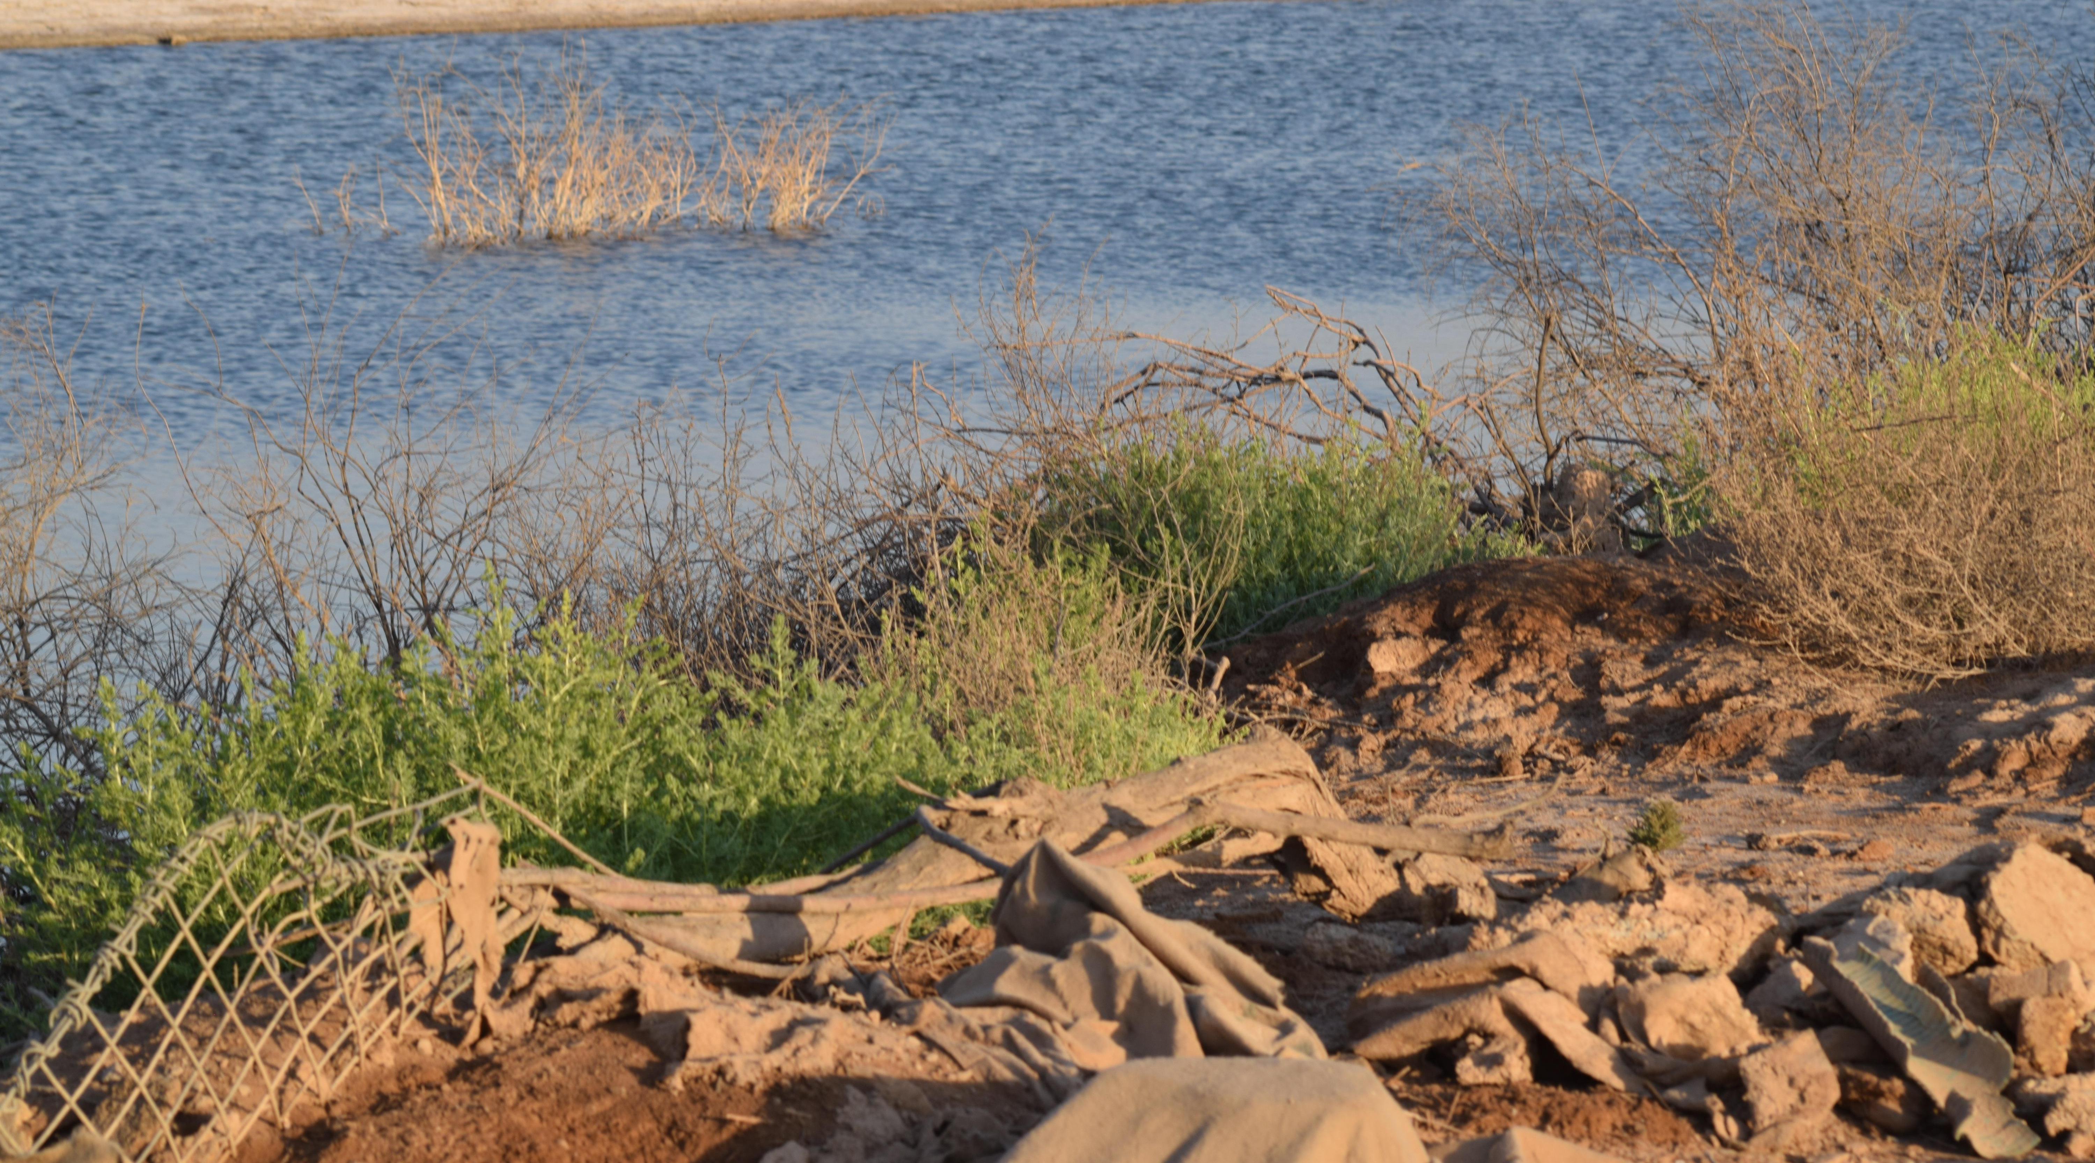
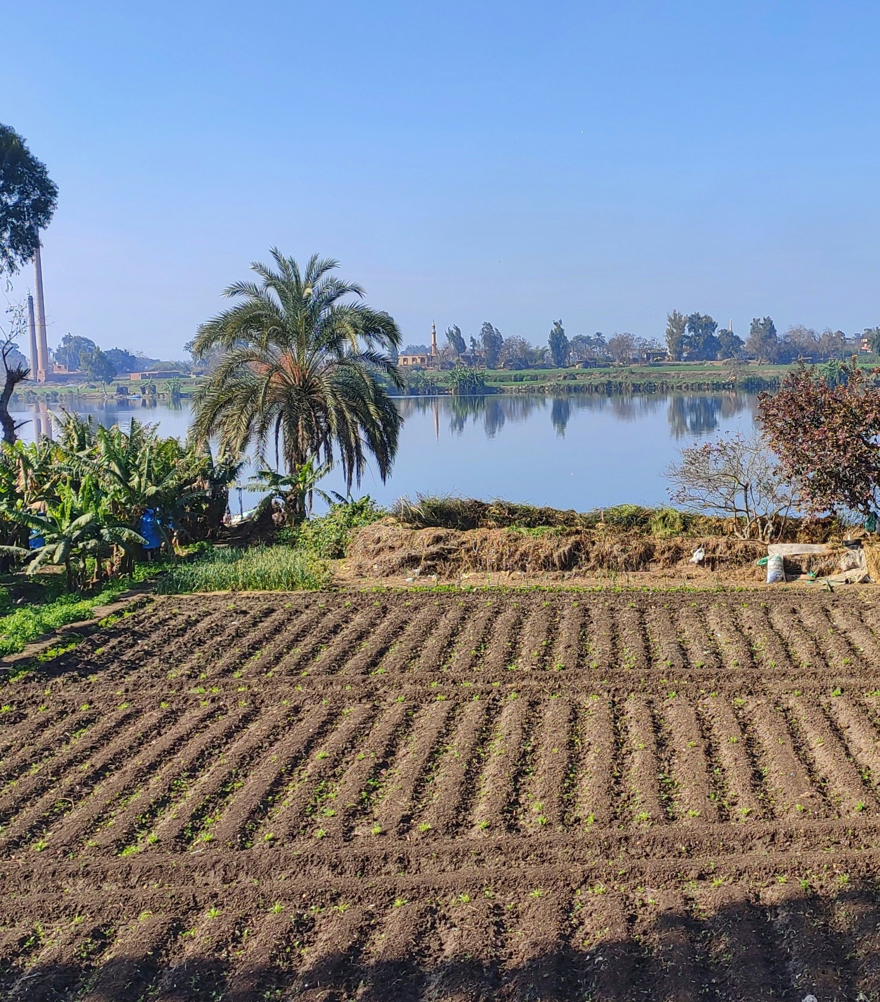
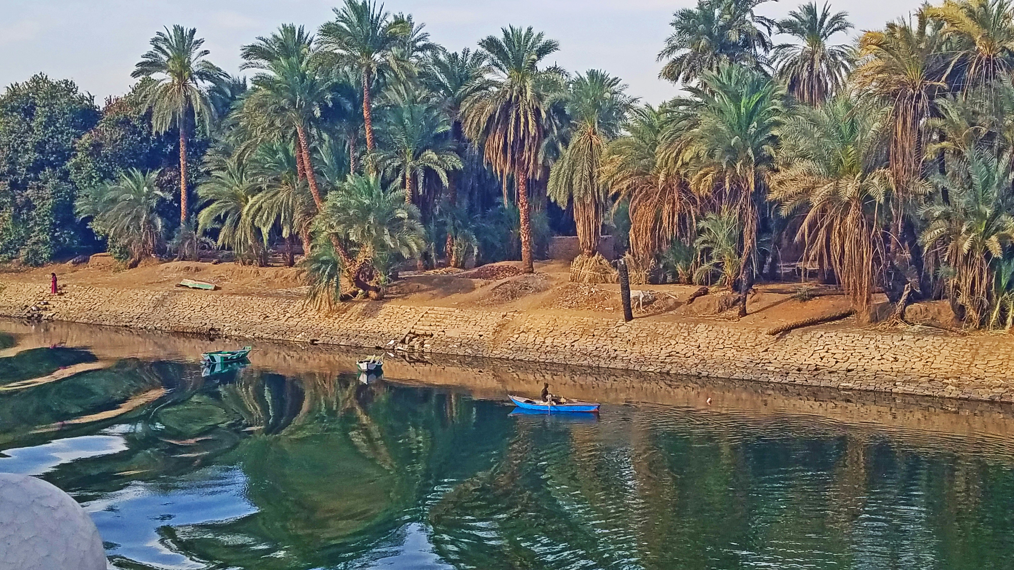
Nile River
Photo: Mohammed Aljimaily/Unsplash
Photo: David Leonard/Unsplash
Photo: Mohamad Sameh/Unsplash

Slide 9
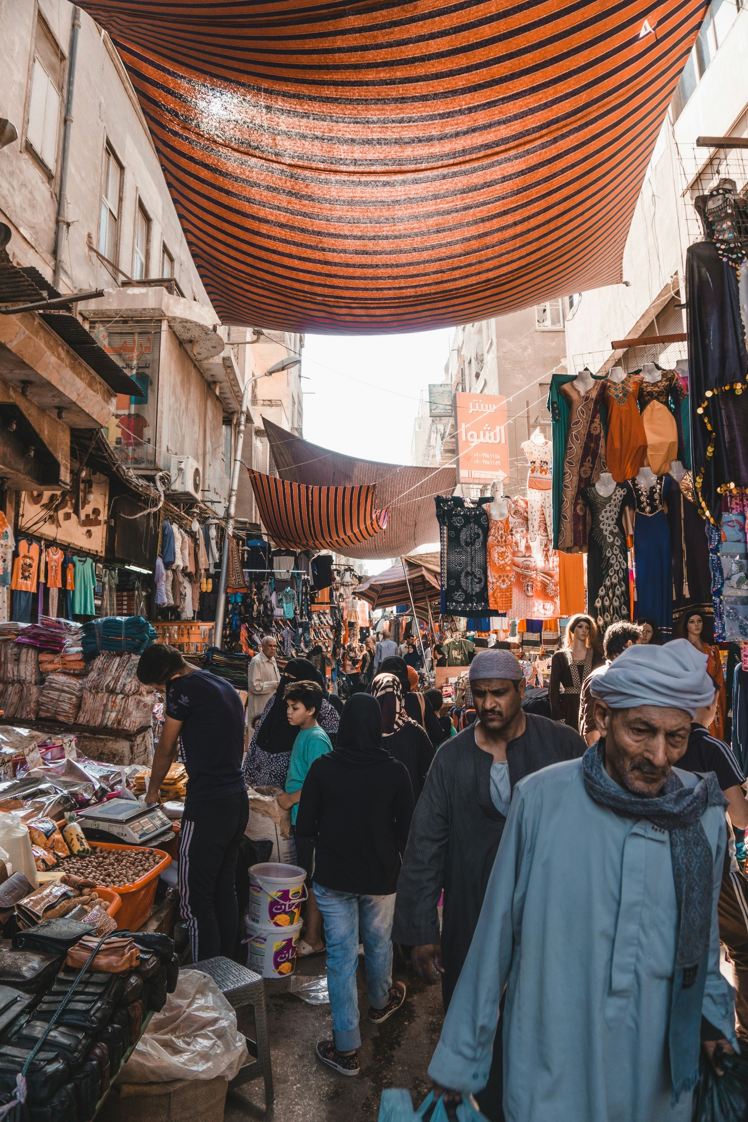
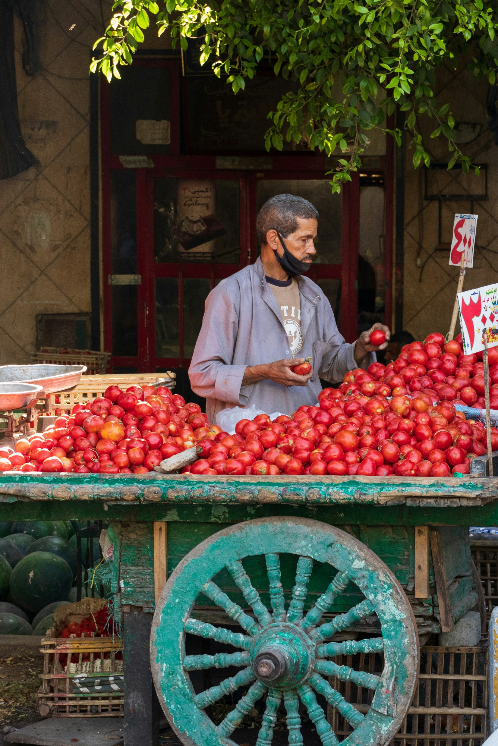
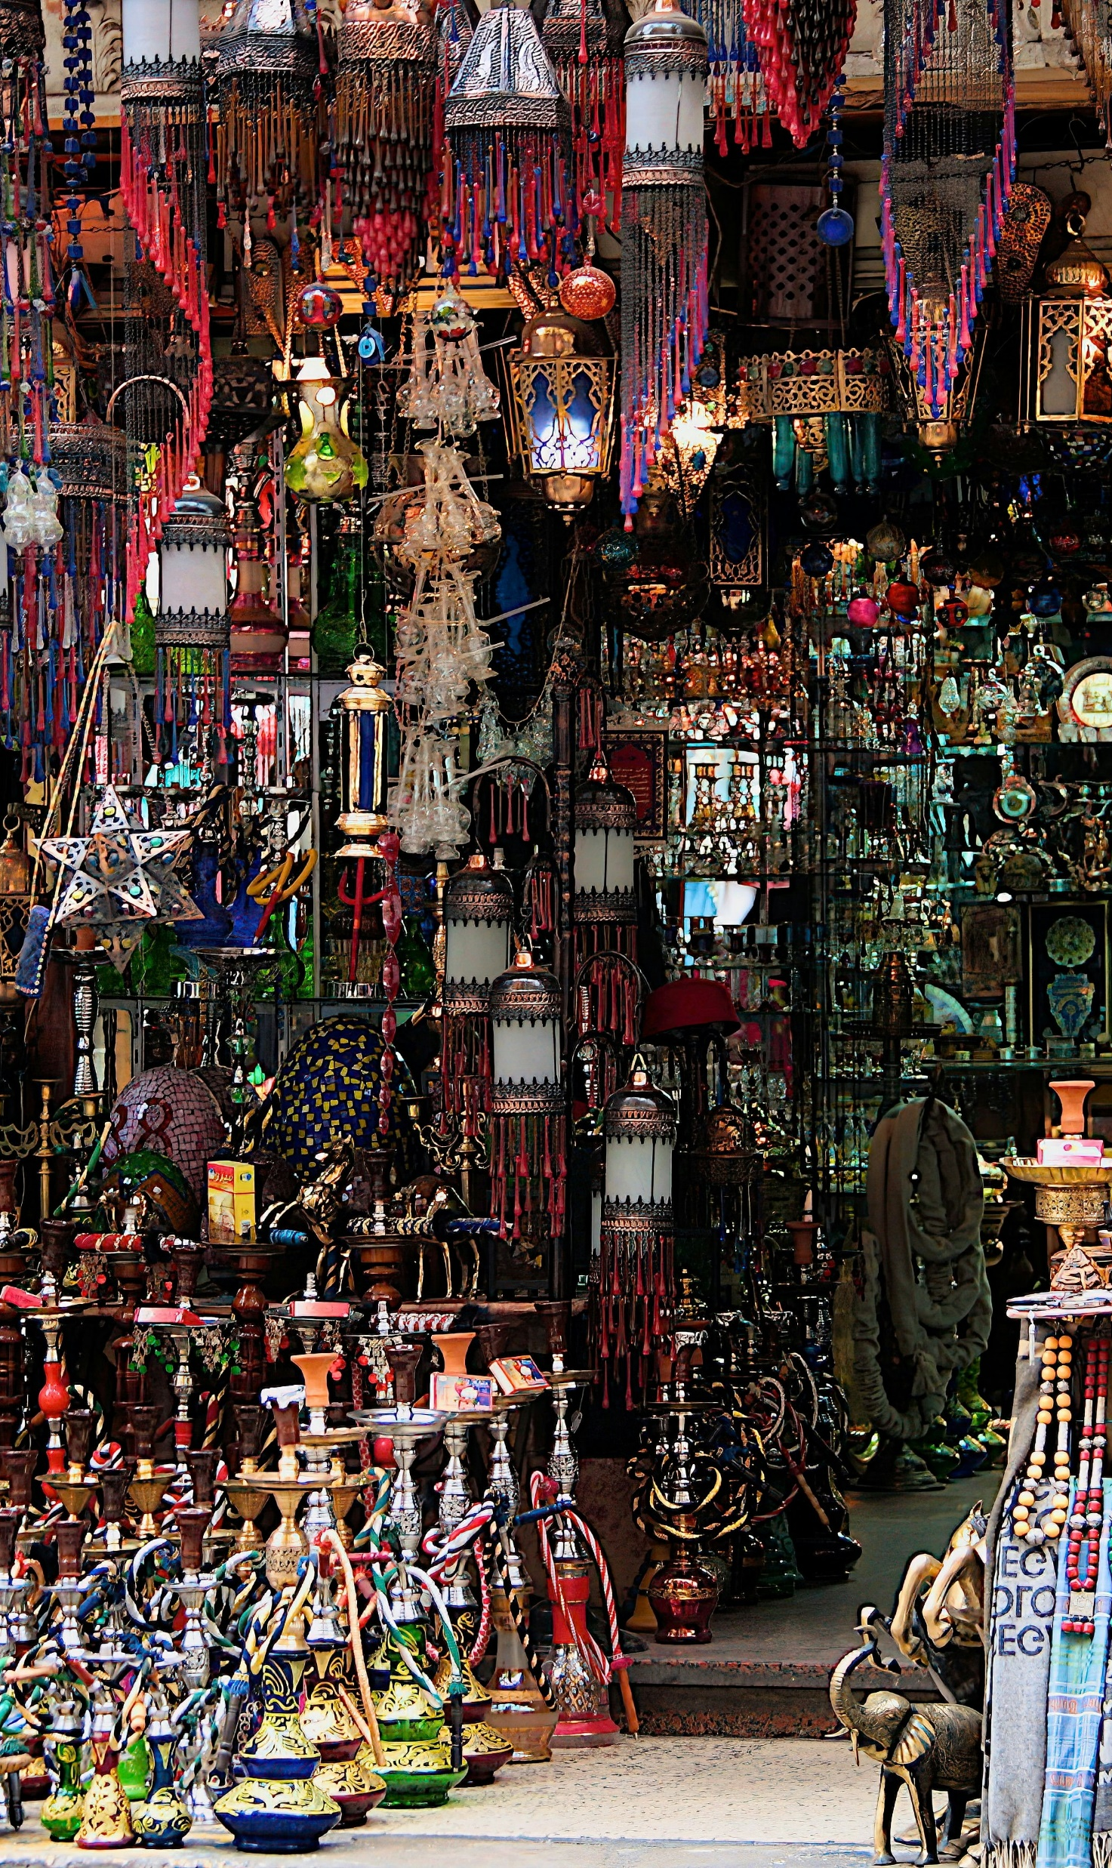
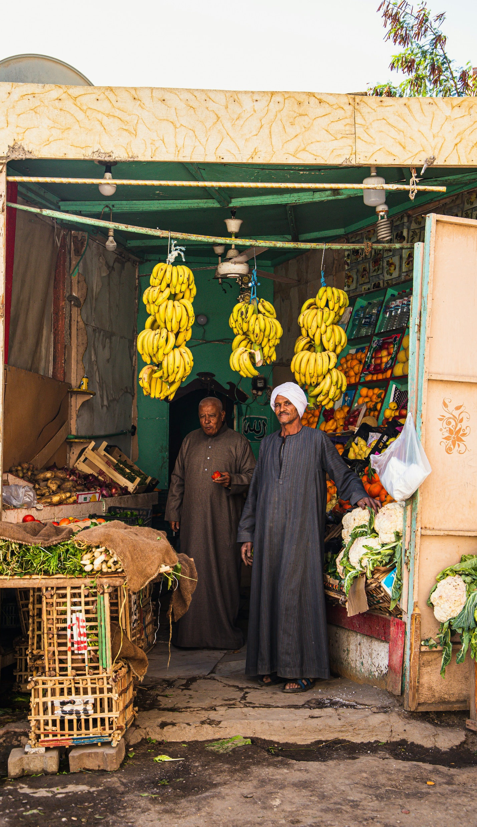
Shopping in a Market
Photo: Alex Azabache/Unsplash
Photo: Yousef Salhamou/Unsplash
Photo: Simon/Unsplash
Photo: Vadim Berg/ Unsplash

Slide 10
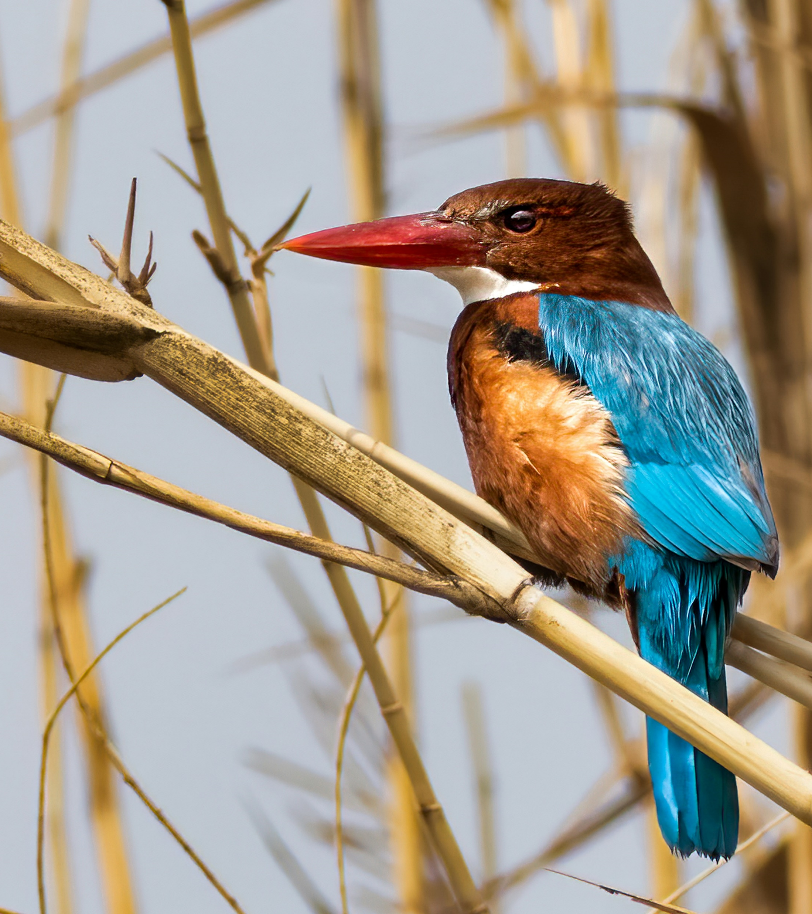
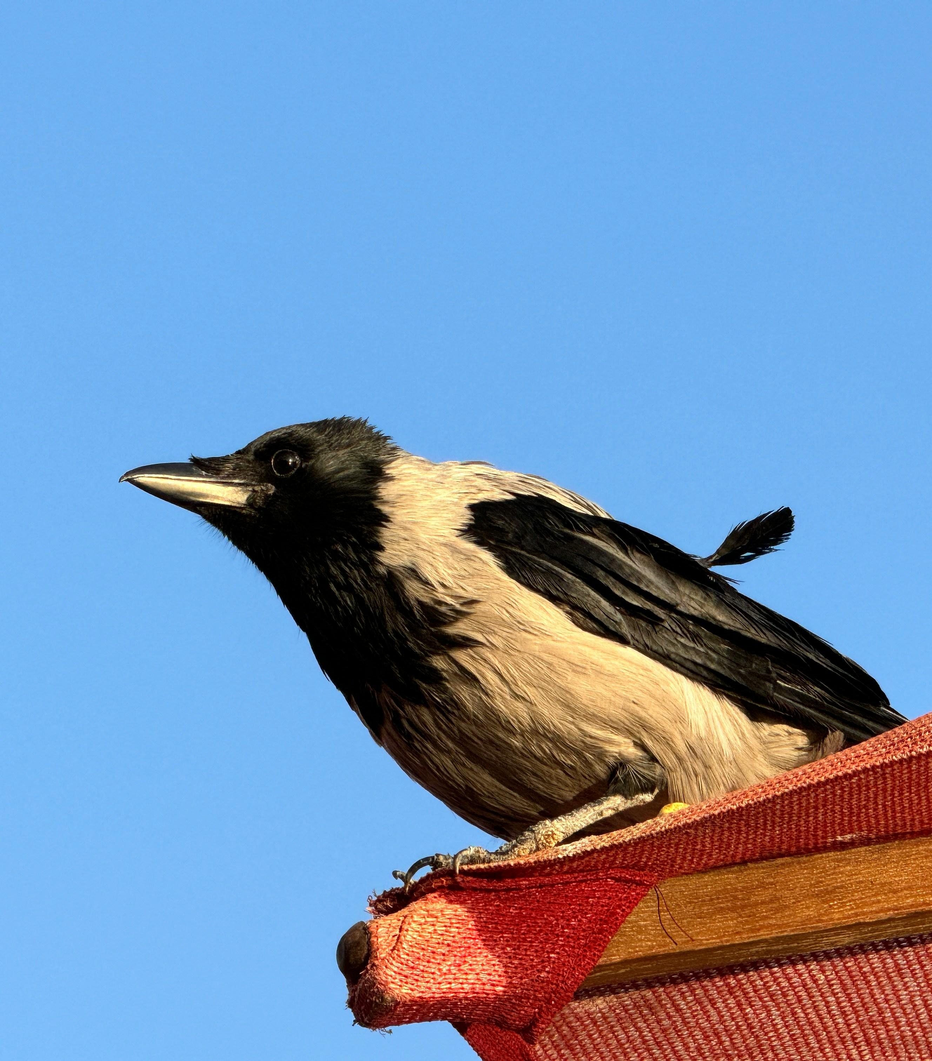
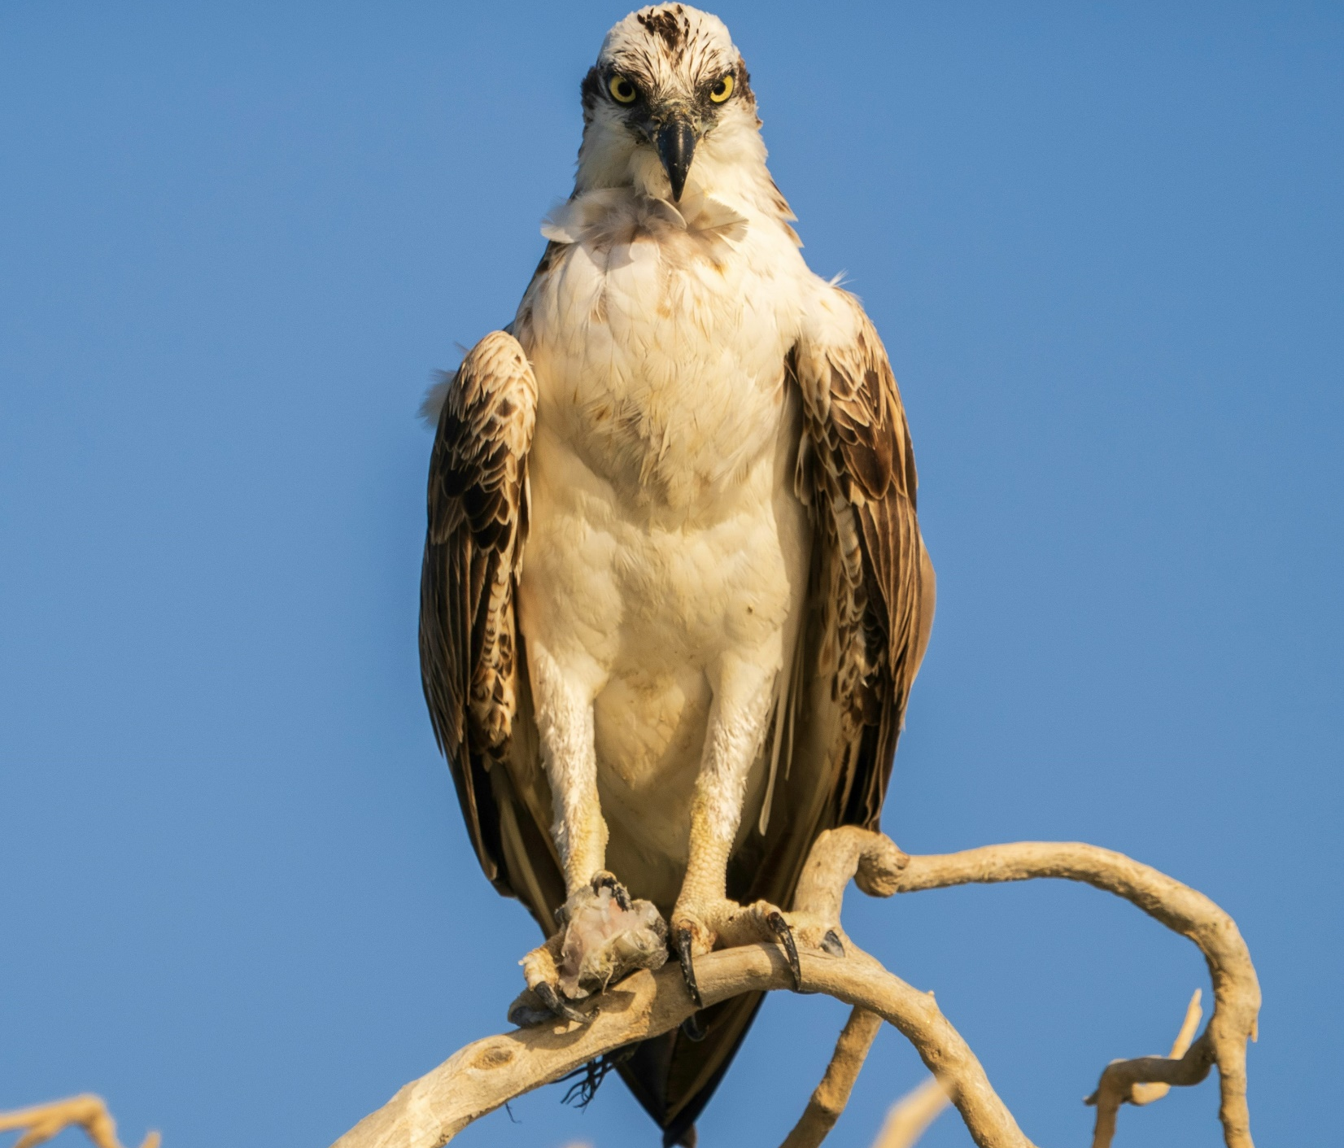
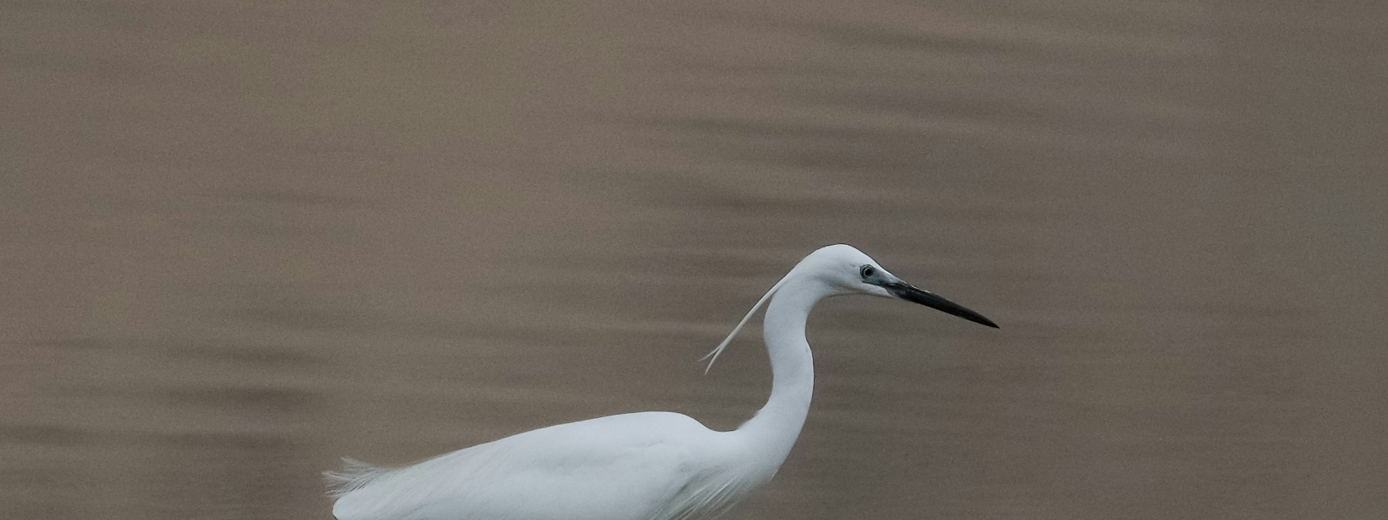
Beautiful Birds
Photo: Michael Mitrakos/Unsplash
Photo:Pascal Van de Vendel/Unsplash
Photo: Ahmed Fareed/Unsplash
Photo: Samier Khodoer/Unsplash

Slide 11
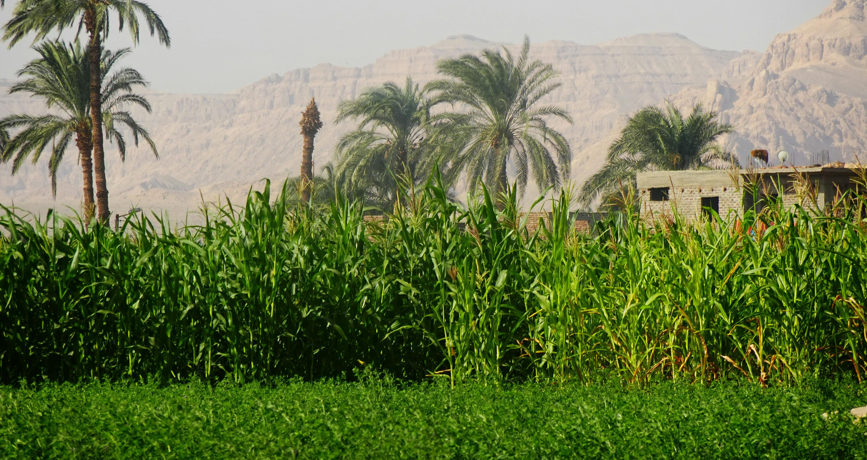
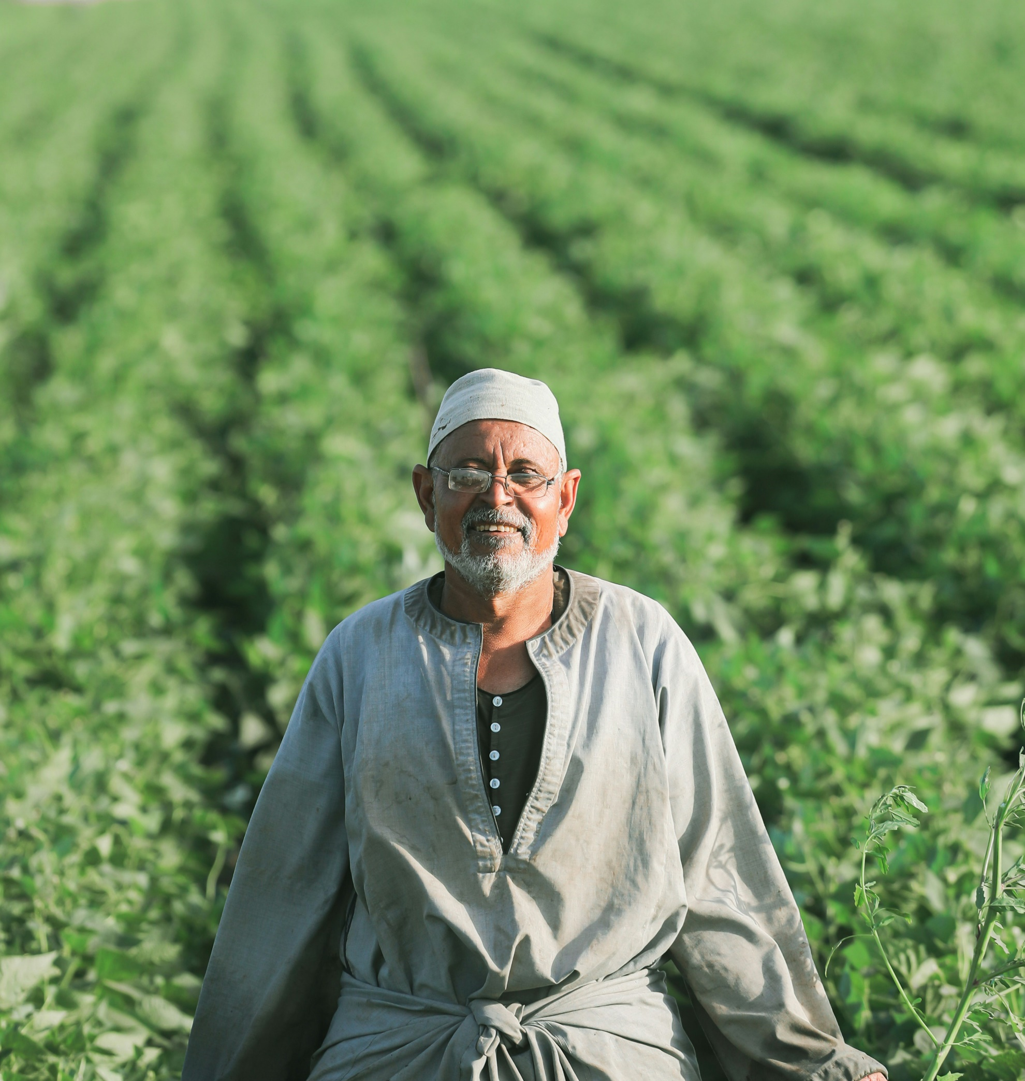
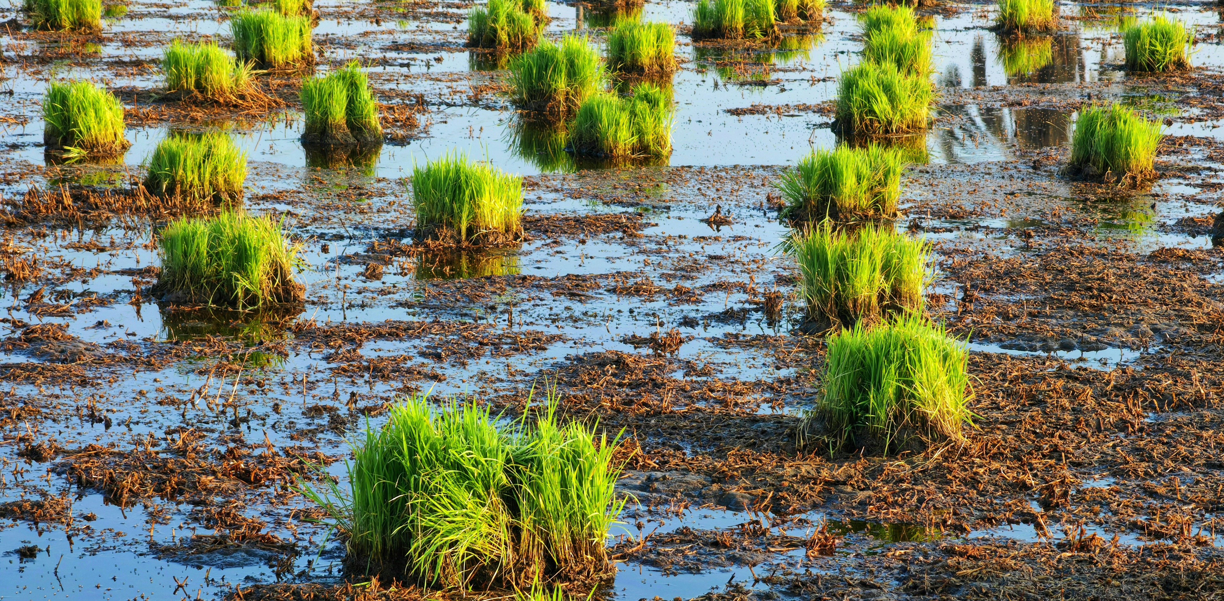
Farming
Photo: M Adoney/Unsplash
Photo;Mohamad Sameh/Unsplash
Photo: Omar Elsharwy/Unsplash

Slide 12

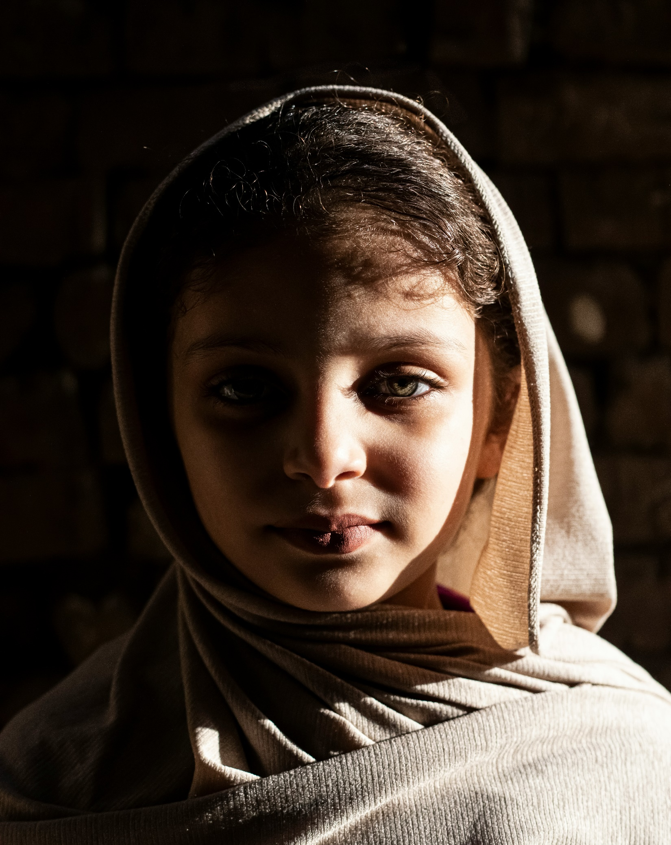
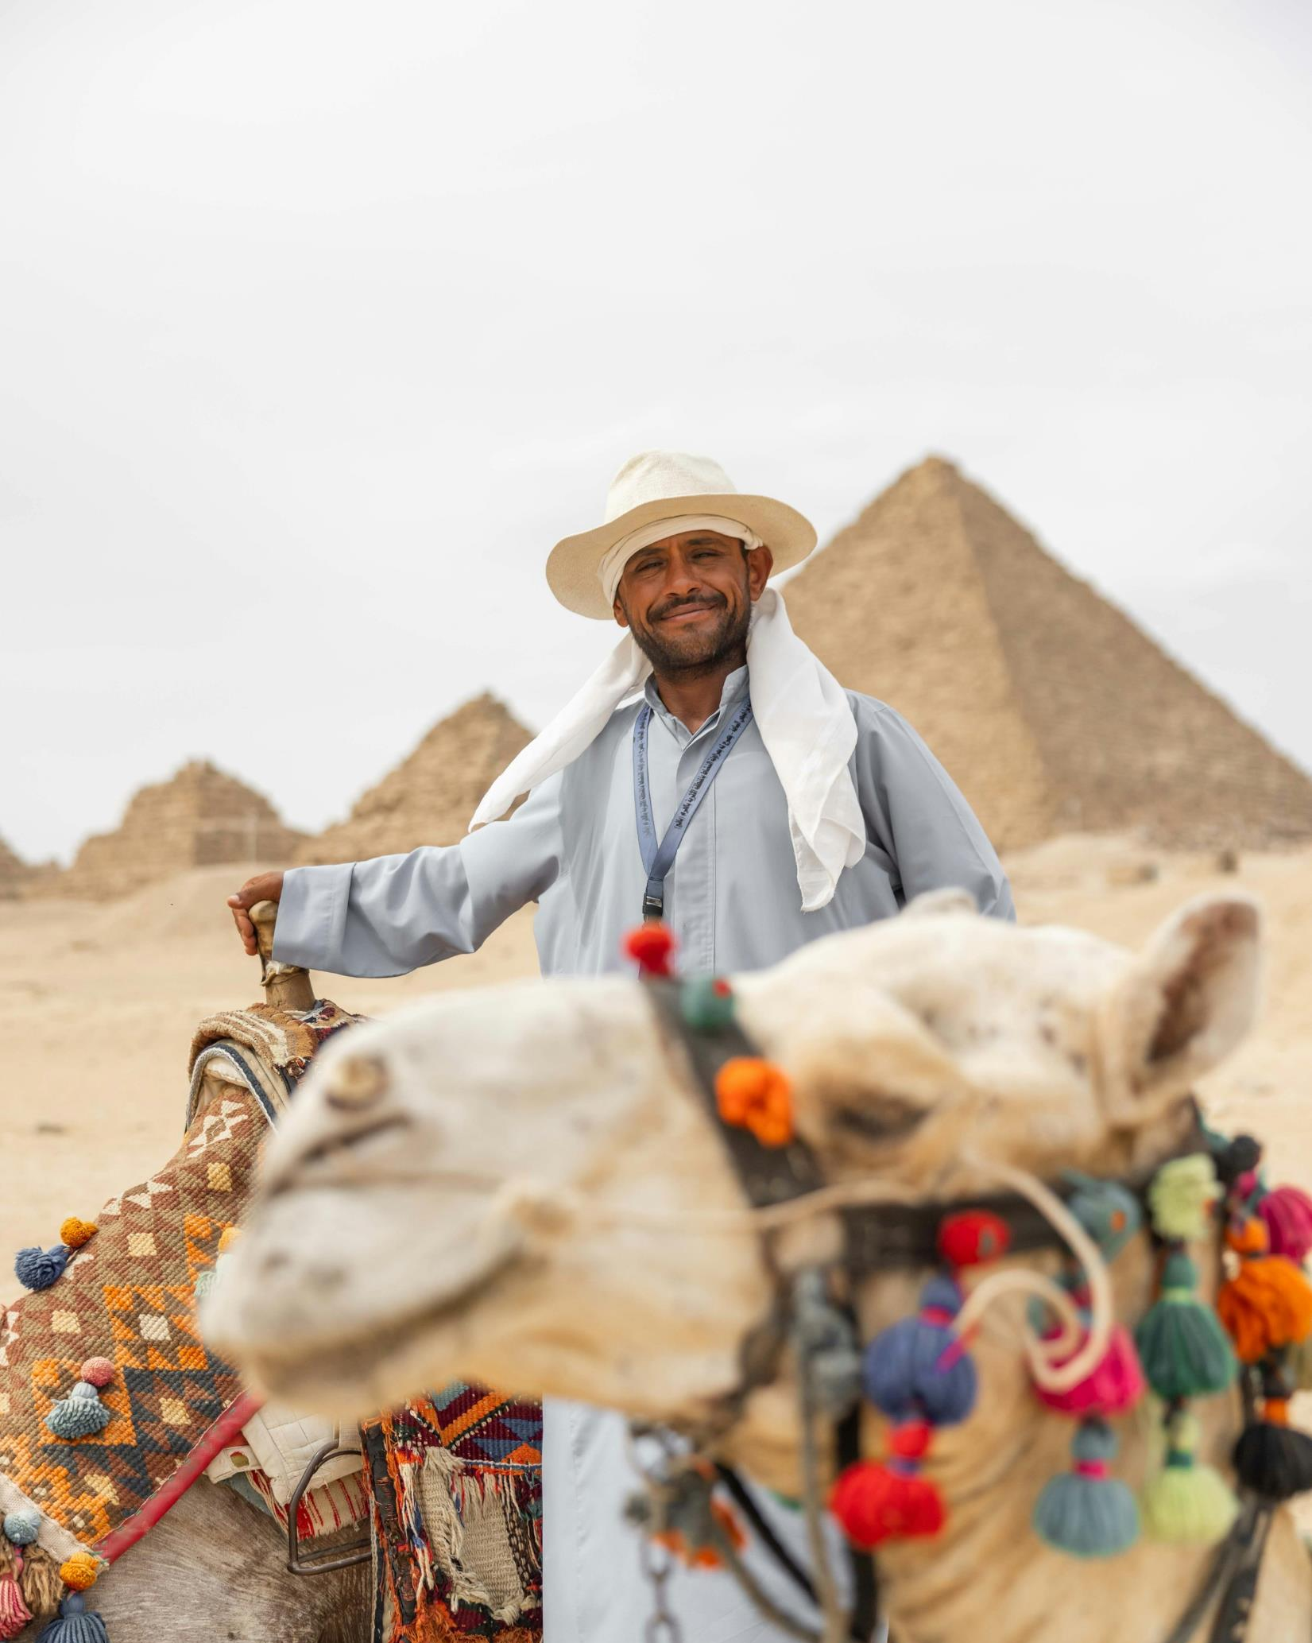
Beautiful People
FamilyID=Office_ArchiveTorn
Photo: Mahamed Salama/Unsplash
Photo: Omar Elsharwy/Unsplash
Photo: Zach Heiberg/Unsplash

Slide 13

Adventures in Culture

Slide 14
L
A
N
G
U
A
G
E
English | Arabic Transliteration | Sounds Like
Welcome | Ahlan wa Sahlan | Ellen Was Ellen
Thank You | Showkron | Show Kran
Please | MinFadLick | Min Fad lick
Hello | Marjaba | Ma Ha Ba
Good Morning | Sabah Alkhyr | Sa Baa Elk Hair
Good Afternoon | Masa Alkhayr | Ma Sa Elk Hair
Yes No | Na’am La | Nag ahm Lah
Come on, Come on | Yella ham | Yella ham
REVIEW

Slide 15

Jesus Loves Me
Words Anna B. Warner
Arabic Pronunciation
Kahd faa-kah hub-nah
Kahd faa-kah hub-nah
Kahd faa-kah hub-nah
Yu-hib-bu-nah Yah-so.

Slide 16

English Translation
Yes, Jesus loves me !
Yes, Jesus loves me!
Yes, Jesus loves me!
The Bible tells me so.

