Slide 1

Global Adventures
Puerto Rico

Slide 2
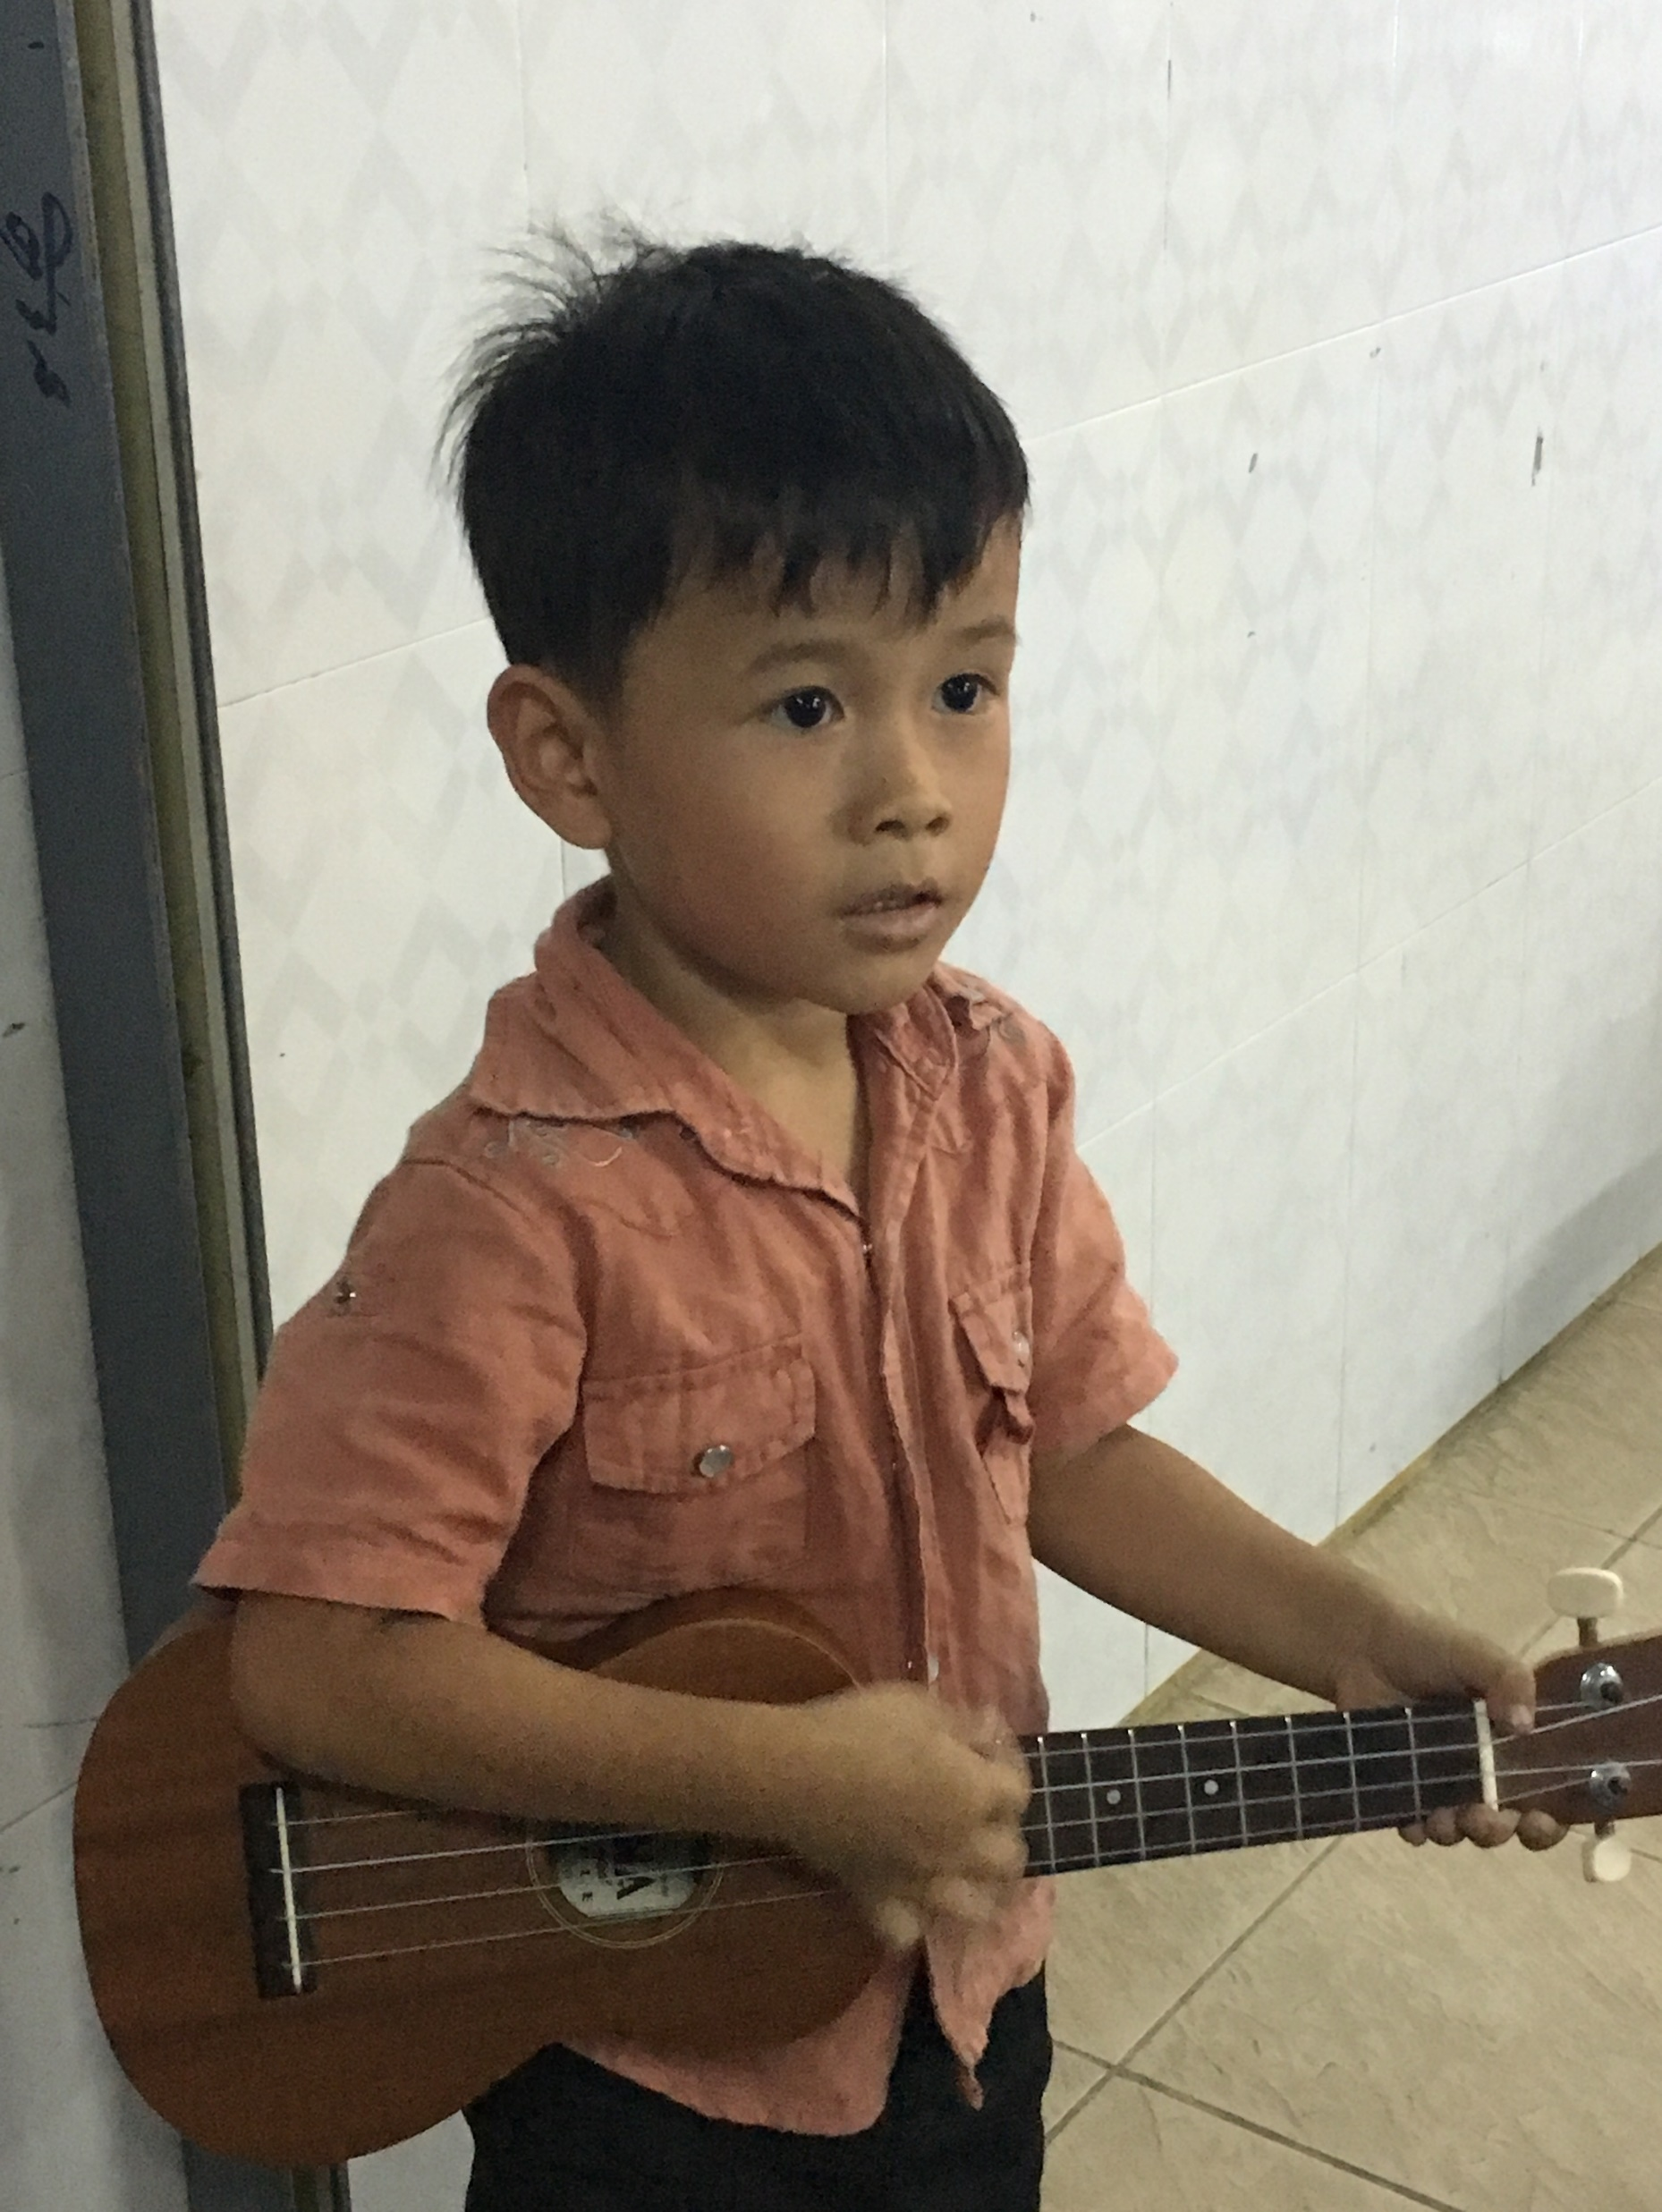
Theme Verse
Sing to the Lord a new song; sing to the Lord,
all the earth. Sing to the Lord, praise his name; proclaim his salvation day after day. Declare his glory among the nations, his marvelous deeds among all peoples.
- Psalms 96:1-3
Unsplash: Ben White

Slide 3

Explore the Country

Slide 4

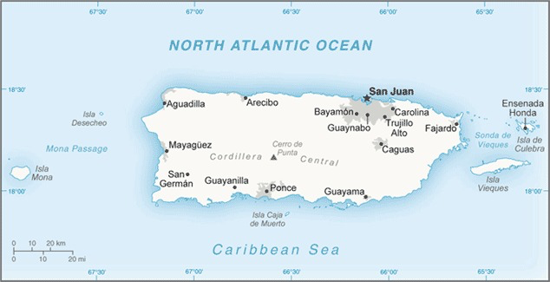
CIA World Fact Book, Public domain, via Wikimedia Commons
CIA World Fact Book, Public domain, via Wikimedia Commons
Puerto Rico

Slide 5
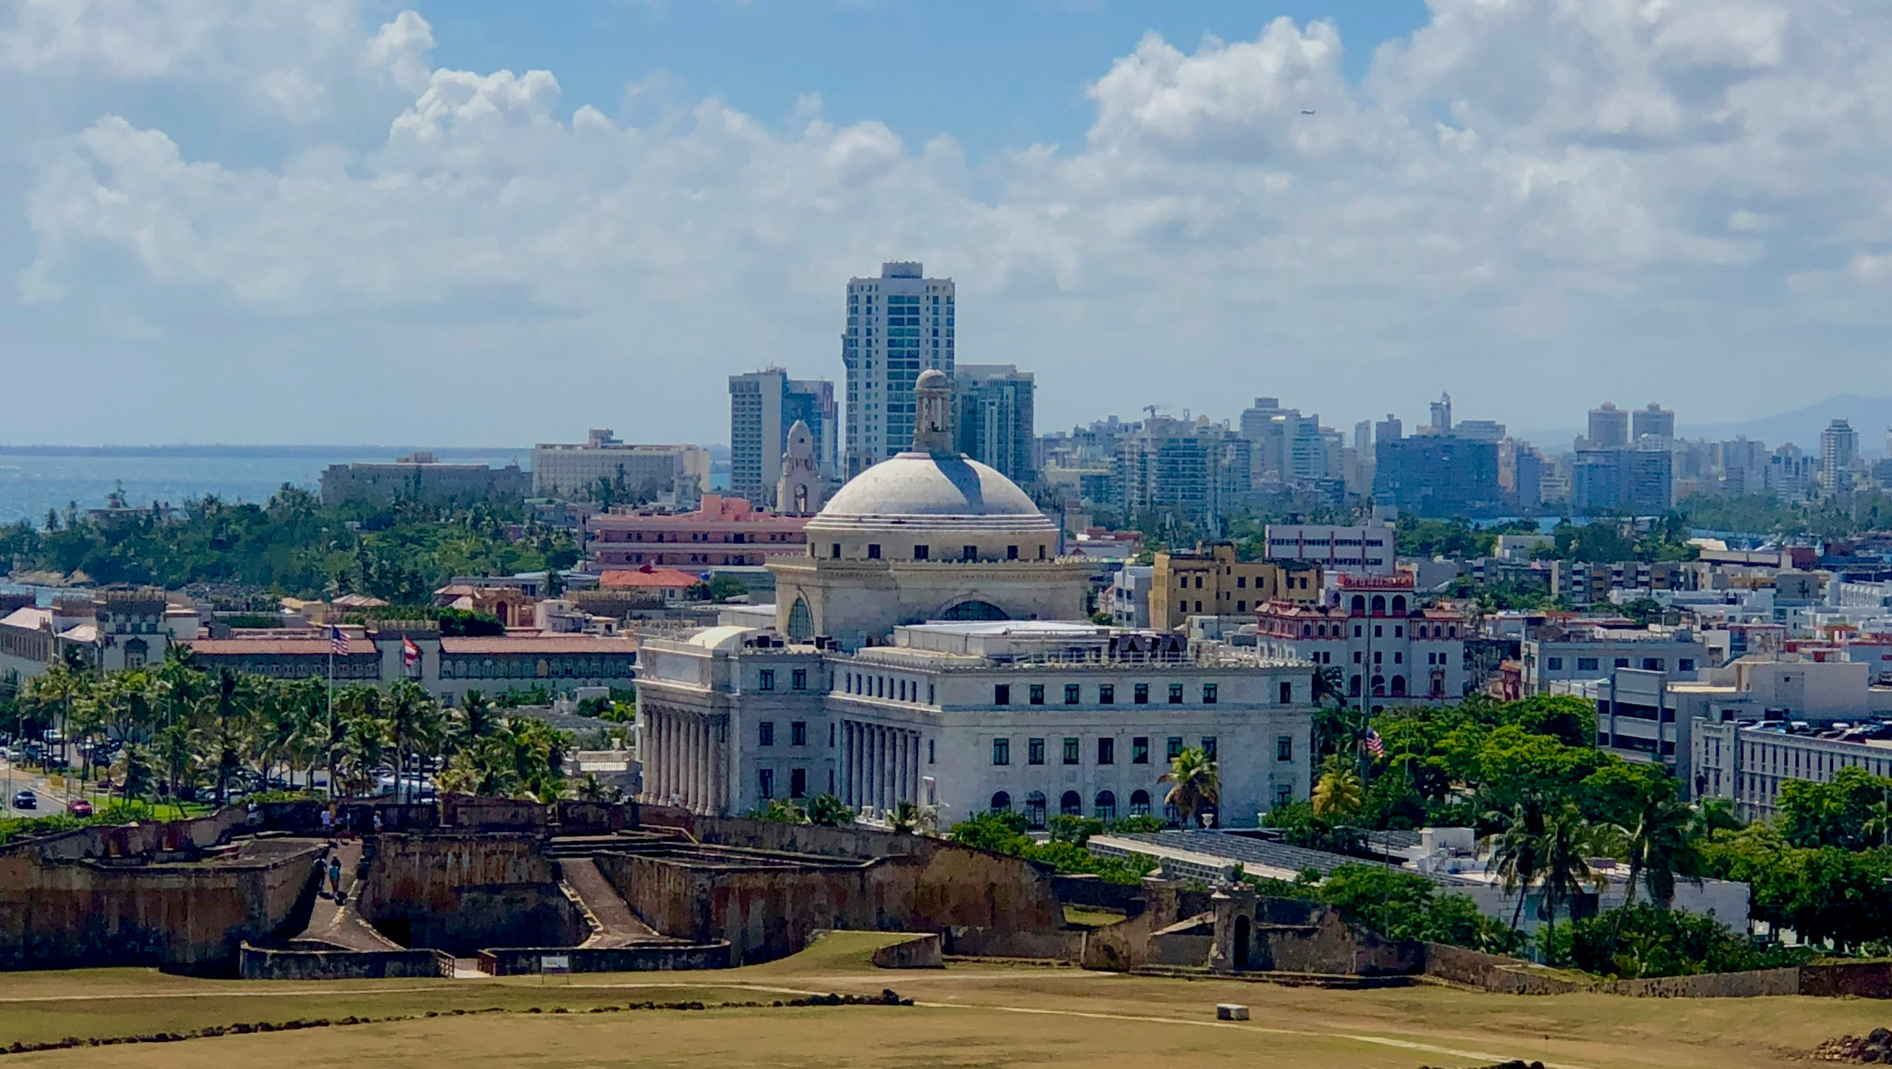
San Juan (the capital city)
Photo: Stephanie Klepacki/Unsplash

Slide 6
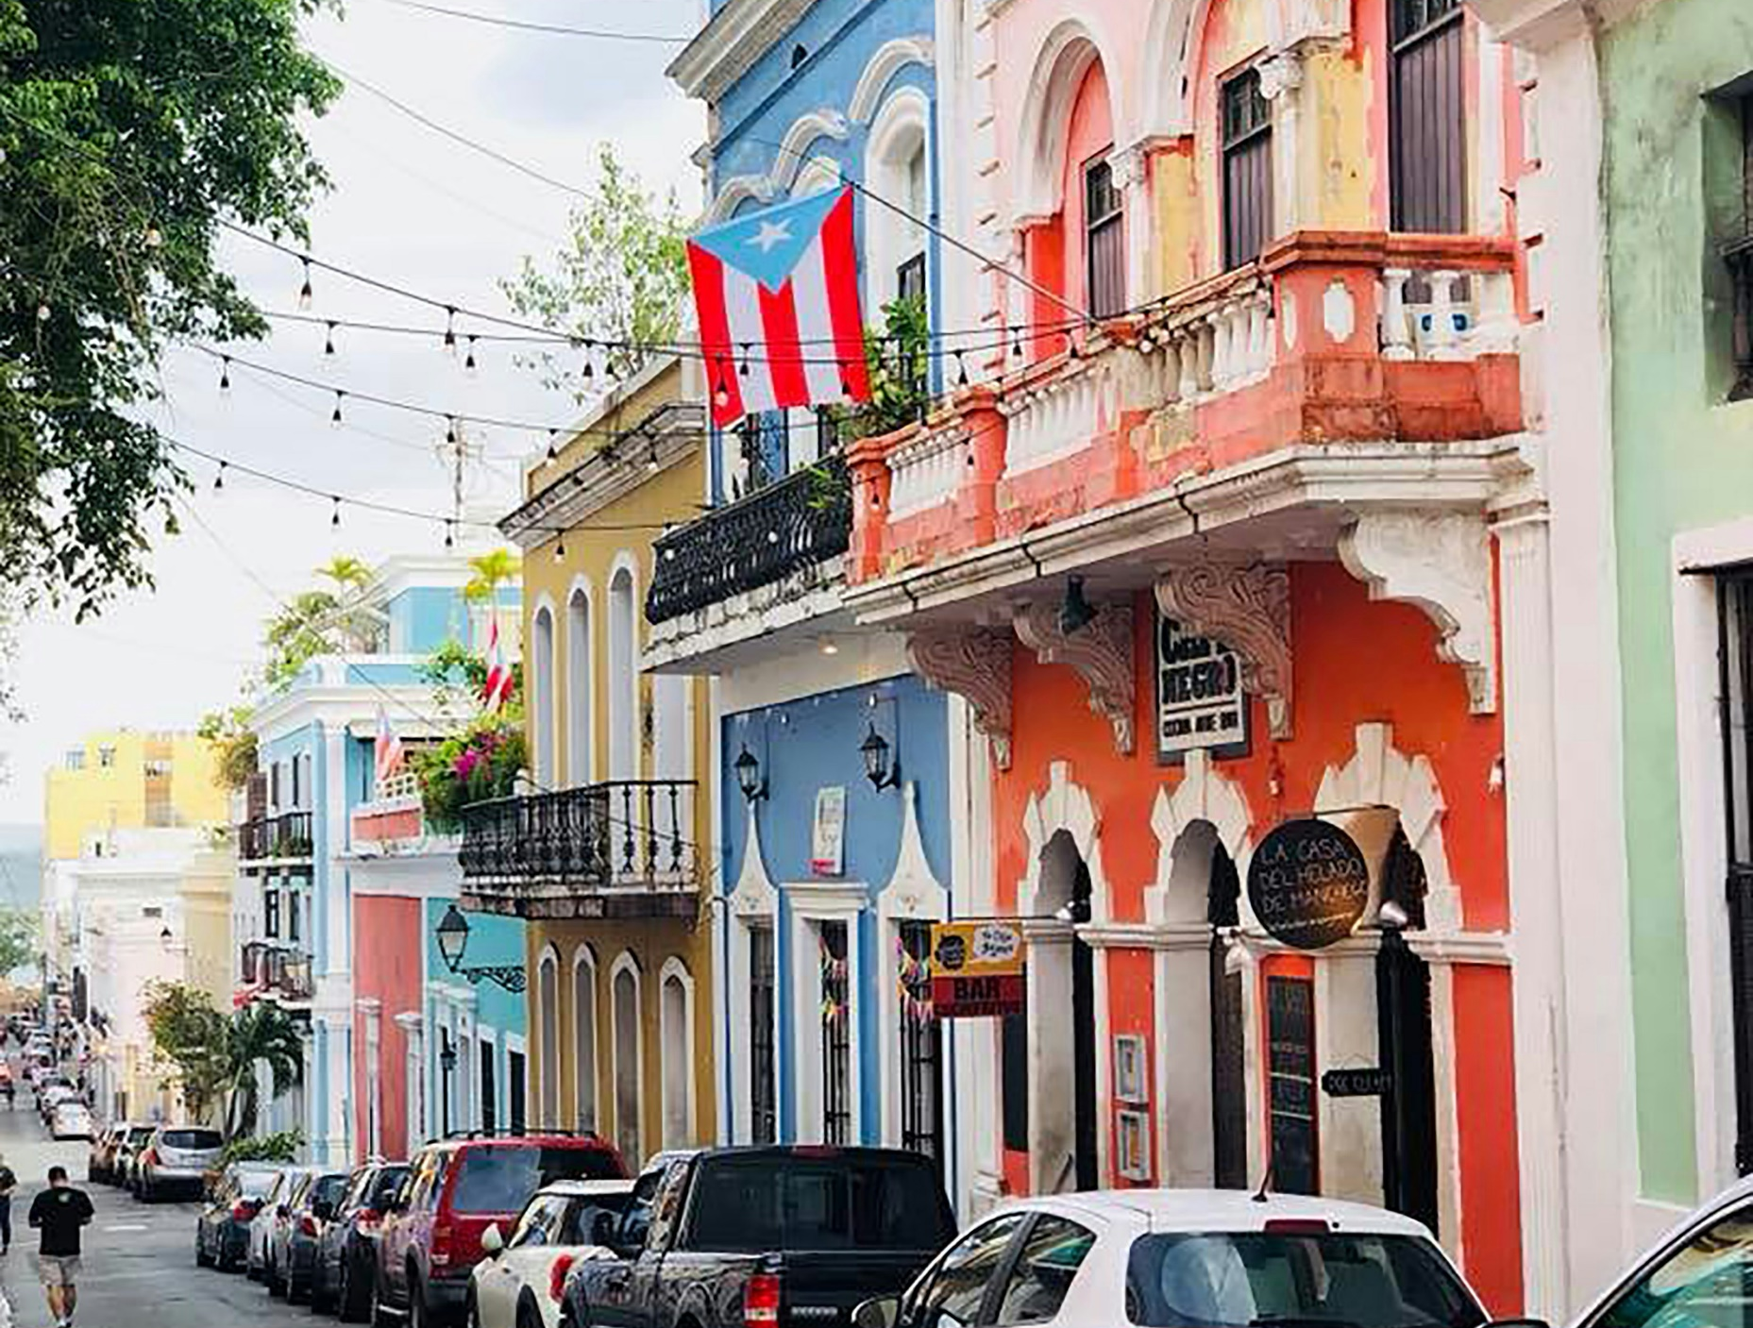
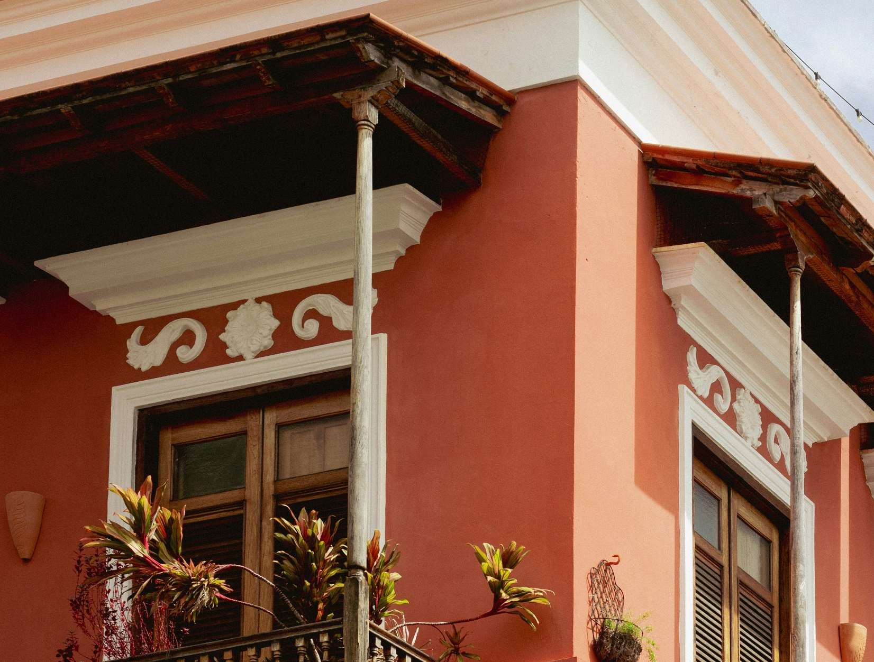
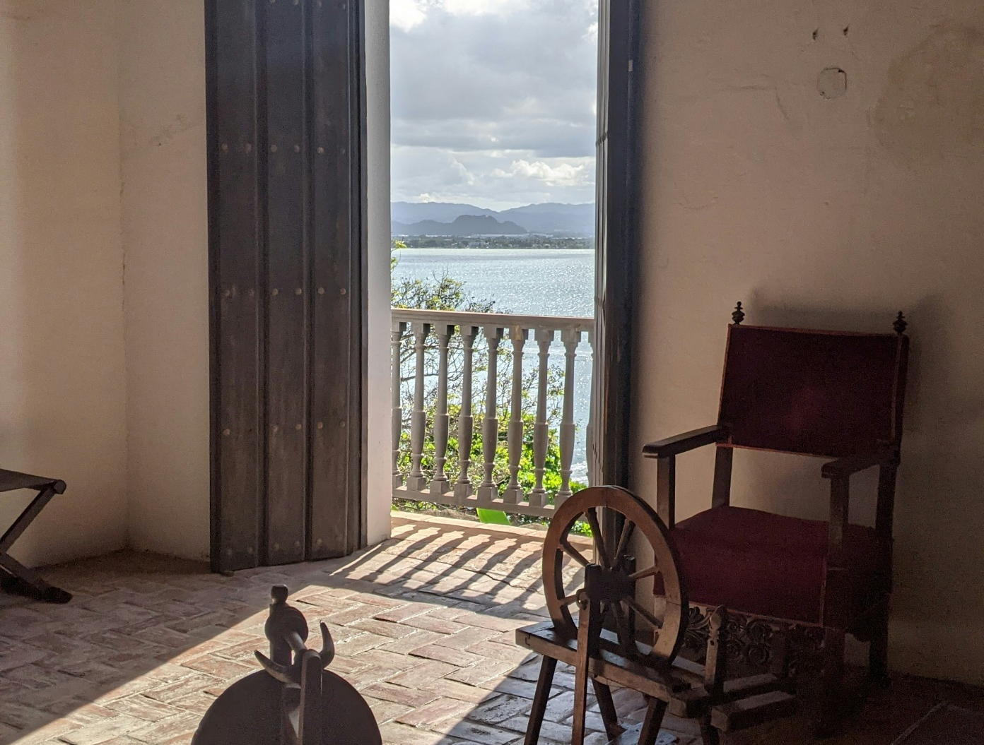
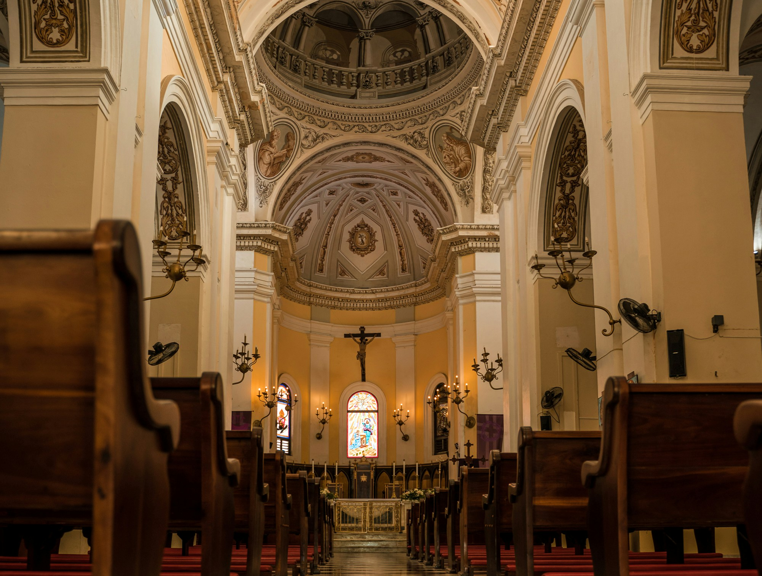
Old San Juan
Photo: Bernardo Cruz/ Unsplash
Photo: Alex George/ Unsplash
Photo: Thomas Isbister/ Unsplash
Photo: Eric Ardito/ Unsplash

Slide 7
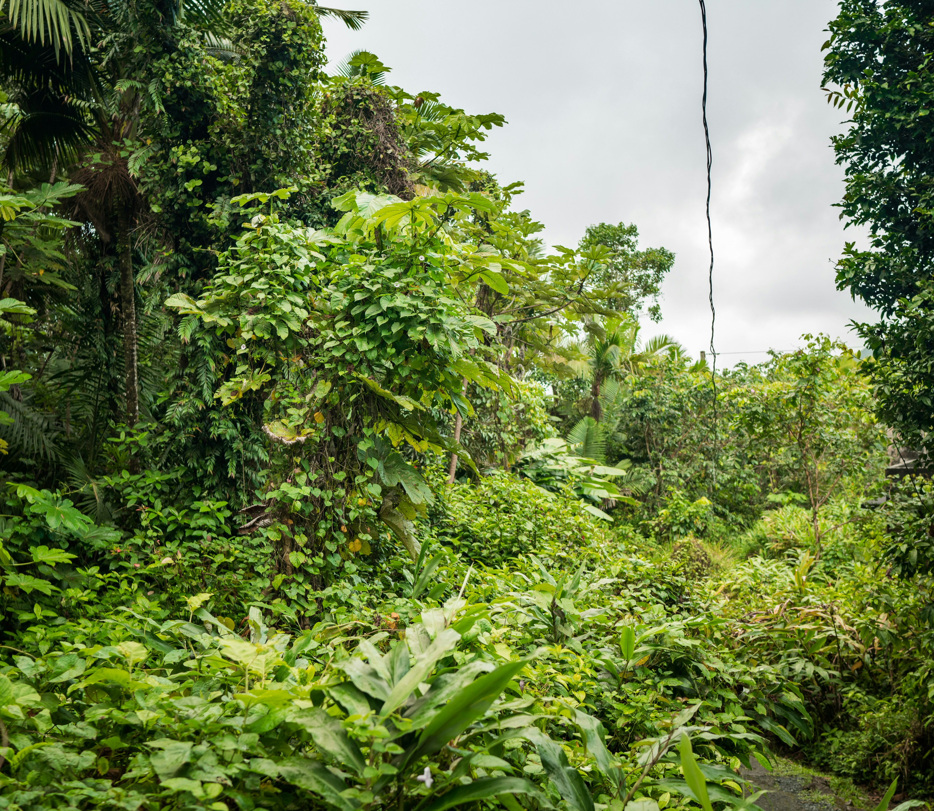
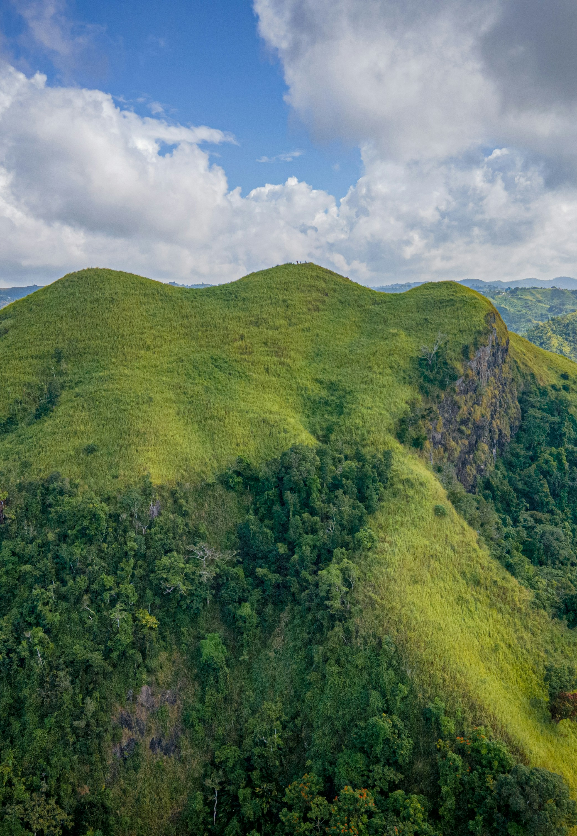
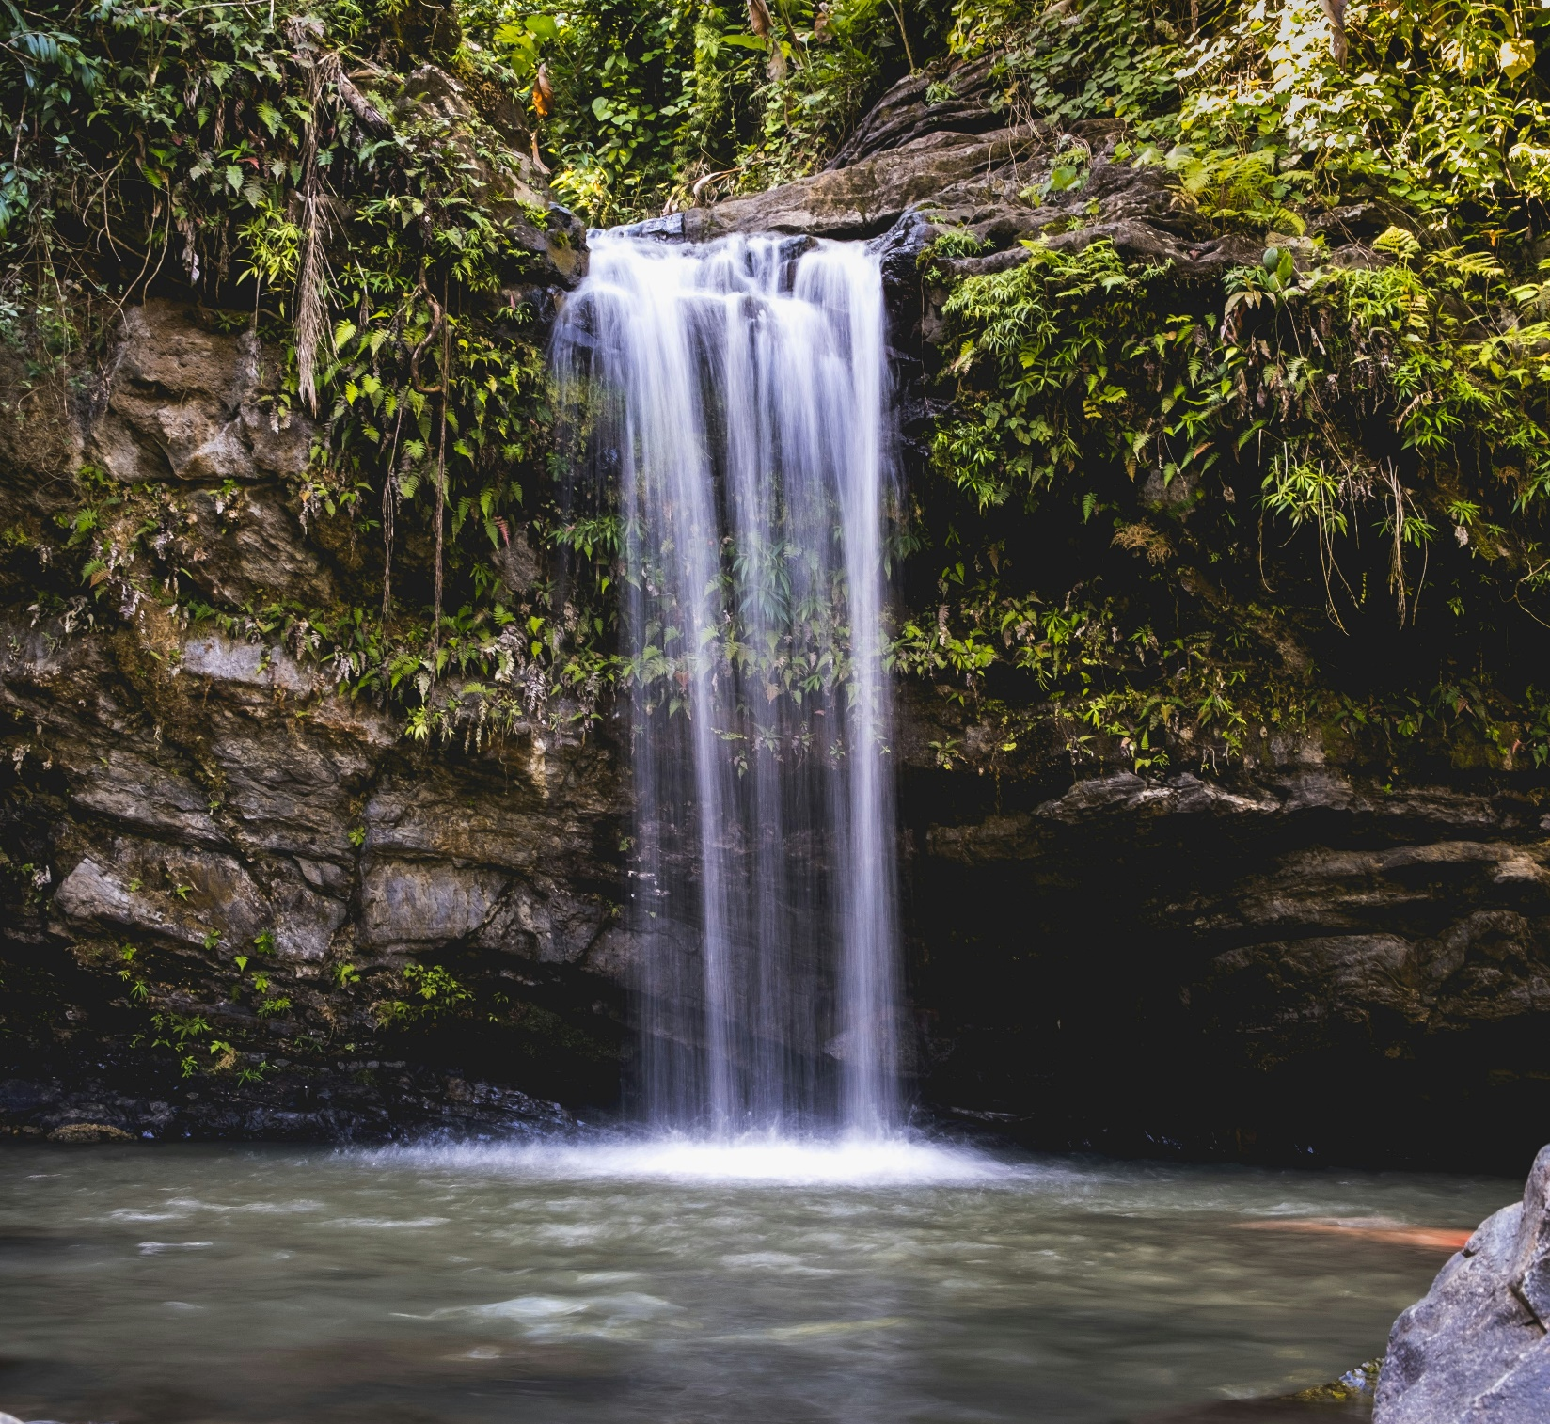
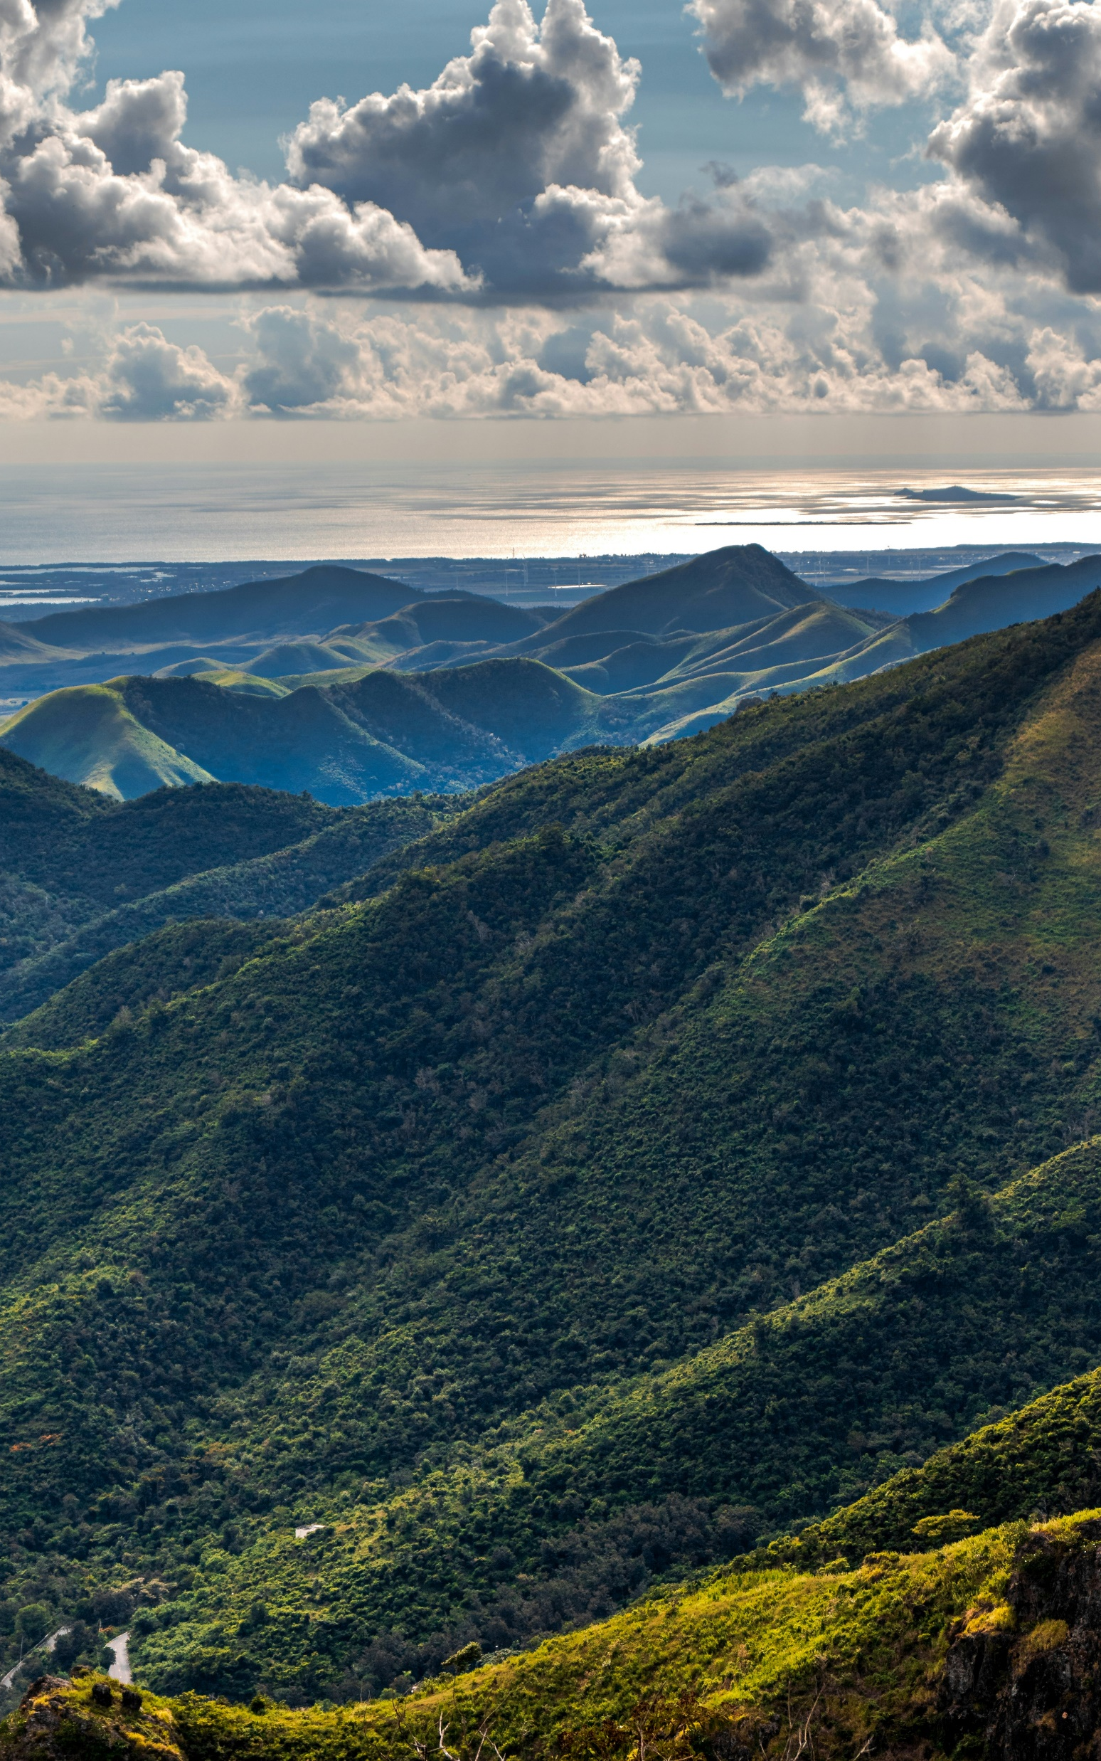
Natural Beauty
Photo: Eric Ardito/Unsplash
Photo: J Amil Santiago/Unsplash
Photo: Wenhao Ruan/Unsplash
Photo: Javier Amador/Unsplash

Slide 8
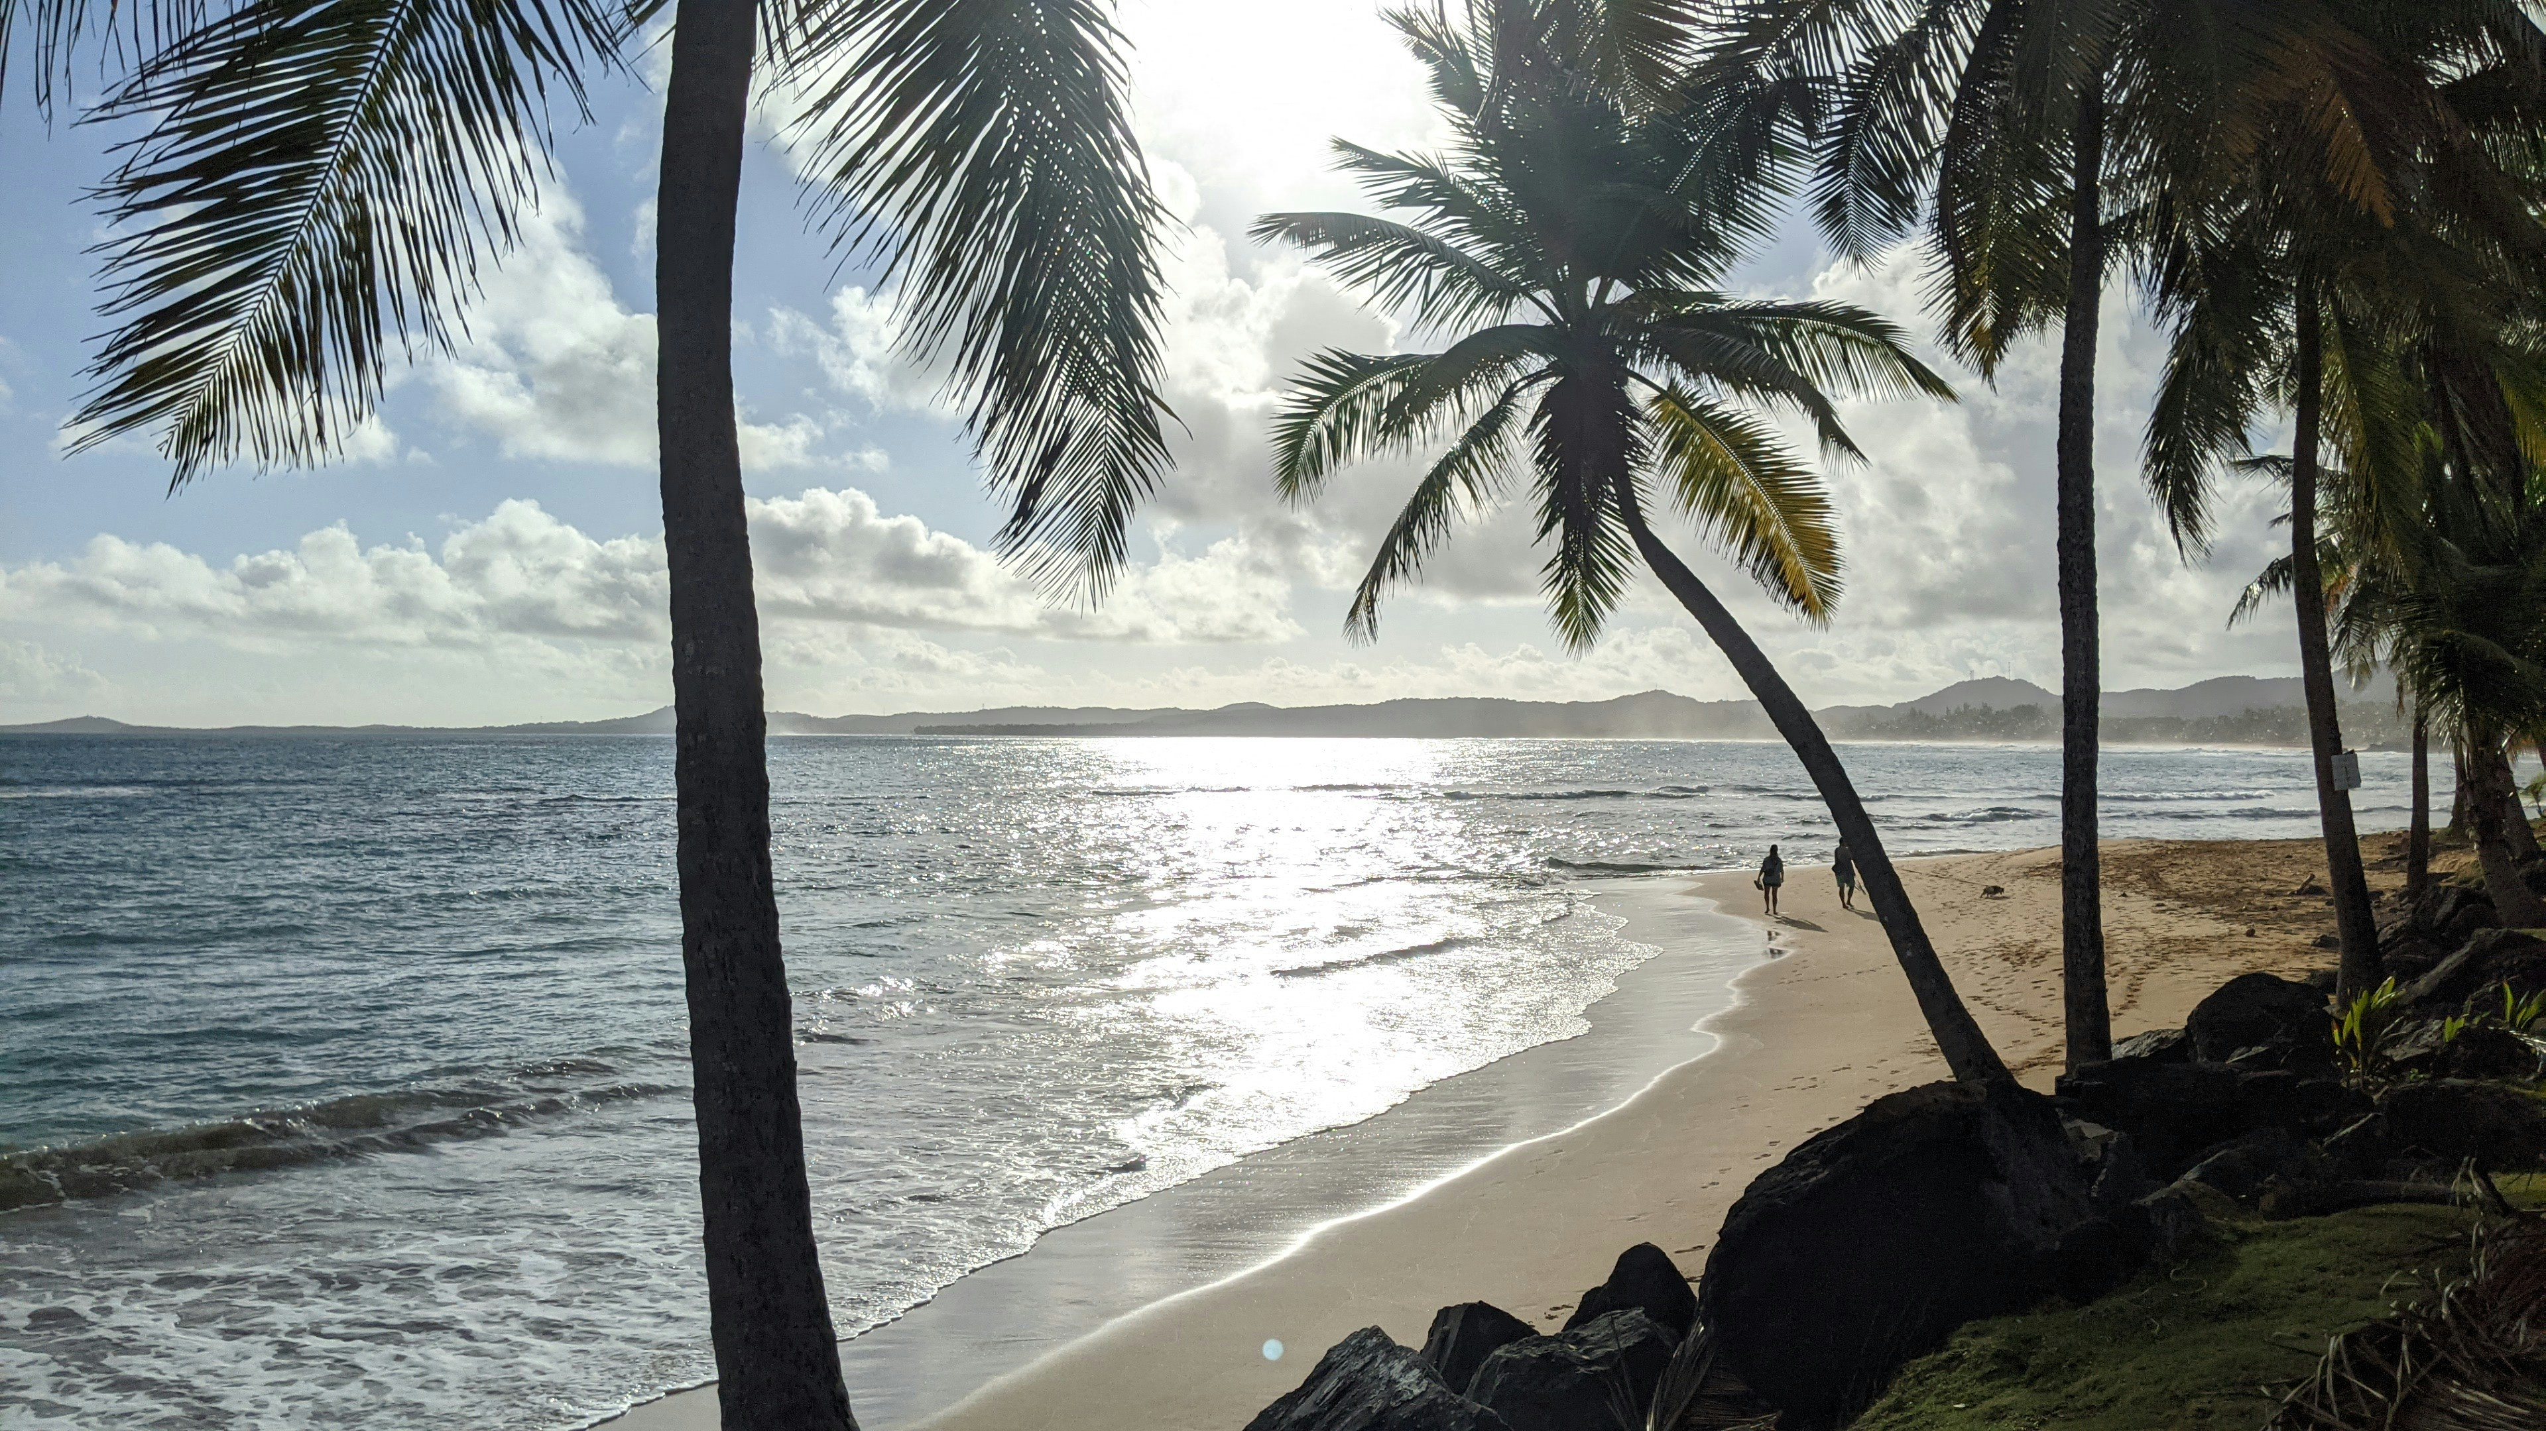
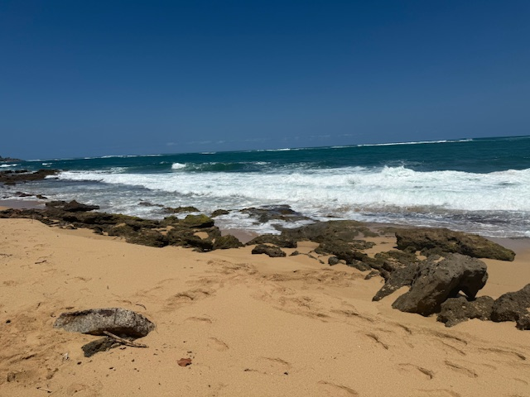
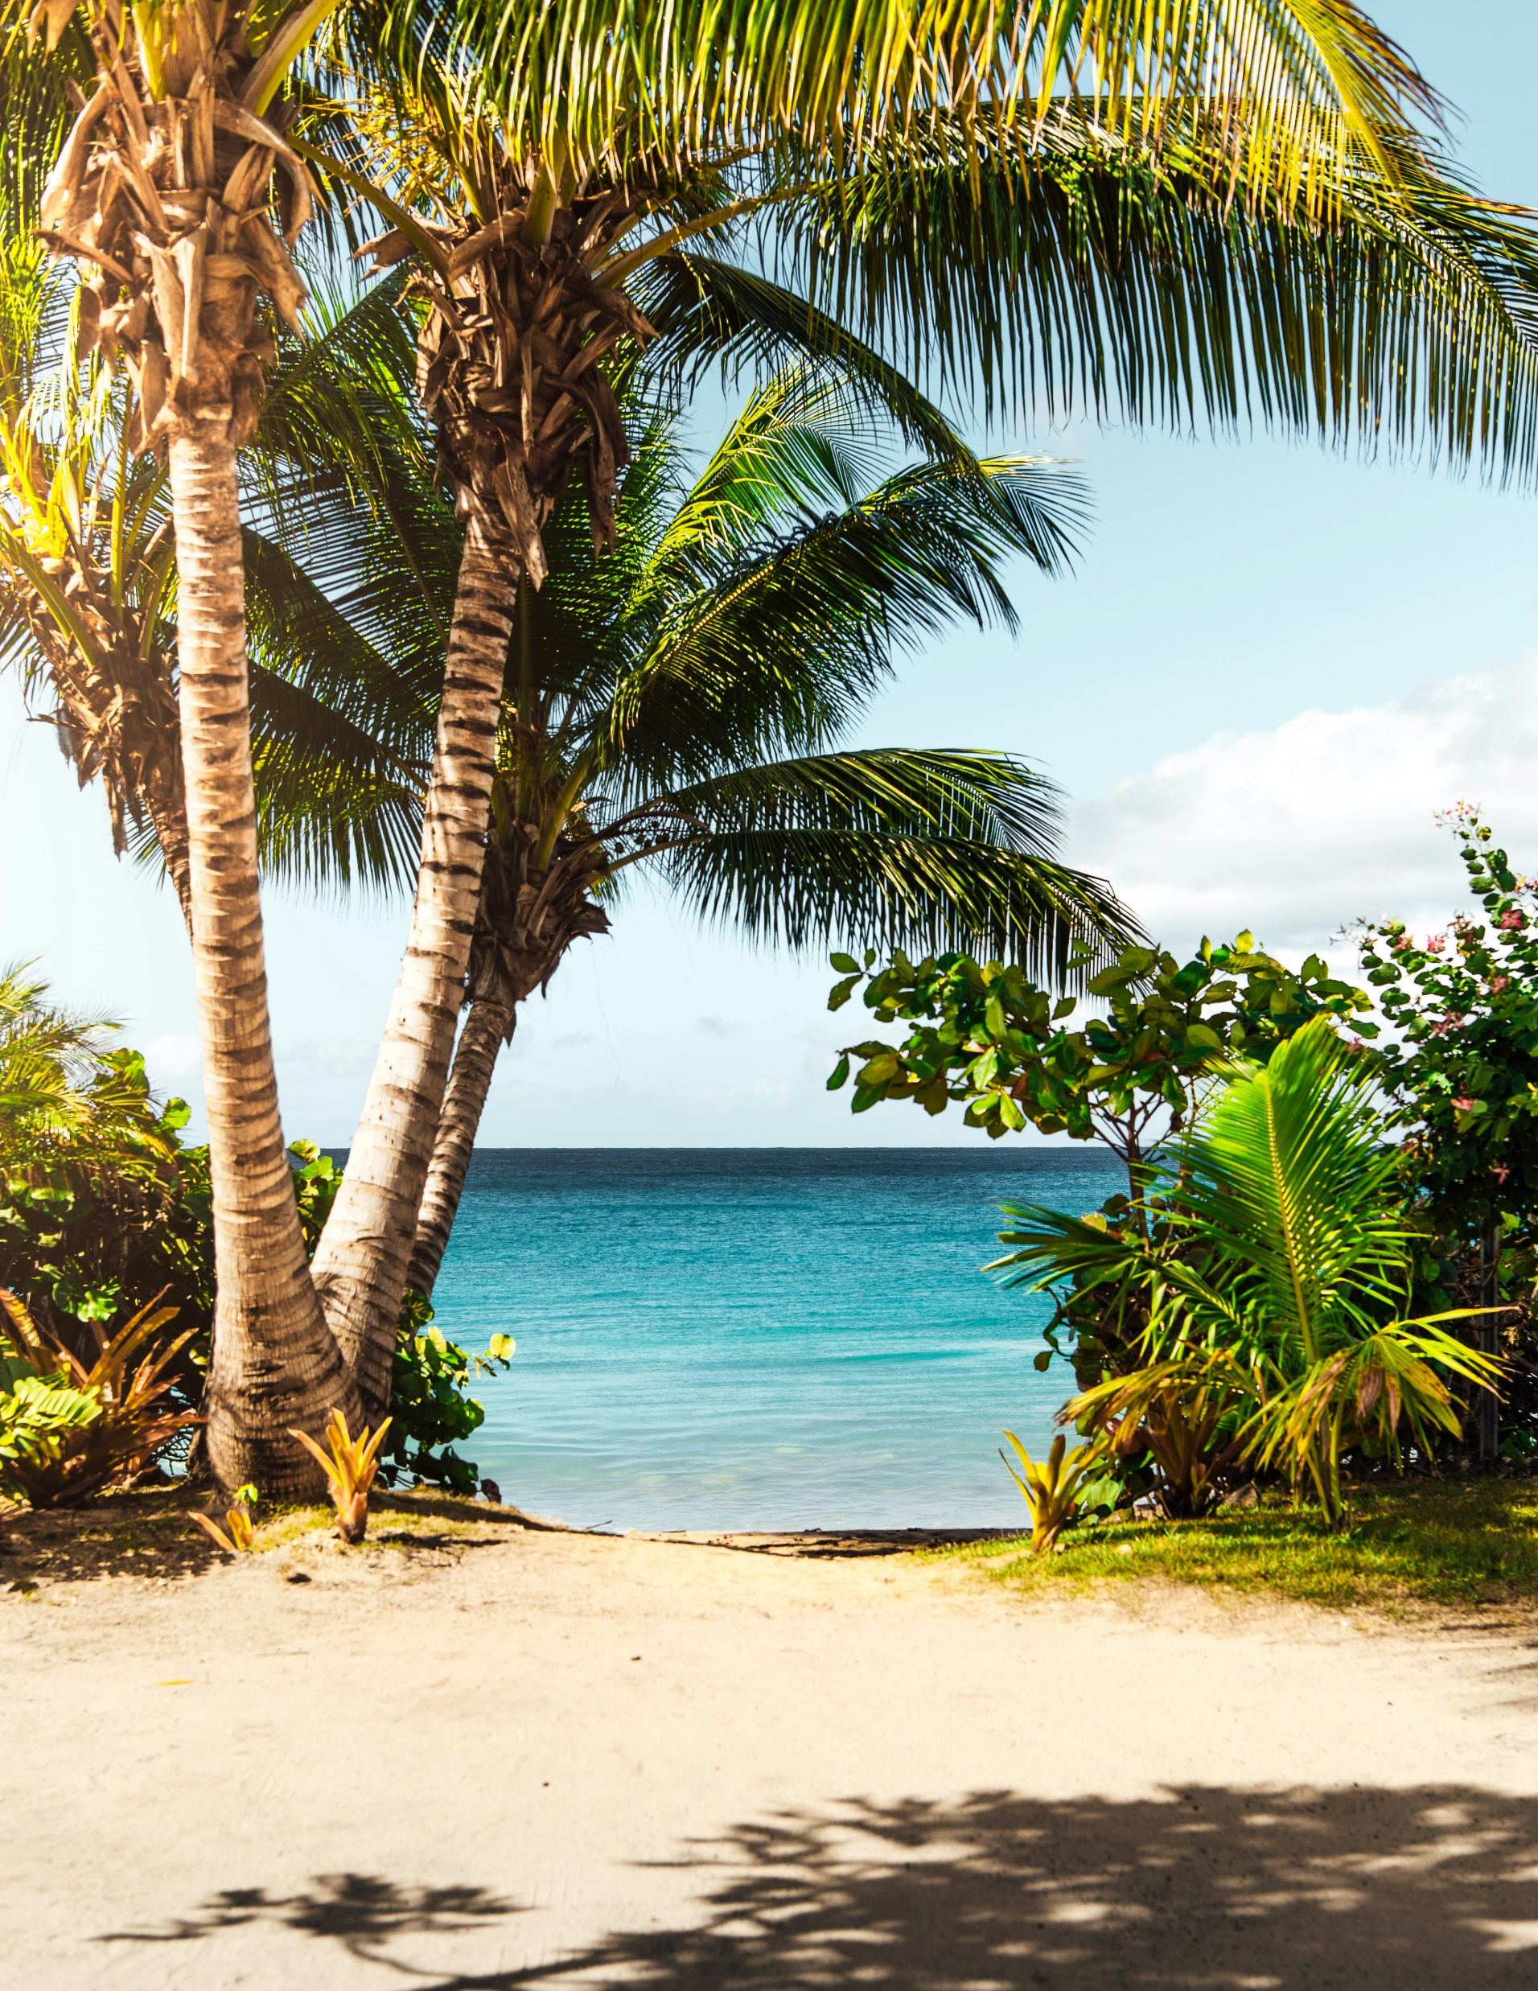
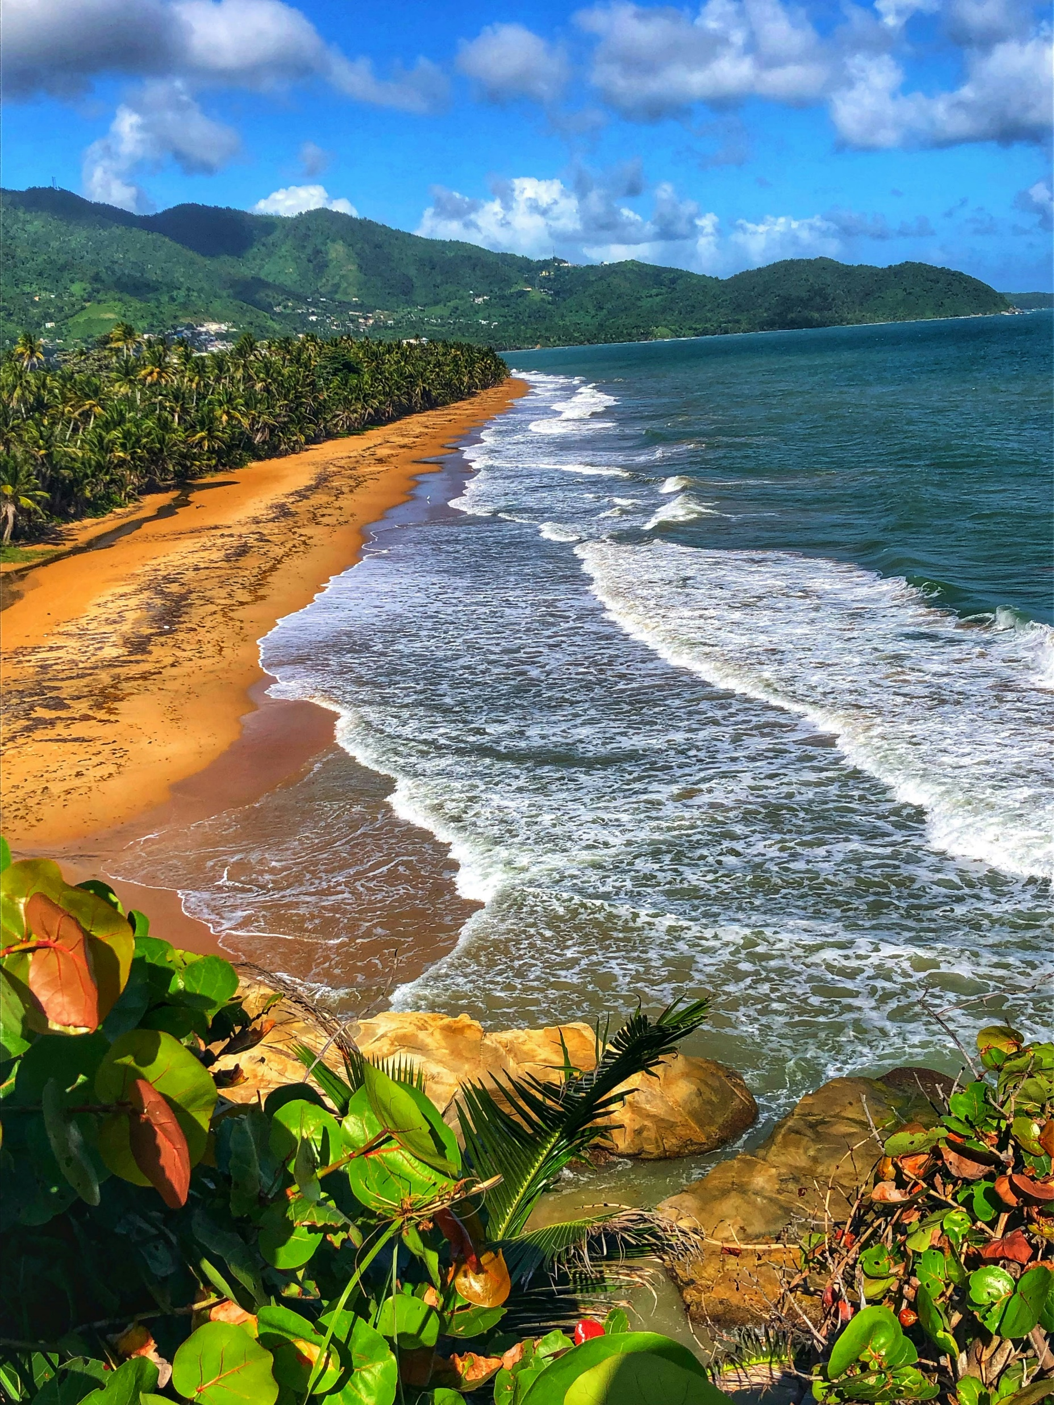
Beautiful Beaches
Photo: Thomas Isbister/ Unsplash
Photo: Jan Coates
Phot: Alex Mnatsakano/ Unsplash
Photo: Matthew Brodeur/Unsplash

Slide 9
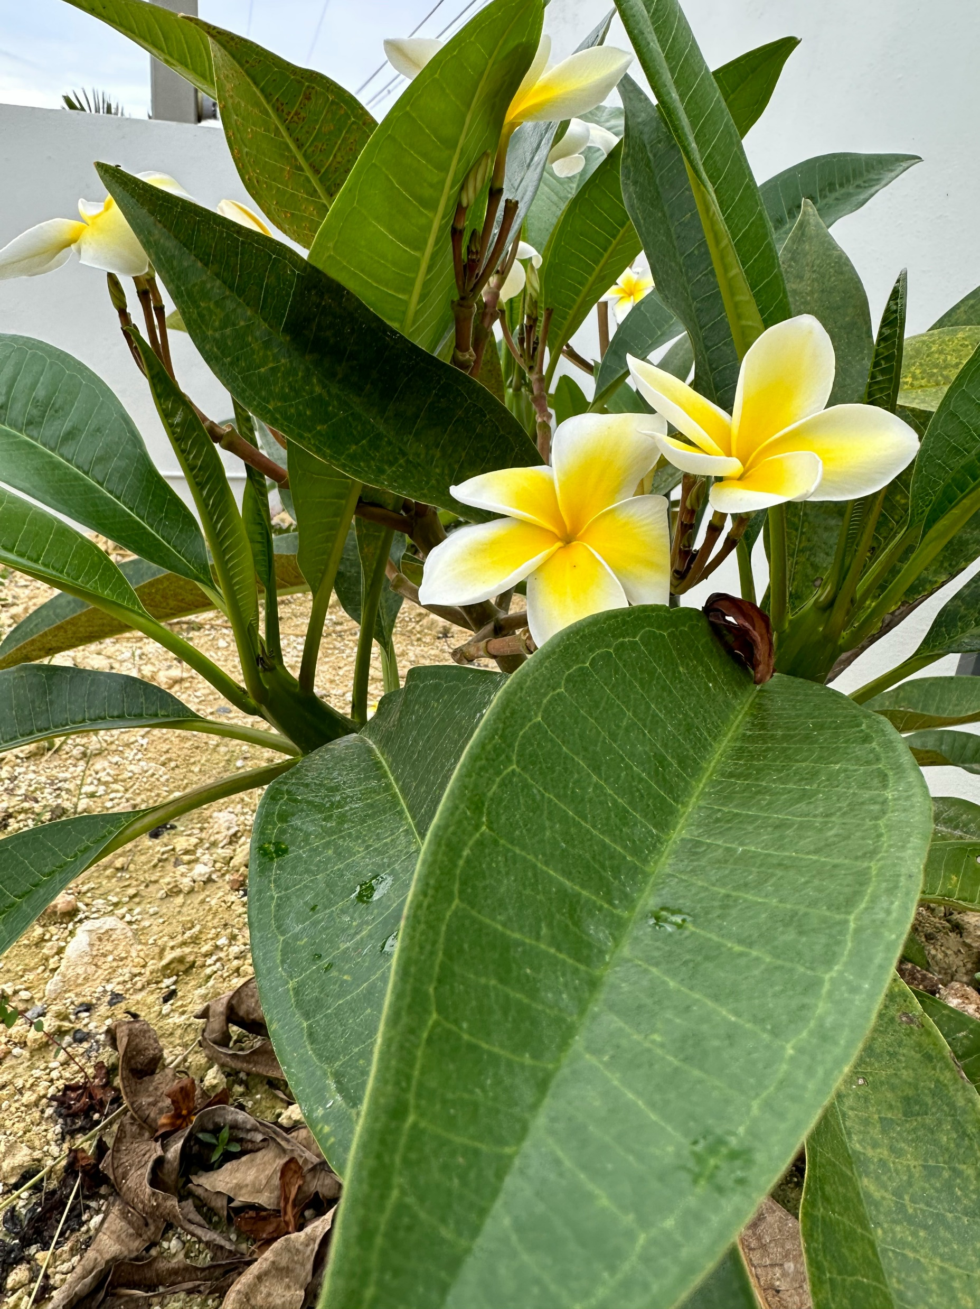
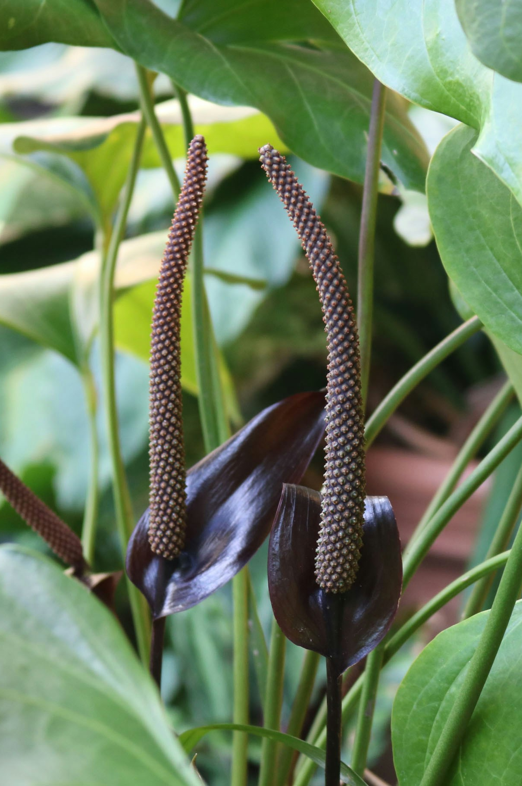
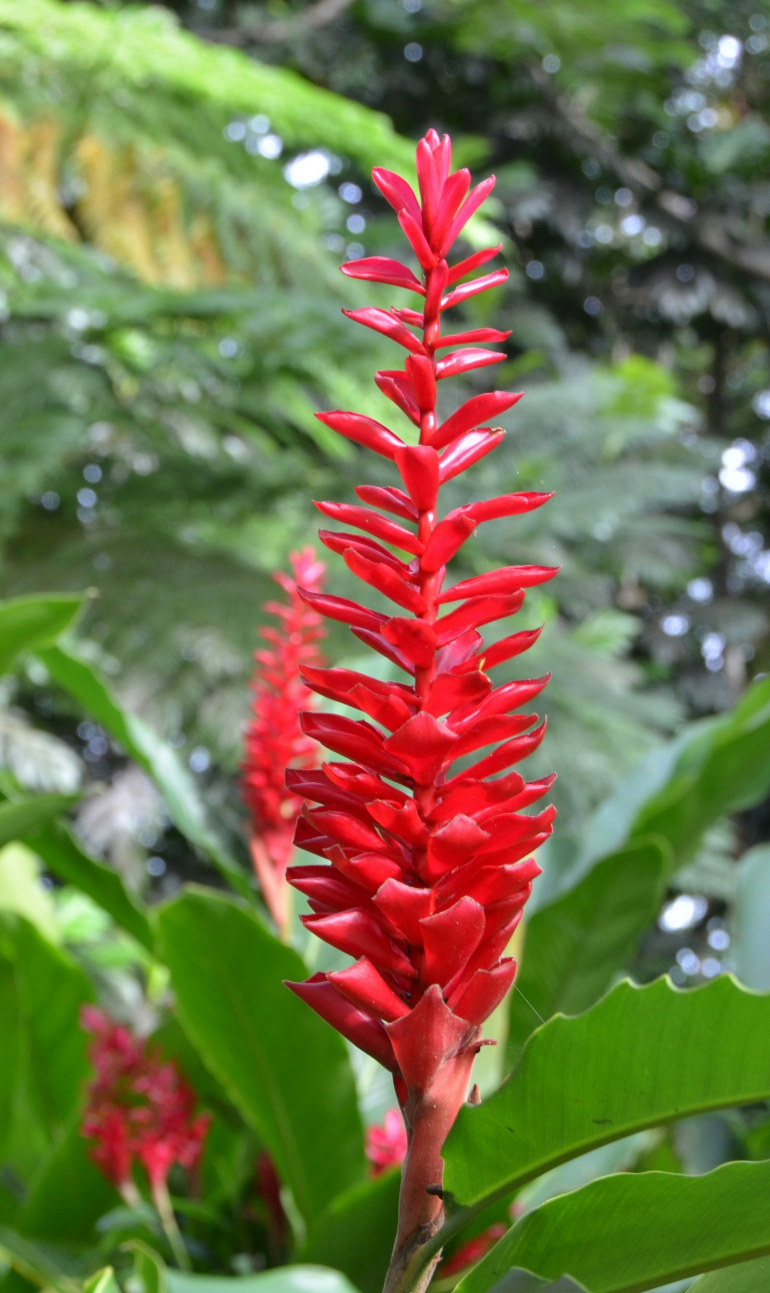
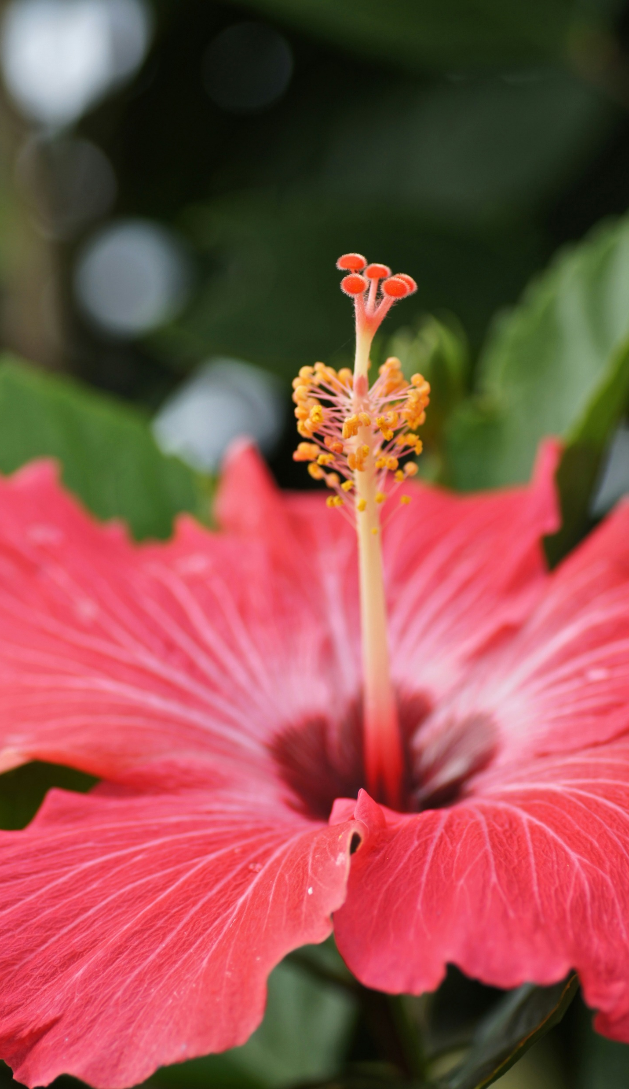
Beautiful Flowers The National Flower is the Puerto Rican Hibiscus
Photo: Reno Intreglia/Unsplash
Photo: Ana Toledo/Unsplash
Photo: P Mantha/Unsplash
Photo: Ronald Flores/Unsplash

Slide 10
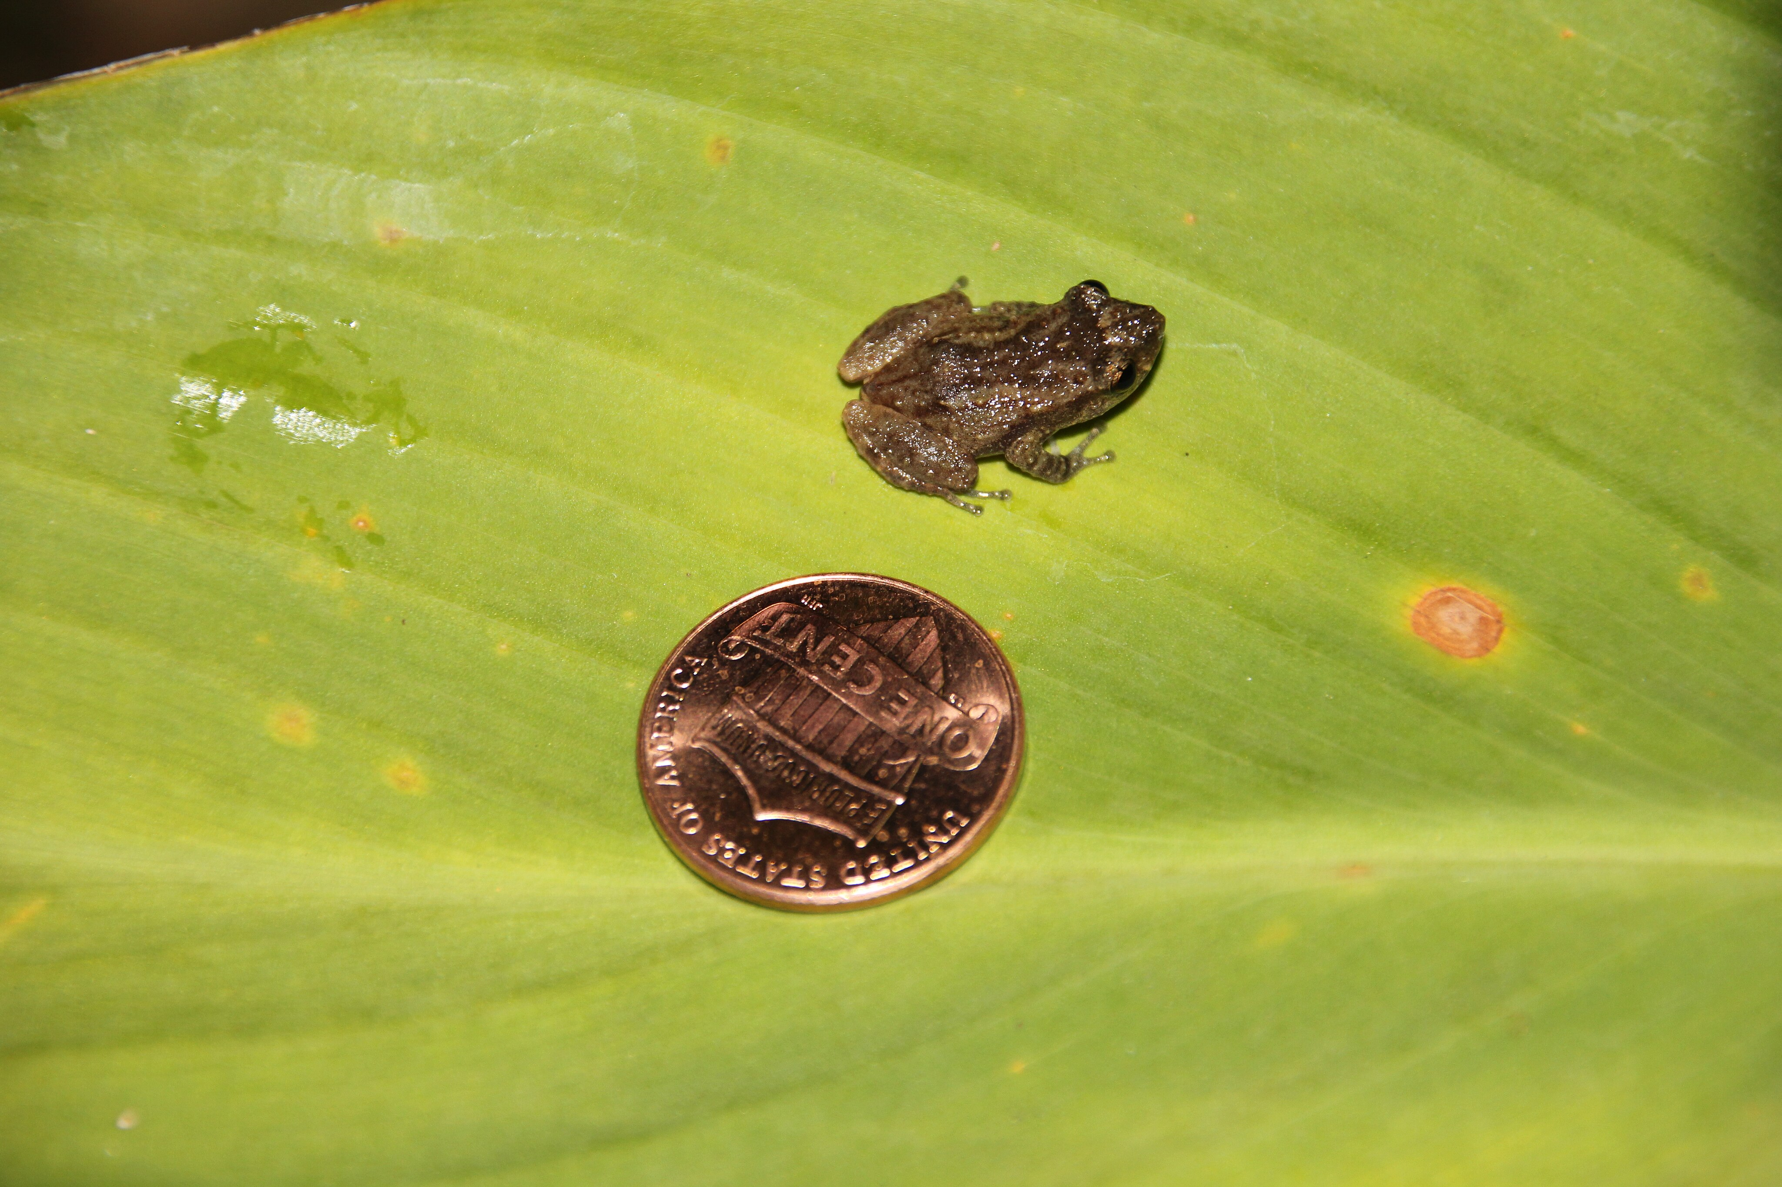
The Coqui Frog (ko-kee)
Photo: Cathybwl, Creative Commons via Wikimedia Commons

Slide 11
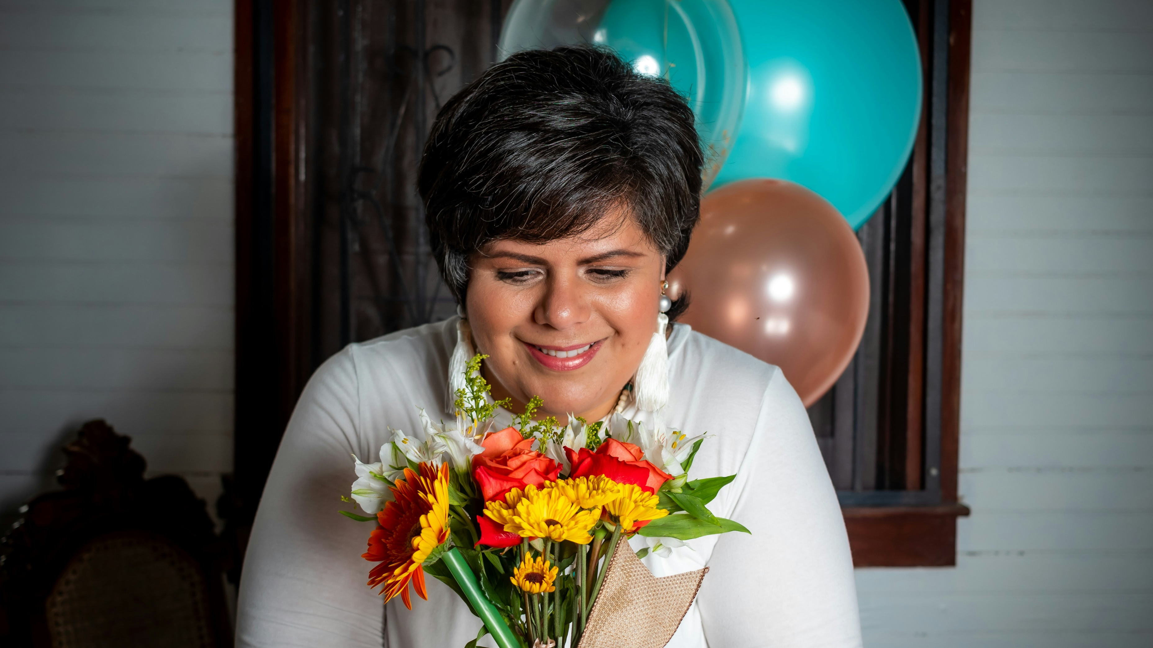
Beautiful People
Photo: Julissa Capdevilla/ Unsplash

Slide 12
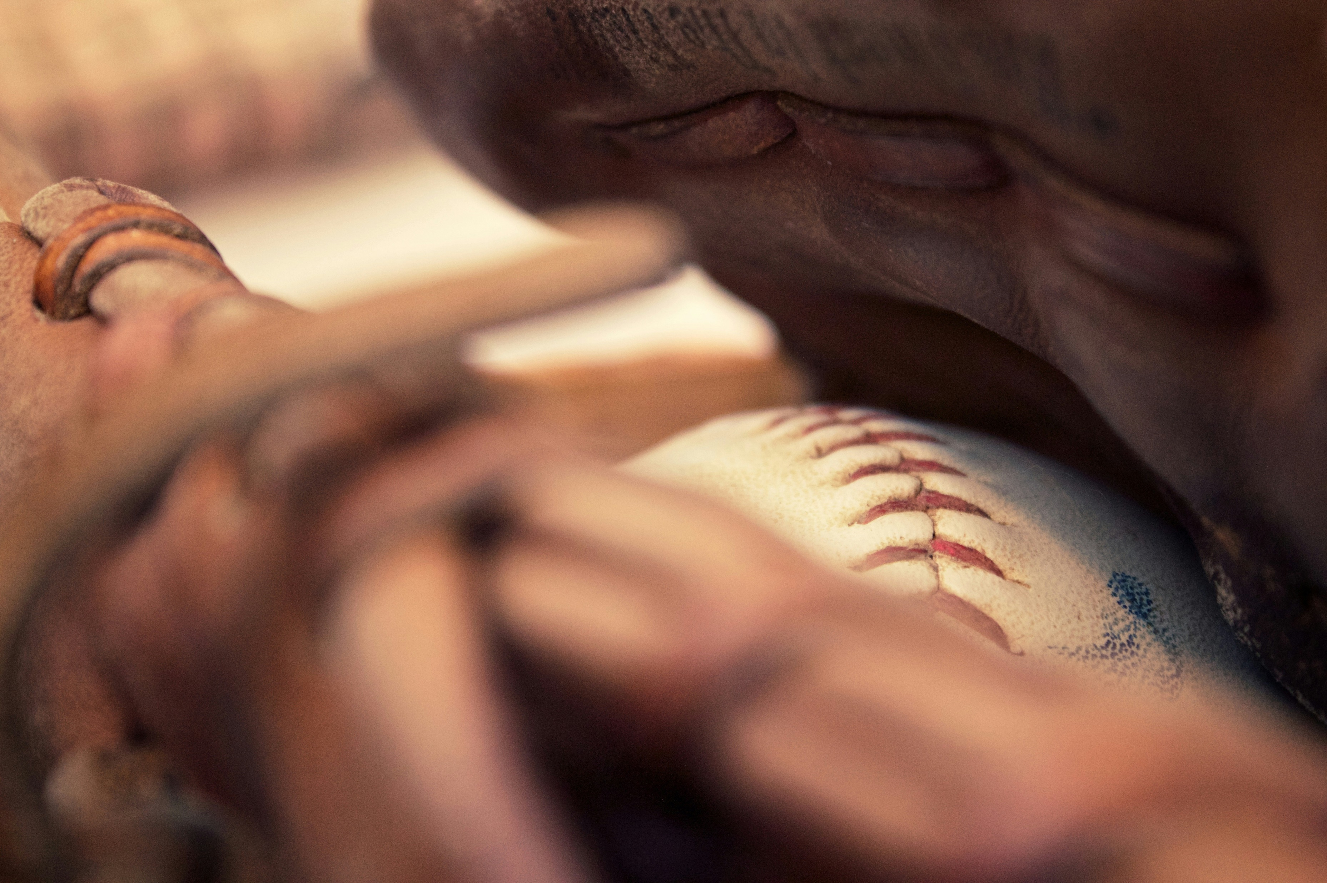
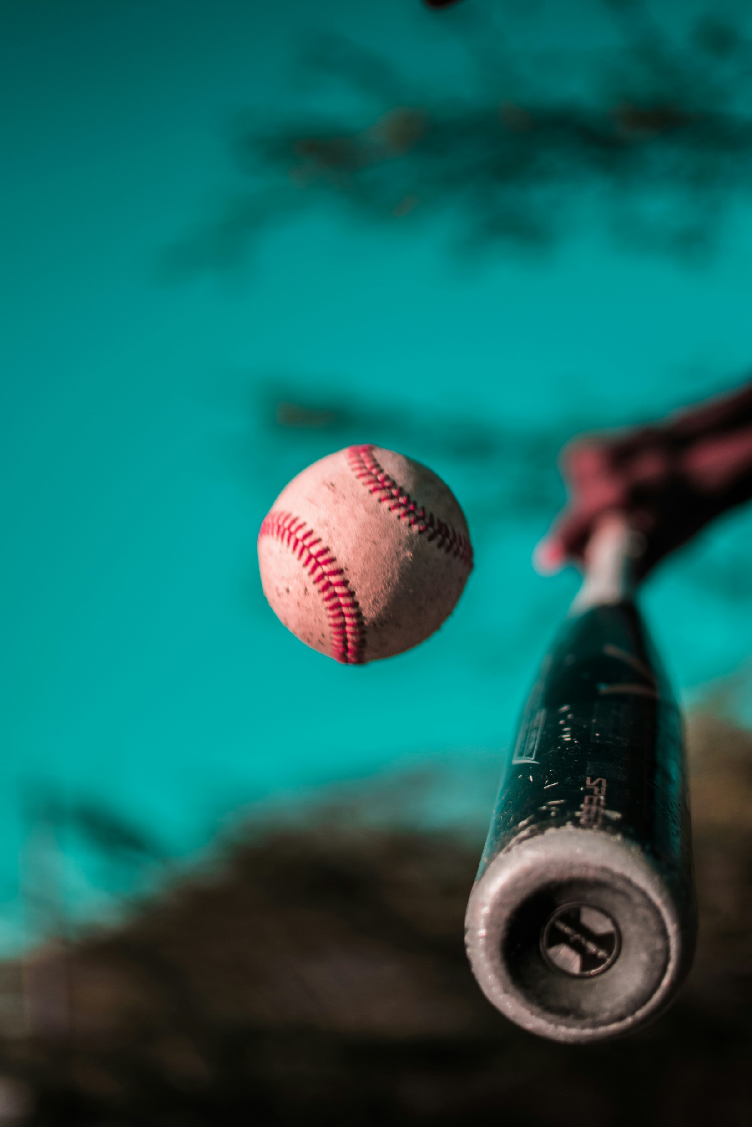
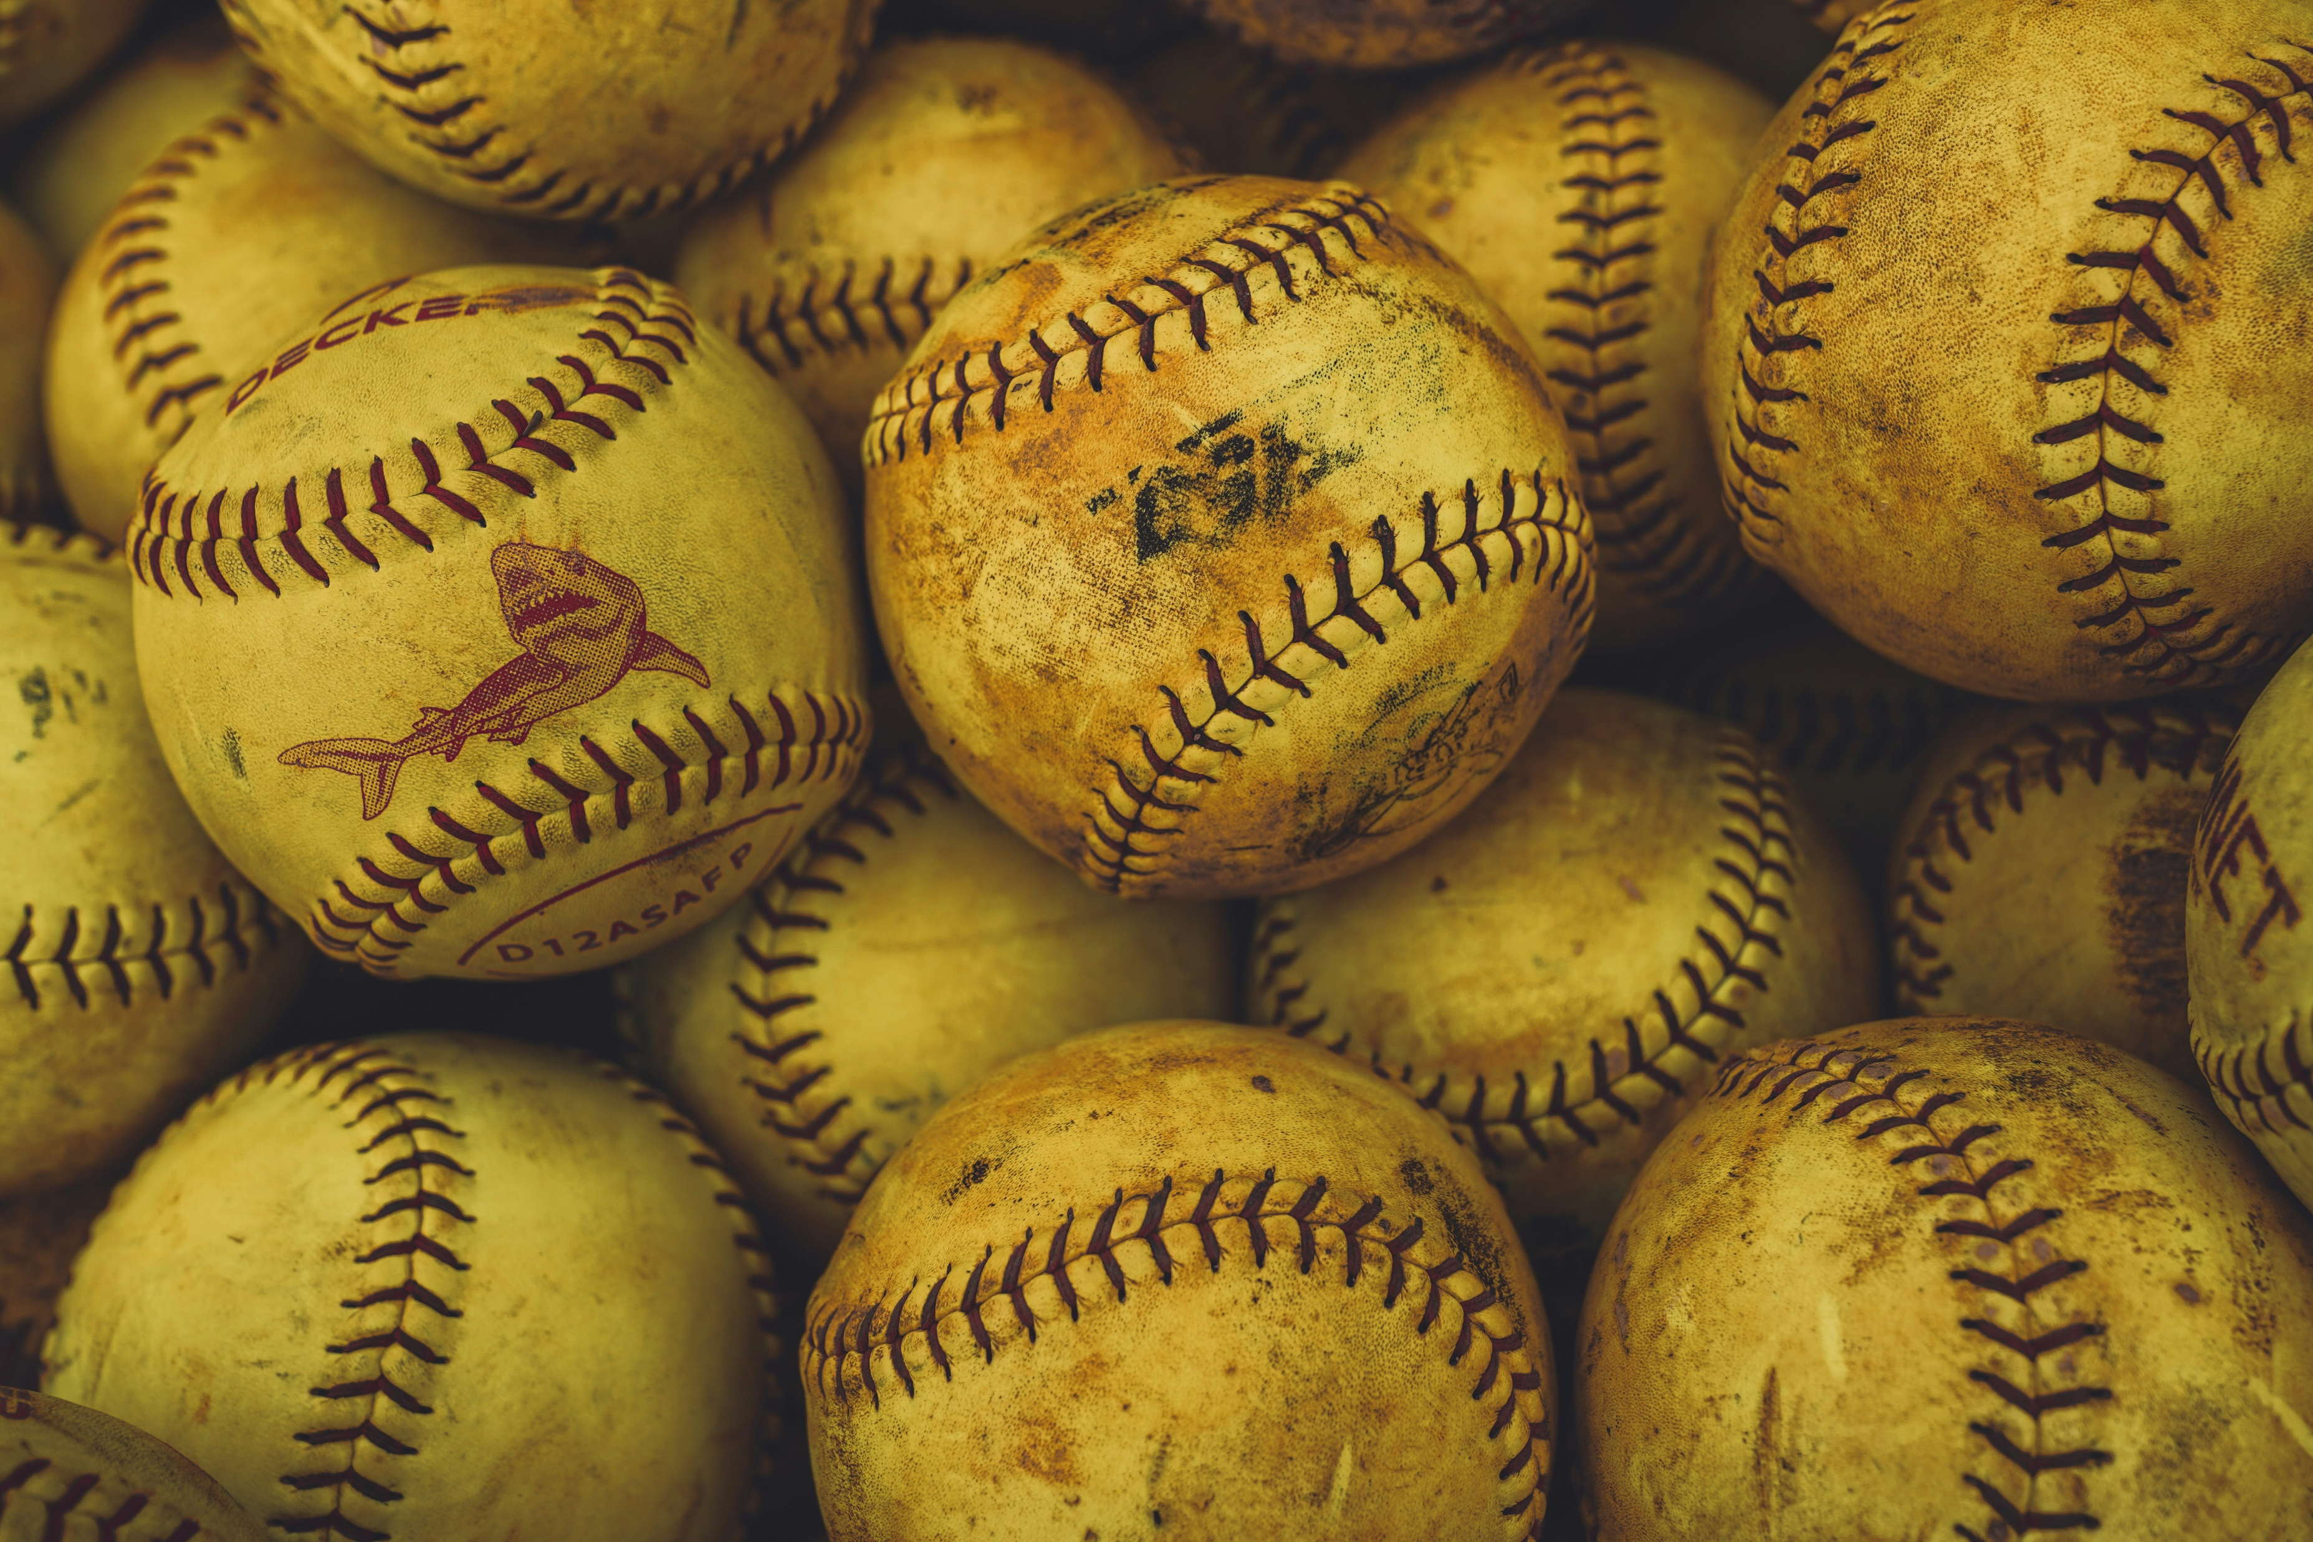
Baseball is the National Sport
Photo: Jon Eckert/Unsplash
Photo: Cameron Cox/Unsplash
Photo: Colynary Media/Unsplash

Slide 13

Explore God’s Work

Slide 14
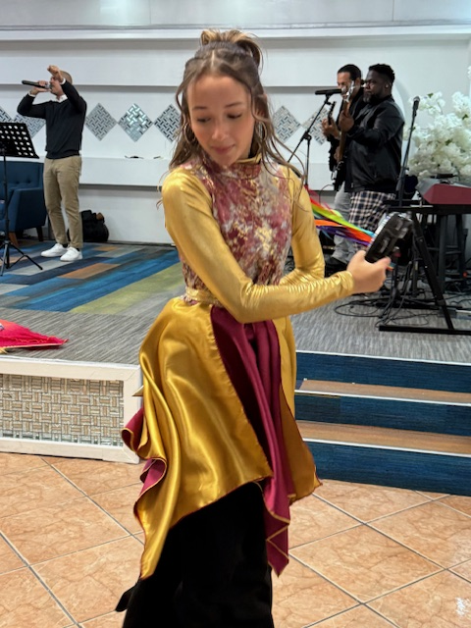
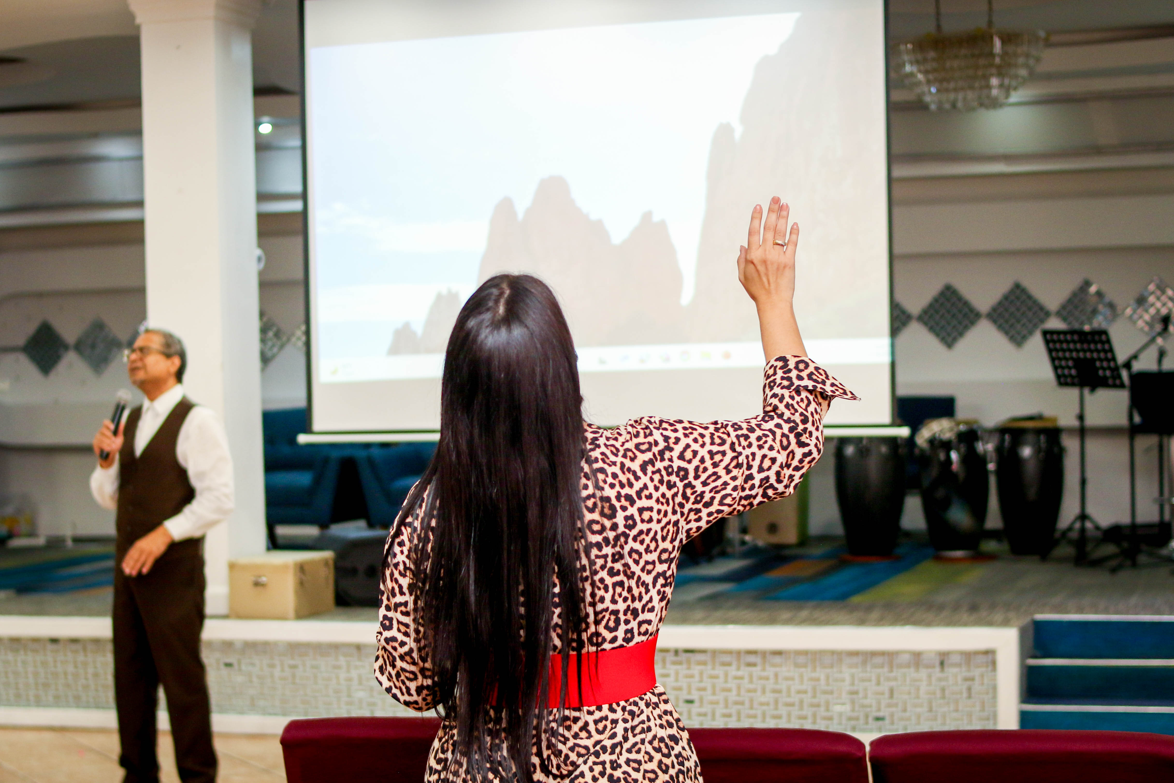
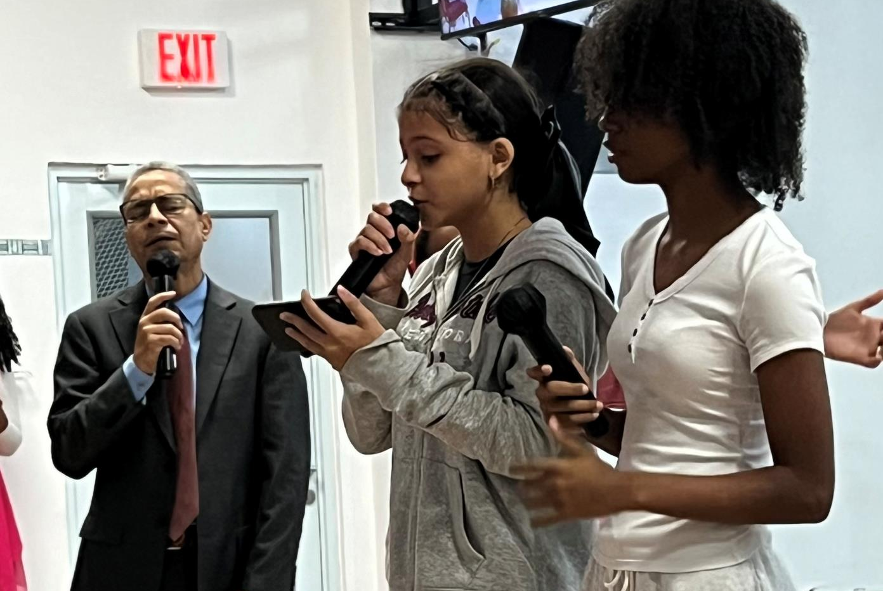
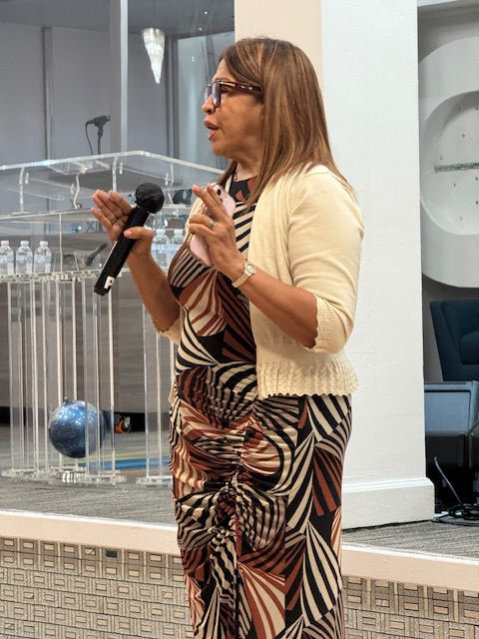
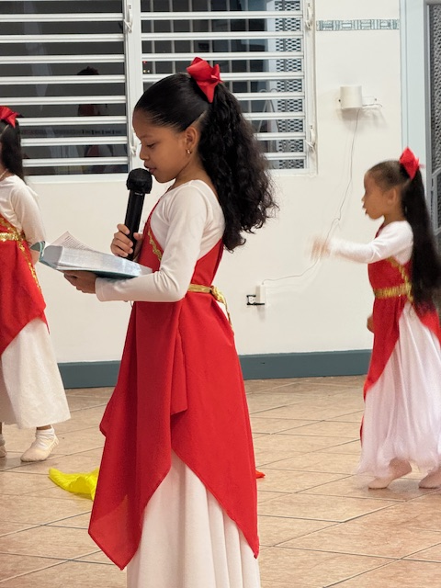
The Free Methodist Church
Puerto Rico
Photos: Jan Coates & Beth Gomez

Slide 15
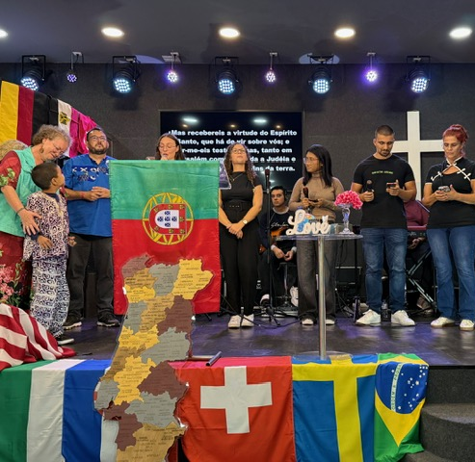
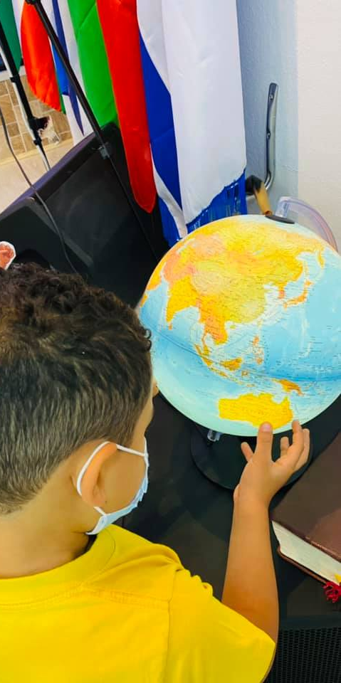
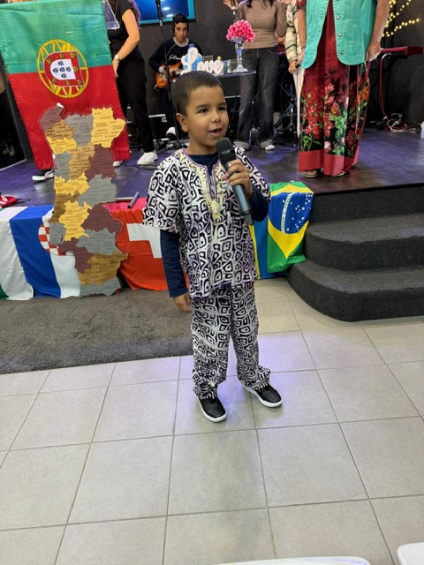
A Church with a Global Heart

Slide 16

Adventure Story

Slide 17
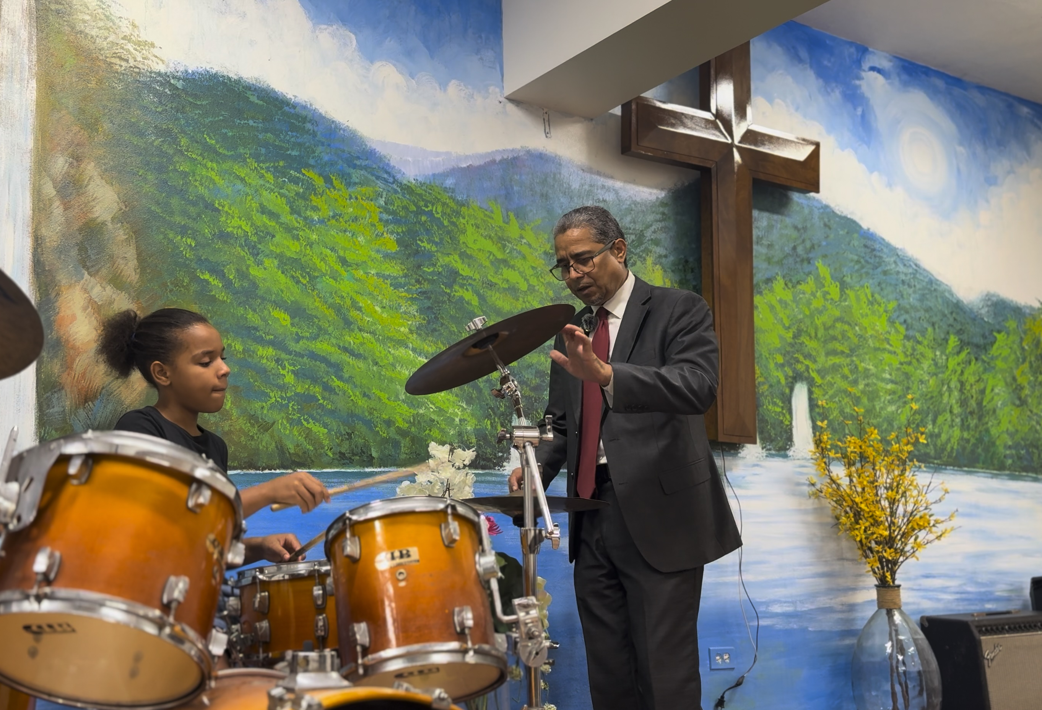
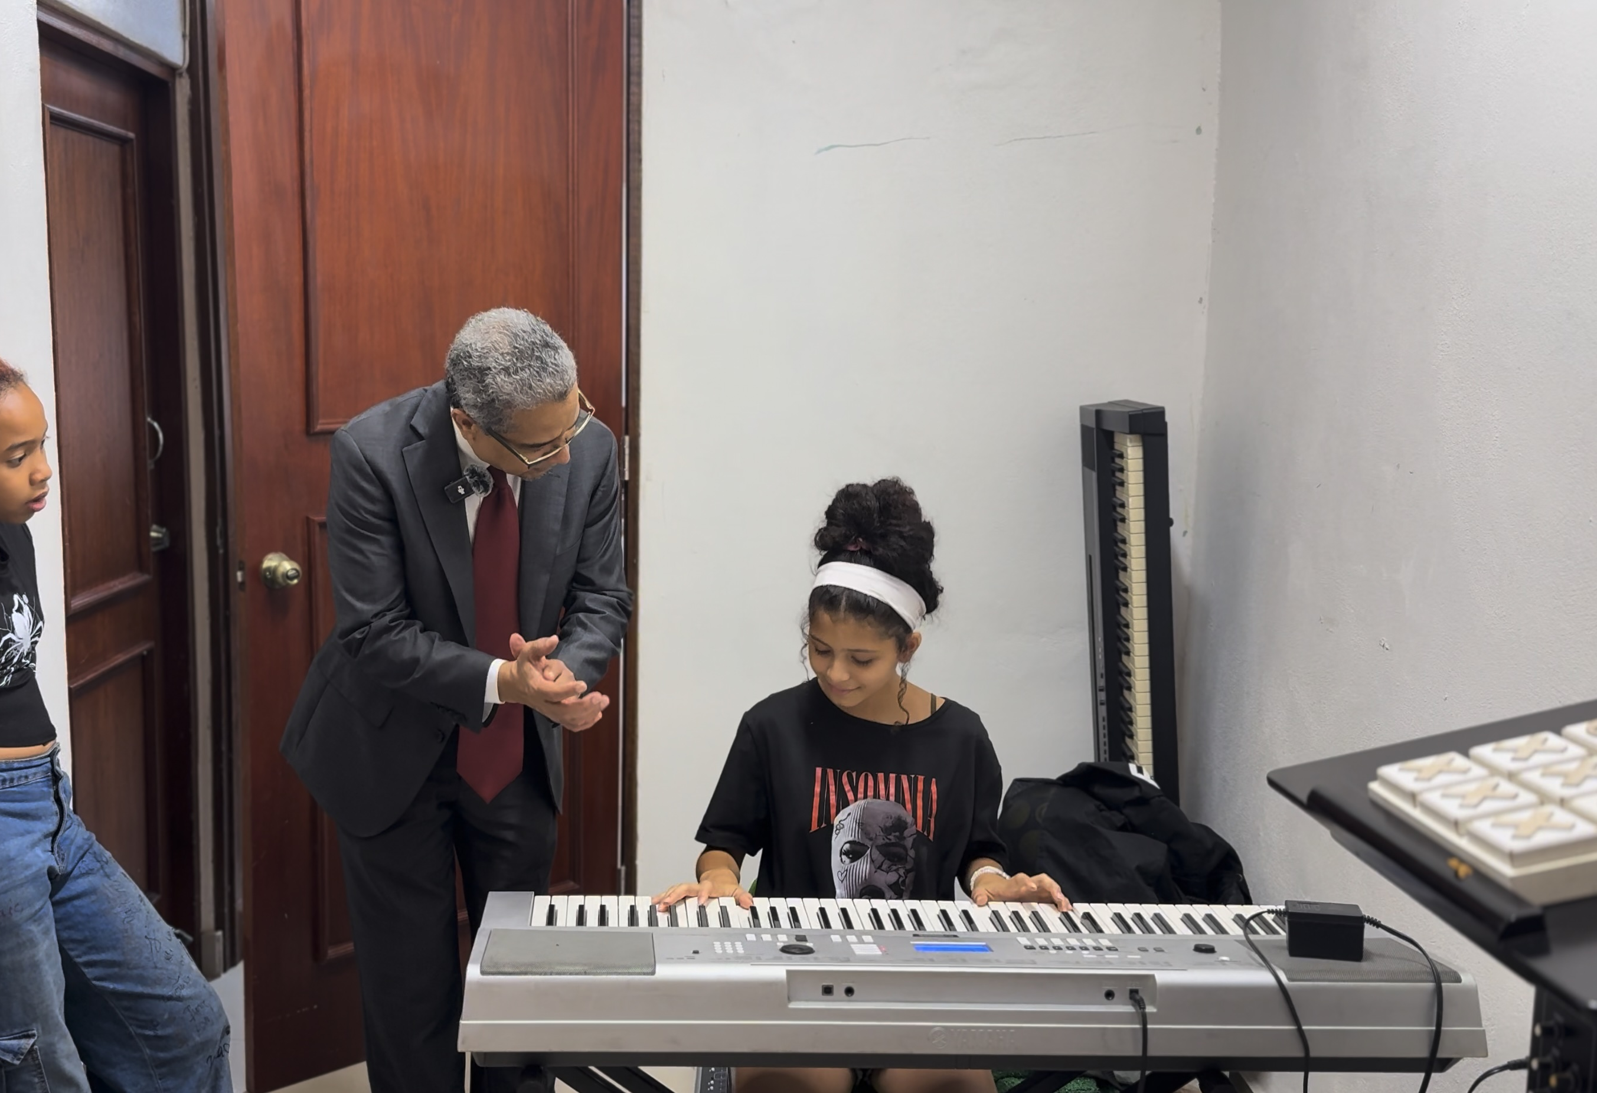
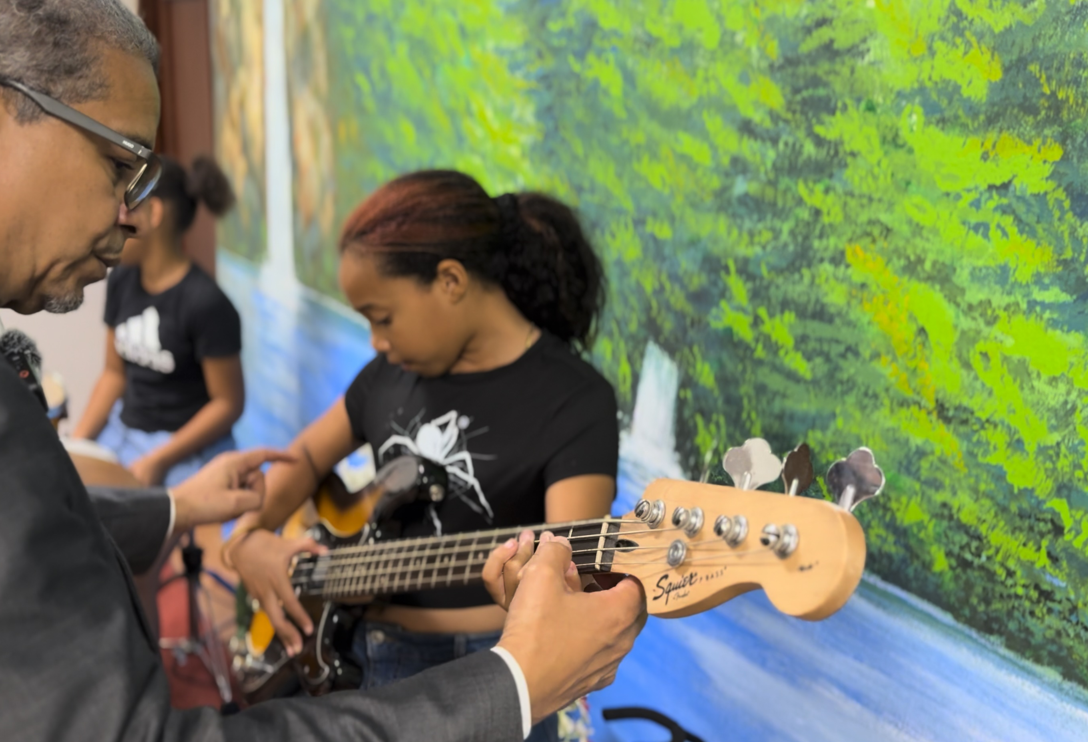
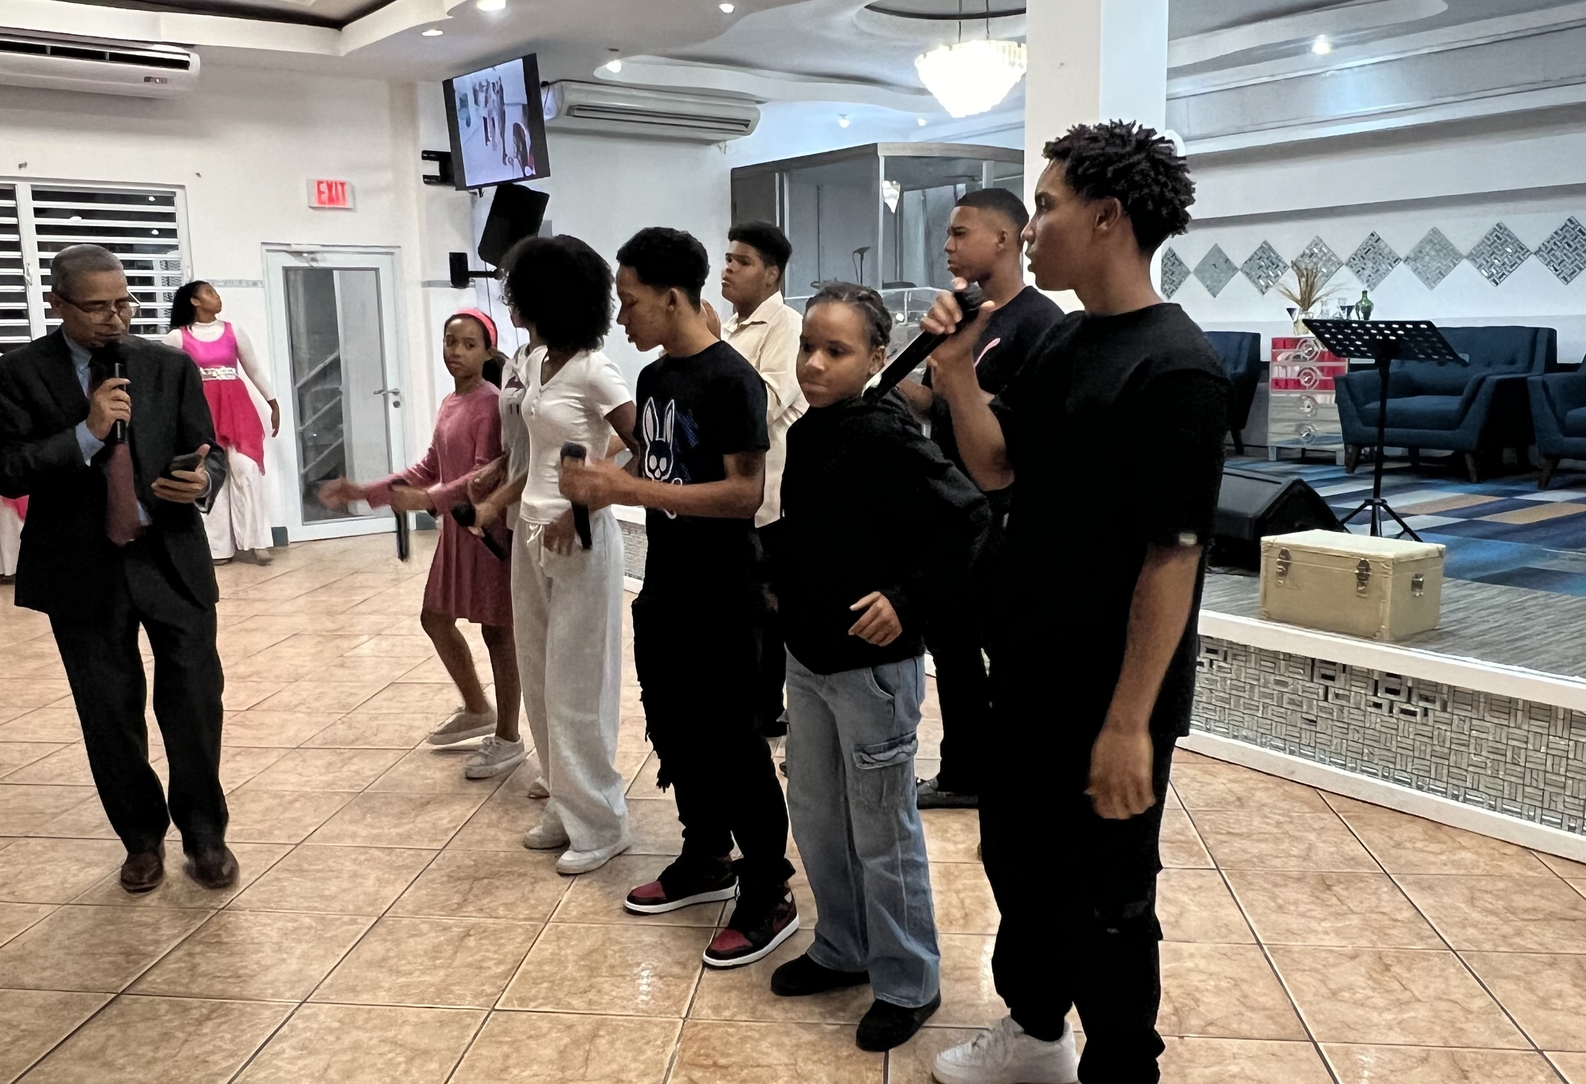
Singing a New Song!
Photos: FMC Latin America

Slide 18

People on Adventure

Slide 19
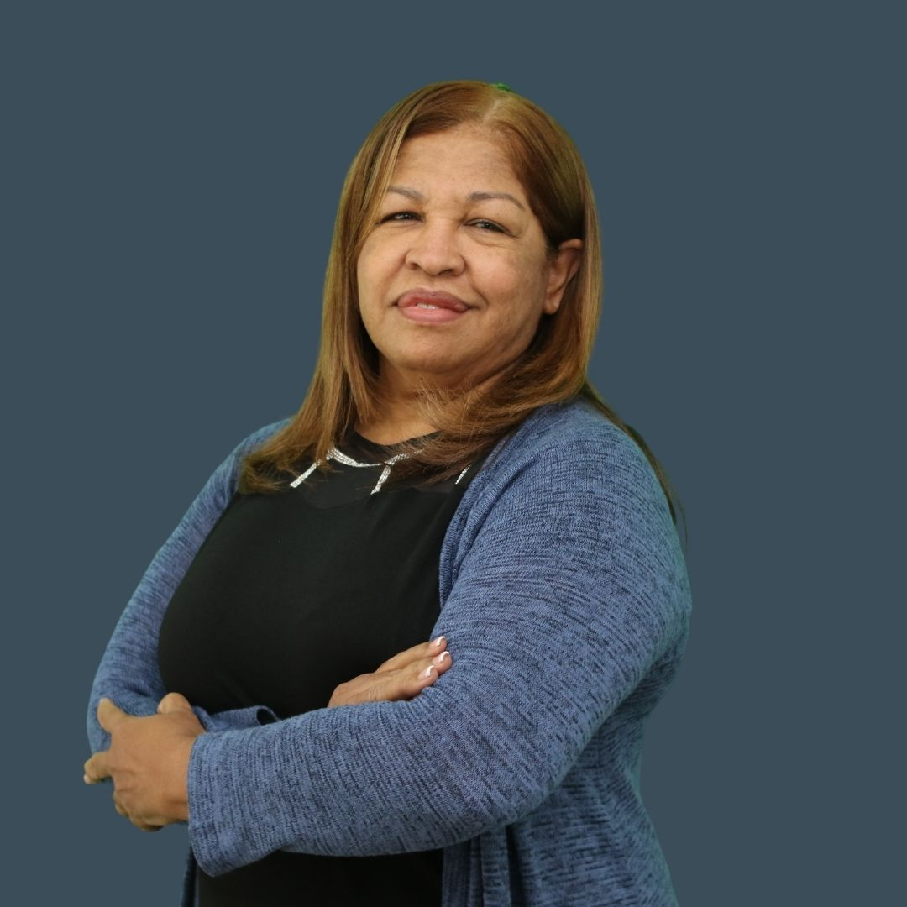
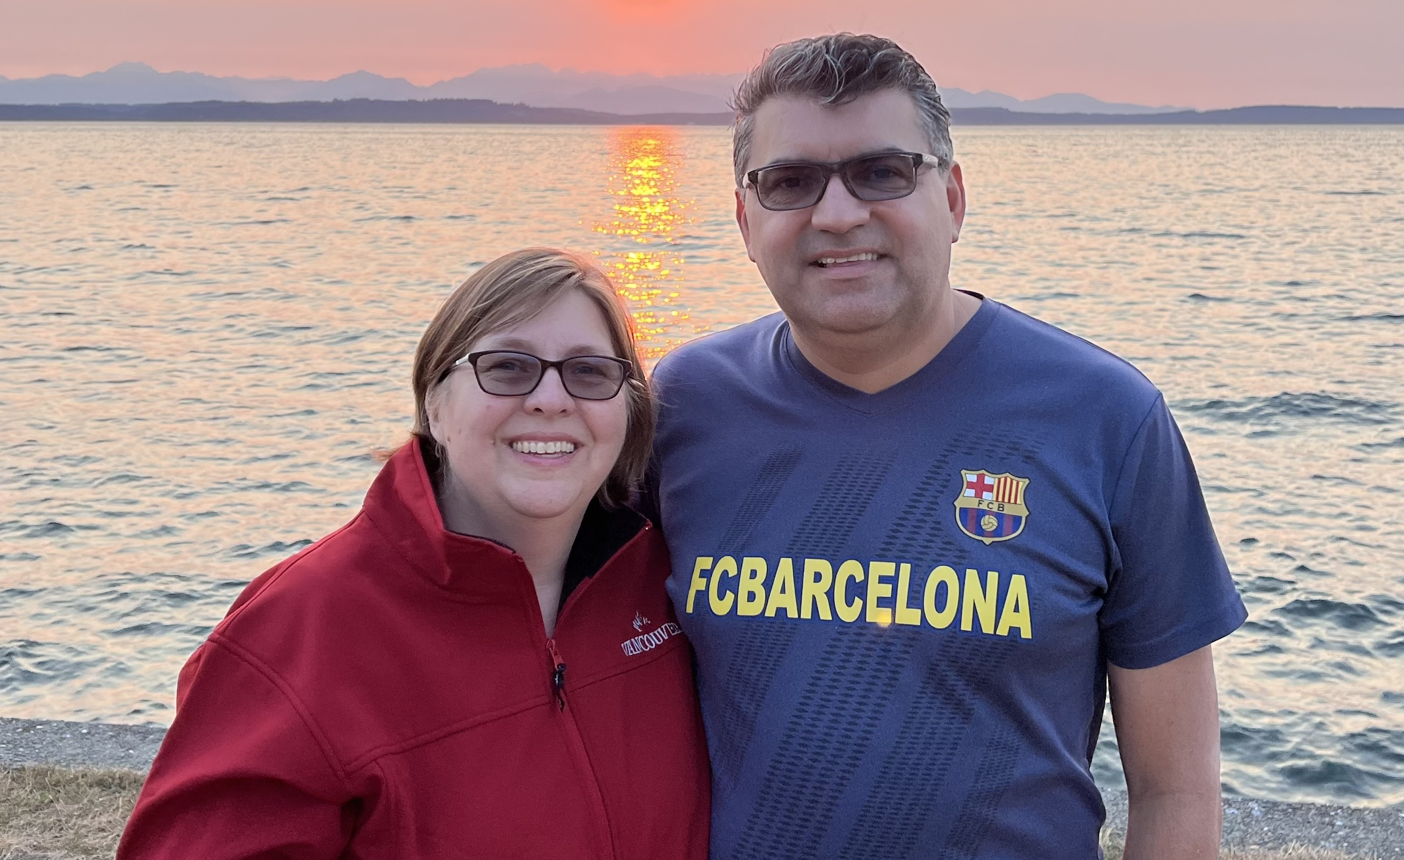
Pastor Ricardo & Beth Gómez
Pastora Mercedes
Pastora Mercedes is Superintendent in Puerto Rico caring for all the pastors and churches.
Pastor Ricardo and Beth help care for all the missionaries and leaders in Latin America.

Slide 20

Adventure in Prayer

Slide 21
Take My Life and Let It Be Pray this song as you sing!
Take my life, and let it be
(Stretch your arms out wide) Consecrated, Lord, to Thee; Take my moments and my days,
(Point to your wrist like you are wearing a watch) Let them flow in endless praise, Let them flow in endless praise.

Slide 22
Take my hands, and let them move
(Hold your hands open in front of you) At the impulse of Thy love; Take my feet and let them be
(Point to your feet) Swift and beautiful for Thee, Swift and beautiful for Thee.

Slide 23
Take my voice, and let me sing
(Touch your throat gently) Always, only, for my King; Take my lips, and let them be
(Point to your lips) Filled with messages from Thee, Filled with messages from Thee.

Slide 24
Take my silver and my gold;
(Make fists like you’re holding treasure) Not a mite would I withhold;
(Open fists) Take my intellect, and use
(Point to your head) Every power as Thou shalt choose, Every power as Thou shalt choose.

Slide 25
Take my will, and make it Thine;
(Both hands on top of your head) It shall be no longer mine. Take my heart; it is Thine own;
(Place hands over your heart) It shall be Thy royal throne, It shall be Thy royal throne.

Slide 26
Take my love; my Lord, I pour
(Touch your heart and then do a pouring motion) At Thy feet its treasure-store. Take myself, and I will be
(Hug yourself and then stretch your arms out wide) Ever, only, all for Thee, Ever, only, all for Thee.

Slide 27

Adventures in Culture

Slide 28
Language
Spanish | English
Guitarra | Guitar
God | Dios
House | Casa
School | Escuela
Bread | Pan

Slide 29

This Is the Day
This is the day. (repeat)
That the Lord has made. (repeat)
I will rejoice. (repeat)
And be glad in it. (repeat)
This is the day that the Lord has made. I will rejoice and be glad in it.
This is the day. (repeat)
That the Lord has made.

Slide 30

Spanish Pronunciation
Es-tay es el dee-uh (repeat)
kay eeso el say-nee-or (repeat)
dee-uh day al-ay-gree-ya (repeat)
ee day go-zo (repeat)
es-tay es el dee-uh kay eeso el say-nee-or dee-uh day al-ay-gree-ya ee day go-zo Es-tay es el dee-uh (repeat)
kay eeso el say-nee-or

