Slide 1

Global Adventures
Set Free

Slide 2
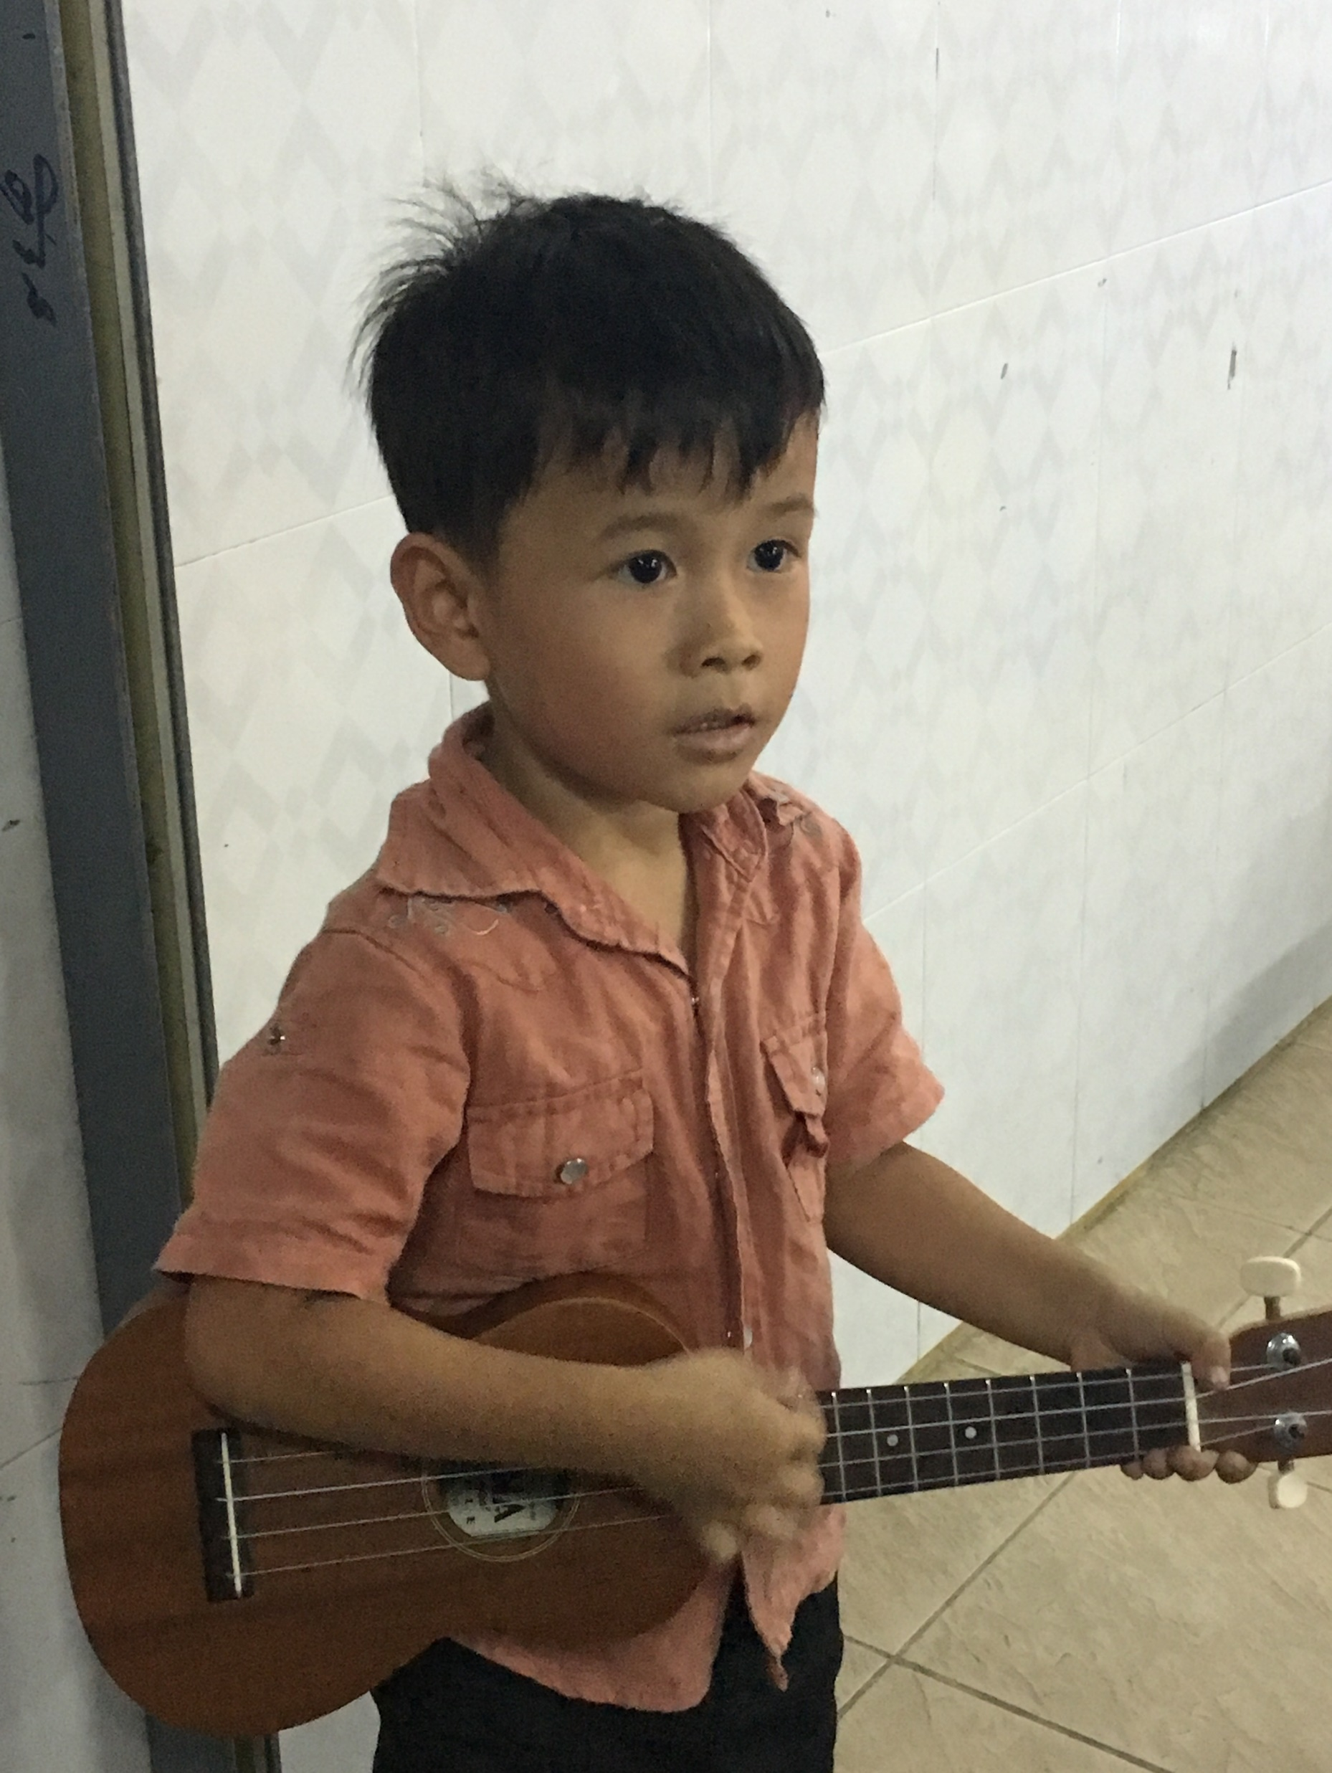
Theme Verse
Sing to the Lord a new song; sing to the Lord,
all the earth.
Sing to the Lord, praise his name; proclaim his salvation day after day.
Declare his glory among the nations, his marvelous deeds among all peoples.
- Psalms 96:1-3
Unsplash: Ben White

Slide 3

Explore the Problems Faced by Children Around the World

Slide 4
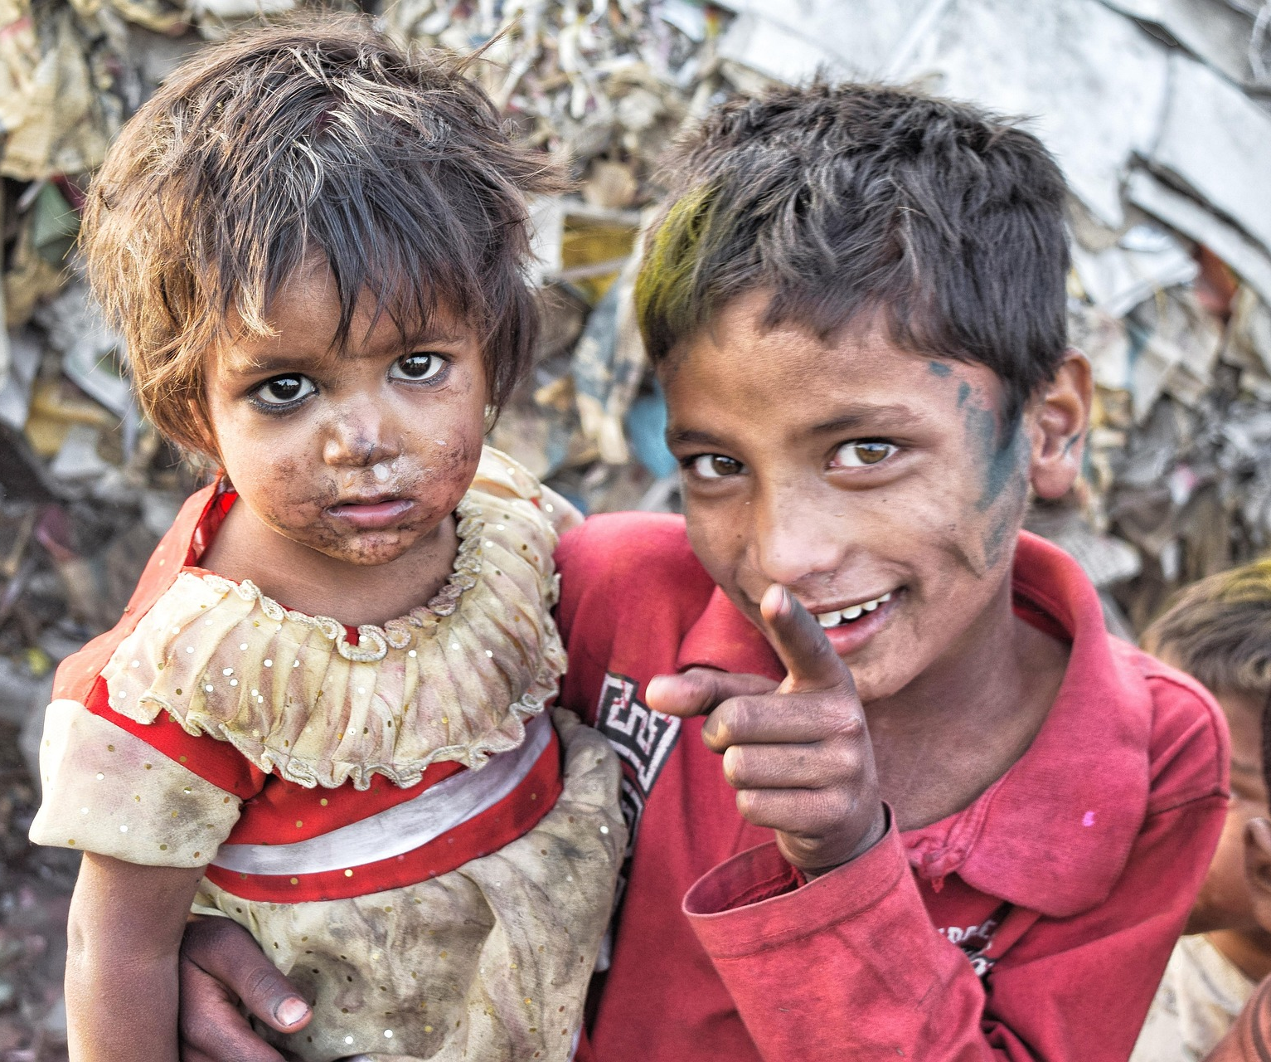
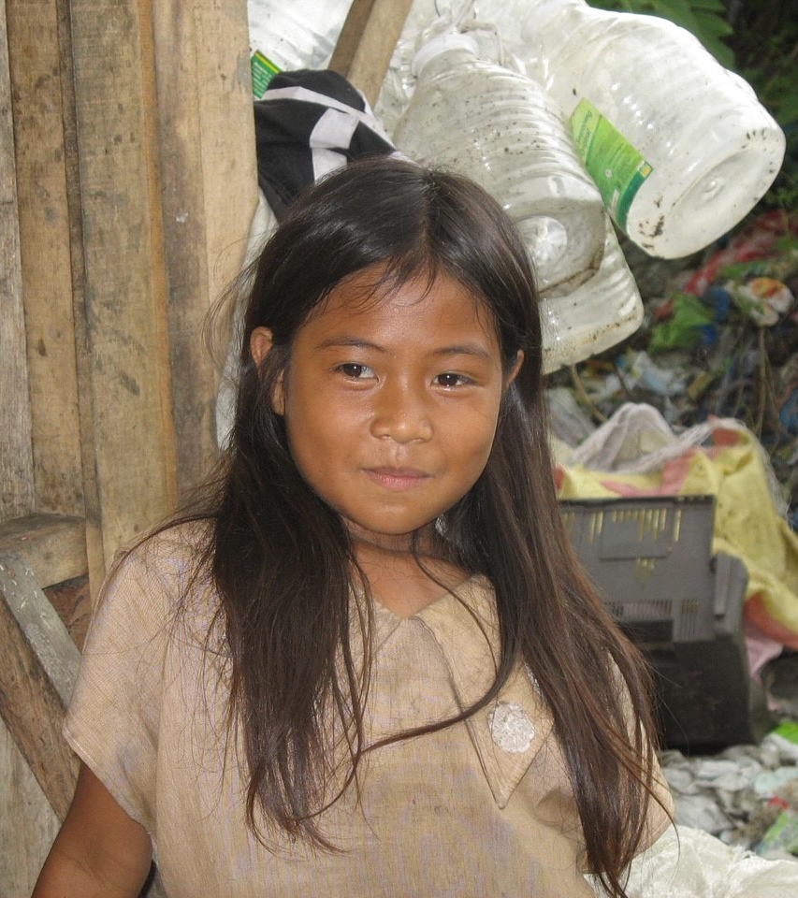
Poverty
Photo Billy Cedeno/Pixabay
Photo: Jan Coates

Slide 5

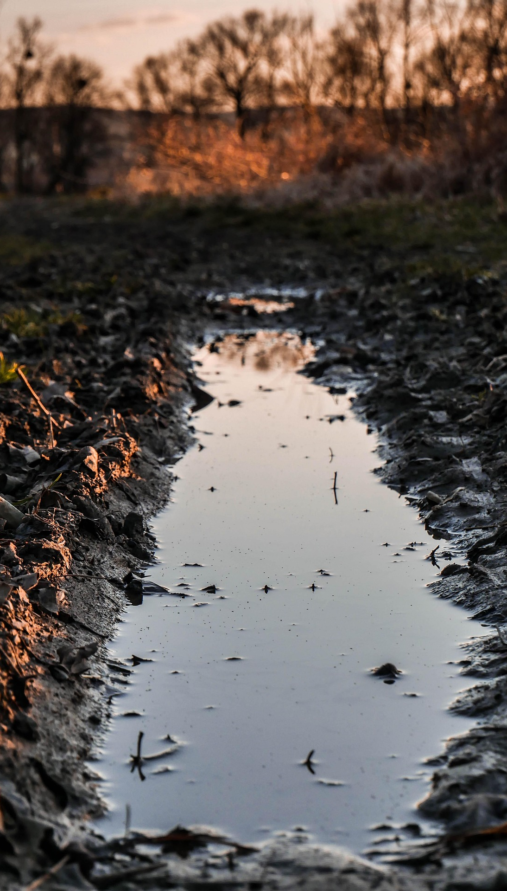
Unsafe Water
Photo: Trevor Gerzan Unsplash
Photo: u_yirilulxqp/Pixabay

Slide 6
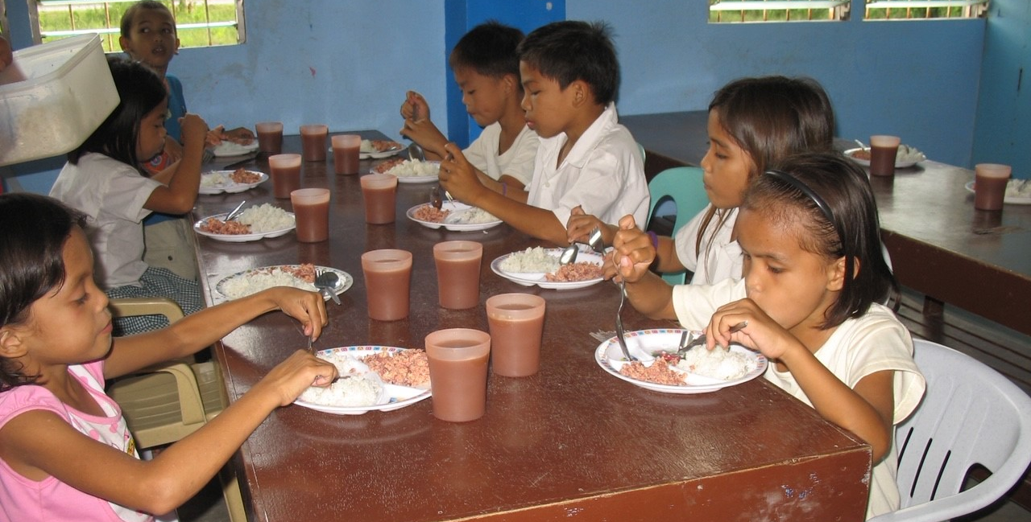
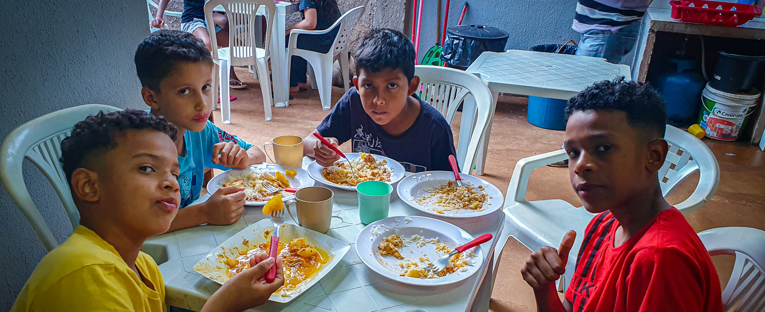
Hunger
Photo: Jan Coates
Photo: Calo Britto

Slide 7
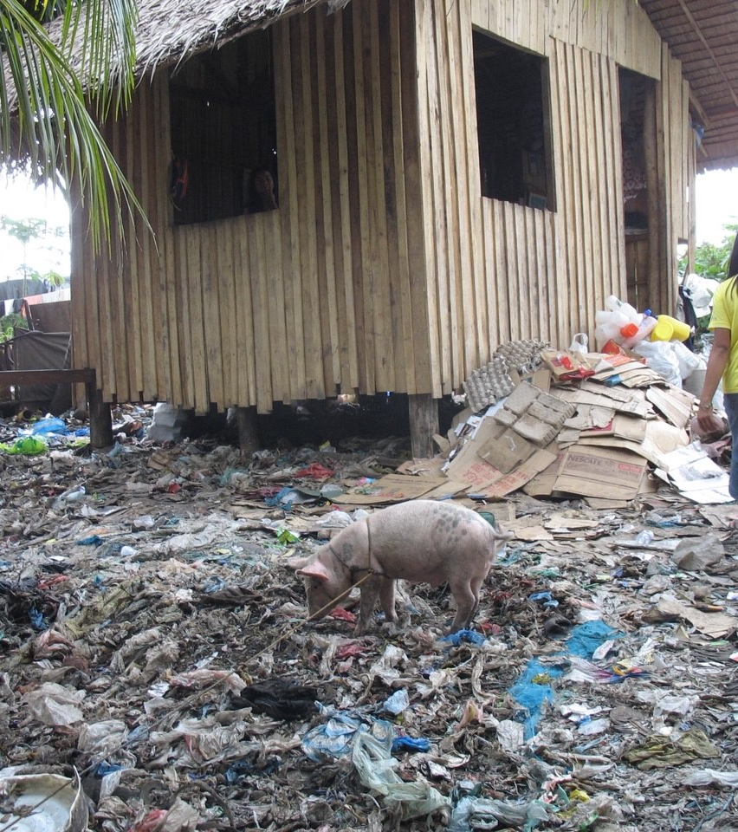
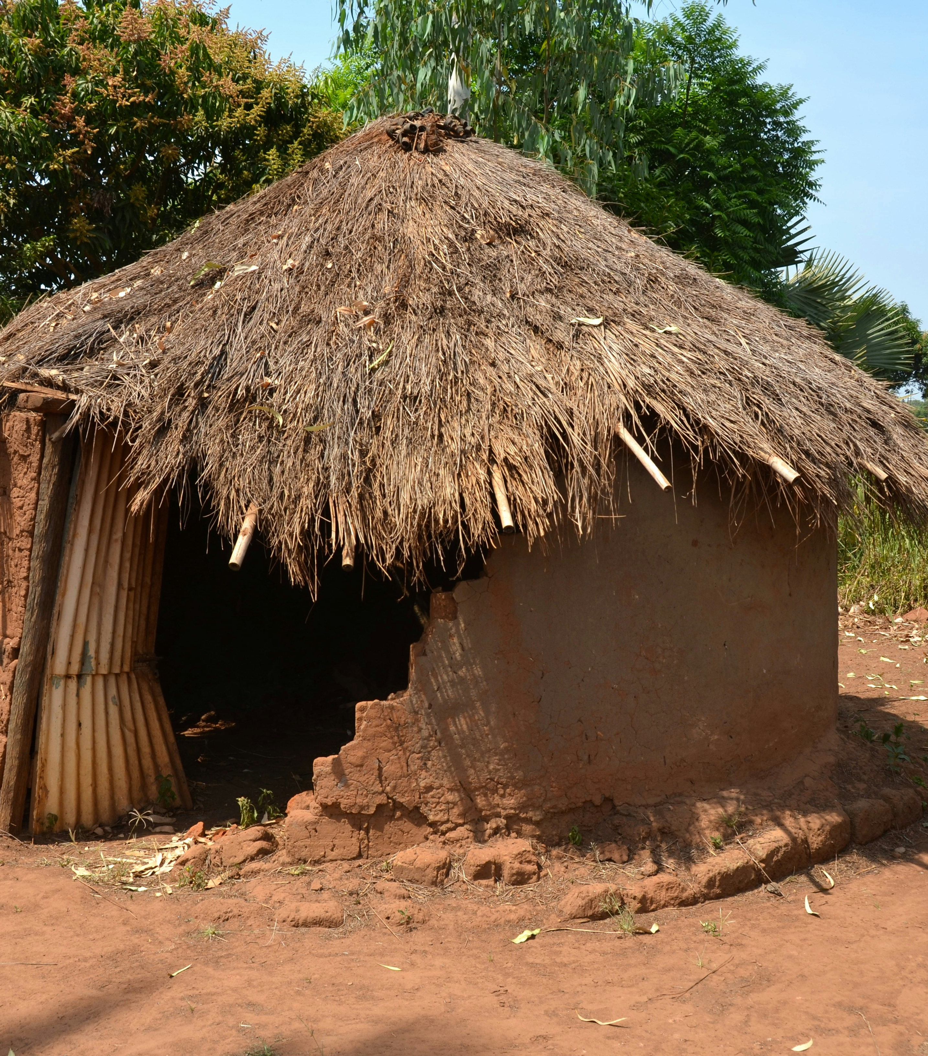
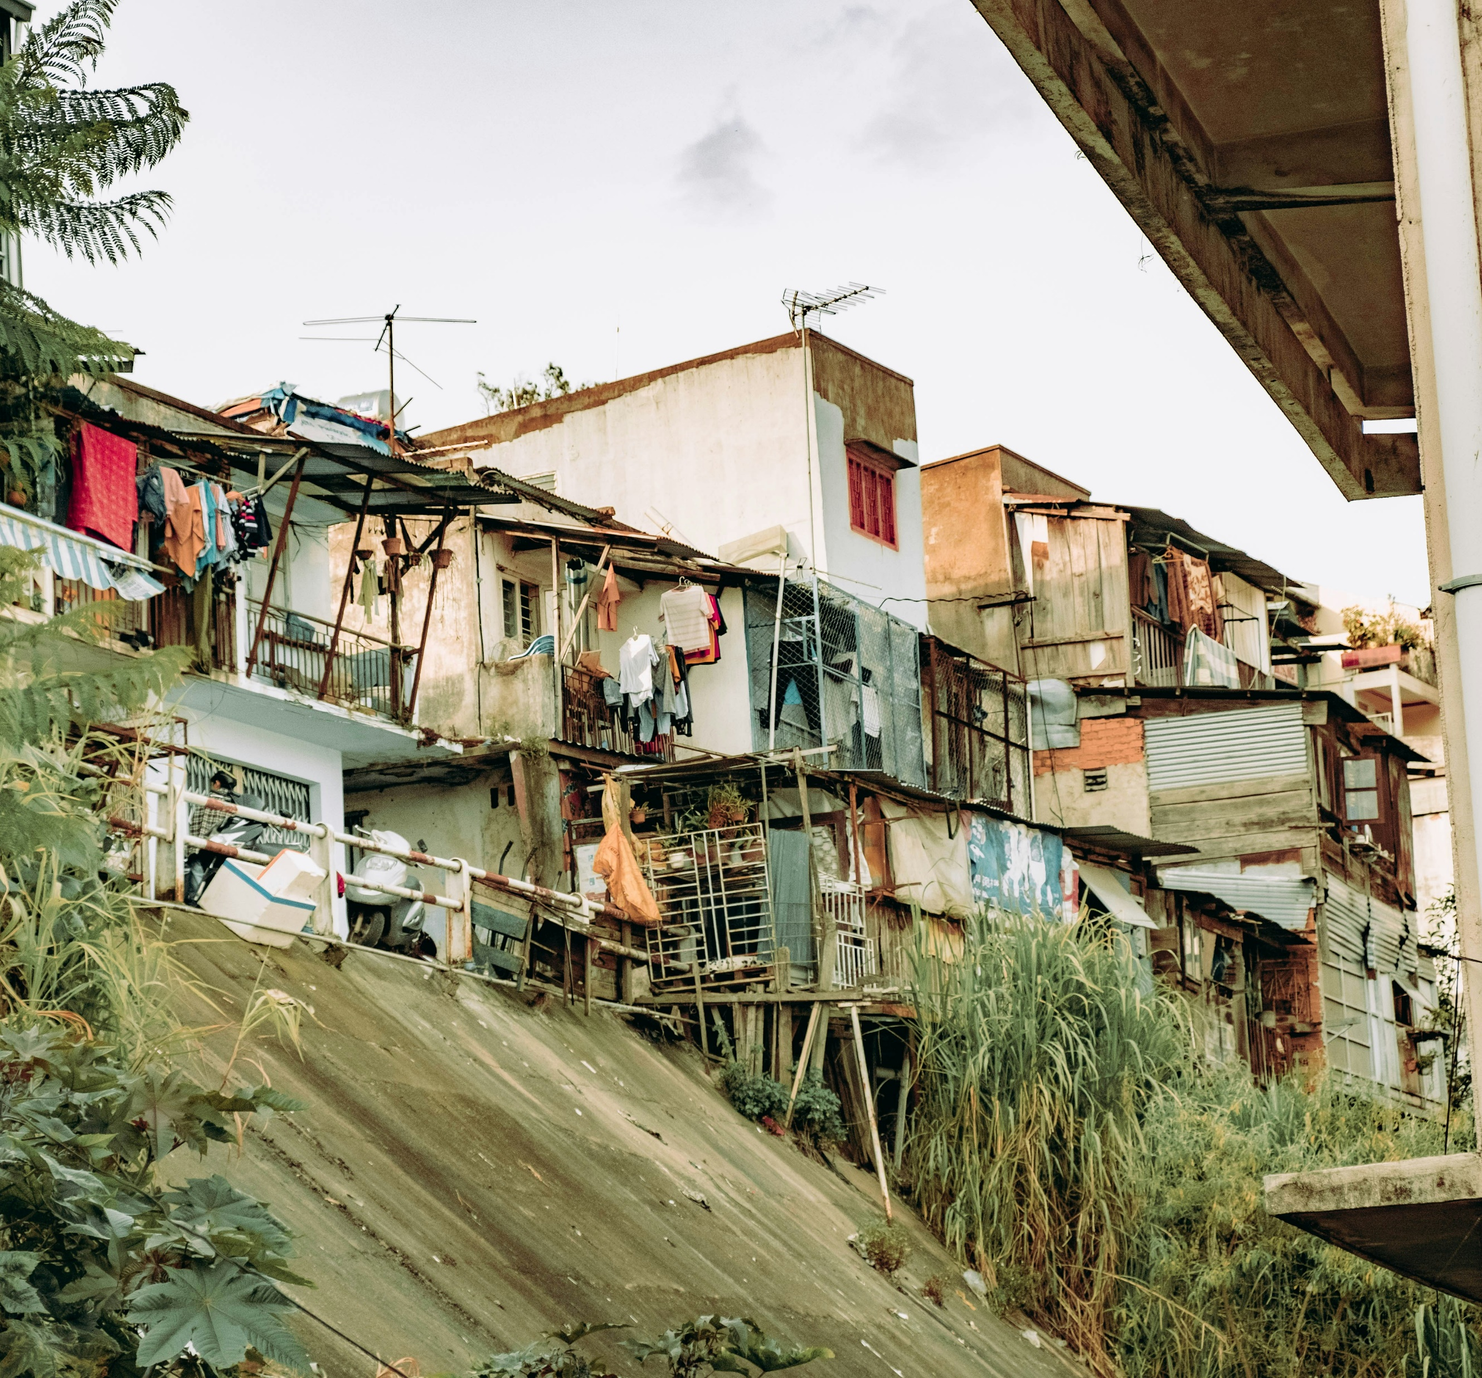
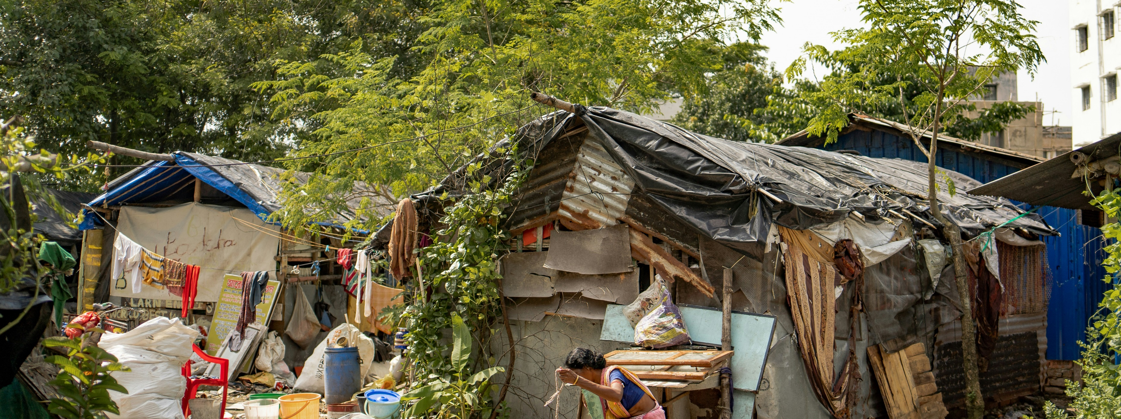
Inadequate Shelter
Photo: Laron Taylor/Unsplash
Photo: Nguyen Kiet/Unsplash
Photo: Ján Coates
Photo: Shelby Murphy/Unsplash

Slide 8
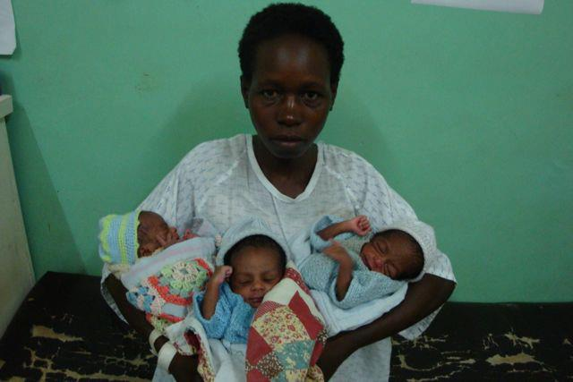
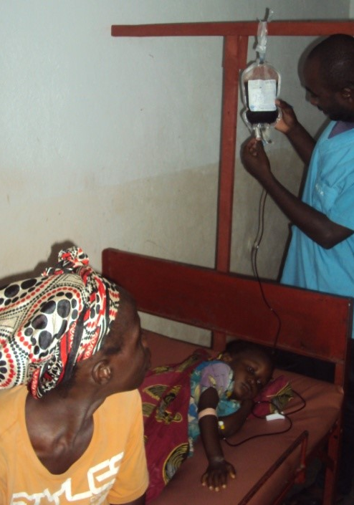
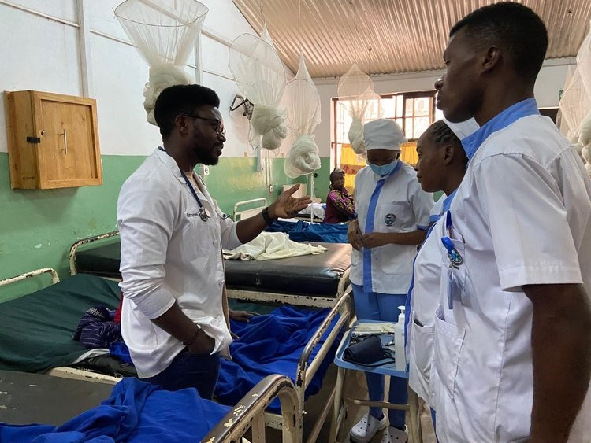
Sickness & Disease

Slide 9
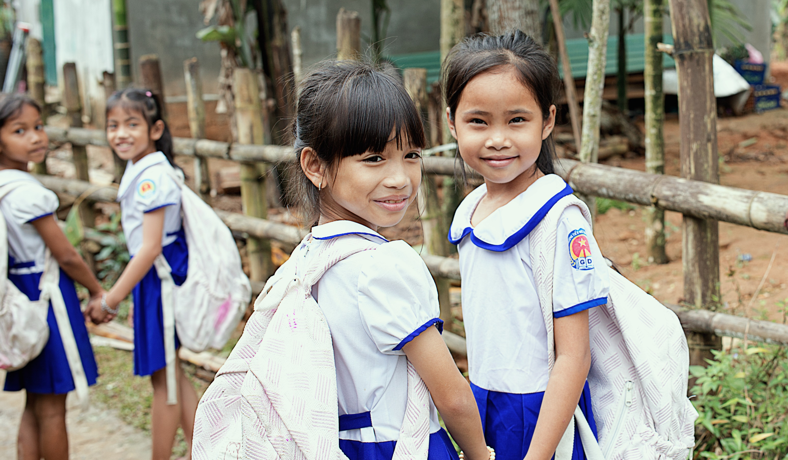
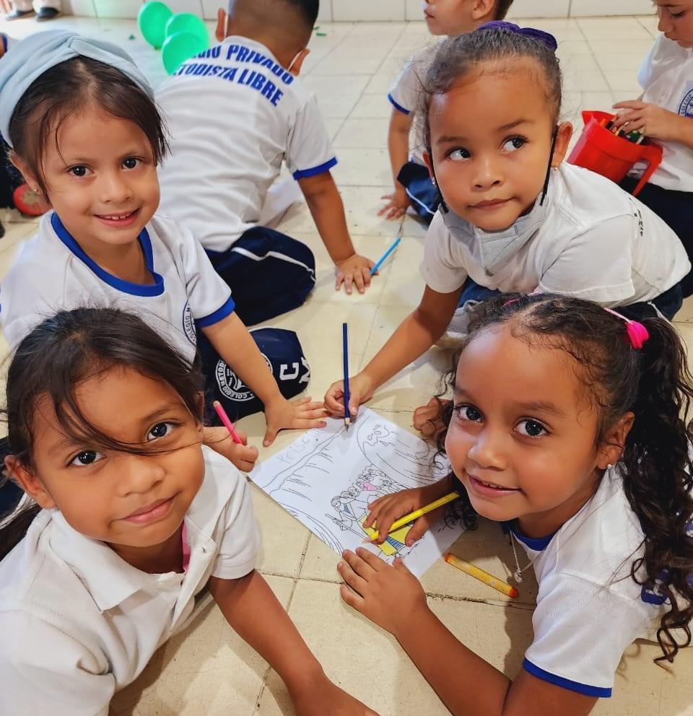
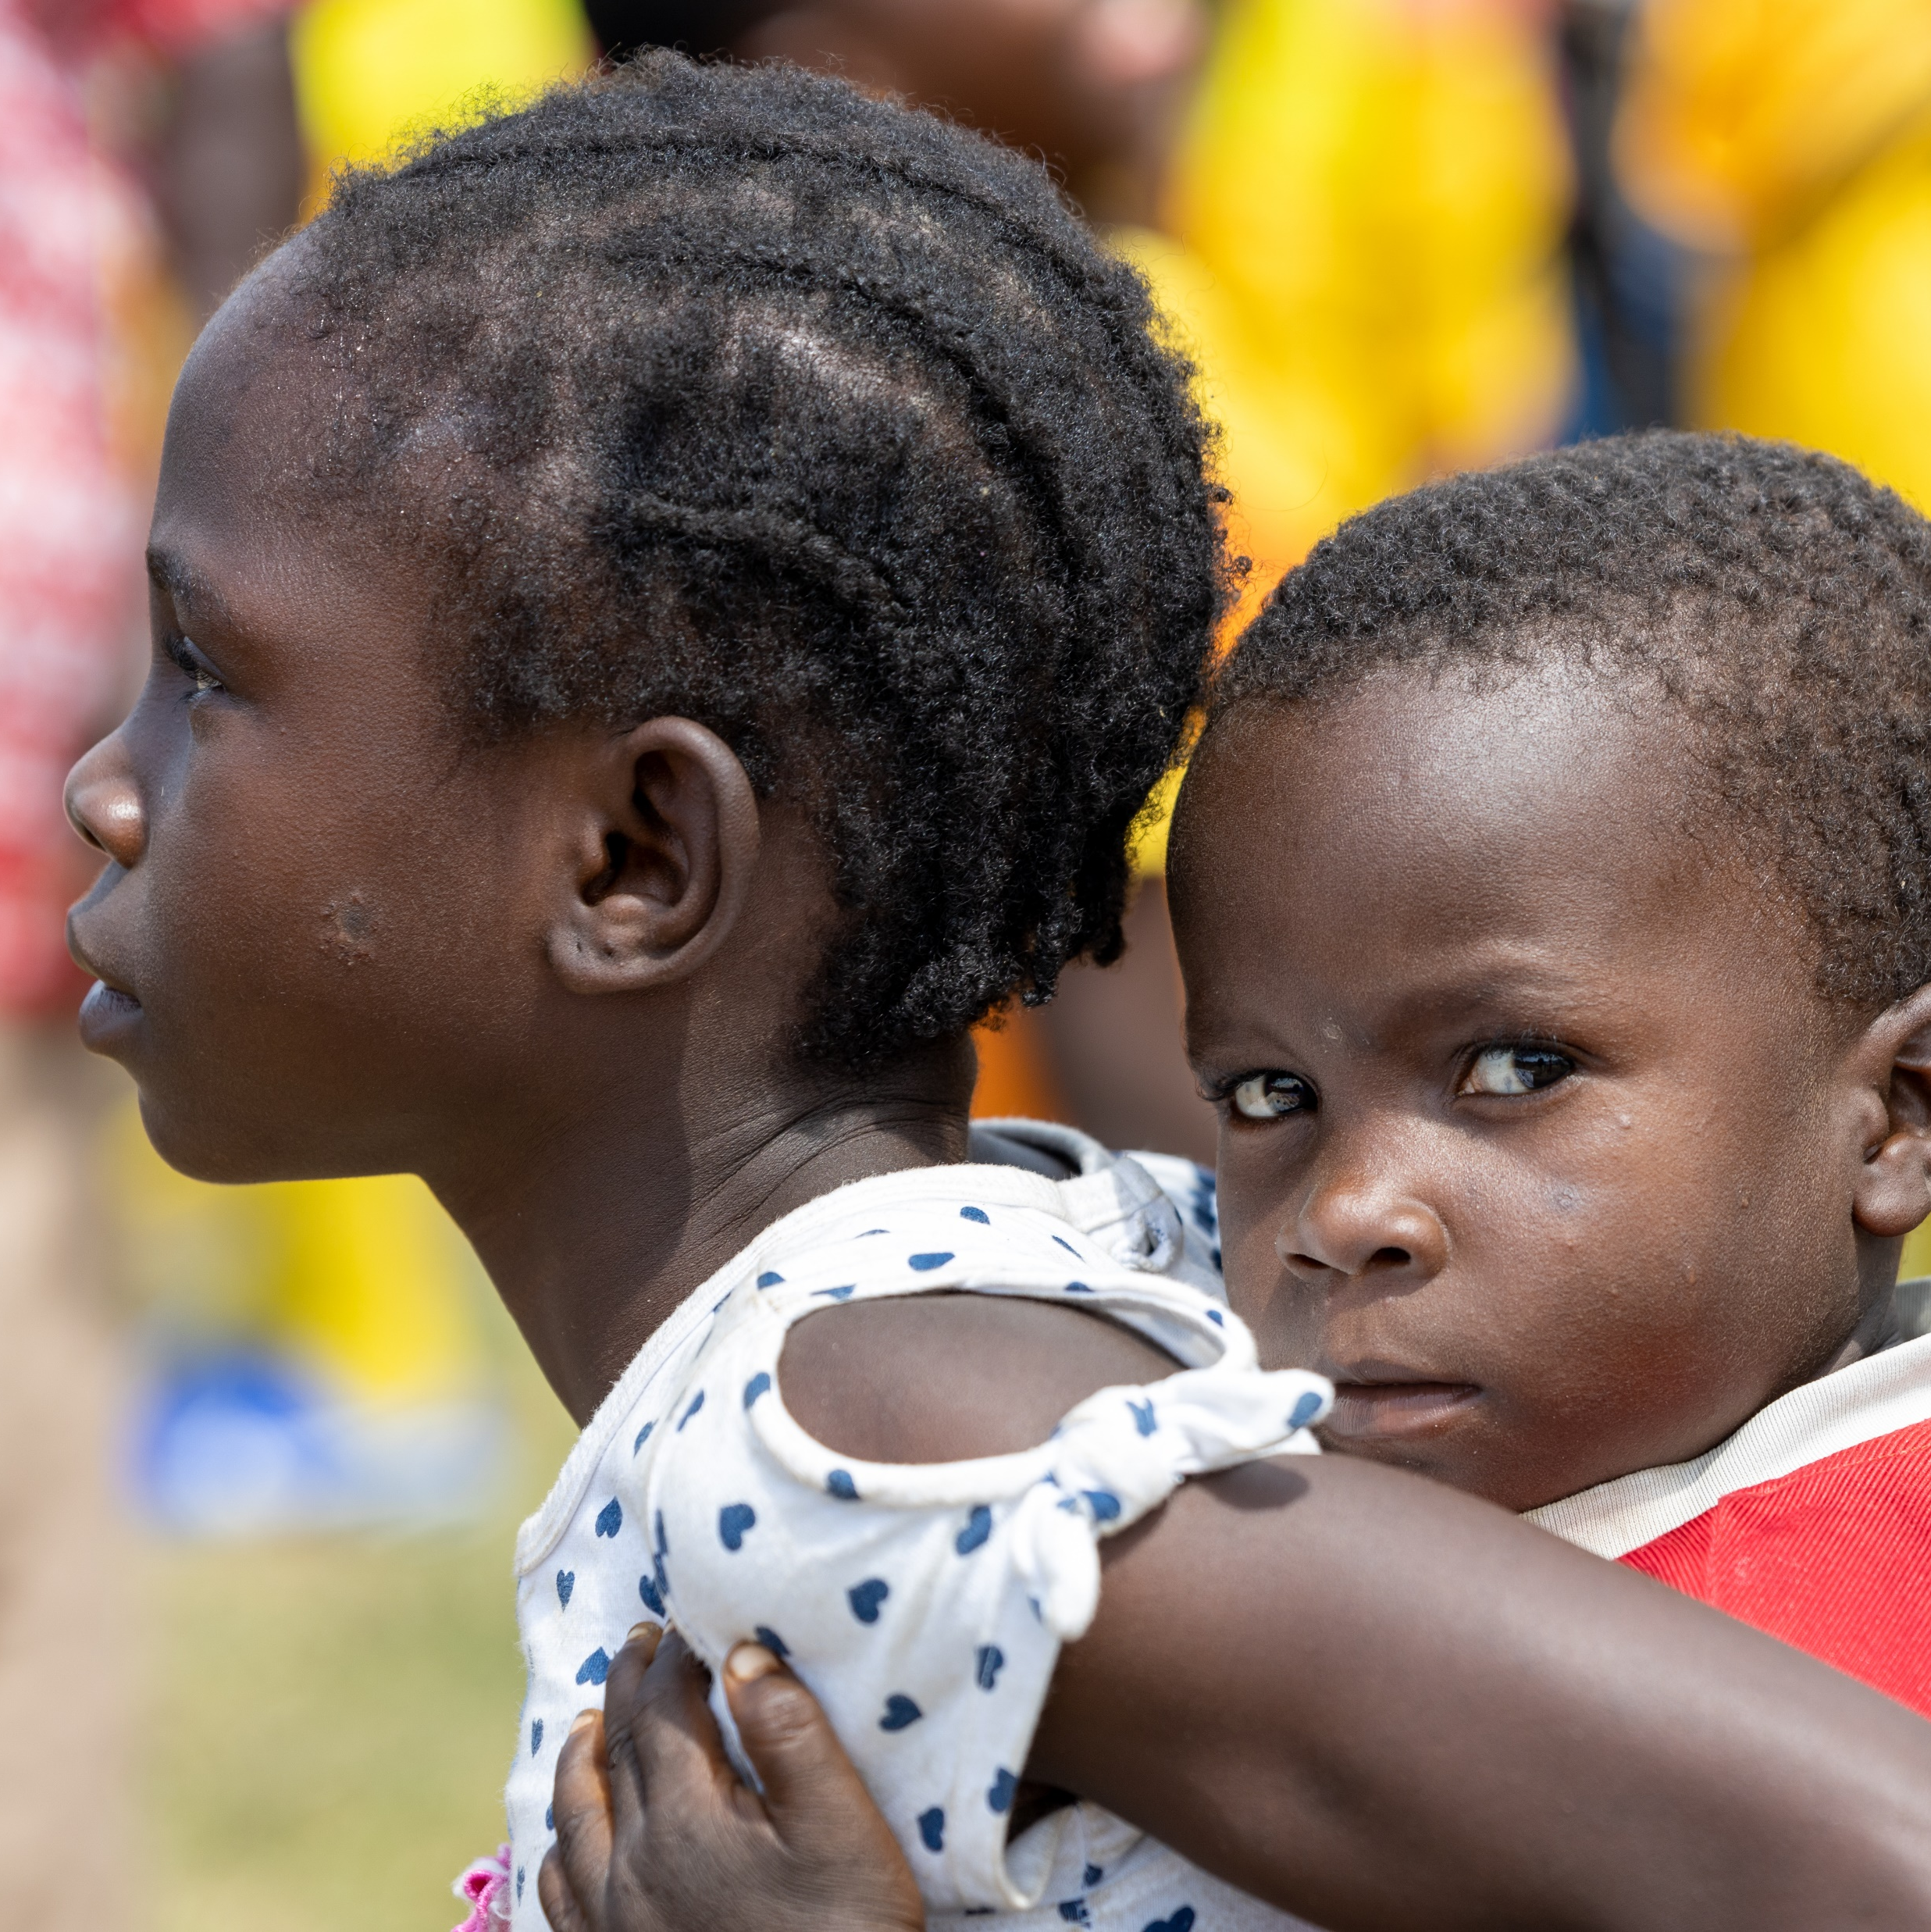
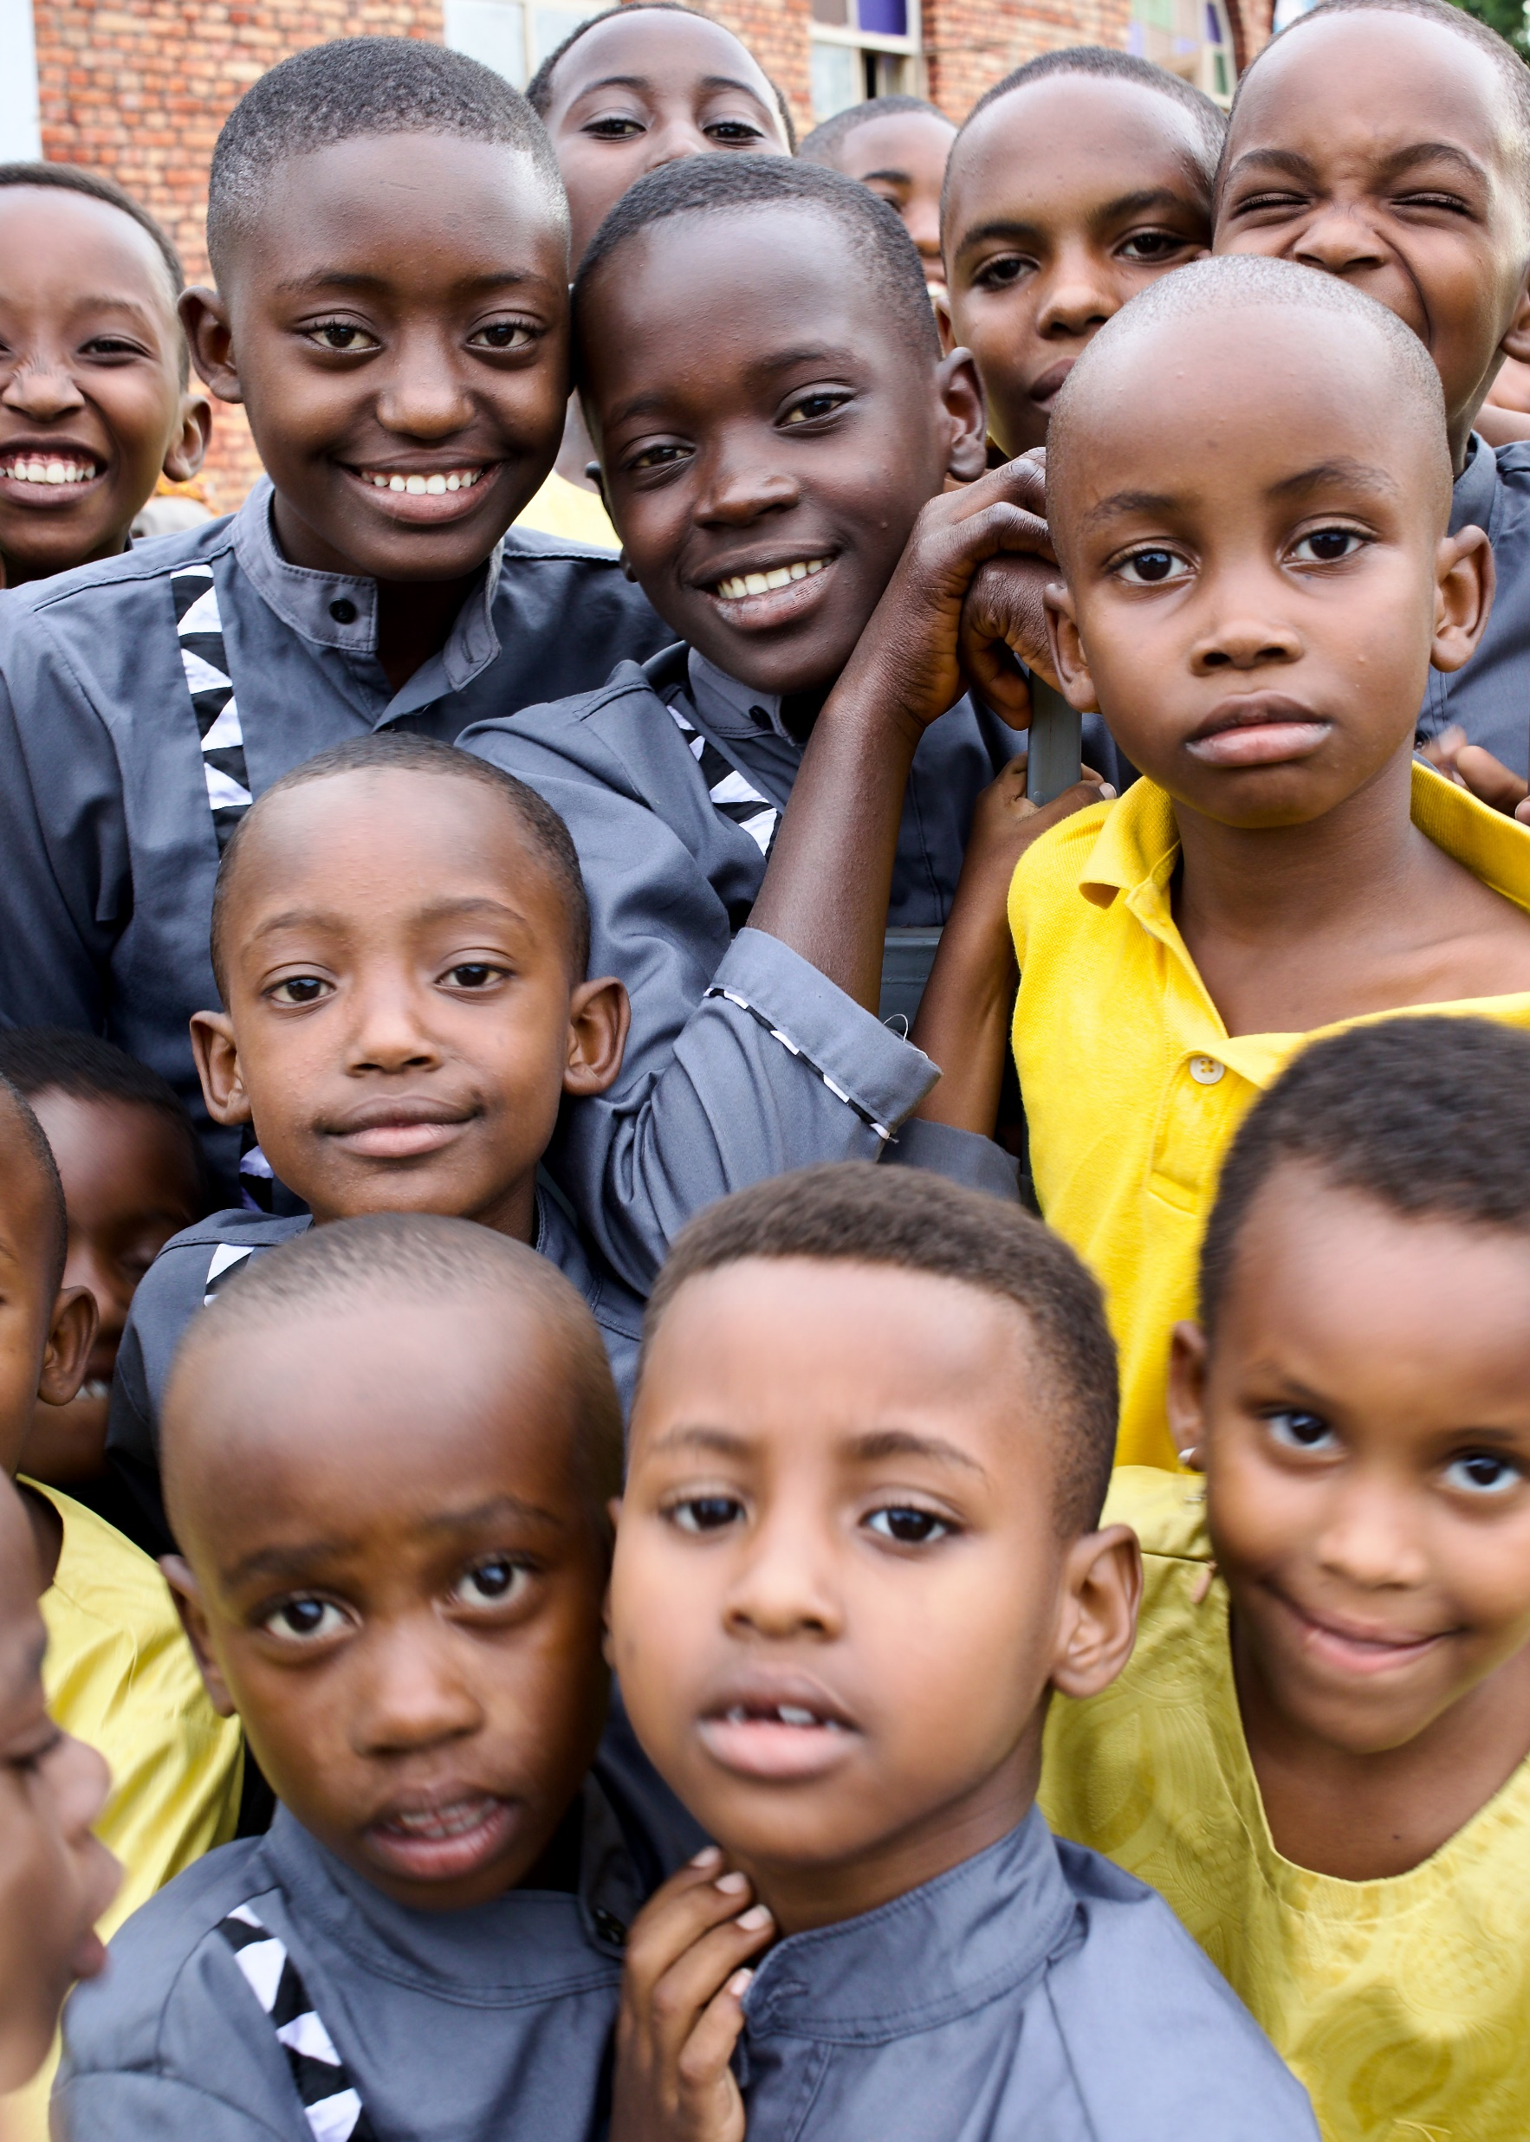

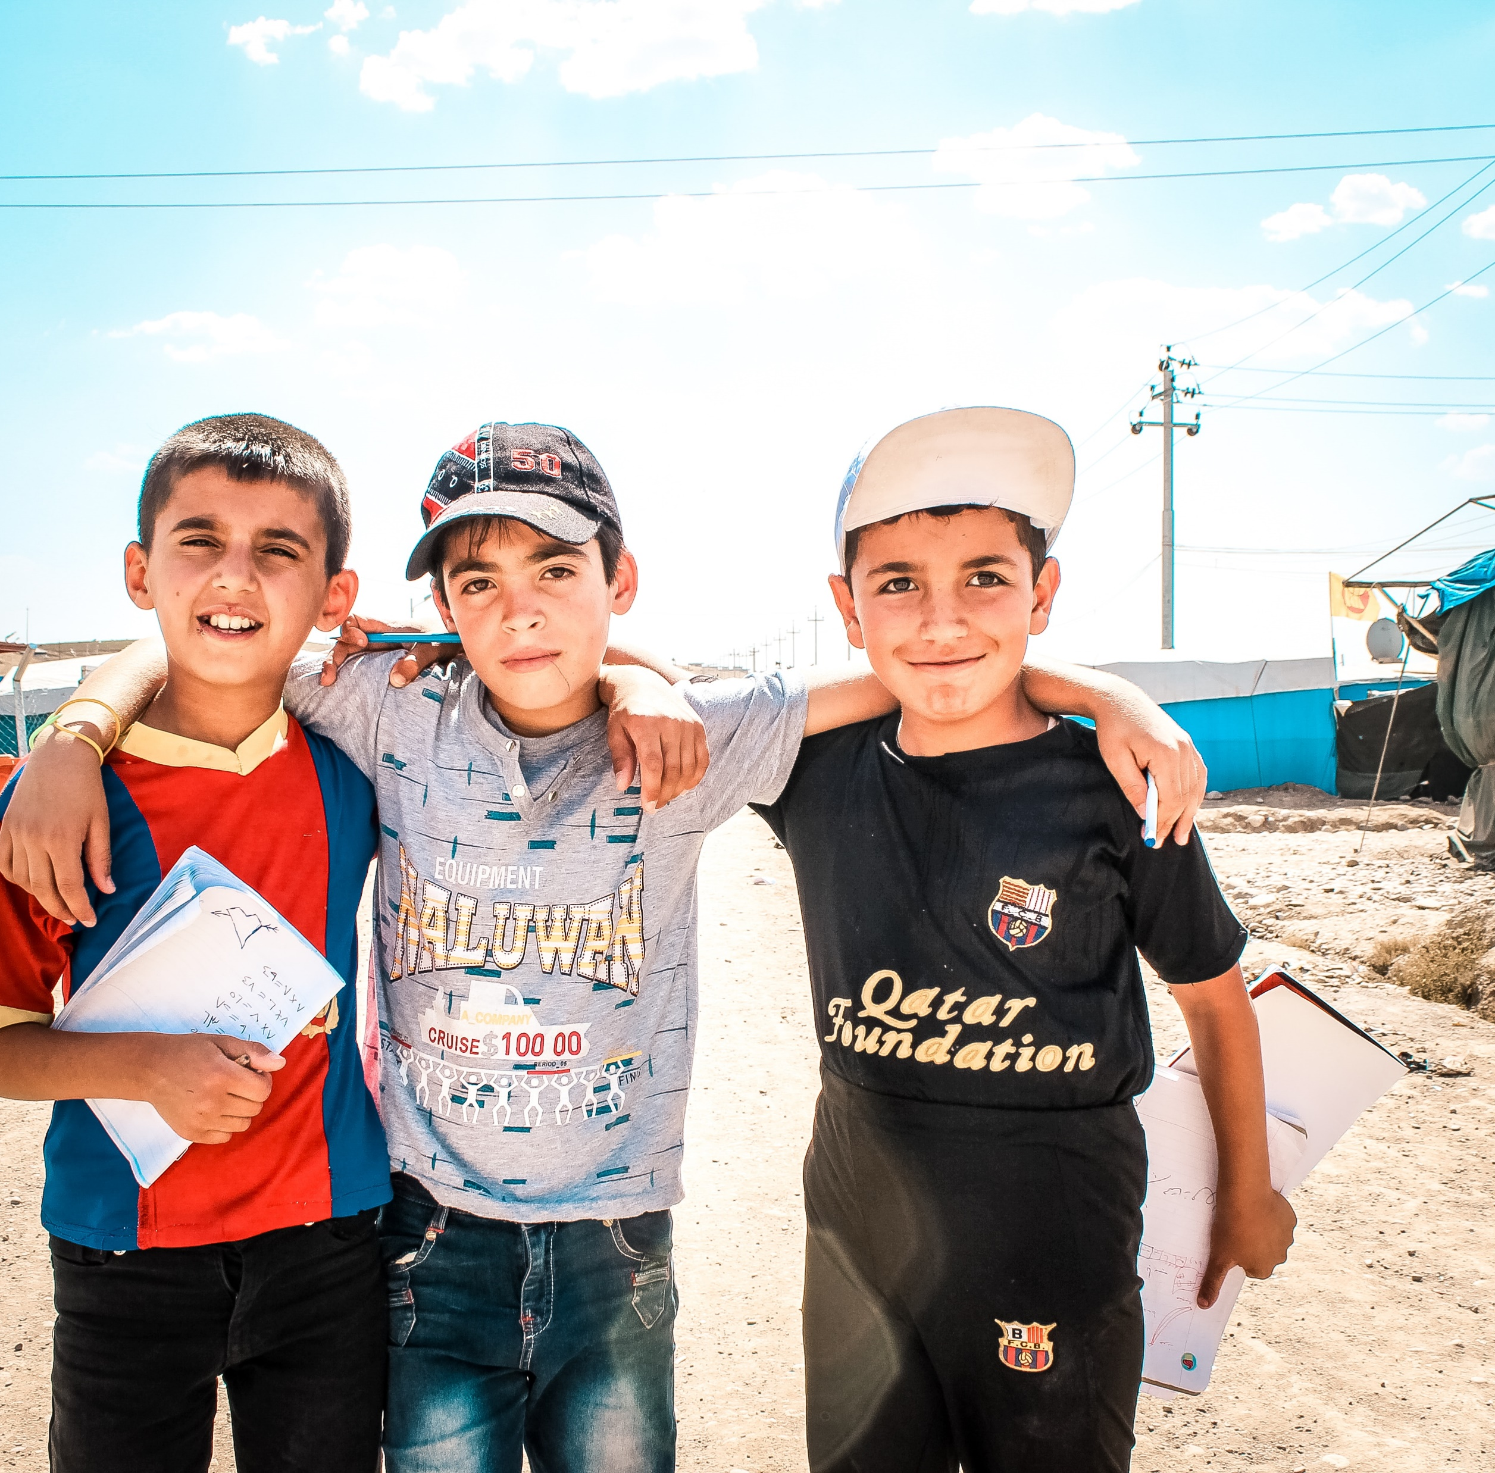
Lack of Education
Photo: Kevin Austin
Photo: Trevor Owen
Photos: Latin America Area
Photo: Calo Britto
Photo: Kevin Austin
Photo: Jonathan Ramalho/Unsplash

Slide 10
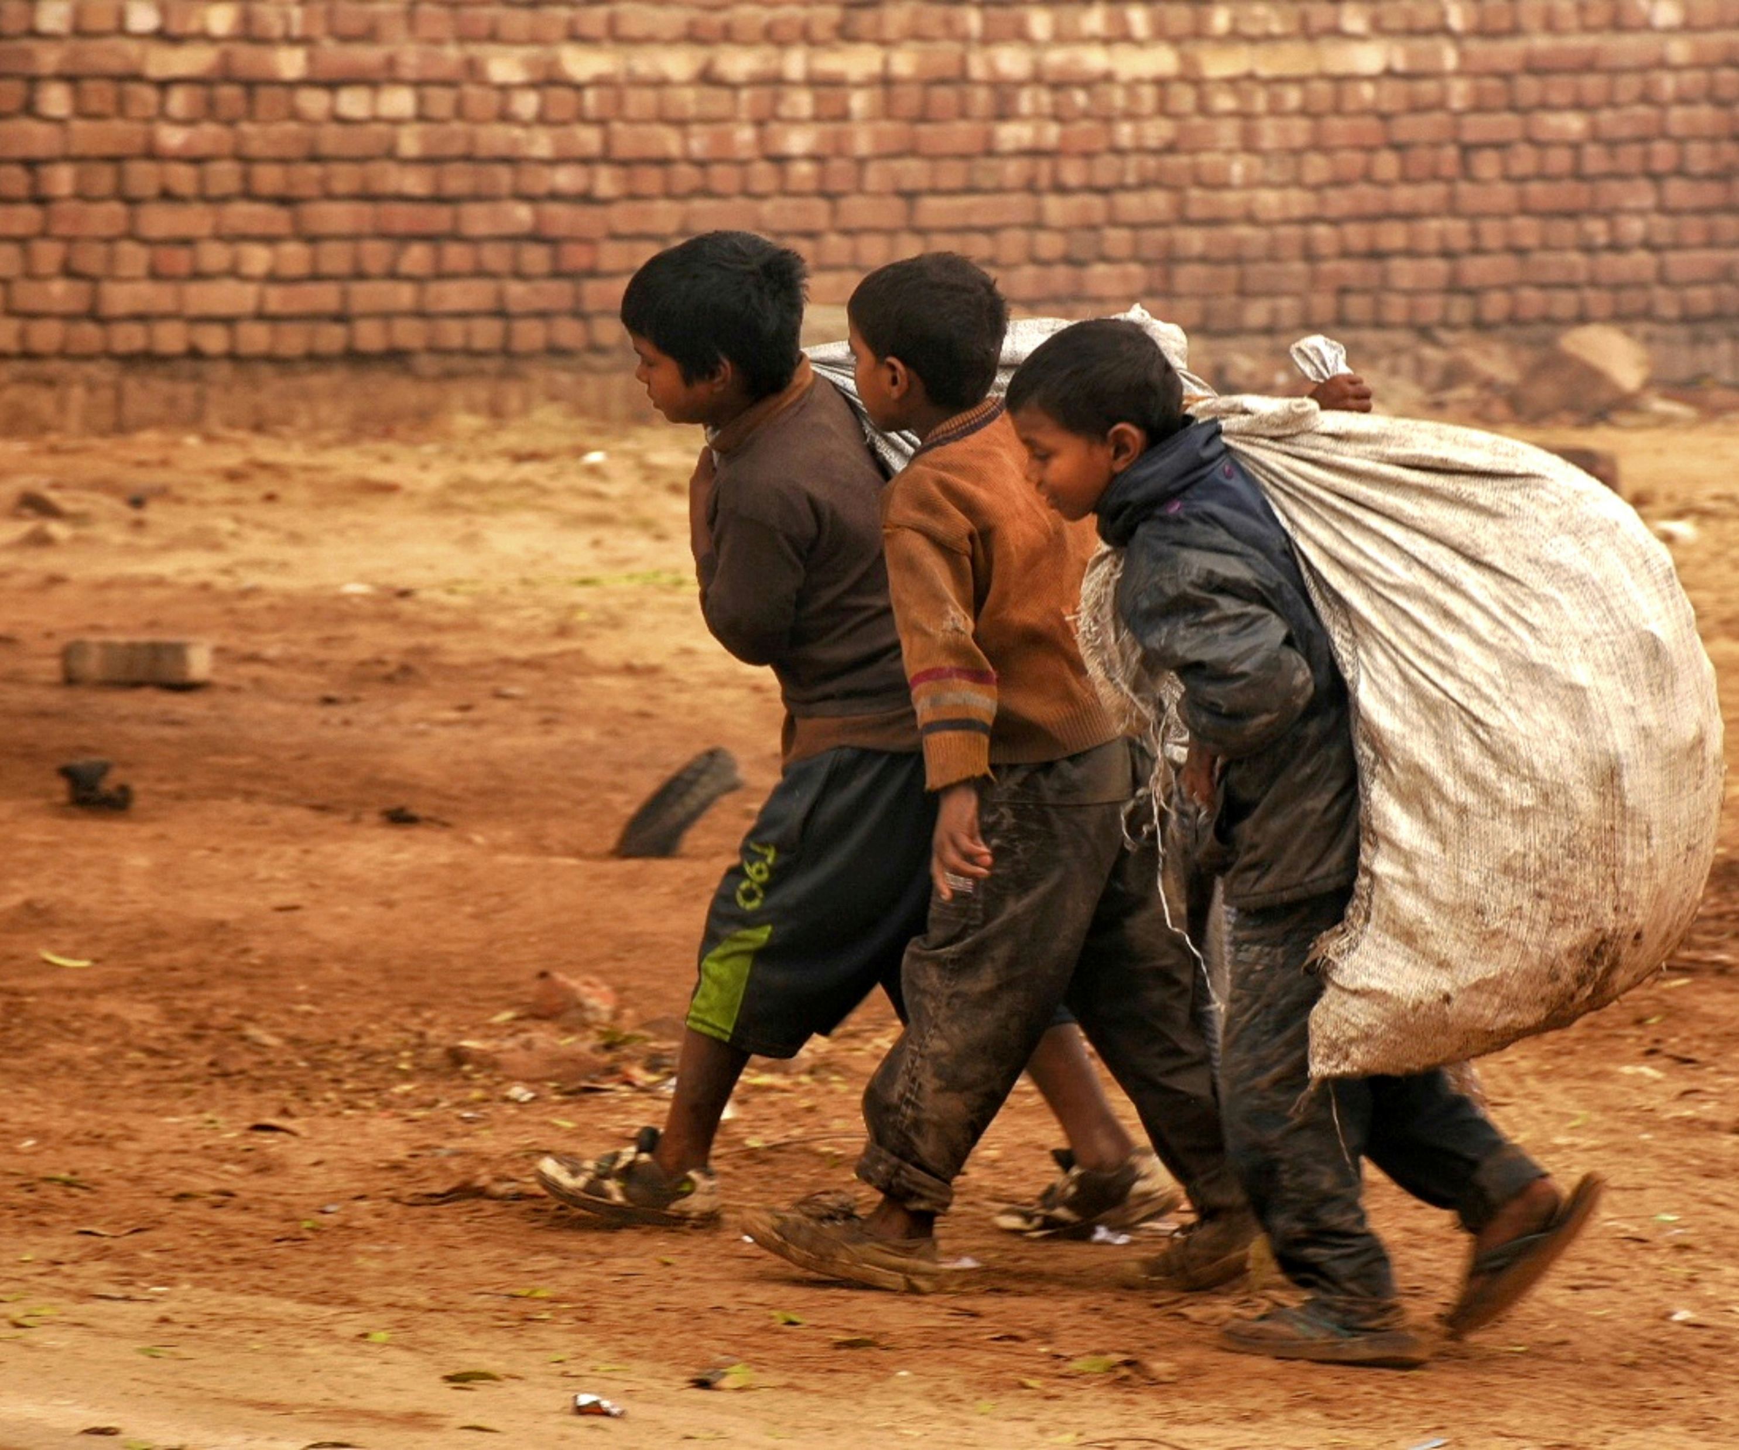
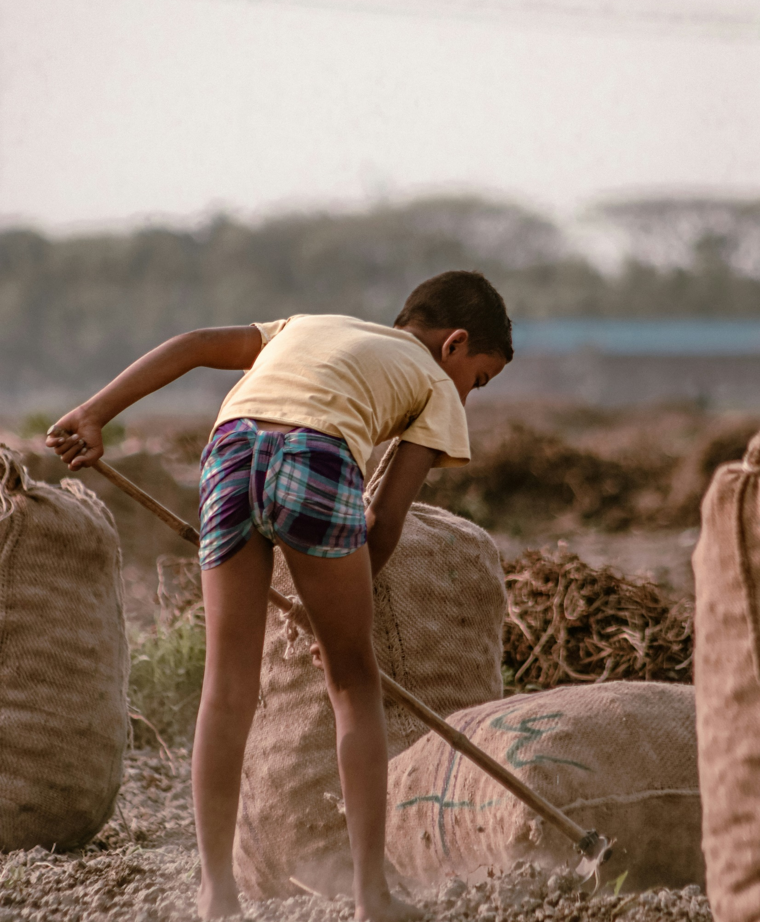
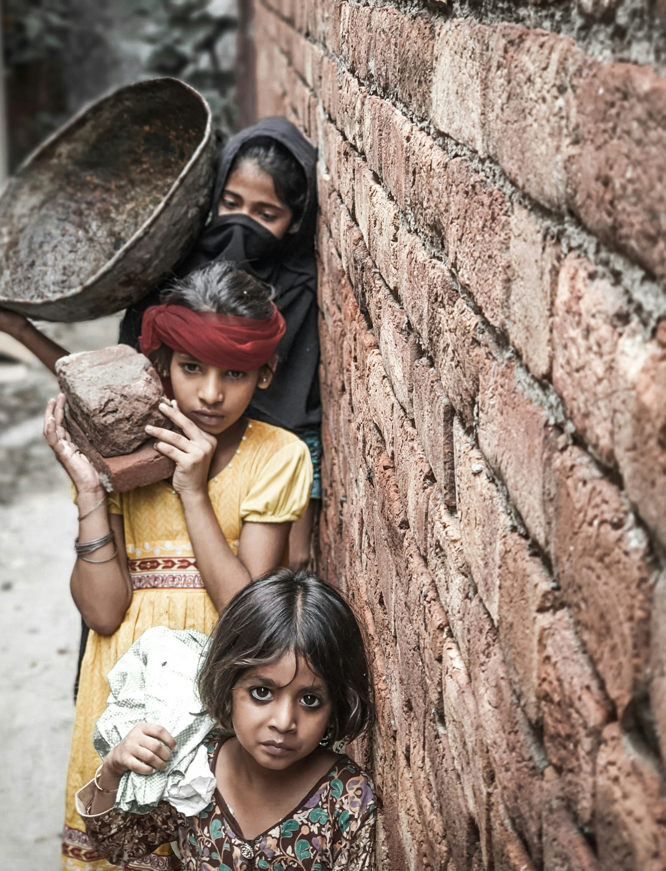
Photo: Simon Reza/ Unsplash
Photo: Dulana Kodithuw/ Unsplash
Child Labor
Photo: Aima Yasir/ Unsplash

Slide 11
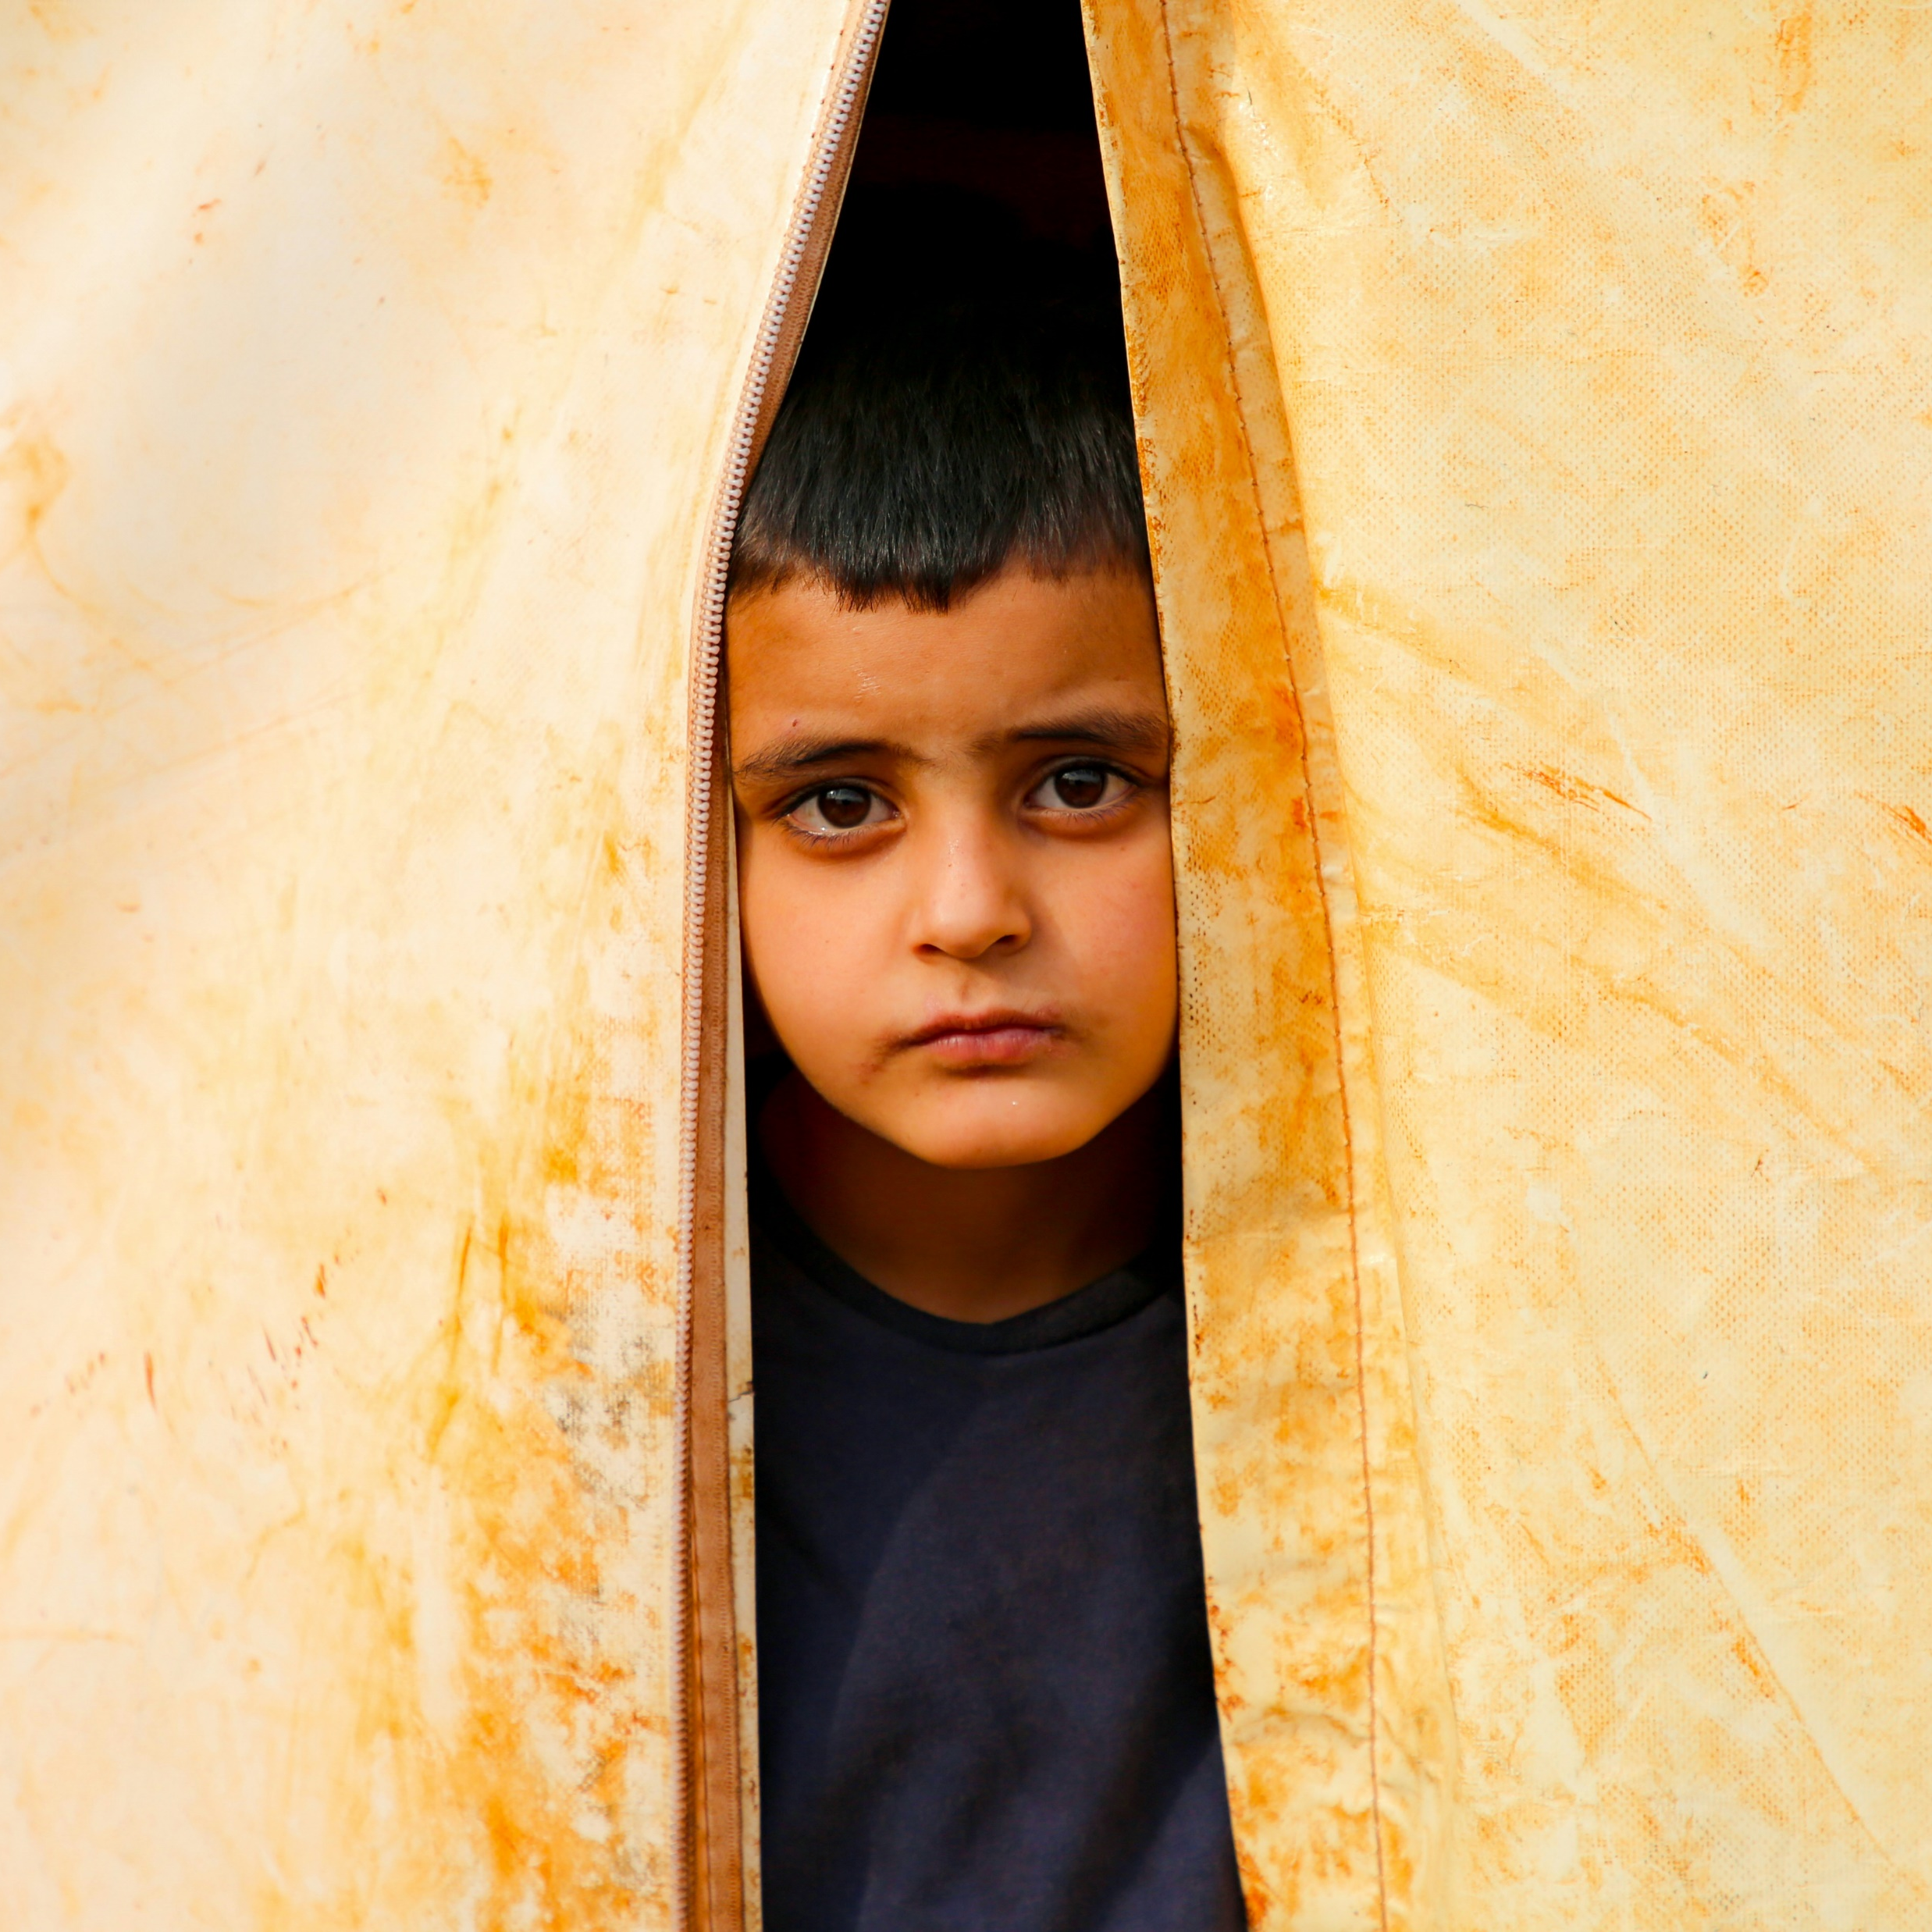

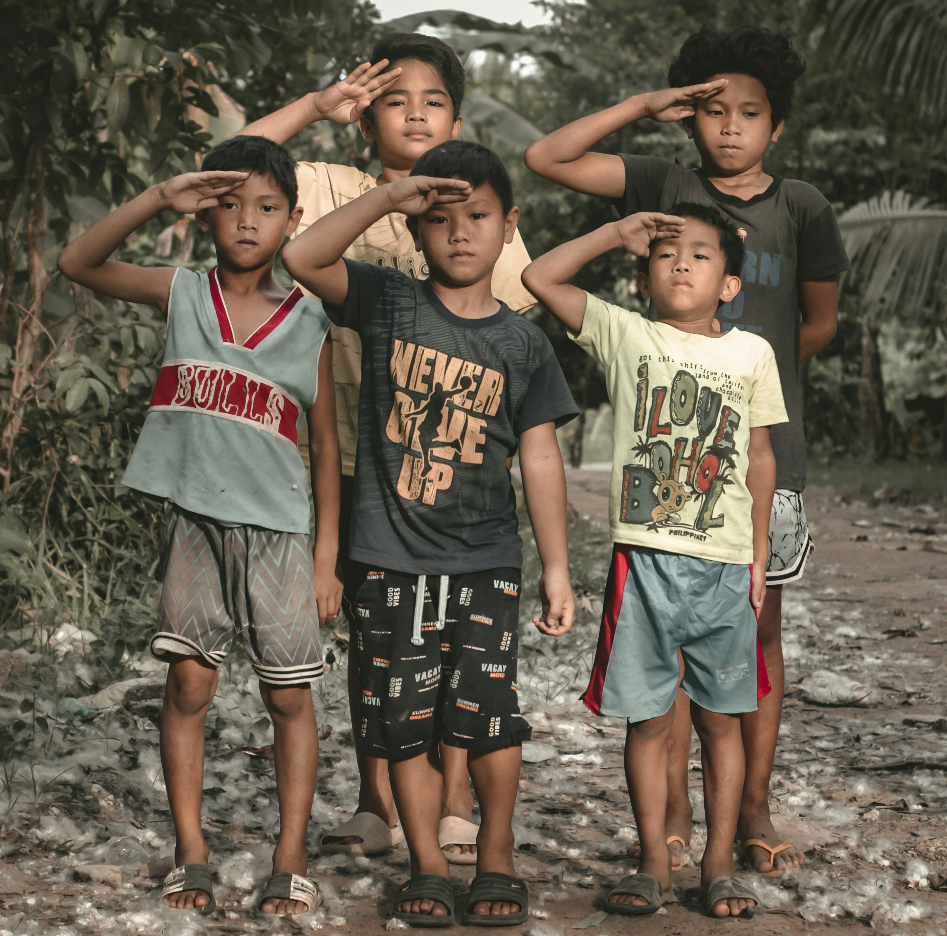
War & Displacement
Photo: Ehteshamul Haque
Photo: Colorblind Photo/Unsplash
Photo: Salah Darwish/Unsplash

Slide 12
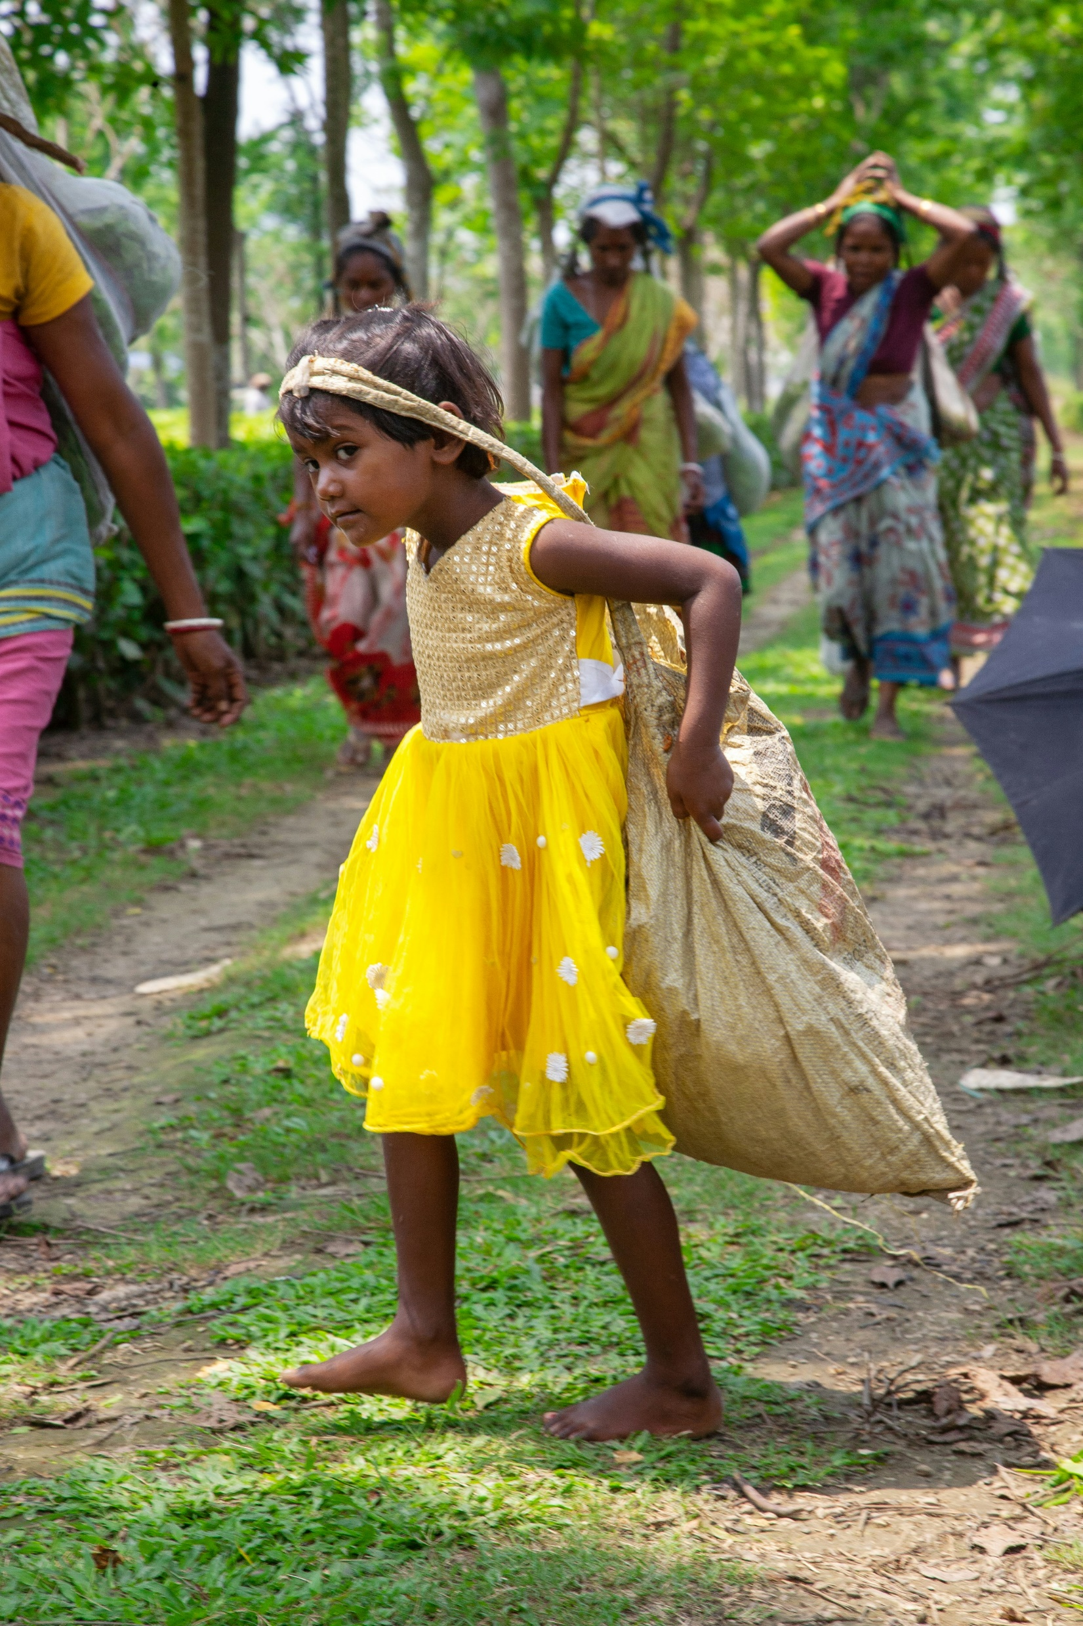
Worldwide there are an estimated 50 million children in slavery

Slide 13
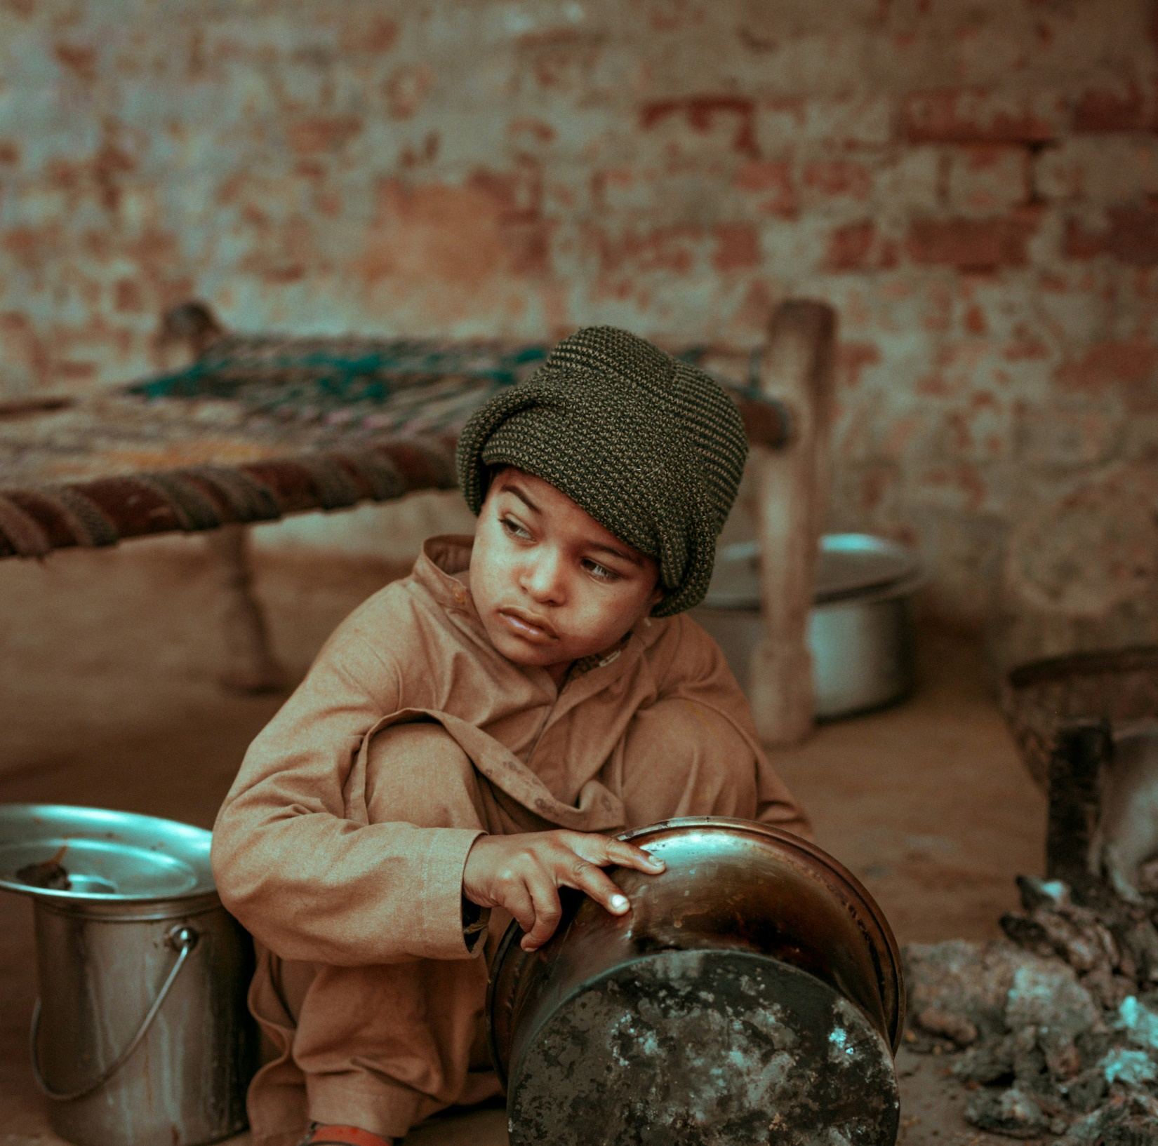
What Makes Children More At Risk?
Being Poor
No Family or Friends to Help Them
Big Disasters – Like Floods and Earthquakes
War or Problems in Their Country

Slide 14

Explore God’s Work

Slide 15
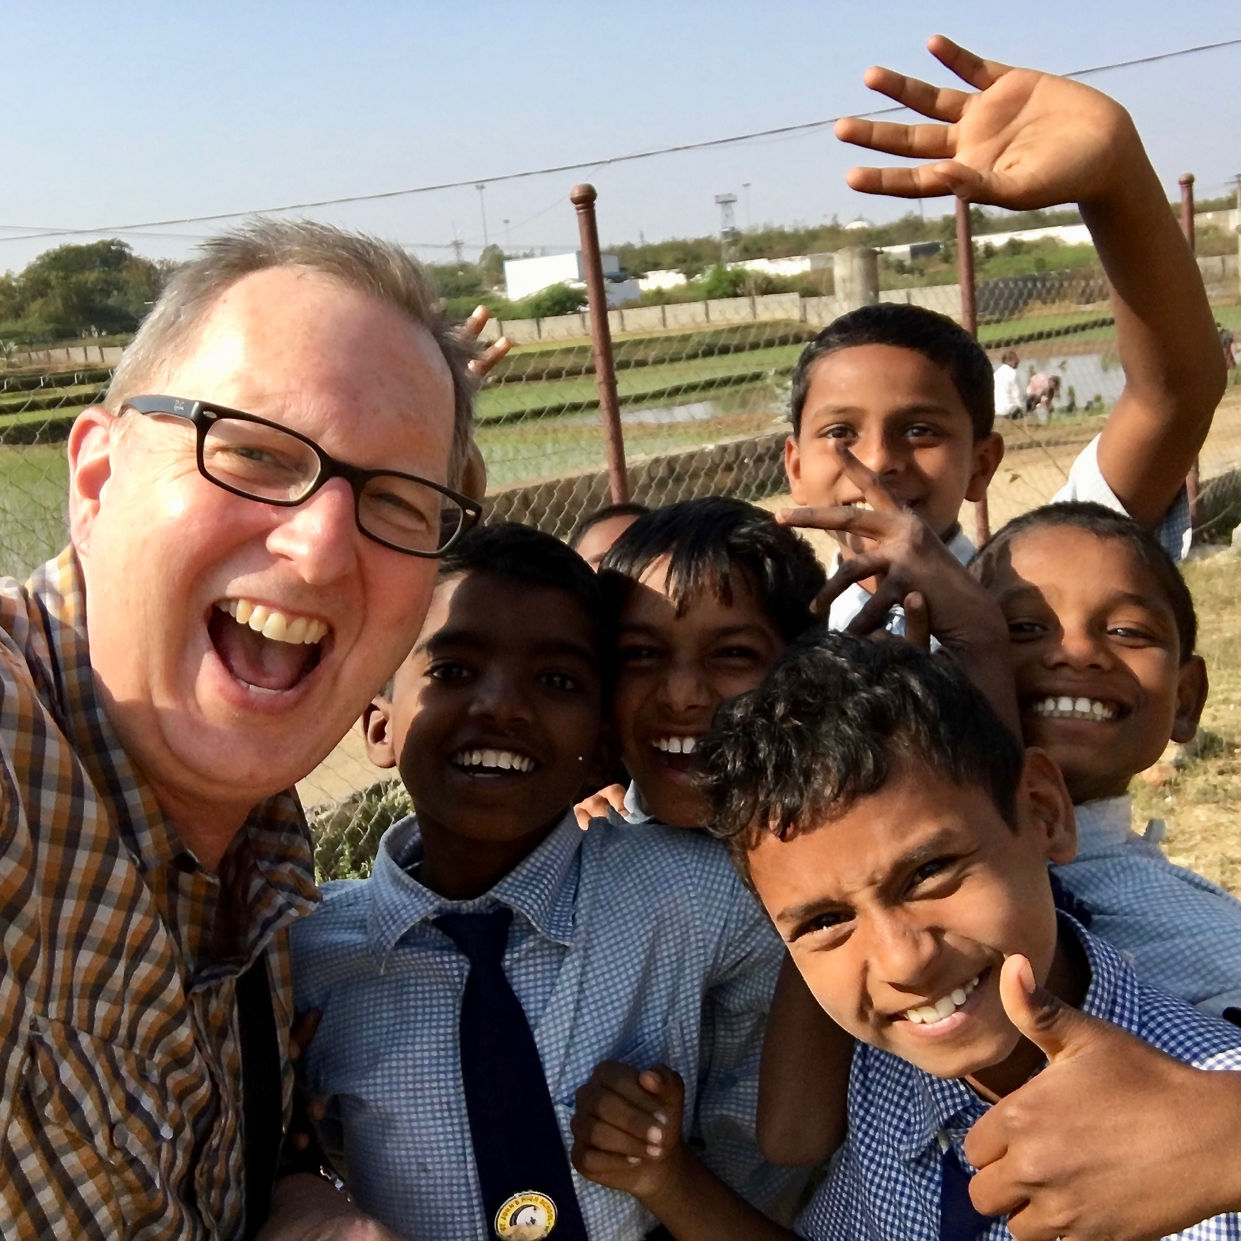
The Set Free Movement began in 2010
under the leadership of Rev. Kevin Austin

Slide 16

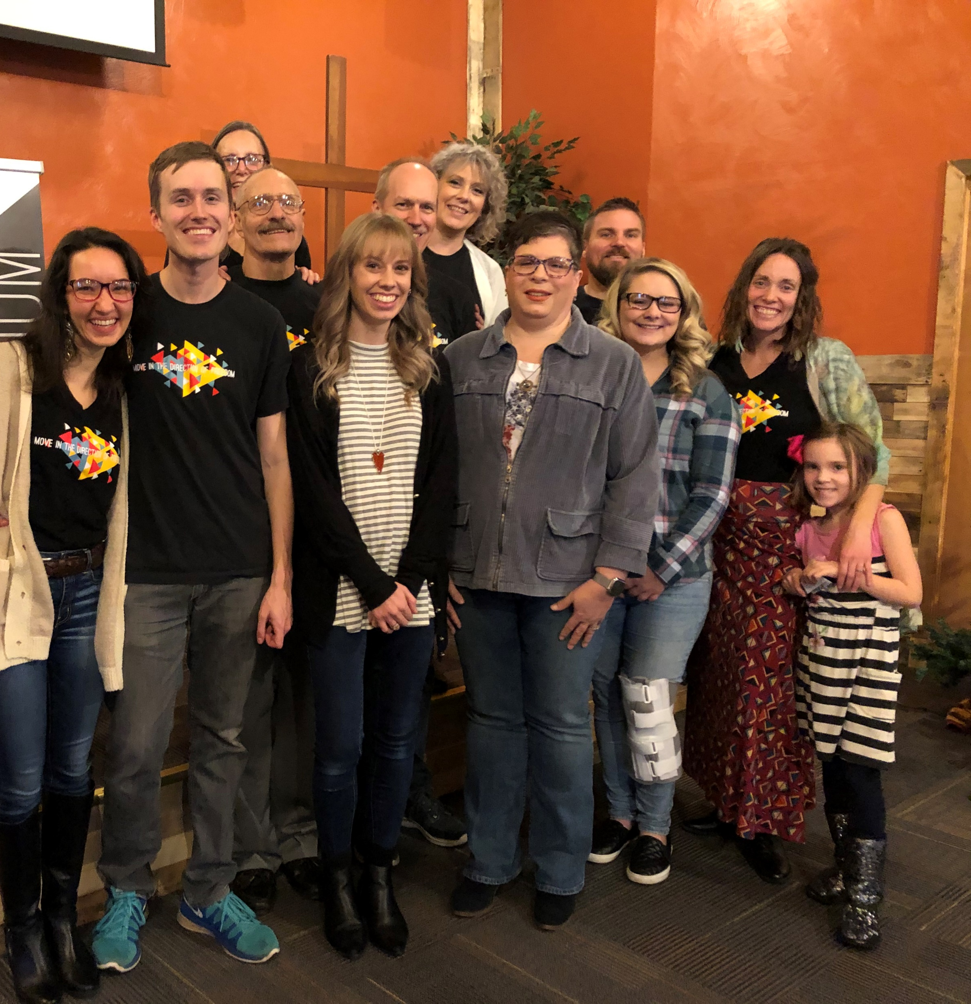

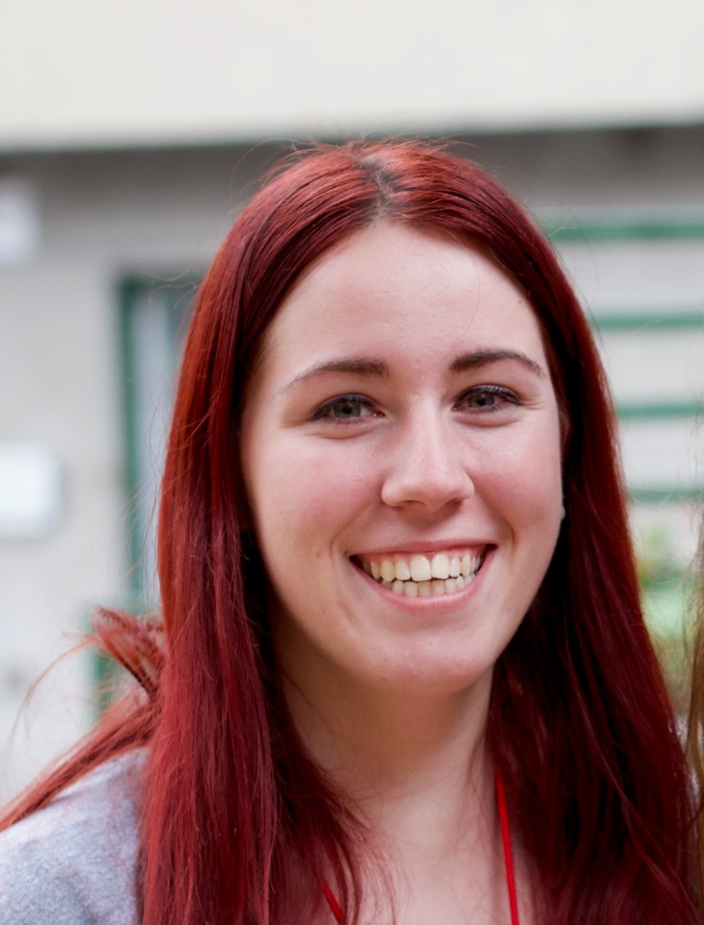
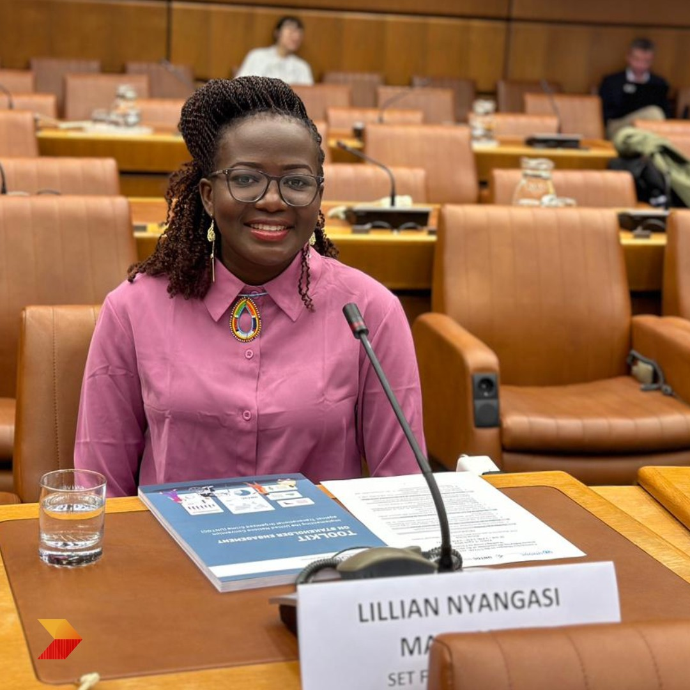
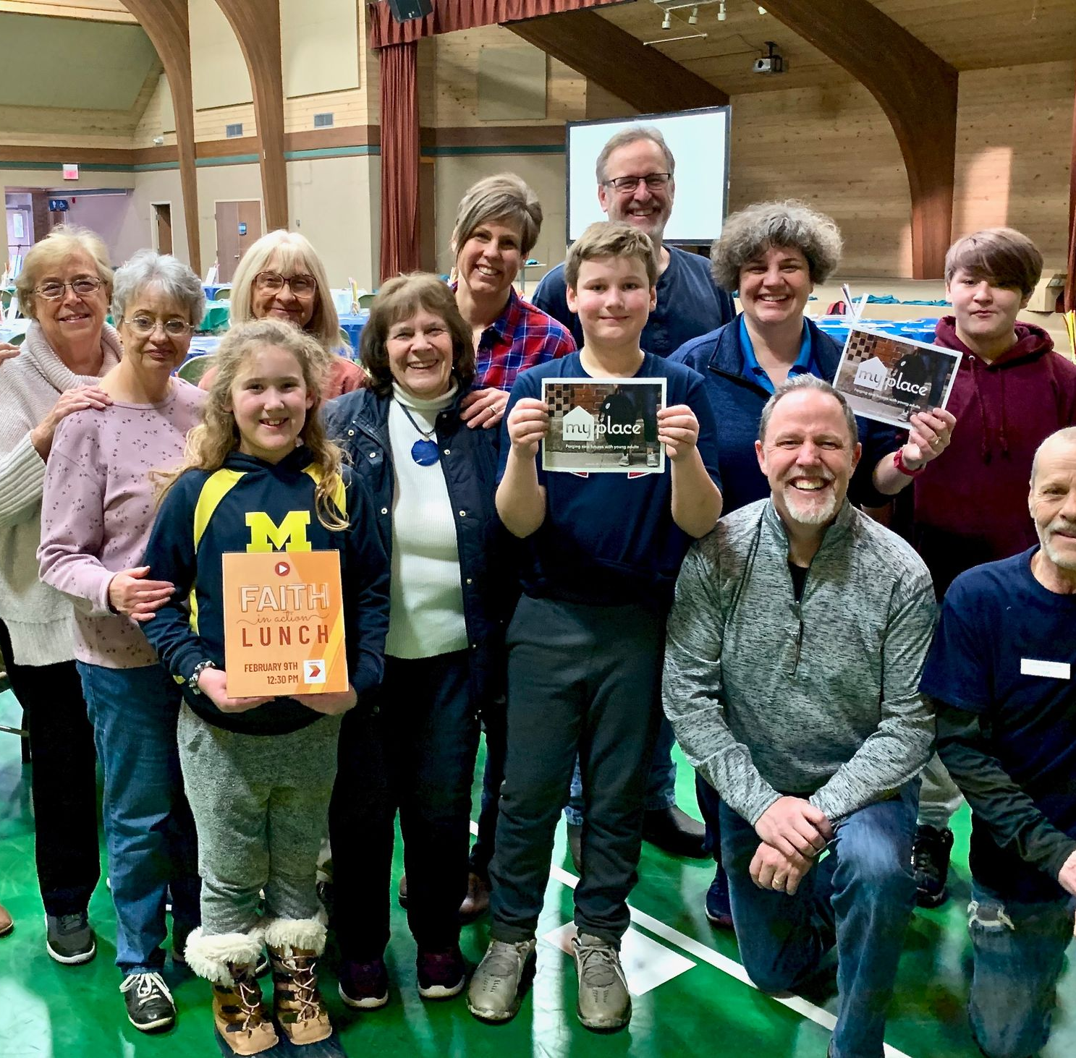
There are now Set Free leaders and teams in at least eight countries.

Slide 17

Adventure Story

Slide 18
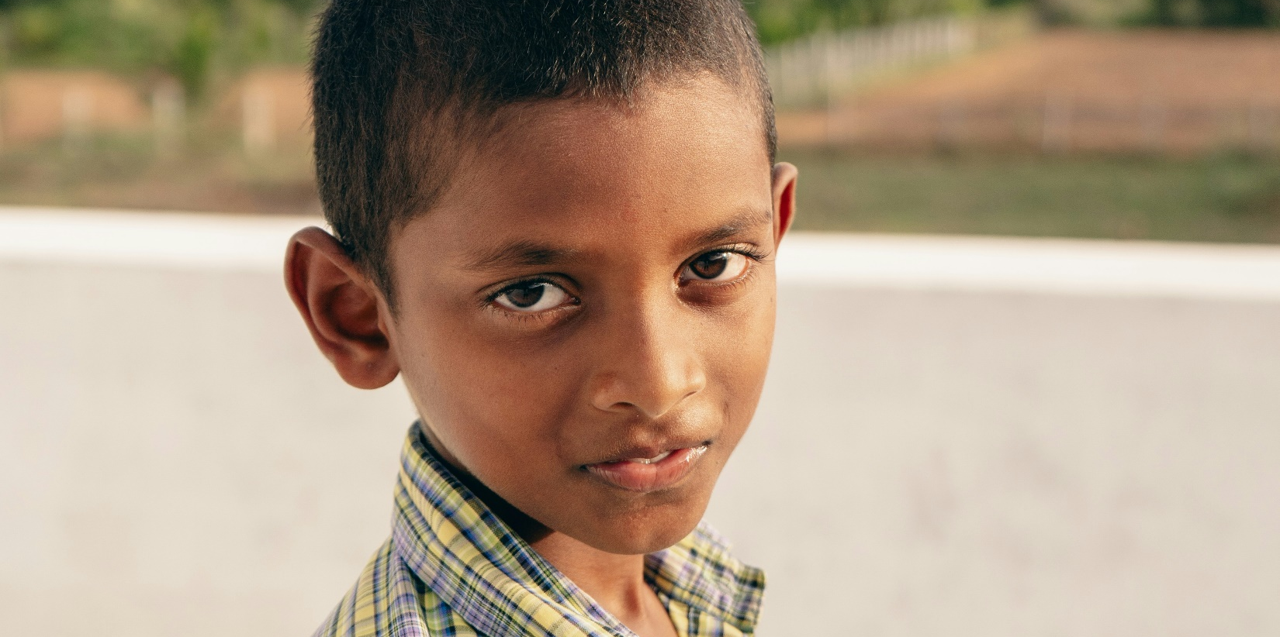
Photo: Karthick Gislen/ Unsplash
This photo is only a representation of the boy in our story.

Slide 19

Adventure in Prayer

Slide 20
Jesus, we believe You set people free. Please help everyone who feels trapped or hurt. Amen

Slide 21

People on Adventure

Slide 22
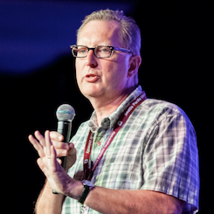
Meet Set Free Director
Kevin Austin

Slide 23

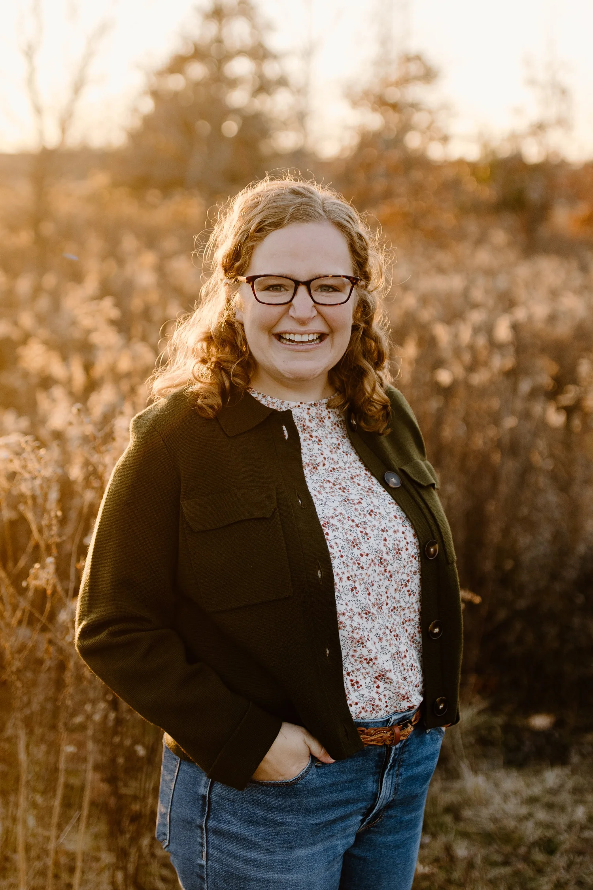
Meet Emily and Emma

Slide 24

Adventures in Culture

Slide 25
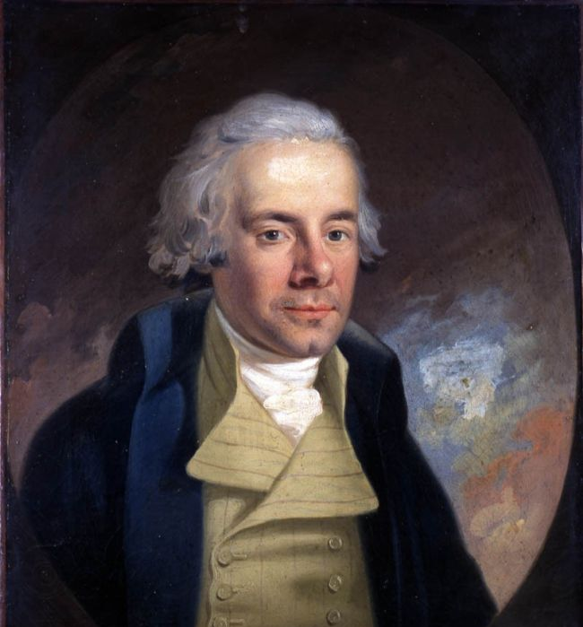
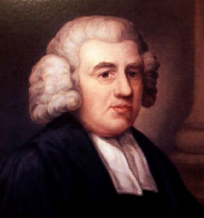
William Wilberforce
John Newton

Slide 26

Amazing grace! how sweet the sound,
That saved a wretch; like me!
I once was lost, but now am found,
Was blind, but now I see.
’Twas grace that taught my heart to fear,
And grace my fears relieved;
How precious did that grace appear
The hour I first believed!
3
Amazing Grace
By
John Newton

Slide 27

The Lord hath promised good to me,
His word my hope secures;
He will my shield and portion be
As long as life endures.
When we’ve been there ten thousand years,
Bright shining as the sun,
We’ve no less days to sing God’s praise
Than when we first begun.

