Slide 1

Global Adventures
Creative Access-PN

Slide 2
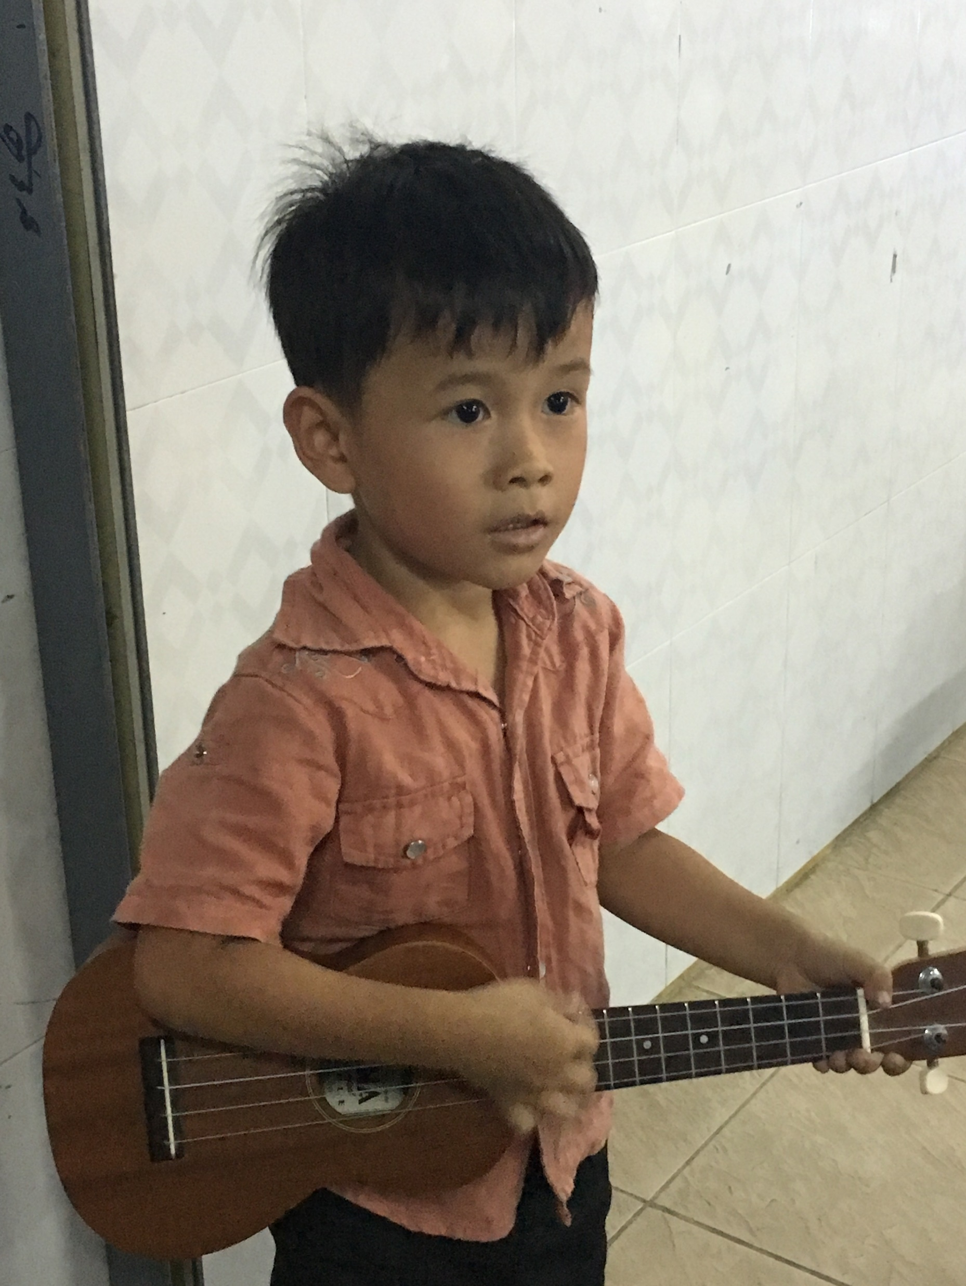
Theme Verse
  Sing to the Lord, all the earth;
  proclaim his salvation day after day.
  Declare his glory among the nations,
  his marvelous deeds among all peoples.
  For great is the Lord and most worthy of praise; he is to be feared above all gods.
  For all the gods of the nations are idols,
  but the Lord made the heavens.
  Splendor and majesty are before him;
  strength and joy are in his dwelling place.
              I Chronicles 16: 23-27
Unsplash: Ben White

Slide 3

Explore the Country

Slide 4
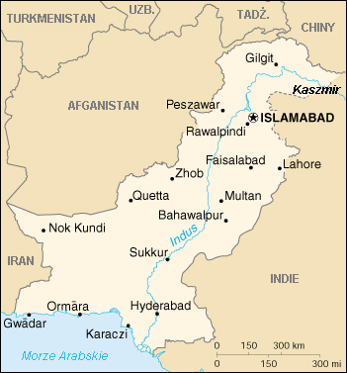
Photo: Public Domain/Wikimedia Commons
Creative Access-PN
Wikimedia Commons: US CIA Public Domain

Slide 5
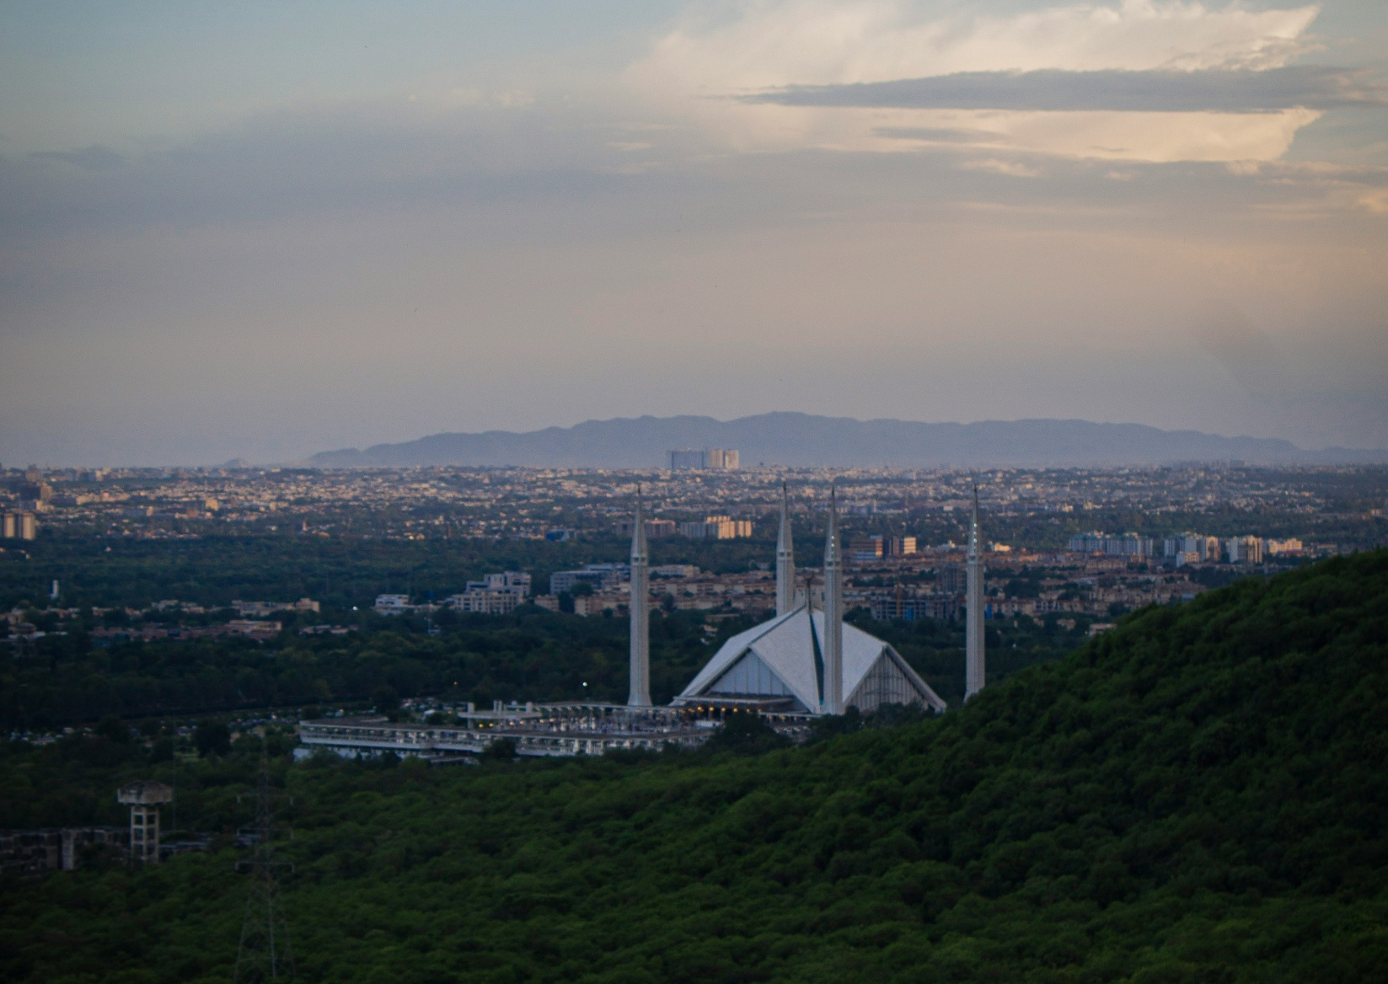
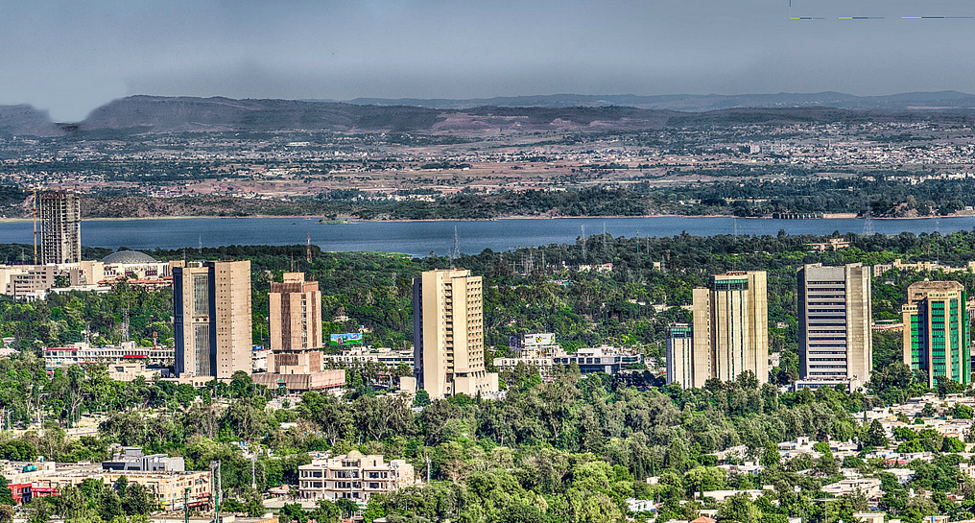
The
Capital City
Photo: amranmangrio, CC BY-SA 4.0 httpscreativecommons.orglicensesby-sa4.0, via Wikimedia Commons
Photo: Muhammad Talha/Unsplash

Slide 6

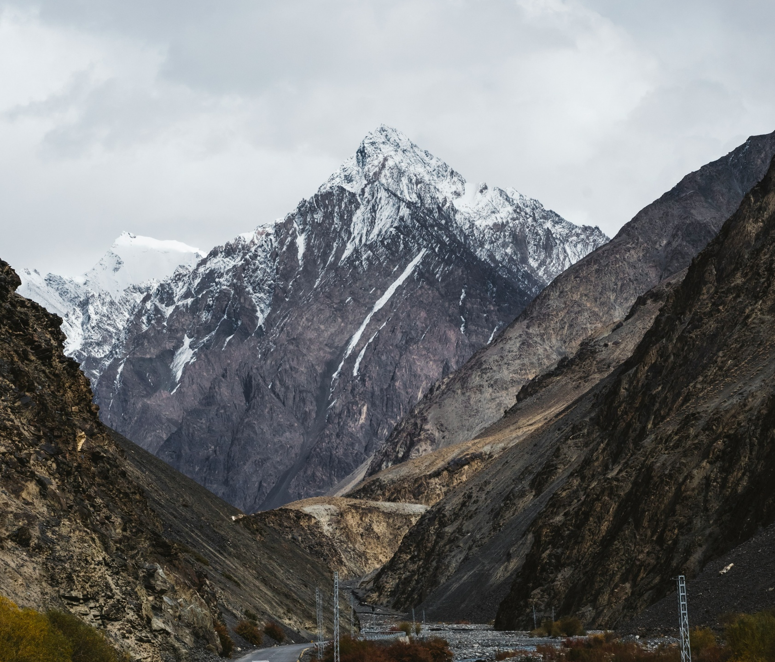
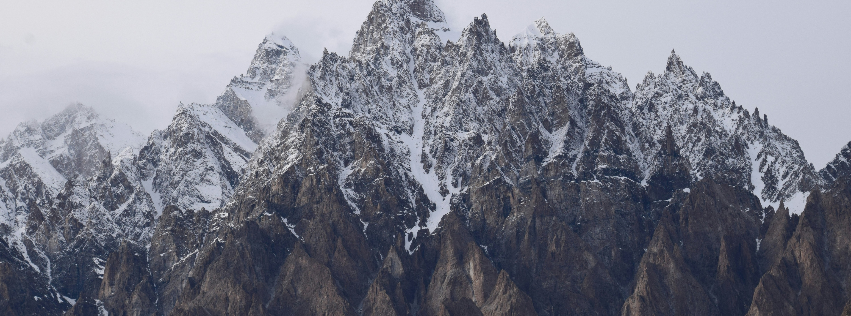
Beautiful Mountains
Photo: Curated Lifestyle/Unsplash
Photo: Kamran Ch/Unsplash
Photo: Sakhi Saad/Unsplash

Slide 7

Amazing Glaciers
Photo: Adnan Temur Barcha/ Unsplash

Slide 8
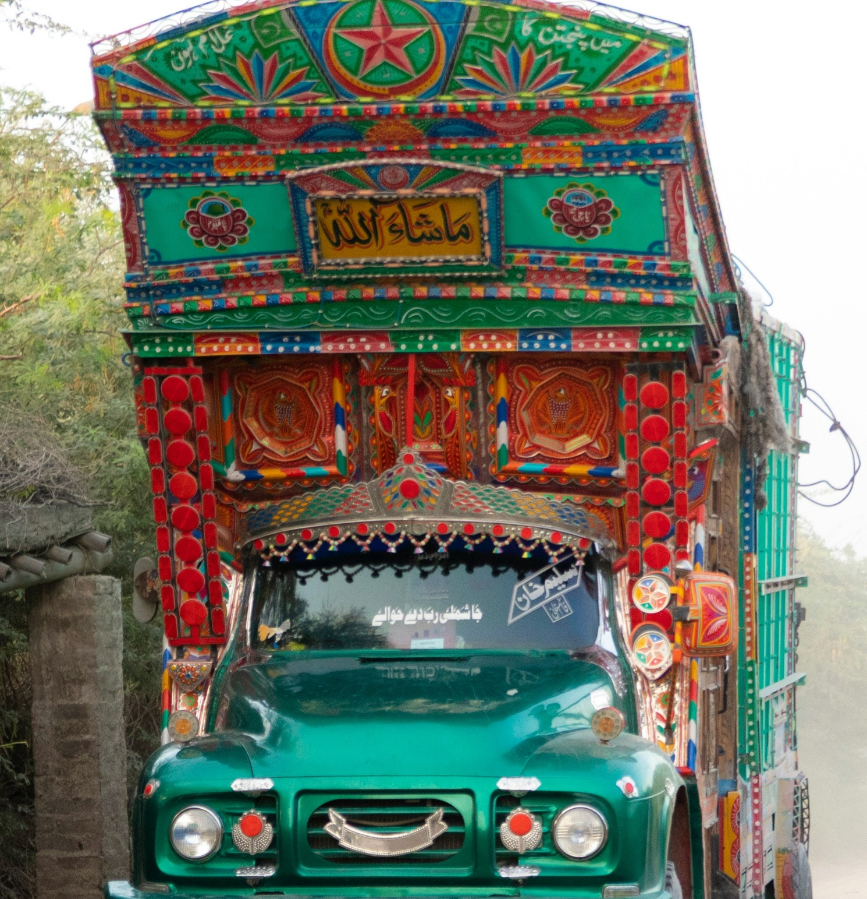
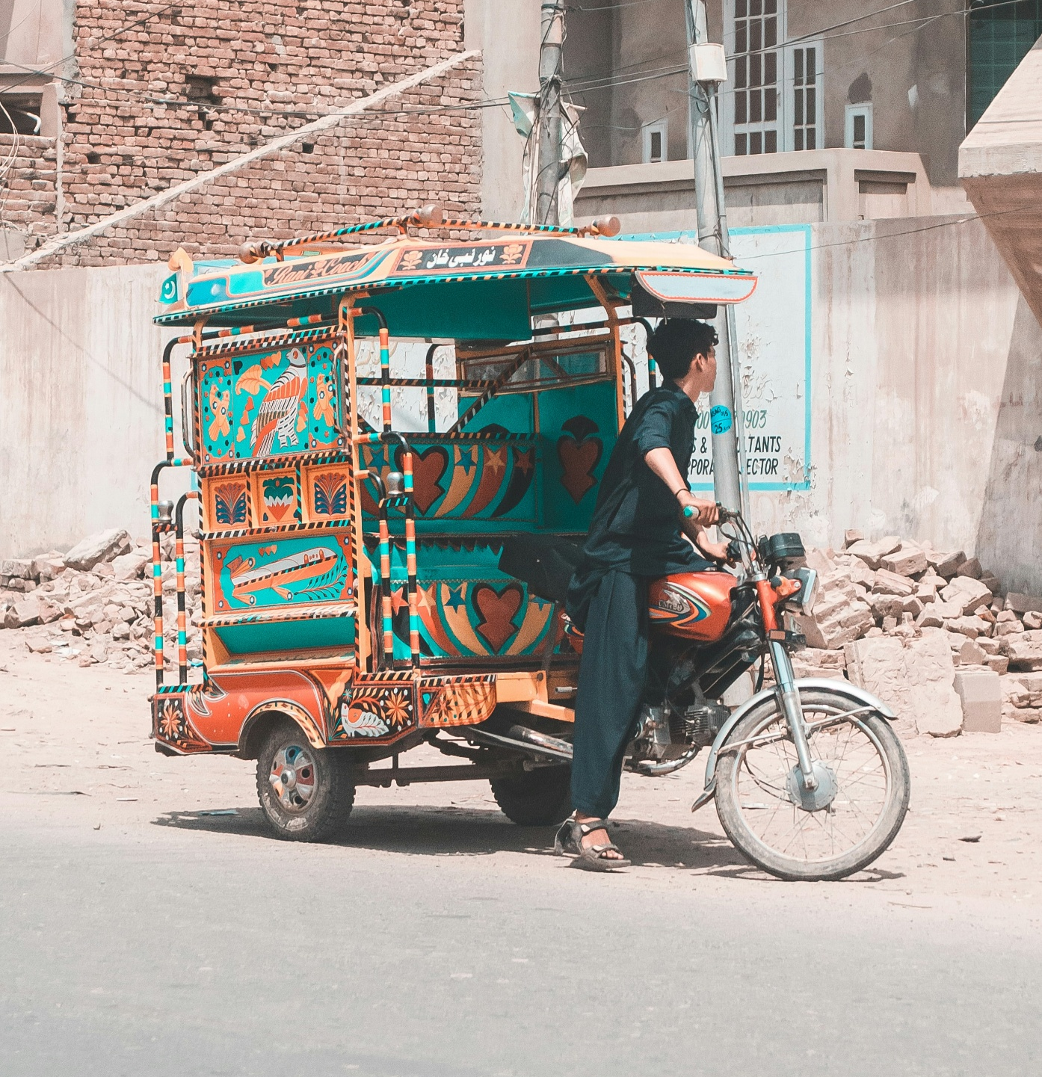
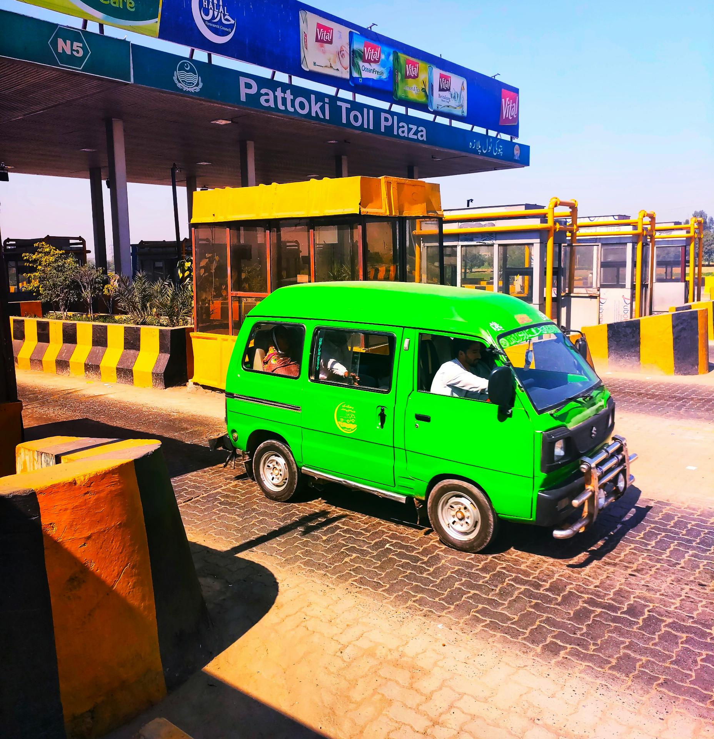
Photo: Maogee Dharshi/Unsplash
Photo: Ayesah Ch/ Unsplash
Photo: Salman Ch/Unsplash
Colorful Transportation

Slide 9
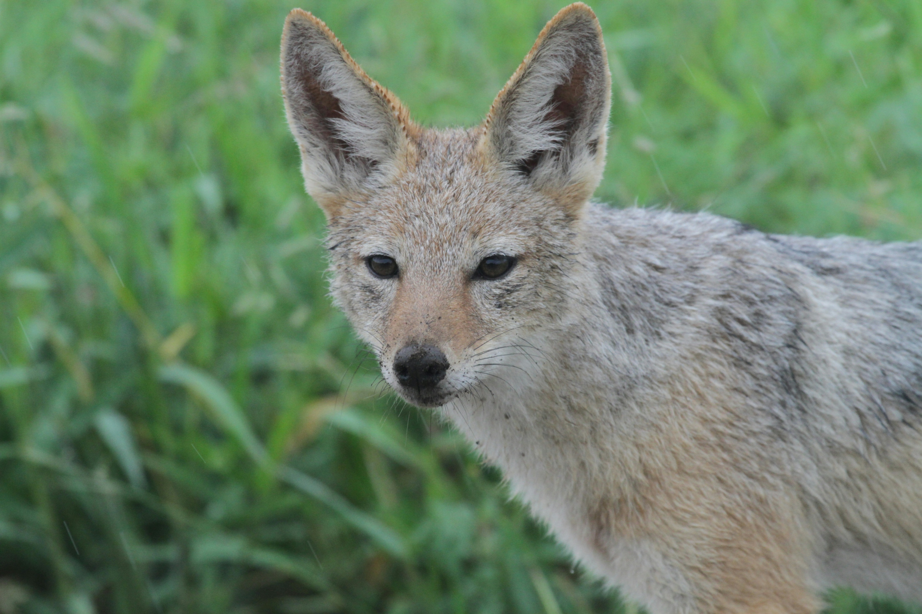
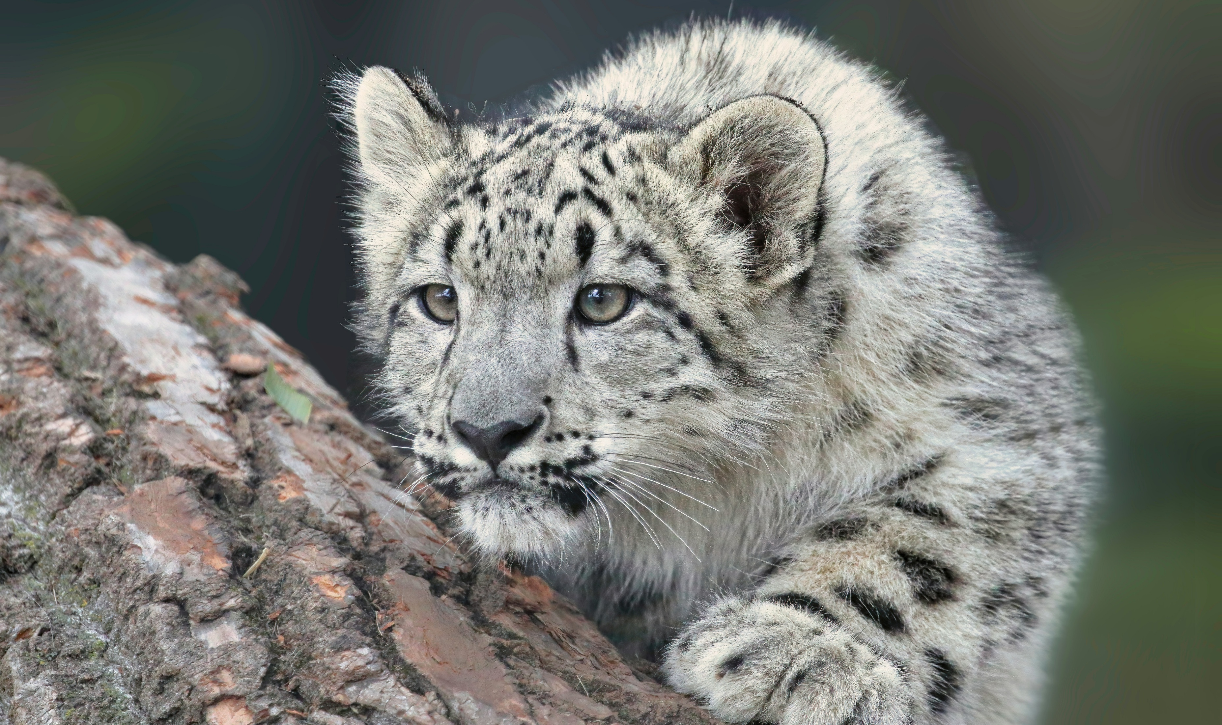
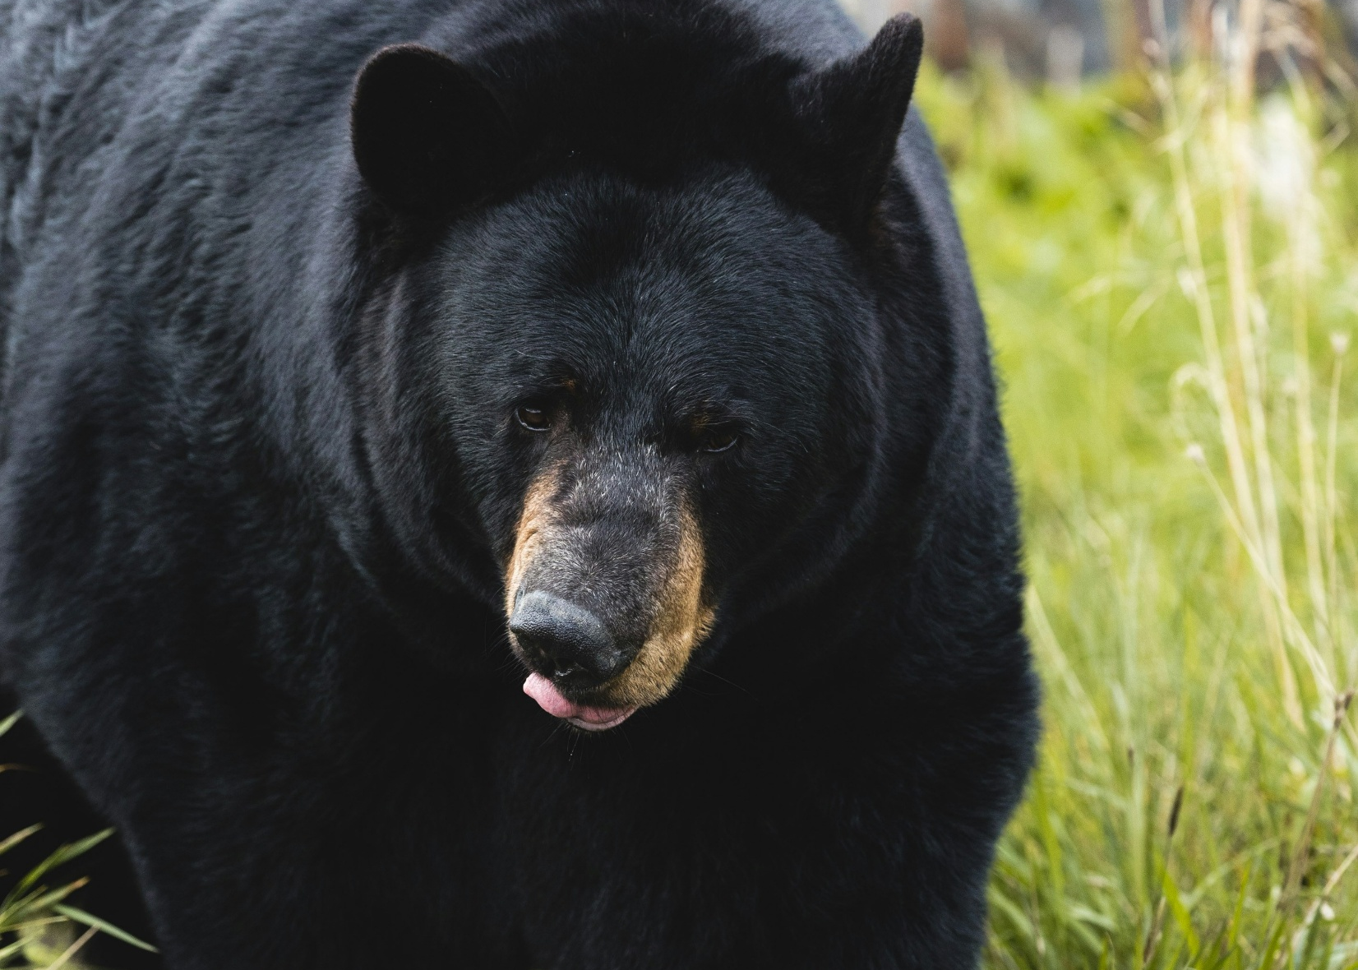
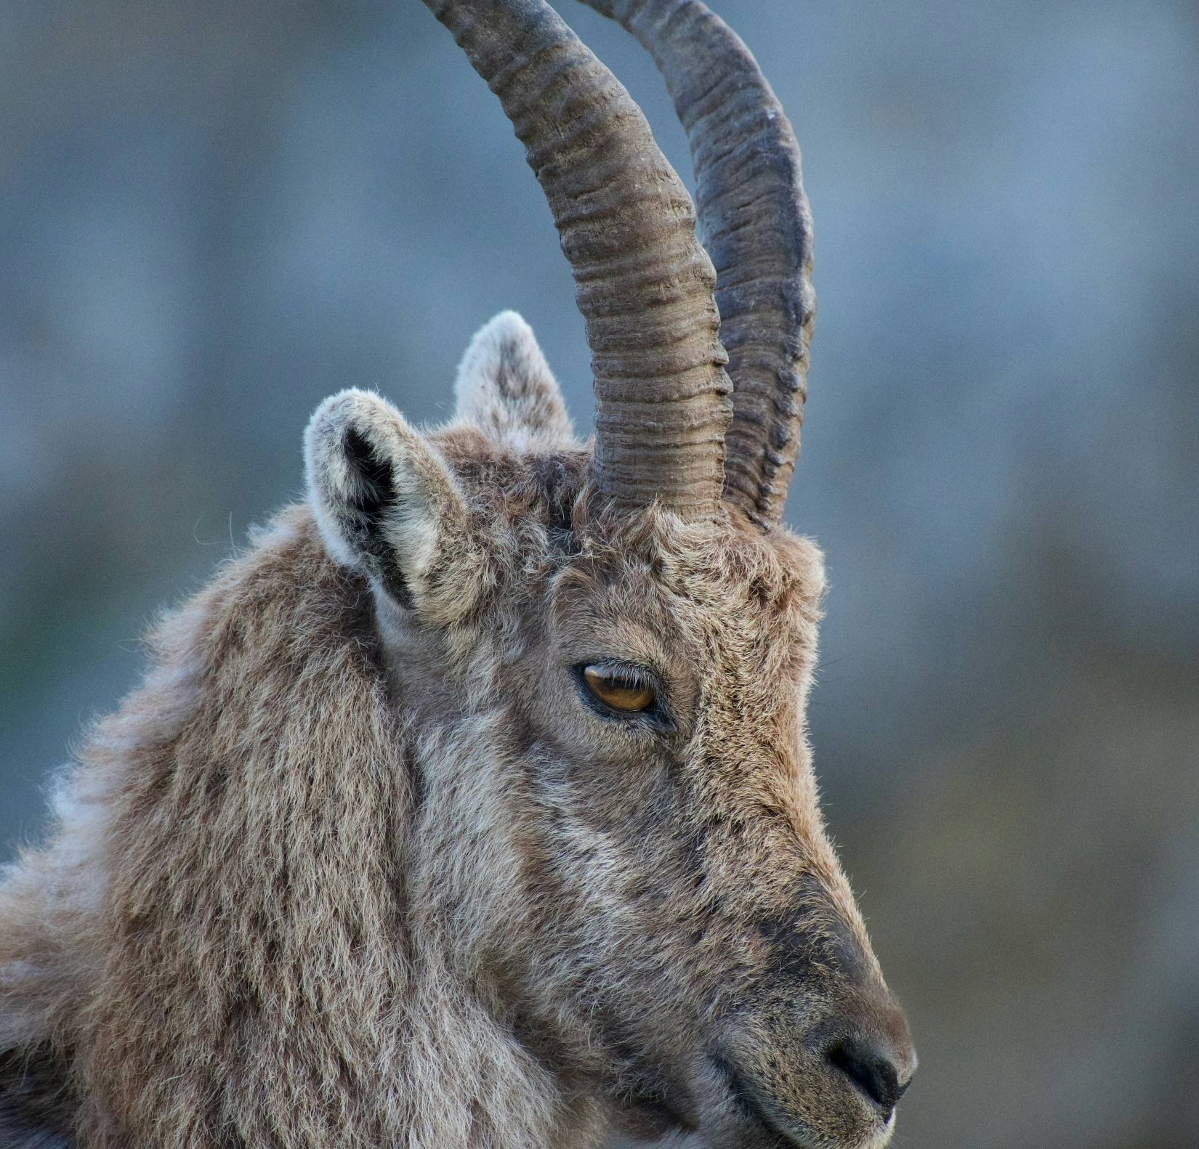
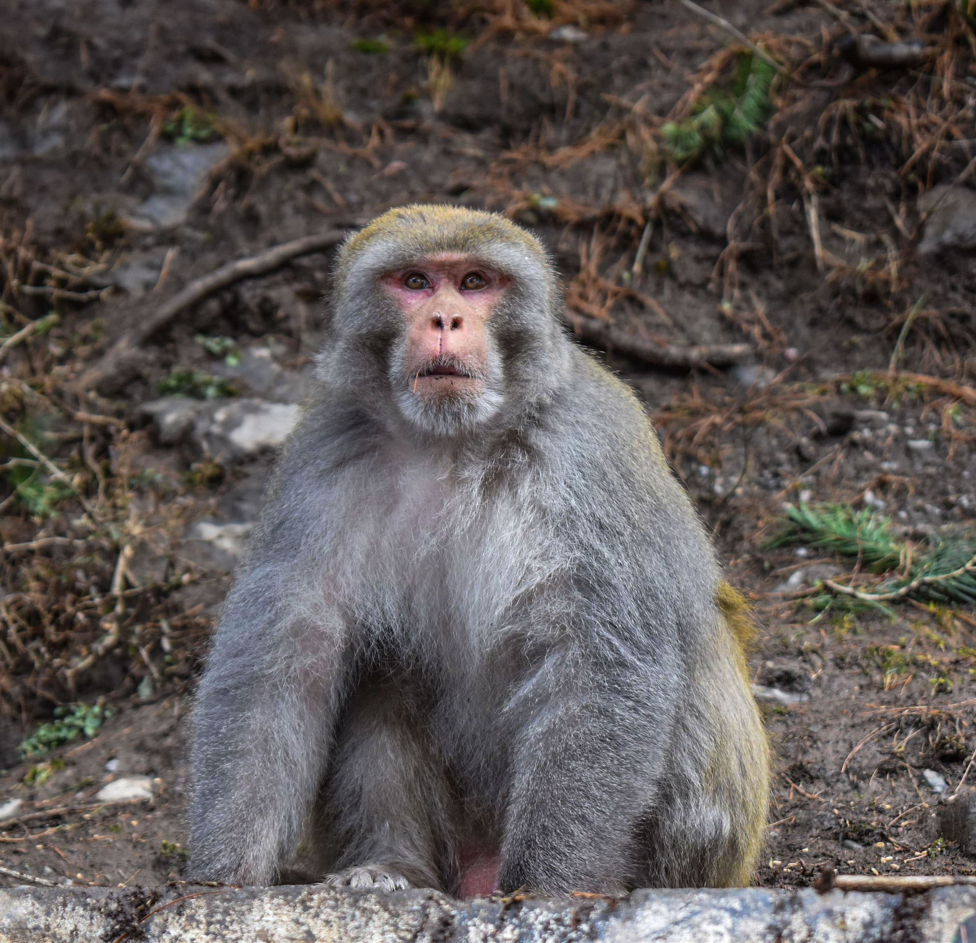
Snow Leopard
Fox
Photo: Mitch Mitchell/Unsplash
Black Himalayan Bear
Photo: Robert Sachow/Unsplash
Ibex
Monkey
Amazing
Wildlife
Photo: Tomas Malik/Unsplash
Photo: Thomas Jarrand/Unsplash
Photo: Isma Noor/ Pixabay

Slide 10
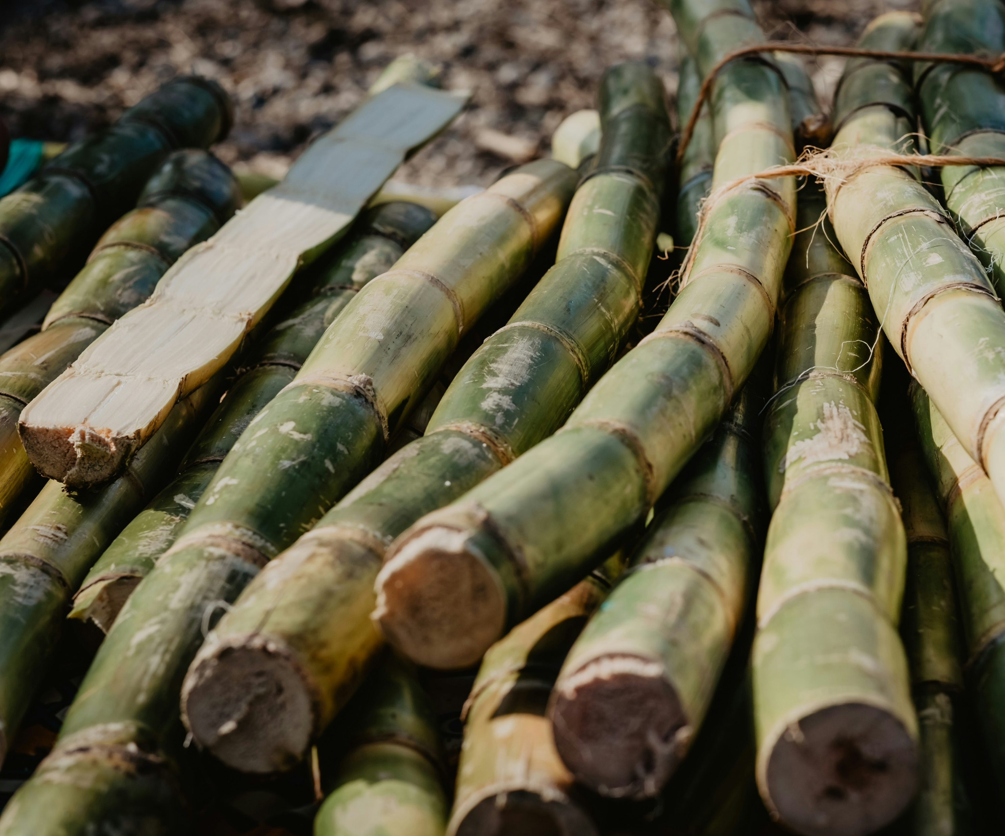
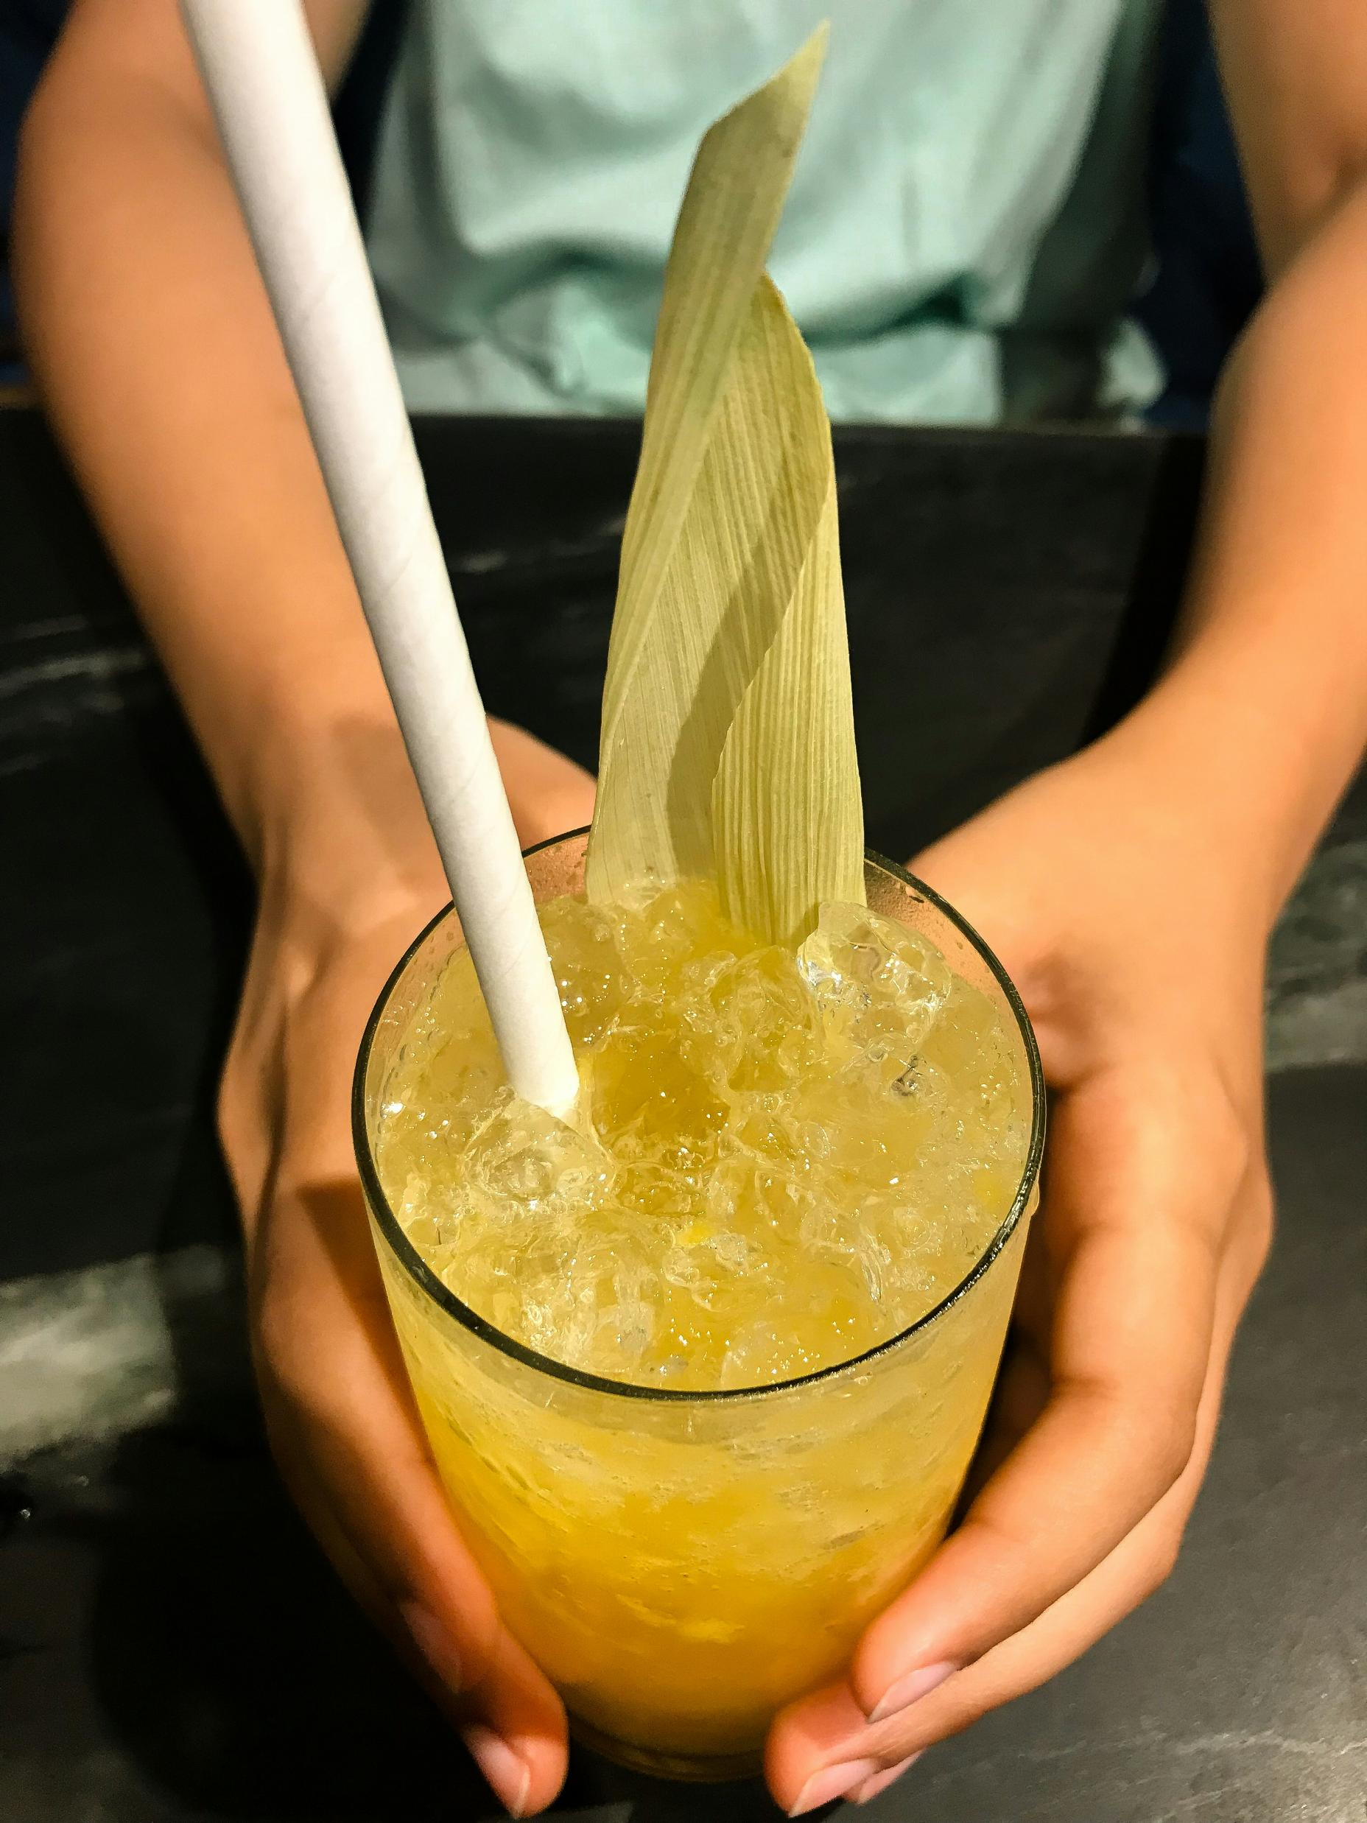
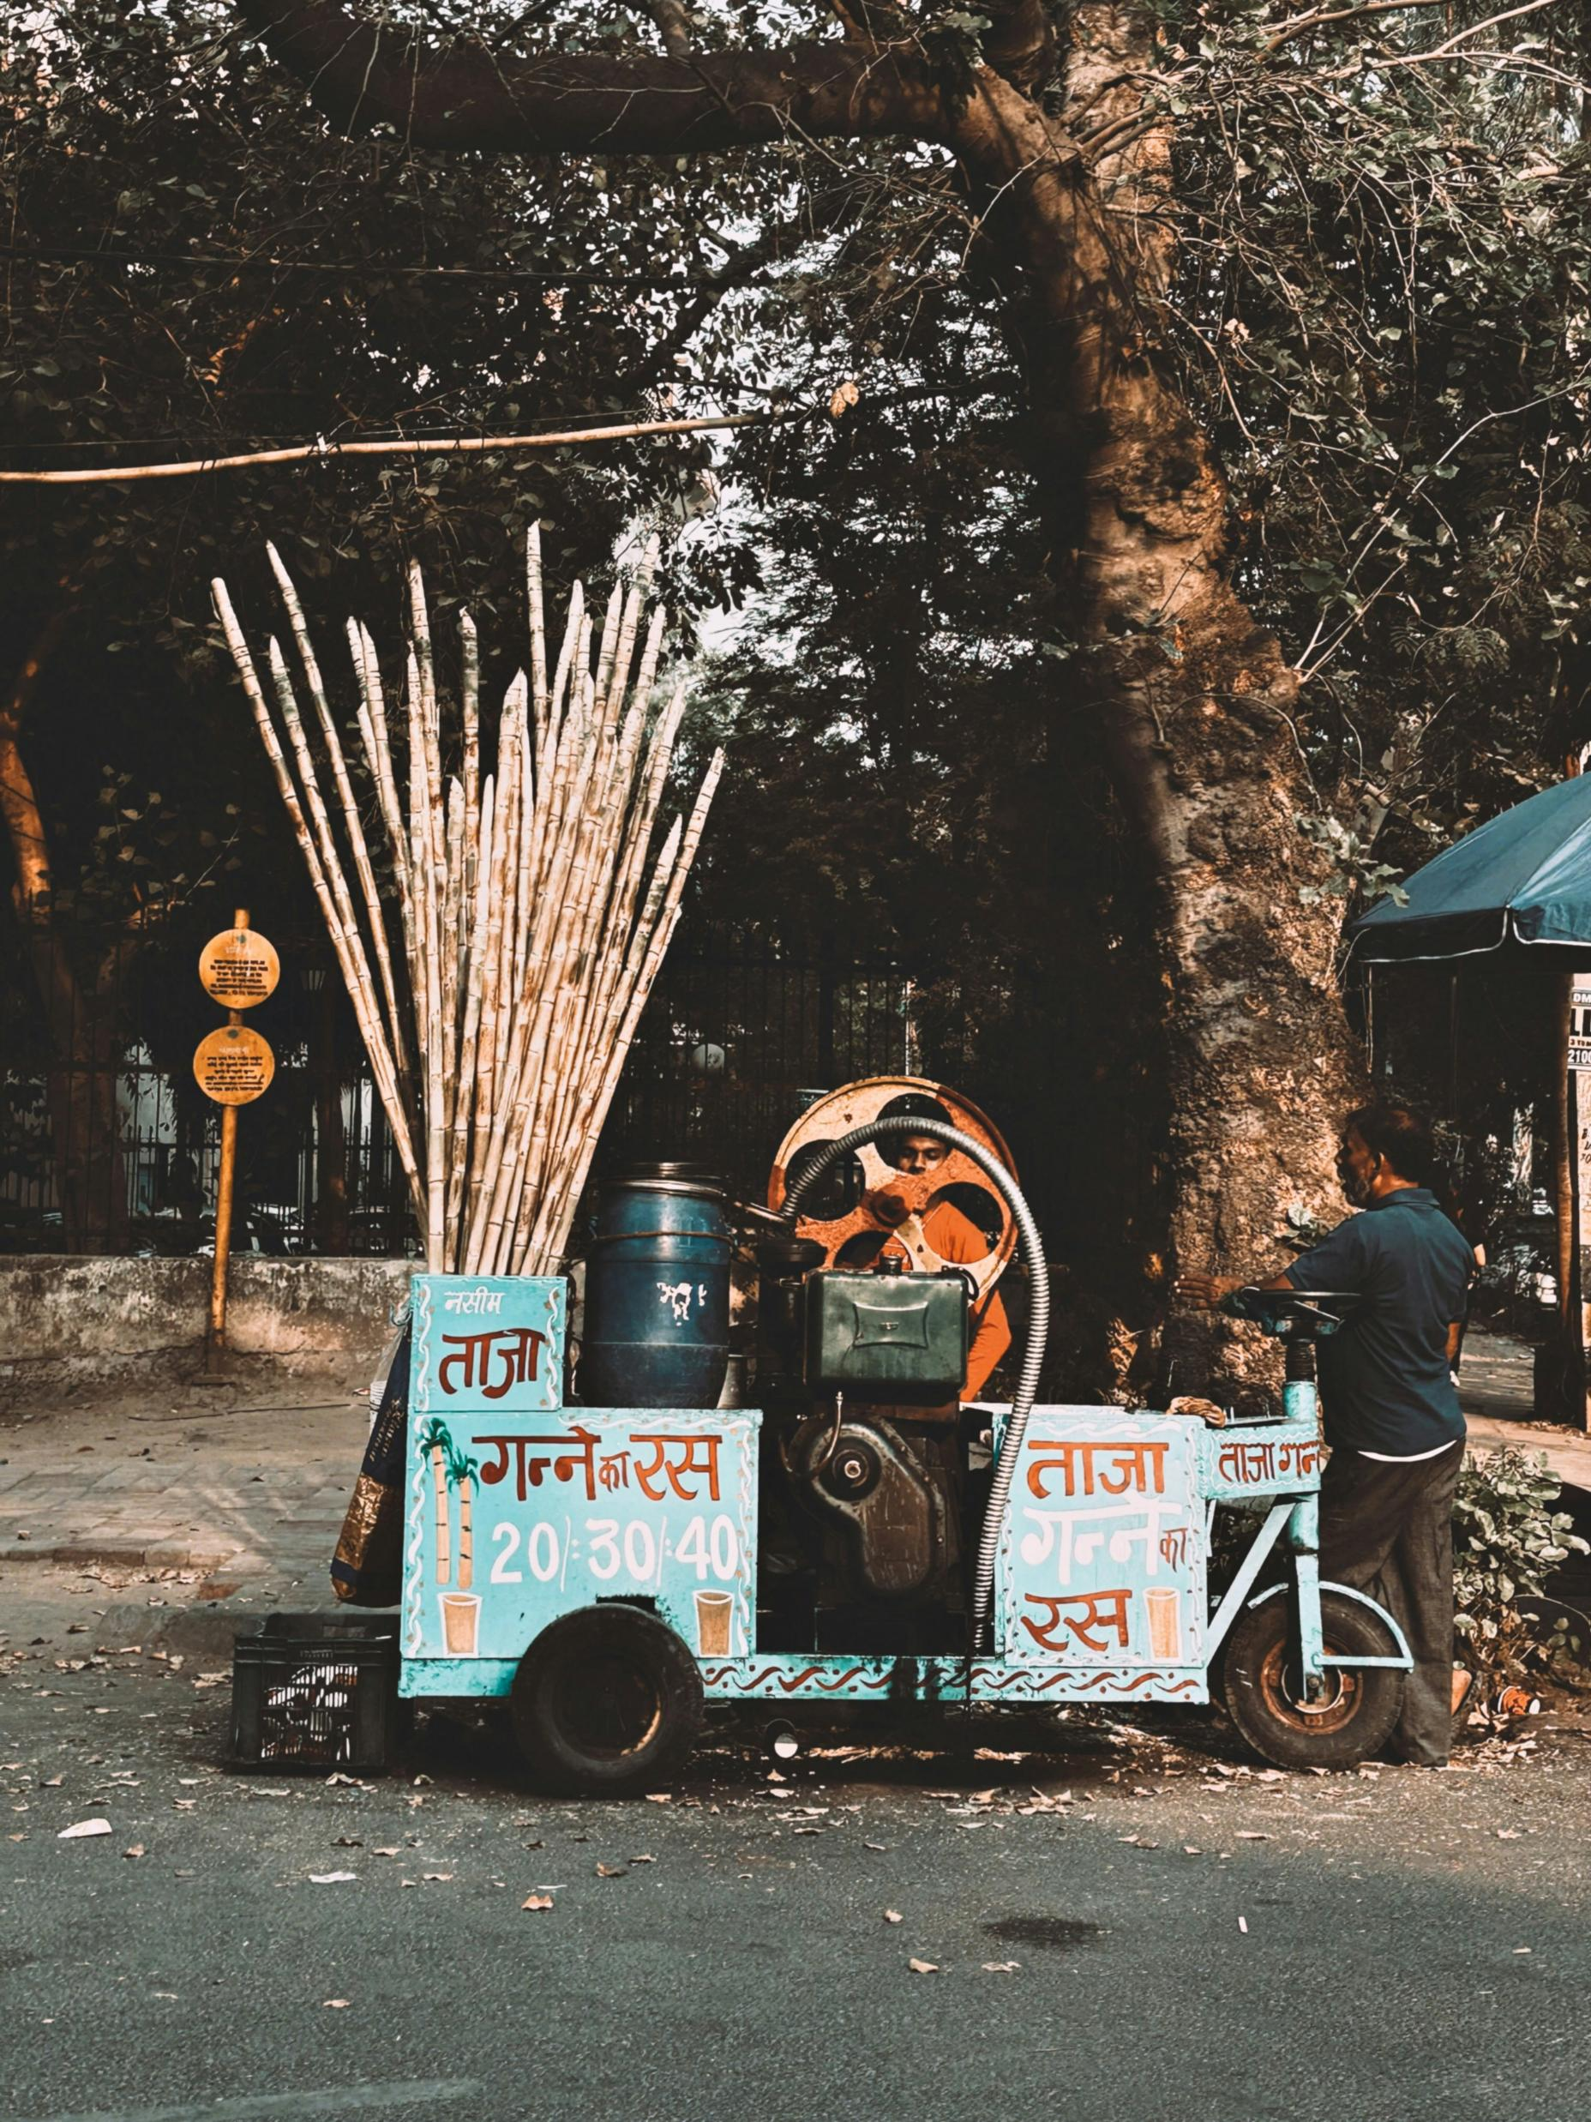
Sugar Cane
Photo: Victoria Priessneitz/ Unsplash
Photo: Saagar Takhi/Unsplash
Photo: Yaed/Unsplash
Fresh Sugar
Cane Juice
Making the Juice

Slide 11
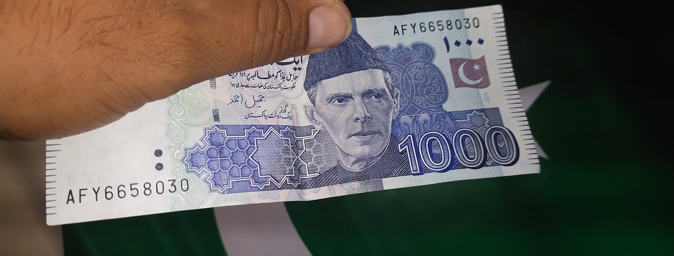
    Rupee

Slide 12
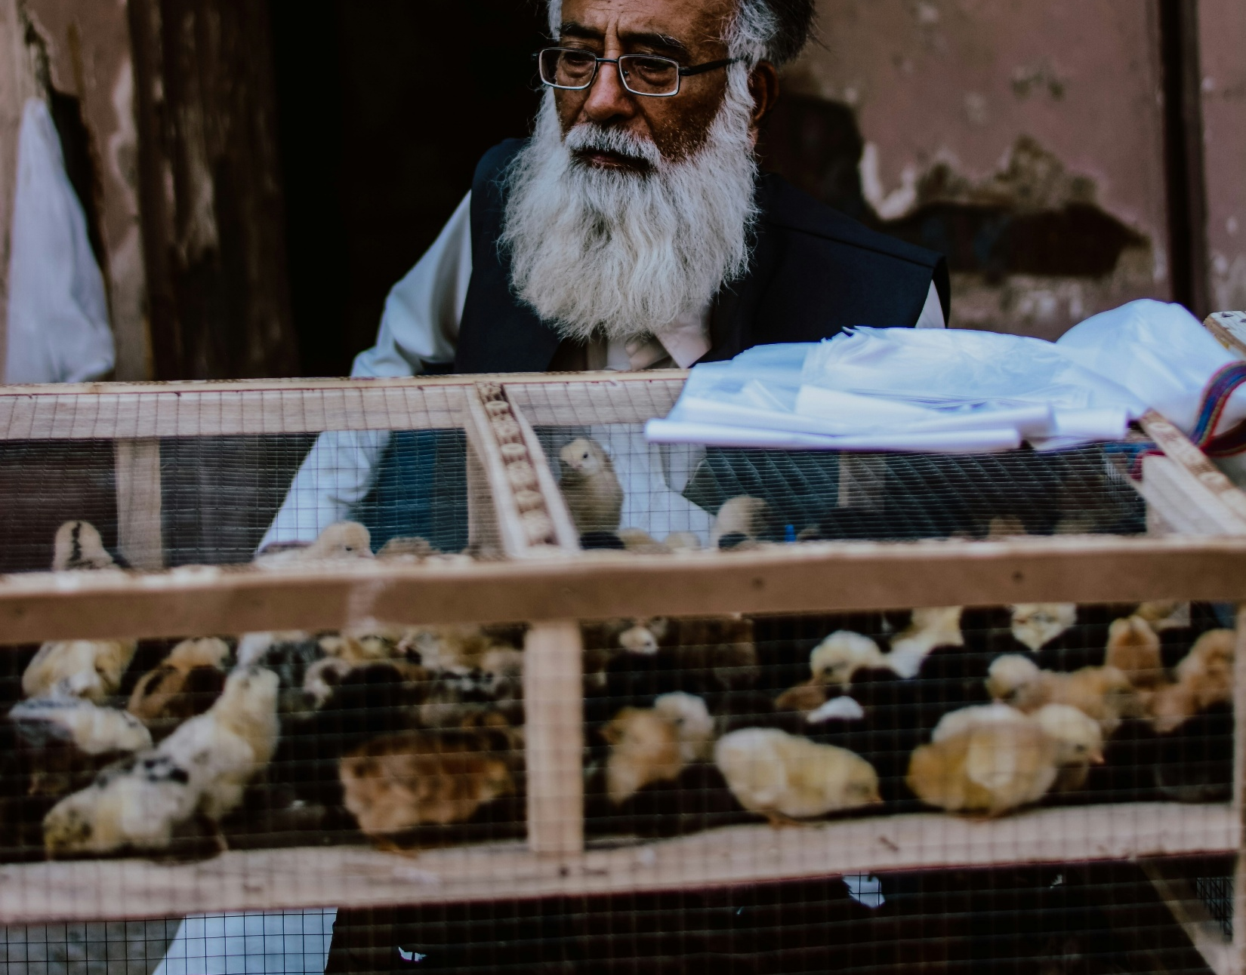
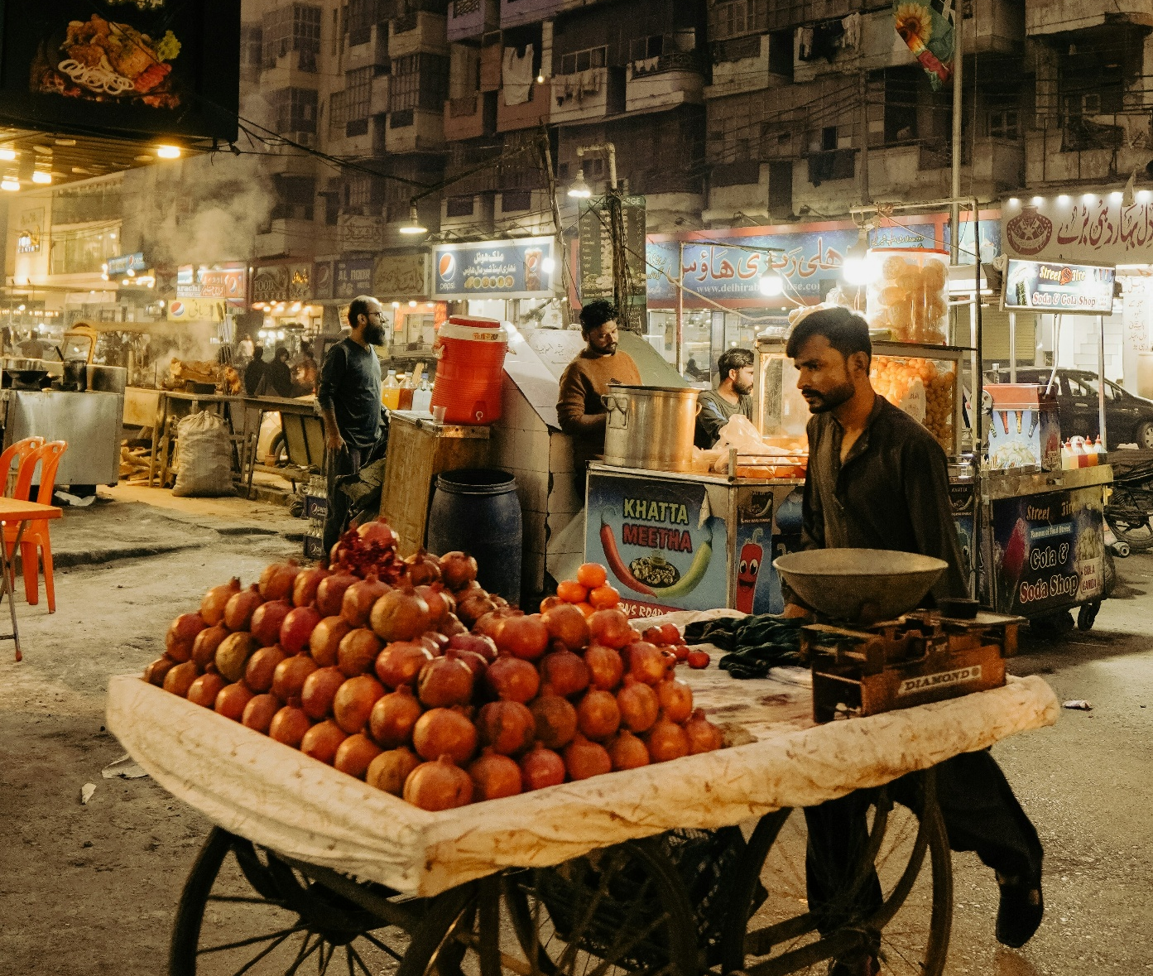
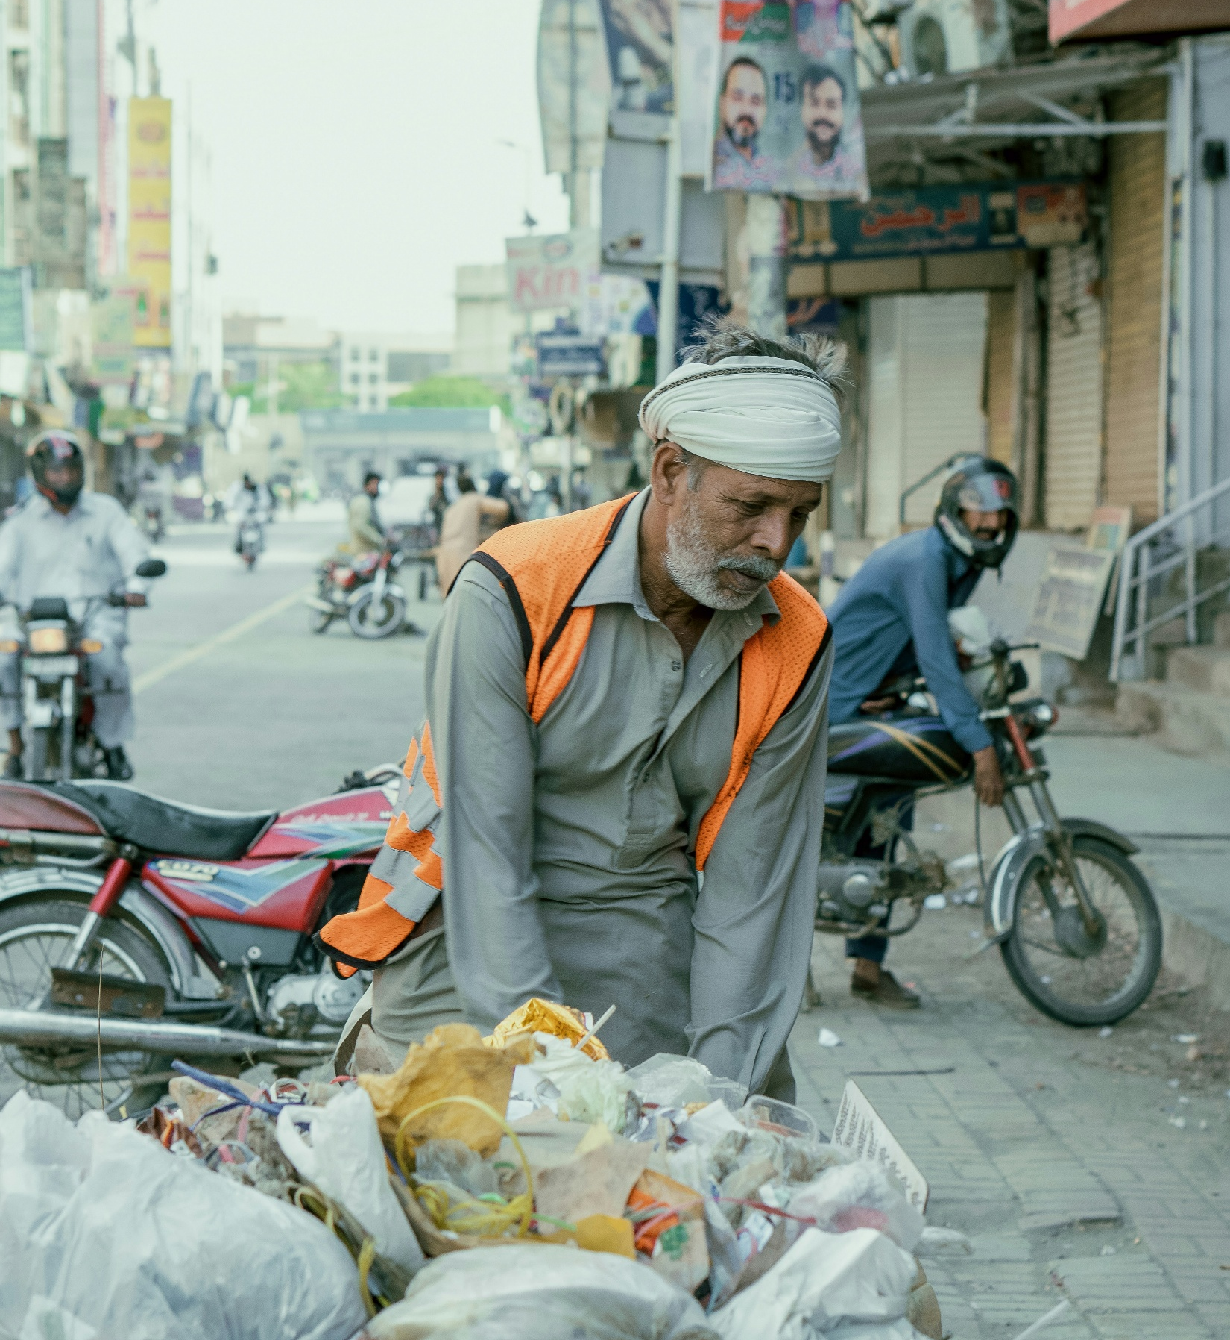
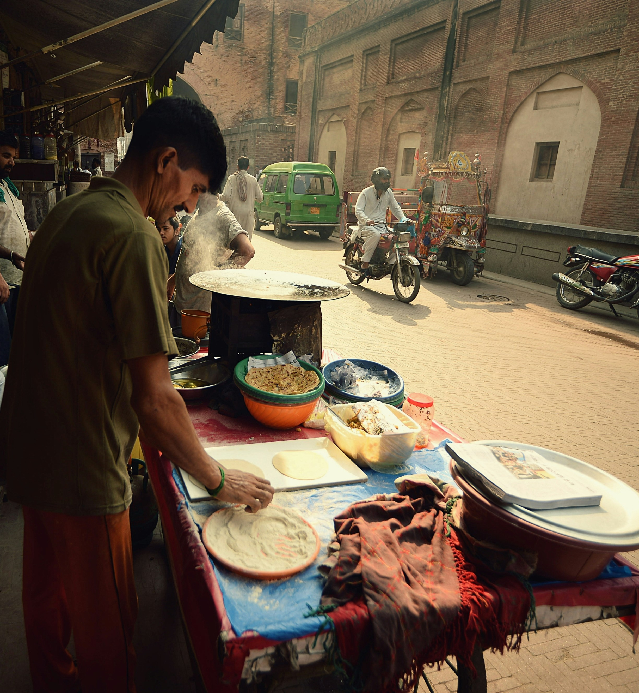
Life Around the City
Photo: Hassam Malik/Unsplash
Photo: Sarang Bhojwani/Unsplash
Photo: Muhammad Quaim/ Unsplash
Photo: Lumensoft Technologies/ Unsplash

Slide 13
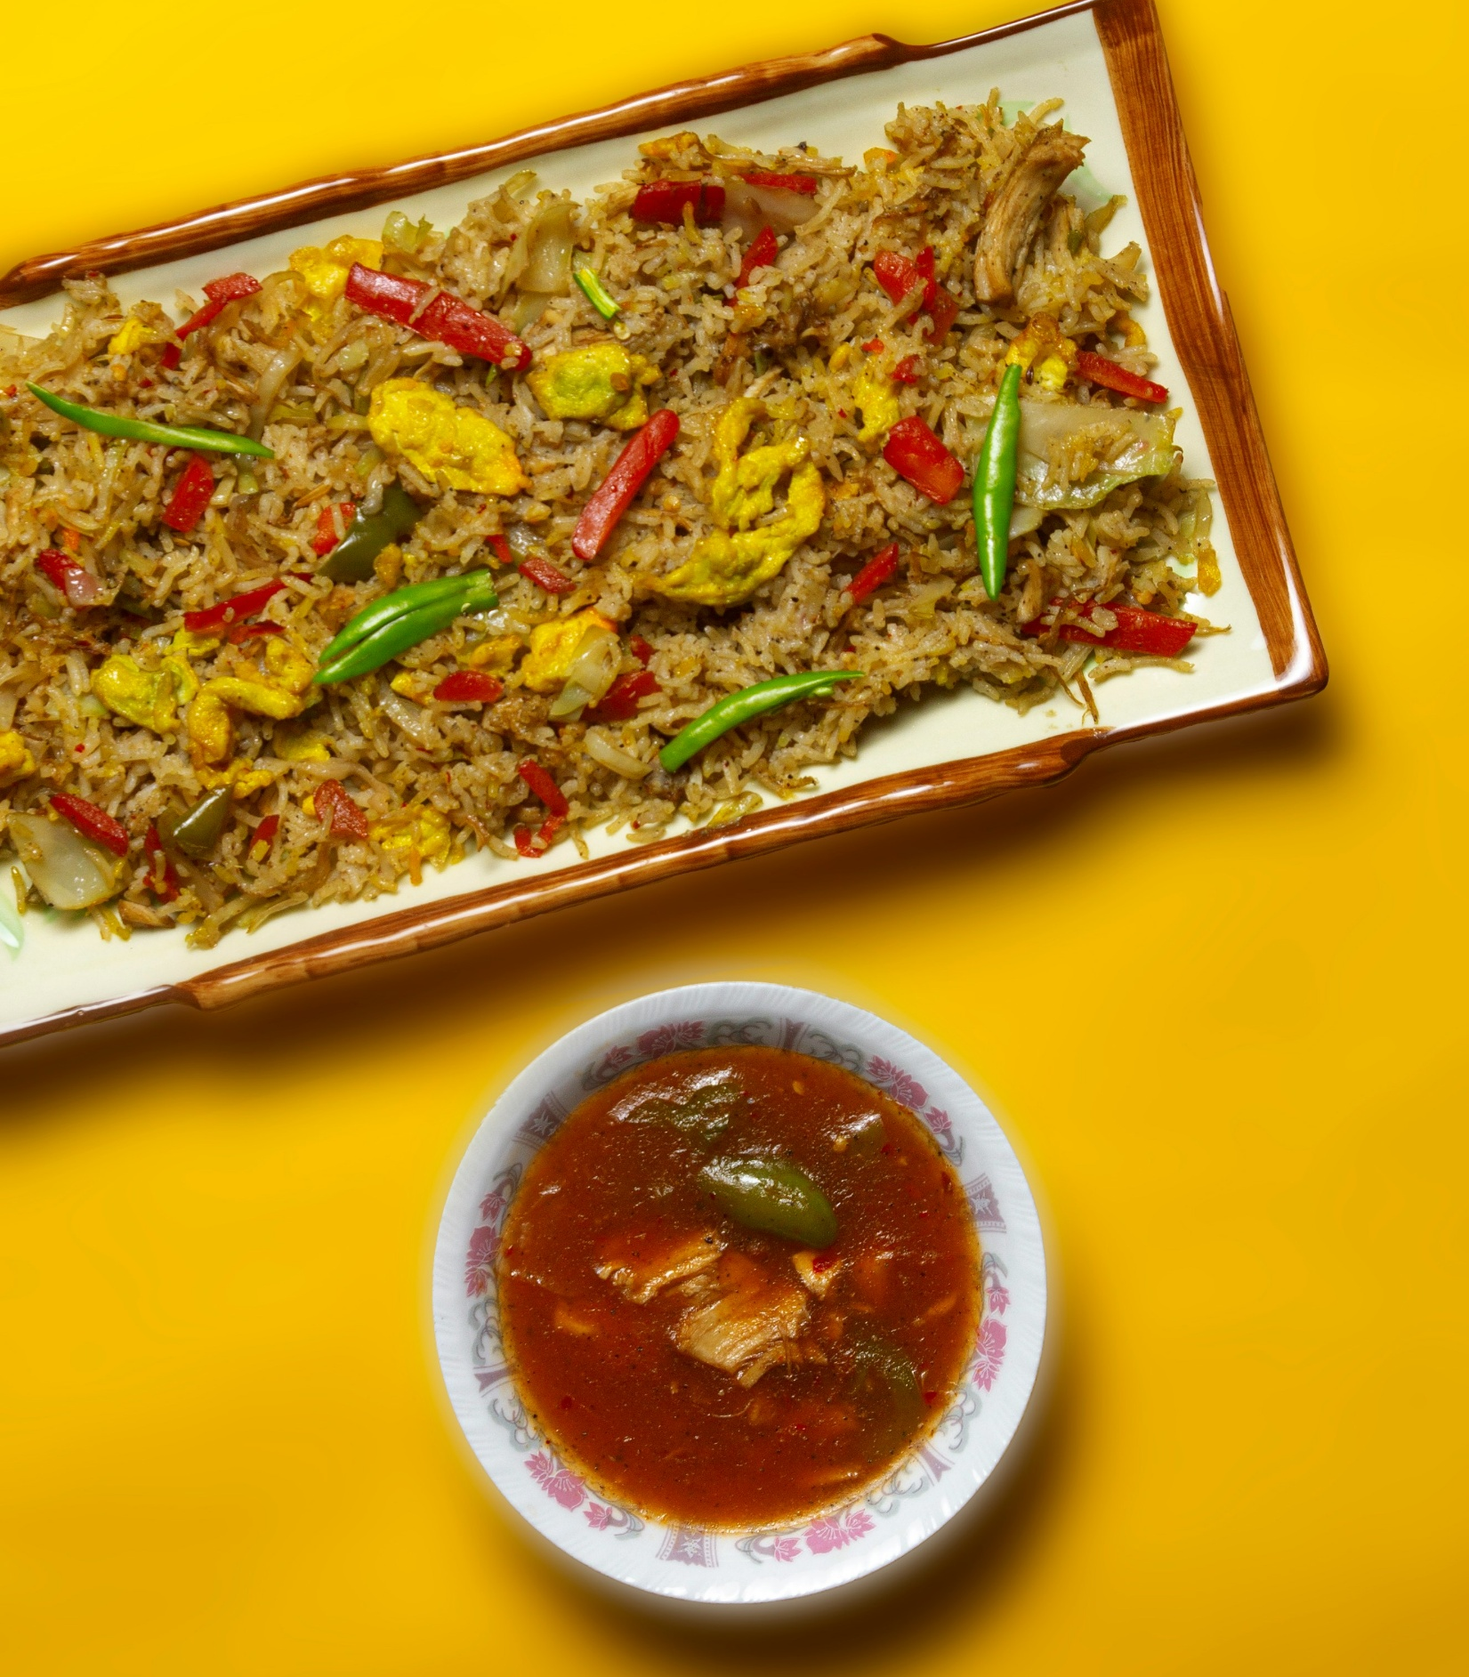
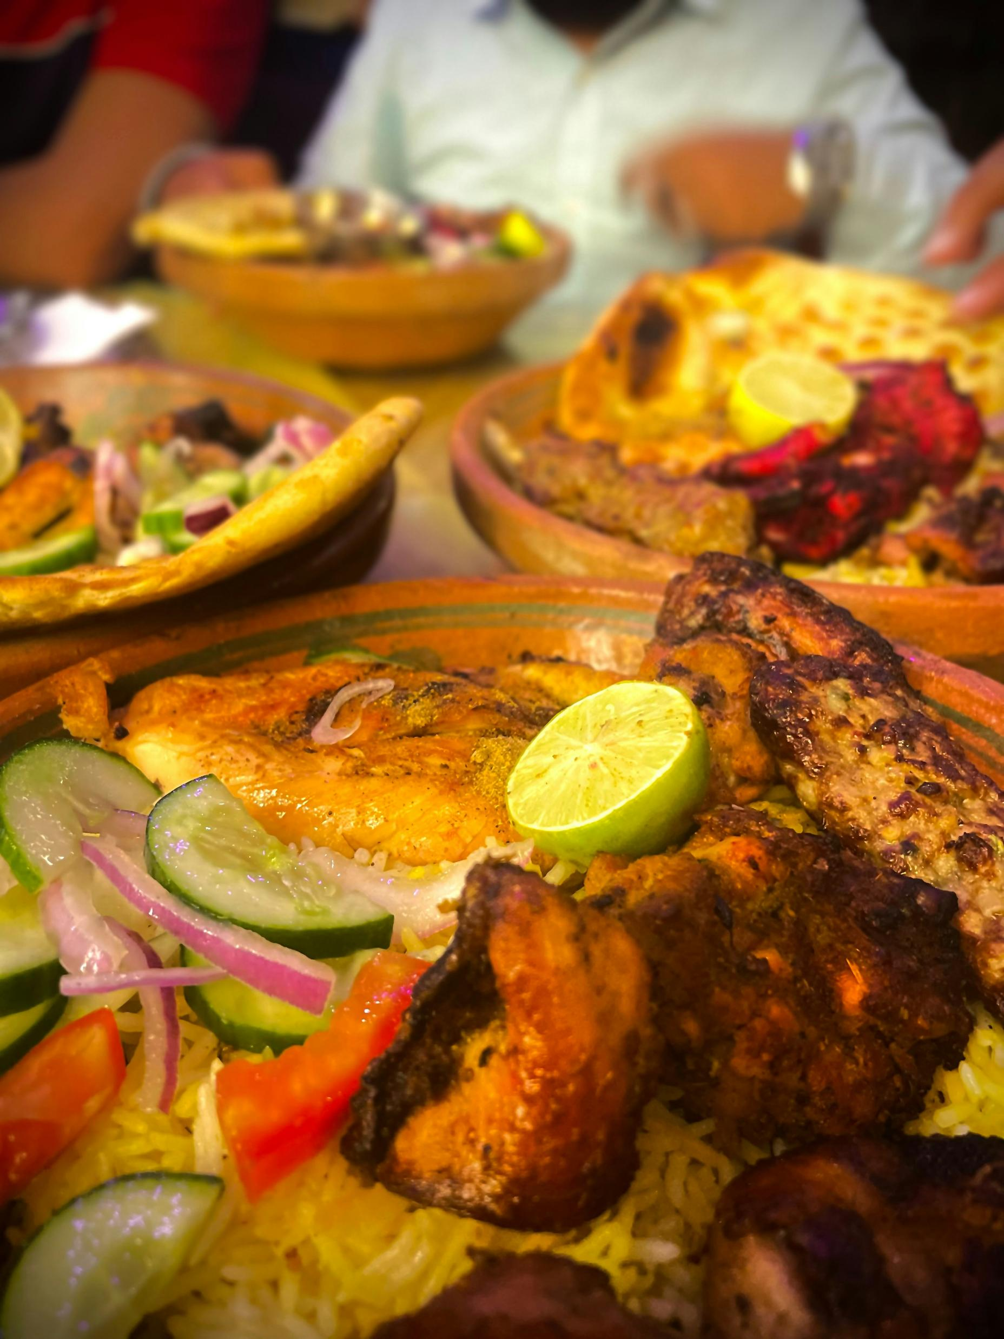
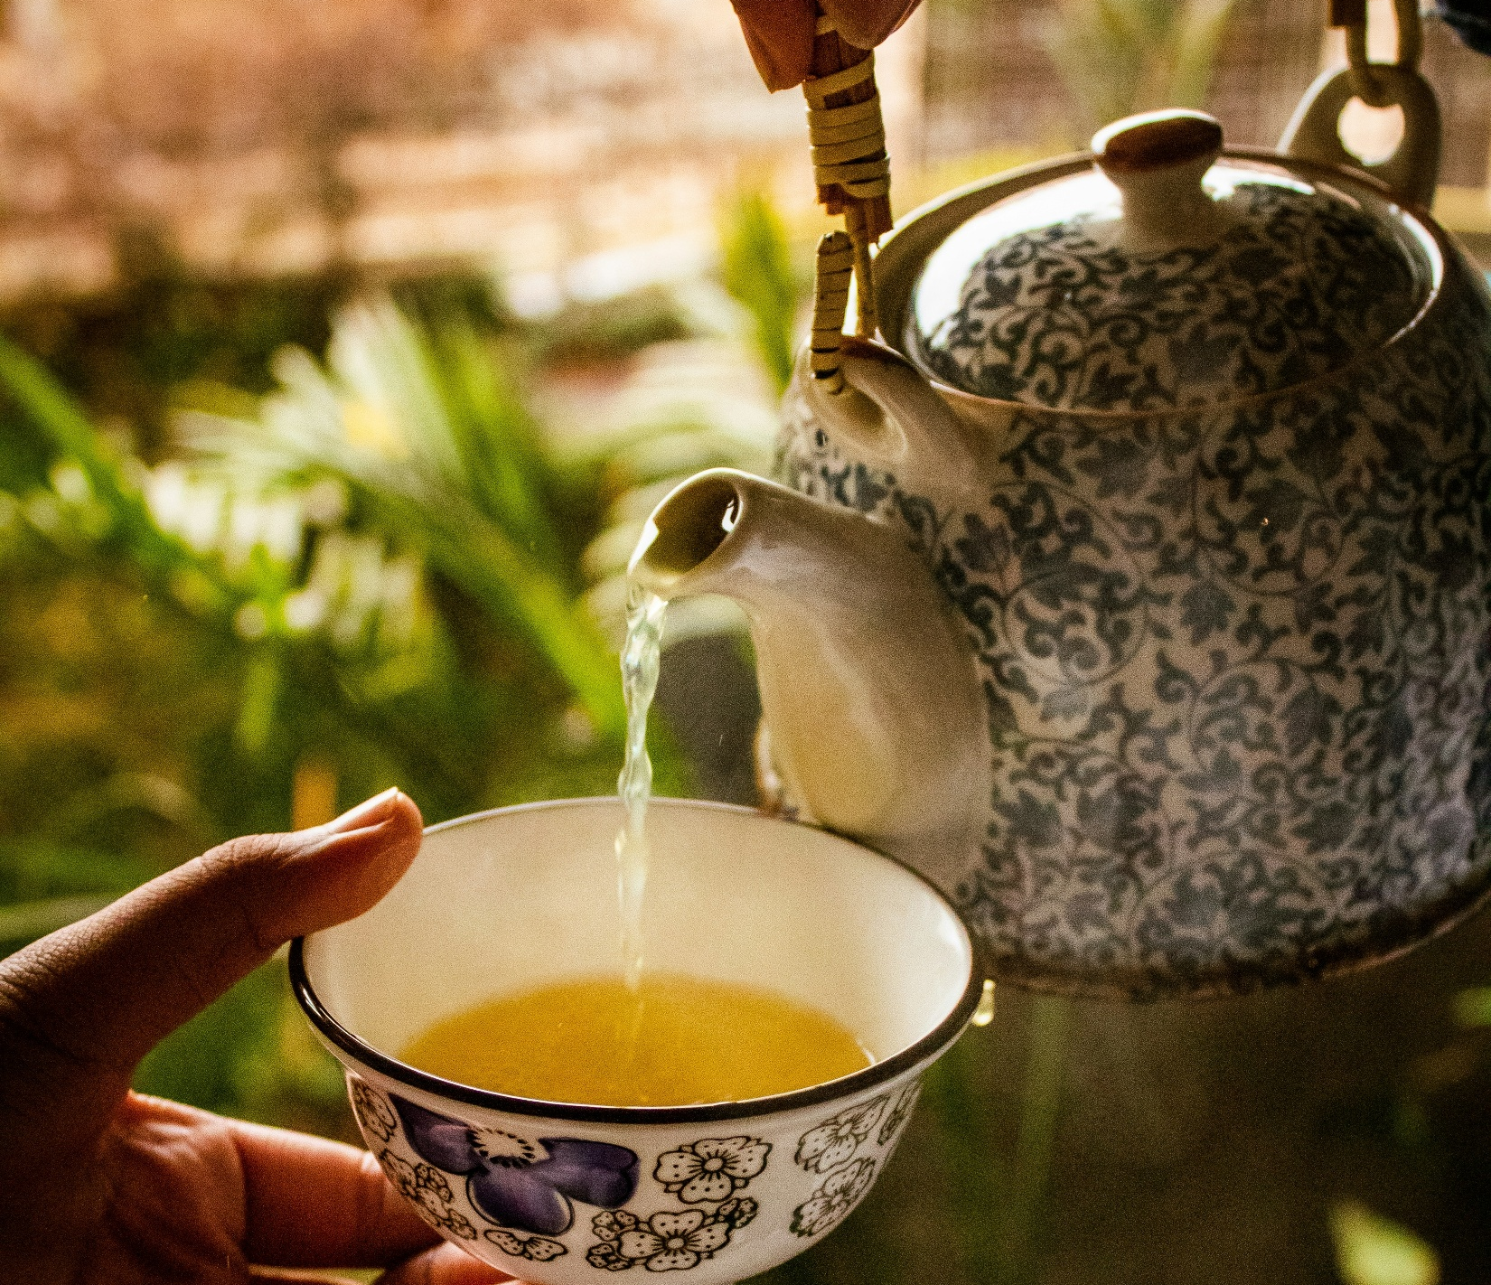
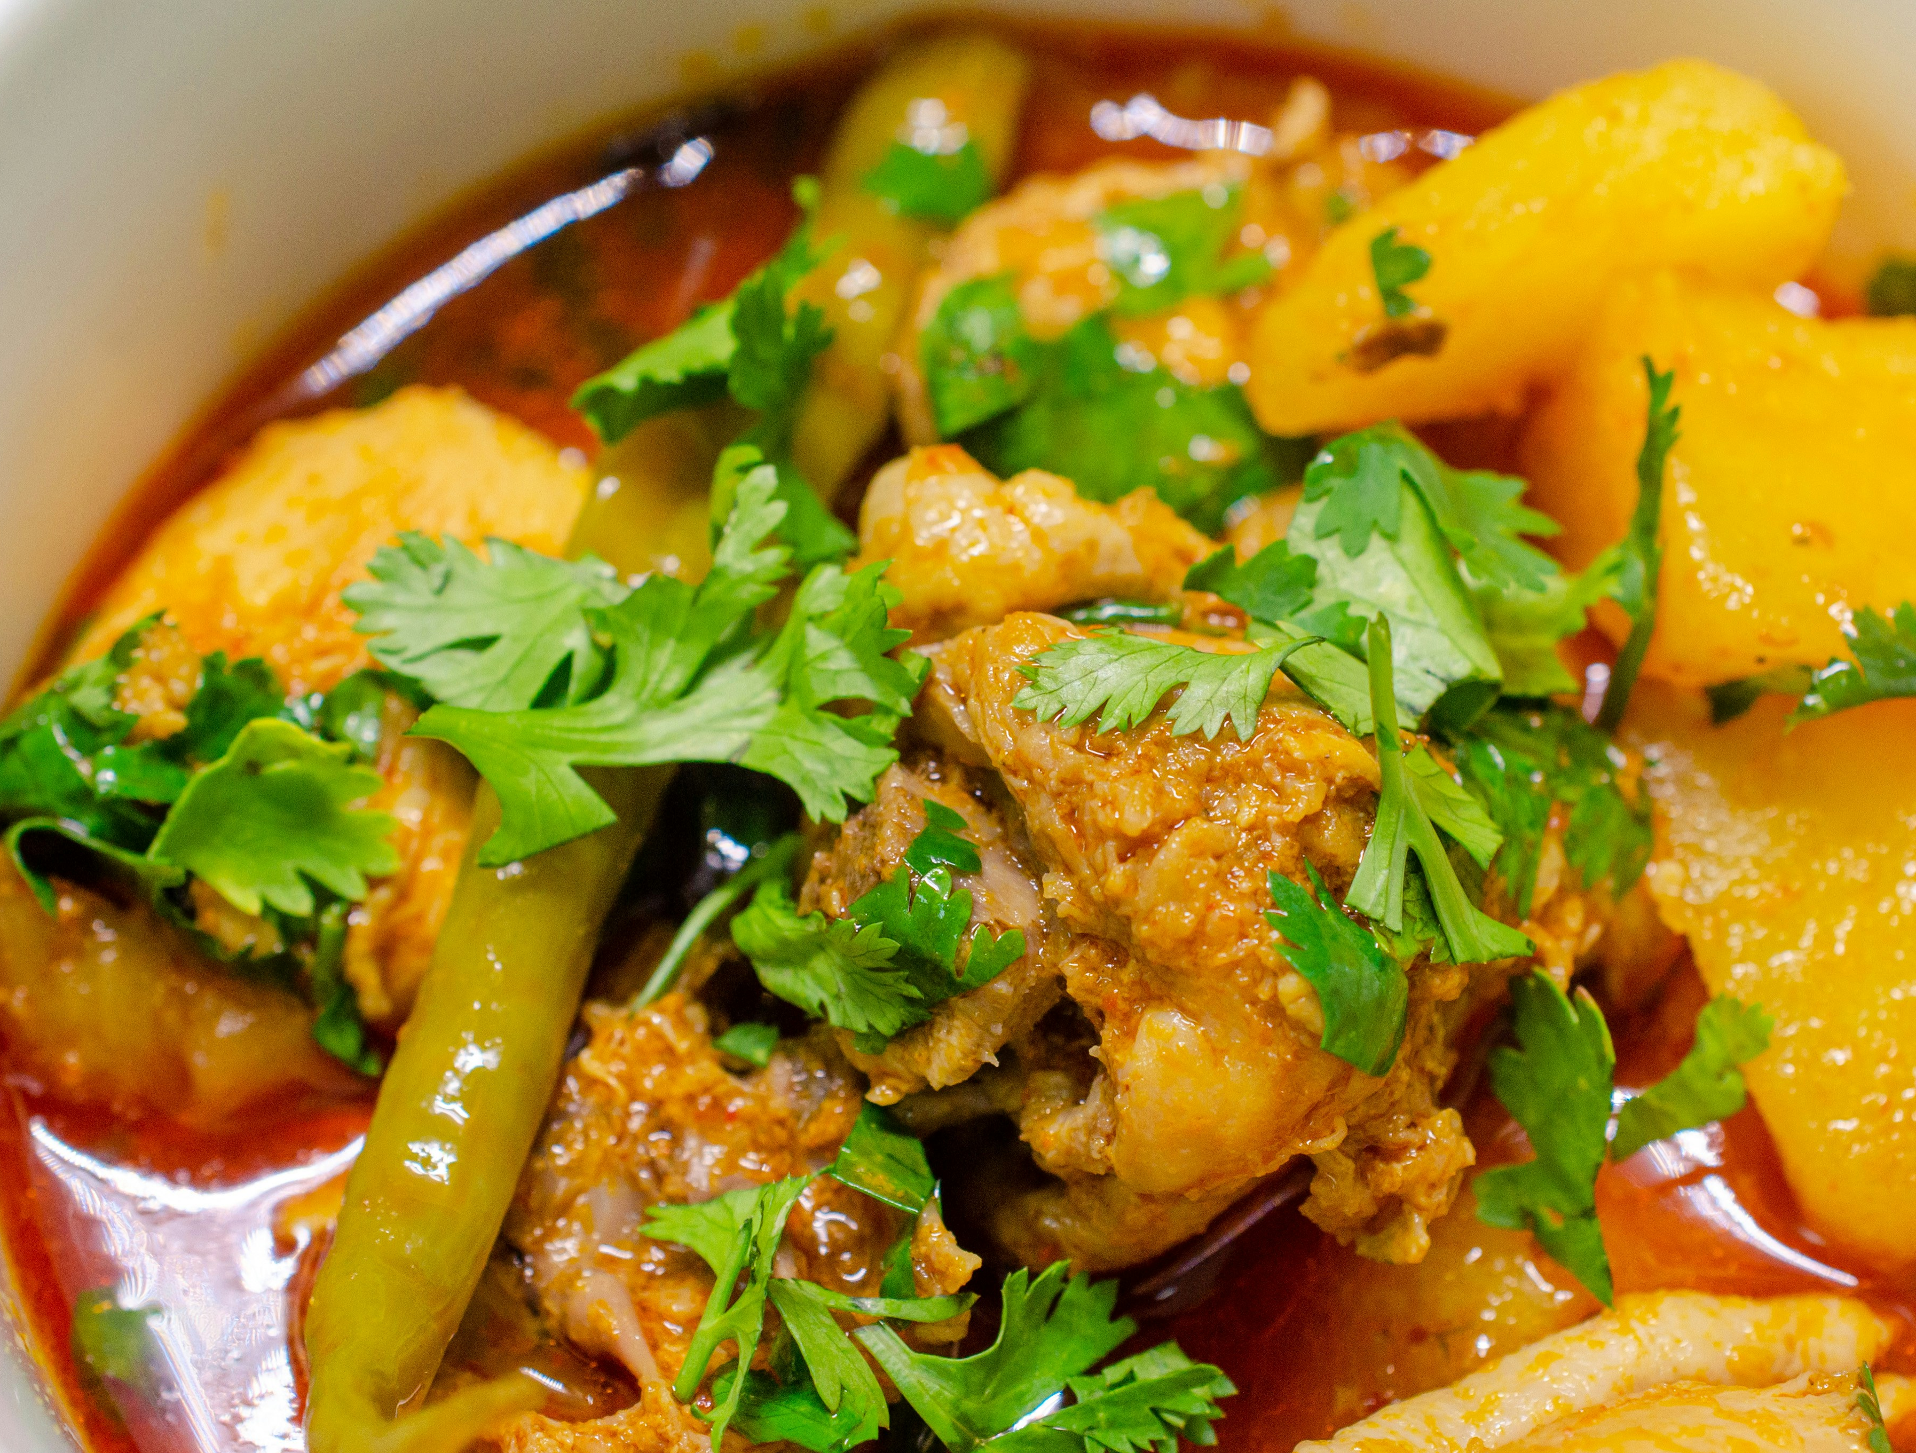
Delicious Food & Tea
Photo: Usman Yousaf/ Unsplash
Photo: Moez Mustafa/Unsplash
Photo: Dr. Muhammad Amer/ Unsplash
Photo: Muhammad Husan/Unsplash

Slide 14
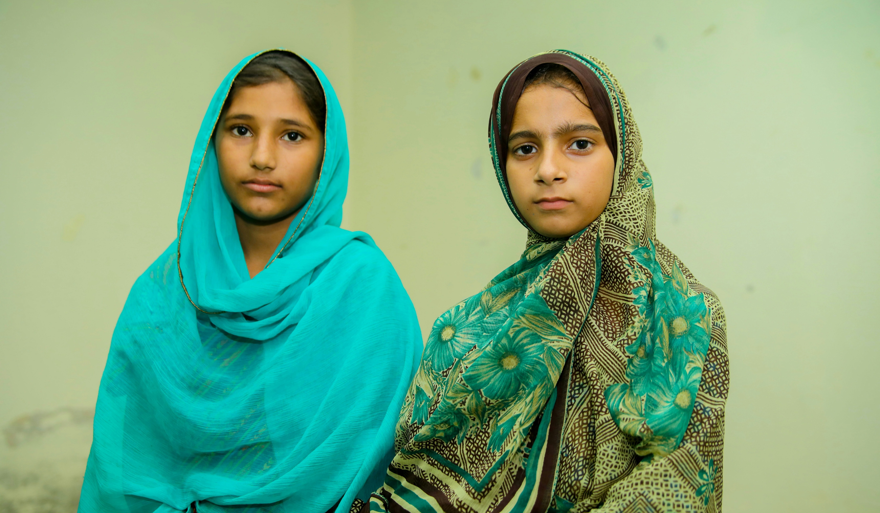
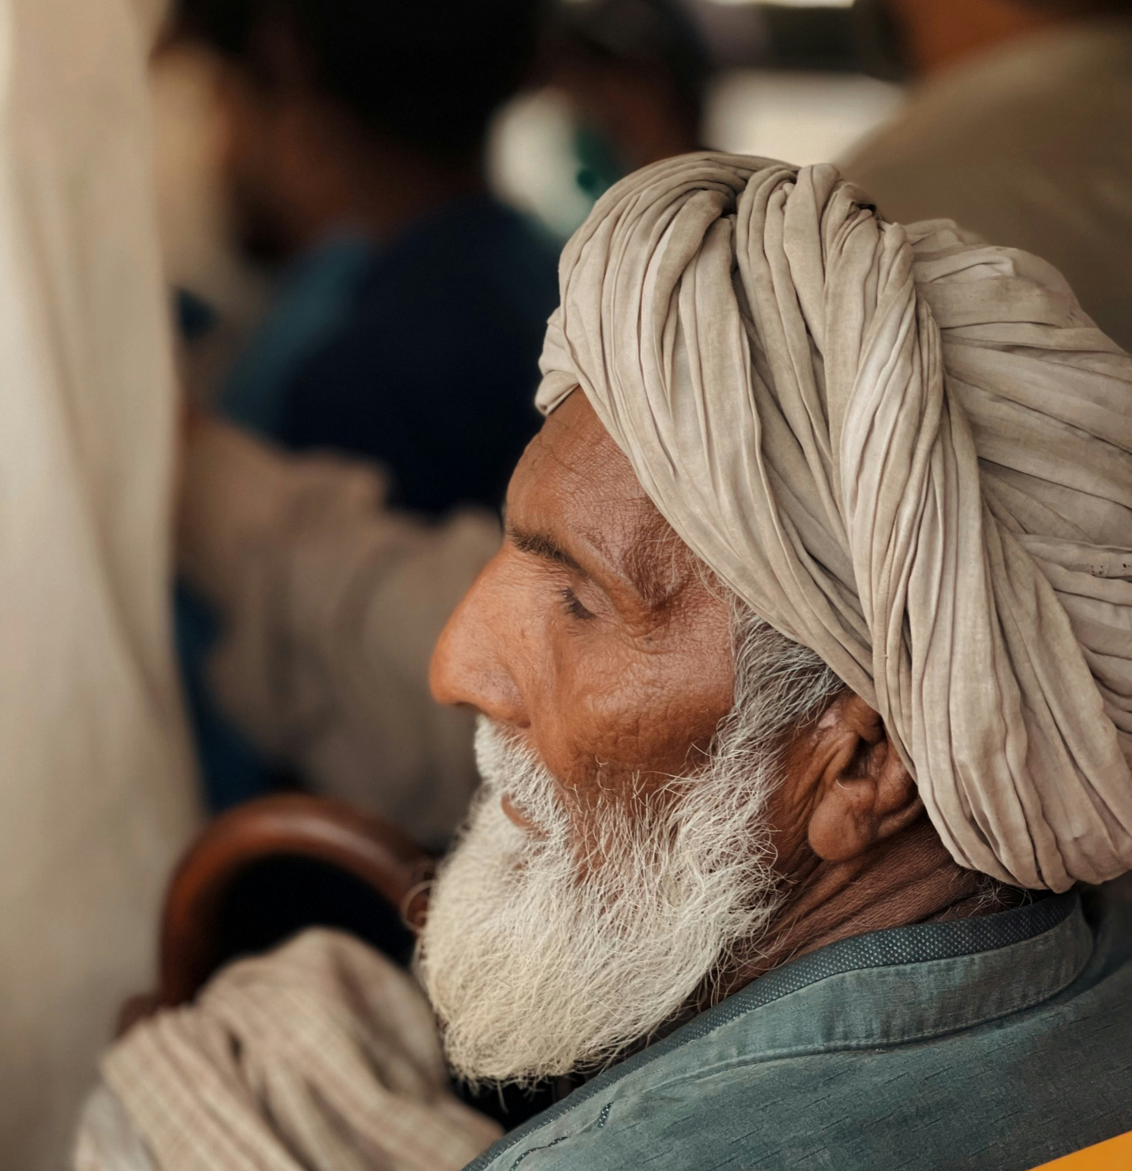
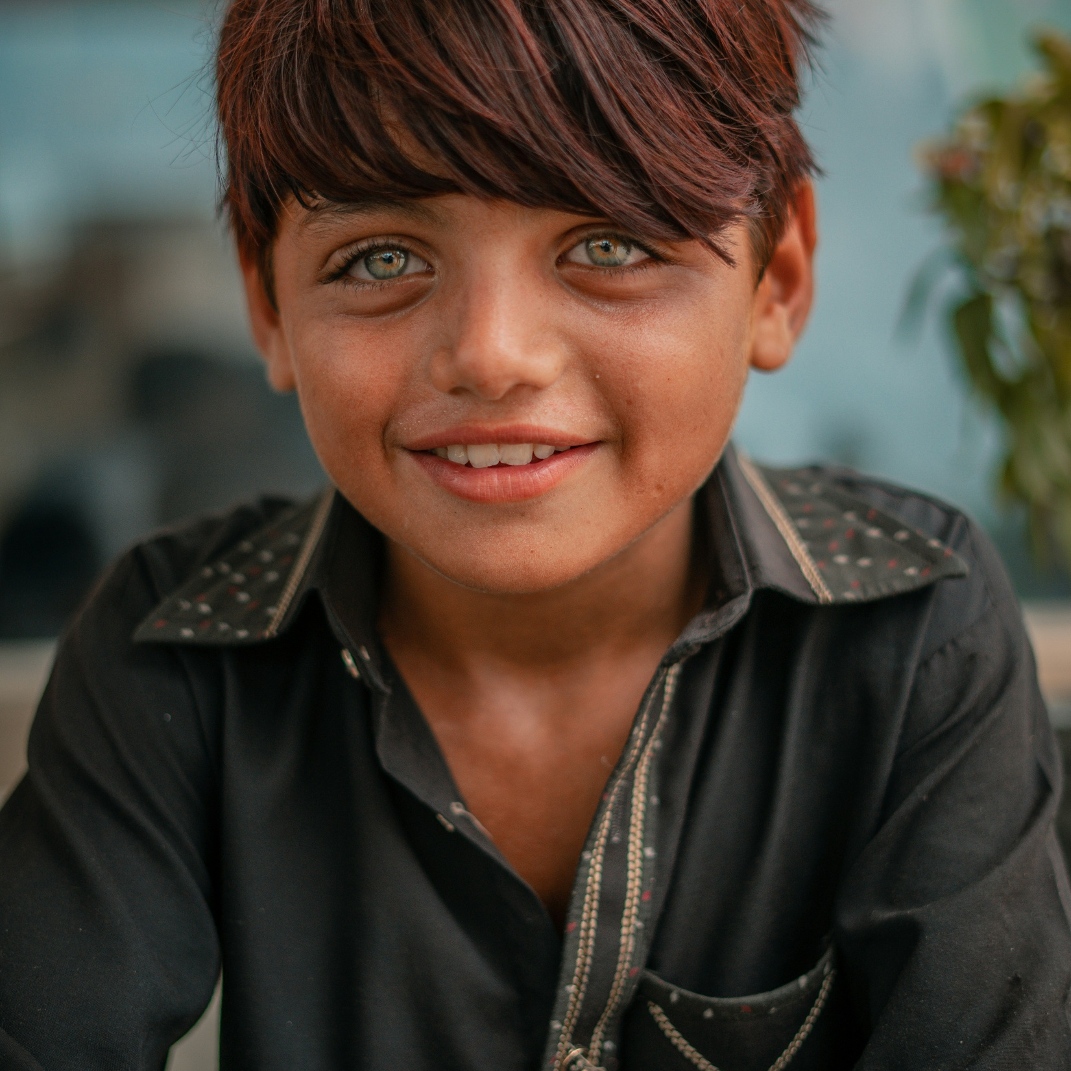
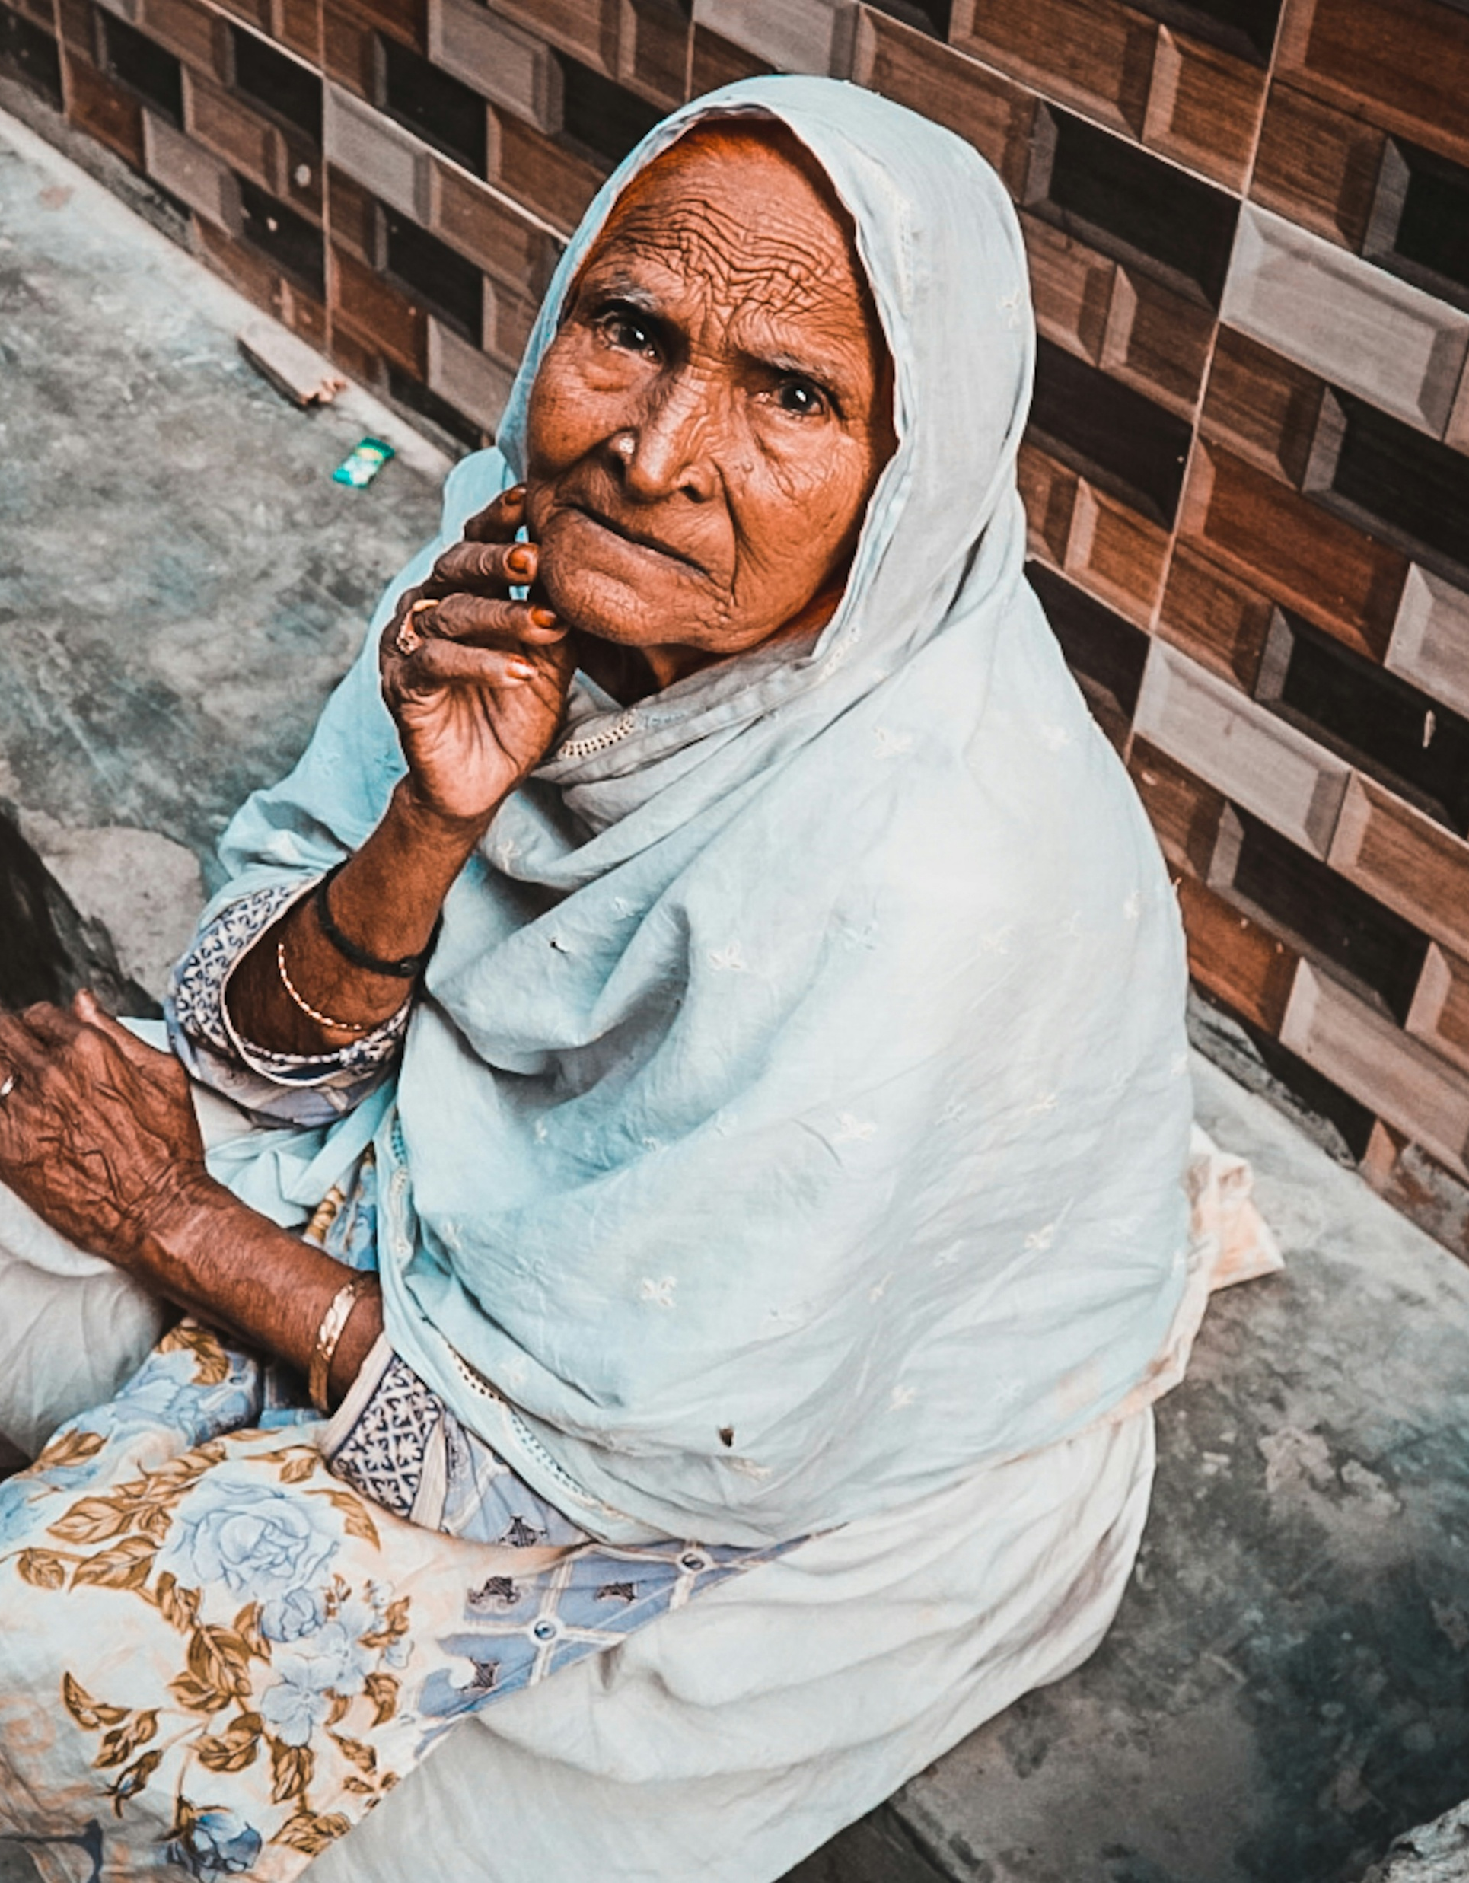
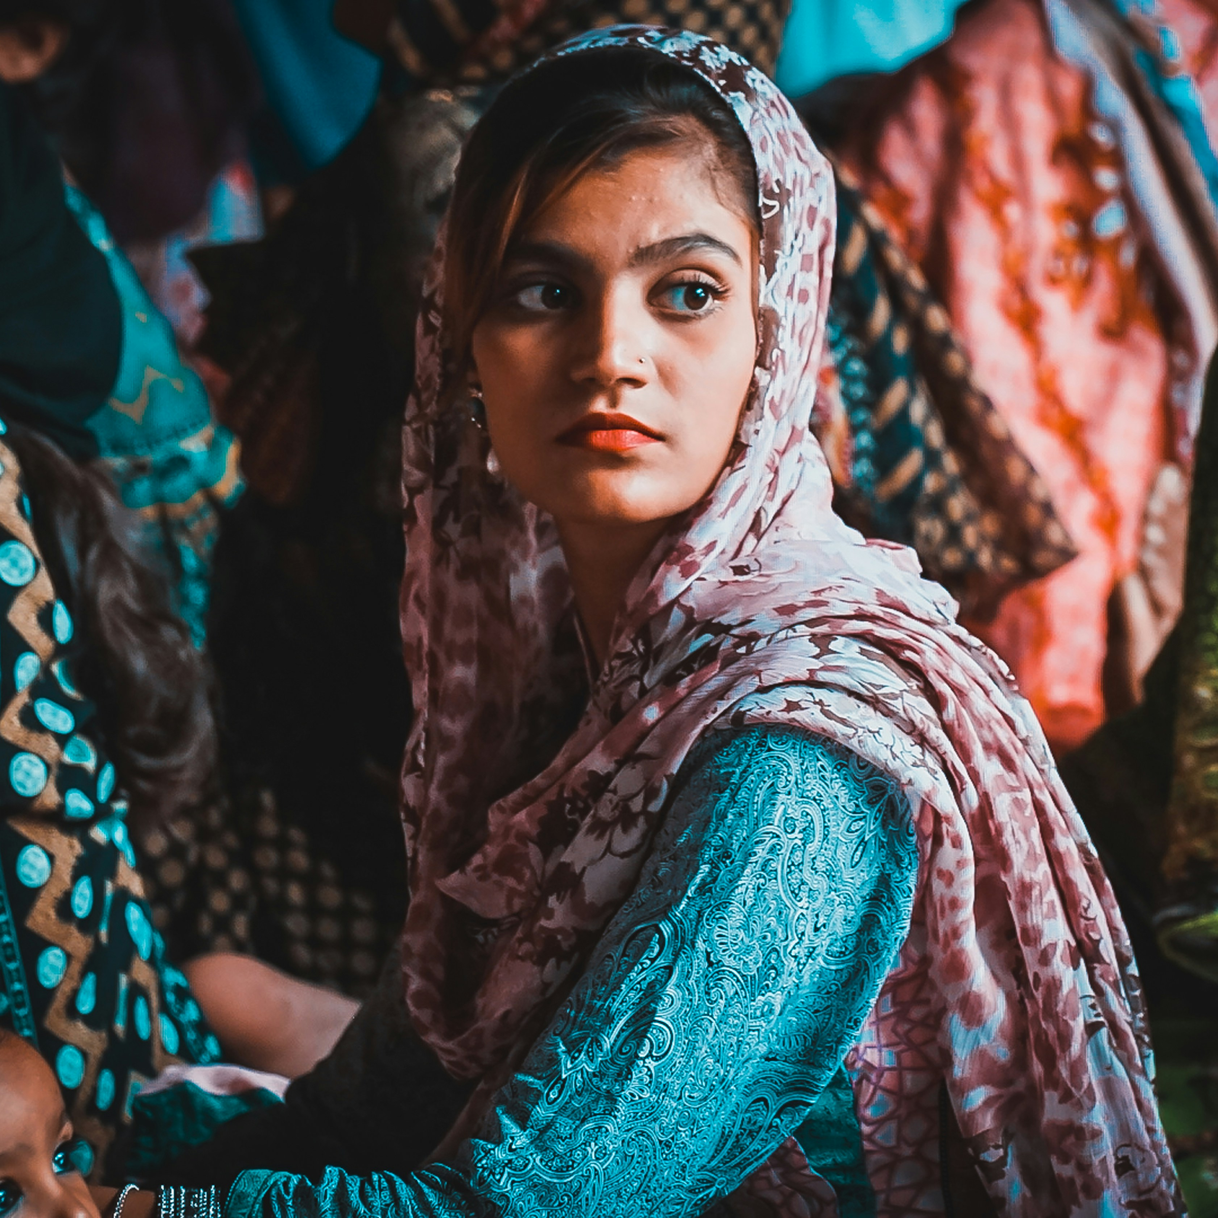
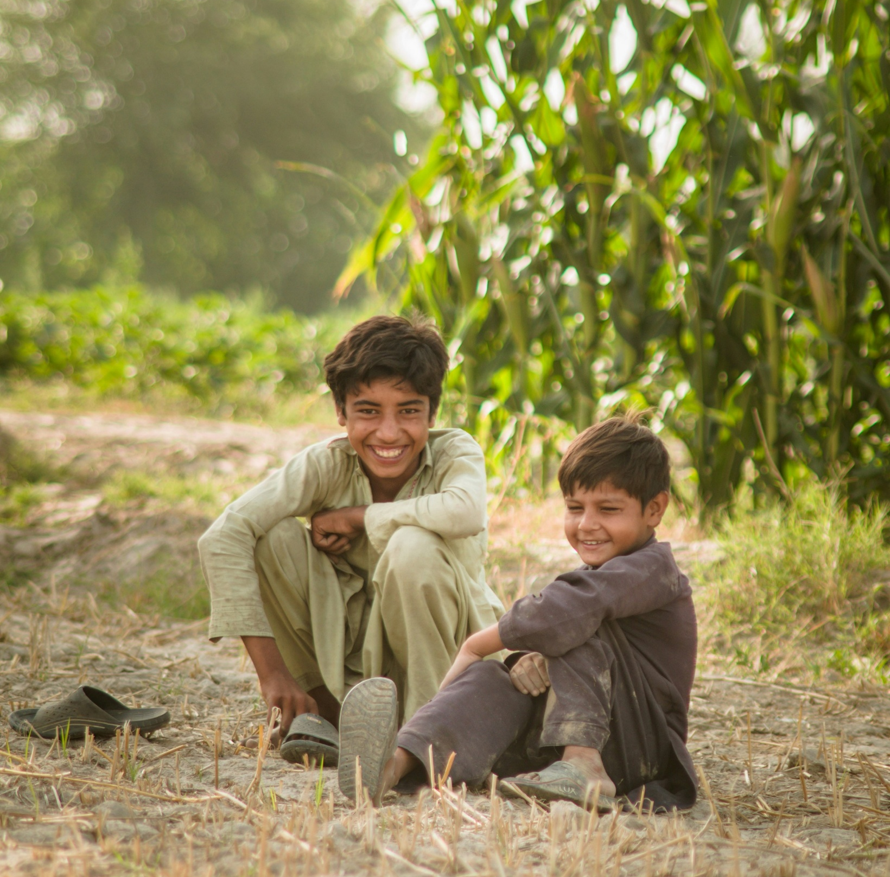
Beautiful People
Photo: Assaf Tanoli/ Unsplash
Photo: Shan A Rajpoot/ Unsplash
Photo: Muhammad Ahsan Raza/Unsplash
Photo: R D Smith/Unsplash
Photo: R D Smith/ Unsplash
Photo: Shazaf Zafar/Unsplash

Slide 15

Explore God’s Work

Slide 16
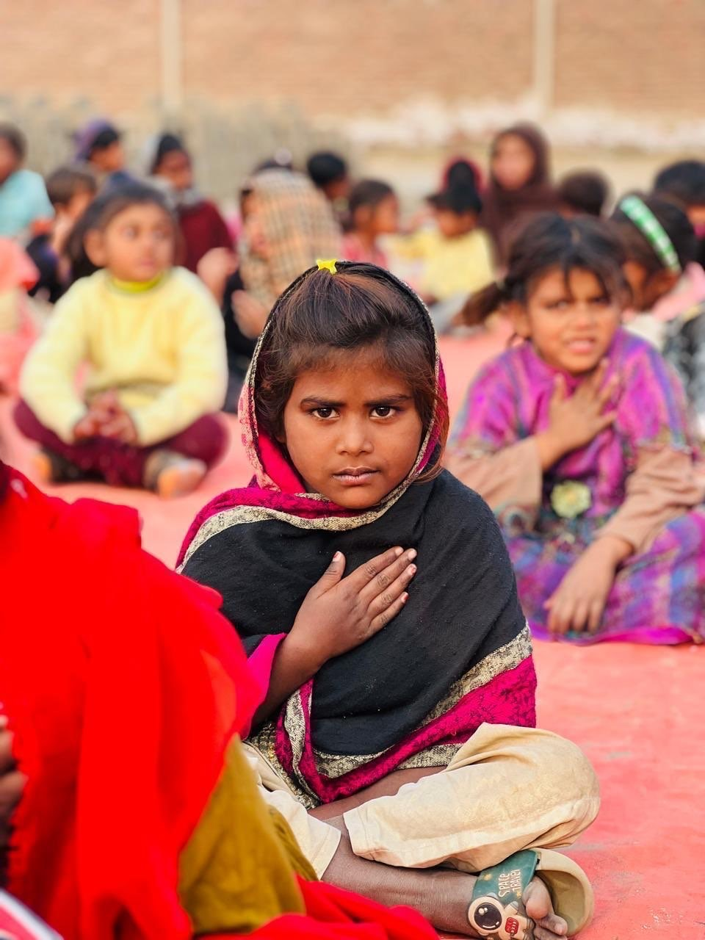
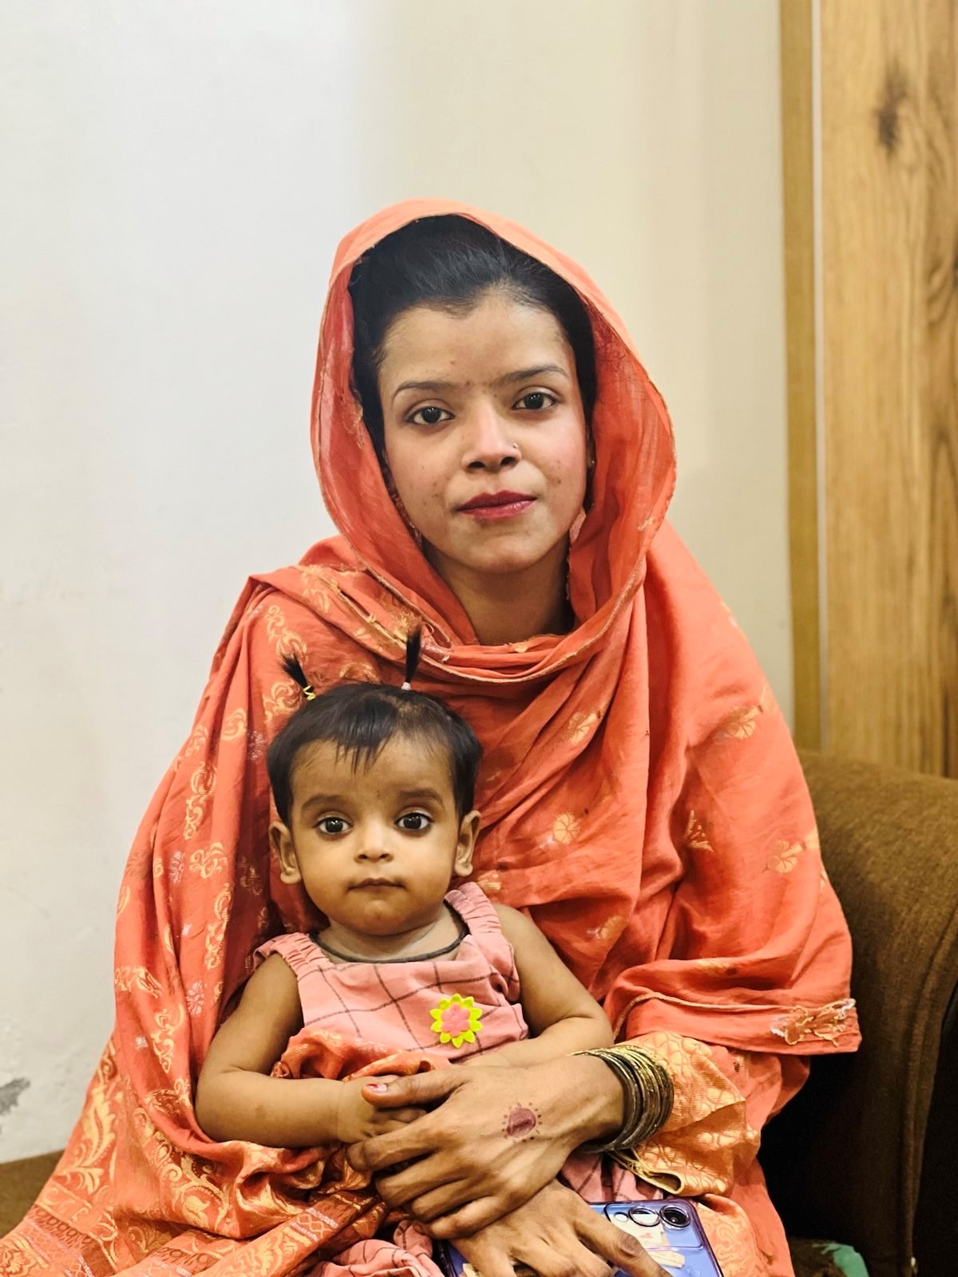
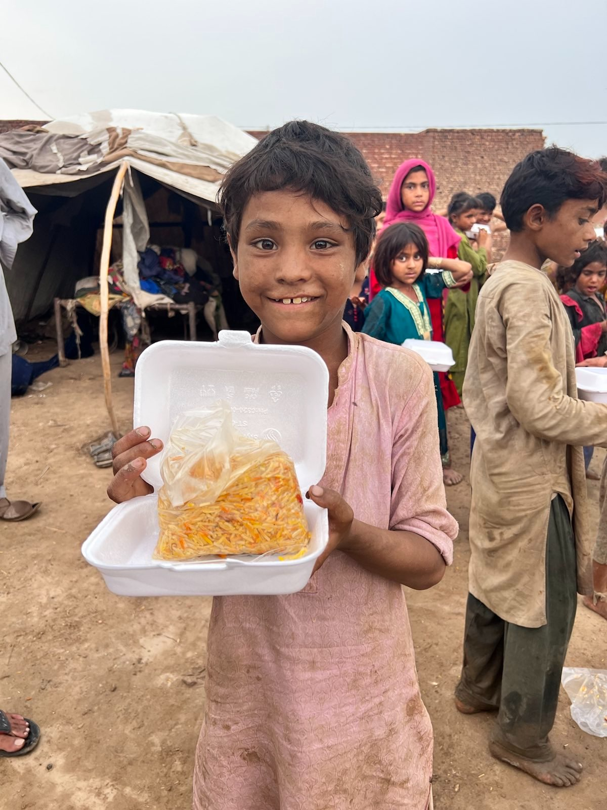
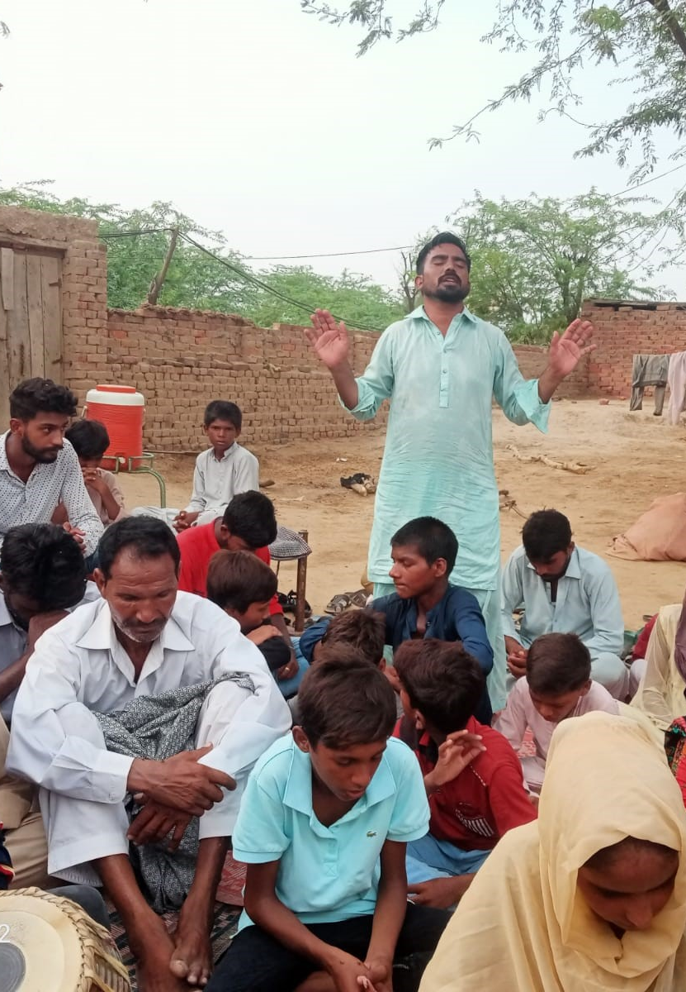
The Free Methodist Church in
Creative Access-PN
Ministry to Children
Ministry to Women
Caring for the Poor
Worship & Discipleship
Photos: FMWM -Asia

Slide 17

Adventure Story

Slide 18
From a Wrong Path to a New Life
Photo: Kevin Austin
Photo:Kevin Austin

Slide 19

People on Adventure

Slide 20
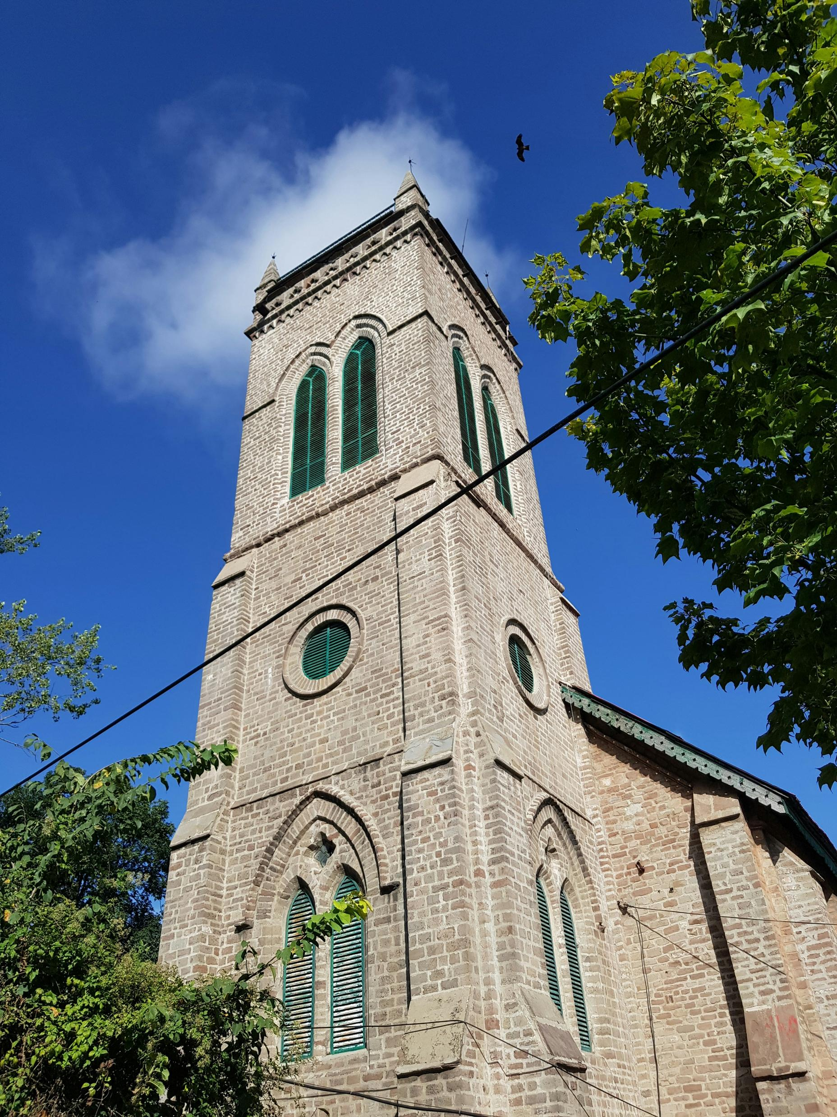
We can’t show pictures of the people on this adventure. Why?
Because we want to keep them safe from anyone who might try to hurt them or make life hard for them. But you can still help – by praying for them!
“Dear God, thank You for Pastor ‘M,’ Amber and Michael. Please keep them safe and help their churches grow.
Give them courage to keep telling other people about
the love of Jesus. Amen.”

Slide 21

Adventures in Culture

Slide 22
Language
Peace be upon you.
As-Salam-o-Alaikum
Thank you
Shu-kri-ya
Goodbye/May God protect you
Khuda Hafiz
And peace be upon you too.
Wa Alaikum Assalam

Slide 23
Yesu Mujh Se Pyar Karta Hai
(Urdu Words by Microsoft Copilot)
MUSIC
Verse 1
Yesu mujh se pyaar karta hai,
Yeh-soo moojh seh pyaar kur-ta hai
Dil mein hamesha meray rehta hai.
Dil mayn ha-may-sha may-ray reh-ta hai
Jab mein darr jaaun, woh sambhalta hai,
Jub mayn durr jaa-oon, woh sum-bhal-ta hai
Har din mera haath pakarta hai.
Har din may-ra haath puh-kur-ta hai

Slide 24
Chorus
Haan, Yesu mujh se pyaar karta hai,
Haan, Yeh-soo moojh seh pyaar kur-ta hai
Haan, Yesu mujh se pyaar karta hai,
Haan, Yeh-soo moojh seh pyaar kur-ta hai
Haan, Yesu mujh se pyaar karta hai,
Haan, Yeh-soo moojh seh pyaar kur-ta hai
Woh mera nijaat dahinda hai.
Woh may-ra ni-jaat da-hin-da hai

Slide 25
Verse 2
Jab mein kamzor hota hoon, woh mazboot hai,
Jub mayn kum-zor ho-ta hoon, woh muz-boot hai
Rasta dikhata, mera muhafiz hai.
Ra-sta di-kha-ta, may-ra moo-ha-fiz hai
Us ki muhabbat kabhi nahi mitti,
Us kee moo-hub-but cub-hee nuh-hee mit-tee
Mere dil mein roshni basti hai.
May-ray dil mayn rosh-nee bus-tee hai

Slide 26
Chorus
Haan, Yesu mujh se pyaar karta hai,
Haan, Yeh-soo moojh seh pyaar kur-ta hai
Haan, Yesu mujh se pyaar karta hai,
Haan, Yeh-soo moojh seh pyaar kur-ta hai
Haan, Yesu mujh se pyaar karta hai,
Haan, Yeh-soo moojh seh pyaar kur-ta hai
Woh mera nijaat dahinda hai.
Woh may-ra ni-jaat da-hin-da hai

