Slide 1

Global Adventures
Spain

Slide 2
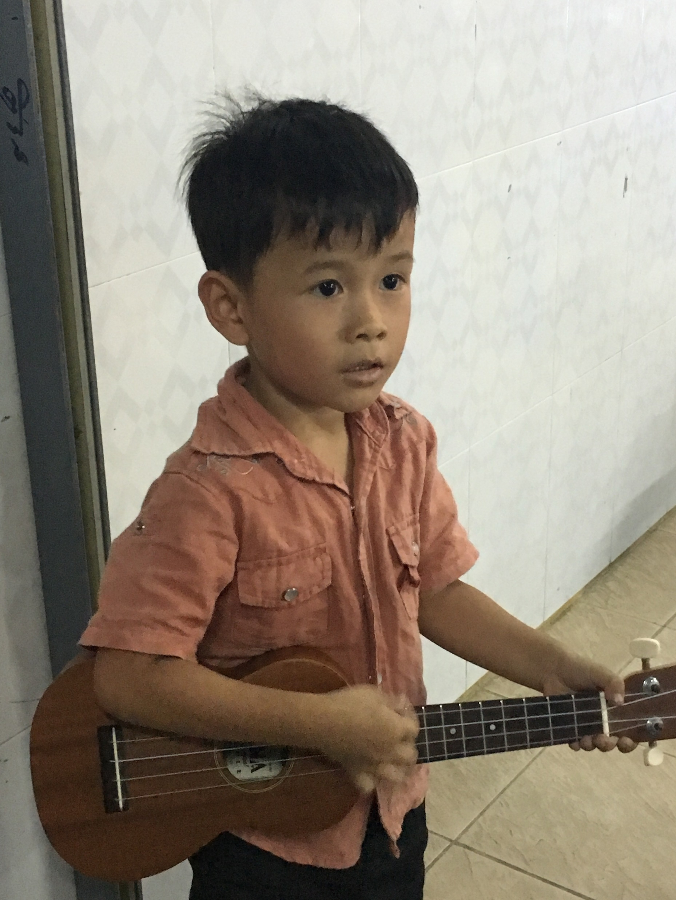
Theme Verse
Sing to the Lord a new song; sing to the Lord,
all the earth.
Sing to the Lord, praise his name; proclaim his salvation day after day.
Declare his glory among the nations, his marvelous deeds among all peoples.
- Psalms 96:1-3
Unsplash: Ben White

Slide 3

Explore the Country

Slide 4
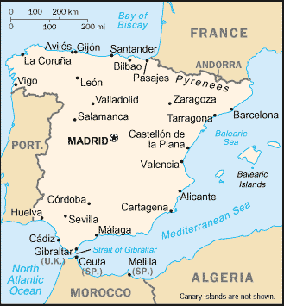
Photo: Resource Database/ Unsplash
Spain
CIA World Fact Book, Public domain, via Wikimedia Commons

Slide 5
Madrid
(the capital city)
Photo: Jorge Fernandez Salas/ Unsplash

Slide 6
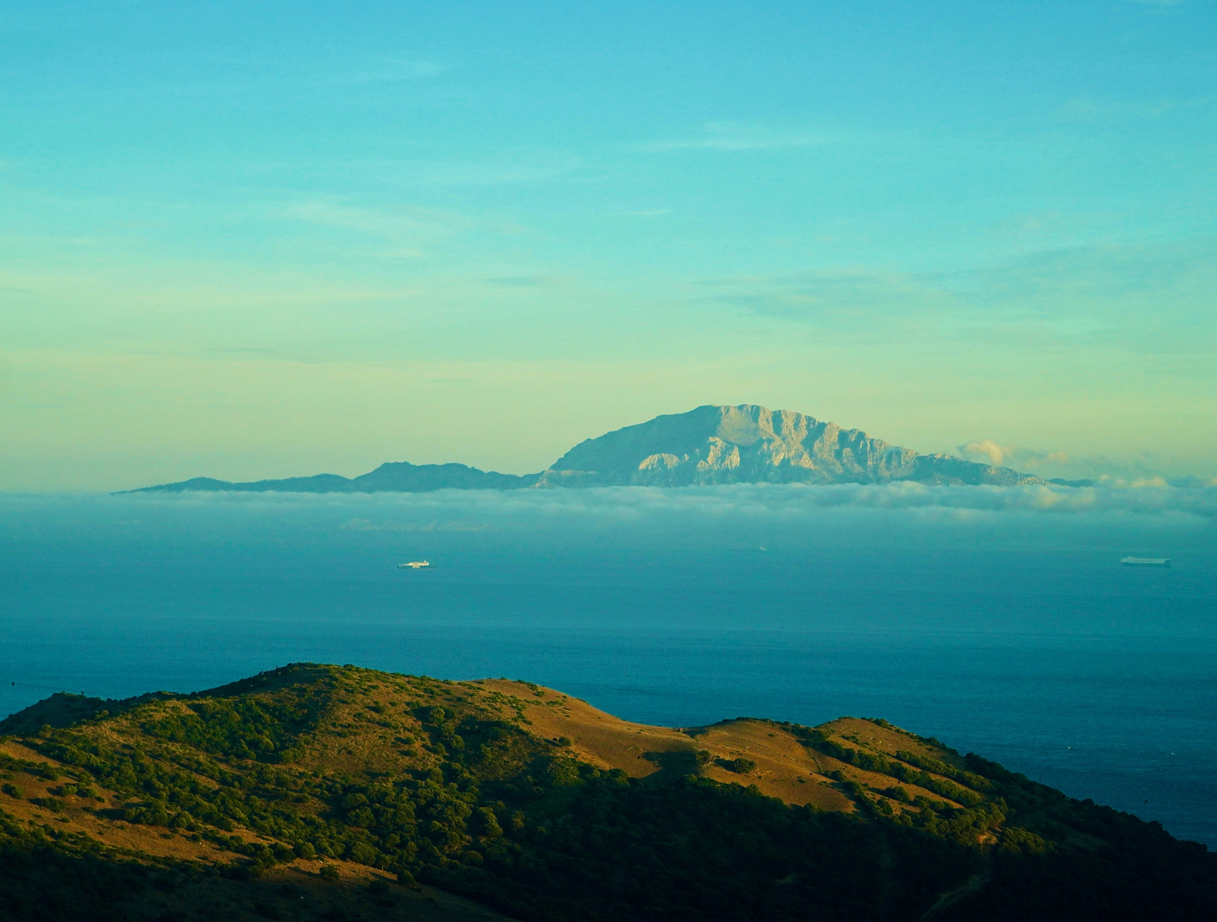
Natural
Beauty
Photo: Allberto Restifo/Unsplash
Photo: Meina Yin/Unsplash
Photo: Reiseuhu/Unsplash
Photo: Dominik Sostmann/Unsplash

Slide 7
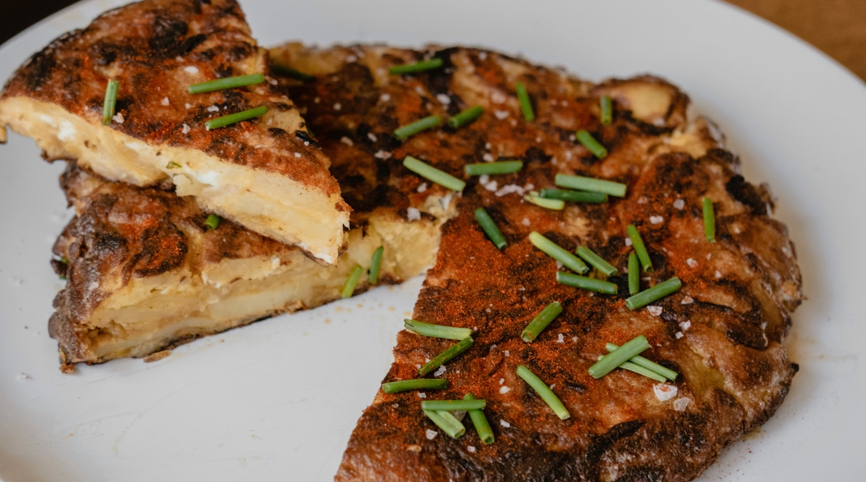
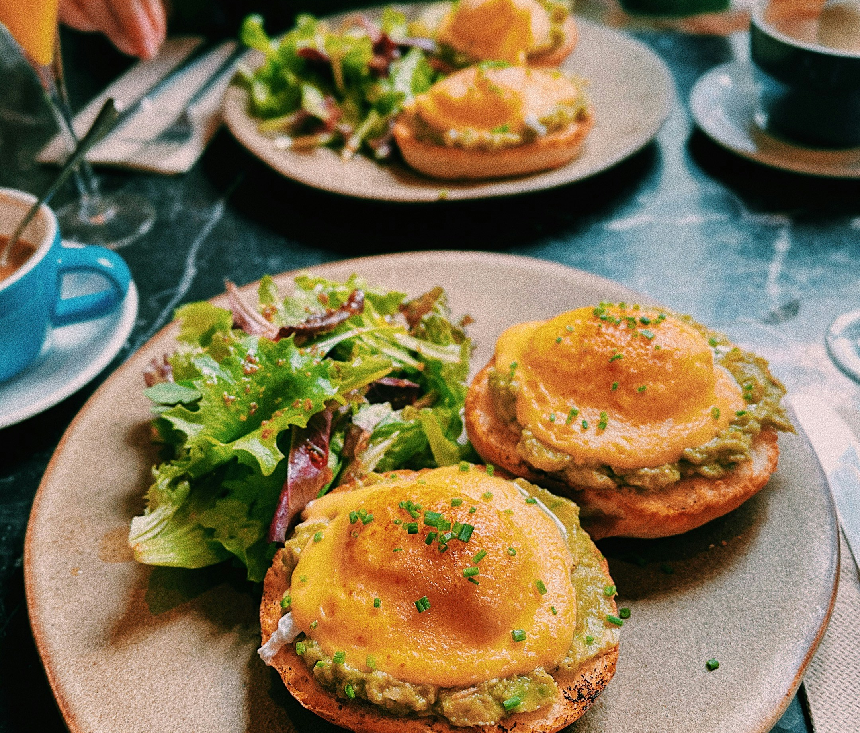
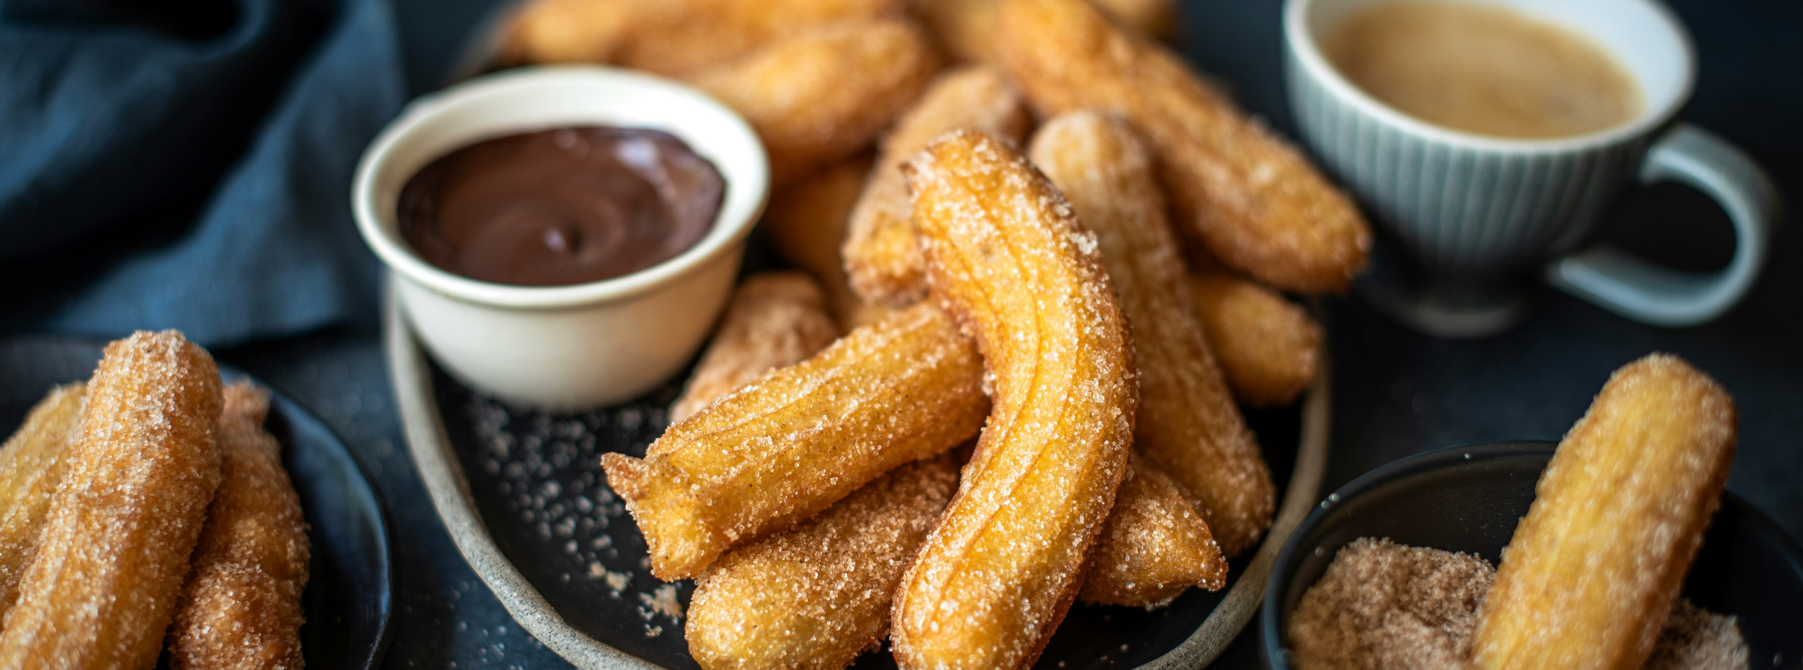
Spanish Tortilla
Tapas
Photo: Alvaro Bernal/Unsplash
Photo: Chase Daley/Unsplash
DELICIOUS FOOD
Churros and Chocolate
Photo: Olimpia Davies/Unsplash

Slide 8
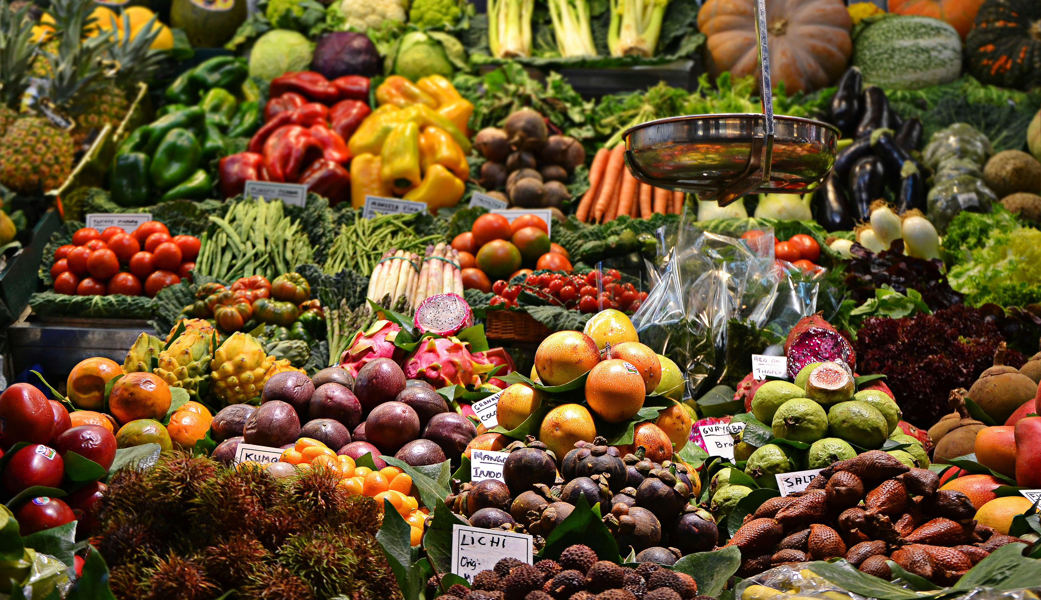
Frutas y Verduras (Fruits & Vegetables)
Photo: Jacopo Maiarelli/Unsplash

Slide 9
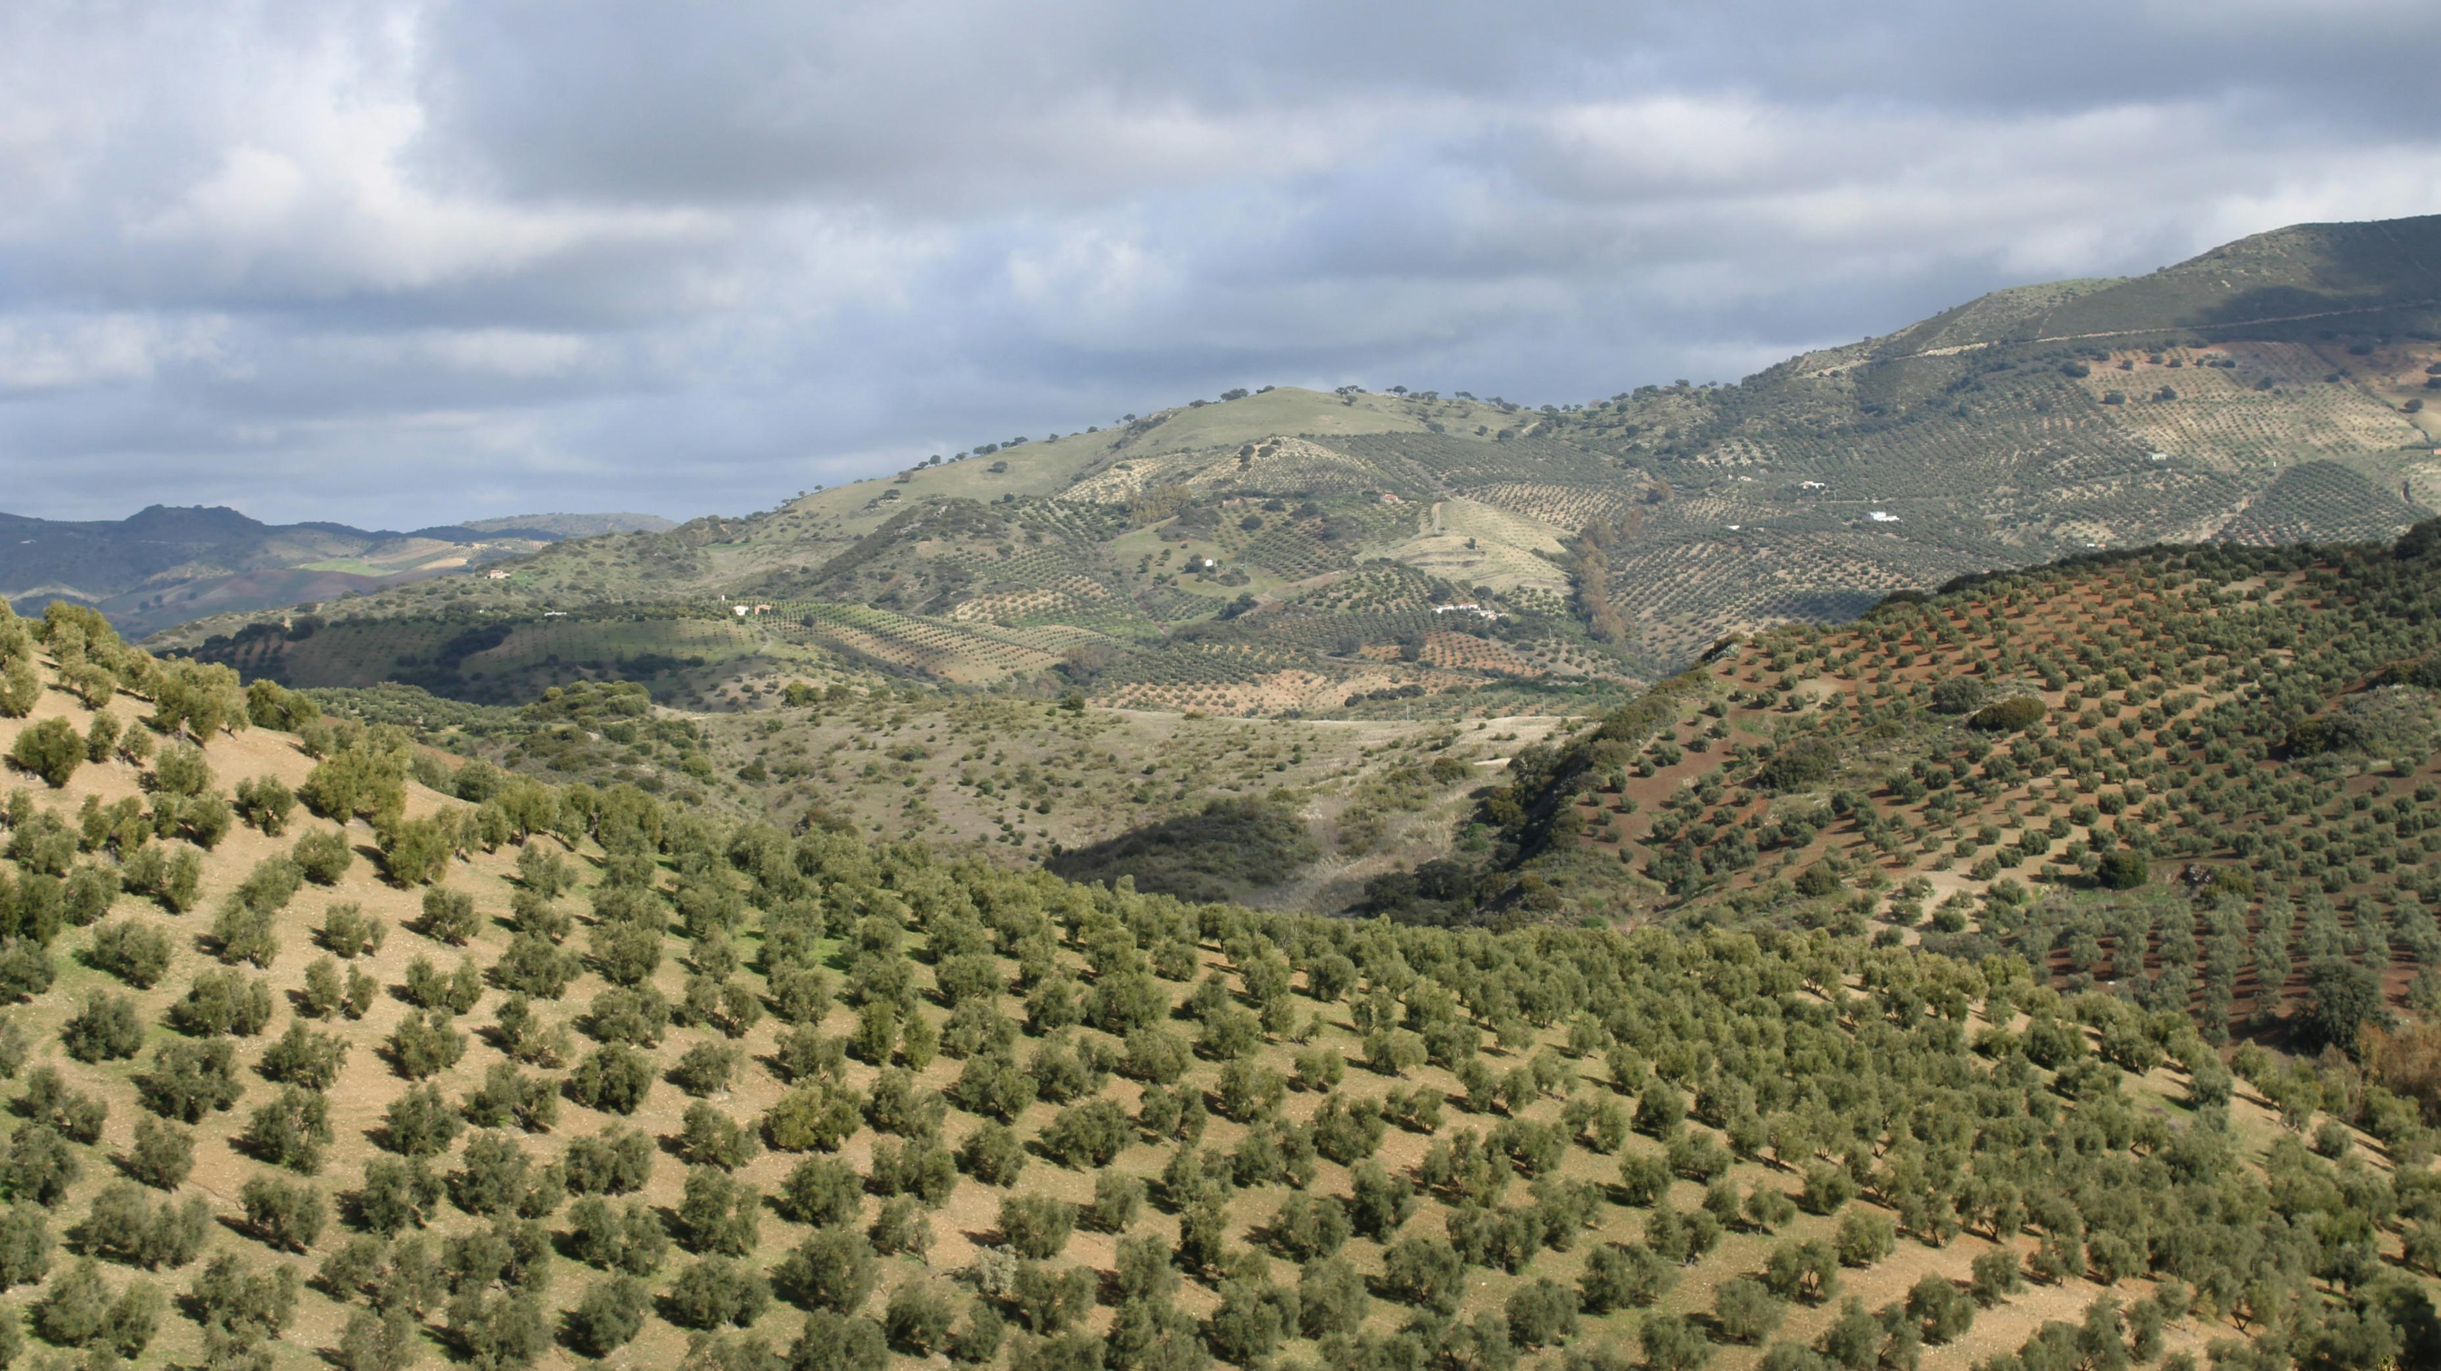
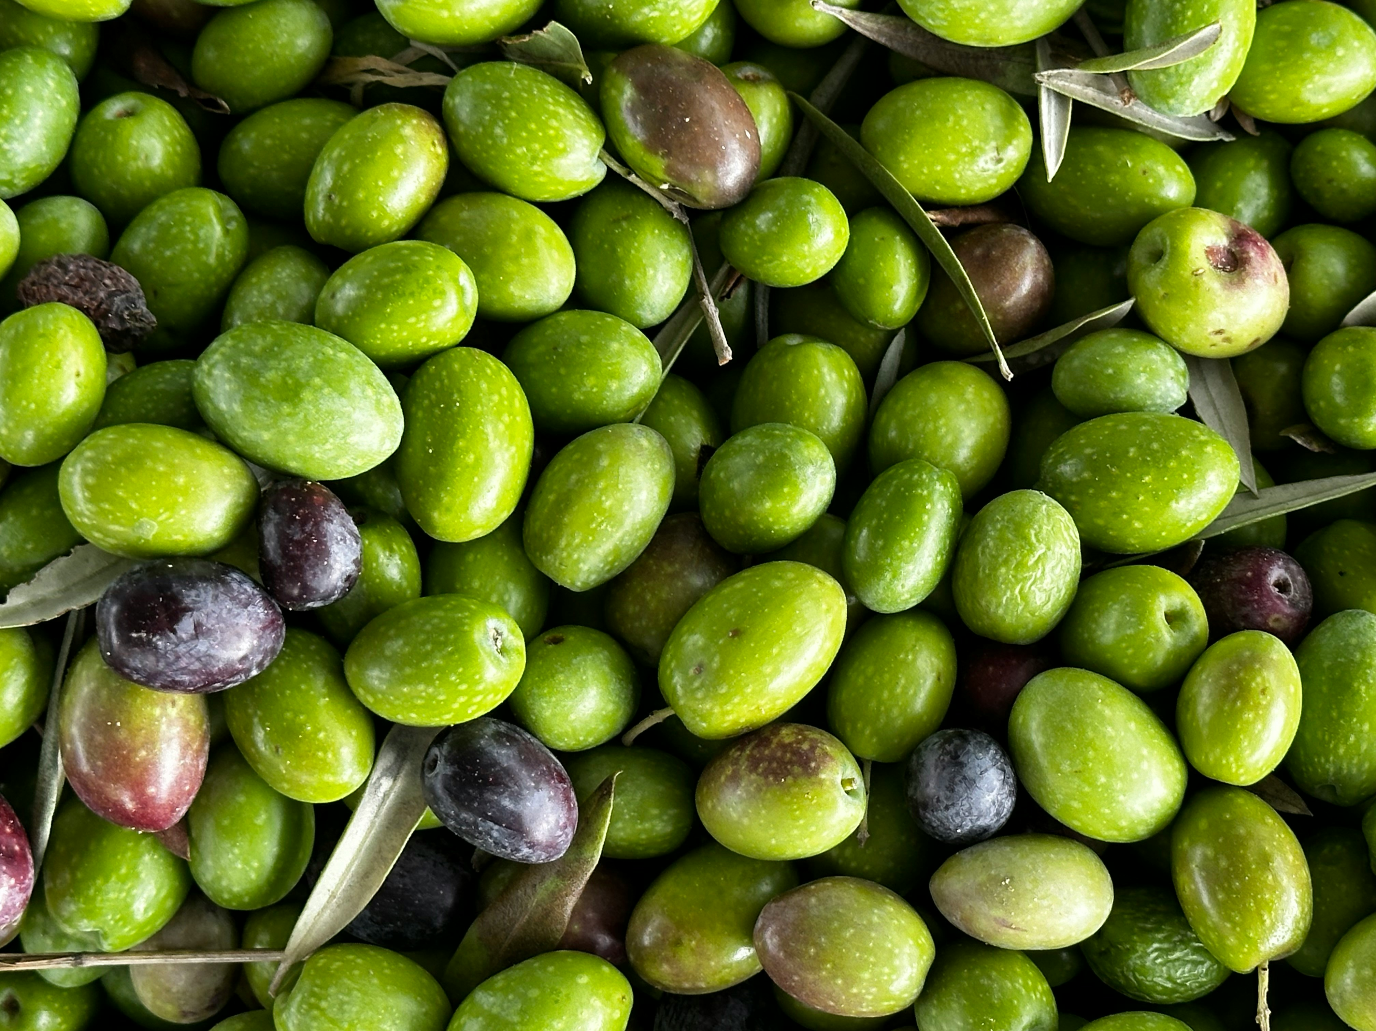
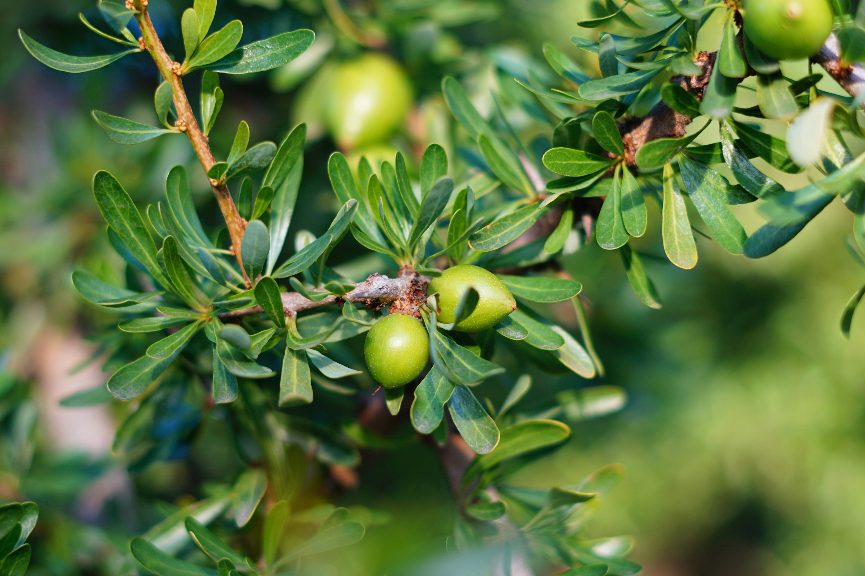
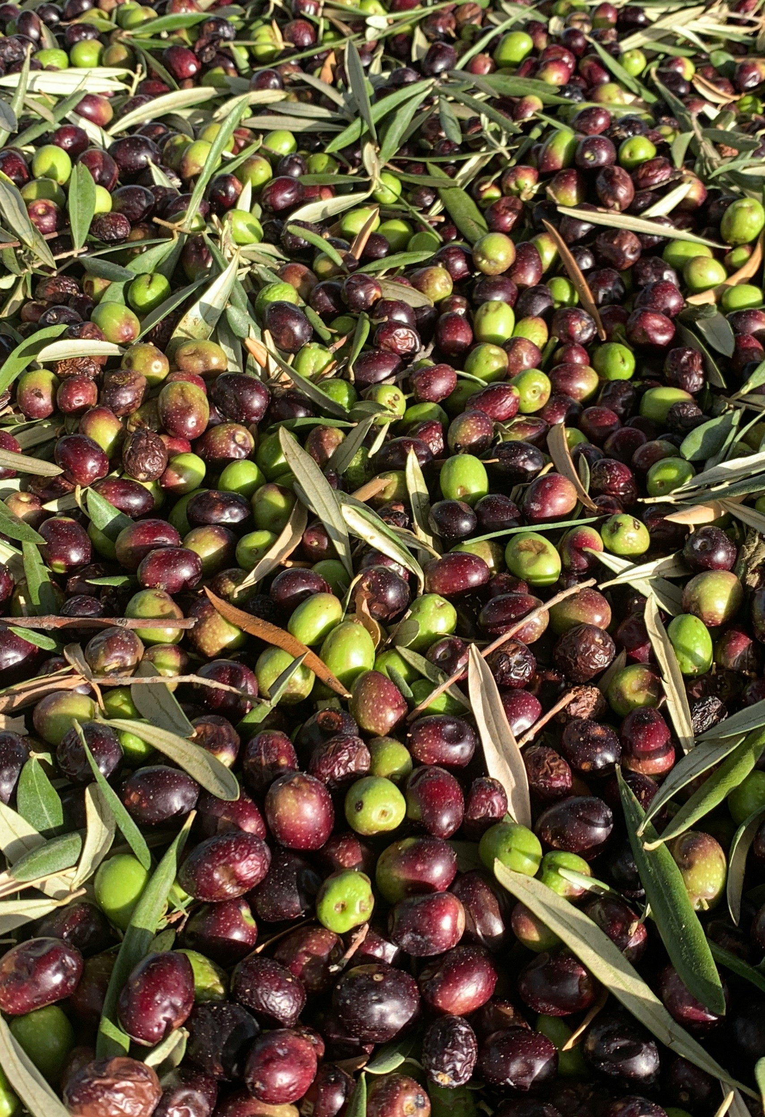
Photo: John Cameron/Unsplash
Photo: Thomas Verbruggen/Unsplash
Spain is Believed to
Have the Most Olive
Trees in the World
Photo: John Cameron/Unsplash
Photo: Rodri Caruso/Unsplash

Slide 10
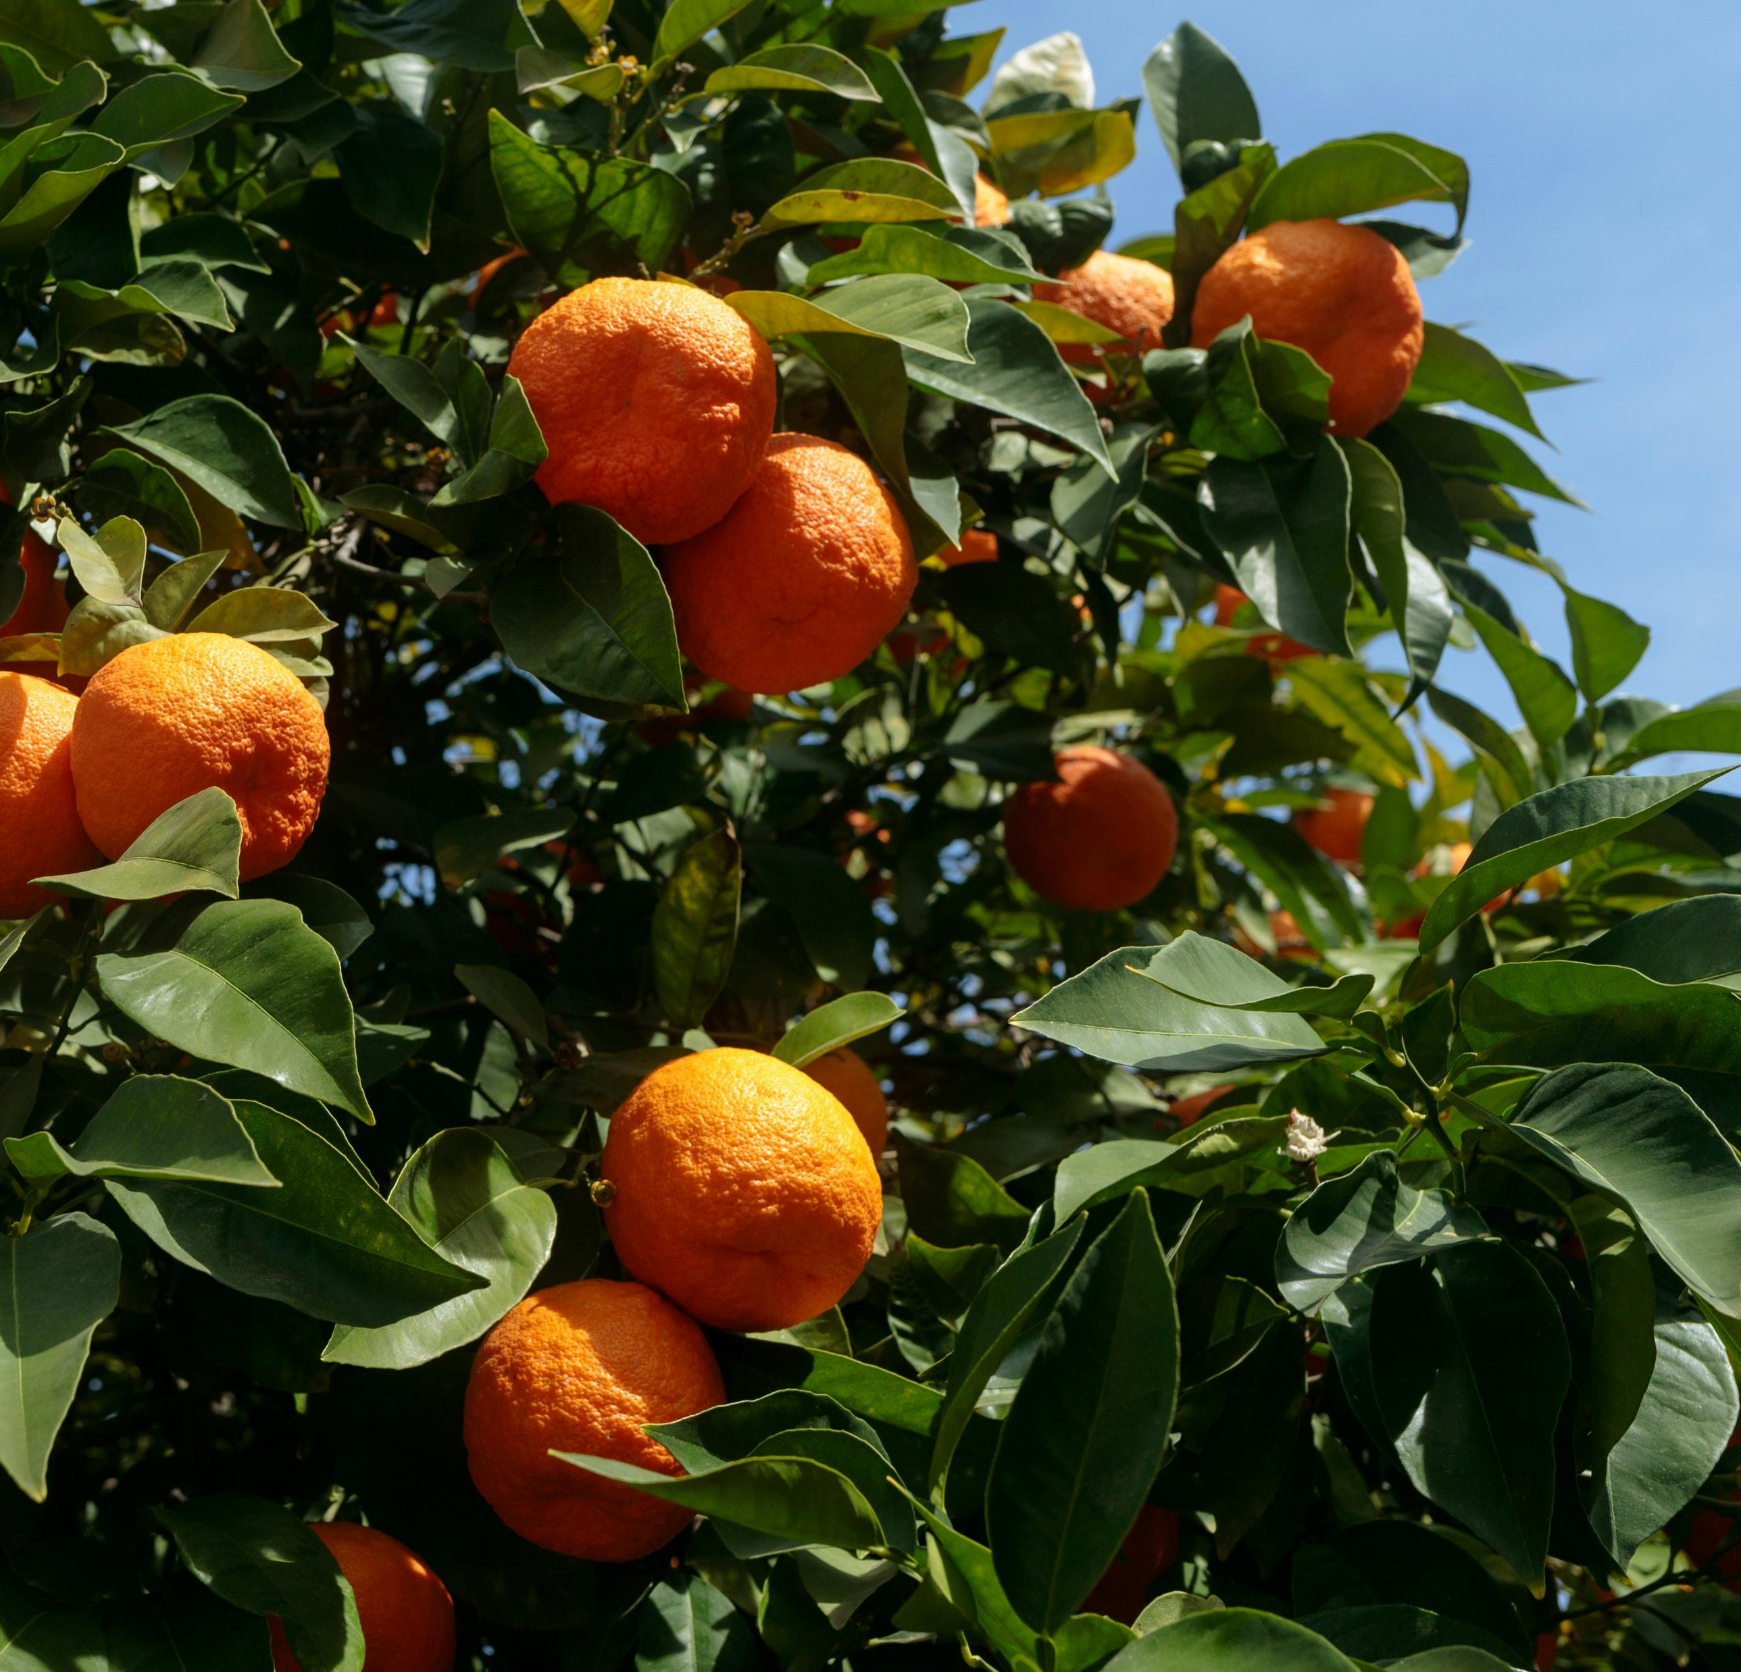
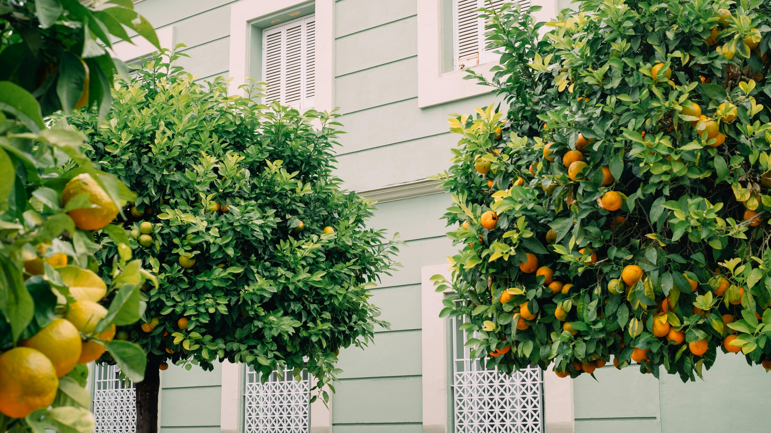
Oranges are Grown in Valencia
Photo: Mitchell Ori/Unsplash
Photo: Molly Lowney/Unsplash

Slide 11
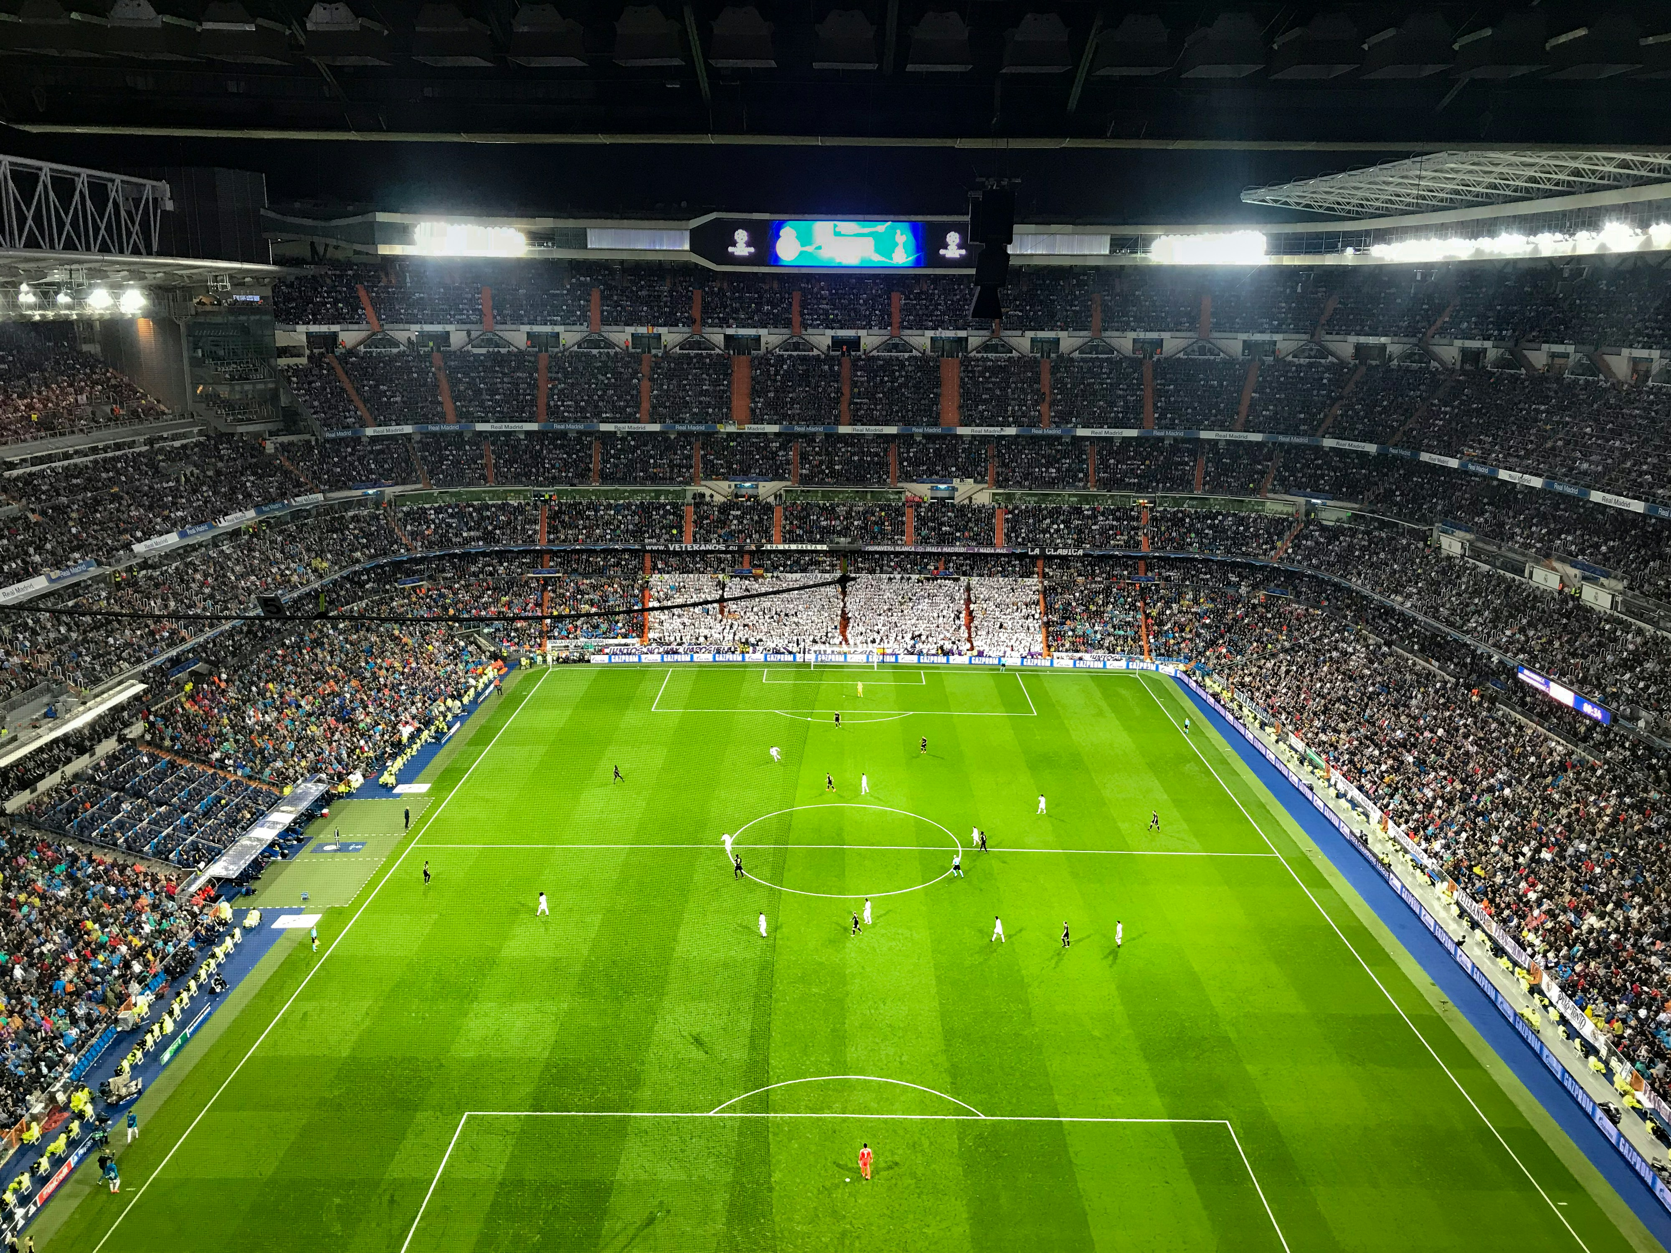
Spain Won the Futbol World Cup in 2026
Photo: Fernando Stabuli/Unsplash

Slide 12
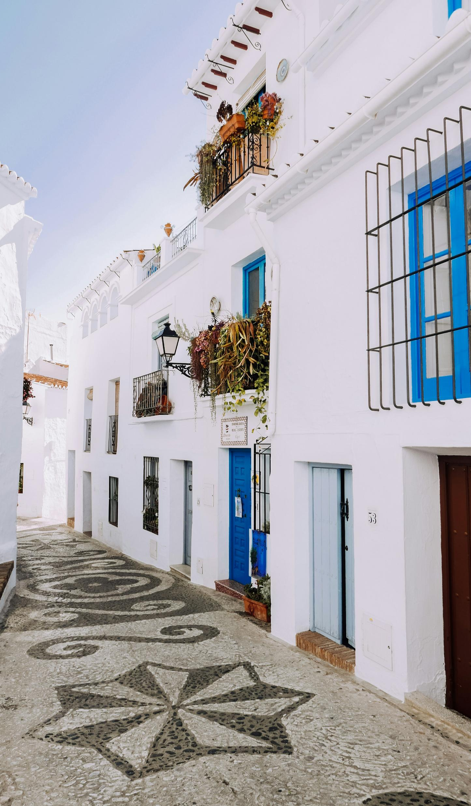
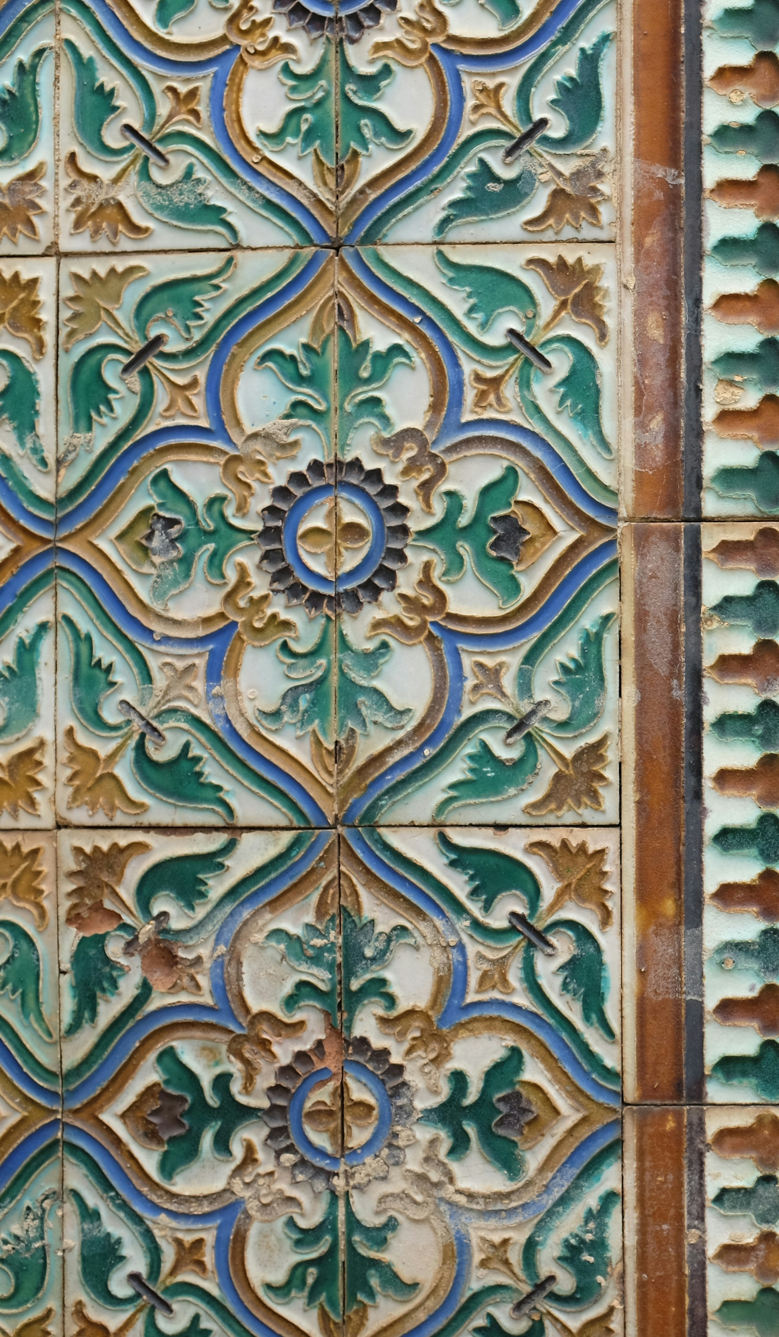
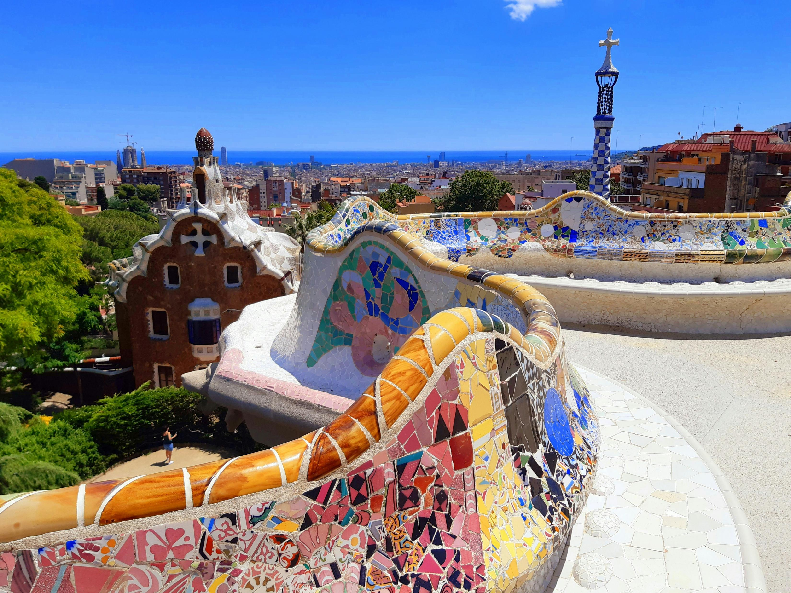
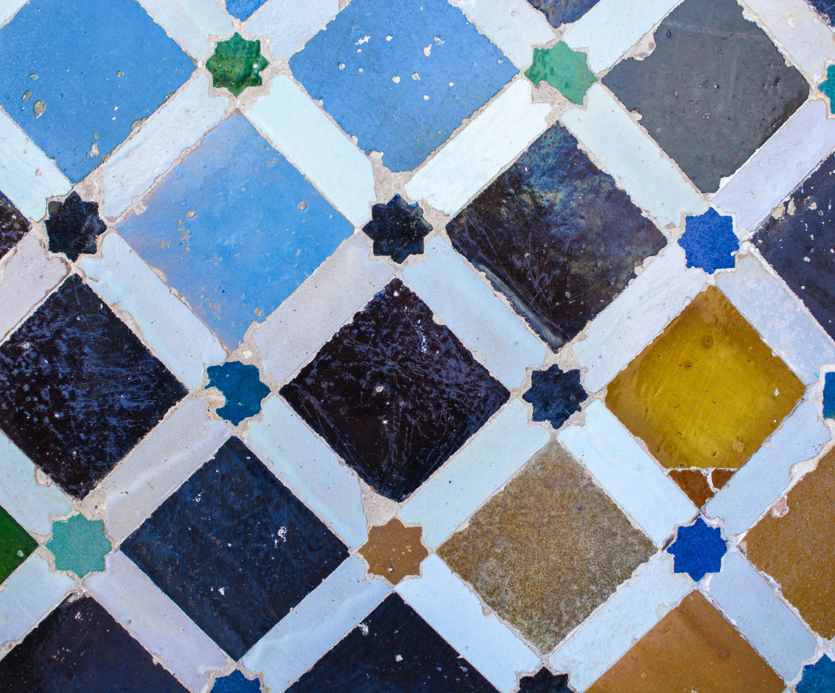
Mosaics Are
Everywhere
Photo: D. Jonez/Unsplash
Photo: Becky Van Dijk/Unsplash
Photo: Marwan Aboul/Unsplash
Photo: Sebastian Yepes/Unsplash

Slide 13
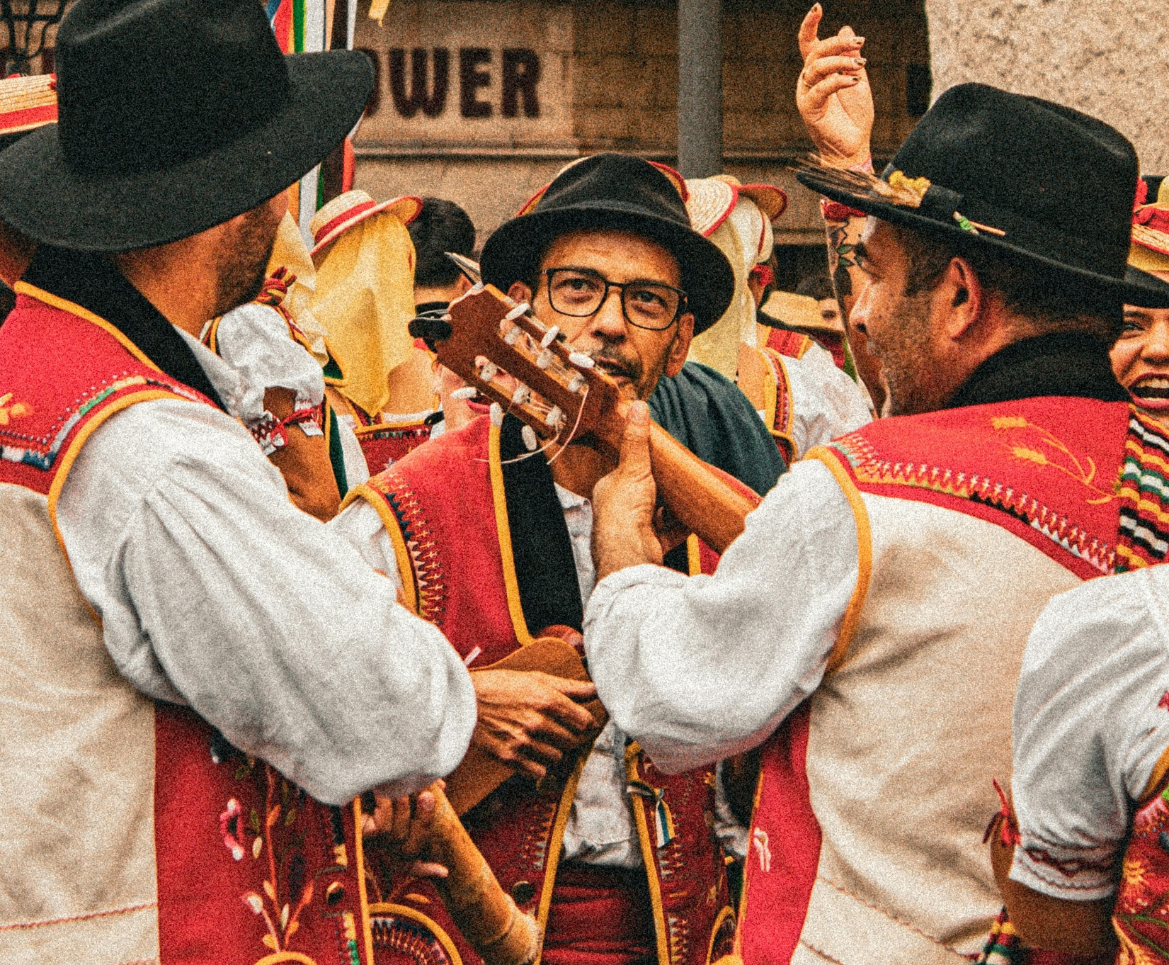
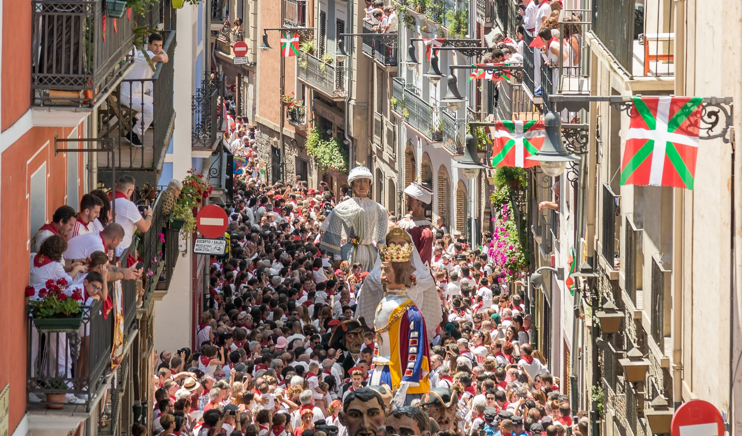
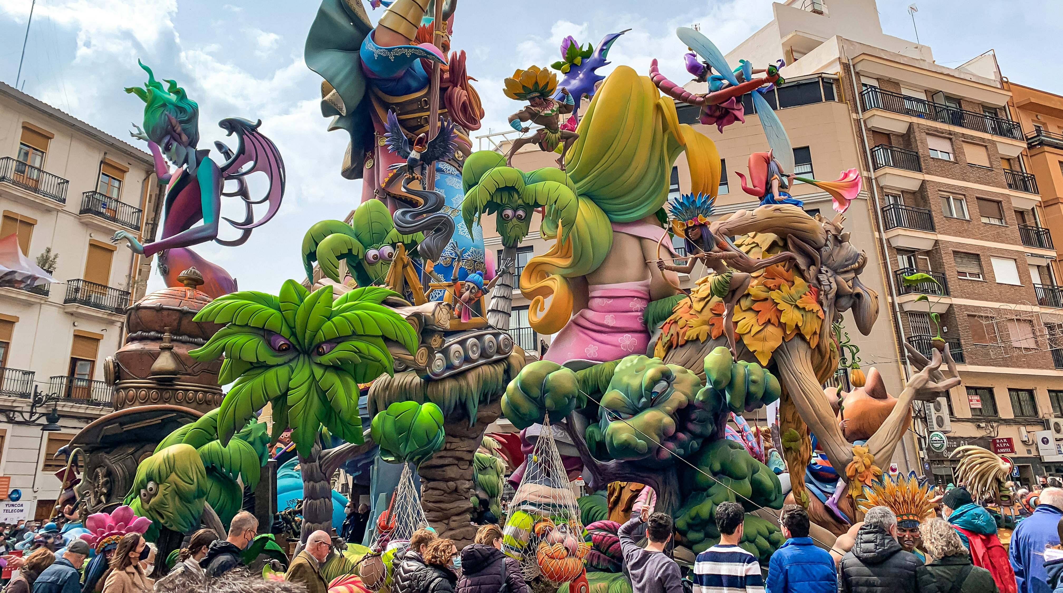
F
E
S
T
I
V
A
L
S
Photo: Junior Verhelst/Unsplash
Photo: San Fermin Pamplona Navarr/Unsplash
Photo: San Fermin pa,Pamplona Navarr/Unsplash
Photo: Marcelo /Unsplash
Photo: San Fermin Pamplona Navarr/Unsplash

Slide 14

Explore God’s Work

Slide 15
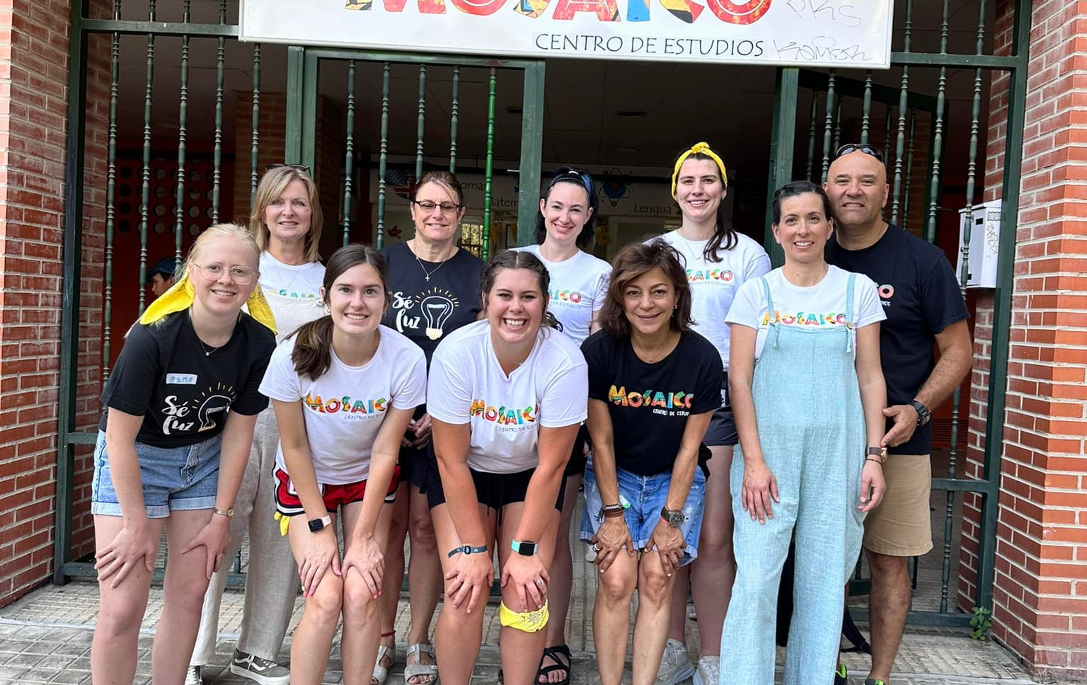
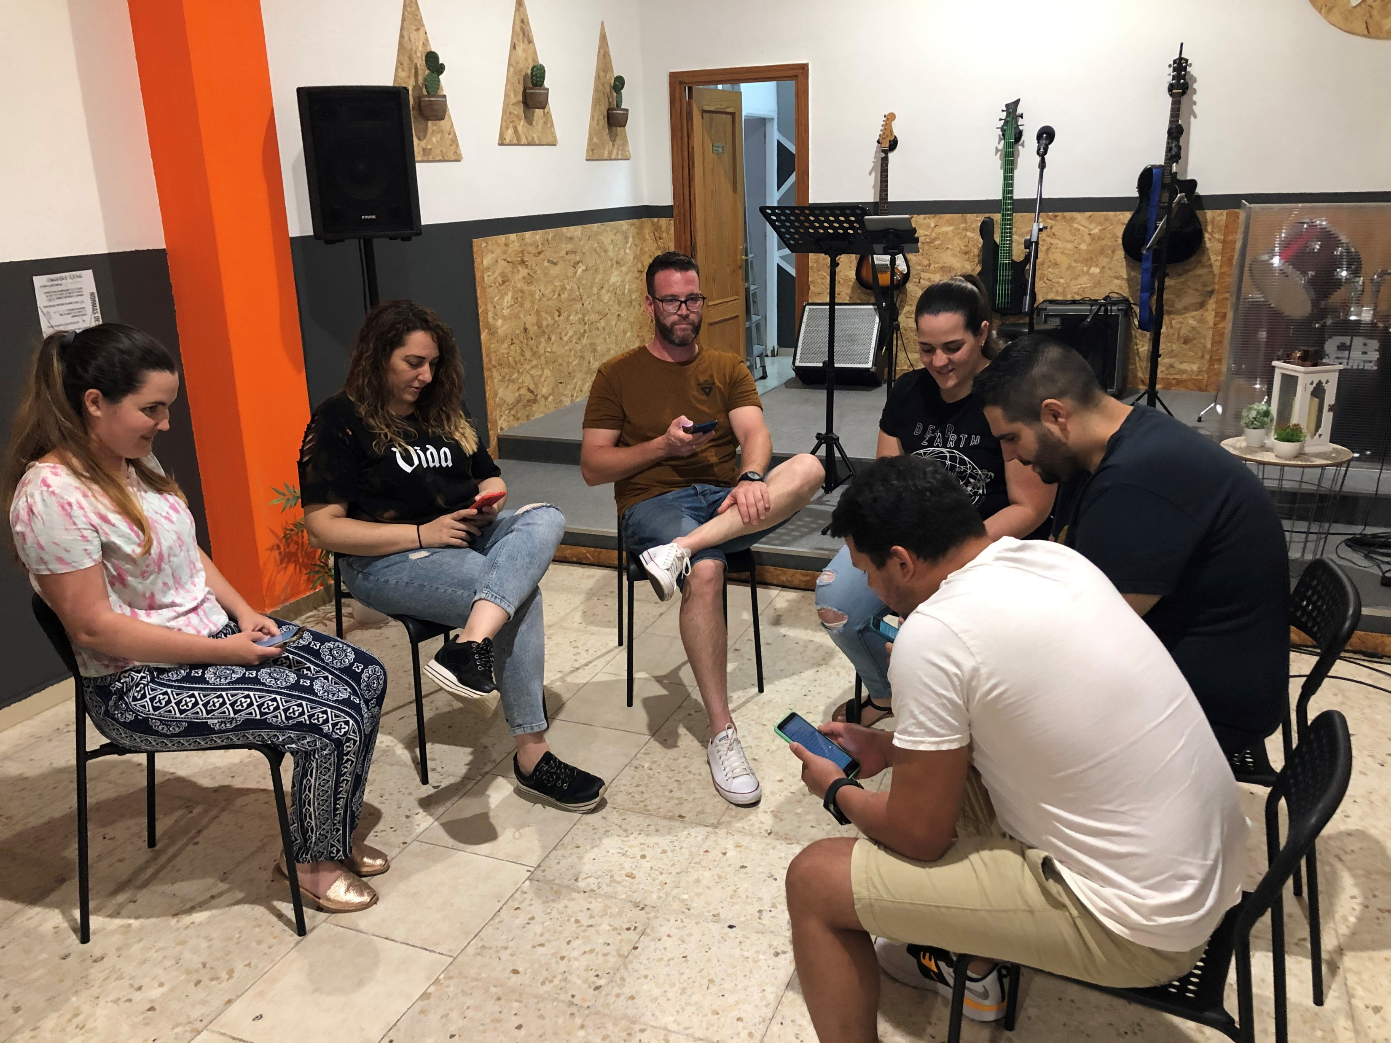
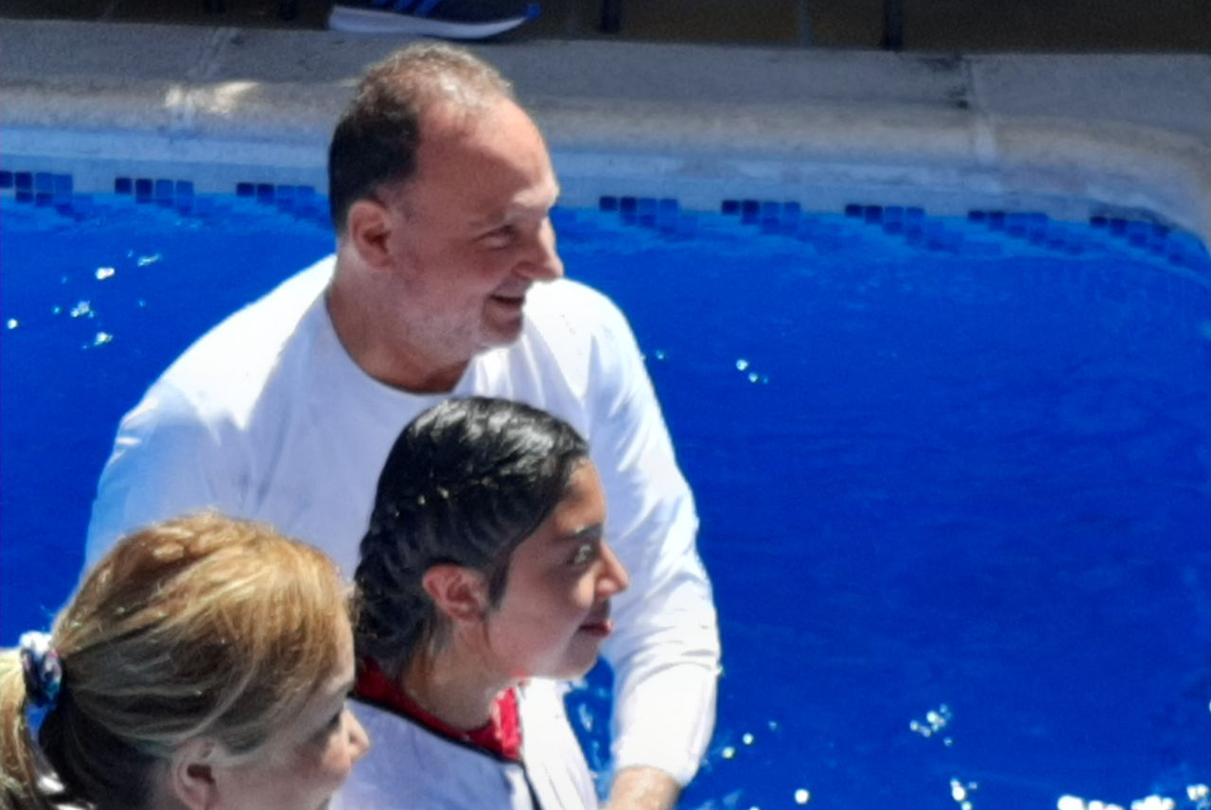
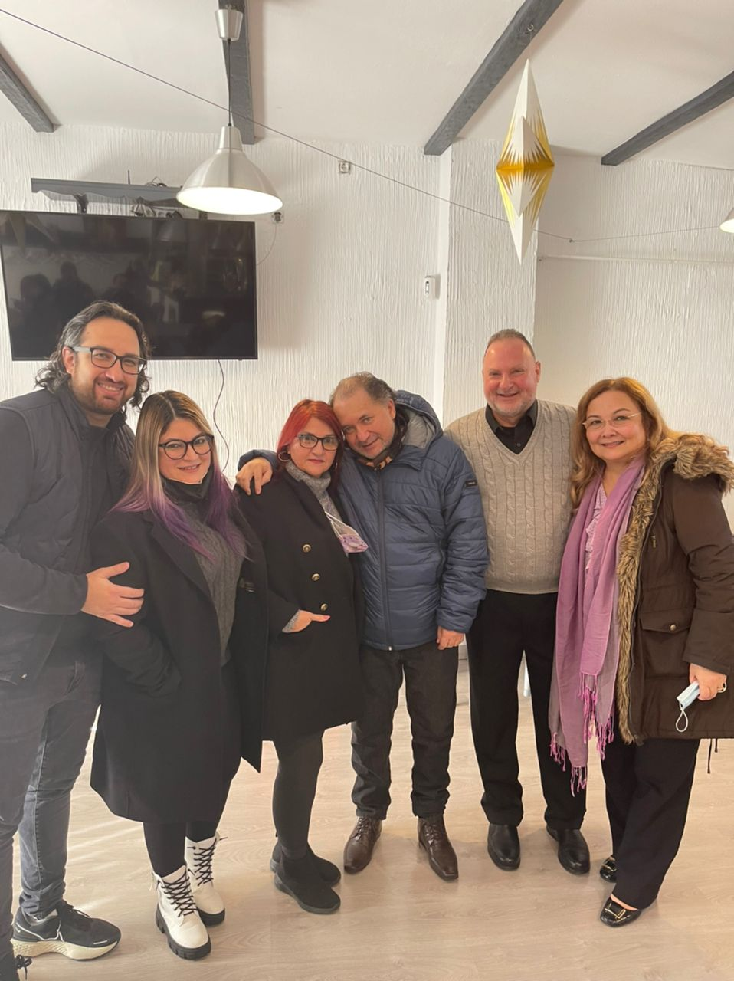
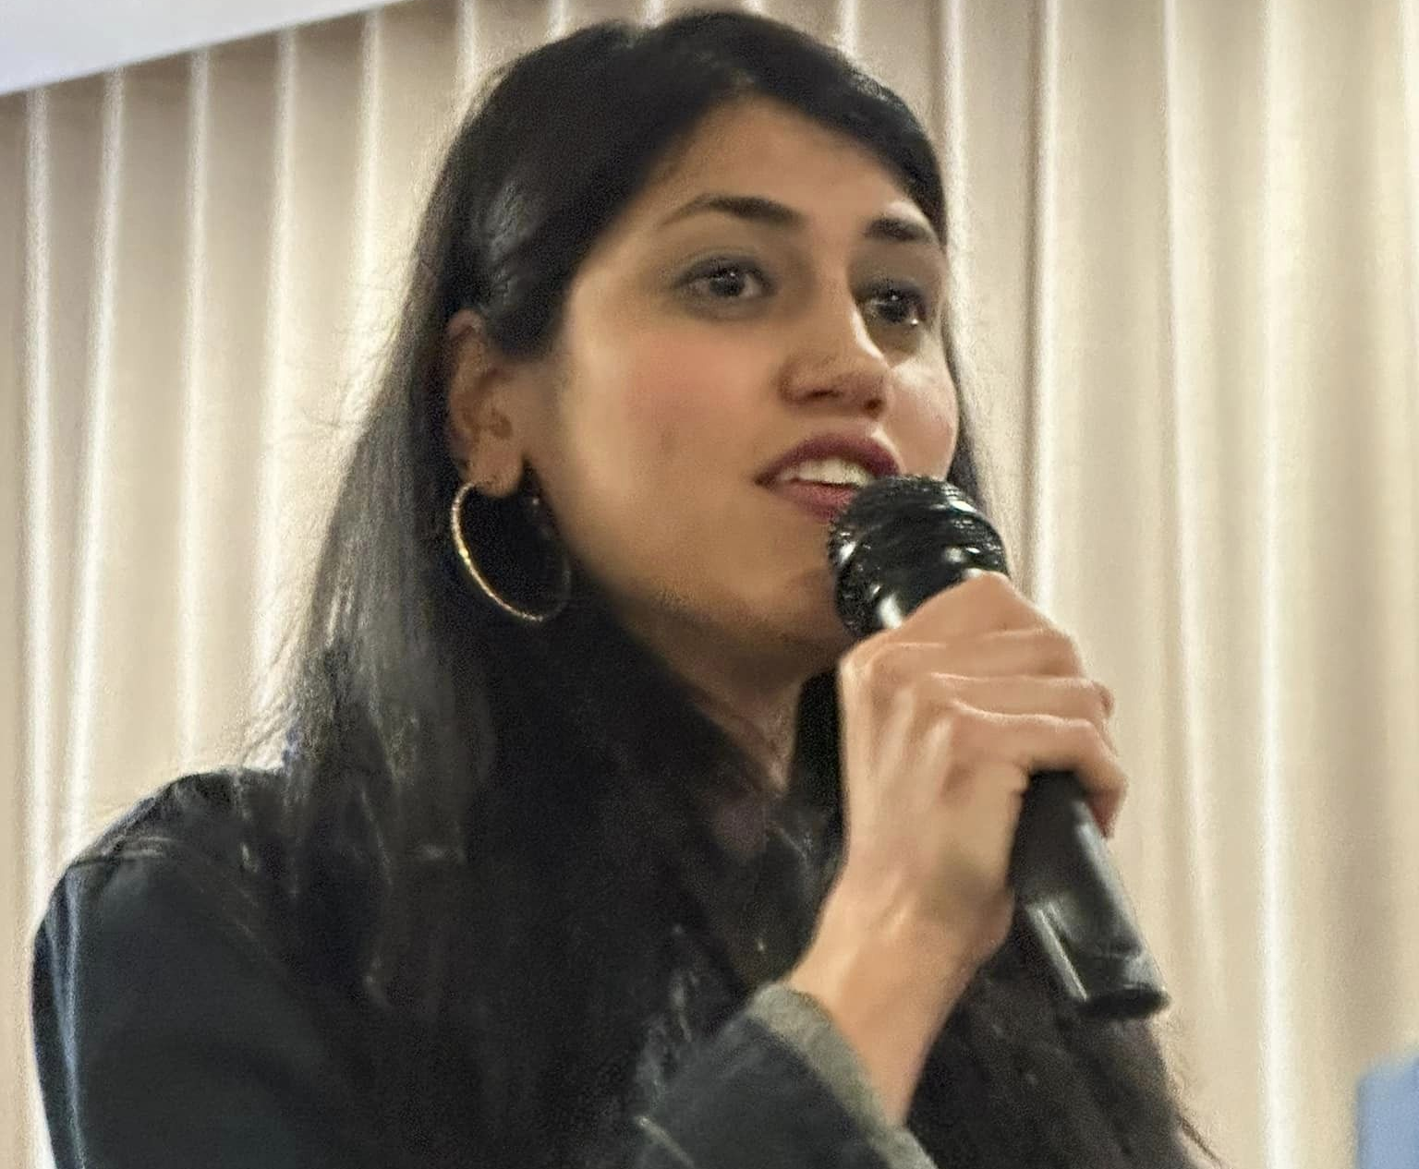
Free Methodist Church
Spain
Photos: FMWM Europe

Slide 16
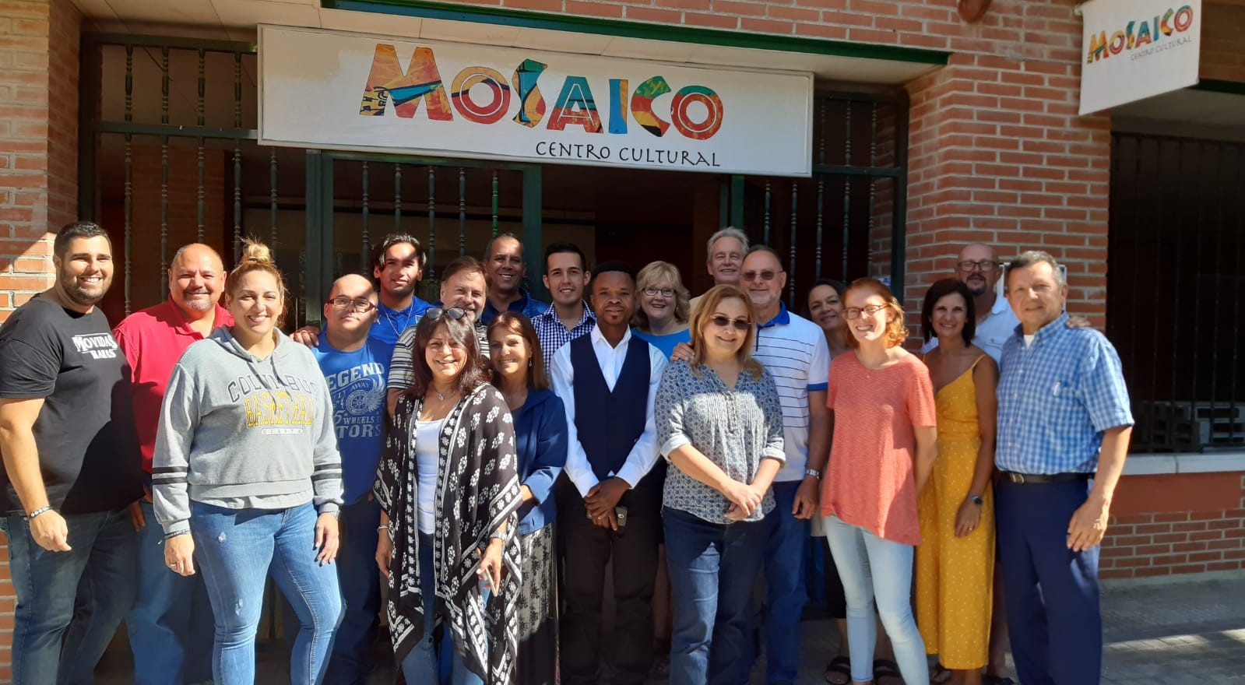
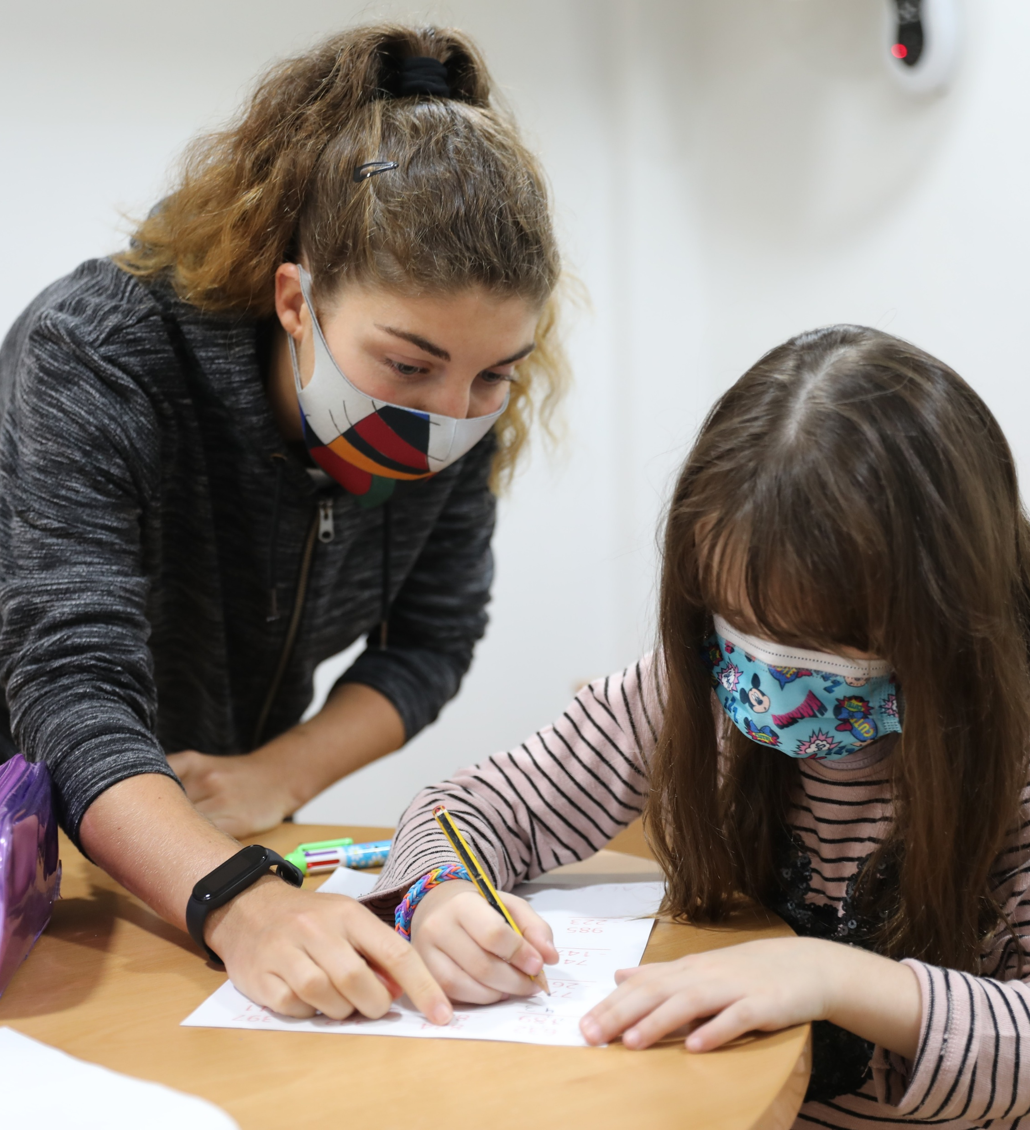
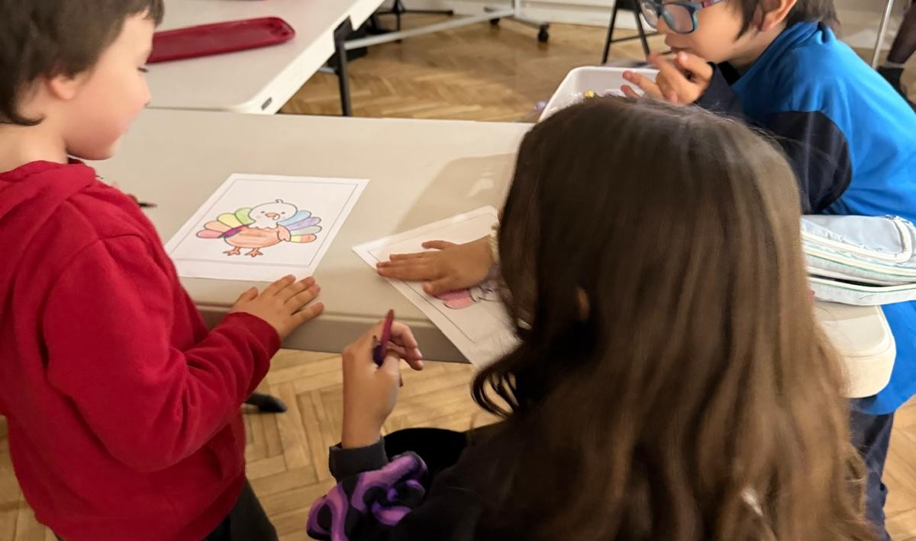
Mosaico Center

Slide 17
Adventure Story

Slide 18
When the Church Prays!
Juan
Photos: Camilo& Magally Mora

Slide 19
People on Adventure

Slide 20
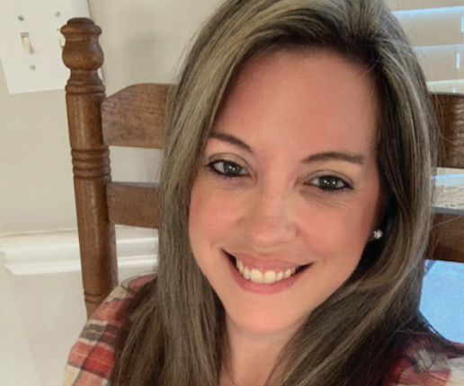
Raul, Abi & Alex Arana
Josh & Susy Fajardo
Kristi Lancaster
Paulo, Clara & Jonas Bettiol
Camilo & Magaly Mora

Slide 21
Adventures in Culture

Slide 22
Language – Polite Phrases
Spanish | English
Gracias | Thank you!
Da nada | You’re Welcome
Por Favor | Please
Lo siento | I’m sorry
Perdón | Excuse me

Slide 23
The Joy of the Lord is My Strength
English: Spanish:
The joy of the Lord is my strength, El gozo del Señor me fortaleza es,
The joy of the Lord is my strength, El gozo del Señor me fortaleza es,
The joy of the Lord is my strength, El gozo del Señor me fortaleza es,
He gives me joy without measure. Su gozo sin medida Él me da.

Slide 24
Pronunciation:
El GO-so dle sayn-YOUR me for-tah-LAY
sah es,
El GO-so dle sayn-YOUR me for-tah-LAY
sah es,
El GO-so dle sayn-YOUR me for-tah-LAY
sah es,
Soo GO-so seen may-DEE-dah El may dah.

